Slide 1
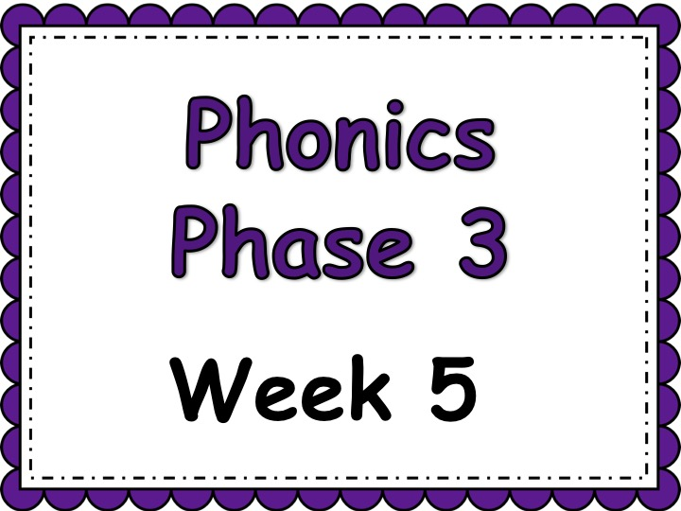

Slide 2

Week 5 Objectives:
Practise previously learned GPCs
Teach four more vowel digraphs
Point to the letters in the alphabet while singing the alphabet song
Practise blending for reading
Practise segmentation for spelling
Teach reading the tricky word my
Practise reading and spelling high-frequency words
Teach spelling two-syllable words
Practise reading captions and sentences
Practise writing captions and sentences

Slide 3
Phase 3: Week 5
 | Monday | Tuesday | Wednesday | Thursday | Friday
Focus | ar | or | ur | er | my
Revise | Practice previously learned GPCs from Phase 2 and 3. | Play quickwrite. Teacher says a sound and children have to write it on their whiteboards. | Practice previously learned GPCs from Phase 2 and 3. | Play quickwrite. Teacher says a sound and children have to write it on their whiteboards. | Sing the alphabet song. Children to point to the letters as they sing.
Teach | Explain that this week, we are looking at digraphs that are made when a vowel is next to an ‘r’. Teach the phoneme ar | Teach ‘or’. Remind children that when there is a vowel and an ‘r’, it makes a new sound. | Teach ‘ur’. Remind children that when there is a vowel and an ‘r’, it makes a new sound. | Teach ‘er’. Remind children that when there is a vowel and an ‘r’, it makes a new sound. | Remind children of vowels. Explain that ‘y’ sometimes acts as a consonant and sometimes as a vowel. It can make 3 sounds (yes my mummy)
Practice | Blend the sounds to read: bark, card, park | Segment the words to spell: fork, born, torn | Blend the sounds to read: surf, curl, turnip | Segment the words to spell: Farmer, herb, perch | Practice reading and spelling the HFWs we, me, be, she, he.
Apply | Write the caption: Goats in a farmyard Yes/No Questions: Are the teeth of sharks sharp? | Read the caption: The light of a torch | Yes/No Questions: Can a burn hurt? | Read the Caption: boats on the river | Read the captions: My dog, my cat, my car

Slide 4
Day 1 ar

Slide 5
revisit
Can you remember these sounds from Phase 2?
s a t p i n m
m d g o c k
e u r b f l
ff ll ss ck

Slide 6
revisit
These are the phase 3 sounds learned so far:
j v w x
y z zz qu
ch sh th ng
ai ee igh oa

Slide 7
revisit
Can you remember these tricky words?
the
no
I
to
go

Slide 8
revisit
Phase 3 tricky words we have learned to read:
he
she
we
me
be
was

Slide 9


Can you remember which letters are the vowels?
a b c d e f g
h i j k l m n
o p q r s t u
v w x y z
a b c d e f g
h i j k l m n
o p q r s t u
v w x y z

Slide 10
This week we are looking at some new digraphs.
These digraphs are when we have a vowel and an ‘r’
Vowel
(a,e,i,o,u)
r
+

Slide 11
ar

Slide 12
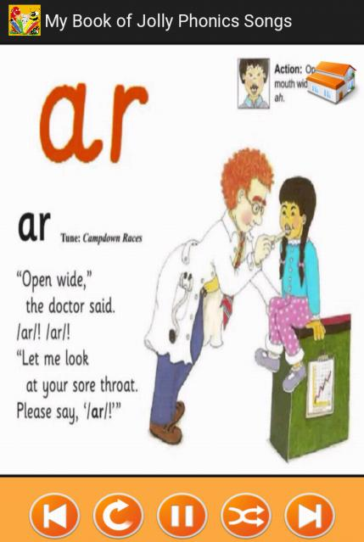

Slide 13
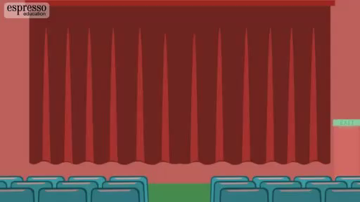

Slide 14
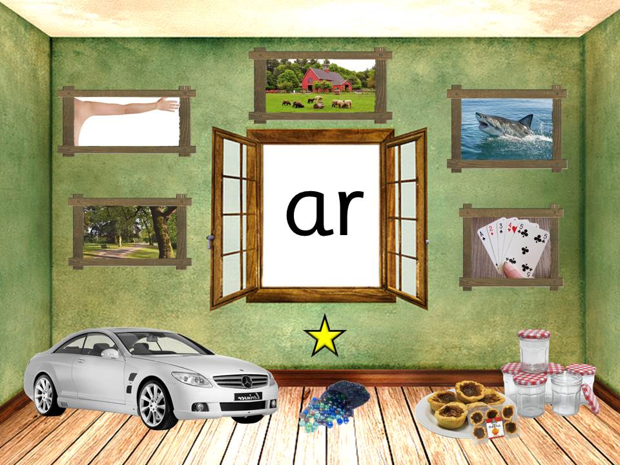

Slide 15
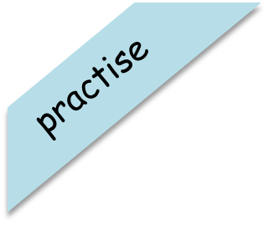
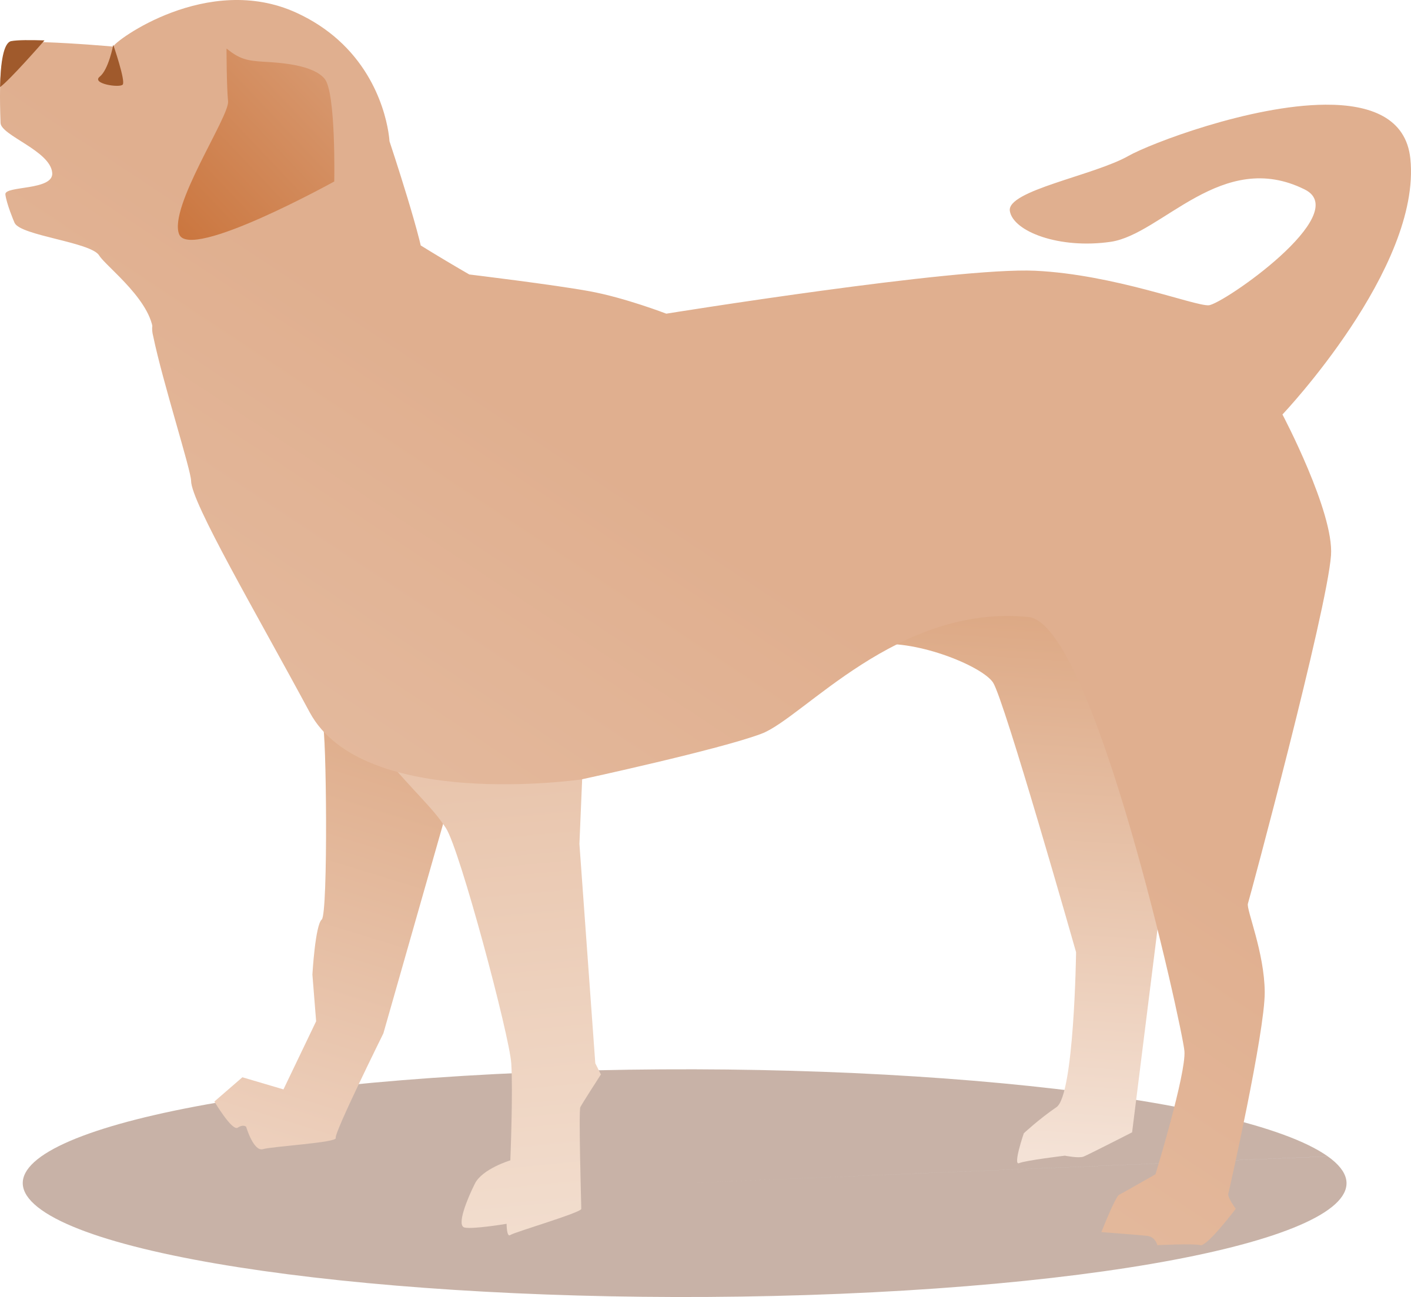
bark
Have a go at reading these words. Click to see the picture:

Slide 16

Have a go at reading these words. Click to see the picture:
card

Slide 17
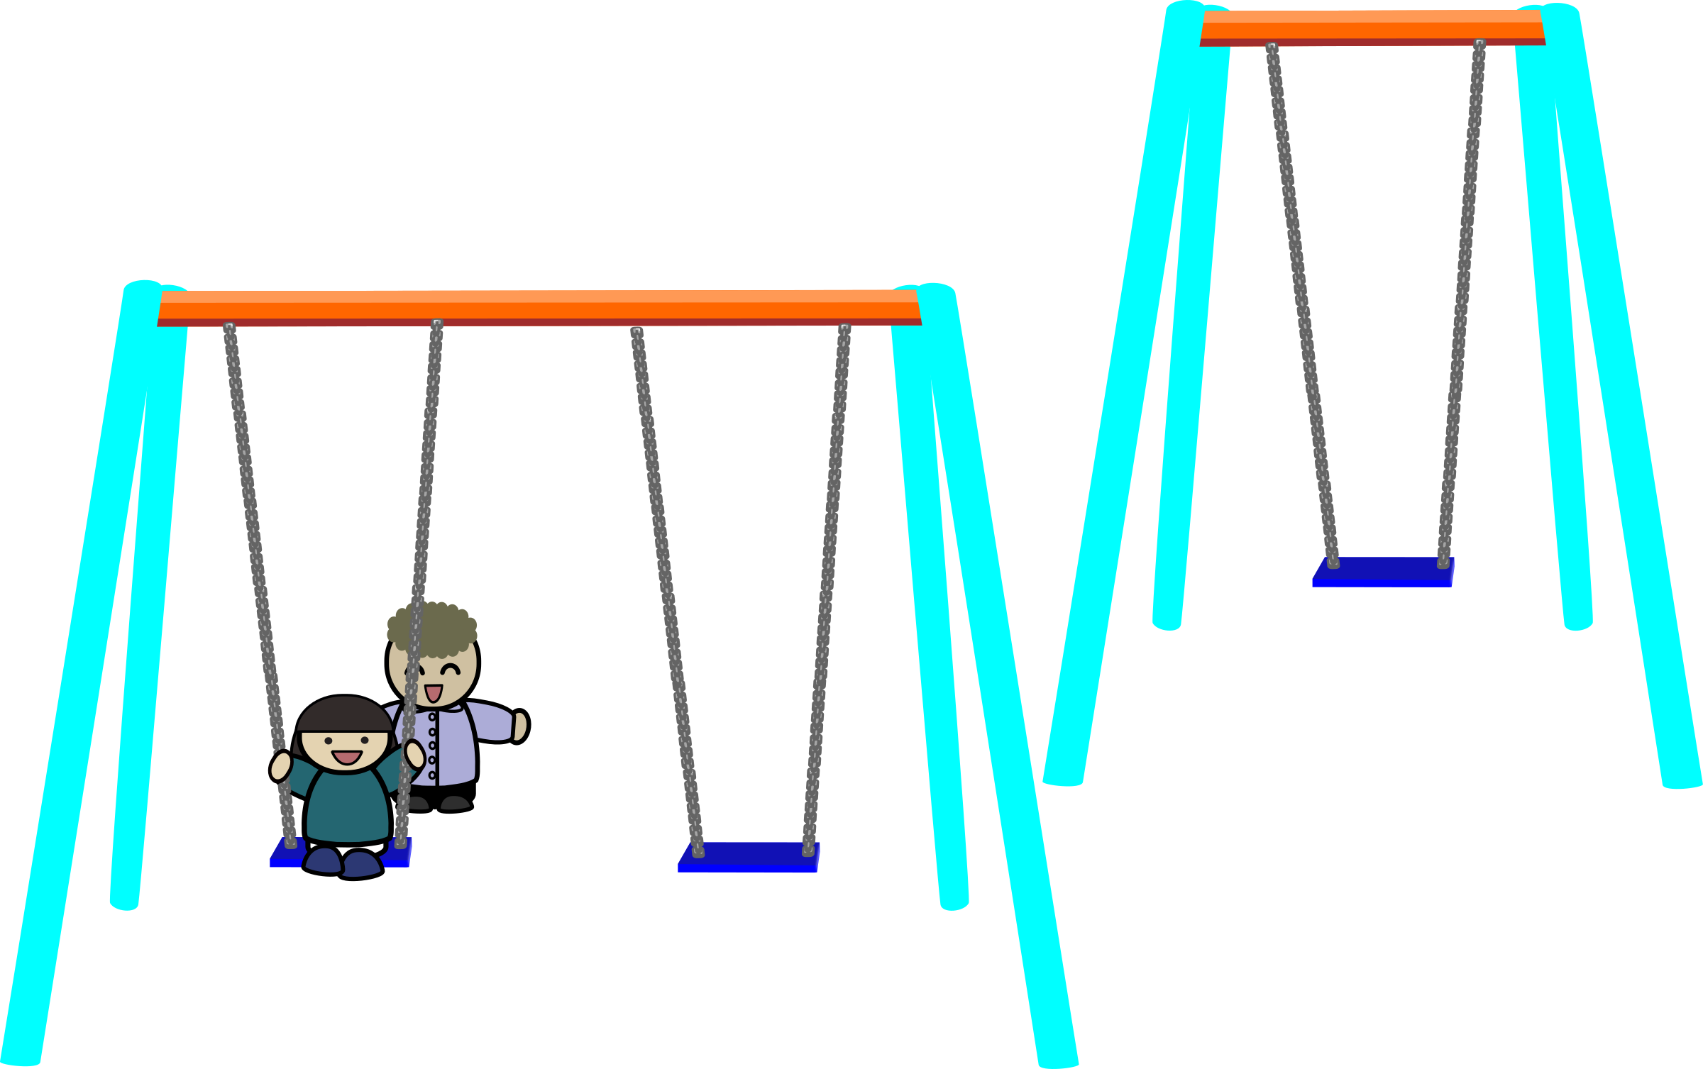
Have a go at reading these words. Click to see the picture:
park

Slide 18



Yes/No Questions:
Are the teeth of sharks sharp?

Slide 19

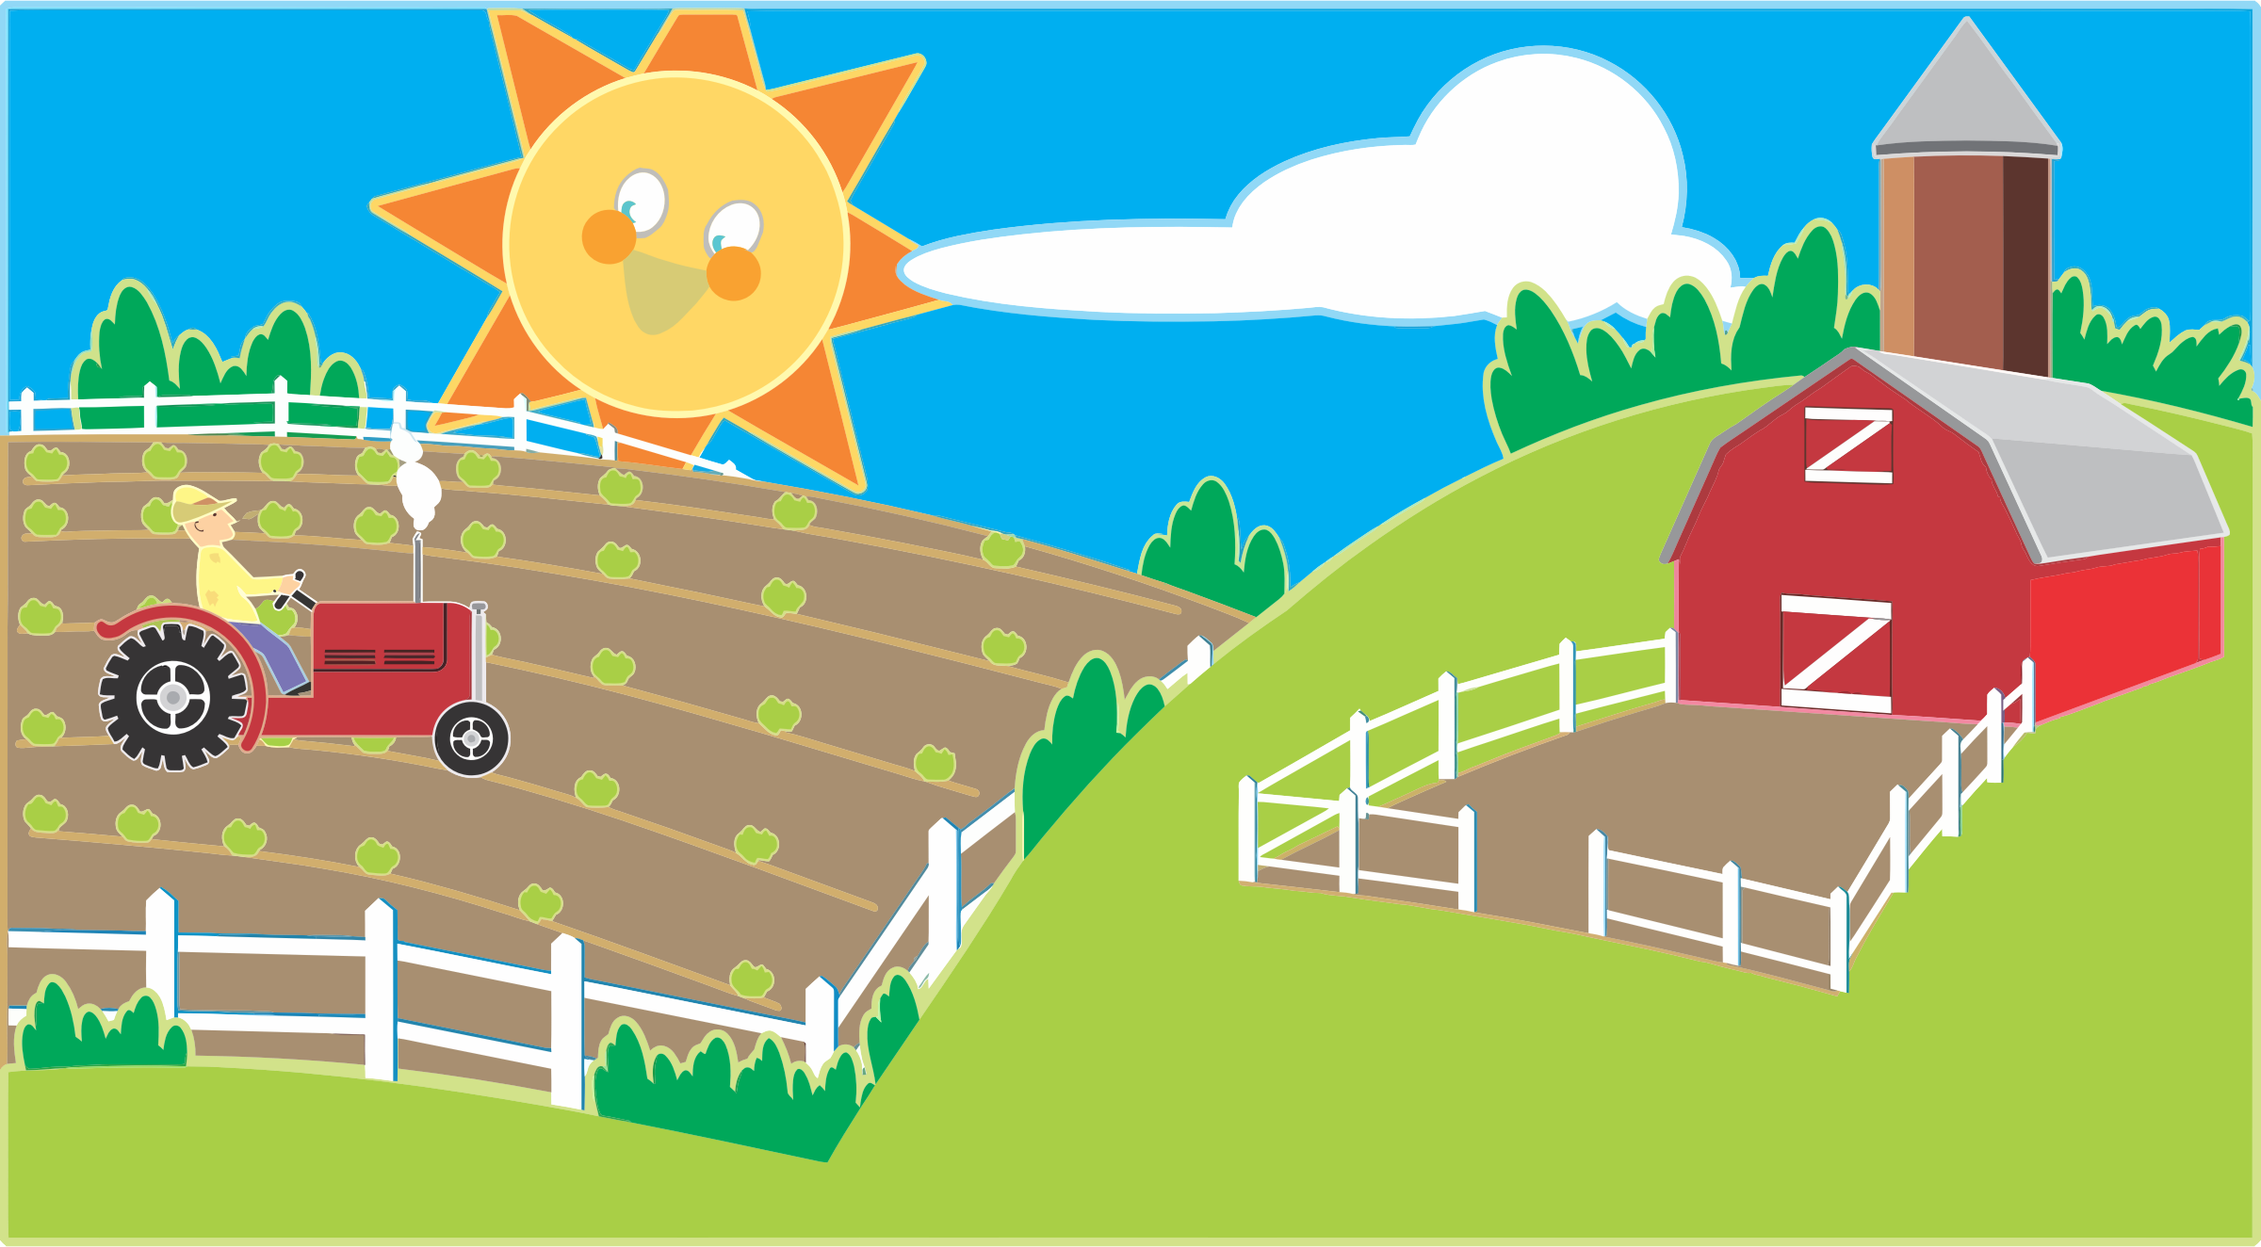

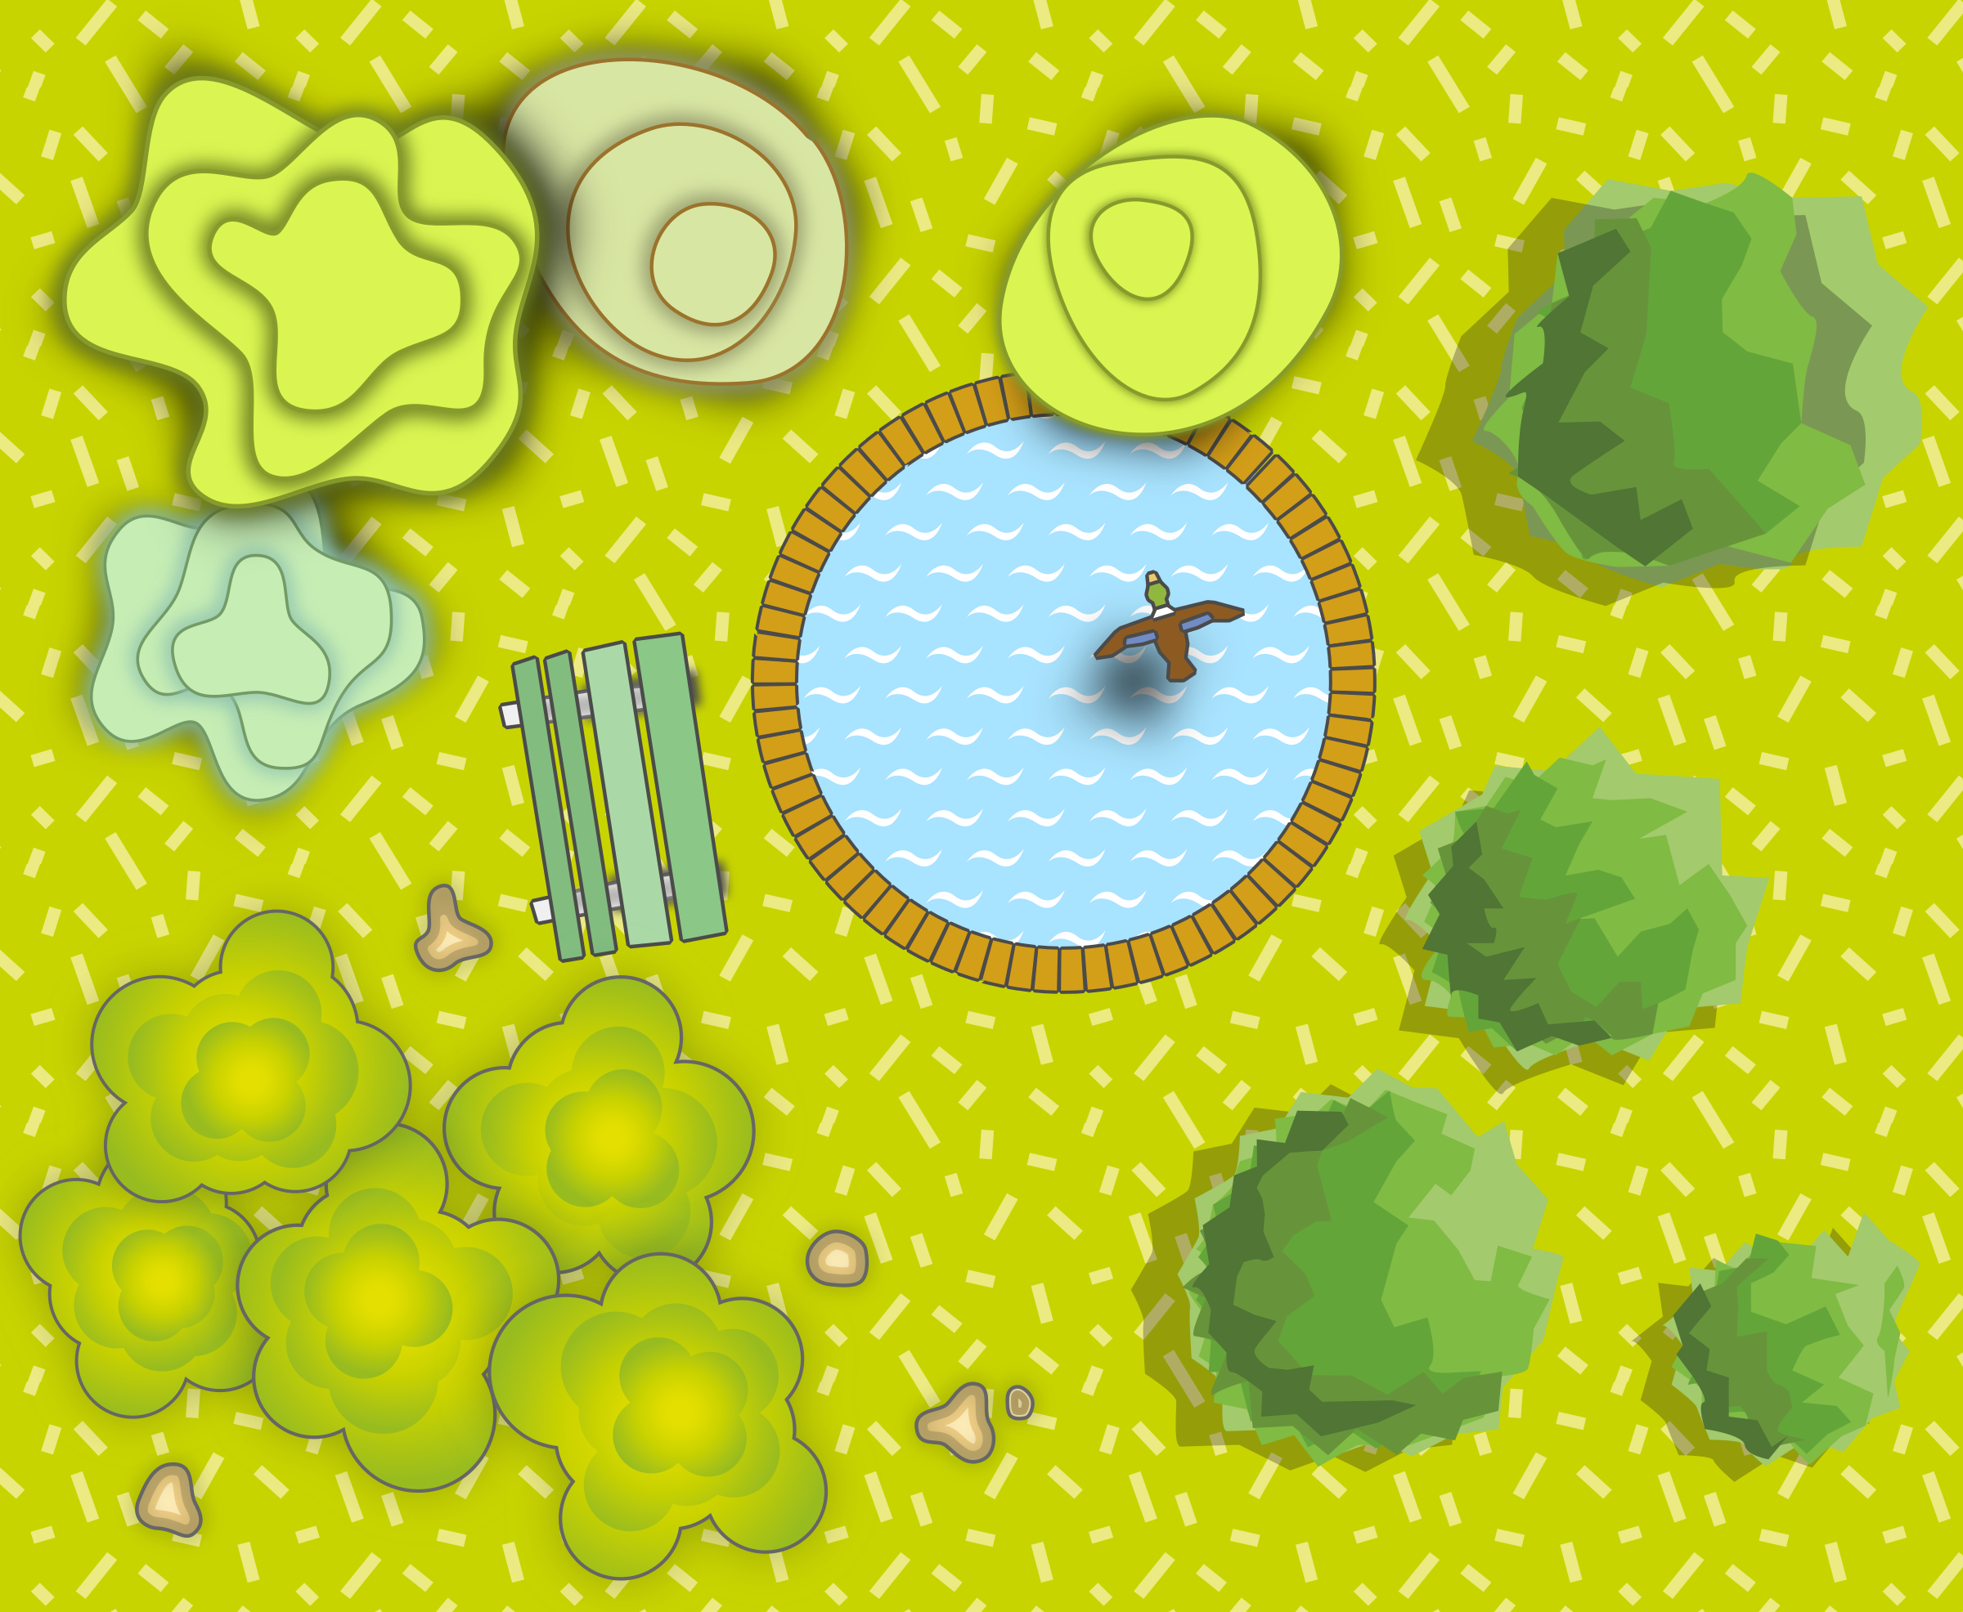


farm
shark
jar
ar
garden
car
star

Slide 20

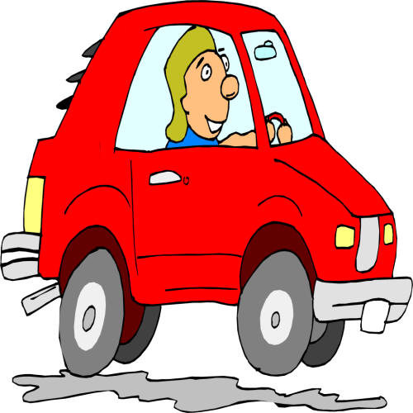

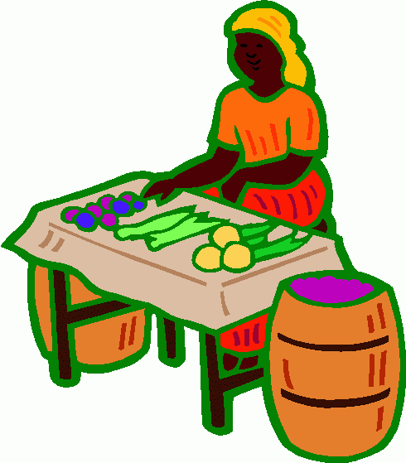

car
Write 3 ar words
jar
star
farm
market

Slide 21
Sentence:
The shark has very sharp teeth.

Slide 22
Day 2 or

Slide 23
revisit
Can you remember these sounds from Phase 2?
s a t p i n
m d g o c k
e u r b f l
ff ll ss ck j

Slide 24
revisit
These are the phase 3 sounds learned so far:
j v w x
y z zz qu
ch sh th ng
ai ee igh oa

Slide 25
revisit
Can you remember these tricky words?
the
no
I
to
go

Slide 26
revisit
Phase 3 tricky words we have learned to read:
he
she
we
me
be
was

Slide 27
Can you remember which letters are the vowels?
a b c d e f g
h i j k l m n
o p q r s t u
v w x y z
a b c d e f g
h i j k l m n
o p q r s t u
v w x y z

Slide 28
This week we are looking at some new digraphs.
These digraphs are when we have a vowel and an ‘r’
Vowel
(a,e,i,o,u)
r
+

Slide 29
or

Slide 30
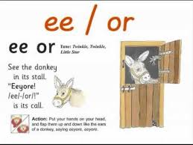

Slide 31
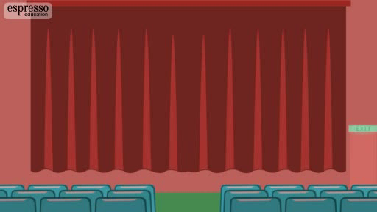

Slide 32
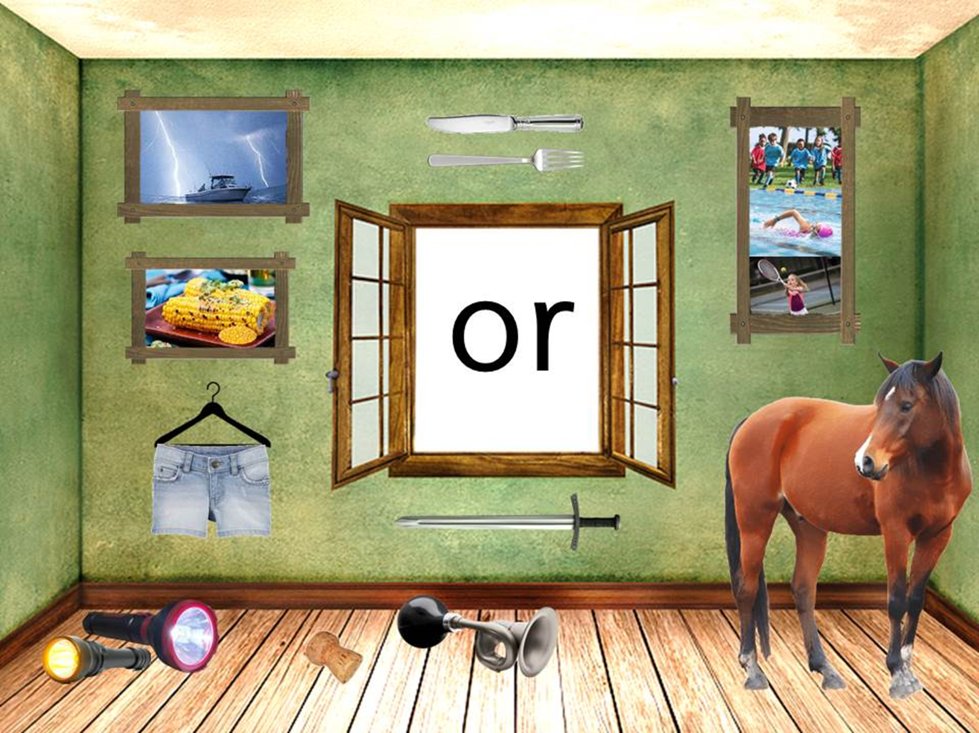

Slide 33
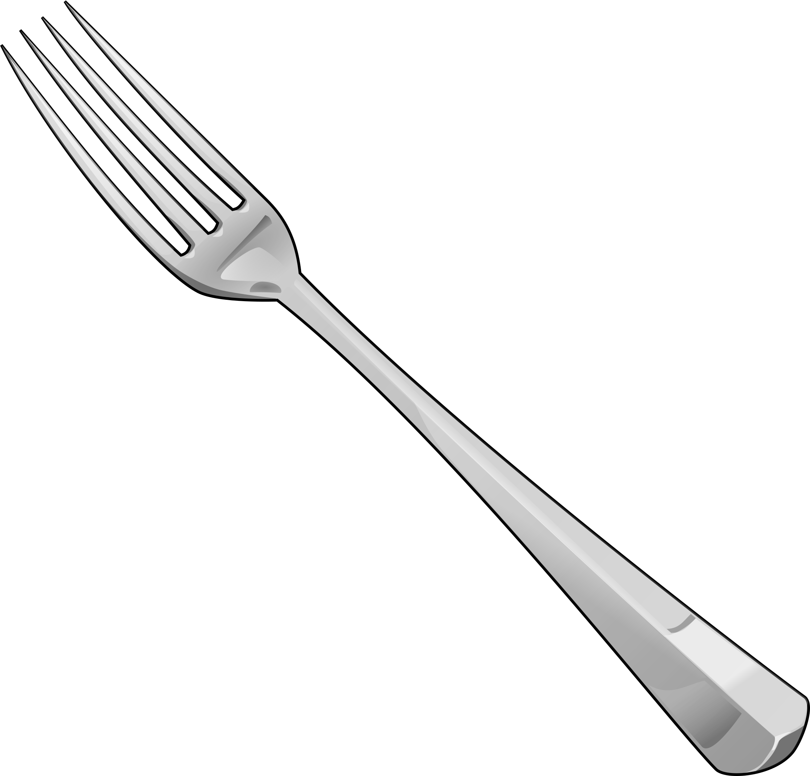
Try and spell out this word (either orally, on whiteboards, with letter fans or magnetic letters)
f
or
k

Slide 34
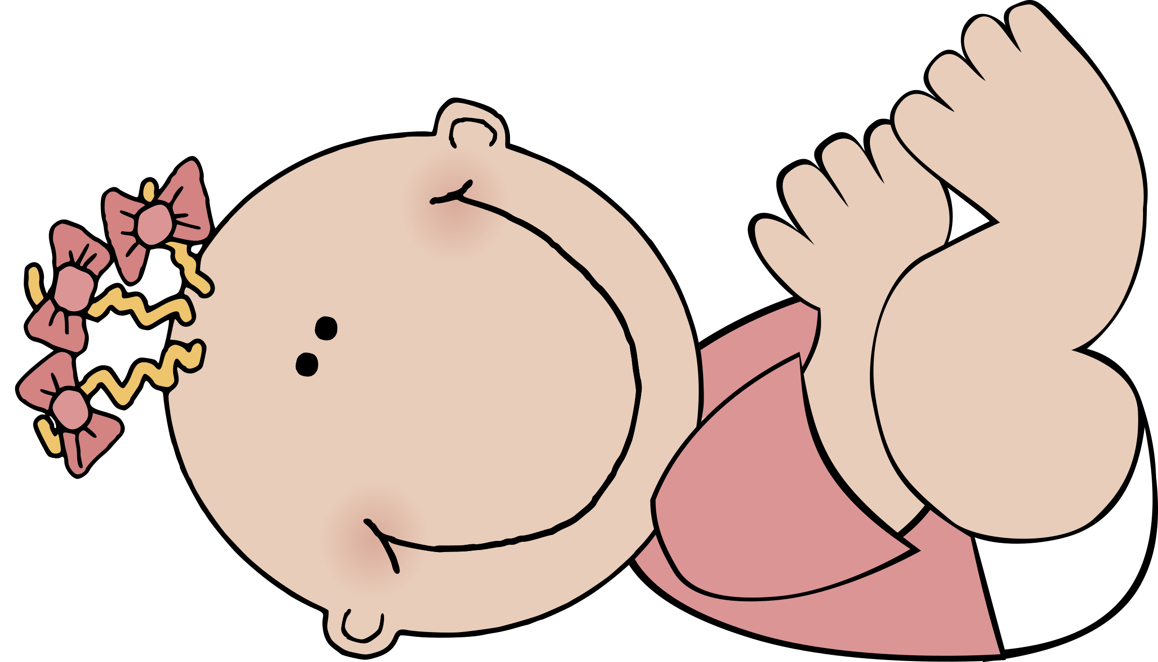
Try and spell out this word (either orally, on whiteboards, with letter fans or magnetic letters)
b
or
n

Slide 35

Try and spell out this word (either orally, on whiteboards, with letter fans or magnetic letters)
t
or
n

Slide 36

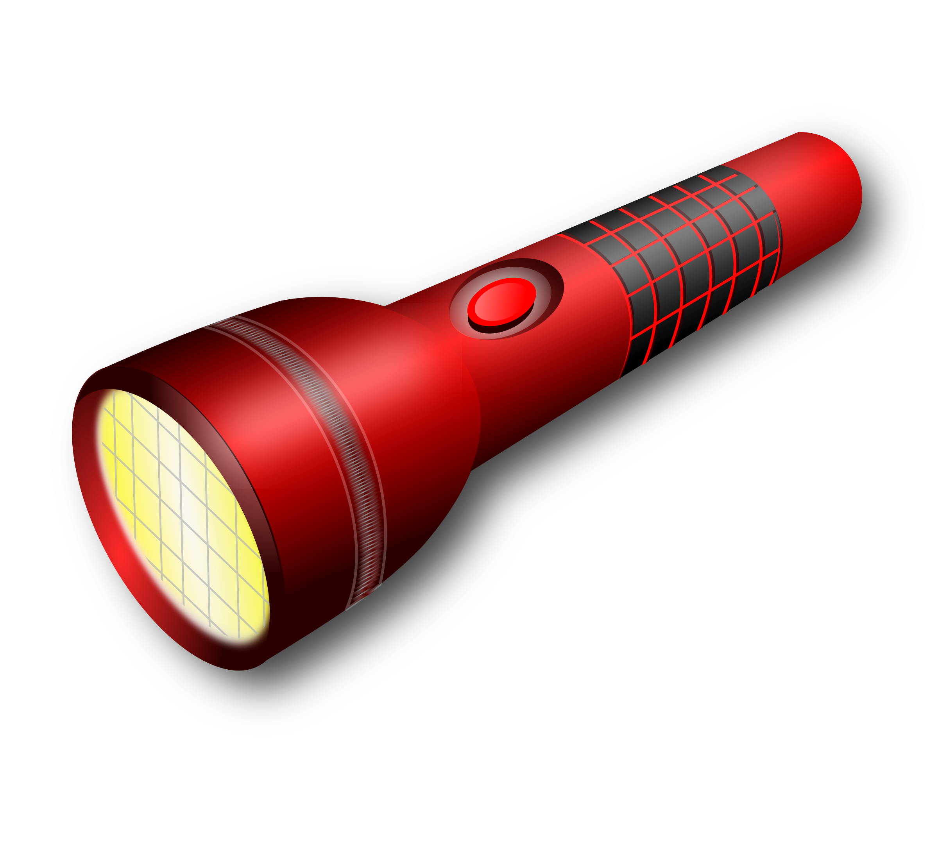
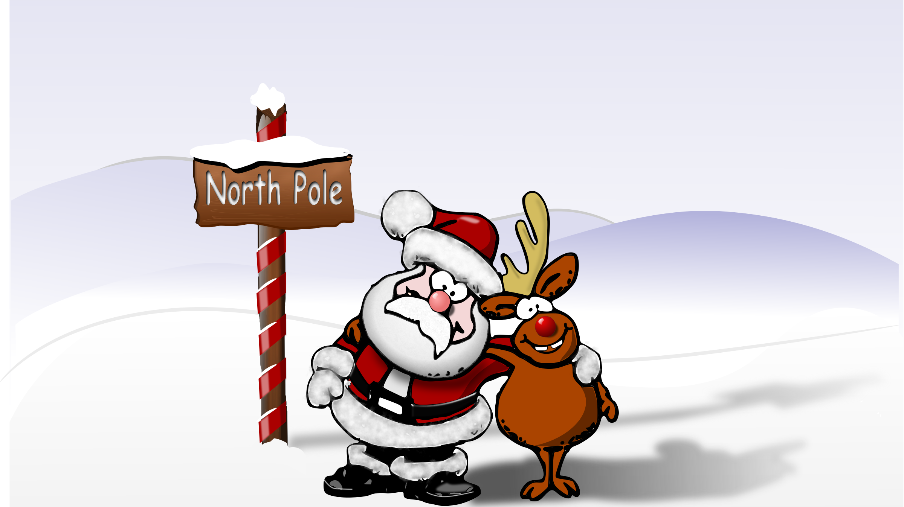
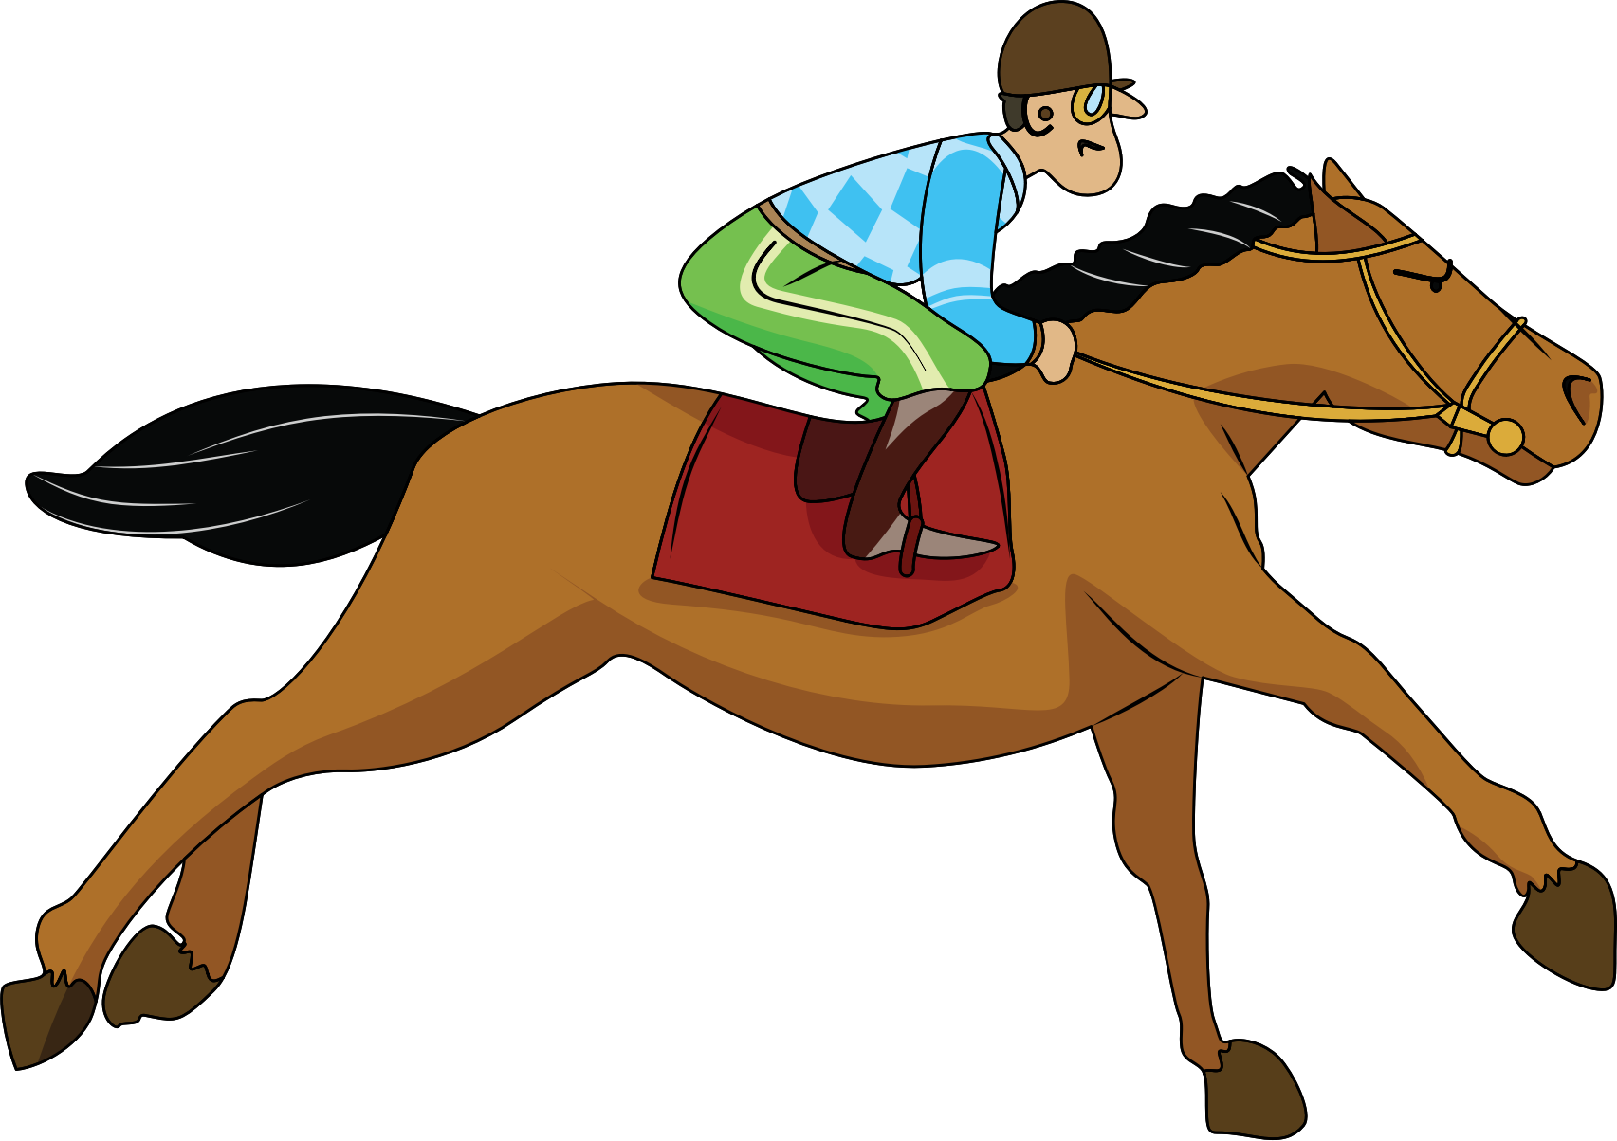

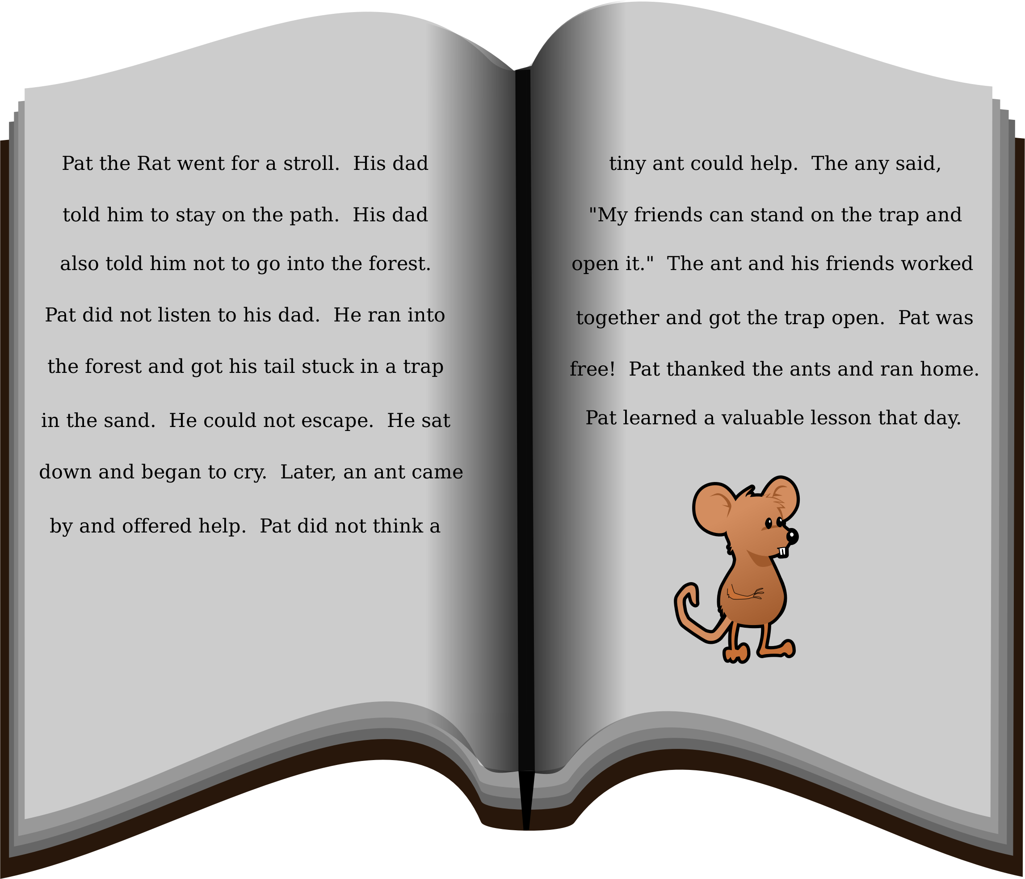
North
acorn
or
torch
storm
story
horse

Slide 37
Day 3 ur

Slide 38
revisit
Can you remember these sounds from Phase 2?
s a t p i n
m d g o c k
e u r b f l j
ff ll ss ck v

Slide 39
revisit
These are the phase 3 sounds learned so far:
j v w x
y z zz qu
ch sh th ng
ai ee igh oa

Slide 40
revisit
Can you remember these tricky words?
the
no
I
to
go

Slide 41
revisit
Phase 3 tricky words we have learned to read:
he
she
we
me
be
was

Slide 42
Can you remember which letters are the vowels?
a b c d e f g
h i j k l m n
o p q r s t u
v w x y z
a b c d e f g
h i j k l m n
o p q r s t u
v w x y z

Slide 43
This week we are looking at some new digraphs.
These digraphs are when we have a vowel and an ‘r’
Vowel
(a,e,i,o,u)
r
+

Slide 44
ur

Slide 45
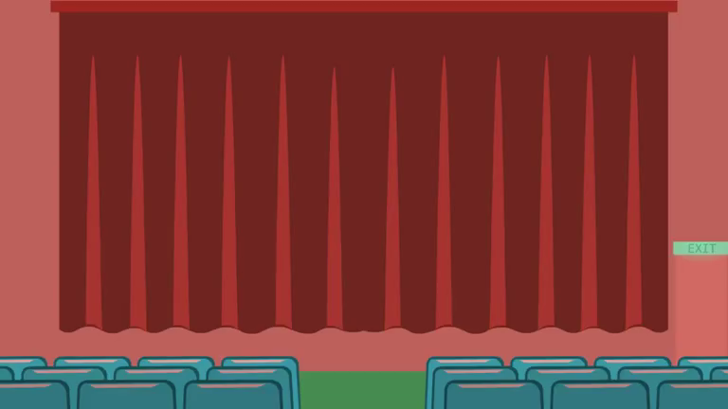

Slide 46



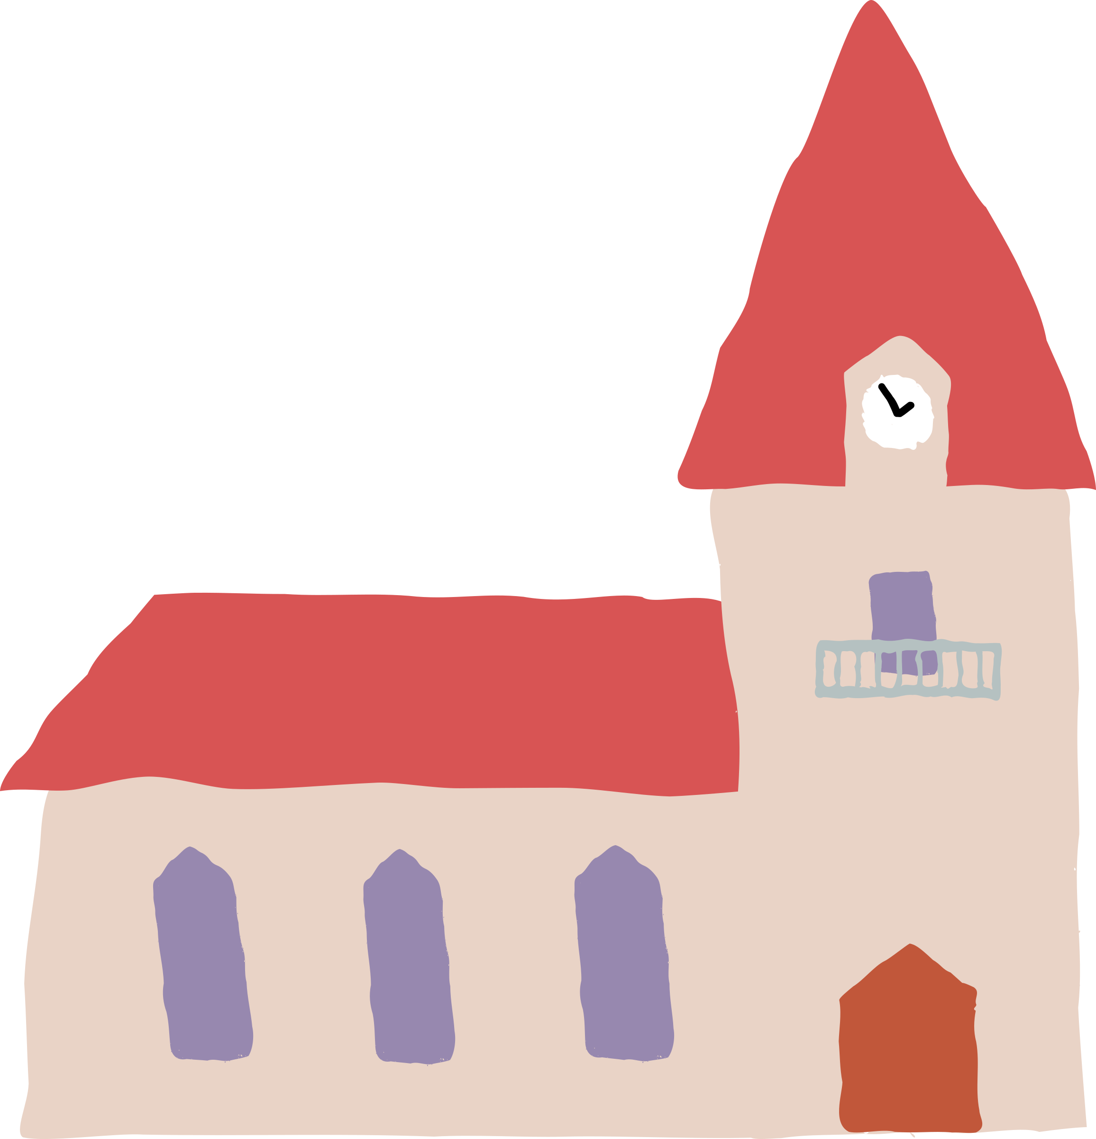
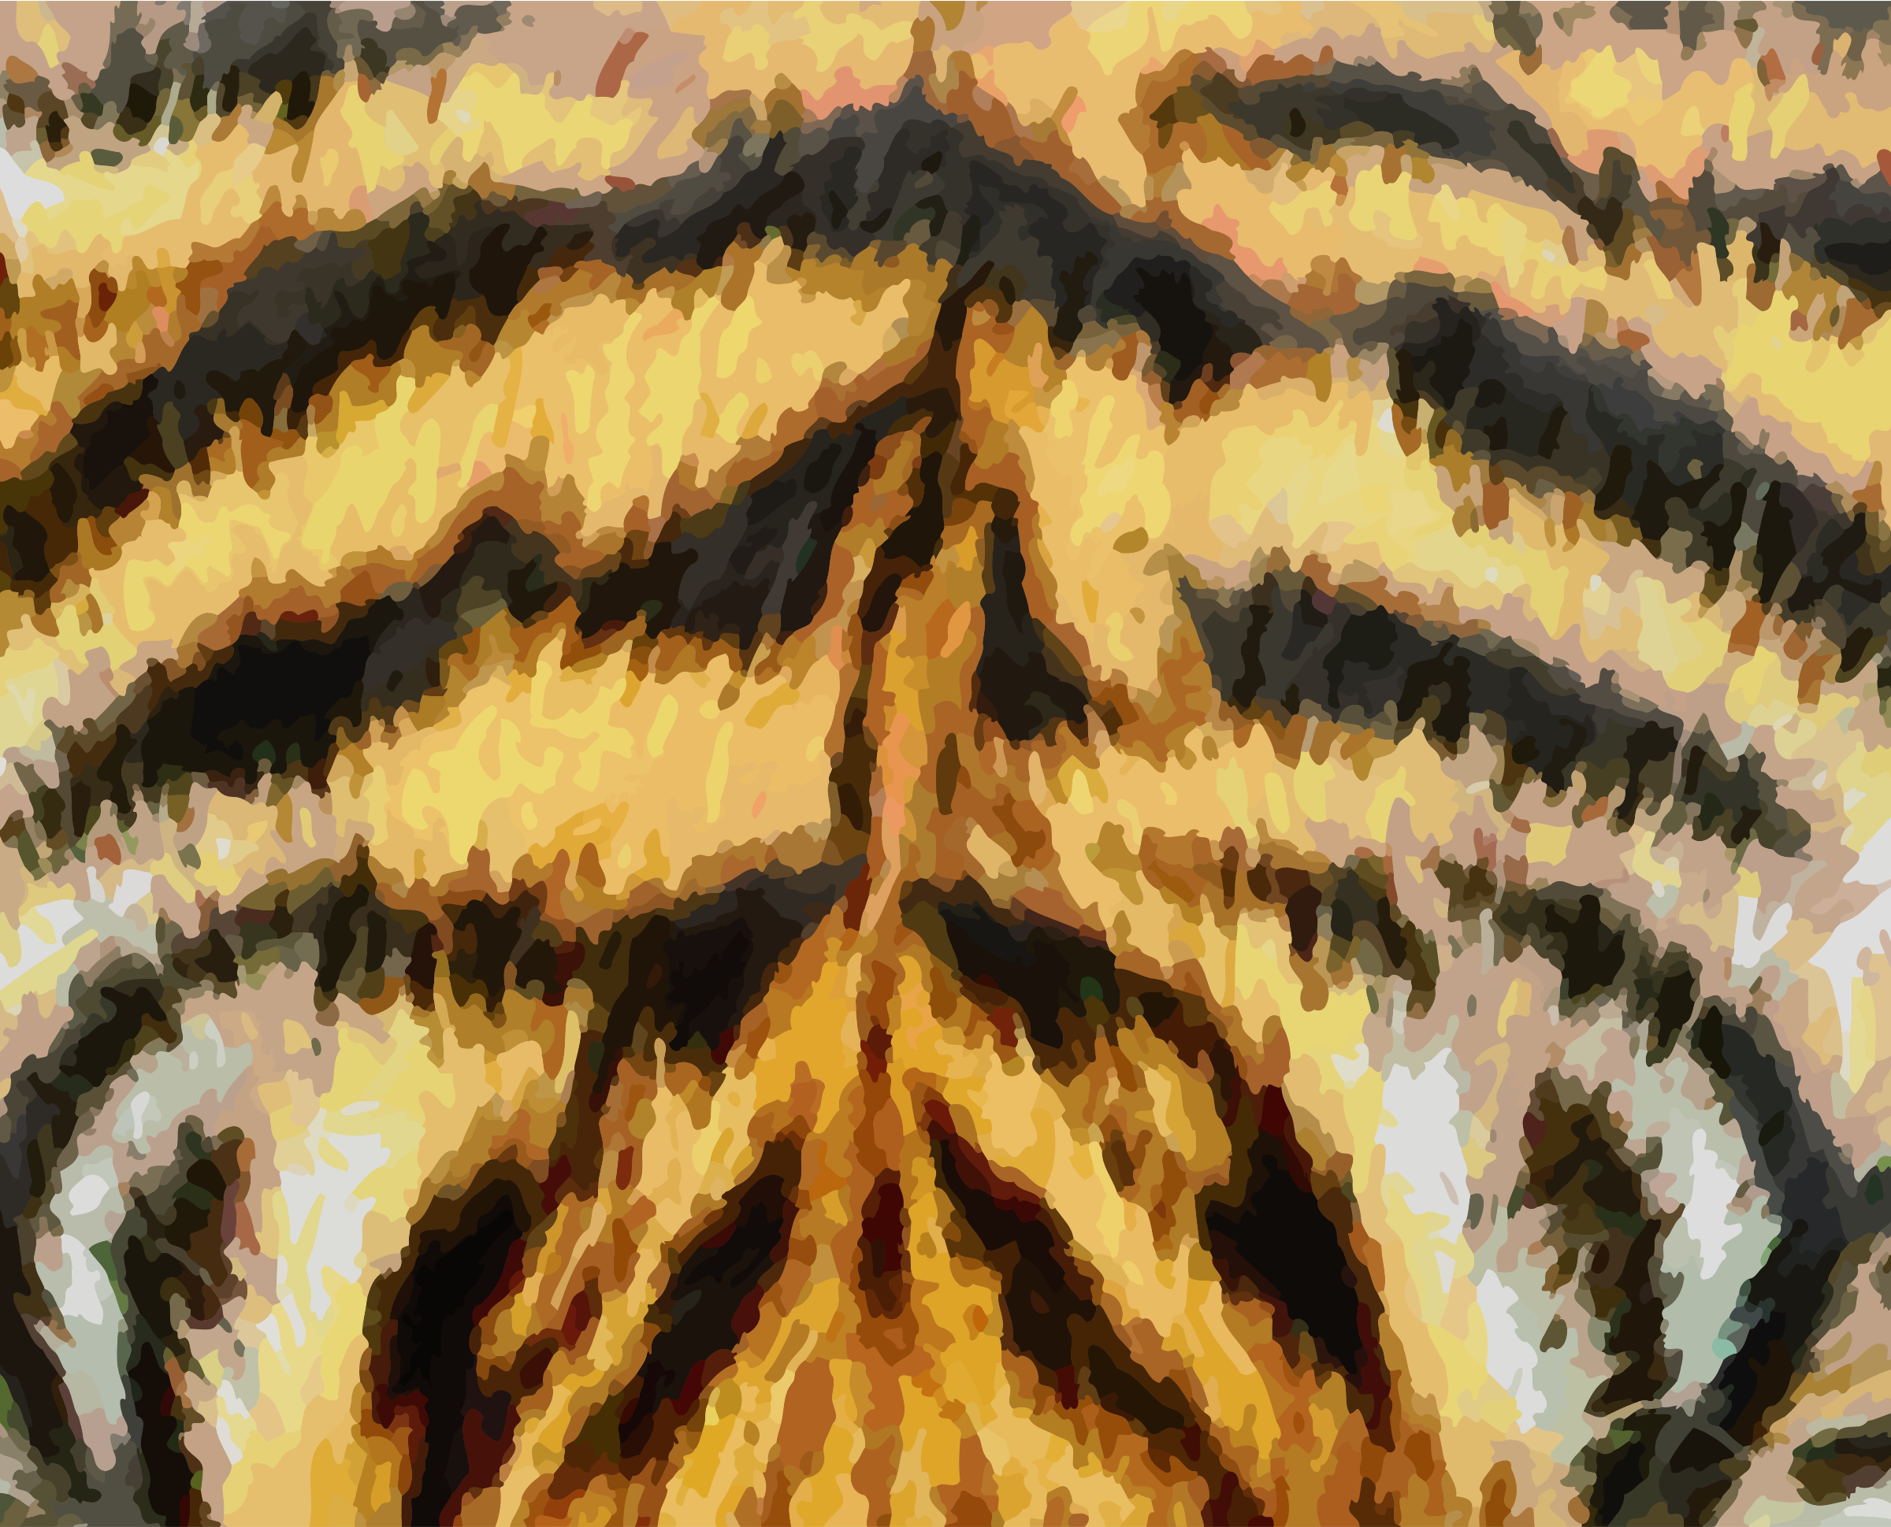
turtle
ur
nurse
curtain
church
fur

Slide 47

Have a go at reading these words. Click to see the picture:
surf

Slide 48
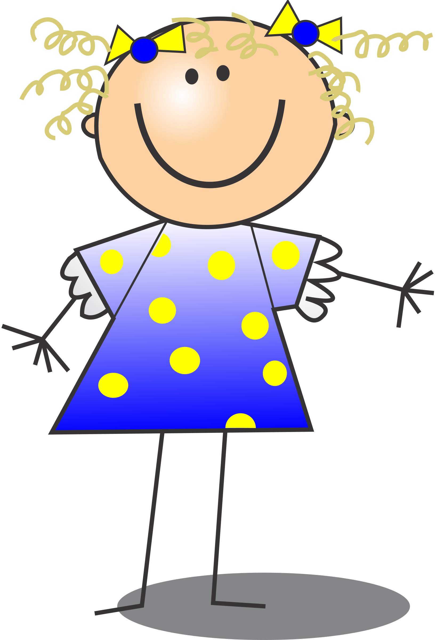
Have a go at reading these words. Click to see the picture:
curl

Slide 49

Have a go at reading these words. Click to see the picture:
turnip

Slide 50

Yes/No Questions:
Can a burn hurt?

Slide 51
Day 4 er

Slide 52
revisit
Can you remember these sounds from Phase 2?
s a t p i n m d
g o c k e u r b
f l ff ll ss ck
j v w

Slide 53
revisit
These are the phase 3 sounds learned so far:
j v w x
y z zz qu
ch sh th ng
ai ee igh oa

Slide 54
revisit
Can you remember these tricky words?
the
no
I
to
go

Slide 55
revisit
Phase 3 tricky words we have learned to read:
he
she
we
me
be
was

Slide 56
Can you remember which letters are the vowels?
a b c d e f g
h i j k l m n
o p q r s t u
v w x y z
a b c d e f g
h i j k l m n
o p q r s t u
v w x y z

Slide 57
This week we are looking at some new digraphs.
These digraphs are when we have a vowel and an ‘r’
Vowel
(a,e,i,o,u)
r
+

Slide 58
er

Slide 60


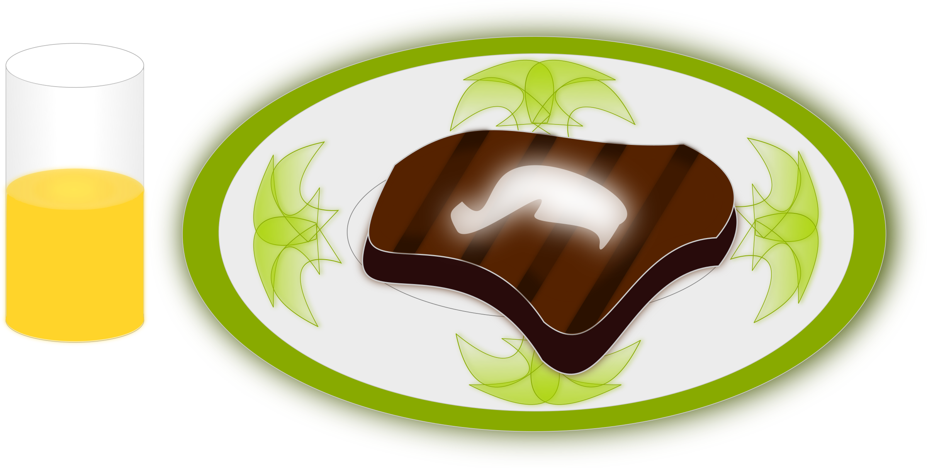

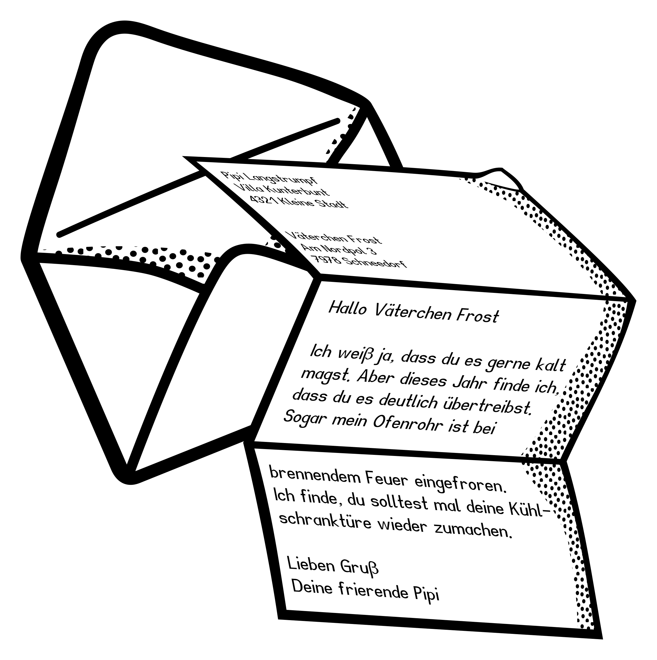
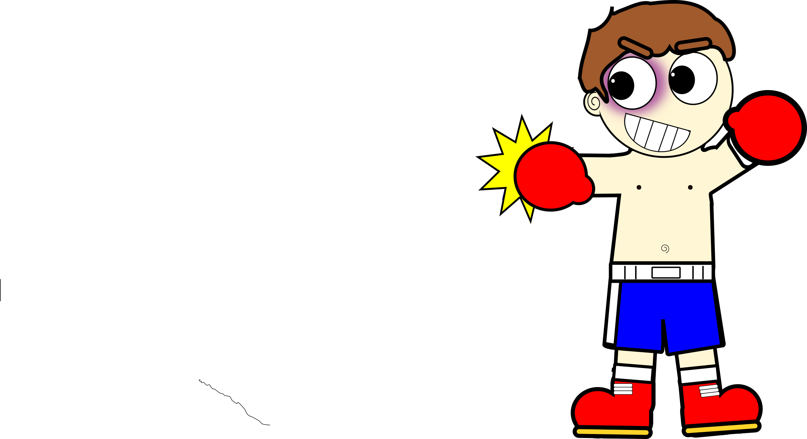
dinner
hammer
er
boxer
ladder
letter
summer

Slide 61
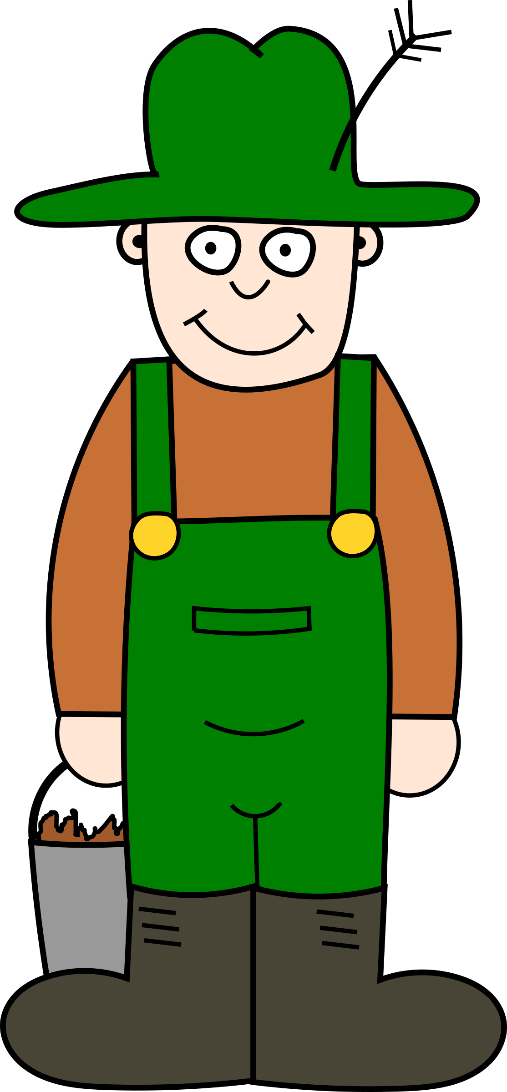
Try and spell out this word (either orally, on whiteboards, with letter fans or magnetic letters)
f
ar
m
er

Slide 62

Try and spell out this word (either orally, on whiteboards, with letter fans or magnetic letters)
h
er
b

Slide 63
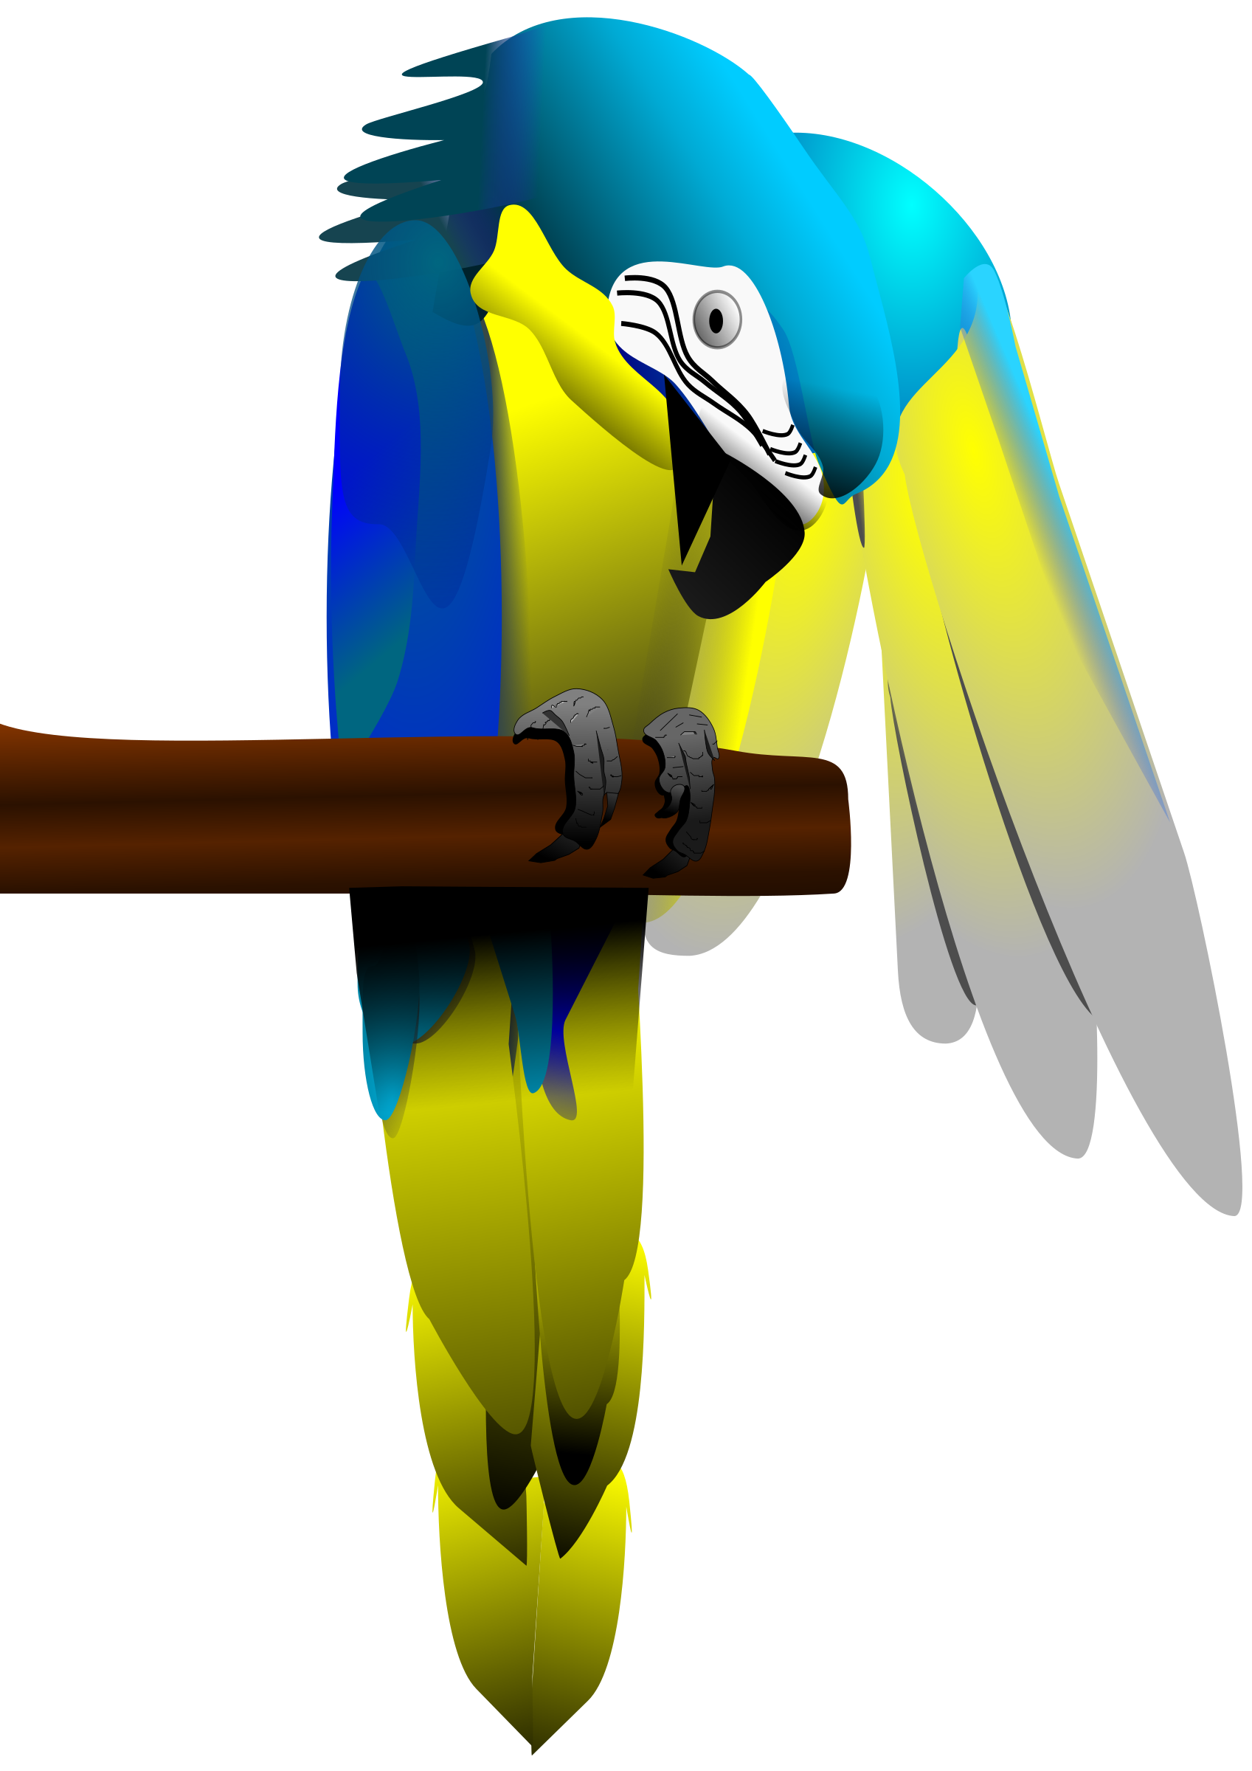
Try and spell out this word (either orally, on whiteboards, with letter fans or magnetic letters)
p
er
ch

Slide 64
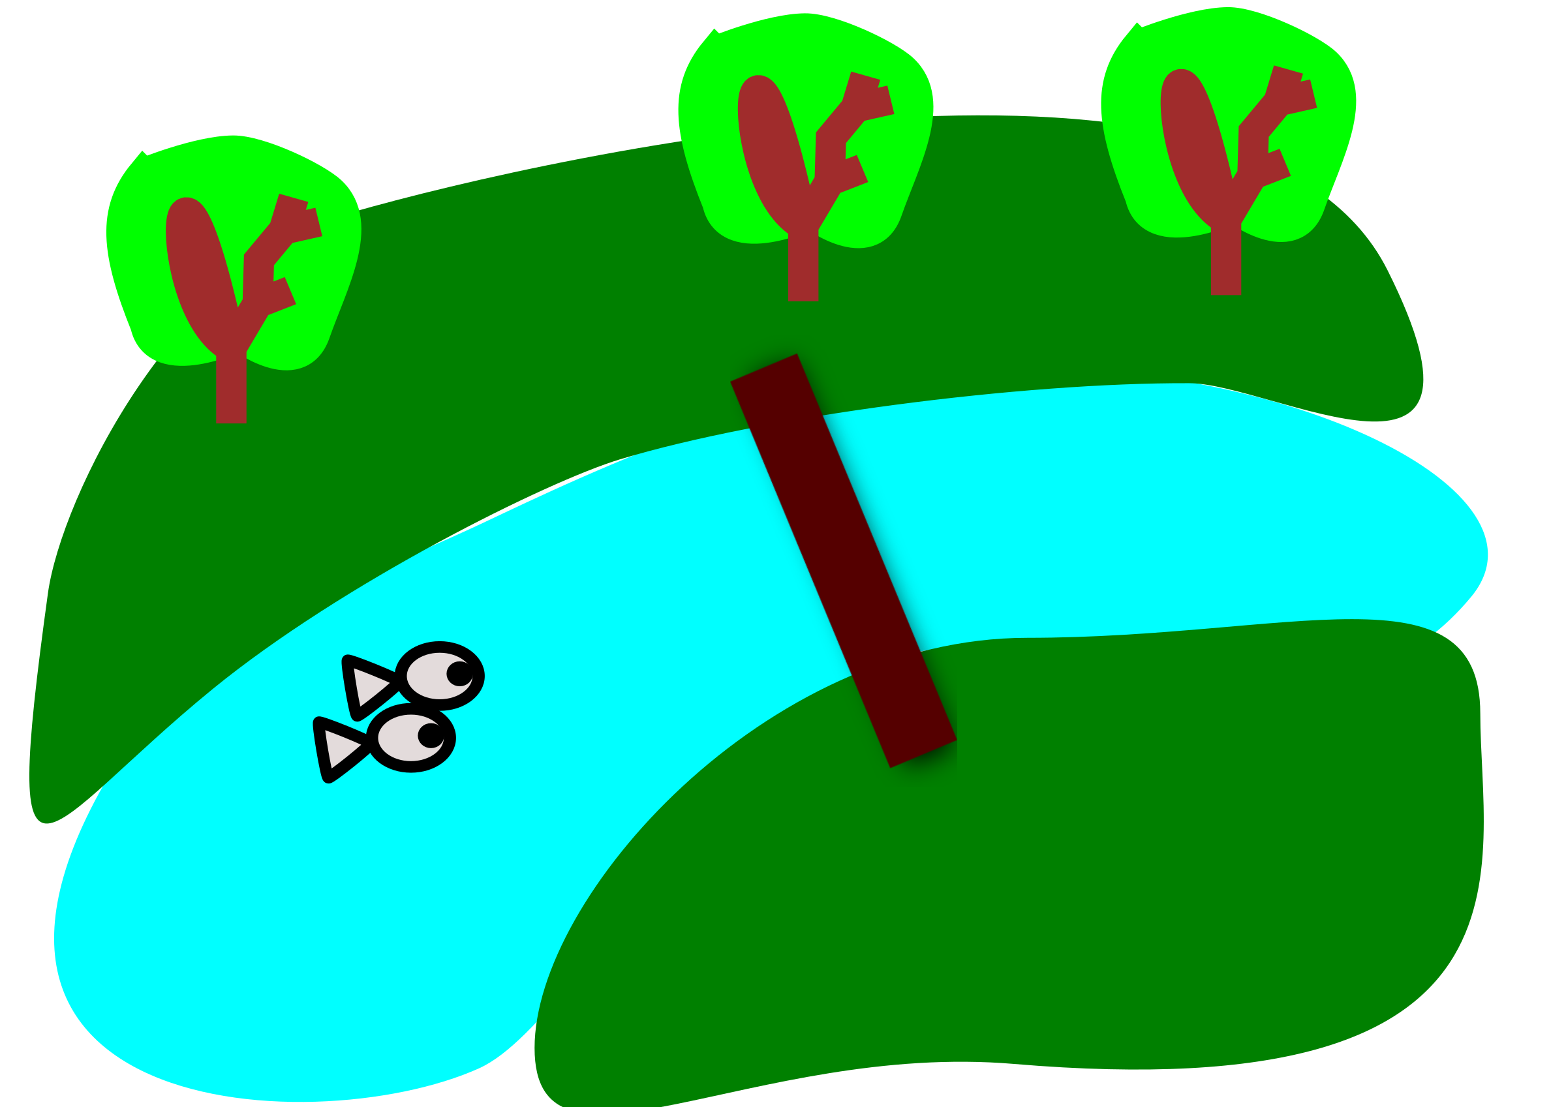
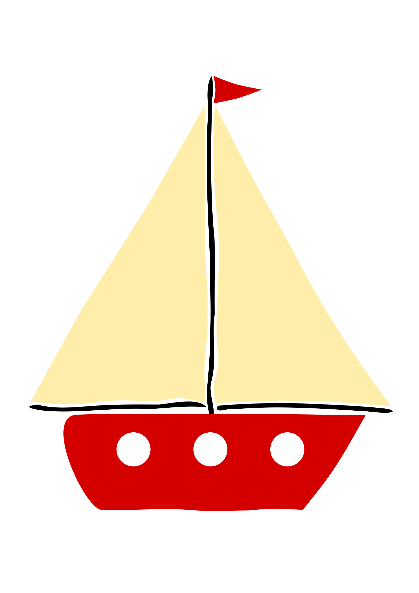
Read the caption:
boats on the river

Slide 65
Day 5 was

Slide 66
revisit
Can you remember these sounds?
s a t p i n m d
g o c k e u r b
f l ff ll ss ck
j v w x

Slide 67
revisit
These are the phase 3 sounds learned so far:
j v w x
y z zz qu
ch sh th ng
ai ee igh oa

Slide 68
revisit
Can you remember these tricky words?
the
no
I
to
go

Slide 69
revisit
Phase 3 tricky words we have learned to read:
he
she
we
me
be
was

Slide 70
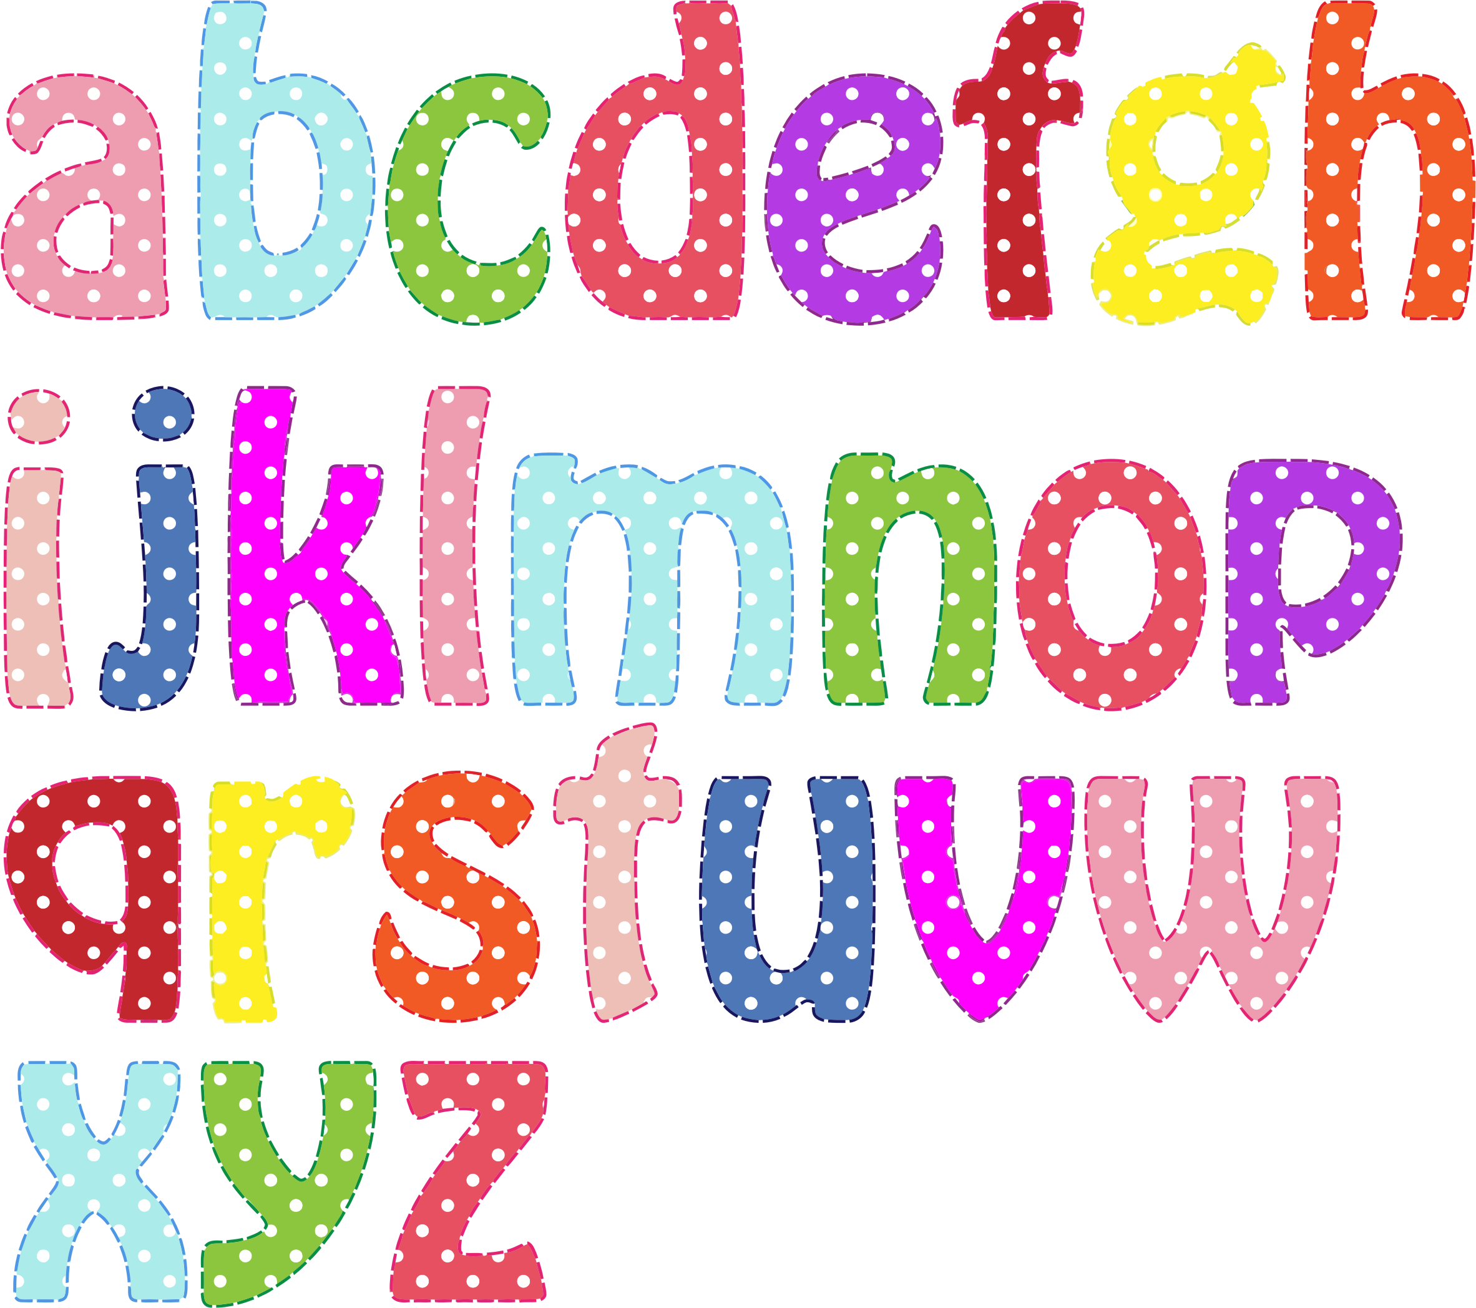
Can you remember which letters are the vowels?

Slide 71
y
Vowels are very special letters. There is a vowel in every word that you read and write.
There are five vowels but there is also another letter that sometimes acts as a vowel. This is the letter ‘y’.

Slide 72
y
The letter ‘y’ can actually make 3 different sounds, depending on how it is used in a word:
“Yes, my mummy”

Slide 73
my
Todays tricky word has a ‘y’ in it. The ‘y’ is acting as a vowel and makes the /igh/ sound

Slide 74
we
Can you remember these tricky words from last week? Remember that vowels sometimes say their ‘sound’ and sometimes say their ‘name’. In these words, the ‘e’ said its name.
be
he
me
she

Slide 75

Have a go at reading this caption:
my dog

Slide 76
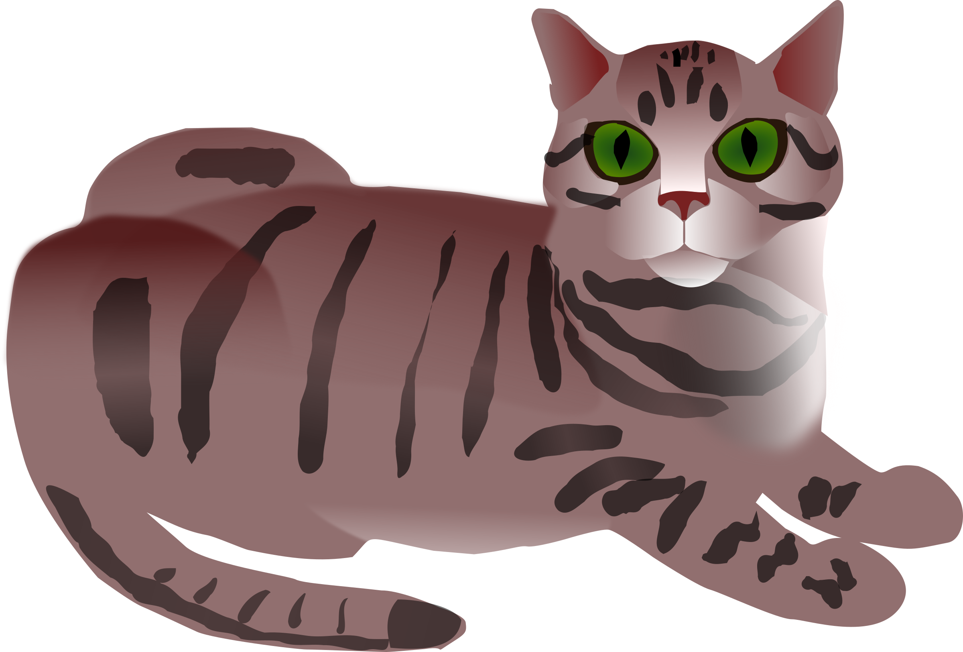
Have a go at reading this caption:
my cat

Slide 77

Have a go at reading this caption:
my car

Slide 78
Acknowledgements:
Page borders from: https://www.teacherspayteachers.com/Store/Miss-Giraffe
All clip art images from: openclipart.og

