Slide 1
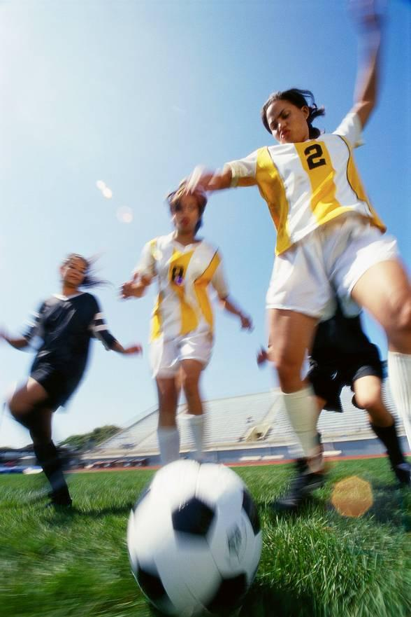
Year Five
God loves me in
my changing
and development
^{1 A Journey in Love - Year 5}

Slide 2
Objectives
* Know that as we grow we will become
different in our…
…bodies
…feelings
…love of God
^{2 A Journey in Love - Year 5}

Slide 3
Keywords
External
Internal
Change
Develop
Ovulation
God
Sensitivity
Puberty
Presence
Celebrate
^{3 A Journey in Love - Year 5}

Slide 4
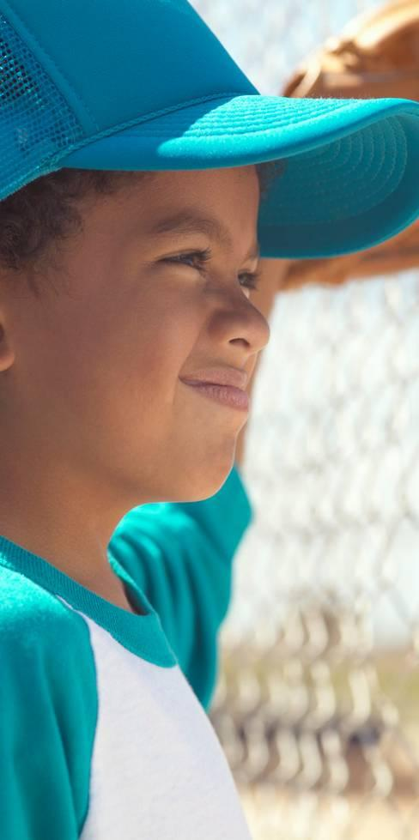
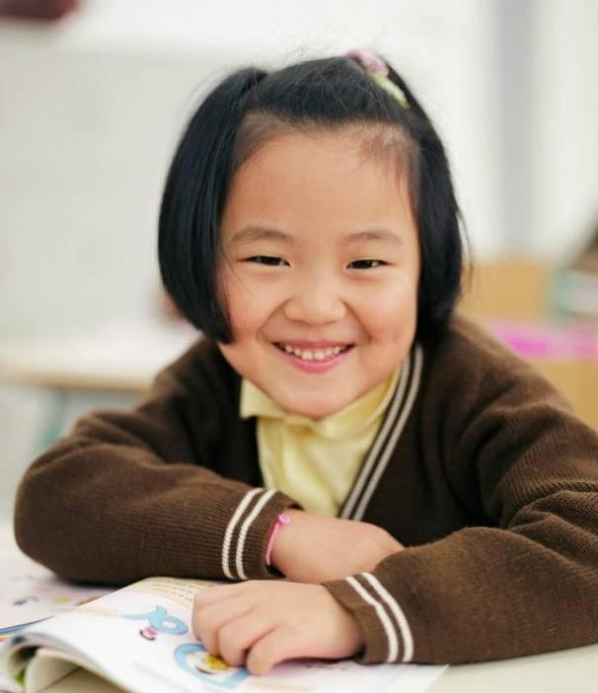
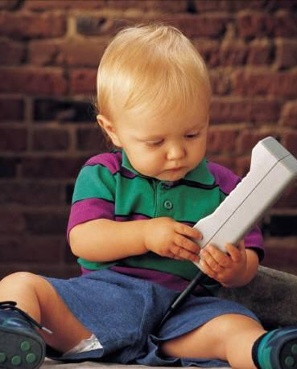
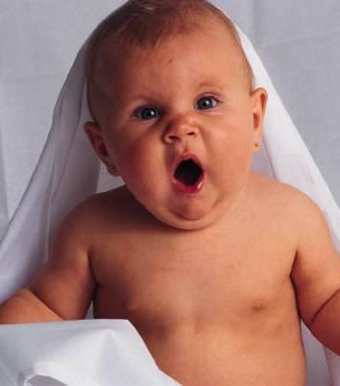
Physical and Intellectual
We have changed in many ways since
we were born.
We have grown…
^{4 A Journey in Love - Year 5}

Slide 5
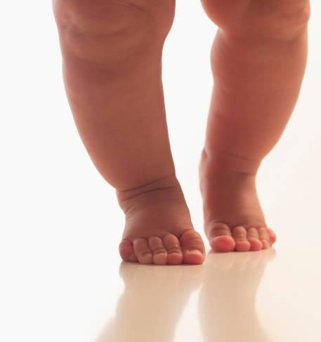
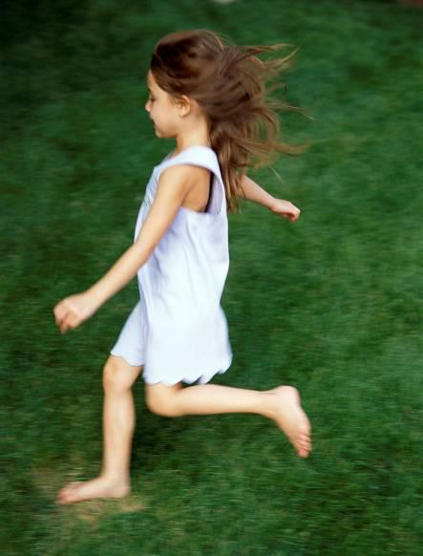
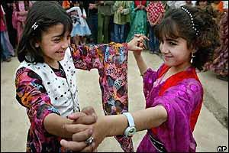
We can do more…
Run
Walk
Feed ourselves
Dance
^{5 A Journey in Love - Year 5}

Slide 6
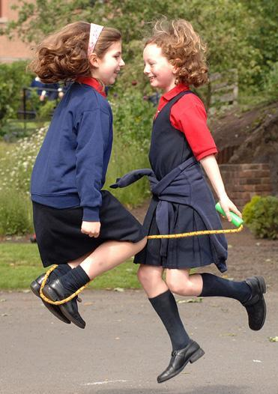
Read and write
Play
Make friends
^{6 A Journey in Love - Year 5}

Slide 7
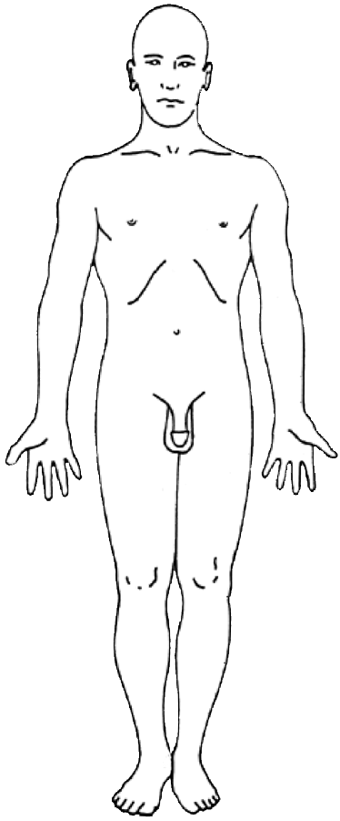
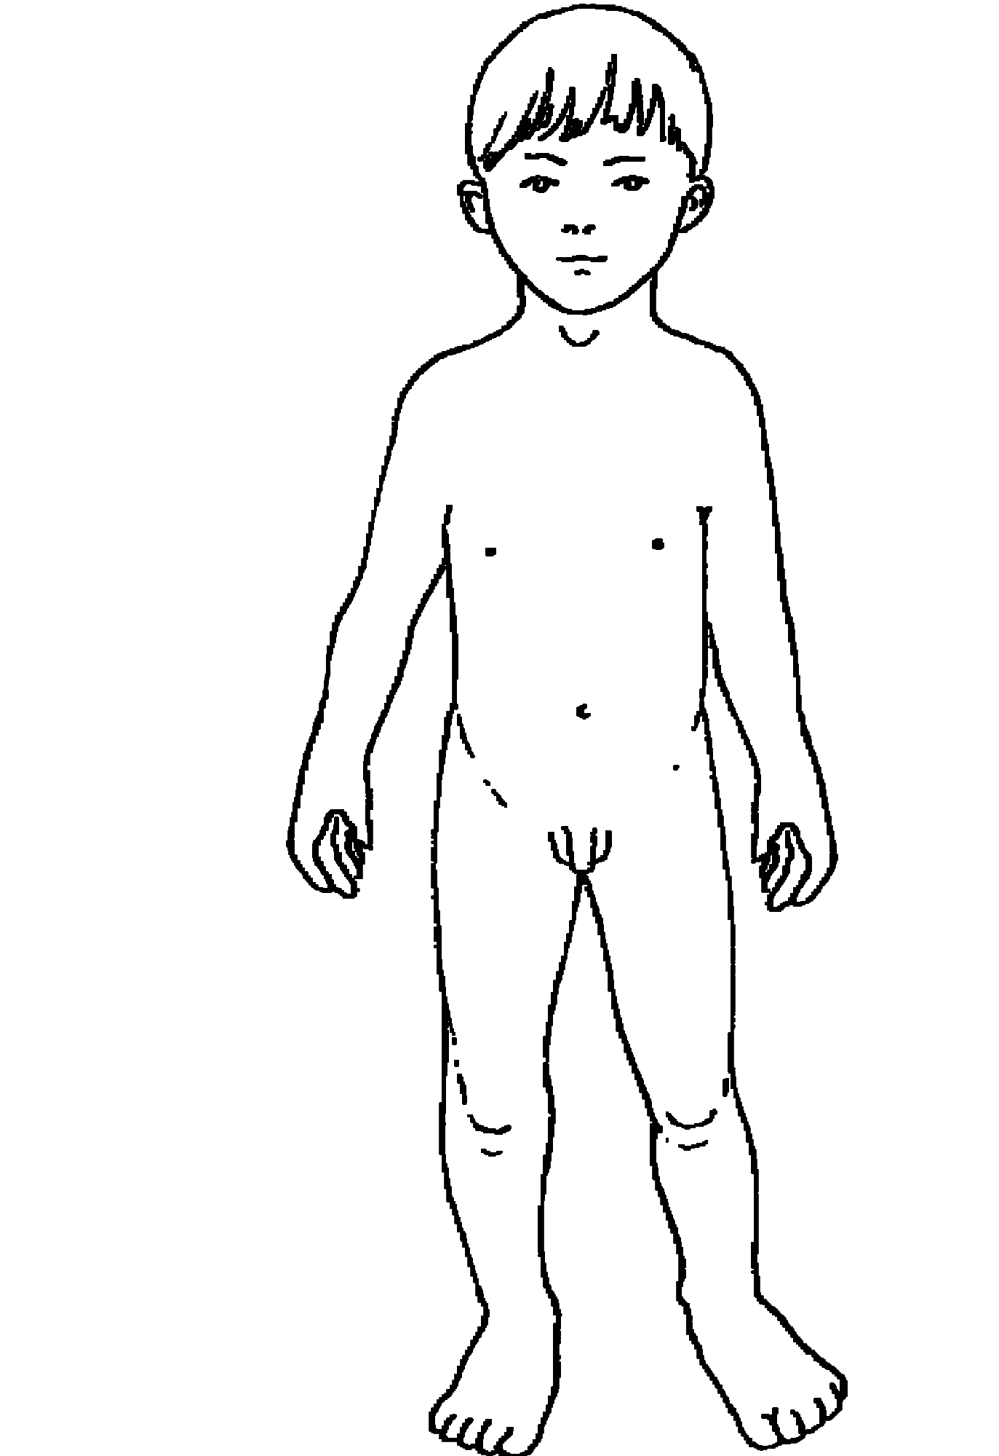
We will change more before we are grown
boy…
…to man
^{7 A Journey in Love - Year 5}

Slide 8
Physical changes in boys
Testosterone in the bloodstream triggers changes
Muscles and bones develop
Voice deepens
Some boys get uneven breast development in early puberty
Waist thickens
Limbs lengthen in proportion to body
Shoulders broaden
Wet dreams and erections
^{8 A Journey in Love - Year 5}

Slide 9
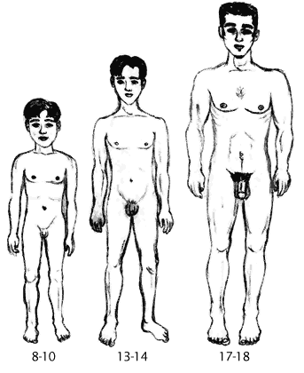
Physical changes in boys continued
Penis and scrotum enlarge
Production of sperm and discharge of seminal fluid during ejaculation
Adam’s apple enlarges
Hair can grow on face, chest and back as well as underarms and pubic area
^{9 A Journey in Love - Year 5}

Slide 10
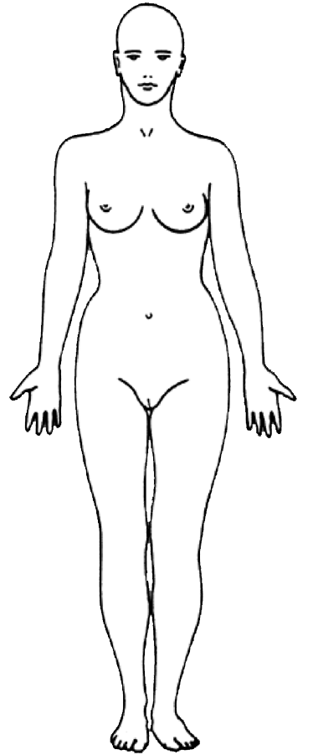
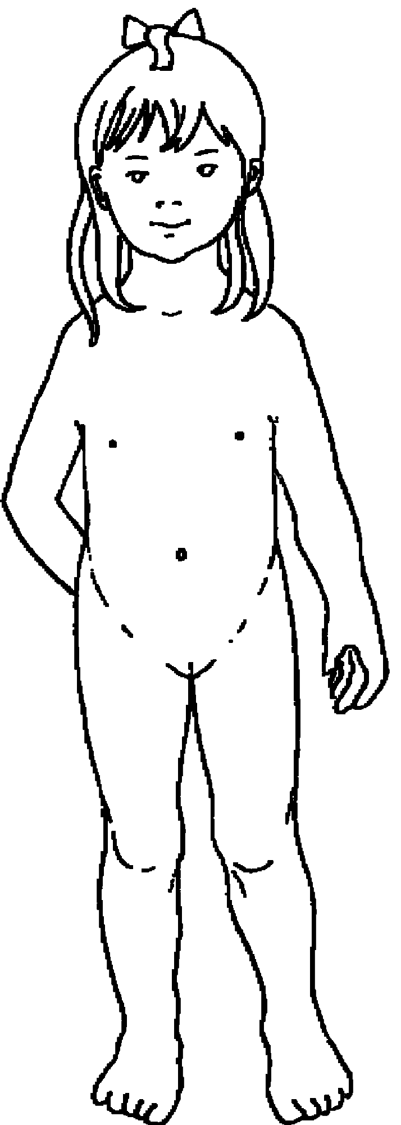
girl…
…to woman
10 A Journey in Love - Year 5

Slide 11
Physical changes in girls
Breasts develop: they come in all shapes and sizes
Hips broaden and waist slims
Ovaries produce oestrogen
Hormonal activity
Menstruation begins (about 12 months after breasts begin to develop)
Uterus enlarges
Usually start to grow hair on underarm, pubic area and legs
Vaginal lining thickens
11 A Journey in Love - Year 5

Slide 12
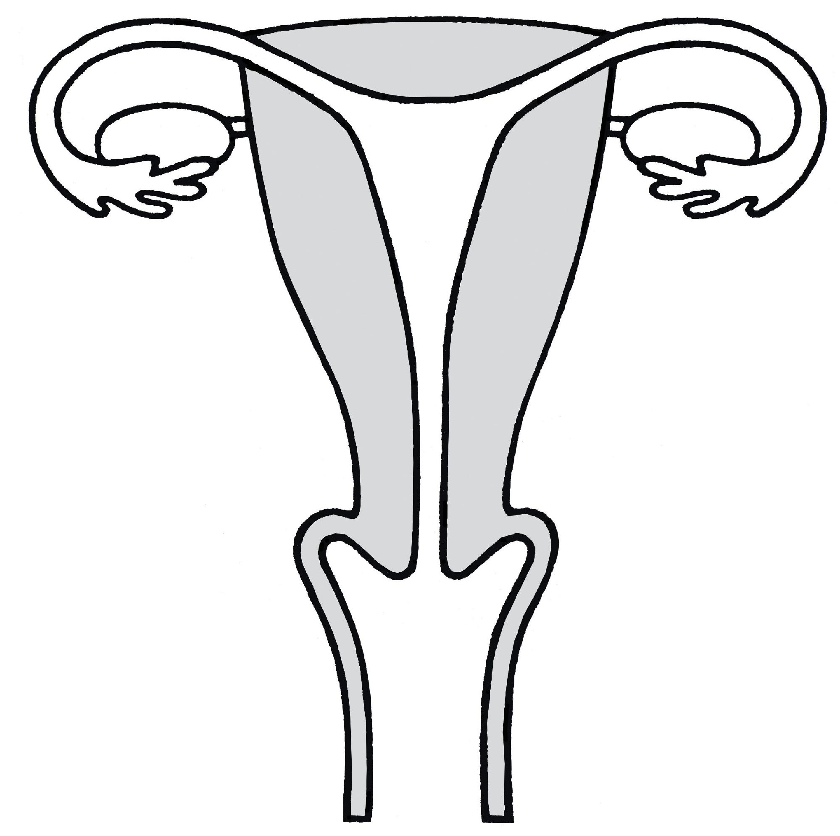
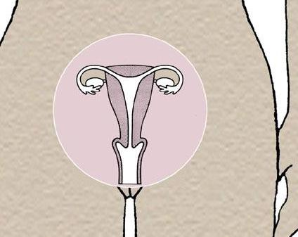
Menstruation
The menstrual cycle is to prepare the female body for reproduction
Inside a woman’s body:
d
c
a. Vagina
b. Cervix
c. Womb (uterus)
d. Fallopian tube
e. Ovary
e
b
a
12 A Journey in Love - Year 5

Slide 13
There are 2 important stages:
1. Menstruation
The menstrual cycle is controlled by hormones released from the pituitary gland. Most menstrual cycles last for about 28 days. The first day of the period marks the start of the cycle and is counted as day 1.
If the uterus does not receive a fertilised ovum, the lining of the uterus breaks down and is shed over the next few days. This is called menstruation.
The lining of the uterus begins to thicken and an ovum begins to develop.
d
c
e
b
a
a. Vagina
b. Cervix
c. Womb (uterus)
d. Fallopian tube
e. Ovary
13 A Journey in Love - Year 5

Slide 14
2. Ovulation
On about the 14th day of the cycle an ovum is released into the fallopian tube. This is called ovulation.
The ovum travels towards the uterus.
The lining of the uterus continues to thicken and gets full of blood in case a fertilised ovum arrives.
If the ovum is not fertilised it will dissolve and a period will occur.
Then the cycle starts again…
d
c
e
b
a
a. Vagina
b. Cervix
c. Womb (uterus)
d. Fallopian tube
e. Ovary
14 A Journey in Love - Year 5

Slide 15
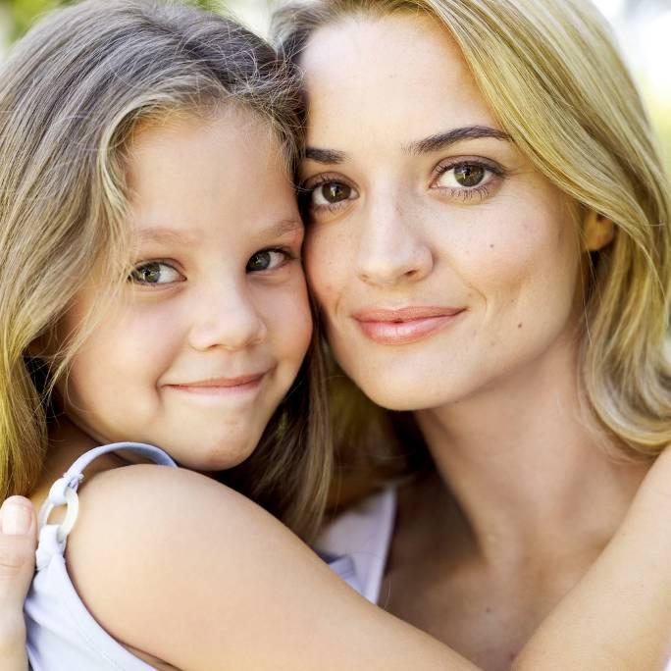
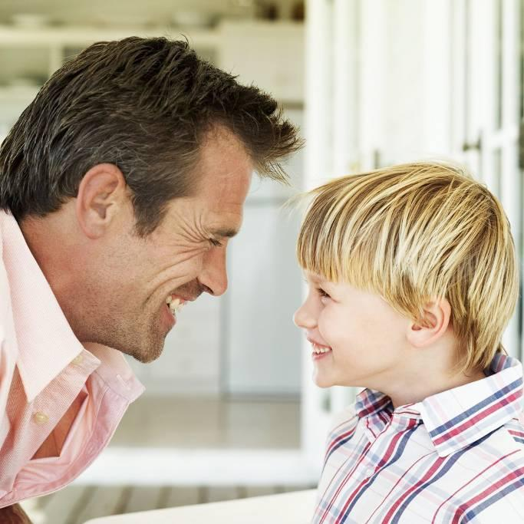
These changes are a natural part of growing up
Physical changes from child to adult mean they bring the ability and potential to become a mother or father.
15 A Journey in Love - Year 5

Slide 16
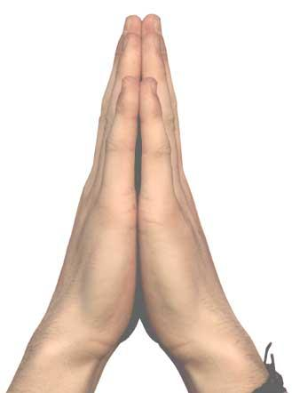
Prayer
Think about how I am growing and developing. Celebrate these changes.
Giver and protector of life,
guide me as I grow
and develop.
Amen.
^{16 A Journey in Love - Year 5}

Slide 17
Social/Emotional
As we grow up our feelings and behaviour change
Production of hormones triggers sexual desire, arousal and urges
Evolving a set of values and moral codes
Seeking independence
Risk-taking behaviour
Concern for the future
Identity formation
17 A Journey in Love - Year 5

Slide 18
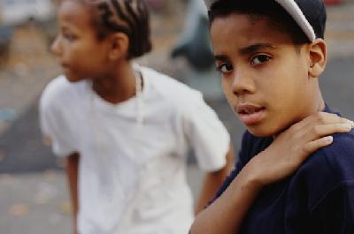
Need for privacy
Easily embarrassed
Moods swing up and down without much warning
May be divided loyalty between self, friends and parents
How can we be more sensitive to our emotional
development and other people’s?
18 A Journey in Love - Year 5

Slide 19
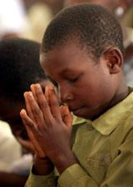
Prayer
Loving Lord,
help us to respect and understand each other better as we continue to change and grow.
Amen.
19 A Journey in Love - Year 5

Slide 20
Spiritual
To live is to change
and to be perfect
is to have changed often.
Cardinal Newman
20 A Journey in Love - Year 5

Slide 21
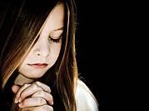
Prayer
God, grant me the serenity to accept the things I cannot change,
courage to change the things I can,
and the wisdom to know the difference.
Amen.
21 A Journey in Love - Year 5

Slide 22
A Friendship Blessing
May you be blessed with good friends.
May you learn to be a good friend yourself.
May you be able to journey to that place in your soul where there is great love, warmth, feeling and forgiveness.
May this change you.
^{22 A Journey in Love - Year 5}
End of presentation

Slide 23
Do I know these things?
I feel good about myself and my body.
I know the language that I use to describe parts, changes and feelings in my body.
I know about the changes of puberty in girls and boys.
I recognise different types of love and who can share it i.e. parents, friends, parents love for their child.
I know that families can be different i.e. 2 dads, foster, 2 mums etc. These all provide love and nurture to children.
I know what physical contact is appropriate. I know who to tell if it is not appropriate. I know the that secrets which impact on me are not good and should be told to an adult.

