Slide 1
Year 3
How we live in love
^{1 A Journey in Love} - Year 3

Slide 2
Objectives
Understand what makes a good friend.
Know that God is our best friend.
^{2 A Journey in Love} - Year 3

Slide 3
Keywords
- God
- Community
- Belonging
- Family
- Father/mother
- Carer/guardian
- Feelings
- Emotions
- Friends
- Changing
- Difference
- Lonely
- Alone
- Forgiving
^{3 A Journey in Love} - Year 3

Slide 4
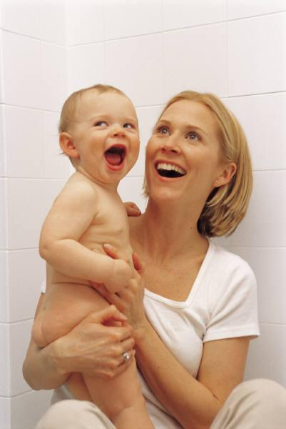
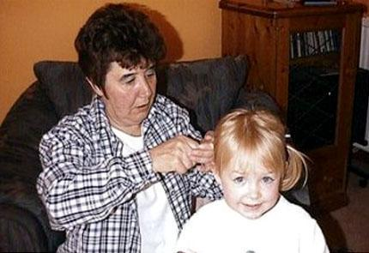
PHYSICAL
Who takes care of me?
Family…
Friends…
Teachers…
Church…
^{4 A Journey in Love} - Year 3

Slide 5
How do I look after myself?
Safety first!
Exercise
Eat well
^{5 A Journey in Love} - Year 3

Slide 6
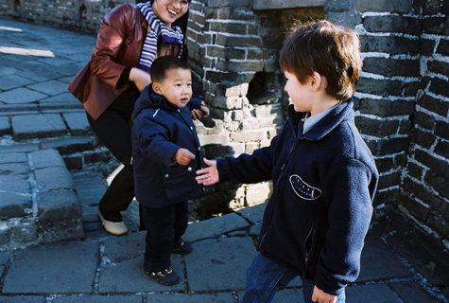
Make friends
Obey rules
^{6 A Journey in Love} - Year 3

Slide 7
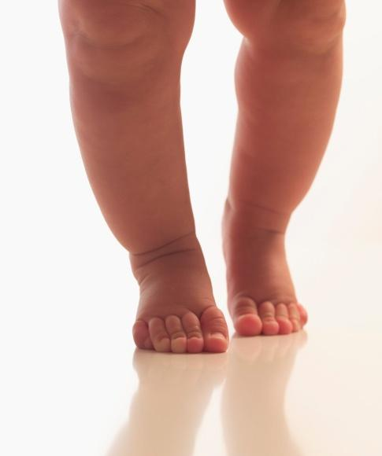
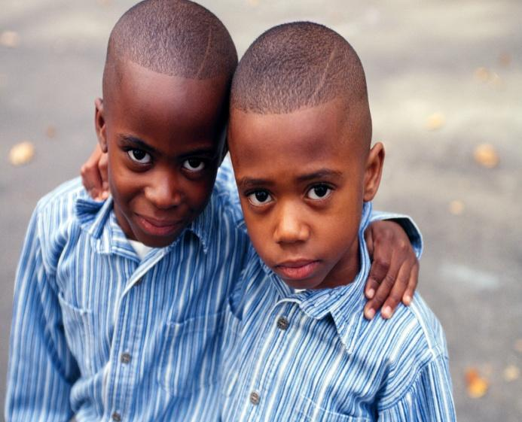
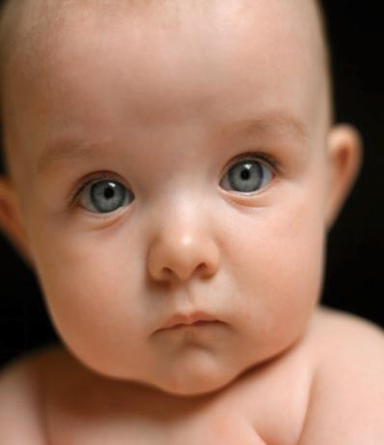
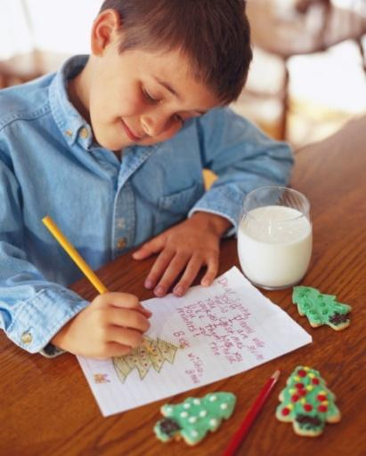
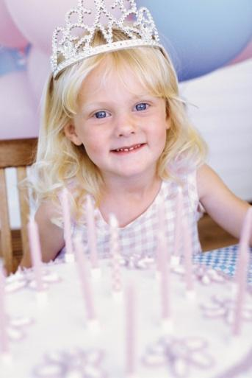
How am I changing?
^{7 A Journey in Love} - Year 3

Slide 8
Prayer
Think of all the people who take care of you
and help you.
Generous God,
bless and care for them.
Amen.
^{8 A Journey in Love - Year 3}

Slide 9
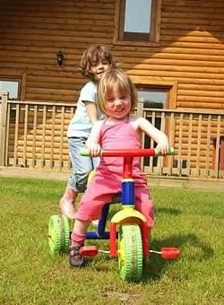
SOCIAL
How do I help others to make and keep friends?
How do I keep myself safe?
How do I take care of others?
^{9 A Journey in Love} - Year 3

Slide 10
The Loner
He leans against the playground wall,
Smacks his hands against the bricks
And other boredom-beating tricks,
Traces patterns with his feet,
Scuffs to make the tarmac squeak,
Back against the wall he stays
And never plays.
The playground’s quick with life,
The beat is strong.
Through sharp as a knife
Strife doesn’t last long.
There is shouting, laughter, song,
And a place at the wall
For who won’t belong.
We pass him running, skipping, walking,
In slow huddled groups, low talking,
Each in our familiar clique
We pass him by and never speak,
His loneness is his shell and shield
And neither he nor we will yield.
He wasn’t there at the wall today,
Someone said he’d moved away
To another school and place
And on the wall where he used to lean
Someone had chalked
“Watch this space.”
^{10 A Journey in Love} - Year 3

Slide 11
Prayer
Bless our friends and help me to be a better friend.
Amen.
11 A Journey in Love - Year 3

Slide 12
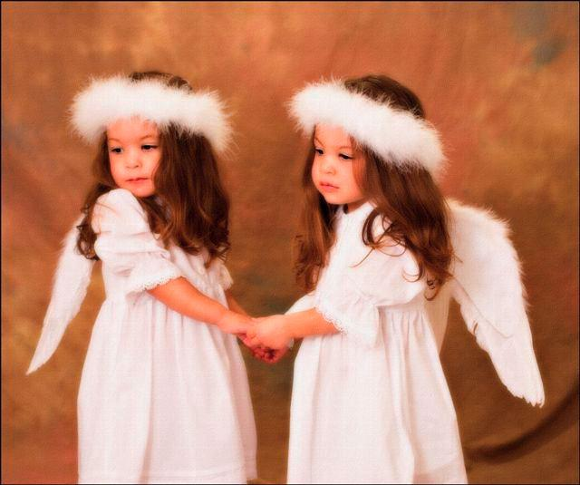
EMOTIONAL
How do you feel when a friend is not there for you?
How do your friends feel when you are not there
for them?
How can you be a more supportive friend?
^{12 A Journey in Love} - Year 3

Slide 13
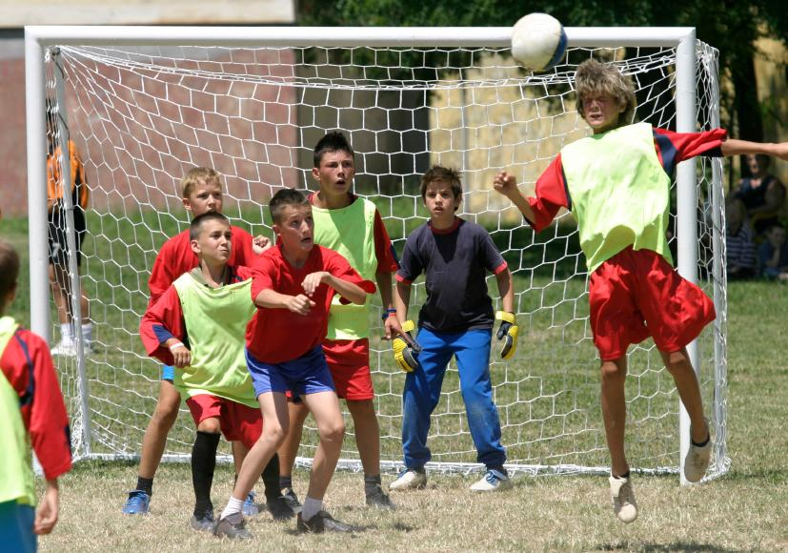
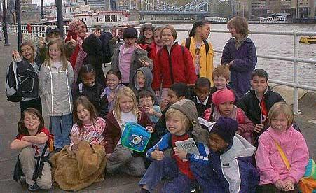
Friends are…
Caring
Forgiving
Loyal
Reliable
Trusting
^{13 A Journey in Love} - Year 3

Slide 14
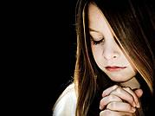
Prayer
Forgive us Lord, for the times
we have not been a
true friend.
Amen.
^{14 A Journey in Love - Year 3}

Slide 15
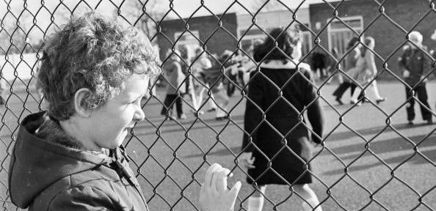
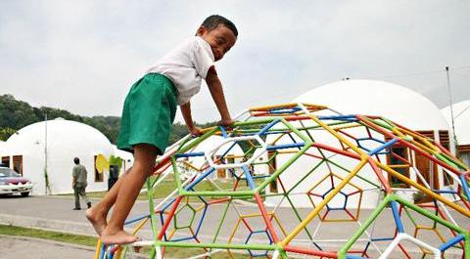
INTELLECTUAL
What is the difference?
Alone
Lonely
^{15 A Journey in Love} - Year 3

Slide 16
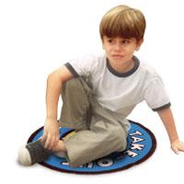
Personal Space
What is personal space?
Why is it important?
Calm down
Pray
Think
Choices
Research
^{16 A Journey in Love} - Year 3

Slide 17
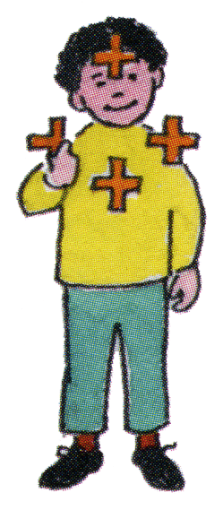
Prayer
Gather in a friendship circle
and share a sign of peace and
friendship,
then pray together.
Thank you God for……………………
(name the person beside me) and bless our time together
in school.
Amen.
17 A Journey in Love - Year 3

Slide 18
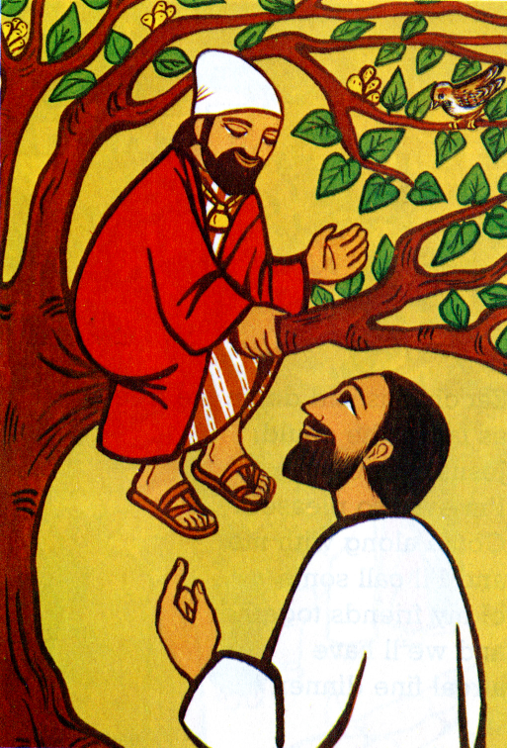
SPIRITUAL
Zacchaeus
was an outcast
^{18 A Journey in Love} - Year 3

Slide 19
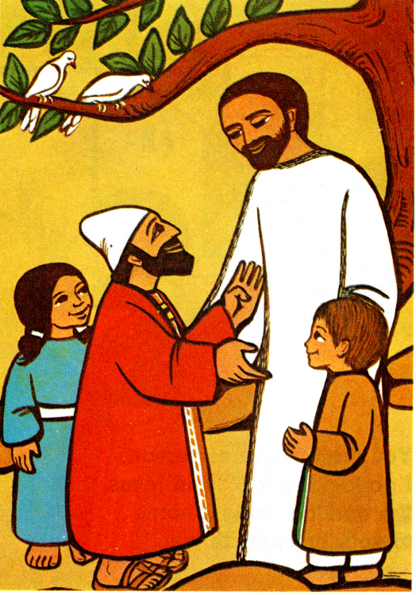
Jesus welcomed him
as his friend
^{19 A Journey in Love} - Year 3

Slide 20
How can I forgive and include others as Jesus did?
^{20 A Journey in Love} - Year 3

Slide 21
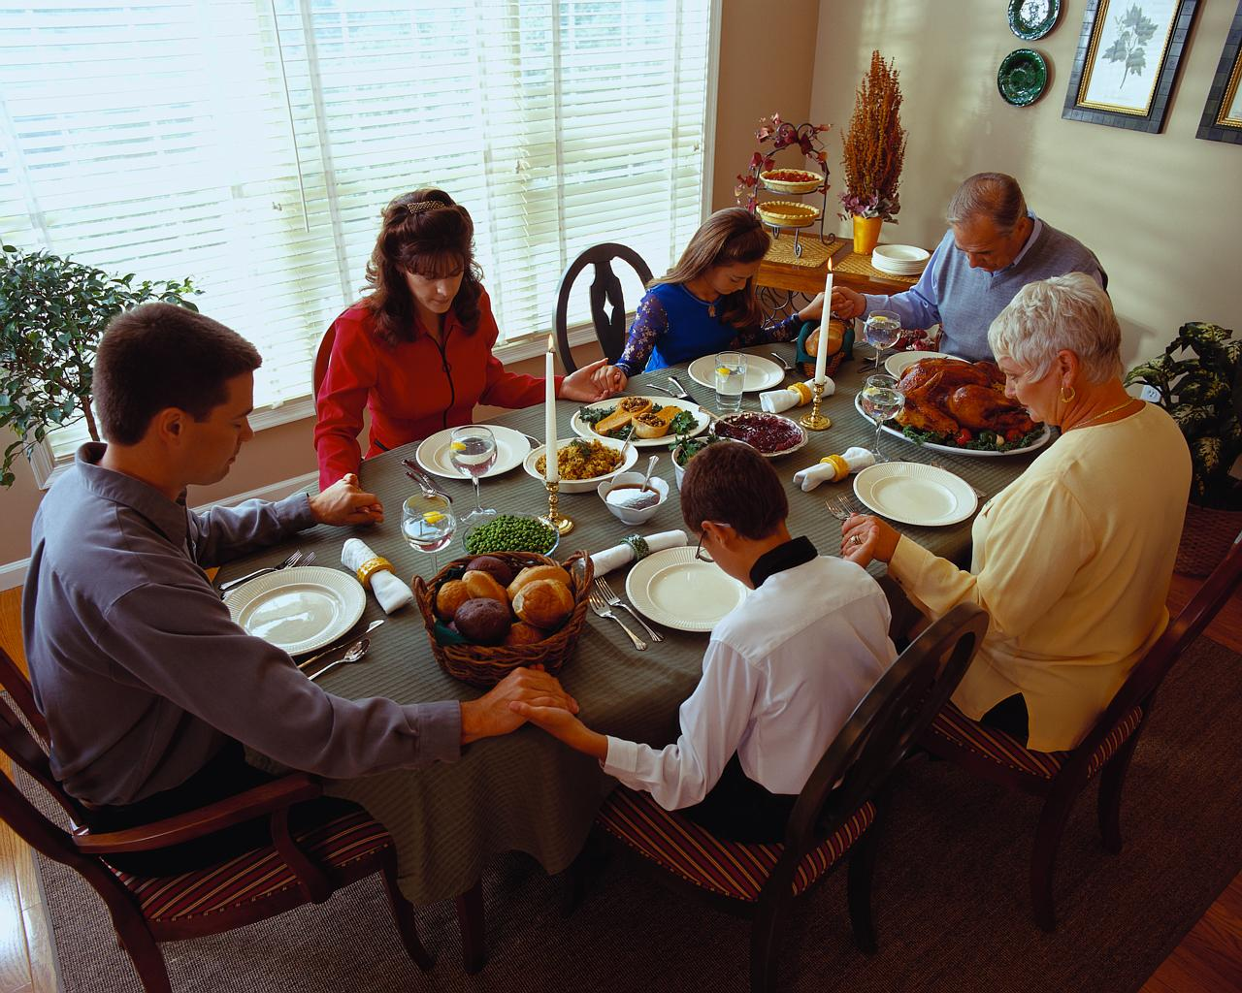
Prayer
Our Father, who art in Heaven,
hallowed be thy Name.
Thy Kingdom come,
Thy will be done, on Earth as it is in Heaven.
Give us this day our daily bread
and forgive us our trespasses,
as we forgive those who trespass against us,
And lead us not into temptation
but deliver us from evil.
Amen.
End of presentation
^{21 A Journey in Love - Year 3}

Slide 22
Do I know these things?
I know about different types of relationships
I know relationship may change over time.
I know what physical contact is appropriate. I know who to tell if it is not appropriate.
I know the that secrets which impact on me are not good and should be told to an adult.
I know that families can be different and similar to mine.
I know that a change in a family can be very painful i.e.. Divorce, bereavement

