Slide 1
PSHE and Citizenship
Health and Wellbeing | Think Positive
PSHE and Citizenship | LKS2 | Health and Wellbeing | Think Positive | You’re the Boss | Lesson 5

Slide 3
Aim
I can identify uncomfortable emotions and manage them effectively.
Success Criteria
I understand why we experience uncomfortable emotions.
I can name some strategies to use to cope with these emotions.
I understand that I am the boss of my brain and can take responsibility for how I act and behave.
This resource is fully in line with the Learning Outcomes and Core Themes outlined in the PSHE Association’s Programme of Study.

Slide 4
The Big Questions

Slide 5
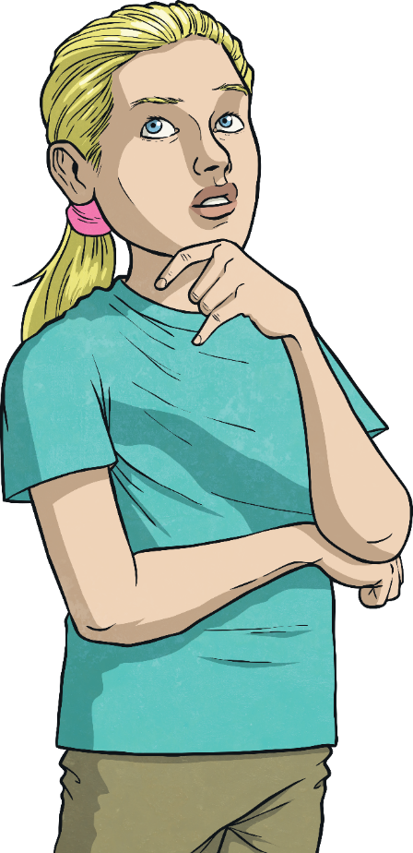
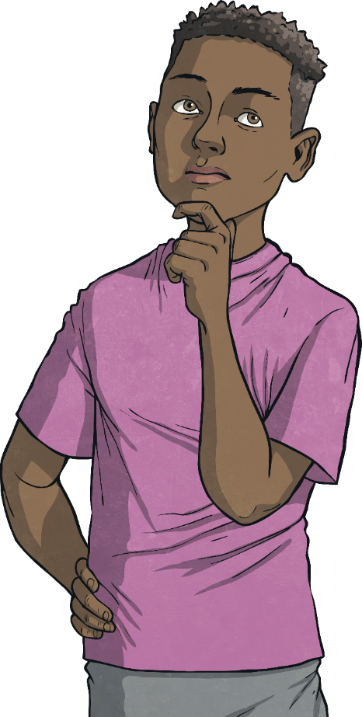
How do uncomfortable feelings affect our actions and behaviour?
What can we do to manage uncomfortable feelings?

Slide 6
Reconnecting

Slide 7
Feelings Charades
Have you ever played the game charades? It’s where you mustn’t speak but you must act out the phrase on the card for others to guess.
We are going to play a game of charades today, in groups. You will need to take turns to read a scenario on a card. Don’t read it out loud – no one else must know what it says. When you read your card, imagine how you would feel if the scenario happened to you. You are then going to act out the emotion you are feeling.
You will need to show how you are feeling with your facial expressions and body language. Try not to use words, as this will possibly give it away.
Your group don’t need to guess what was on the card – they need to guess the emotion or feeling that you are showing.

Slide 8
Exploring

Slide 9
Uncomfortable Feelings
Some feelings are pleasant but others make us feel uncomfortable.
Can you and your partner think of some uncomfortable feelings?
sadness
anxiety
nervousness
jealousy
stress
worry
guilt
anger
embarrassment
insecurity
shame
loneliness

Slide 10
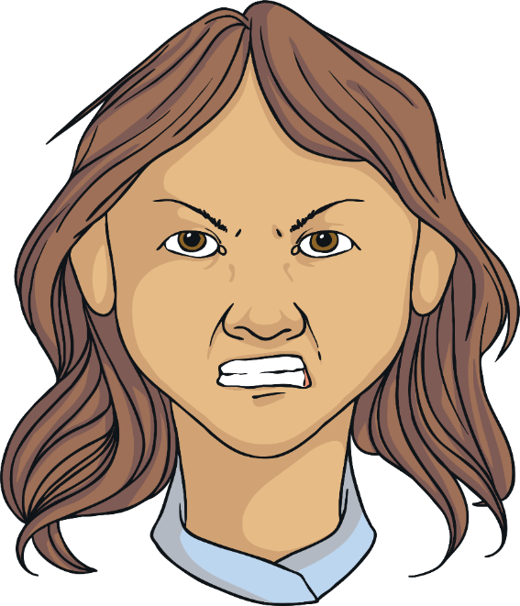
Uncomfortable Feelings
Understanding Anger
Anger is one of the most difficult emotions to control. We often hear people saying that they lost control or they lost their temper.
Anger is actually a useful emotion. Anger steps in when another uncomfortable feeling is in danger of taking control of us!
If we are experiencing intense feelings (such as sadness, fear, jealousy or anxiety), anger can be a way of coping.
It also lets other people know how you are feeling without you having to explain in words.

Slide 11
Uncomfortable Feelings
Anger helps us to know when something isn’t right. It acts like a warning to our brains to do something about the situation we are in and gives us the energy to do what we need to do.
Anger does not just affect us emotionally, it affects us physically too.
When we feel angry, we might feel hot, dizzy, sick or our hearts might beat faster. We might feel like crying or we might want to hurt someone or something.
This is because our brains are releasing chemicals to help us deal with the situation. It is getting us ready to fight or run away – something early people, hundreds of thousands of years ago, would have had to do when there was any danger.
What sorts of things make you angry?

Slide 12
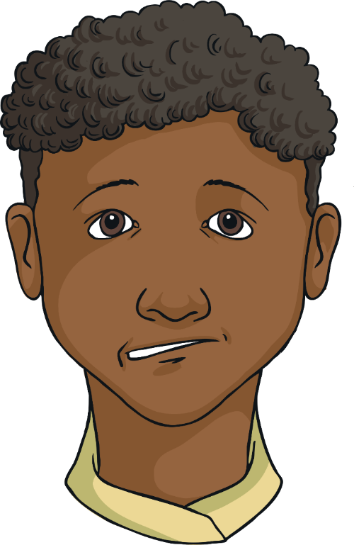
Uncomfortable Feelings
Understanding Worry
Some people worry a little and some people worry a lot!
Sometimes, what starts out as a little worry turns into a big worry, if our minds don’t take control.
Feeling nervous or anxious are emotions that feel similar to feeling worried.
We all worry or get nervous about different things but whatever the worry is, it can make you feel pretty uncomfortable. Some people feel sick with worry, others get a dry mouth, a nervous, fluttery feeling in their stomach or they might feel hot and sweaty.
What sorts of things do you worry about?

Slide 13
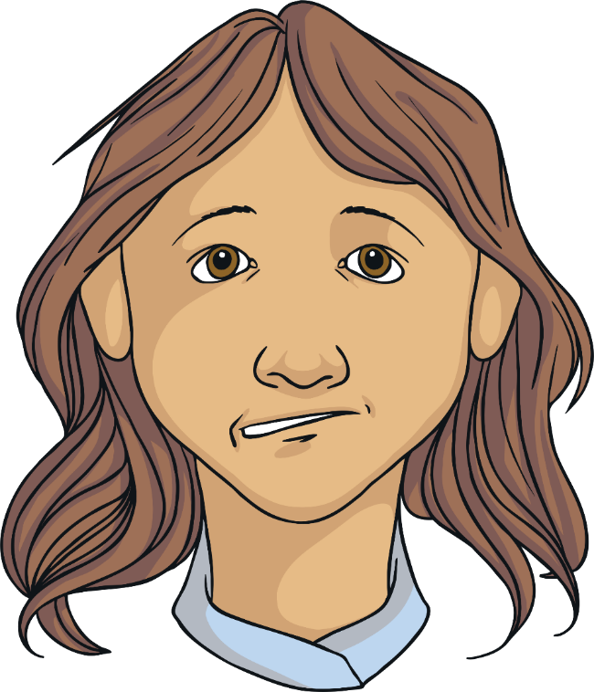
Uncomfortable Feelings
How does feeling nervous, anxious or worried affect our behaviour?
Well, if we are worried about a particular event, we might end up avoiding it, not going and missing out.
People might stop inviting us to things and including us in the group of friends if we never join in.
If we are anxious about something like a test, we might not do very well because our nerves distract us from thinking clearly.

Slide 14
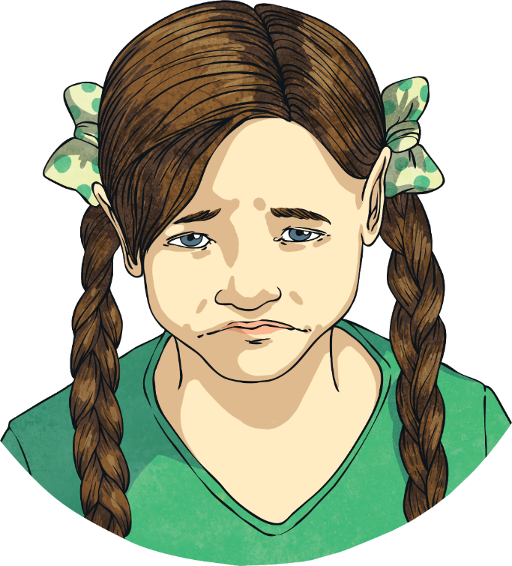
Uncomfortable Feelings
Understanding Grief
When something very sad has happened we experience an emotion called grief. When we are extremely sad, we usually feel like crying. That’s our body’s way of dealing with the grief and letting it out.
There’s nothing wrong with crying when you’re feeling sad. In fact, it allows your mind to clear out the sadness and make room for more positive thoughts.

Slide 15
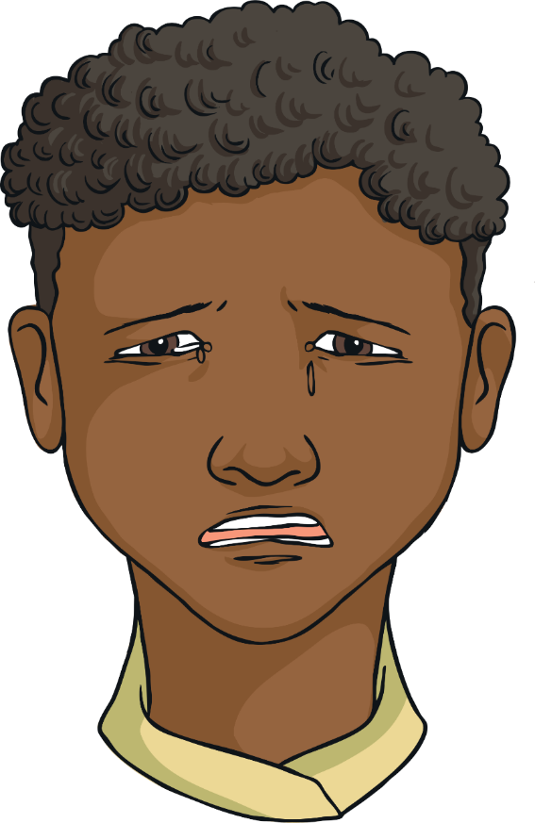
Uncomfortable Feelings
When we are experiencing grief, it can prevent us from getting on with life and doing things we enjoy.
Feeling extreme sadness can make little tasks seem really difficult and we often feel like giving up.

Slide 16
Uncomfortable Feelings
These uncomfortable feelings, such as sadness, fear and anger, come from the lower part of our brain (the downstairs, if our brain was like a house).
The upper part of our brain (the upstairs) is in charge of thinking clearly, making sensible decisions, reasoning and using logic.
When we panic or our anger is getting out of control, we need our upstairs brain to take control of our downstairs brain.

Slide 17
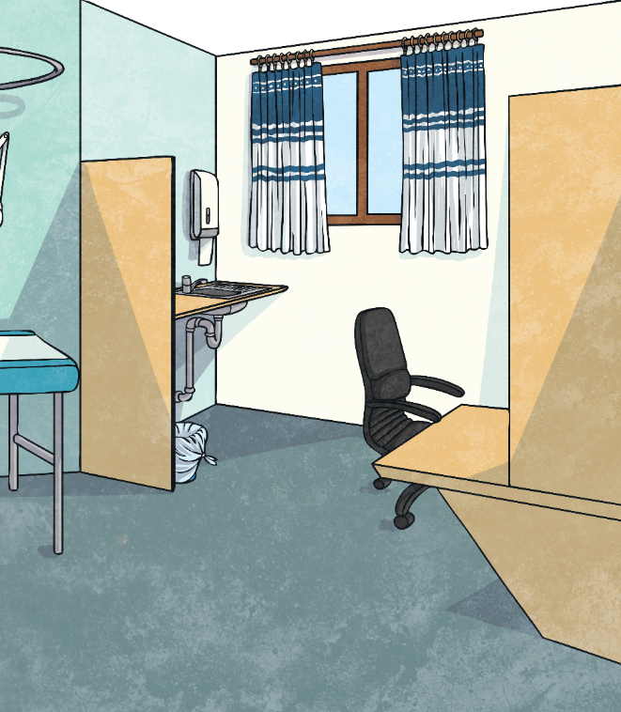
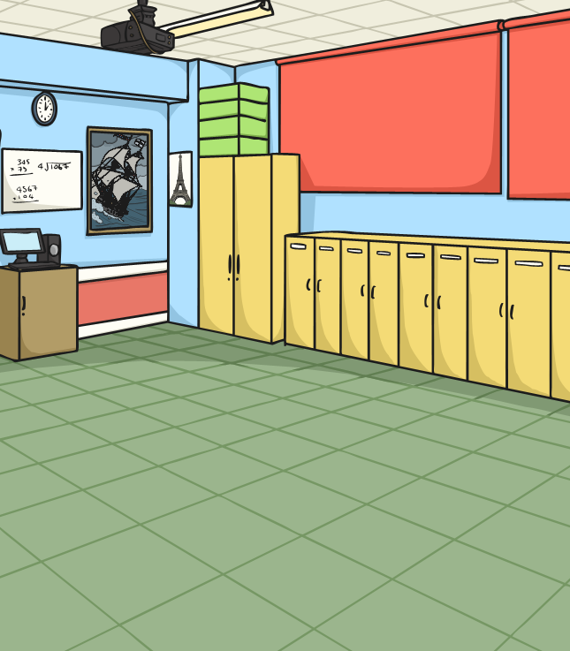
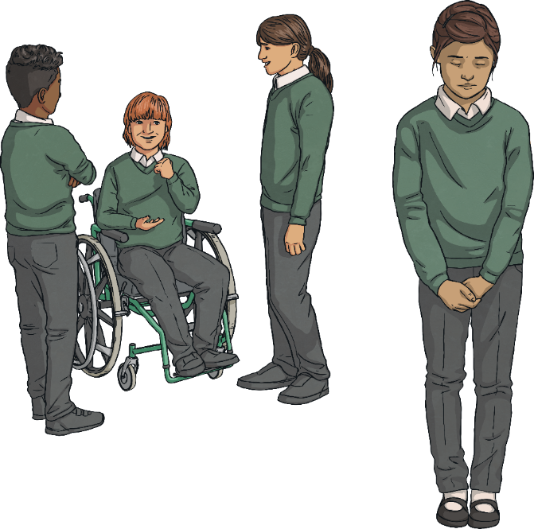
Uncomfortable Feelings
Uncomfortable feelings are completely normal. But feeling them often is not good for our mental health and wellbeing.
People who experience feelings of anger, sadness, worry or loneliness very often need help and support. Just as we would go to the doctor if our leg hurt, we should speak to a trusted adult and get support if we think we might be experiencing poor mental health.

Slide 18
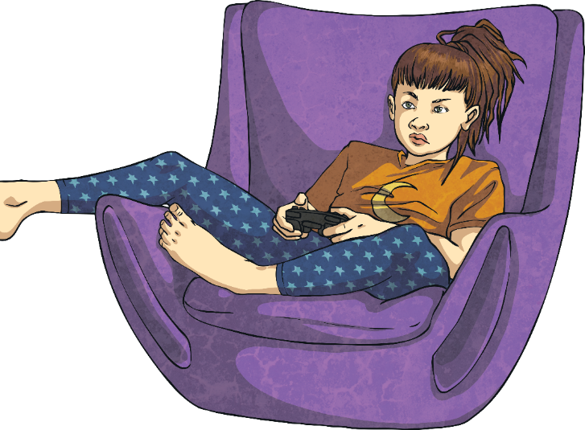
Take Control
It isn’t wrong to feel these emotions. In fact, it can be healthy to allow ourselves to experience these feelings. But it wouldn’t be good to feel these emotions for too long or too often. We need to take control and know how to manage uncomfortable feelings.
Let’s explore some ways to cope with uncomfortable feelings and take control. After all, you’re the boss of your brain!

Slide 19
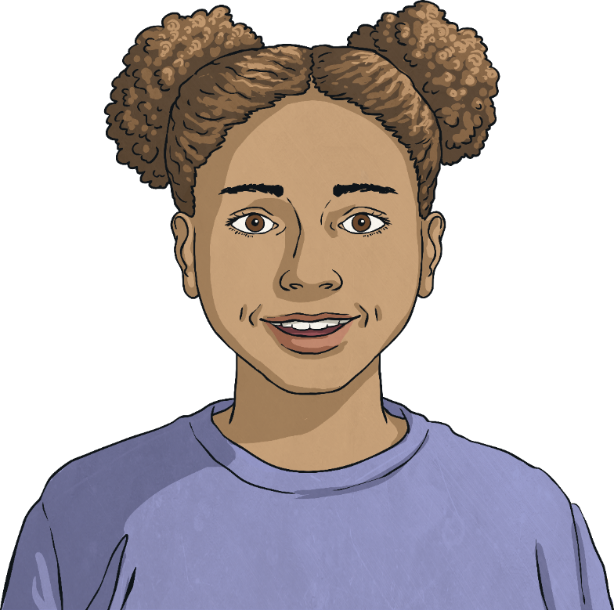
Take Control
There are lots of things you can do when you want to calm down, take control and feel better.
Do you already have any techniques that work well for you when you are feeling bad?

Slide 20
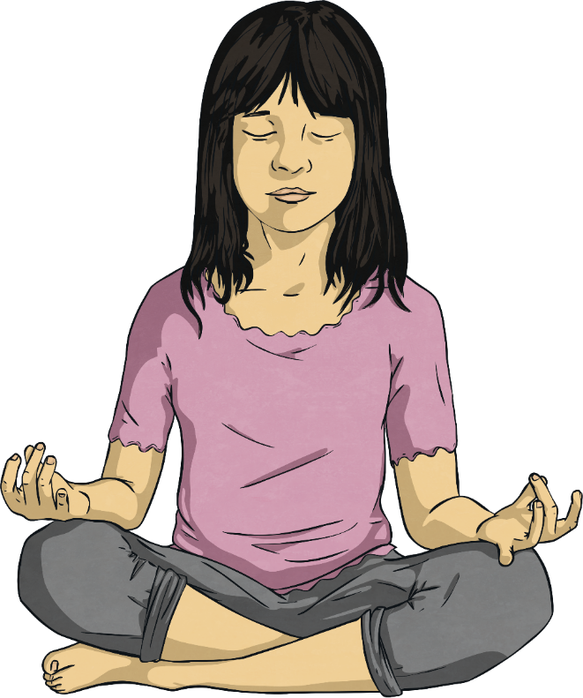
Take Control
Breathe!
Yes – we breathe all the time, but using our breathing to calm us down can help us gain control of our feelings.
When you breathe, your brain releases chemicals that calm you down, so it is particularly helpful if you are feeling angry or anxious.

Slide 21
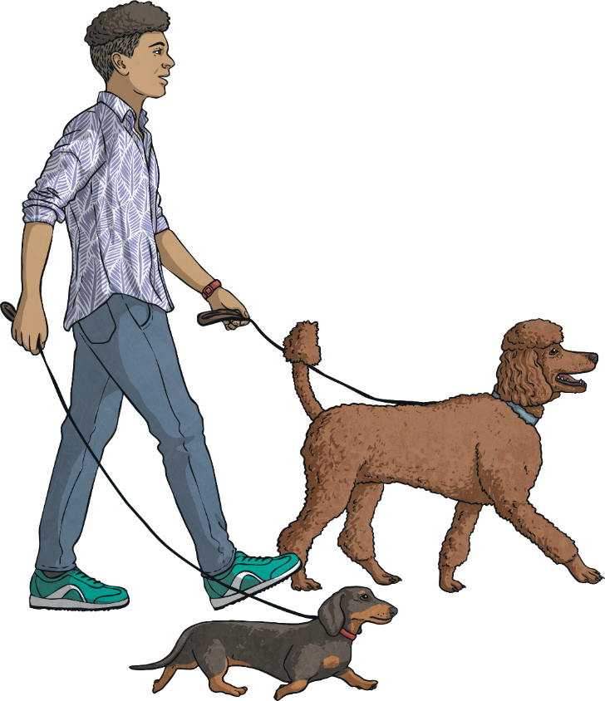
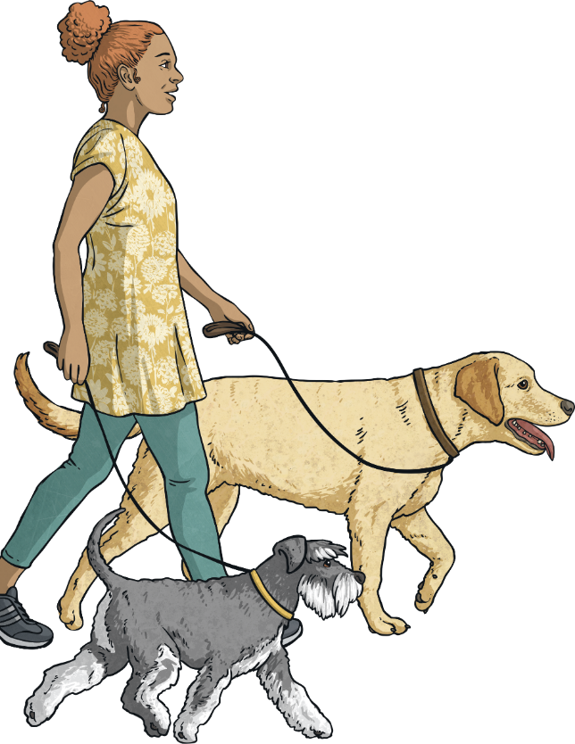
Take Control
Go For a Walk
When an uncomfortable feeling, such as anger, is taking over your mind, it can really help to go for a walk – away from the thing that has triggered the angry feeling.
Give yourself time and space to be the boss of your brain and gain control over your emotions.
Taking a walk to get some fresh air and a bit of exercise is also great for your mental health.

Slide 22
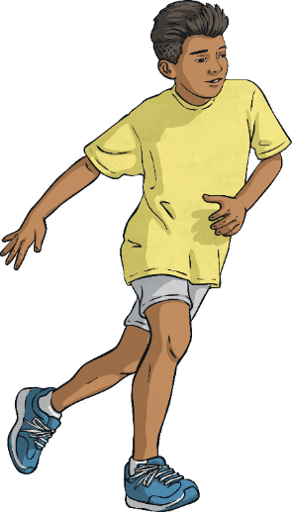
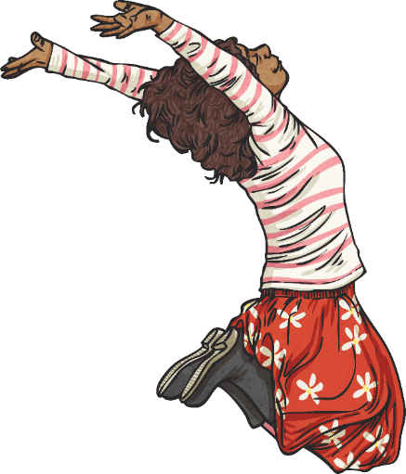
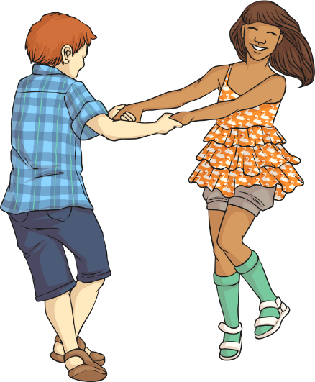
Take Control
Do Something Active
Doing something active, like running, dancing, or jumping on a trampoline, can help get rid of the chemicals in your brain that are making you feel bad.
Physical activity makes our brains release ‘feel-good’ chemicals, which can make us feel a lot better.
Think of some active things that you like doing.

Slide 23
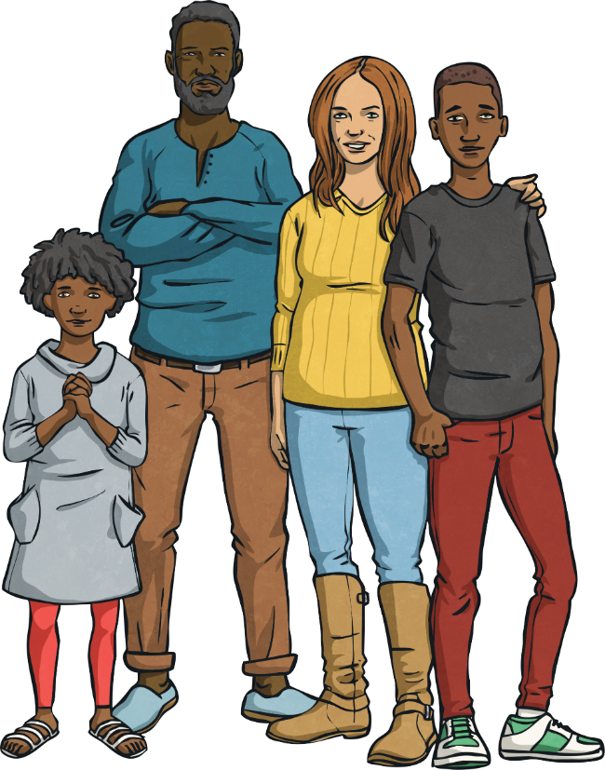
Take Control
Get Help From Others
Spending time with others can really help distract us from our uncomfortable feelings.
Talking to others about how we feel can
really help. They might have experienced
the same feelings you are experiencing
and might have some good advice.
Just talking about your feelings can help you take control of them. The more you understand why you feel the way you do, the more you can focus on ways to start to feel better.

Slide 24
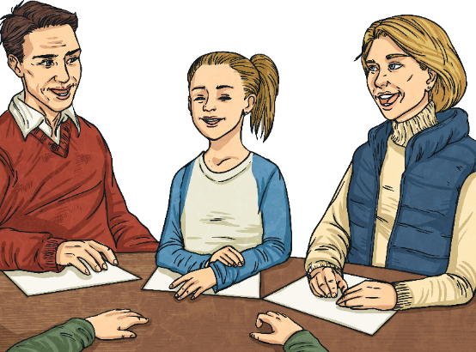
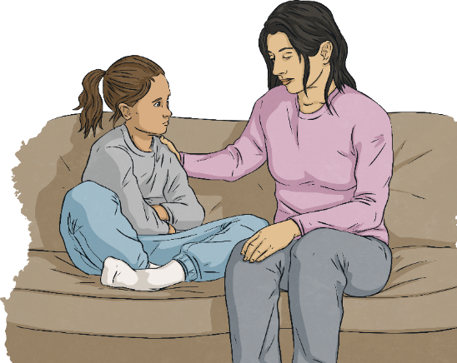
Take Control
Nobody should feel isolated, lonely or helpless. There is help available for when we feel unable to get control of our uncomfortable emotions by ourselves. This might involve sharing thoughts with those close to you, speaking to a counsellor, having some kind of therapy sessions or seeing the doctor. Nobody has to suffer in silence.

Slide 25
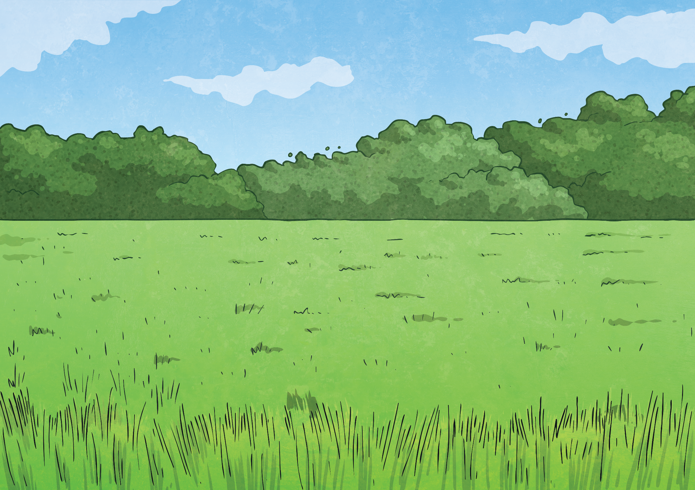
Consolidating
Reflecting

Slide 26
Consolidating

Slide 27
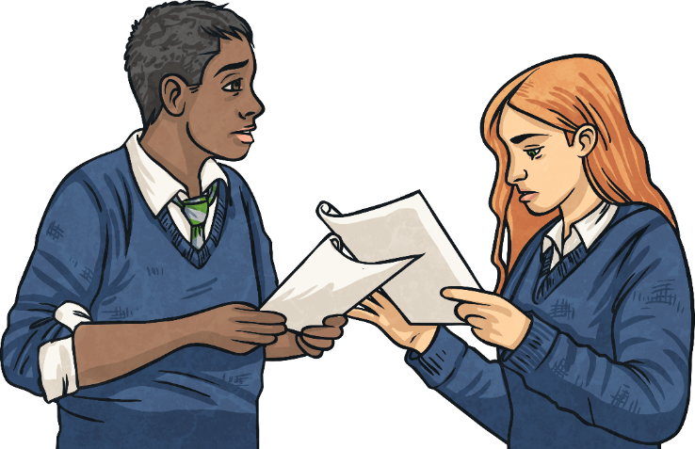
Act It Out
It’s time to work in groups again.
Using the scenario cards from earlier, you are going to create a short sketch (a piece of drama).
You will all need to play a part and this time you will include dialogue.
Act out the scenario and think about what different characters would do and say. How will you act and react?
You will then need to take it
further and decide how the
character experiencing the
uncomfortable emotion is
going to cope with it.

Slide 28
Reflecting

Slide 29
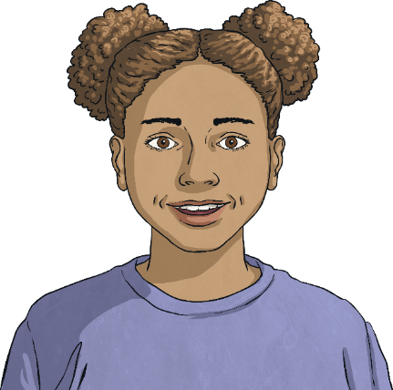
It’s Up to Me!
We can’t choose what happens to us or what other people do.
We can’t really choose how we feel about the things that happen to us.
But we can choose to understand our feelings, to learn about what makes us feel that way and we can get better at managing those feelings.
Tell your partner what you are going to do differently now that you have learnt about uncomfortable feelings and how to manage them.
The next time my brother draws on my picture, I am going to breathe deeply, tell him I am upset and give him his own piece of paper.

Slide 30
The Big Questions

Slide 31
How do uncomfortable feelings affect our actions and behaviour?
What can we do to manage uncomfortable feelings?

Slide 32
Aim
I can identify uncomfortable emotions and manage them effectively.
Success Criteria
I understand why we experience uncomfortable emotions.
I can name some strategies to use to cope with these emotions.
I understand that I am the boss of my brain and can take responsibility for how I act and behave.
This resource is fully in line with the Learning Outcomes and Core Themes outlined in the PSHE Association’s Programme of Study.

Slide 34
Aim
I can apply a positive attitude towards learning and take on new challenges.
Success Criteria
I understand that mistakes are part of learning.
I have strategies I can use when something is challenging.
I know what it takes to be a good learner.
This resource is fully in line with the Learning Outcomes and Core Themes outlined in the PSHE Association’s Programme of Study.

Slide 35
The Big Questions

Slide 36
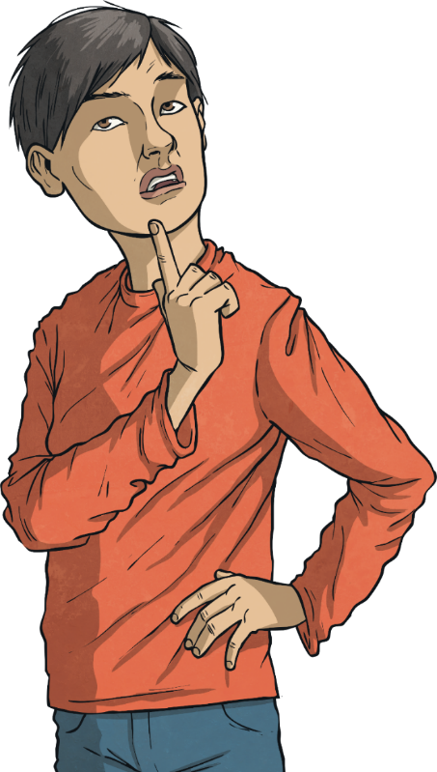
What is a positive attitude to learning?
What strategies can we use when we find something challenging?

Slide 37
Reconnecting

Slide 38
How Do We Learn?
Think of something you can do well.
It could be something most people can do, like read.
Or it could be something that not many others can do, like tricky ballet moves, some nifty football skills, a magic trick or horse riding.
Whatever it is, try to think back to a time when you couldn’t do this thing and you had to learn how to do it.
How did you learn?
Was it quite easy or difficult?
Did it take a long time or did you learn quite quickly?
Were there times when you felt like giving up?

Slide 39
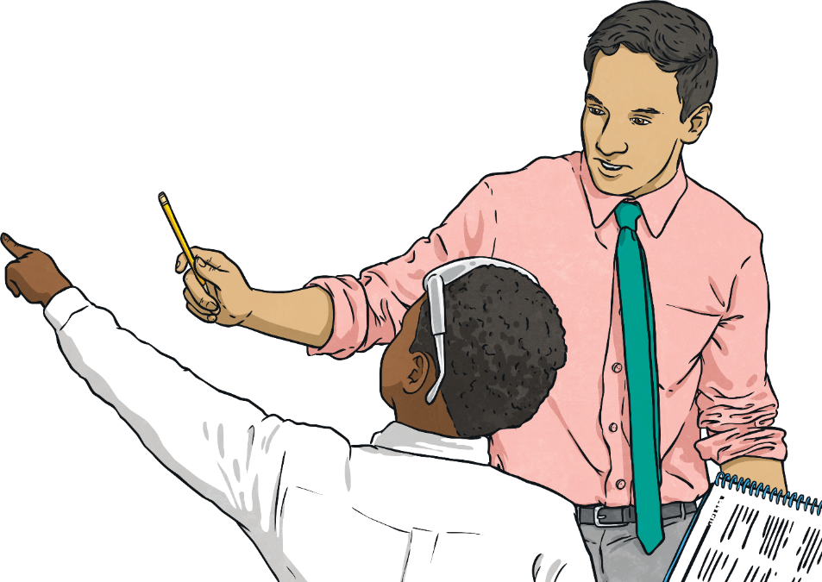
How Do We Learn?
What are the different ways we learn new things?
Tell your partner the ways in which you have learnt things and try to decide what your favourite way of learning is.

Slide 40
Exploring

Slide 41
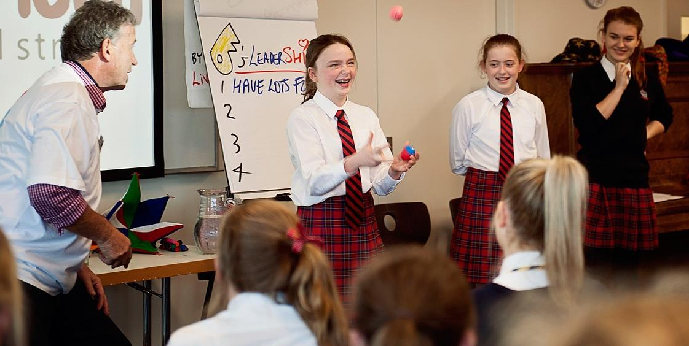
Always Learning
All around the world, people are learning! After all, no one knows it all!

Slide 42
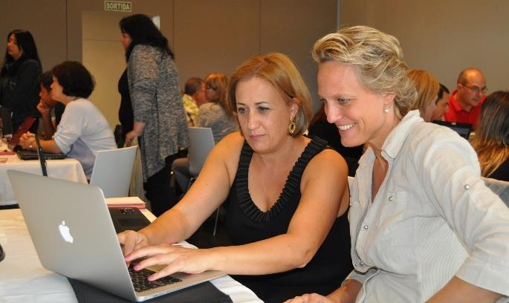
Always Learning
We start learning as babies and we don’t stop learning all through our lives.

Slide 43
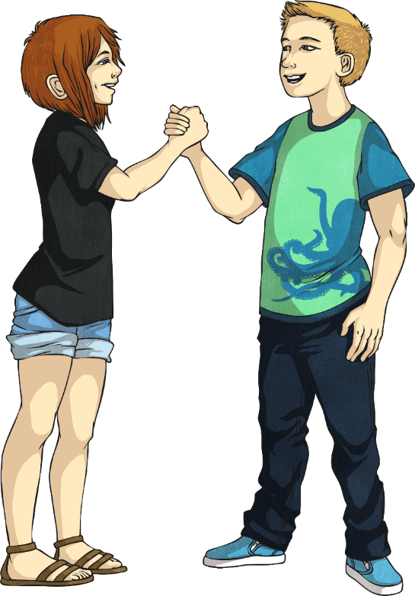
Always Learning
Talk to your partner about your favourite thing to learn.
It could be a subject you learn at school or something you learn at a club.
Try to describe to your partner why you like learning this.

Slide 44
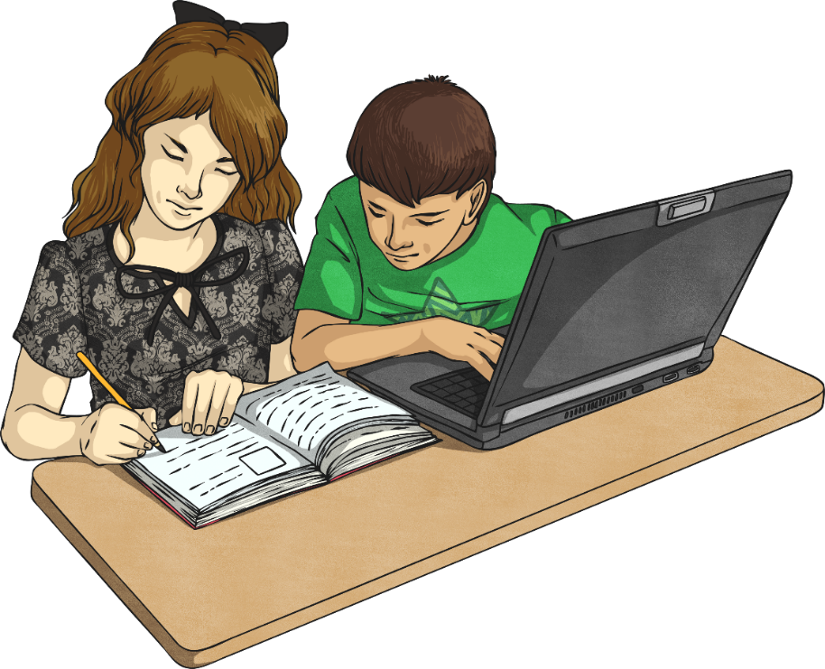
Always Learning
Now, tell your partner about something you are not so keen on learning.
Try to describe why you don’t like learning it.

Slide 45
Always Learning
What reasons did you give for why you didn’t like learning something?
This is too hard…
This is boring…
I don’t understand this…
I’m rubbish at this subject…

Slide 46
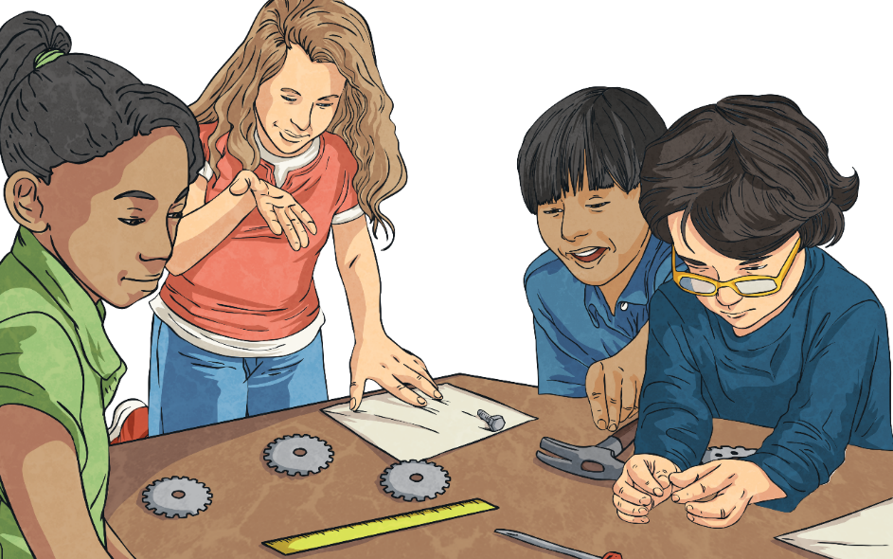
What Makes a Good Learner?
In your groups, think about and discuss things that you think make a good learner - what skills you need and what kinds of characteristics are useful for learning.
Let’s share some ideas from each group about what you think makes a good learner.

Slide 47
What Makes a Good Learner?
how we view challenge
asking questions
learning from others’ success
getting help when needed
believing in yourself
watching and listening carefully
sharing ideas
learning from our mistakes
lots of practice
trying a different approach
Next

Slide 48
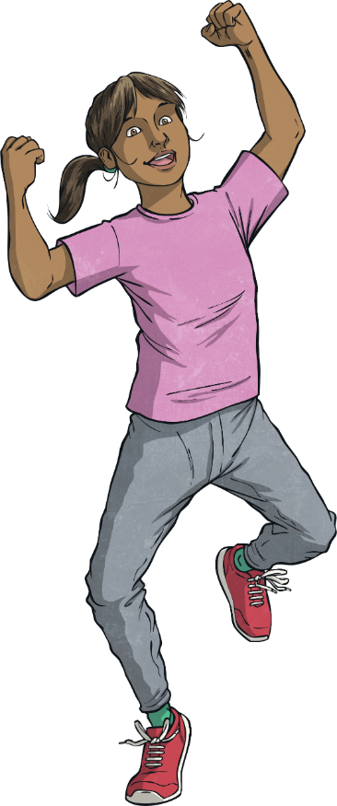
How We View Challenge
Back
We often prefer learning things we find easier. It gives an easier chance of success and succeeding at something feels good.
But if we find something easy, are we actually learning?
Have you ever succeeded at something you found really hard?
Succeeding at something that was a real challenge, after initially failing, feels AMAZING!
We need to see challenge as a good thing, not a bad thing. Challenge means we are stretching our brains, learning and improving. Bring it on!

Slide 49
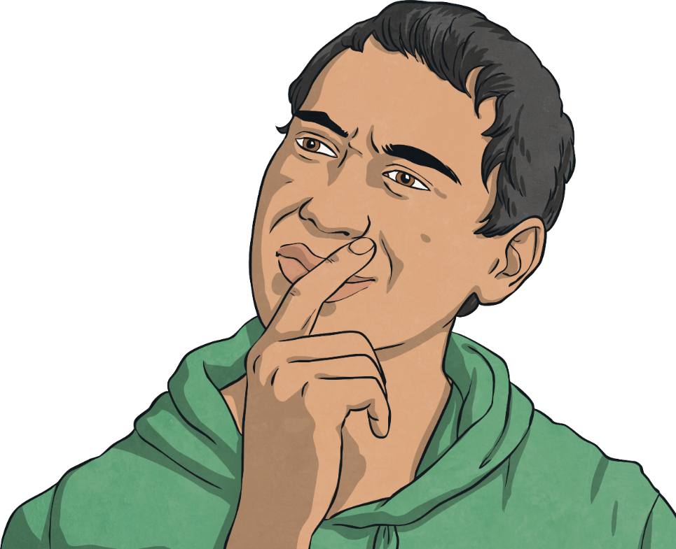
Asking Questions
Back
If you have a thirst for knowledge, it means you want to learn and know more. How do we find things out that we don’t know? We ask questions.
Asking good questions involves you in learning and means you get the information you want at the time you want it.

Slide 50
Believing in Yourself
Back
‘Whether you think you can or you think you can’t, you’re right!’
Henry Ford, the man who set up the Ford car company, realised that your mindset and belief in yourself affects your chances of success.
If you think you will succeed (and put the effort in) you will.
If you think you will fail, you are less likely to really try and you’ll give up before you can succeed.

Slide 51
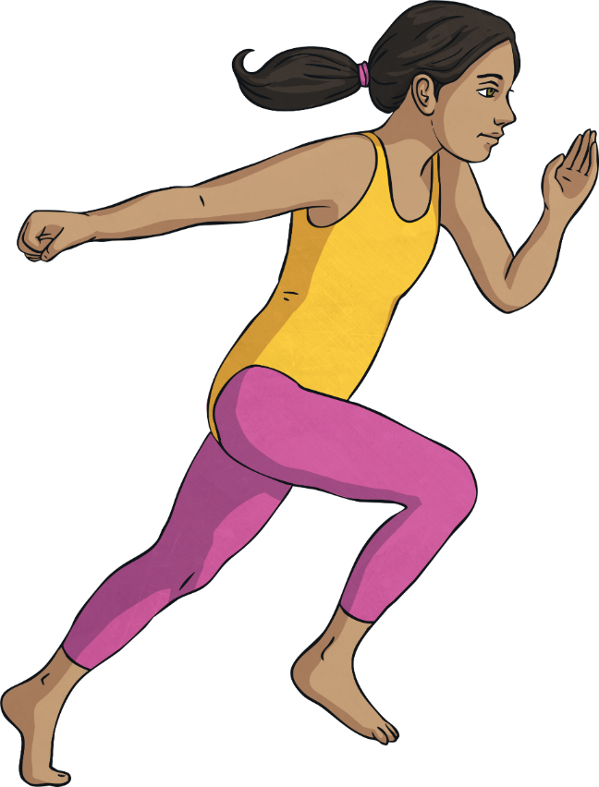
Learning From Others’ Success
Back
This can be tough. When someone else does well and you are finding it tough, the natural reaction is to feel jealous of them and maybe even dislike them.
But what if you tried to look at why they did well and tried to be more like them? Maybe they succeeded because they practised more or maybe they tried lots of different strategies and learnt from their mistakes.
Maybe they have developed a great method that works, that they would share with you.

Slide 52
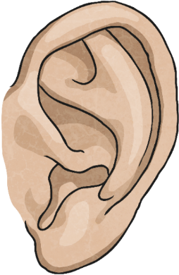
Watching and Listening Carefully
Back
A lot of what we learn is through watching and listening. As babies, we listened to others talk and copied them.
If a young child wants to learn how to kick a ball, they watch someone else do it, then try to copy them.
Really listening and watching carefully, whether it is in class, at a club, or at home, will help you learn.

Slide 53
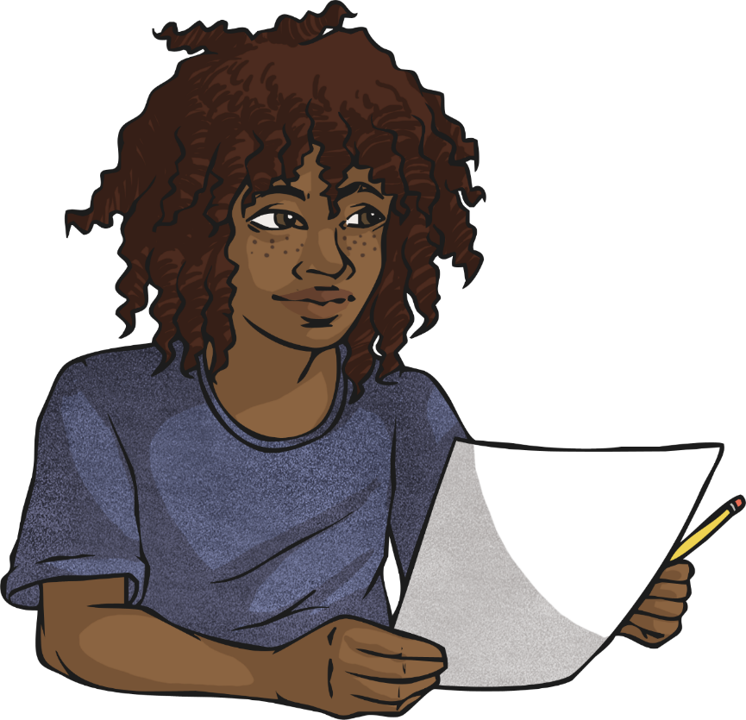
Learning From Our Mistakes
Back
Everyone makes mistakes – we’re only human after all!
Mistakes are great! When we know what we have done wrong, or what didn’t work, we make improvements.
Each mistake moves our learning on.
We shouldn’t be frightened to make mistakes. In fact, mistakes are proof that you’re trying!

Slide 54
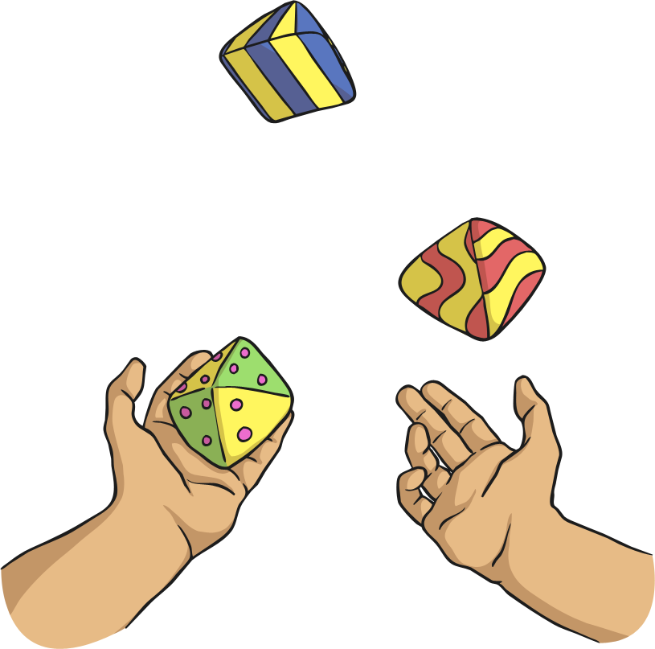
Lots of Practice
Back
‘The expert in anything was once a beginner.’
No one is born being able to draw, play an instrument or add fractions!
Everything we learn as we get older is done through practising it – lots!
As babies we had to learn to talk, walk and feed ourselves. The more we did, the better we got.
It’s the same for everything else, whether it’s riding a bike, learning a foreign language or learning to juggle.

Slide 55
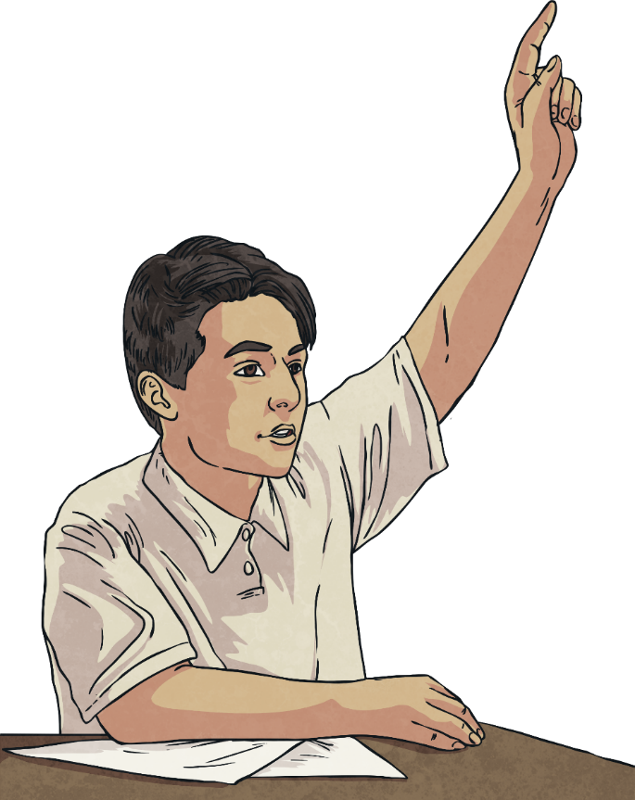
Getting Help When Needed
Back
We’re not learning if we are getting someone else to do things for us. But sometimes, we really do need help to get us on the right track or to get us started.
It’s OK to get a little help when you’ve tried and tried but got a little stuck.
Admitting when we need help can take a lot of courage and knowing when to ask for help (not too soon and not too late) takes practice.

Slide 56
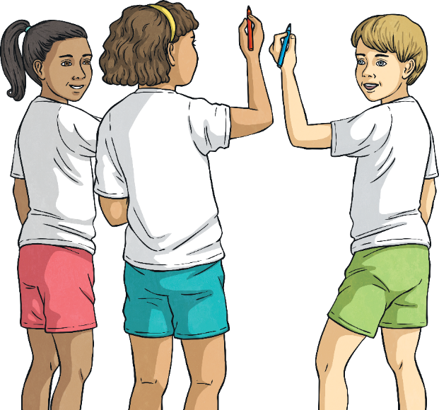
Sharing Ideas
Back
You know what they say… ‘Two heads are better than one!’
And maybe three are better than two!
Listening to others’ ideas and sharing our own can lead to great things. Often a combination of ideas works out to be brilliant.
Don’t be afraid to suggest an idea and always be respectful of others’ ideas.

Slide 57
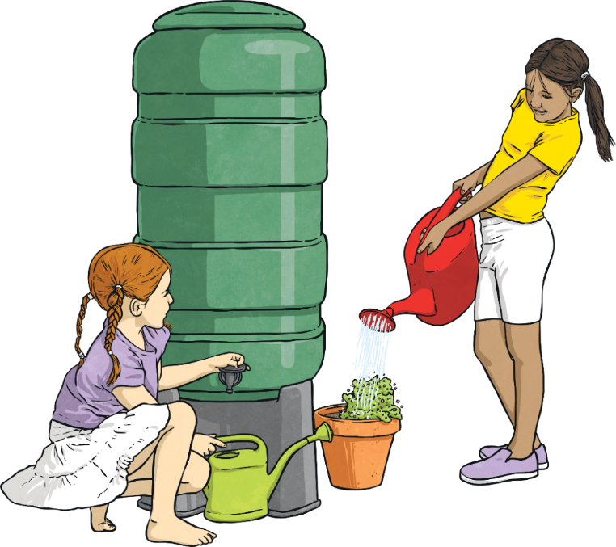
Trying a Different Approach
Back
When people say to keep trying, they don’t necessarily mean to keep trying the same thing in the same way.
If you have tried one way and haven’t succeeded at something, then perhaps it’s time to try a different approach.
For example, if you have tried learning your times tables by looking at them on a sheet that you have stuck on your bedroom wall but it just isn’t working, why not try learning them as songs, set to music?
Maybe you just need to try a different learning style or a different way to solve the problem.

Slide 58
Reflecting
Consolidating

Slide 59
Consolidating

Slide 60
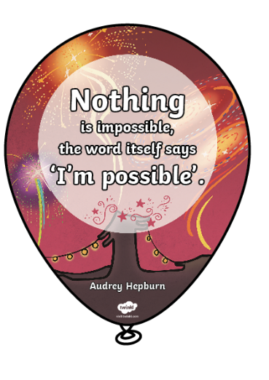
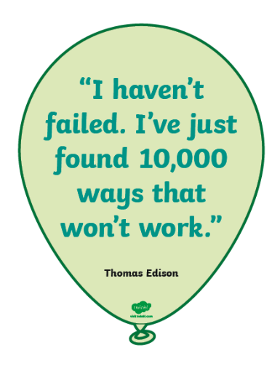
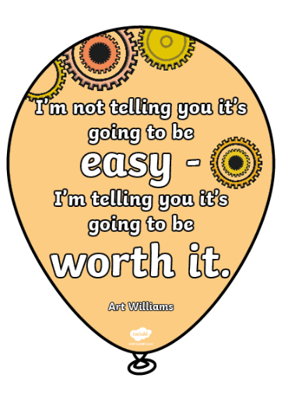
Great Learners
Over the years, some very famous and important people have had something to say about learning from our mistakes, sticking at something, trying different strategies and embracing challenge.
Look at the quotes on your tables and choose your favourite one.
Use the quote to create your own poster to display in school.

Slide 61
Reflecting

Slide 62
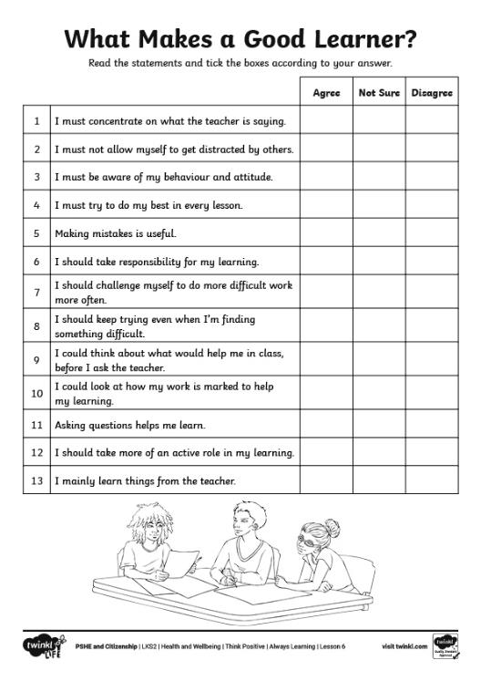
Take the Survey
So, what makes a good learner? We have learnt about lots of different aspects of being a good learner today.
Now, it’s time to fill in a survey, thinking about everything we have discussed in today’s lesson.
Read through each statement carefully and then tick one of the boxes on the right-hand side.

Slide 63
The Big Questions

Slide 64
What is a positive attitude to learning?
What strategies can we use when we find something challenging?

Slide 65
Aim
I can apply a positive attitude towards learning and take on new challenges.
Success Criteria
I understand that mistakes are part of learning.
I have strategies I can use when something is challenging.
I know what it takes to be a good learner.
This resource is fully in line with the Learning Outcomes and Core Themes outlined in the PSHE Association’s Programme of Study.

