Slide 1
Welcome to LIONS Class!
A parent’s guide

Slide 2
Who are the teachers?
THE CLASS IS TAUGHT BY TWO teachers.
MRS Hursthouse teaches every Monday, Tuesday and Wednesday.
Mrs brear teaches Every Wednesday afternoon, Thursday and Friday.
Mrs Holt is the teaching assistant who will be in class everyday.

Slide 3
WHAT IS A TYPiCAL DAY LIKE?
COVID and risk assessments may mean we need to be flexible and do things differently for a while.
However, We try and build a familiar routine for the children so the day runs as smoothly as possible.
Mornings follow a similar routine.
Afternoons are a little more varied but we try and keep the routine of a lesson familiar so children know the expectation.
Behaviour rewards are given as credits and golden stars on the behaviour chart.
Failure to follow the school rules will incur a consequence for the child.
Consequence 1 = a verbal reminder
Consequence 2 = yellow (visual reminder)
Consequence 3 = red (sanction eg missed playtime and note home to inform parents in planners)

Slide 4
will they have homework?
Homework will be set every Friday.
It will be uploaded onto class dojo and your child will complete IT in a homework book and upload a photo of IT INTO THEIR DOJO PORFOLIO.
TEACHING STAFF CAN THEN MONITOR COMPLETION AND GIVE FEEDBACK ACCORDINGLY.
ALL WEEKLY SPELLINGS AND TIMESTABLES ARE TESTED ON A FRIDAY.

Slide 5
Will year 3 work be a lot harder?
it is traditionally a big jump for most from KS1 to KS2, but we aim to make the transition as managed as possible.
Work will always be planned to your child’s needs and challenge is good!
Don’t worry if it takes a little while for your child to adjust to the higher expectation, this is normal in year 3. remember the non-negotiables are end of year expectations.

Slide 6
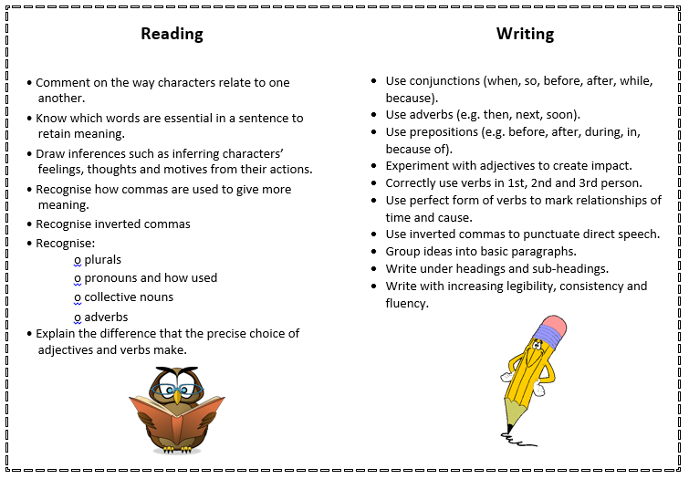
YEAR 3 NON-negotiables

Slide 7
How do you assess in year 3 and 4?
there are no statutory assessment tests (SATS) in year 3 or 4.
Formal assessments take place in Nov, Feb and June but these are just to guide teacher assessment.
The key differences in testing are:
Timing is more stringent
Reading test requires pupils to read far more rapidly and at length.

Slide 8
What is the multiplication table check?
The Multiplication tables check (MTC) WILL BE SAT at the end of Year 4.
It expects that all year 4 children can recall, within 5 seconds, every times table to 12x12.
Times tables are so important to maths in Year 6 and beyond, so it really is something we need to focus on.
Everything you can do to practice and help your child learn these tables will be a bonus!

Slide 9
How do I know which tables to work on with my child?

Slide 10
What will be the topic in September?

Slide 11
Any other questions?

