Slide 1
PSHE and Citizenship
Relationships | VIPs
PSHE and Citizenship | KS1 | Relationships | VIPs | Who Are Your VIPs? | Lesson 1

Slide 3
Aim
I can talk about the very important people in my life and explain why they are special.
Success Criteria
I can identify how people show each other that they care.
I can write the characteristics of my VIPs to explain why they are special to me.
I can think about how I can be a VIP to others.
This resource is fully in line with the Learning Outcomes and Core Themes outlined in the PSHE Association’s Programme of Study.

Slide 4
The Big Questions

Slide 5
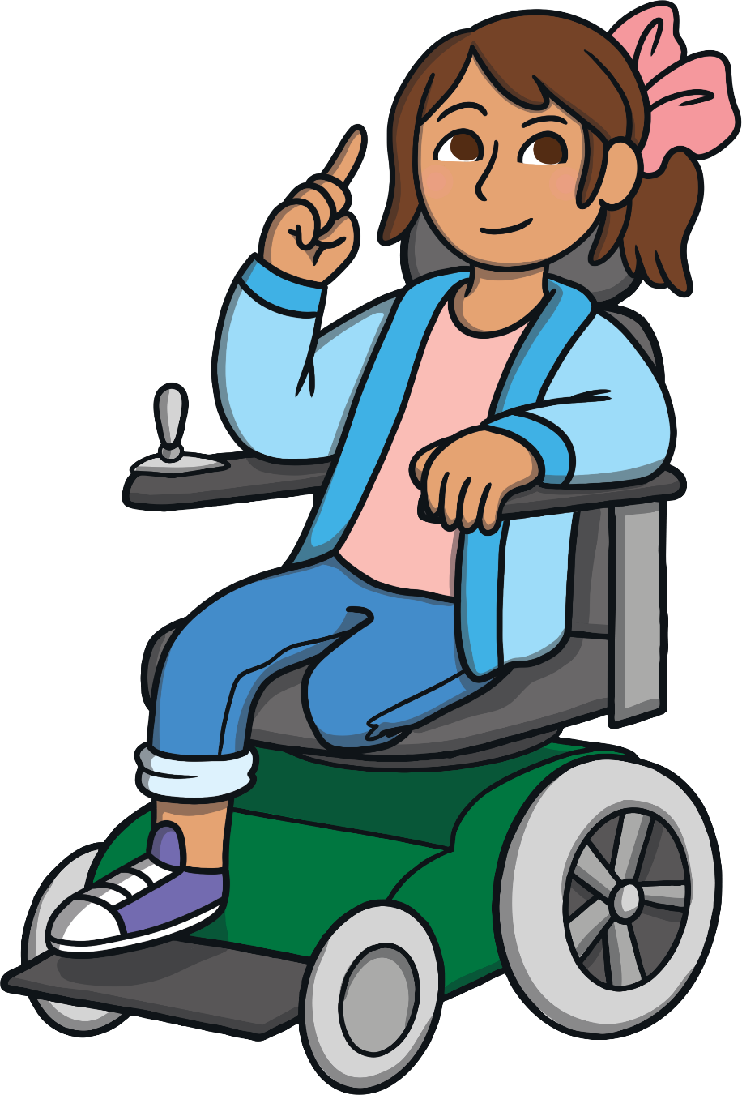
Who are our special people?
What makes them special?

Slide 6
Reconnecting

Slide 7
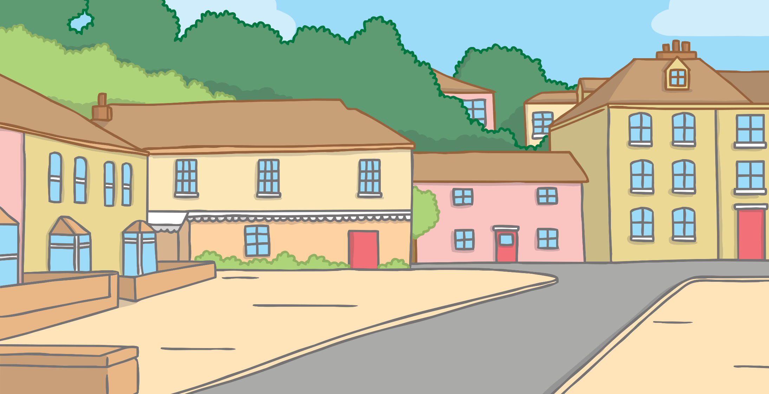
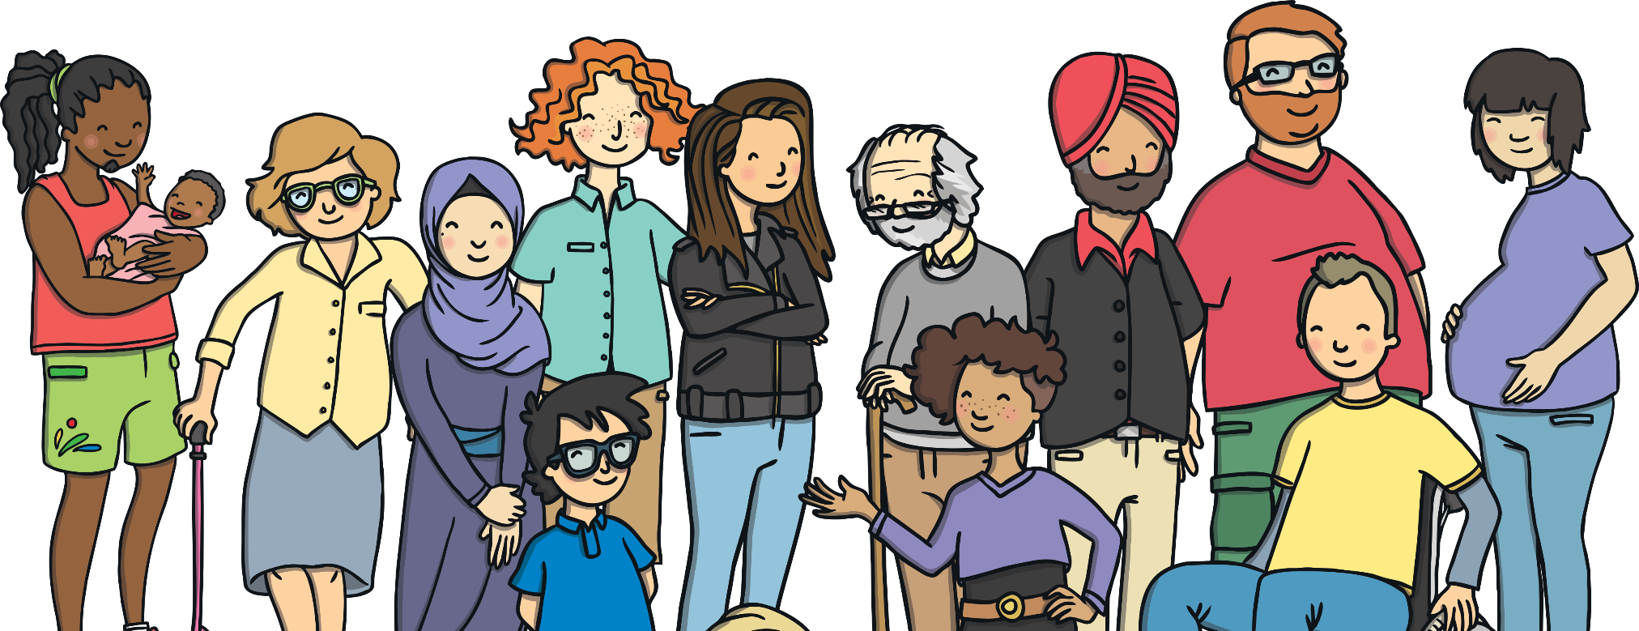
What Are VIPs?
VIP stands for Very Important Person.
All people are important in their own way but we have people in our lives who are particularly special to us. These are our VIPs!
People can be special to us for many different reasons. They are often people who we trust, who help us feel safe and who we enjoy spending time with.

Slide 8
Exploring

Slide 9
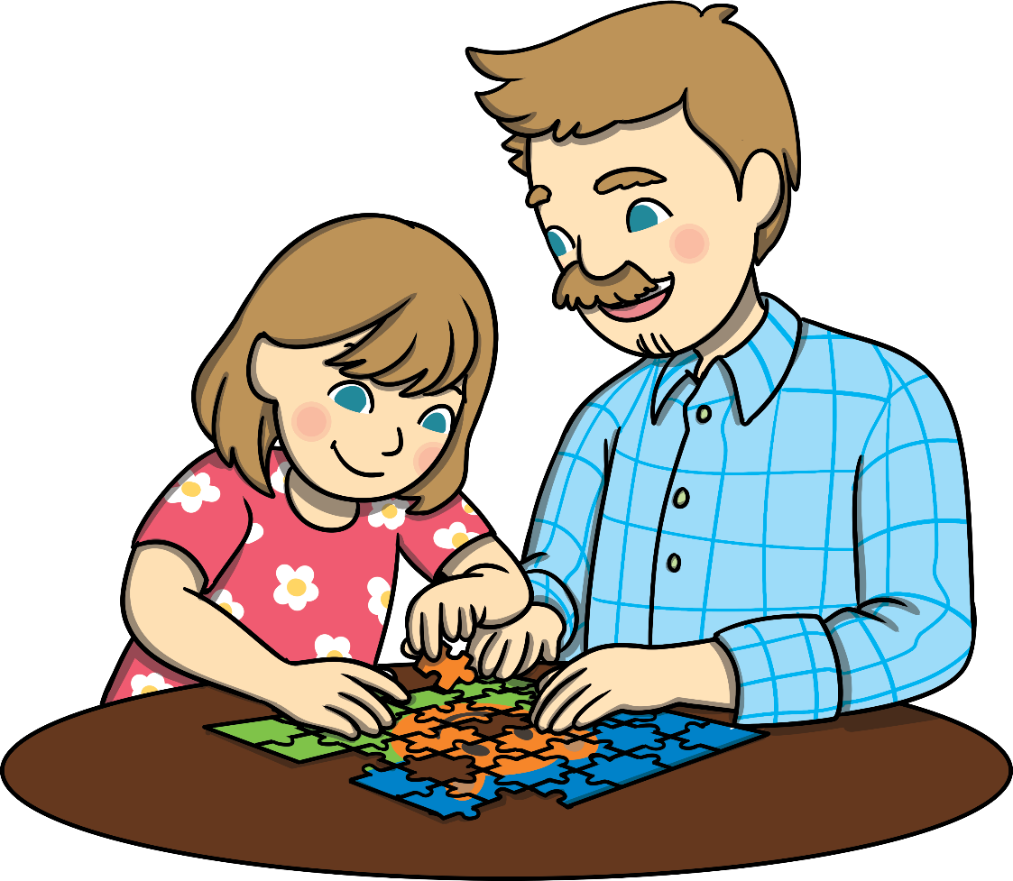
My VIPs
We all have people who are special to us in our lives. The people who are special to us might not be the same people who are special to someone else – this is OK as we are all different!
Sit quietly and think about who your VIPs are.
If you feel happy to, share who your VIPs are with a partner then maybe with the class.

Slide 10
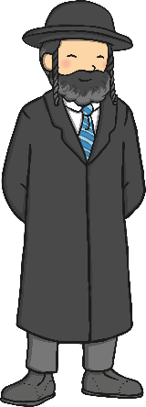
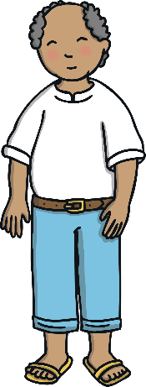
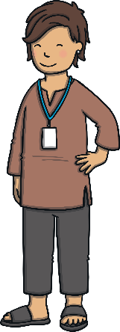
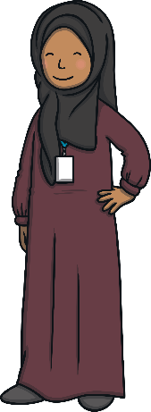
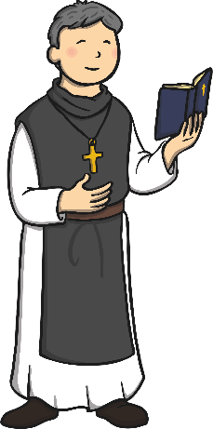
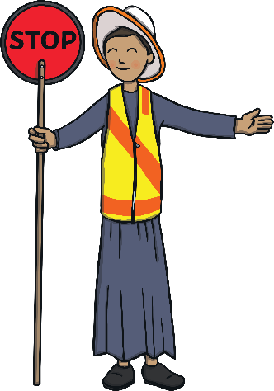
My VIPs
Why are your VIPs special to you?
Share your thoughts with a partner and then the class, if you feel happy to do so.

Slide 11
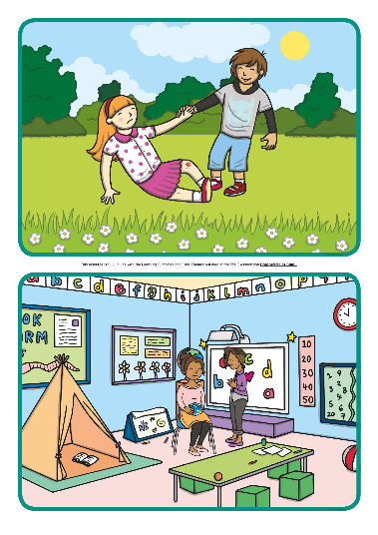
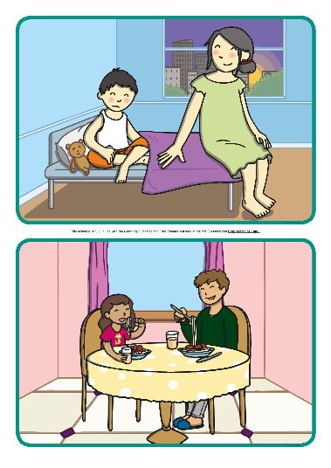
How VIPs Show They Care
The special people in our lives show they care for us in lots of different ways. In your groups, look carefully at the picture you are given.
Talk with your group about how the people in the picture are showing that they care for each other.
After you have finished, share your picture and your thoughts with the class.
Why do you think they are special to each other?

Slide 12
Consolidating
Reflecting

Slide 13
Consolidating

Slide 14
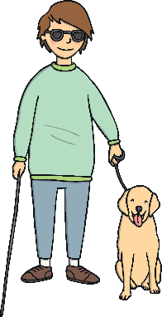
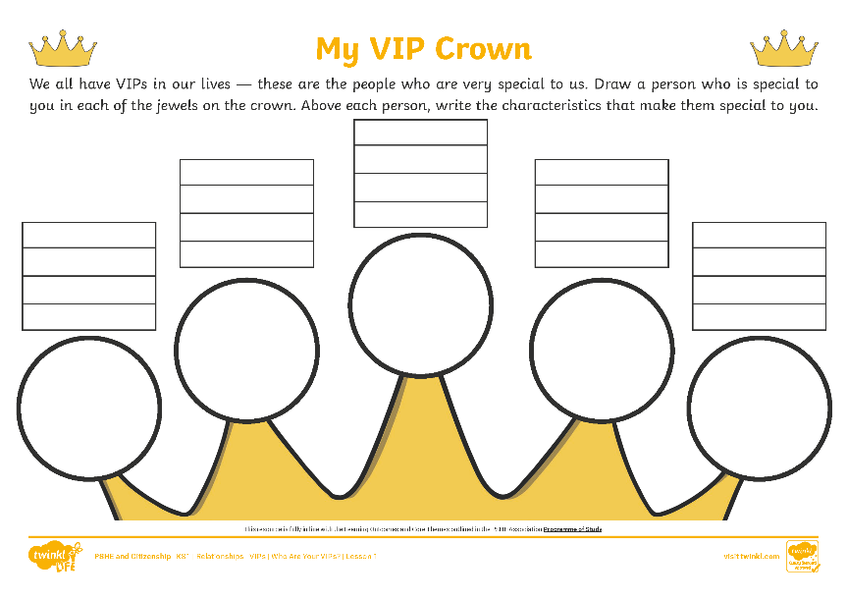
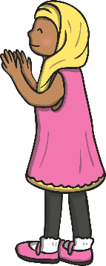
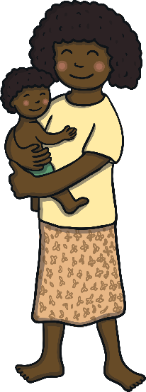
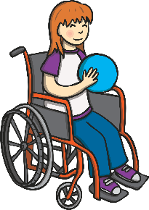
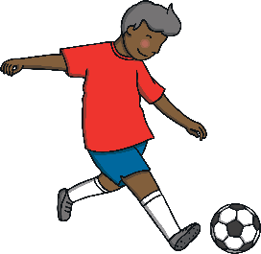
VIP Crown
We all have VIPs in our lives and thinking about what makes them special can help us to be better VIPs to others.
On the crown, draw pictures of some of the VIPs in your life and above each picture, write characteristics they have that make them special to you. They might be kind, funny or helpful to you when you feel sad.

Slide 15
Reflecting

Slide 16
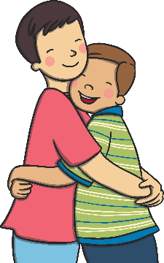
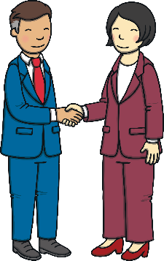
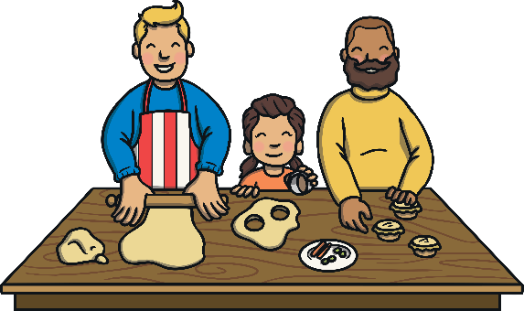
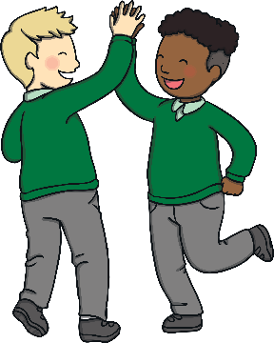
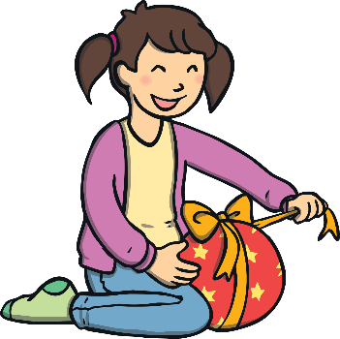
Being a VIP to Others
Our VIPs are the important people in our lives, the people who are special to us and show us that they really care.
How are you going to show others that you care about them, both at home and at school? How are you going to be a VIP to others?
Take a moment of quiet and then share your thoughts with the class.
Showing others we care about them is really important. It can help others to feel happy and helps us to feel good inside too.
Let’s be a caring class!

Slide 17
The Big Questions

Slide 18
Who are our special people?
What makes them special?
What have you learnt today that is going to help you?

Slide 19
Aim
I can talk about the very important people in my life and explain why they are special.
Success Criteria
I can identify how people show each other that they care.
I can write the characteristics of my VIPs to explain why they are special to me.
I can think about how I can be a VIP to others.

Slide 21
Aim
I can describe why families are important.
Success Criteria
I can identify who is in my family.
I can explain why we need our families and how they can help us.
I can give reasons to explain why members of my family are important to me.
I can think of ways families can show each other they care.
I can identify that not all families are the same and I can respect those families that are different to mine.
This resource is fully in line with the Learning Outcomes and Core Themes outlined in the PSHE Association’s Programme of Study.

Slide 22
The Big Questions

Slide 23
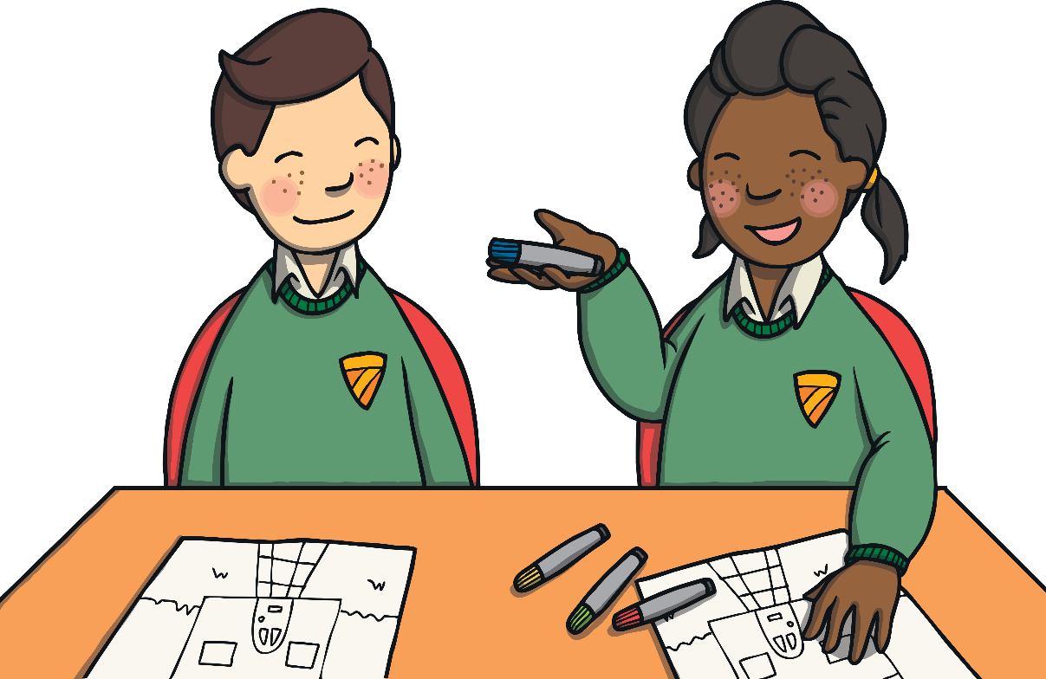
How should the people in your family make you feel?
Why are families important?

Slide 24
Reconnecting

Slide 25
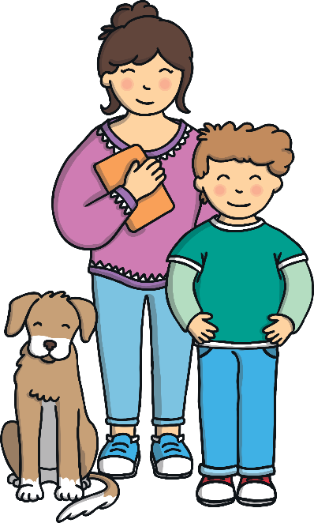
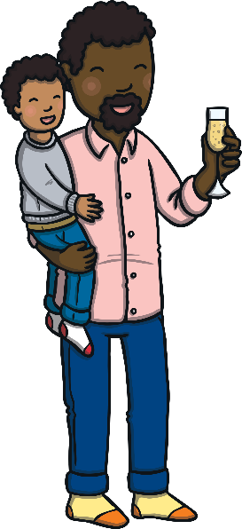
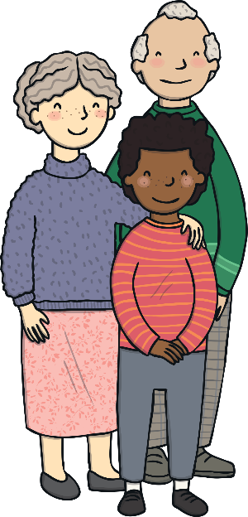
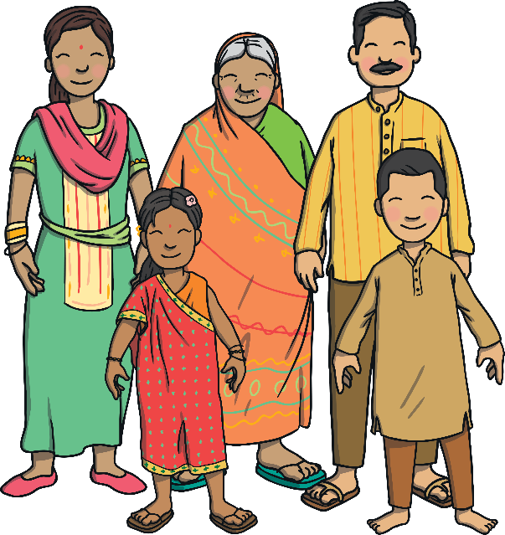
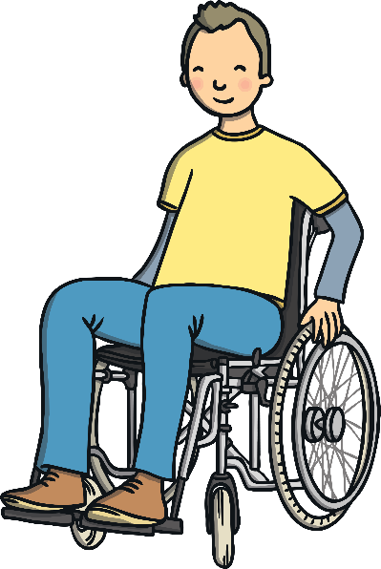
Our Families
We all belong to a family group.
These family groups will all be different. Some may be big, others may be small and they may have a different mix of people in them.
This is OK — we are all different and difference is something to be celebrated!
Who is in your family? Tell a partner.

Slide 26
Exploring

Slide 27
When We Need Our Families
The special people in our family are those who help us to feel safe, happy, loved, cared for and healthy. They are the people we trust and who help to meet our basic needs.
When might we need the special people in our family?
When we are worried about something.
When we are hungry.
When we are feeling sad.
When we want to go somewhere.
When we are feeling happy.
When we are proud of something.
When we want to play a game.
When we need some help.

Slide 28
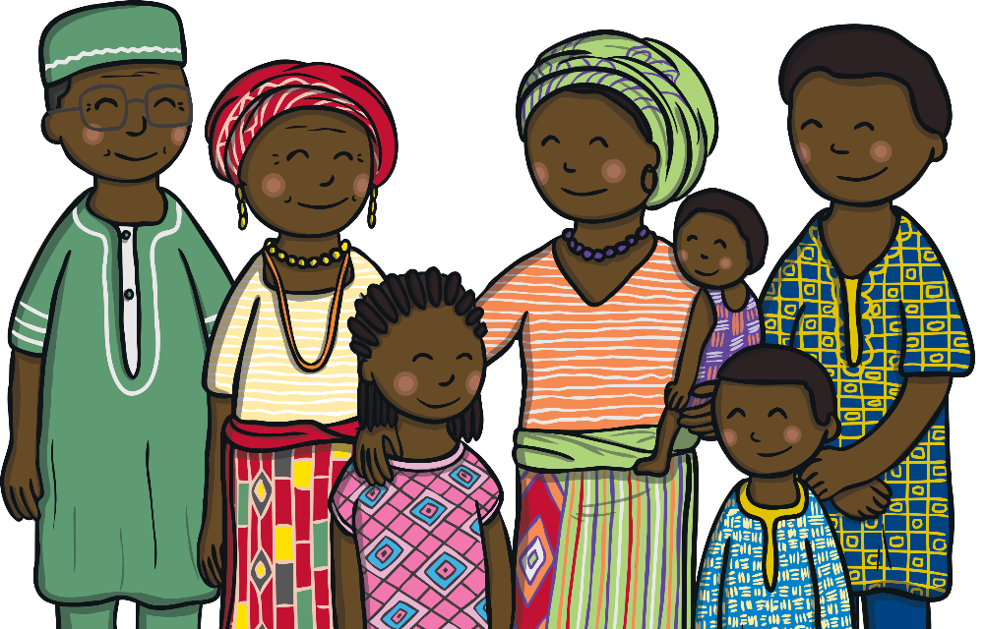
When We Need Our Families
Can you think of any other times when we might need the special people in our family?
Families can go through challenging times. It is important to talk to someone we trust if we are worried about anything at all.

Slide 29
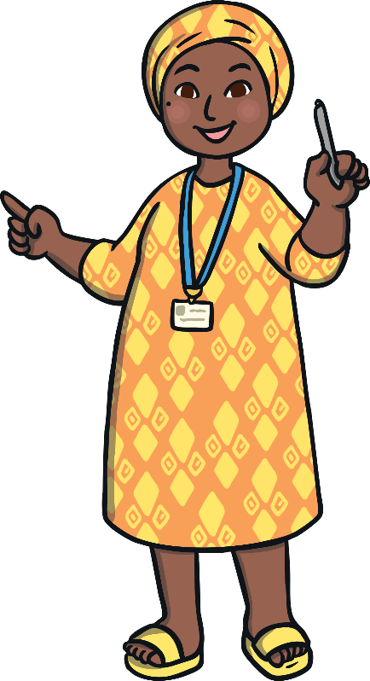
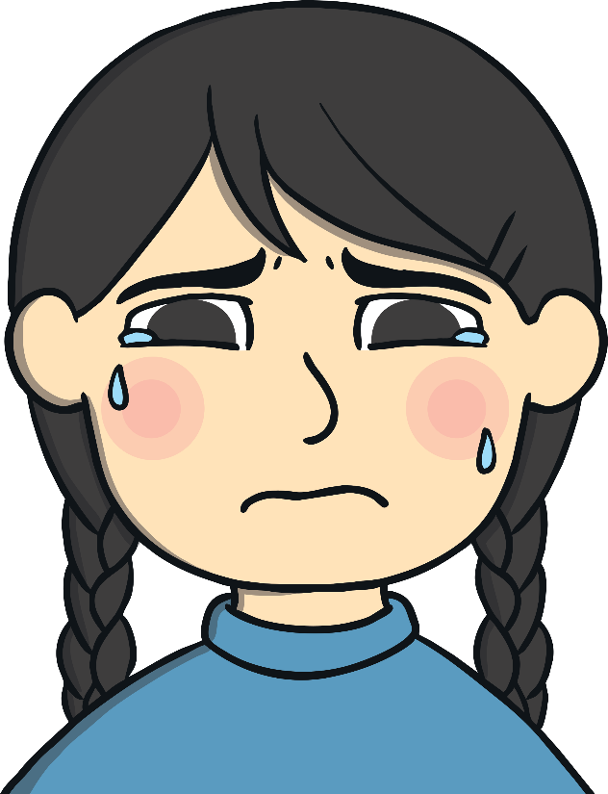
When We Need Our Families
Sometimes, something happens in a family that makes a person feel worried, uncomfortable or unsafe.
This might be when someone is hurt or touched in a way that doesn't feel OK. If this happens, it is important to tell a trusted adult about it.
This could be another person in our family or a grown-up at school. Every child has the right to feel happy, healthy and safe at home with their family.

Slide 30
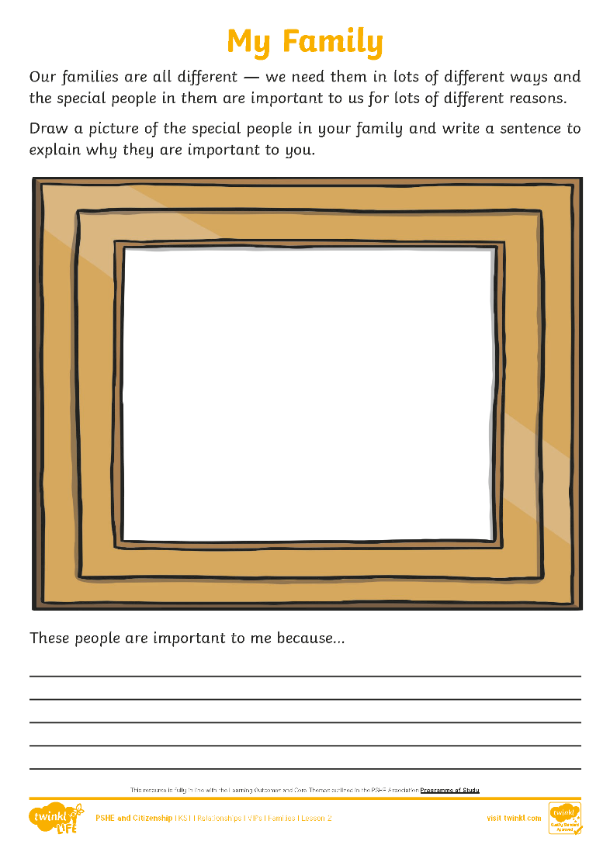
My Family
Our families are all different — we need them in lots of different ways and the people in them are important to us for lots of different reasons.
Draw a picture of the special people in your family and write a sentence to explain why they are important to you.
After you have finished, share your work with the class, if you feel happy to do so.
Consolidating
Reflecting

Slide 31
Consolidating

Slide 32
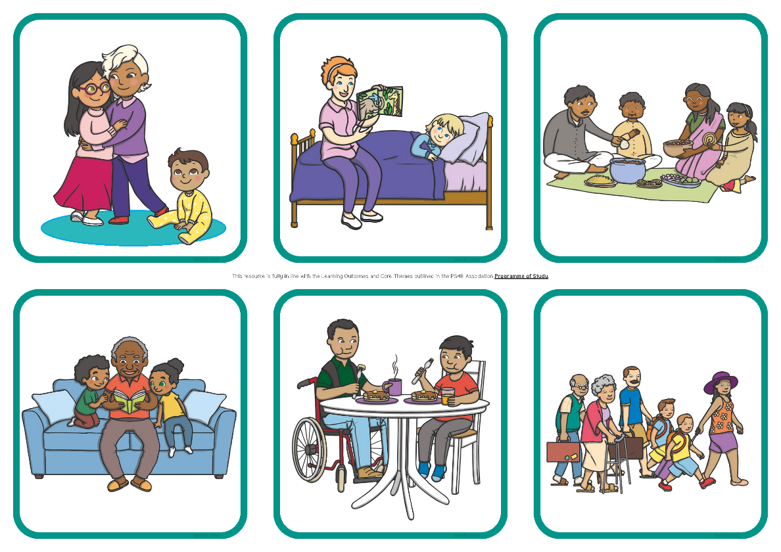
Caring
It is important that families show each other that they care. It helps everyone to feel safe and happy.
Look at the picture cards in your groups.
How are the families showing each other that they care?
Why is this important?

Slide 33
Reflecting

Slide 34
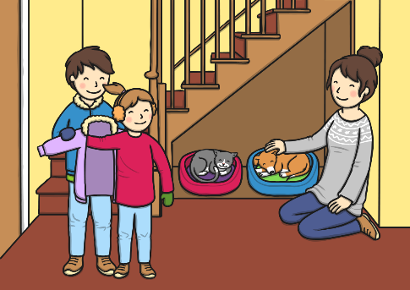
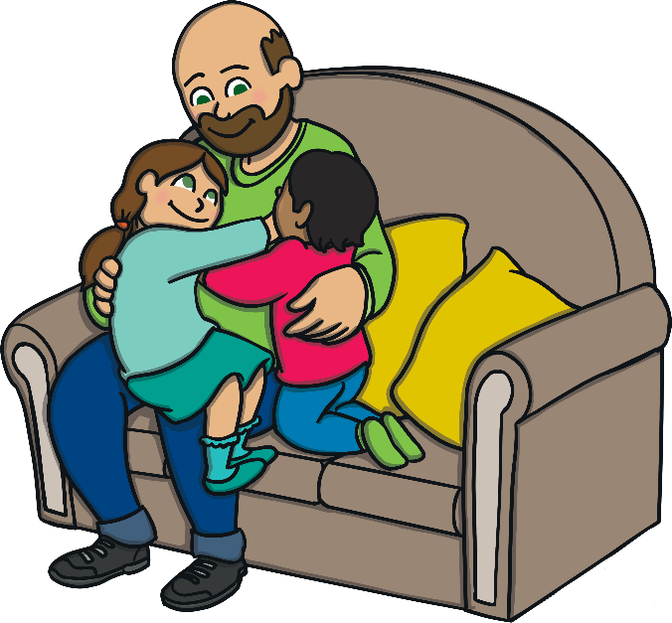
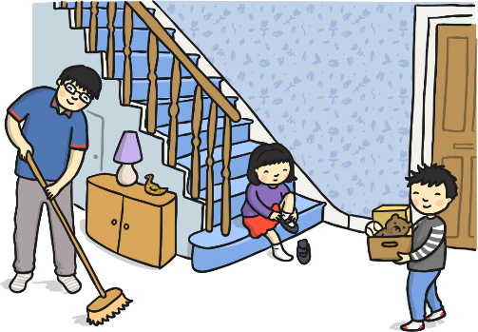
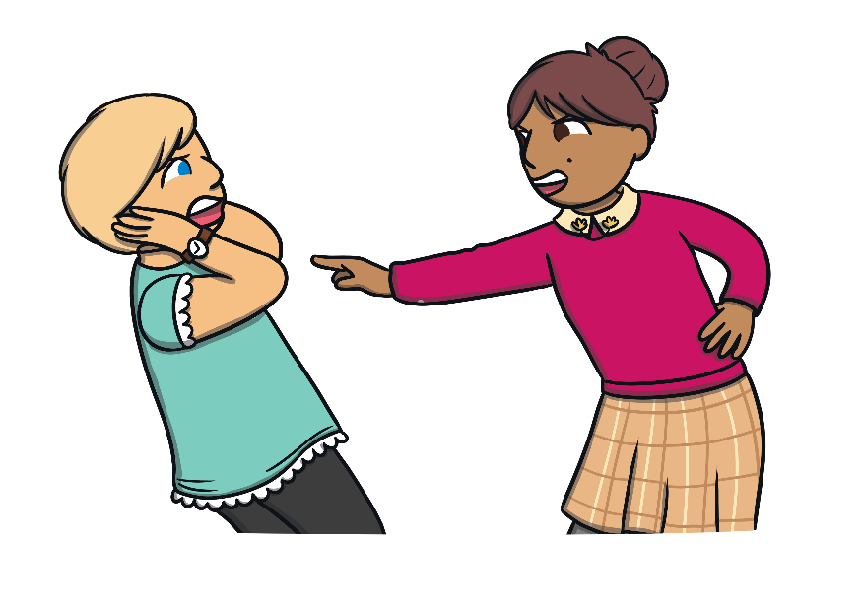
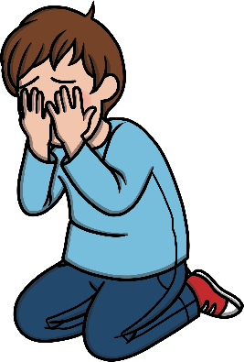
How Can I Help My Family?
Families help each other in lots of different ways.
Look at these pictures. How are the families helping each other?
Sometimes, we might feel worried about one of our VIPs. If we ever feel upset by someone who is special to us feeling worried, sad or not seeming themselves, it is also important to speak to a trusted adult to get help and support.
If we need help or support for anything that worries us, either something that is happening to us or to someone we love, there are lots of people we can speak to. This might be an adult in school, an adult in our family or someone whose job it is to look after others like a doctor, nurse or police officer.
It is important that we help, care for and are kind to all the special people in our lives. Look at all the ways people are helping each other in these pictures.
If we ever feel worried or uncomfortable about something that is happening to us within our family, it is important to speak to our trusted adults to get help and support.
It is also important to remember that all children have the right to live safe, happy and healthy lives.

Slide 35
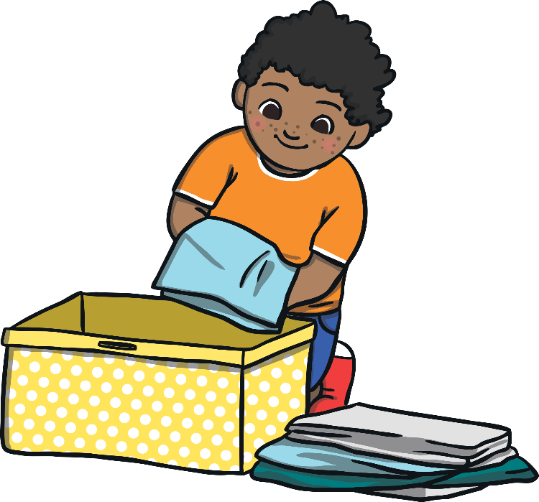
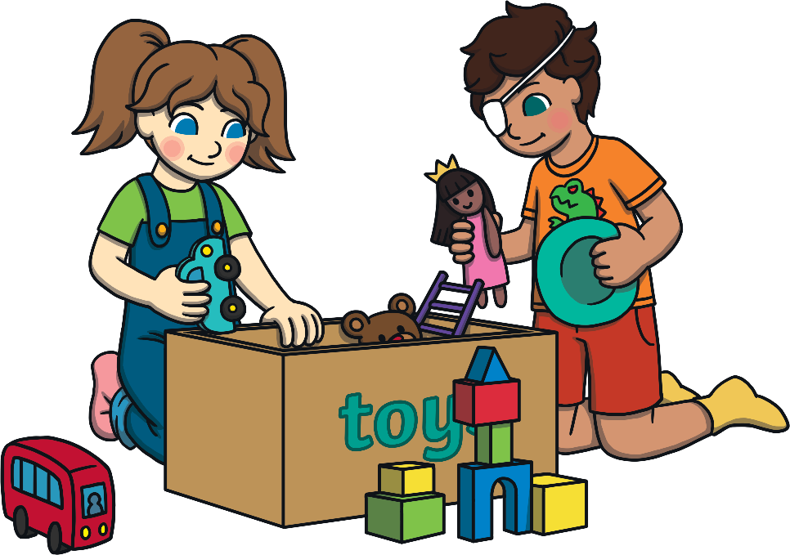
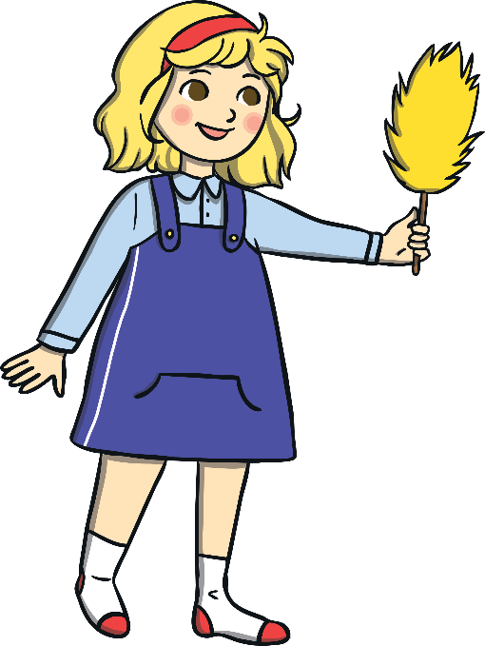
How Can I Help My Family?
Take a moment of quiet to think about how you could help your family.
Special people in our family can help us to feel safe, happy and loved and when we feel good inside, we can help others to feel good inside too.
If you feel happy to, share your thoughts with the class.
Let’s be a class that cares for and helps all the special people in our lives.

Slide 36
The Big Questions

Slide 37
How should the people in your family make you feel?
Why are families important?
What is the most important thing you have learnt?

Slide 38
Aim
I can describe why families are important.
Success Criteria
I can identify who is in my family.
I can explain why we need our families and how they can help us.
I can give reasons to explain why members of my family are important to me.
I can think of ways families can show each other they care.
I can identify that not all families are the same and I can respect those families that are different to mine.

Slide 39
Prayer

