Slide 1
Welcome to Dolphins!
July 2020
Key stage One

Slide 2
Who are the KS1 teachers?
Miss Yardley is the class teacher. Mrs Whittles is the fantastic morning teaching assistant and Mrs Sheen is the fantastic afternoon teaching assistant.

Slide 3
Meet the KS1 Team

Slide 4
Year 1 Non-negotiables.

Slide 5
What is a typical day like in KS1?

Slide 6
Where will I sit?

Slide 7
Where will I put my things?

Slide 8
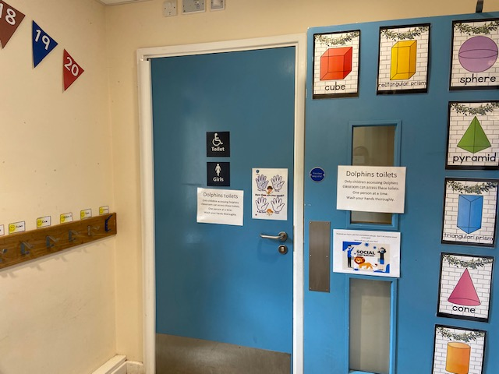
Where are the toilets?

Slide 9
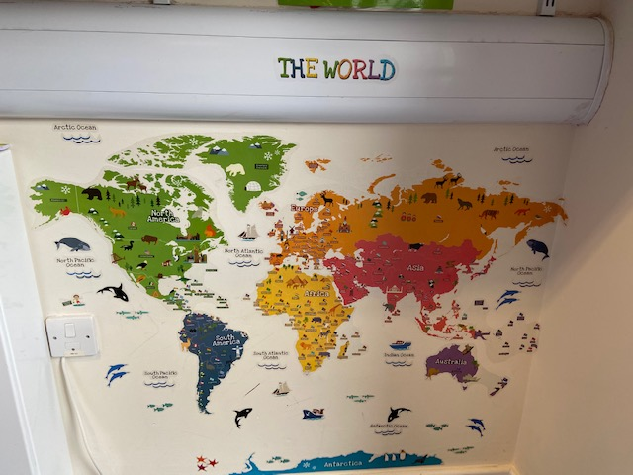
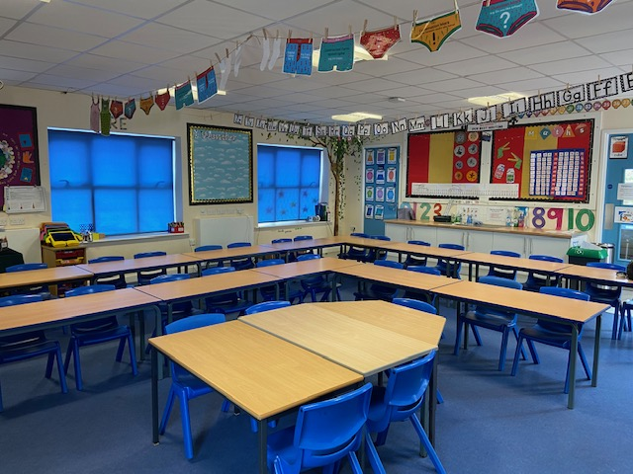
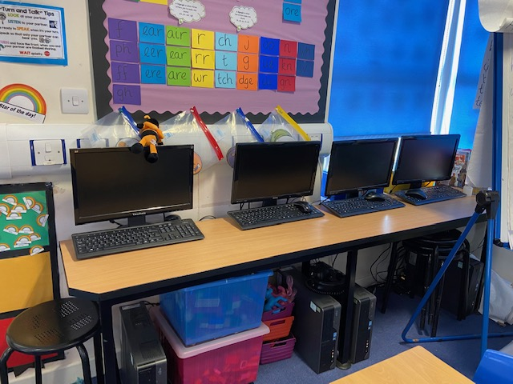
Areas of interest in the classroom.

Slide 10
A recipe for our school.
‘A handful of childrens smiles, 5 spoons of happiness, 8 bags of friendship, 6 cups of pride, 5 spoons of love and a sprinkle of confidence.
Mix together the smiles and happiness in a bowl, add the friendship and love and mix altogether.
Then add the pride with a sprinkle of confidence.
This makes a happy class.’
Harry Y2

Slide 11
We look forward to seeing you all in September. If you have any questions please feel free to get in touch via ClassDojo
Miss Yardley, Mrs whittles and Mrs Sheen.

