Slide 1
PSHE and Citizenship
Relationships | Be Yourself
PSHE and Citizenship | UKS2 | Relationships | Be Yourself | Uncomfortable Feelings | Lesson 3

Slide 3
Aim
I can explore uncomfortable feelings and understand how to manage them.
Success Criteria
I can identify uncomfortable feelings.
I can discuss situations which might lead to uncomfortable feelings arising.
I can describe ways to manage uncomfortable feelings.
I can think about how I am going to manage my own uncomfortable feelings.
This resource is fully in line with the Learning Outcomes and Core Themes outlined in the PSHE Association’s Programme of Study.

Slide 4
The Big Questions

Slide 5
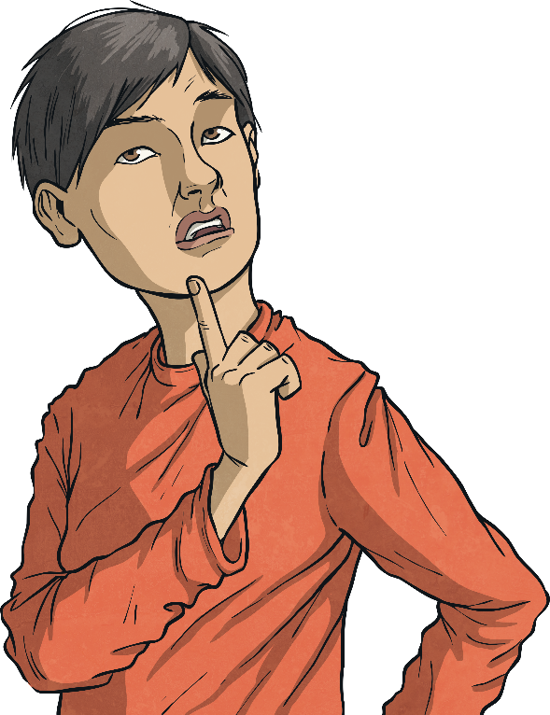
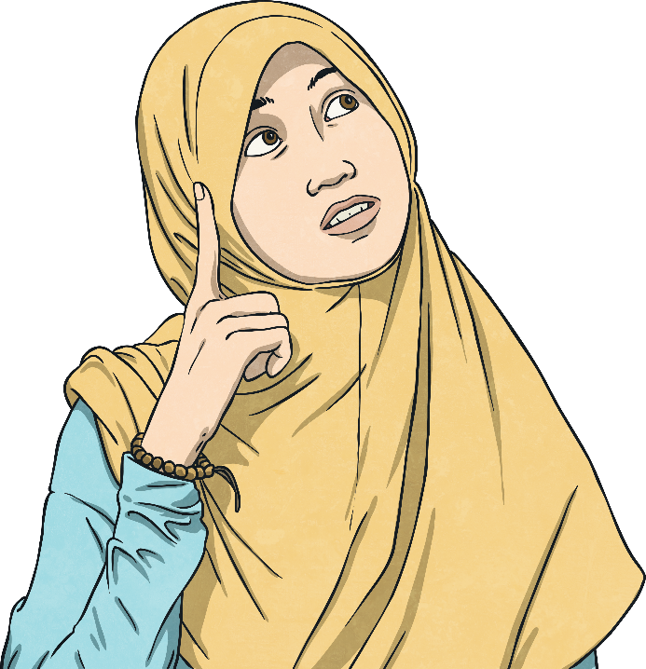
What are some of the uncomfortable feelings that people can feel?
What can we do to manage them?

Slide 6
Reconnecting

Slide 7
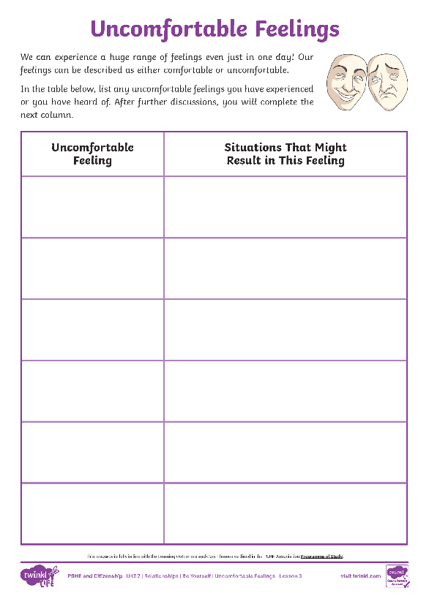
Feelings
We can experience a huge range of feelings even just in one day! Our feelings can be described as either comfortable or uncomfortable.
Comfortable feelings are those which feel OK when we experience them. Uncomfortable feelings are those which unsettle us and do not feel OK.
In pairs, using the Uncomfortable Feelings Activity Sheet, write down a list of any uncomfortable feelings you have experienced or heard about.

Slide 8
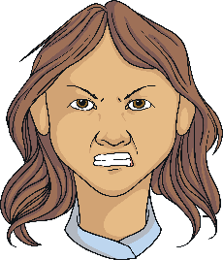
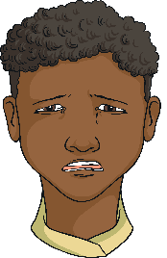
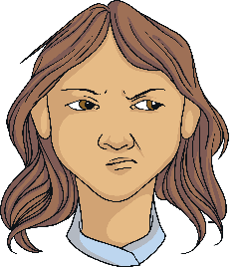
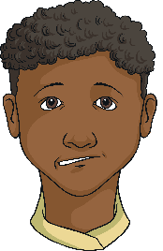
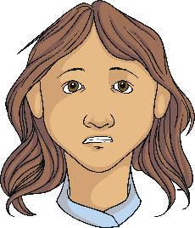
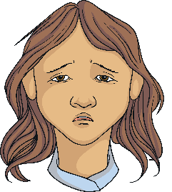
Feelings
These are some of the uncomfortable feelings we may experience.
anger
sadness
jealousy
worry
anxiety
fear
loneliness
It’s OK to feel these feelings but it is important we manage them so they don’t hurt us or other people.

Slide 9
Exploring

Slide 10
Feeling Uncomfortable
There are often certain situations which result in us feeling these uncomfortable feelings.
Using your Uncomfortable Feelings Activity Sheet, discuss with a partner the situations that might lead to us experiencing the feelings you have listed on your sheet.
Identifying the situations that might lead to us experiencing uncomfortable feelings can help us manage them. It can help us prepare for those situations or help us to decide not to become involved in certain things.

Slide 11
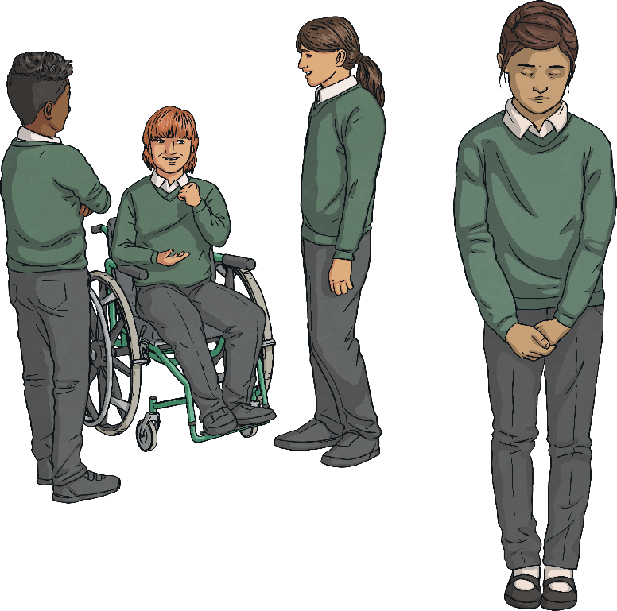
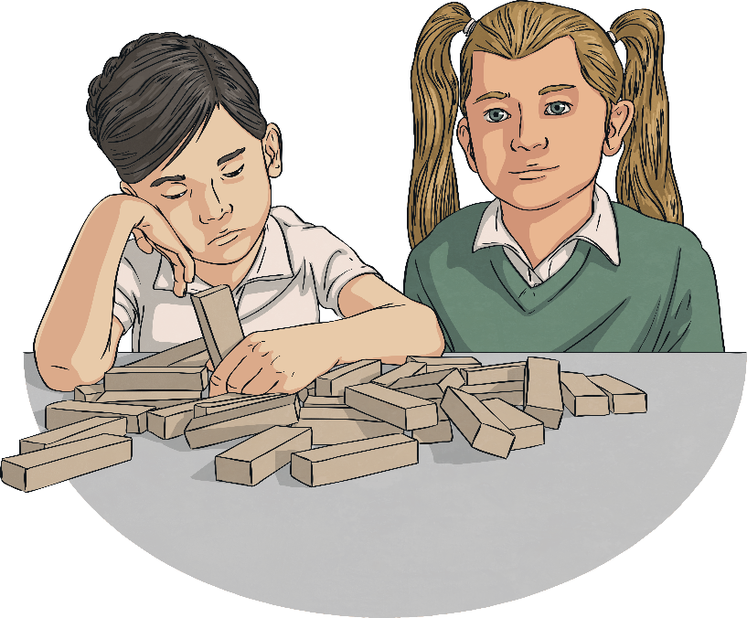
Managing Feelings
For example, if we are feeling happy, it is a nice feeling for others to be around. If we are feeling grumpy, it is not as comfortable to be around for others.
The effects our feelings have on others around us can impact how comfortable or uncomfortable the feeling is for us.

Slide 12
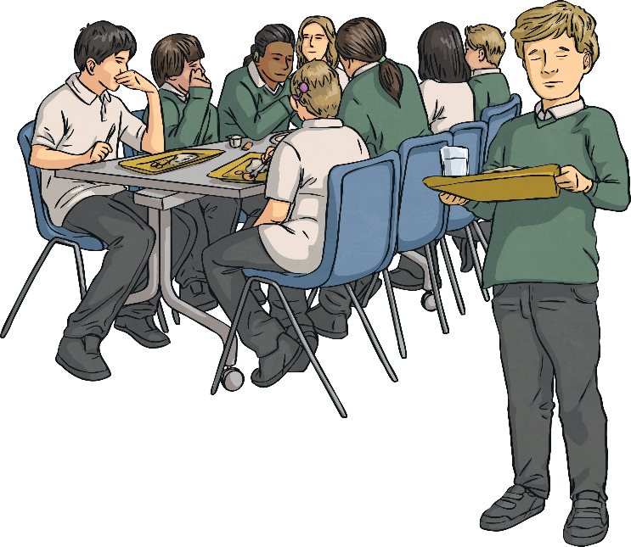
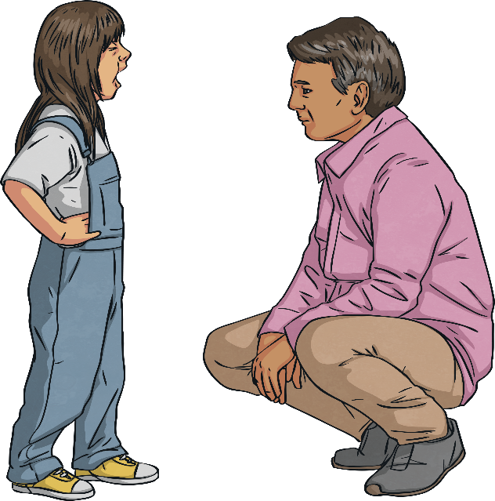
Managing Feelings
Unfortunately, this can lead to people pretending they are not experiencing any of their uncomfortable feelings, or it can lead to people managing them in a way that makes others feel very uncomfortable.
For example, if someone is feeling angry and becomes aggressive, this can make others feel very uncomfortable.

Slide 13
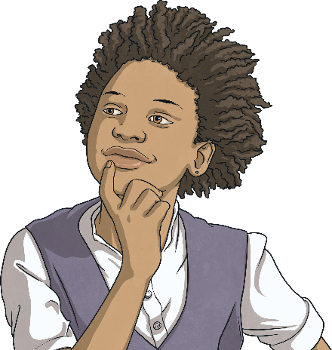
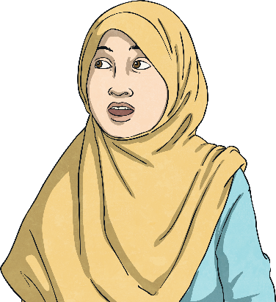
Managing Feelings
There are two key parts of managing your feelings.
Firstly, you need to be able to identify and understand the feeling you are experiencing. This involves recognising and giving attention to the feeling rather than trying to ignore it.
Secondly, being able to recognise when and how to seek support or a listening ear is important in accepting your feelings and empowering yourself to respond and handle the feelings in a way that works for your wellbeing.

Slide 14
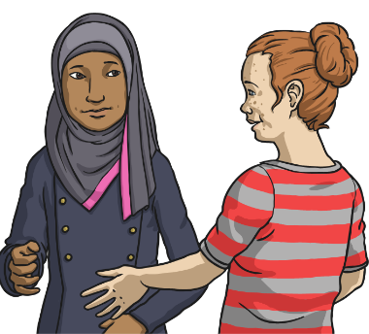
Managing Feelings
The following are ideas of ways to manage our uncomfortable feelings.
Explain honestly and calmly how you are feeling and why.
When you do this, make sure you state facts and your own opinions rather than drawing your own conclusions.
“I am feeling cross because I really wanted to win that game and I found losing hard.”
This expression of true emotions does not make anyone else feel uncomfortable and allows others to help.
Find ways to calm yourself so that you feel ready to talk.
This can include fidgeting with something, listening to music, breathing calmly, playing with playdough, having a hug, lying down or reading a story. What works for one person may be different to what works for another person, so it is important to find the thing that calms you down.

Slide 15
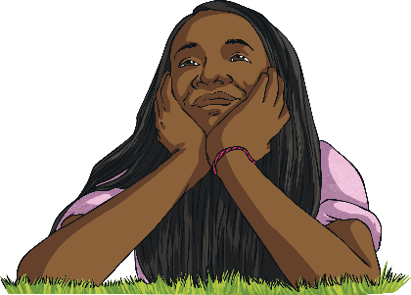
Managing Feelings
Feeling confident and positive.
When you are experiencing an uncomfortable feeling, have a positive idea about how things could be better and feel confident enough to voice that idea. This can quickly make the uncomfortable feeling feel comfortable.
Be kind to yourself.
We all have days when we feel sad or grumpy and we don’t always know why we are having these feelings. It is important to allow ourselves to have these feelings and to try and explain to others that we are in a certain mood.
Think yourself happy.
Sometimes we can change our thoughts to become positive by thinking positively and smiling. The impact this can have on ourselves can lift our mood. However, it is important to not just block uncomfortable feelings out if there is a reason for them.

Slide 16
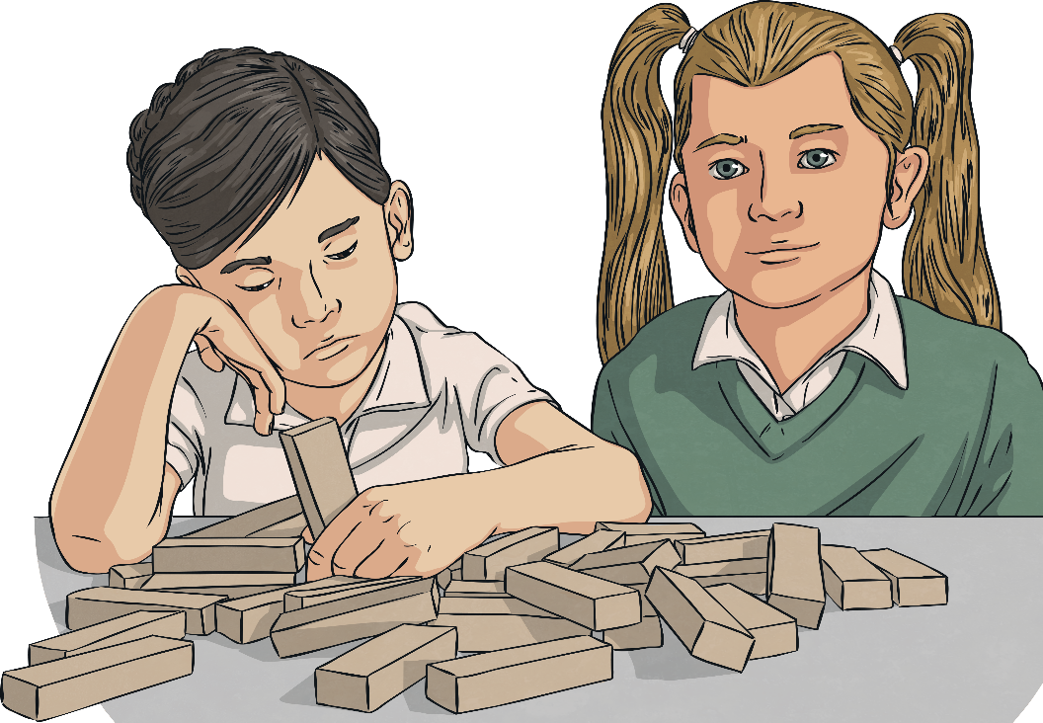
Seeking Support
Feeling emotions that make us and those around us uncomfortable sometimes is normal and very common.
Experiencing these emotions more often is referred to as mental ill health. Just like our bodies need looking after, our minds need to be looked after too.
What would you do to get help if you were physically ill?

Slide 17
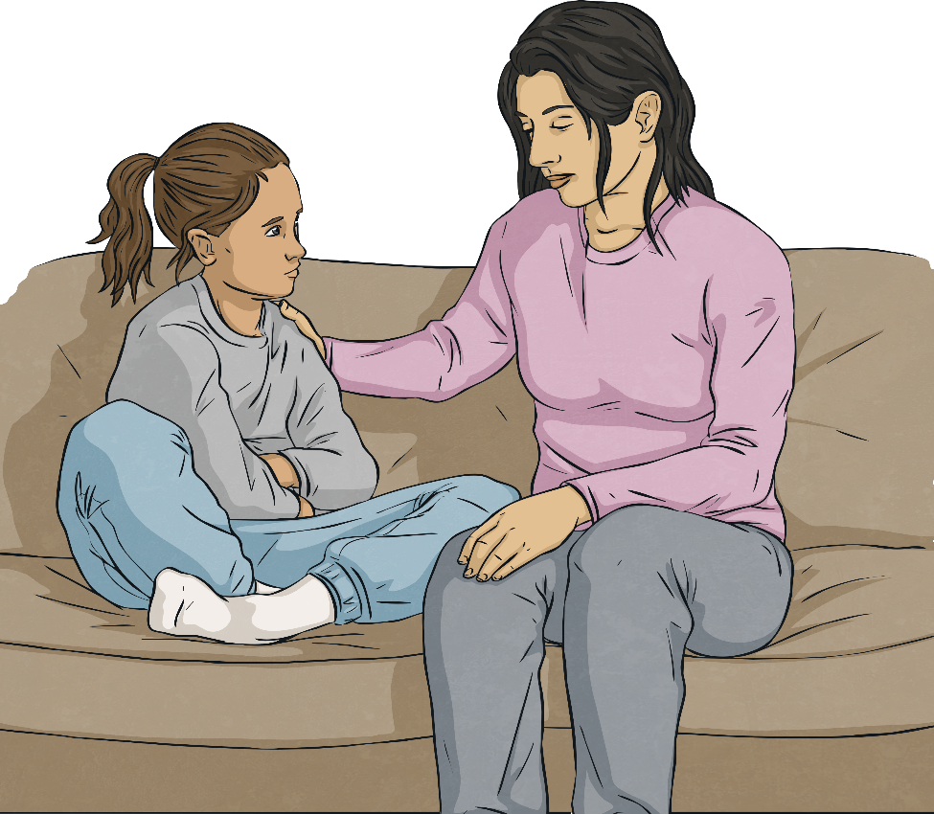
Seeking Support
Being mentally unwell is no different from being physically unwell. We don't have to soldier on, pretending everything is fine when it isn't.
When our uncomfortable emotions get on top of us, it's time to seek support.
Tell a trusted adult, at home or at school, how you are feeling and get some help. Many people can resolve the issues that are causing them to feel bad, then get on with living a happier life.
Who could you talk to if you needed support with your mental wellbeing?

Slide 18
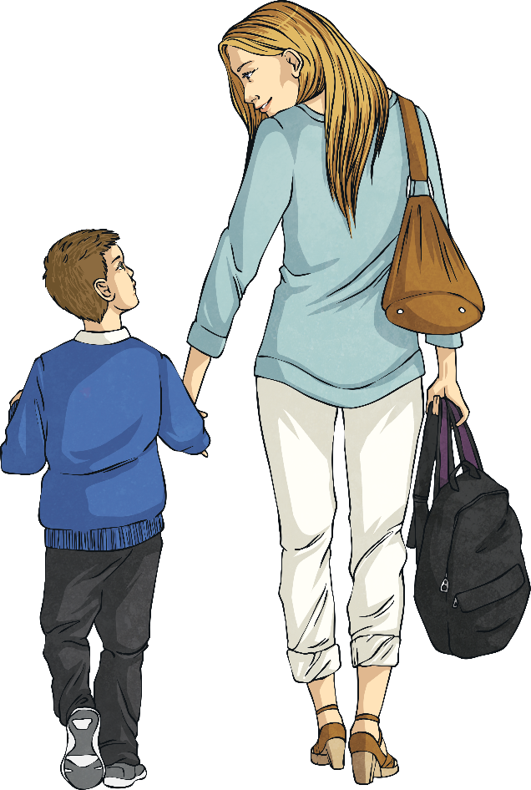
Managing Feelings
Talking to someone you trust about any uncomfortable feelings you have is also important.
Consolidating
Reflecting

Slide 19
Consolidating

Slide 20
Putting It into Action
When our own feelings or our friends’ feelings are uncomfortable or tricky, we can sometimes respond in a way which can lead to disagreements or falling out due to our own feelings and behaviour or that of our friends.
It is important to recognise when a friend is experiencing an uncomfortable feeling. You can then show tolerance of their situation but also maintain the importance of being treated with respect in a healthy positive friendship.

Slide 21
Putting It into Action
If someone behaves in a way which is unsettling, for example if our friend is angry and is then aggressive towards us, it is important to remember that we do not have to match their feelings or behaviour. We do not need to be angry or aggressive in return. We might need some space and to talk through the situation.
It is also important that when our friend has calmed down, we explain to them how their behaviour impacted us and how we would prefer them to behave when they next experience an uncomfortable feeling.

Slide 22
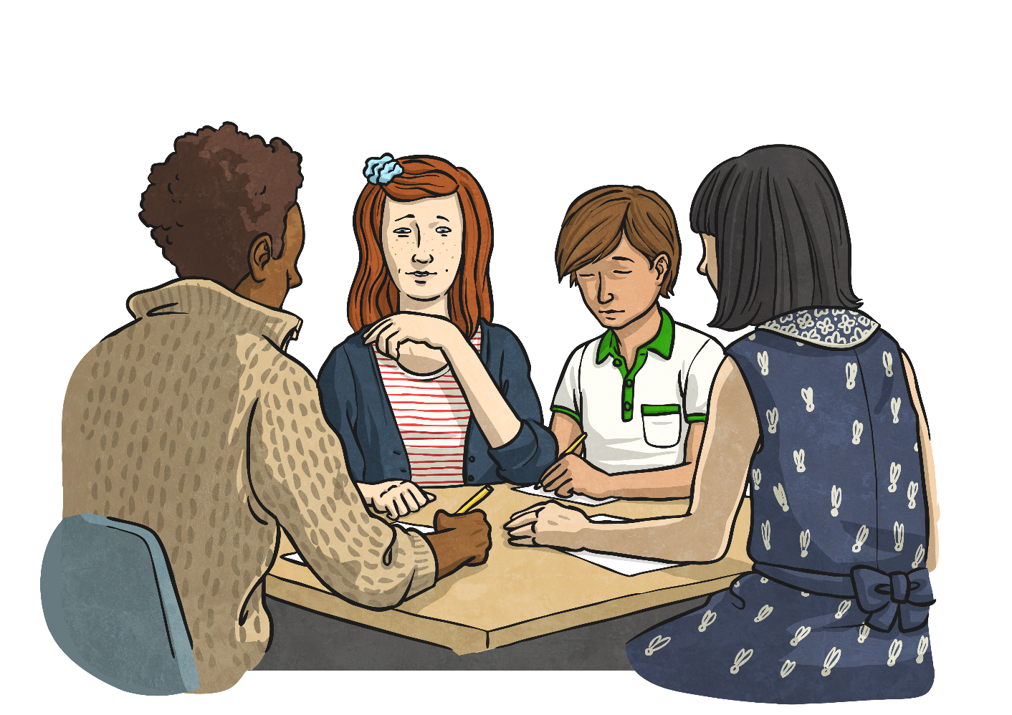
Putting It into Action
Work in a group to plan and prepare a role play showing someone experiencing an uncomfortable feeling, then showing how they manage that feeling and how the whole situation impacts on the people around them.

Slide 23
Reflecting

Slide 24
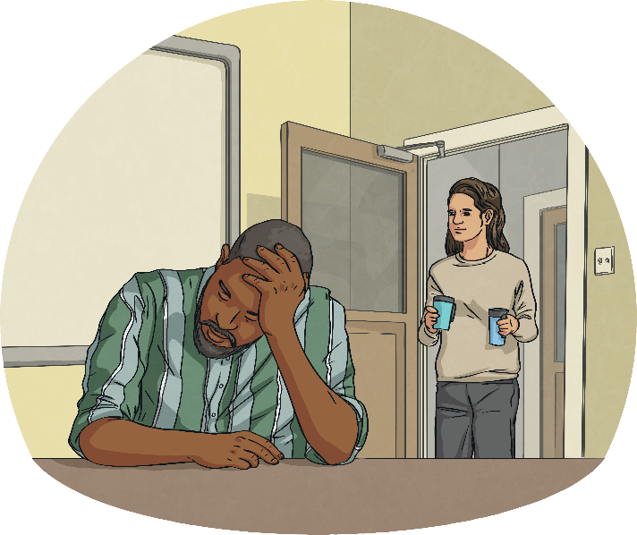
Bottling Feelings
It is really important we are honest and open about how we are feeling. It can be very tempting to block out any uncomfortable feelings and only acknowledge the comfortable ones.
However, if we do this, those uncomfortable feelings, thoughts and experiences do not vanish. They just build up and can become larger and more uncomfortable than the original experience and feeling.

Slide 25
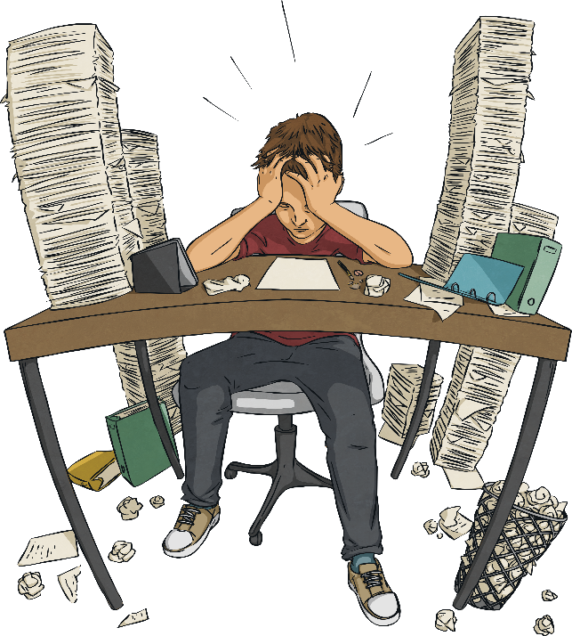
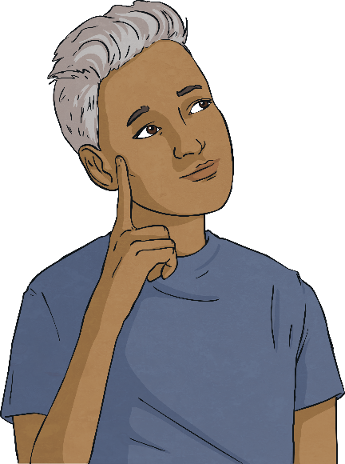
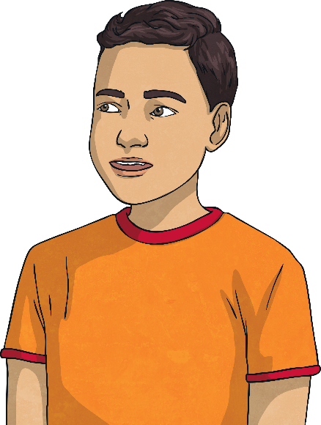
Bottling Feelings
It is very important that we have strategies for managing these uncomfortable feelings, so we do not feel that our only option is to bottle them up.
Take a moment of quiet to think about how you are going to manage any uncomfortable feelings you have. Remember, talking to someone you trust is a great way to start.

Slide 26
The Big Questions

Slide 27
What are some of the uncomfortable feelings that people can feel?
What can we do to manage them?
How have your thoughts and answers changed since the beginning of the lesson?

Slide 28
Aim
I can explore uncomfortable feelings and understand how to manage them.
Success Criteria
I can identify uncomfortable feelings.
I can discuss situations which might lead to uncomfortable feelings arising.
I can describe ways to manage uncomfortable feelings.
I can think about how I am going to manage my own uncomfortable feelings.

Slide 30
Aim
I can understand why we sometimes feel shy or nervous and know how to manage these feelings.
Success Criteria
I can identify situations that might make me feel shy or nervous.
I can discuss the impact of how we choose to respond to feeling nervous and shy.
I can identify strategies that might help me to feel confident and behave confidently.
This resource is fully in line with the Learning Outcomes and Core Themes outlined in the PSHE Association’s Programme of Study.

Slide 31
The Big Questions

Slide 32
What situations might make us feel nervous or shy?
How can we feel and act more confident in these situations?

Slide 33
Reconnecting

Slide 34
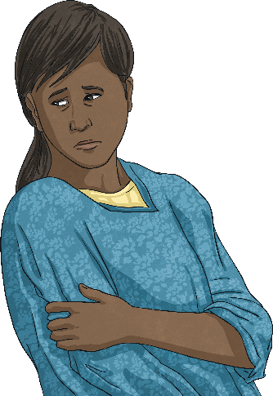
Feeling Shy and Nervous
How is the child in each scenario feeling? Why do you think they are feeling that way?
Sam is starting at a new school. He is confident and happy about his new beginning but he is feeling a little strange. He has noticed that his stomach feels jumpy and he feels a little bit sick.
Saskia has started playing football with a new team. She loves playing football but does not know anyone on this team. She is normally very outgoing and confident but she is finding it hard to speak to others. She is being very quiet.

Slide 35
Feeling Shy and Nervous
Adnan is taking his ballet exam today. He has worked really hard for this exam but is worried about whether or not he will pass. He can’t eat anything and his stomach feels a bit funny.
Do you have any experiences of feeling shy or nervous? Share them with the class, if you feel happy to.
Remember to focus on what was happening, what was going to happen and how you felt emotionally and physically.
Remember, feeling shy and nervous is very normal in certain situations. We are going to explore these feelings a little more.

Slide 36
Exploring

Slide 37
Fight or Flight
Adrenaline is required when we need to have quick reactions. When we are feeling nervous, our body produces extra adrenaline – however, this extra adrenaline isn’t always needed and therefore it can make us feel a bit sick, have a gurgling stomach or we may even feel shaky and dizzy.
In some situations where people feel nervous, they use this extra adrenaline to cope with the situation. At other times, people use this extra adrenaline to flee from the situation. These two different responses are known as fight or flight.
Feeling nervous is both normal and natural. It is a physical response to a situation. We do not need to feel worried about the fact that we are nervous but we do need to recognise the feeling and know that we can choose how we respond to it.

Slide 38
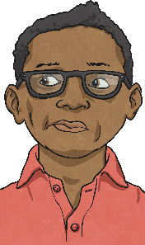
Fight or Flight
The following examples show two different responses to feeling nervous.
Two boys are getting ready to go to their new secondary school. They are both feeling a bit nervous and shy.
This boy goes into his new school and does not feel able to speak to anyone. He looks at the floor and does not make eye contact with anyone. He feels sick all day and comes home from school feeling that he has not made any new friends. He feels worried about going in tomorrow.
This boy goes into his new school and feels nervous but looks around and smiles at anyone who looks his way. He asks another boy what his name is and which school he used to go to. These boys spend all morning talking and going around school together. They arrange to walk to school together the following day.
How have the two boys chosen to respond to feeling nervous? What is the impact of their choice? Share your thoughts with a partner and then with the class.

Slide 39
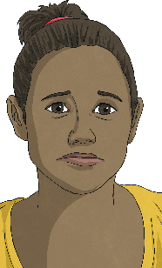
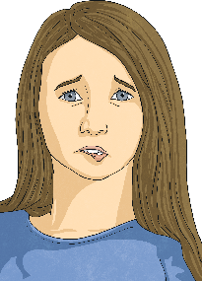
Fight or Flight
Two girls are going to their first sleepover at a friend’s house. They are both feeling nervous about spending the night away from their family.
This girl arrives at the sleepover and tells her friends she is feeling nervous about being away from her family all night. Her friends tell her that they feel nervous too but that they are also excited. Her friends are supportive and tell her that if she is missing her family, she should let them know and they will give her a big hug.
This girl arrives at the sleepover and does not tell any of her friends how she is really feeling. She tries to hide her nerves. She is very quiet and misses some of the conversations her friends are having because she is thinking so much about her family. As none of her friends know how she is feeling, they begin to think she is in a bad mood with them and start feeling upset with her.
How have the two girls chosen to respond to feeling nervous? What is the impact of their choice? Share your thoughts with a partner and then with the class.

Slide 40
Fight or Flight
Two children are going on an aeroplane for the first time and are both feeling nervous.
This child tells their family how they are feeling and their family talk through all the things the child is worried about to ensure they understand what is happening. They then focus on all the exciting things they are going to do after the flight and happily get on the plane together.
This child does not tell their family how they are feeling. When it is time to board the plane, this child starts crying and refuses to get on. Their family do not understand what is happening and they start to feel a bit cross.
Why does the situation make one person feel shy or nervous but make another person feel motivated and inspired? Share your thoughts with a partner and then with the class.
Remember, feeling nervous is both normal and natural. It is a physical response to a situation. We do not need to feel worried about the fact that we are nervous but we do need to recognise the feeling and know that we can choose how we respond to it.

Slide 41
Handling Setbacks
In life, we all have times when things don’t go right. This is called a setback. We can sometimes feel like we have failed or made a mistake when this happens.
For example, Helen has been working hard to make bracelets for her friends to bring into school. However, when Helen takes the bracelets into school they each break as her friends try to fasten the bracelets around their wrists. Helen feels low and thinks that she has failed her friends and she starts to believe that she can’t make bracelets.

Slide 42
Handling Setbacks
Whenever we try anything new, adventurous or outside of our comfort zone, we run the risk of it going wrong. This is part of learning and is normal and natural. It can feel frustrating but it is important that we learn how to move forward from these feelings to ensure they don’t prevent us from learning and achieving success in the future.
In the example from the previous slide, Helen needs to realise that none of her friends wanted the bracelets to break either. She needs to recognise that the bracelets were all beautiful and that they showed just how much time she had spent and how much she cares for her friends. Helen needs to forgive herself and speak as kindly to herself as she would to a friend if this had happened to them. Finally, Helen needs to accept that while the bracelets have broken this time, they can always be made again and she can check with a grown-up at home to help to prevent them breaking again.

Slide 43
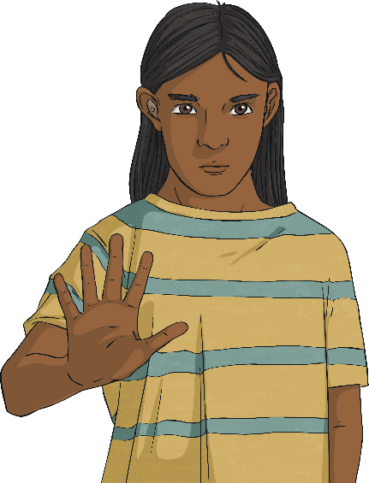
Mind over Matter
Being confident doesn’t mean we never feel nervous or shy. It means recognising how we are feeling, confronting our nerves and getting the support from those around us. This helps us to have a strong mental attitude – we believe we can face our fears. This is sometimes called ‘mind over matter’.
There are different ways in which we can achieve this feeling.
We can address our worries and concerns to try and make them feel less important.
We can focus on the positive outcomes of the situation rather than our nerves.
We can share our thoughts and feelings with those around us.
Once we have used one of these strategies successfully, we will then feel much more confident the next time we are in the same situation.

Slide 44
Mind over Matter
Is it okay to feel shy or nervous or is this a feeling we should try and hide?
Discuss this in your groups and then share your thoughts with the class.
It is important that we recognise that people do feel nervous and shy. It is important that we understand that these feelings are natural and normal. We can then better understand how others are behaving around us and not judge their behaviour. It can also help us to talk to others about their feelings which enables us to support and help them.
Accepting our own shyness means we can address it and then, with support, make choices that will help us feel more confident.
Consolidating
Reflecting

Slide 45
Consolidating

Slide 46
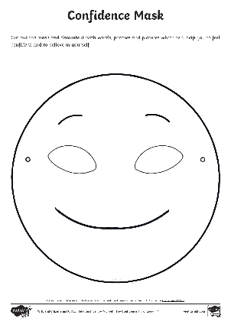
Being Confident
Using your Confidence Mask Activity Sheet, can you create your own mask to wear to enable you to feel confident?
You can decorate your mask with words, phrases and pictures which will help you to feel confident and believe in yourself. This will be very unique to you but you may wish to include things such as:
talk to others
support
positive
believe
trust
faith
hope
accept
understand
honesty
friends
truth

Slide 47
Reflecting

Slide 48
Masks
Why are masks appropriate for today’s lesson?
Sometimes we wear a confidence mask to help make the feeling become a reality. It encourages us to feel confident and makes us believe in ourselves, even when we are feeling shy or nervous.
We can wear this mask even if we do not have a physical mask with us. We can create self-confidence and a positive attitude to something we know we are nervous or shy about. Our confidence draws other people to us and makes us fun to be with. We can also be confidently truthful about our nerves and shyness and then move forward with our support network.

Slide 49
The Big Questions

Slide 50
What situations might make us feel nervous or shy?
How can we feel and act more confident in these situations?
Have any of your answers changed since the beginning of the lesson?

Slide 51
Aim
I can understand why we sometimes feel shy or nervous and know how to manage these feelings.
Success Criteria
I can identify situations that might make me feel shy or nervous.
I can discuss the impact of how we choose to respond to feeling nervous and shy.
I can identify strategies that might help me to feel confident and behave confidently.

Slide 52
Prayer

