Slide 1
PSHE and Citizenship
Living in the Wider World | Diverse Britain
PSHE and Citizenship | LKS2 | Living in the Wider World | Diverse Britain | Tolerance and Respect | Lesson 5

Slide 3
Aim
I can describe a diverse society and talk about why it is important.
Success Criteria
I can interpret a diversity data table.
I can write a poem to explain and celebrate diversity.
I can identify ways to show respect to others.
I can discuss why showing respect and being tolerant is important.
I can explain what discrimination is, can describe behaviour which is prejudiced and know what to do if I see it happening.
This resource is fully in line with the Learning Outcomes and Core Themes outlined in the PSHE Association’s Programme of Study.

Slide 4
The Big Questions

Slide 5
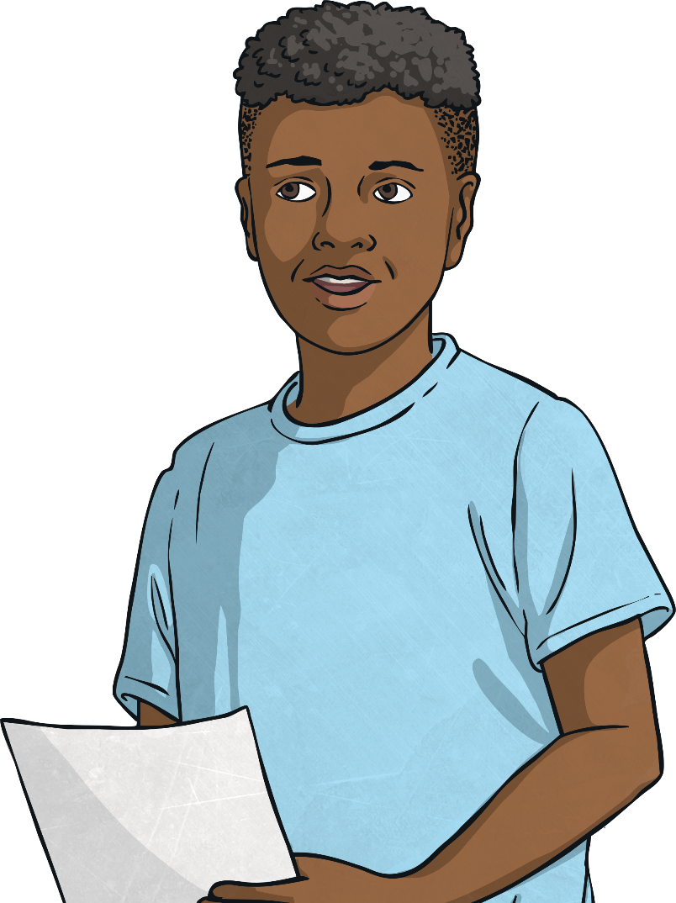
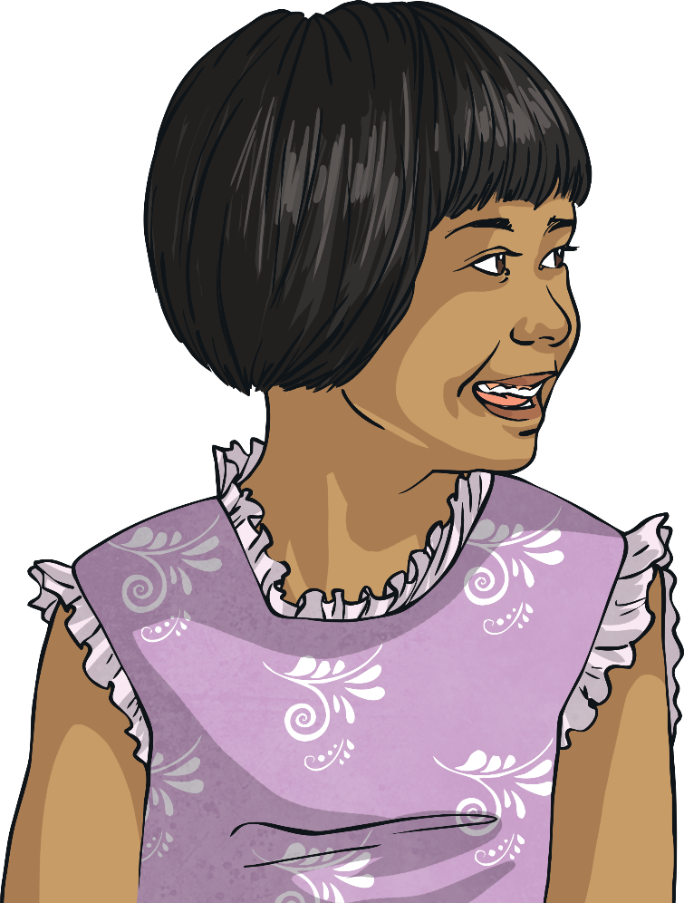
Why should we be respectful of others?
What is diversity and why is it important?

Slide 6
Reconnecting

Slide 7
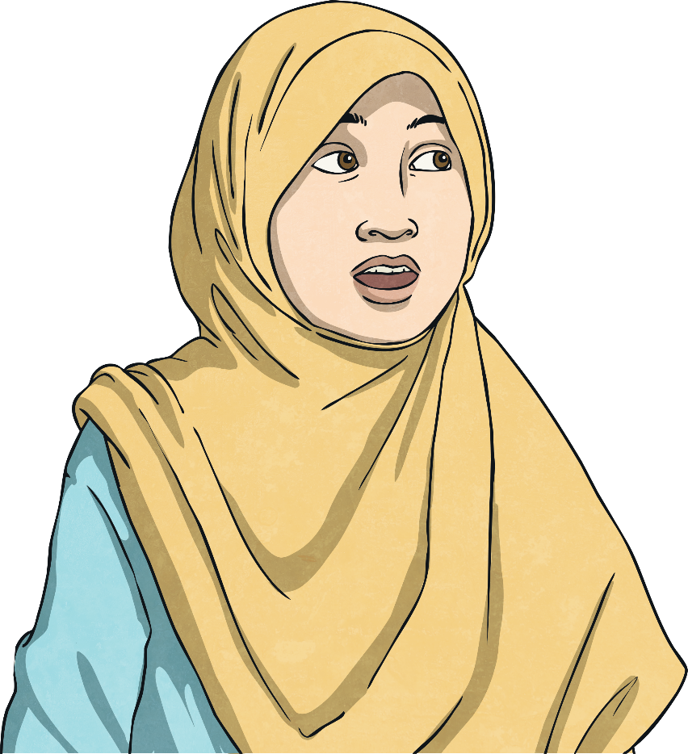
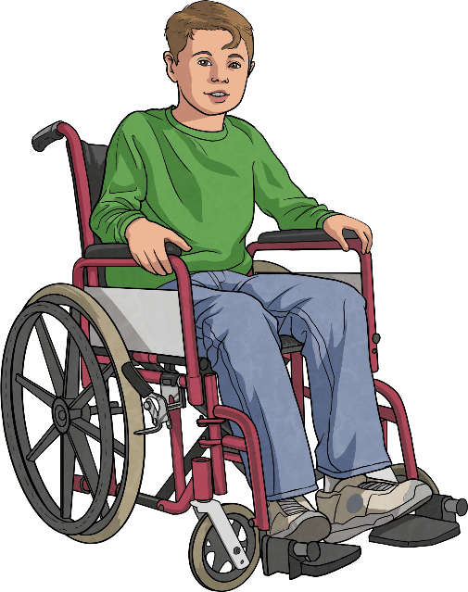
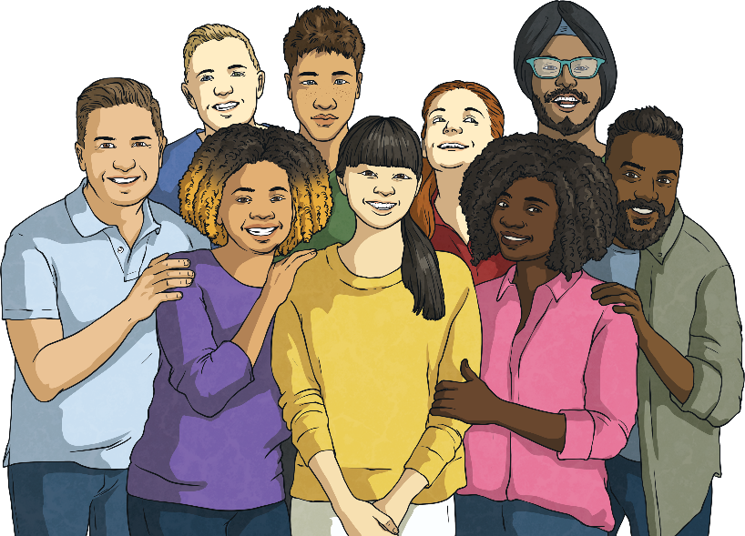
Diversity
Diverse means a wide variety.
Society means a community where people are living together.
So, in what ways can a society be diverse?
Share your thoughts with a partner. You can use the pictures to help you.
Now, share your ideas with the whole class.

Slide 8
Exploring

Slide 9
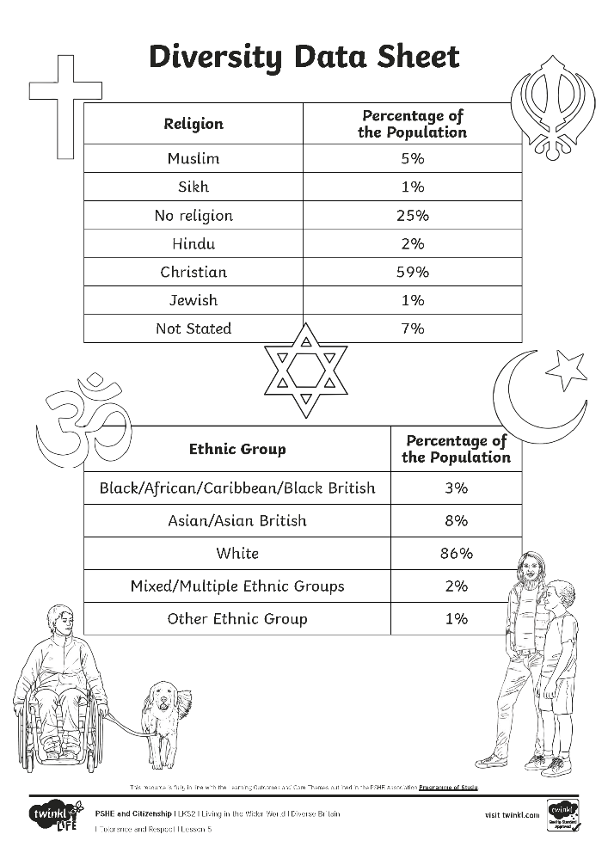
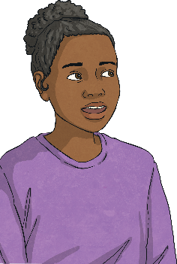
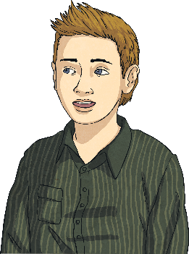
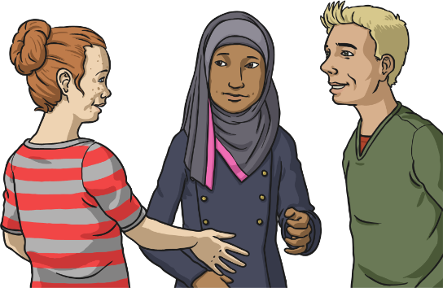
Diverse Britain
Britain and other British Isles are diverse societies because there is a variety of people from different ethnic groups and religions.
People who live in Britain and other British Isles come from lots of different ethnic, religious and cultural backgrounds. We are fortunate to live in a diverse society.
Here are two data tables which show the range of identities of people living in Britain.

Slide 10
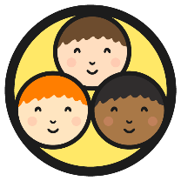
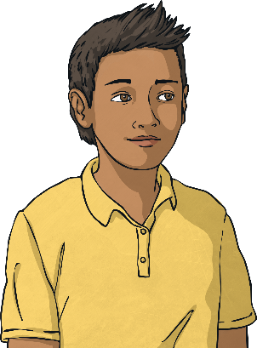
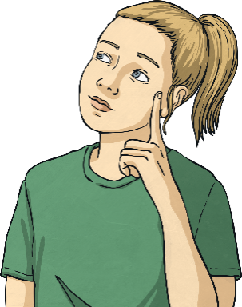
Diverse Britain
What do the data tables tell us about the diversity within Britain?
Look carefully at both Diversity Data Tables with your group. Using your coloured pens, write your answers to these questions on your piece of paper.
Which different religions can be found in Britain and other British Isles?
Which different ethnic groups
can be found in Britain and other British Isles?
Could there be any more religions that aren’t in the data table? Why? Can you think of any?
Could there be any more ethnic groups that aren’t in the data table? Why? Can you think of any?
What did you find out?
Share your findings with the class.

Slide 11
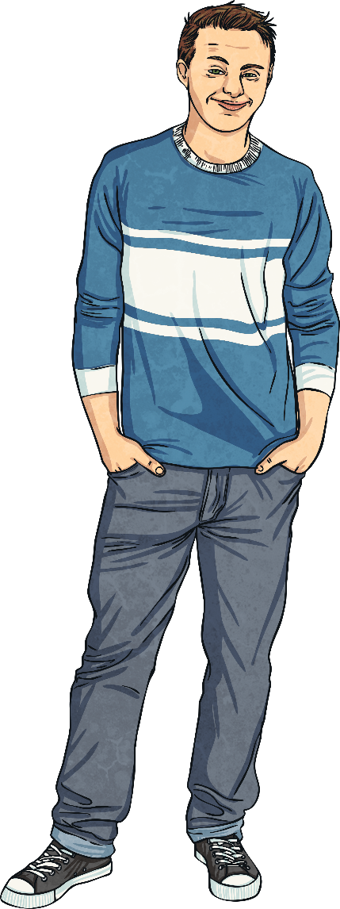
The Importance of Diversity
Why do you think diversity is important?
Diversity is important because it means we can spend time with, and learn new things about the world from, lots of different people.
It also helps us learn how to get along with people who are different to us, which can make the world a better place for everyone.
Diversity is important because differences make our communities and country strong and beautiful.
Consolidating
Reflecting

Slide 12
Consolidating

Slide 13
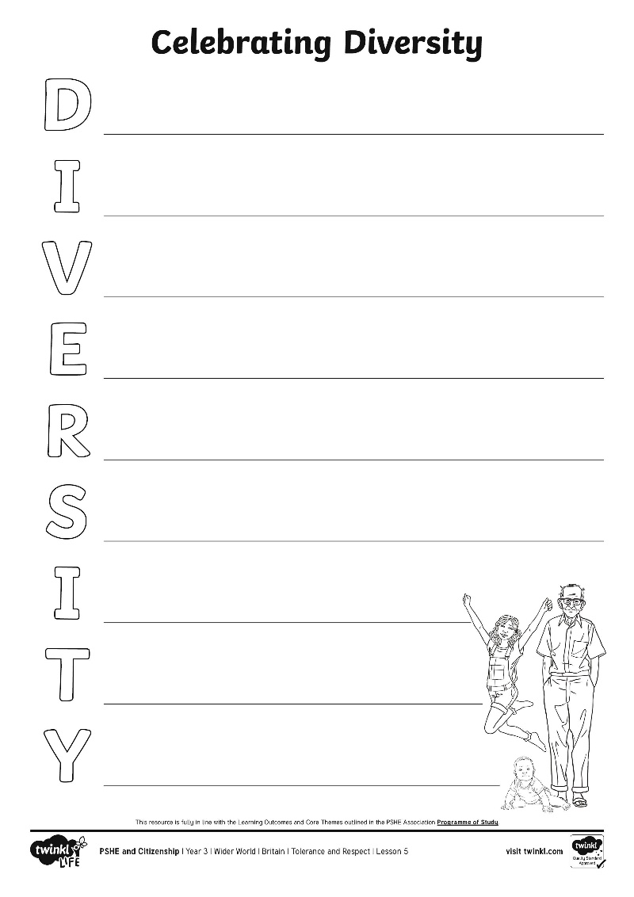
Celebrating Diversity
Diversity in the British Isles is something to be celebrated.
Write an acrostic poem to explain to others what diversity is and why it should be celebrated.
What could you include in your poem?
Word Bank:
different
nationality
ethnic
society
difference
celebrate
grow
learn
understanding
religious
respect
tolerance
exciting
beautiful
strong

Slide 14
Reflecting

Slide 15
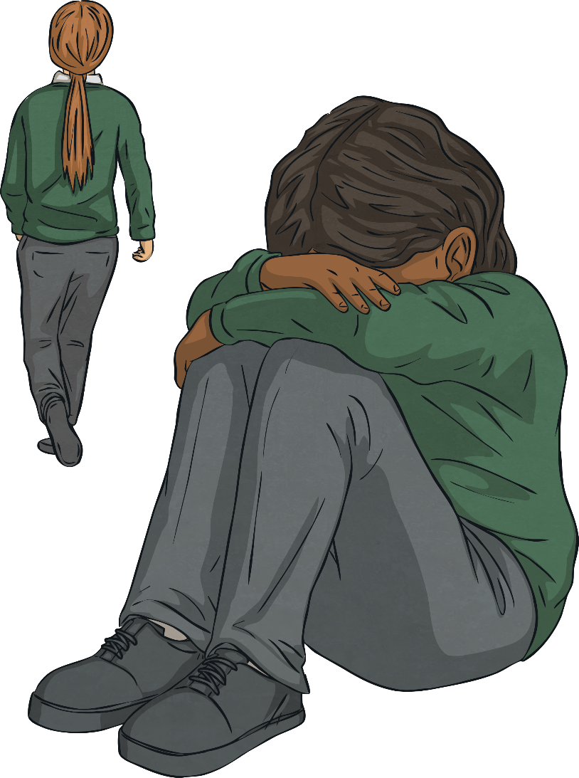
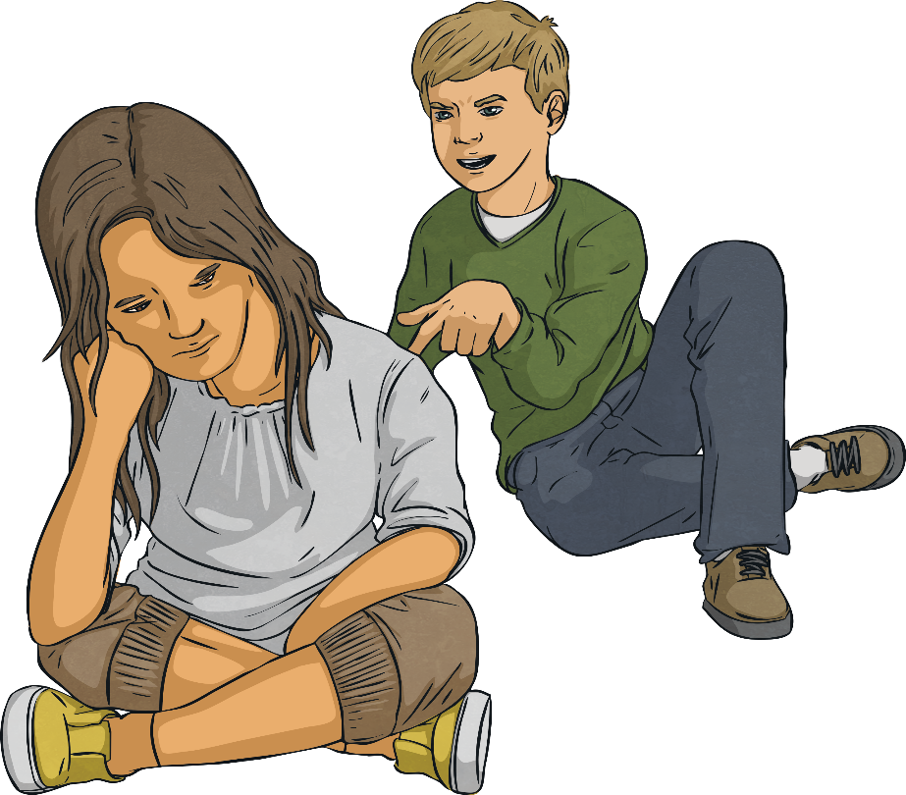
Being Respectful and Tolerant
We live in a diverse country; we are all different. Being respectful and tolerant of others can help make us all feel happier.
Unfortunately, in our country and throughout the world, people are sometimes treated unfairly and without respect by others because of differences between them. This is called discrimination and is often based on prejudiced thoughts and feelings, ones which are not based on truth or reason.
How does this make you feel?

Slide 16
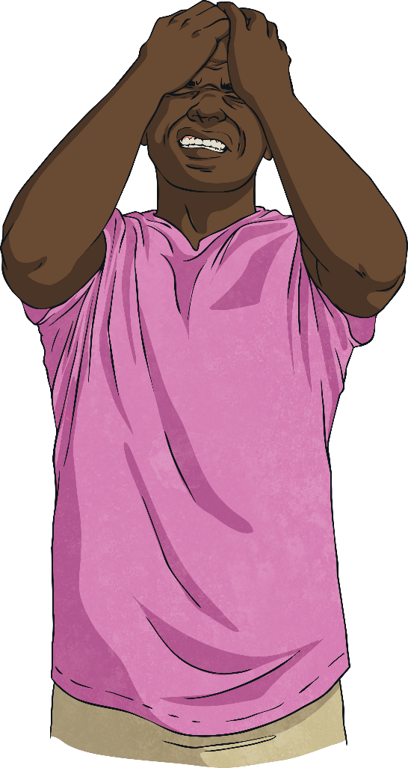
Being Respectful and Tolerant
This is unacceptable behaviour and is against British laws and rights. Discrimination and prejudice because of the differences between people can stop people being able to live a happy, safe, healthy and fulfilling life.
What could we do if we see discrimination and prejudice happening?

Slide 17
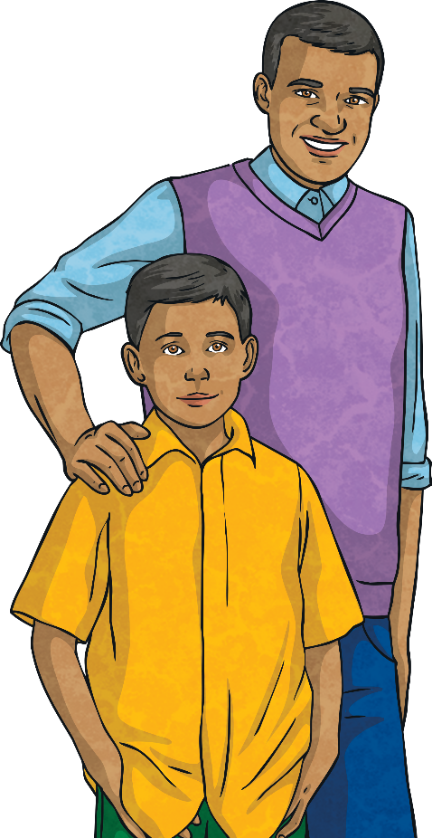
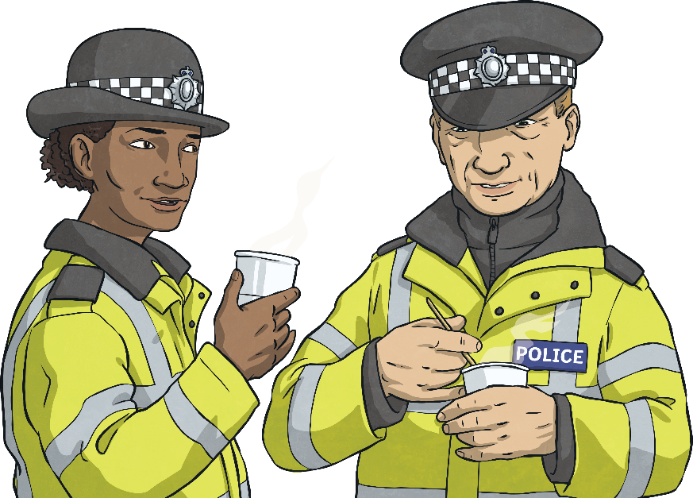
Being Respectful and Tolerant
It is important we live in a way which celebrates difference and makes sure we are treating all people fairly, with respect and kindness no matter who they are, where they are from, what they can or can’t do or how they choose to live their life.
If we see or experience behaviours which are not doing this, it is important to tell a trusted adult and ask for help to help make it stop.

Slide 18
Being Respectful and Tolerant
Take a moment to think about your answer to this question:
How can I show respect to those who are different to me? Write your ideas on a sticky note.
What a lot of wonderful ideas! Let’s all make sure we do these in our daily school life and in our local community.
Let’s do our bit to make the world a happier, more accepting and tolerant place - helping all people live the life they deserve.

Slide 19
The Big Questions

Slide 20
Why should we be respectful of others?
What is diversity and why is it important?
How could you use what you have learnt today in school?

Slide 21
Aim
I can describe a diverse society and talk about why it is important.
Success Criteria
I can interpret a diversity data table.
I can write a poem to explain and celebrate diversity.
I can identify ways to show respect to others.
I can discuss why showing respect and being tolerant is important.
I can explain what discrimination is, can describe behaviour which is prejudiced and know what to do if I see it happening.

Slide 23
Aim
I can explain what being British means to me and to others.
Success Criteria
I can express my ideas and opinions through words and drawings.
I can respect ideas and opinions which are different to my own.
I can explain what the benefits of living in a diverse community are.
I can reflect on how I can show care and concern for others.
This resource is fully in line with the Learning Outcomes and Core Themes outlined in the PSHE Association’s Programme of Study.

Slide 24
The Big Questions

Slide 25
What does being British mean to me?
Does ‘being British’ mean the same to all people?

Slide 26
Reconnecting

Slide 27
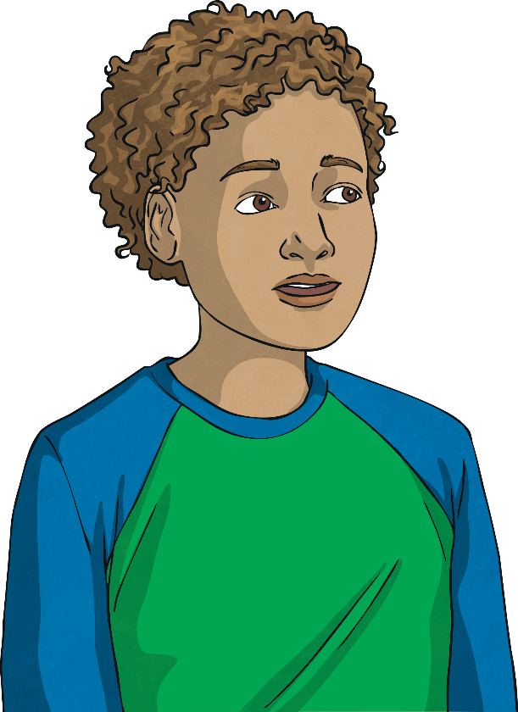
My View
What does being British mean to you?
Write your answers on a sticky note and once you have finished, stick it on the large piece of paper at the front of the classroom.
After we have all finished we are going to share some of your responses.
We have seen that within our class being British means something different to us all; this is exciting!

Slide 28
Exploring

Slide 29
A Wider View
Being British means different things to different people throughout Britain and other British Isles. This is because of the range of different people with different values and customs living here.
Although we have differences in our thoughts and ideas, we are all British citizens.
Being a British citizen means we have common rights and that we live under the same rules and laws. So, although we have different opinions, we have similarities too.
It is important to respect ideas and opinions that are different to our own; this makes us tolerant people and helps our country to be a happy place.

Slide 30
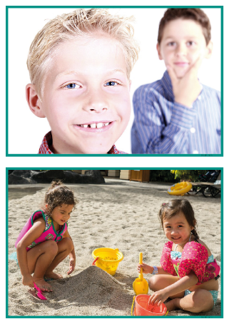
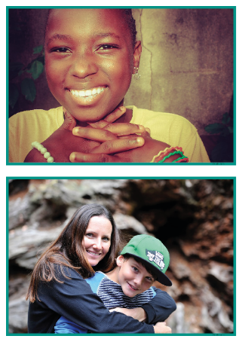
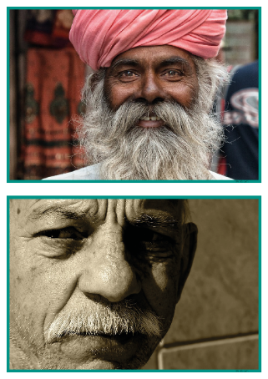
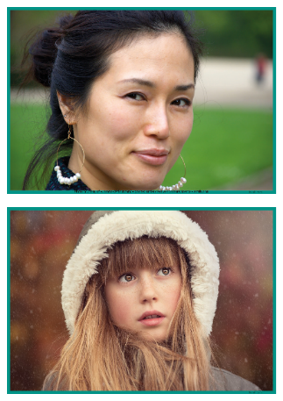
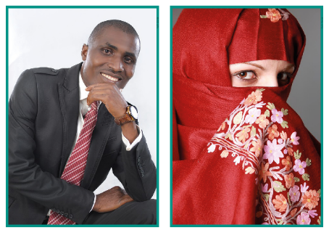
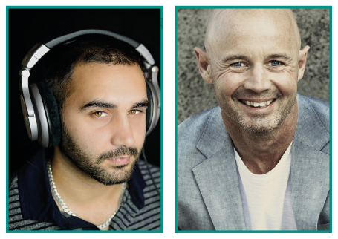
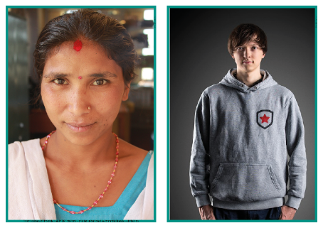
British Citizens
What does being British mean to different British citizens?
Work in a group to look carefully at a photograph of a British citizen.
In your group, discuss what being British might mean to the person in your photograph. Use these questions to help you decide.
Where might they live?
What might being British mean to them?
What might their job be?
What might they do in their free time?
How old do you think they are?

Slide 31
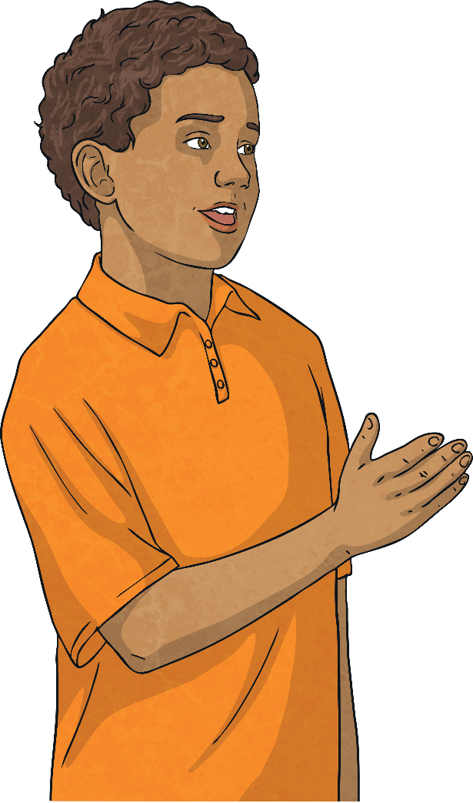
British Citizens
In your groups, show the rest of the class your photograph and share with them your thoughts.
Although ‘being British’ means something different to us all, these differences in our ideas and experiences are something to be celebrated. It is something that makes our country an exciting place to live.
Consolidating
Reflecting

Slide 32
Consolidating

Slide 33
Being British
What does being British mean to you?
What might being British mean to others?
You are going to draw pictures to show your answers to these questions.
Word Bank:
values
customs
beliefs
traditions

Slide 34
Reflecting

Slide 35
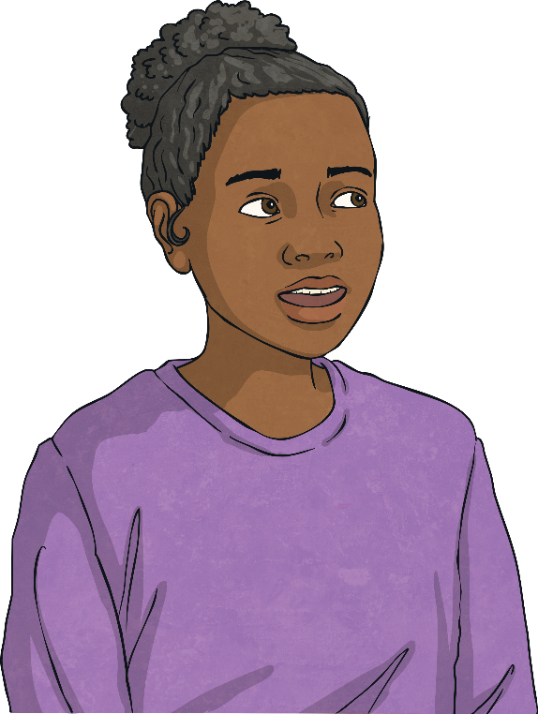
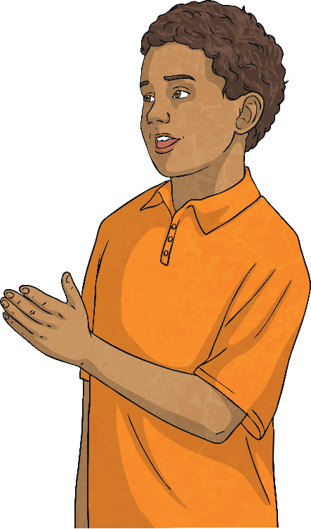
What I Have Learnt
We have come to the end of our work on Britain and being British and what a lot we have explored!
We have investigated what it is like to live in Britain and other British Isles and learnt all about democracy, rules, laws, liberty, tolerance and respect and why these are important for all British people.
Take a moment to think about your answers to these questions:
What is the most important thing you have learnt during this topic?
Have any of your views changed?
How are you going to use what you have learnt to help make the community you live in a happy place? How are you going to show care and concern for others in school and your local community?

Slide 36
The Big Questions

Slide 37
What does being British mean to me?
Does ‘being British’ mean the same to all people?
Have your answers to these questions changed from the
beginning of the lesson?

Slide 38
Aim
I can explain what being British means to me and to others.
Success Criteria
I can express my ideas and opinions through words and drawings.
I can respect ideas and opinions which are different to my own.
I can explain what the benefits of living in a diverse community are.
I can reflect on how I can show care and concern for others.

Slide 39
Prayer

