Slide 1
PSHE and Citizenship
Health & Wellbeing | Think Positive
PSHE and Citizenship | UKS2 | Health and Wellbeing | Think Positive | The Cognitive Triangle | Lesson 1

Slide 3
Aim
I understand the link between thoughts, feelings and behaviours.
Success Criteria
I can discuss and describe a range of thoughts, feelings and behaviours.
I can discuss the impact negative thoughts can have on ourselves and others.
I can turn negative thoughts into positive thoughts.
This resource is fully in line with the Learning Outcomes and Core Themes outlined in the PSHE Association’s Programme of Study.

Slide 4
The Big Questions

Slide 5
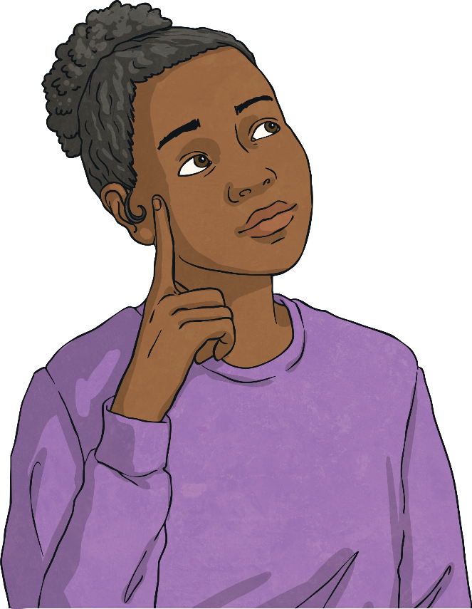
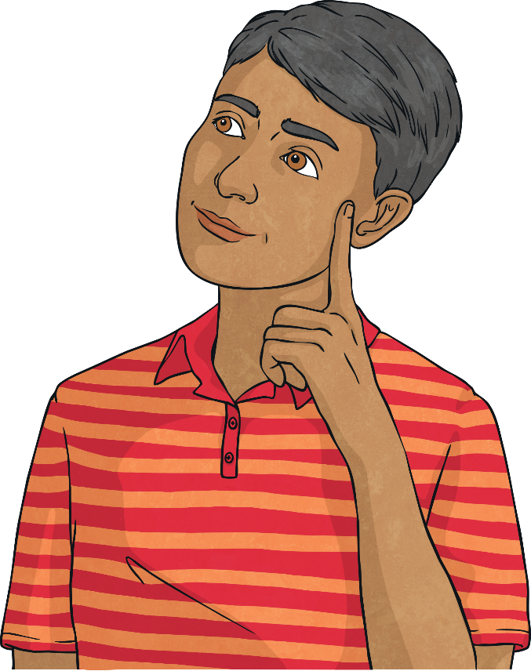
What are thoughts, feelings and behaviours?
How do thoughts, feelings and behaviours influence each other?

Slide 6
Reconnecting

Slide 7
Positive and Negative Thoughts
To start today’s lesson, we need to split into two teams.
1
One team is going to come up with as many positive thoughts as they can that someone might have in the morning, before school.
2
The other team is going to come up with as many negative thoughts as they can that a person might have in the morning, before school.
For now, just focus on the thought, rather than how the person might be feeling or what they might do.
Let’s share some of your ideas…

Slide 8
Exploring

Slide 9
Thoughts, Feelings and Behaviours
The different thoughts we have can trigger a range of emotions.
Think about the negative thoughts that we have just shared and look at the feelings words below. Think carefully about one of the negative thoughts and decide which feelings word best describes how you would feel if you had that negative thought.
worried
embarrassed
overwhelmed
angry
nervous
tearful
stressed
frightened
jealous

Slide 10
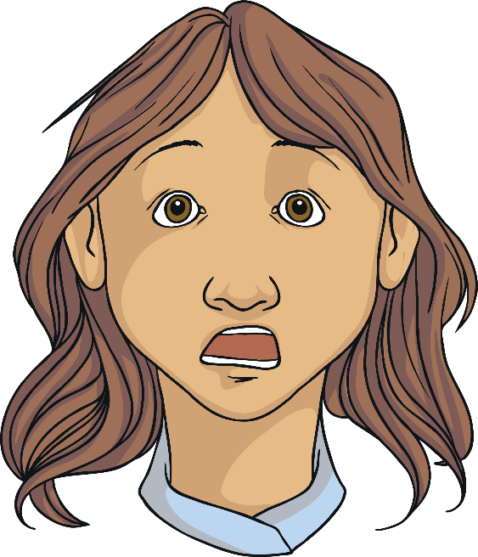
Thoughts, Feelings and Behaviours
Let’s look at an example of a negative thought that someone might have and how that thought might make them feel.
Oh no, it’s our class assembly today. I hate speaking in front of people.
What feelings will the person thinking this thought experience?

Slide 11
Thoughts, Feelings and Behaviours
The thoughts we have can make us feel a certain way.
And the way we feel can affect our actions (what we decide to do).
The child who is not looking forward to speaking in the class assembly is probably feeling nervous, worried, anxious and perhaps even frightened.
How might these feelings affect their actions?
What might they do?
Why might they behave in this way?

Slide 12
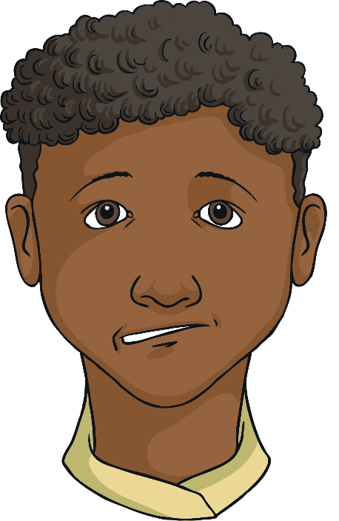
Thoughts, Feelings and Behaviours
The way we feel can influence our behaviour.
There are lots of things that might happen when someone is feeling nervous or anxious.
Something that often happens is that the person avoids doing the things that make them feel that way.
The child in our example might decide they simply cannot speak in the class assembly so they don’t participate.
This is called avoidance and it doesn’t help in the long run. If we keep avoiding things that make us feel bad, then we never get better at doing them and we don’t allow ourselves the chance to build confidence.

Slide 13
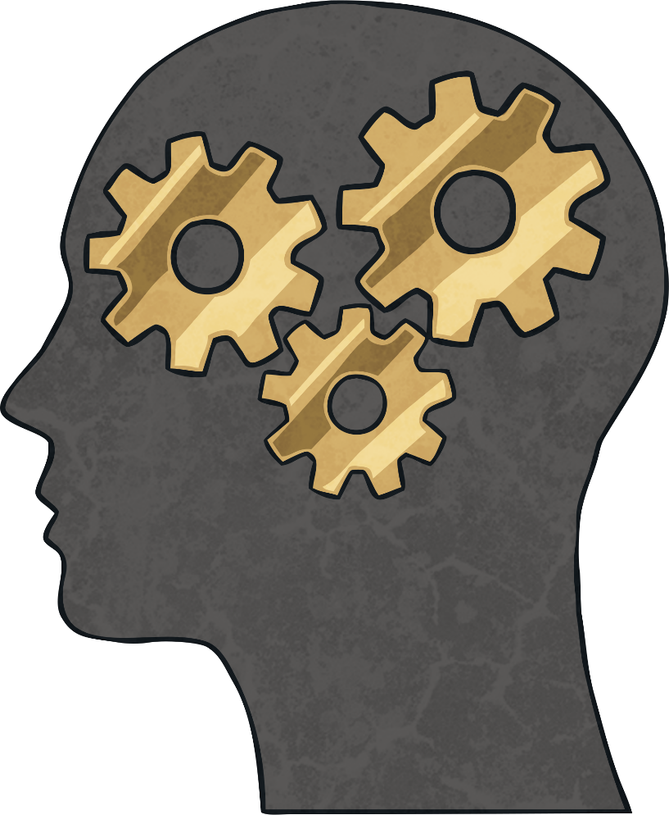
The Cognitive Triangle
What does cognitive mean?
The word cognitive relates to the process of thinking and other mental processes (things we do with our minds).
Our cognitive functioning includes memory, judgement, reasoning and emotional responses.

Slide 14
The Cognitive Triangle
Our thoughts, feelings and behaviours are all closely linked and each one affects the other two. It can be shown in a diagram using a triangle.
Thoughts
Feelings
Behaviours

Slide 15
The Cognitive Triangle
Let’s look at the example of the child and the class assembly.
I really can’t speak in the class assembly today.
What if I am sick on stage?
I’ve never done this before so I can’t do it.
I feel nervous and sick.
I won’t join in with the assembly today.
I never want to feel like this again so I won’t ever do it.

Slide 16
The Cognitive Triangle
What impact has this negative thought had on the child and their behaviour?
Will anyone else be affected by this child’s behaviour?
Will the negative thoughts help the child next time they are faced with a similar situation?
Impact on self
Impact on others

Slide 17
The Cognitive Triangle
The cognitive triangle can be positive or negative. If it is negative, it can be hard to break the cycle. Recognising that we are having negative thoughts and how they are impacting on our feelings and behaviour is the first step to changing it into a positive triangle.
Negative thoughts, feelings and behaviour
Positive thoughts, feelings and behaviour

Slide 18
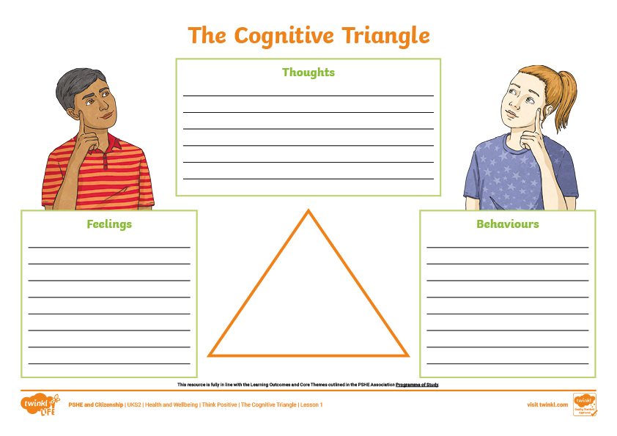
The Cognitive Triangle
You are all now going to have a go at fitting a scenario into the cognitive triangle by thinking about how our thoughts, feelings and behaviours can all be linked and can affect each other.
Look at the scenario that you and your partner have been given. Use the sheet to write down the thoughts, feelings and behaviours that the person in the scenario might experience.

Slide 19
Consolidating
Reflecting

Slide 20
Consolidating

Slide 21
The Chain Reaction
The way we think affects the way we feel and the way we feel affects the way we act or behave.
Our behaviour reinforces the way we think and so the chain goes on and on.
thought
feeling
behaviour
Today, you are going to make a paper chain, showing a typical negative thought that you have had, how it makes you feel and how you then react.

Slide 22
The Chain Reaction
Think carefully about a negative thought that you recently had or one you often have.
Write the thought on the top strip, then think about how that thought makes you feel.
Write that on the second strip, then consider how the thought and feeling might make you behave.
Write the behaviour on the last strip. Cut them out and fasten together to form a chain.

Slide 23
The Chain Reaction
Once you have made a negative paper chain, you are going to make a positive one on the same subject.
Think about how you could change the initial thought from a negative one to a positive one.
Consider how you would then feel differently and how you would behave differently.

Slide 24
Reflecting

Slide 25
Turn a Negative into a Positive
Let’s think again about the child who didn’t want to speak in the class assembly.
With your partner, discuss how the thought, feeling and behaviour could all be positive instead of negative.
Use your whiteboards, or spare paper, to draw a triangle and write the thought, feeling and behaviour on the three corners.

Slide 26
The Big Questions

Slide 27
What are thoughts, feelings and behaviours?
How do thoughts, feelings and behaviours influence each other?

Slide 28
Aim
I understand the link between thoughts, feelings and behaviours.
Success Criteria
I can discuss and describe a range of thoughts, feelings and behaviours.
I can discuss the impact negative thoughts can have on ourselves and others.
I can turn negative thoughts into positive thoughts.
This resource is fully in line with the Learning Outcomes and Core Themes outlined in the PSHE Association’s Programme of Study.

Slide 30
Aim
I understand the concept and impact of positive thinking.
Success Criteria
I can identify helpful and unhelpful thoughts.
I can name some strategies to deal with unhelpful thoughts.
I can generate positive affirmations.
This resource is fully in line with the Learning Outcomes and Core Themes outlined in the PSHE Association’s Programme of Study.

Slide 31
The Big Questions

Slide 32
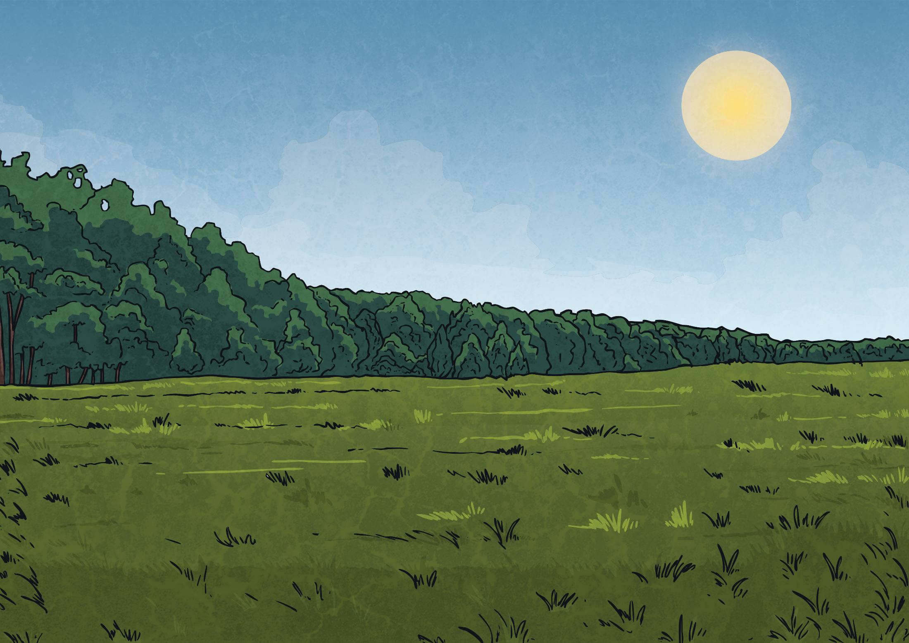
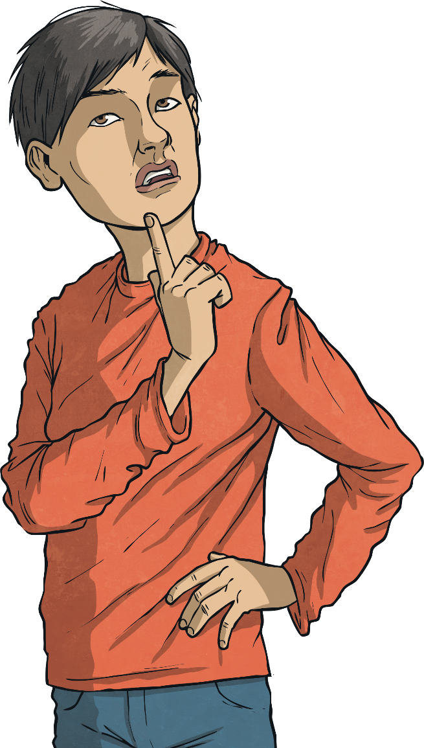
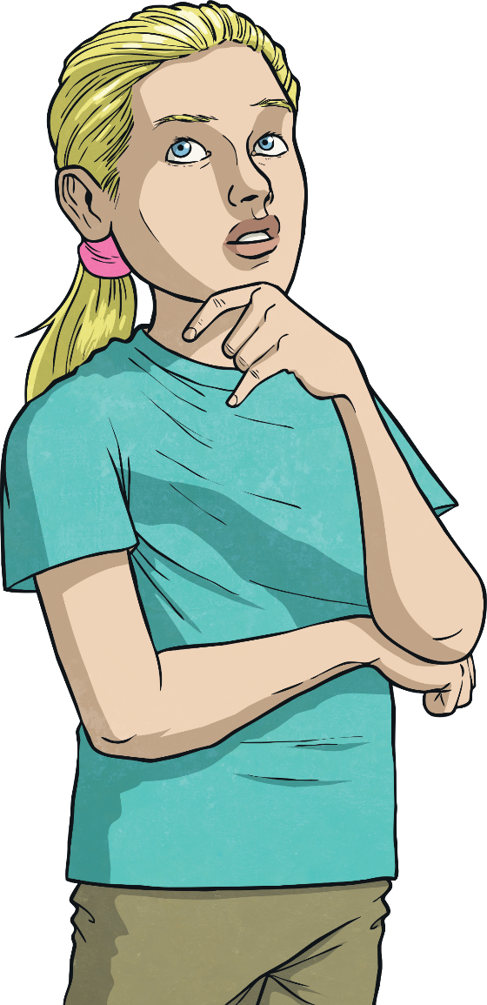
How do helpful and unhelpful thoughts affect the way we feel and act?
What should we do when we have unhelpful thoughts?
How can we encourage helpful thoughts?

Slide 33
Reconnecting

Slide 34
Penny for Your Thoughts
Have you ever heard the saying 'a penny for your thoughts'? It is said when one person is deep in thought and another person wants to know what they are thinking.
Our thoughts can be positive or negative and it is completely normal to have a mixture of both.
Sometimes we keep our thoughts to ourselves, especially the negative ones, but it can be good to share your thoughts with someone else. That’s why this expression can be a good one to use – it helps people to share their thoughts, instead of bottling them up.

Slide 35
Penny for Your Thoughts
On your penny, write a negative thought that you have had recently or one you often have…
It might be one where you are thinking something negative about yourself.
It might be a thought linked to a particular worry or fear.
It might be a negative thought about something that is going to happen.
Let’s share some of the negative thoughts you wrote down to make sure we are all clear about what a negative, or unhelpful, thought is.

Slide 36
Exploring

Slide 37
Unhelpful Thoughts
What is the impact of negative thoughts? After all, they are just thoughts!
With your partner, think of some consequences of negative thoughts…
Why might negative thoughts be called unhelpful thoughts?
How might they affect the way we feel?
How might they impact the way we act?
What might happen because of a negative thought?
Can negative thoughts affect those around us?

Slide 38
Unhelpful Thoughts
According to science, we tend to dwell on negative thoughts more than positive thoughts. This means they tend to stick around for longer in our minds. This is a real nuisance because those negative thoughts can cause us to produce stress chemicals in the brain which make us feel uncomfortable feelings.
When was the last time you felt any of these emotions?
self-doubt
panic
guilt
anger
worry
tearful
jealousy
stress
fear

Slide 39
Dealing With Unhelpful Thoughts
Unhelpful (or negative) thoughts are normal and are a part of life. It isn’t wrong to have them but we need to know what to do with them, especially if we seem to be having a lot of them!
There are different strategies that work for different people.

Slide 40
Dealing With Unhelpful Thoughts
Use worry dolls or a worry monster.
Share your thoughts with someone you love and trust.
Write your thoughts down in a thought journal.
Listen to the unhelpful thoughts and talk back to them.
Remind yourself that thoughts are not facts!
Next

Slide 41
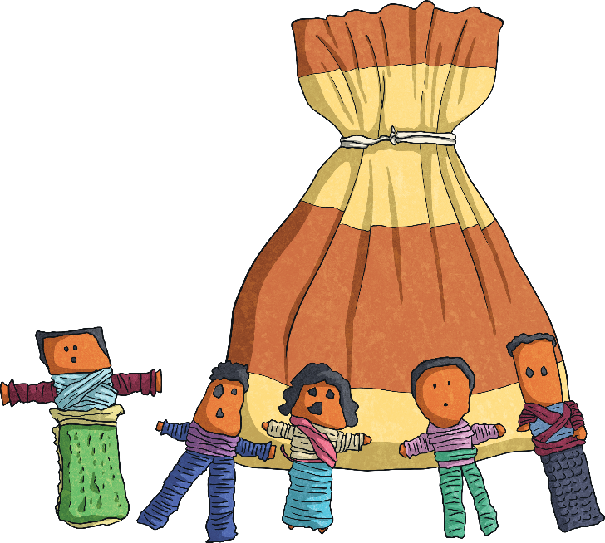
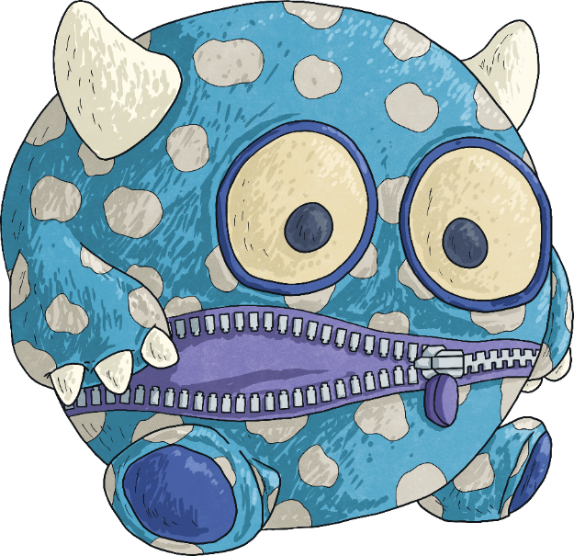
Worry Dolls and Worry Monsters
Back
Dealing With Unhelpful Thoughts
Many people tell their unhelpful thoughts to worry dolls. These tiny dolls originated in Guatemala. They are usually kept in a small bag or box and a lot of people keep them under their pillow. If you share the negative thoughts with the dolls, then put them under your pillow before you go to sleep, it can leave your mind clear to get a good night’s sleep.
Worry monsters work in a very similar way. Many children use worry monsters to eat up their unhelpful thoughts! They are cuddly toys who eat the worries you have written down on pieces of paper. A lot of people also use these at night before going to sleep.

Slide 42
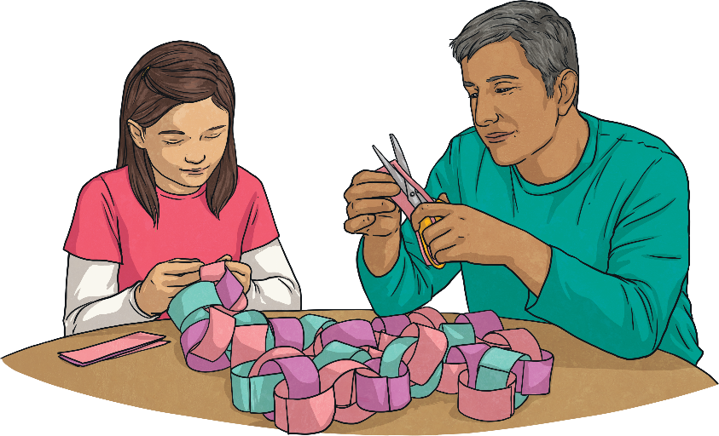
Dealing With Unhelpful Thoughts
Back
Sharing Thoughts with Others
Just as sharing your negative thoughts with worry dolls (or feeding them to a worry monster) can help get them off of your mind, telling them to someone else can also help.
Talking to a family member or a close friend about your worries or fears can often be a great way to deal with them. Other people may have some good advice or might be able to help you see that they are not as bad as you think they are.

Slide 43
Dealing With Unhelpful Thoughts
Back
Keeping a Thought Journal
Writing unhelpful thoughts down is a bit like sharing them with someone else. Although there is no one there to listen and give advice, it does help you to get them out of your head. When you read them back, they often don’t seem quite as bad and you can sometimes see a way to turn them into more helpful thoughts.

Slide 44
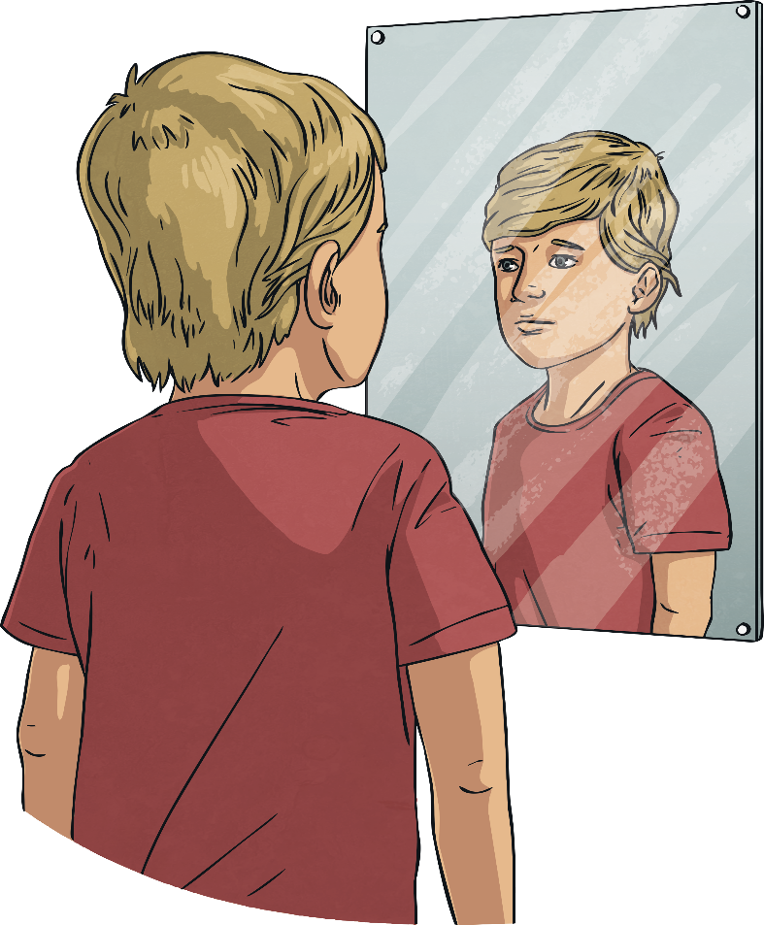
Dealing With Unhelpful Thoughts
Back
Talking Back to Unhelpful Thoughts
Even if you are on your own, with no worry dolls and nowhere to write your unhelpful thoughts down, you can learn to identify your negative thoughts and talk back to them.
You could maybe give your negative voice a name and imagine you are giving them the sort of advice you would give a friend if they shared these thoughts with you.
Remember, you don’t have to talk out loud – the thoughts are inside your head!

Slide 45
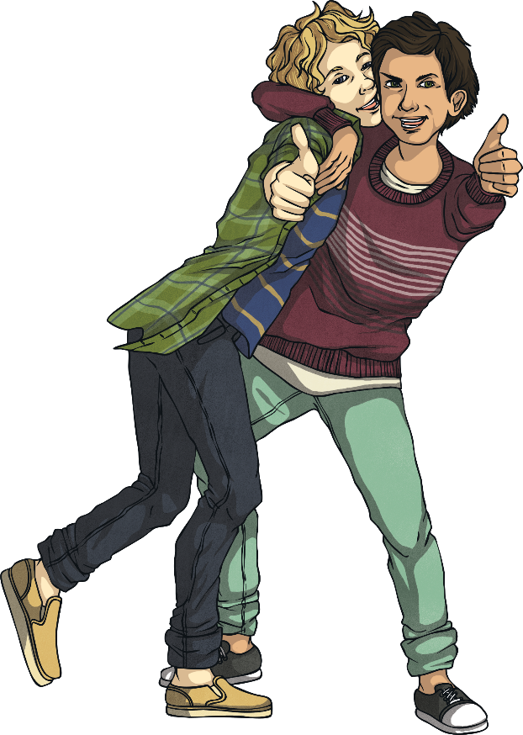
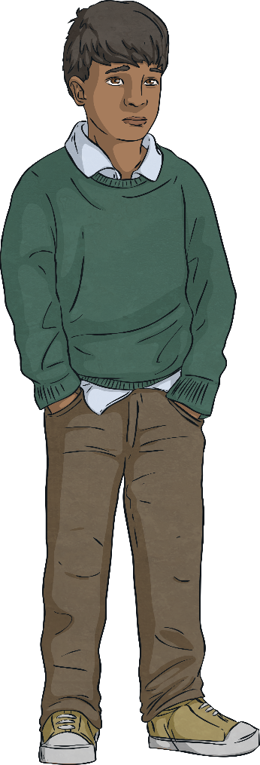
Back
Dealing With Unhelpful Thoughts
Thoughts Are Not Facts!
Negative thoughts can be very powerful and we tend to believe they are true, even if we have no real proof.
We might be thinking,
‘I am so stupid. I bet I am the only one who doesn’t understand this. I can’t ask the teacher because everyone will laugh at me.’
But that doesn’t make it true. Our thoughts come from within us and we all think differently. We all have different personalities and different opinions. Some people are more positive thinkers than others.
Remember, thoughts are not facts!

Slide 46
Developing a Positive Mental Attitude
So, how can we learn to be more positive and not have so many negative thoughts?
Like anything, if we can get into good habits and if we practise at it, we will get better at doing it.
We can use the techniques we have just learnt about when negative or unhelpful thoughts pop into our heads.
There are other things we can do too, to promote a healthy, positive mindset.
Can you think of anything that might help us have a more positive attitude?
Let’s take a look at some ideas…

Slide 47
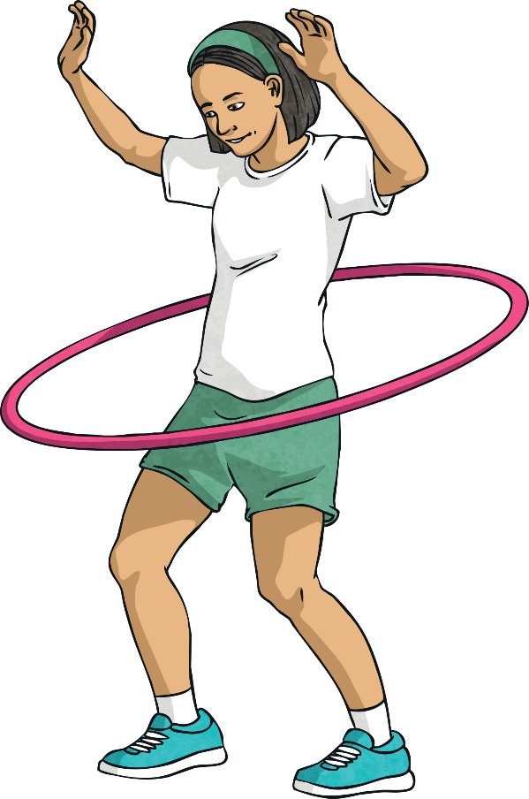
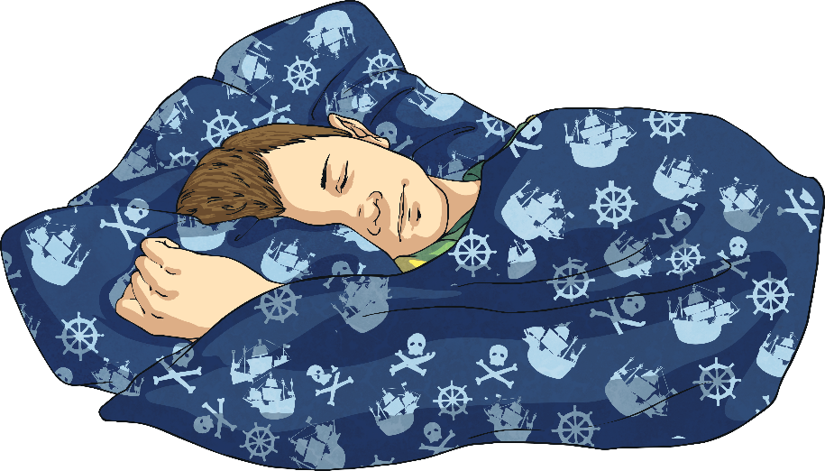
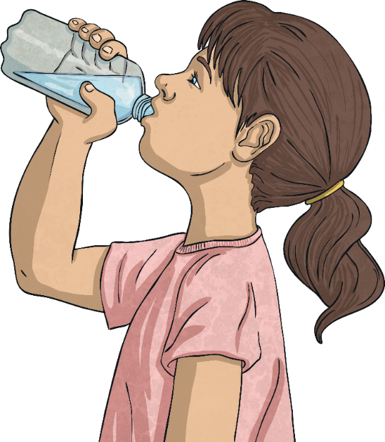
Developing a Positive Mental Attitude
Look After Your Body
Eat healthily – good food improves your mood!
Get plenty of exercise – exercise makes your brain release feel-good chemicals called endorphins.
Get enough sleep – it’s hard to stay positive when you’re tired and grouchy!
Drink enough water – when our body is dehydrated, it can affect our mood in a negative way.

Slide 48
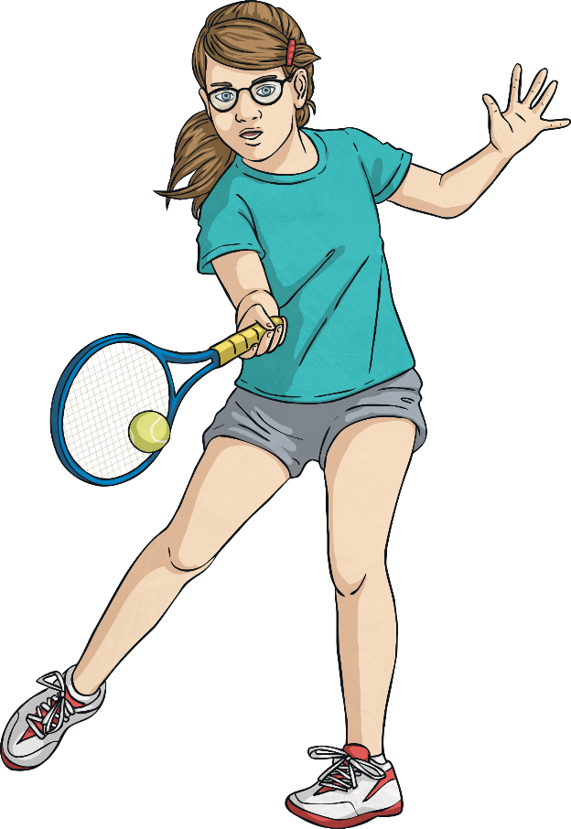
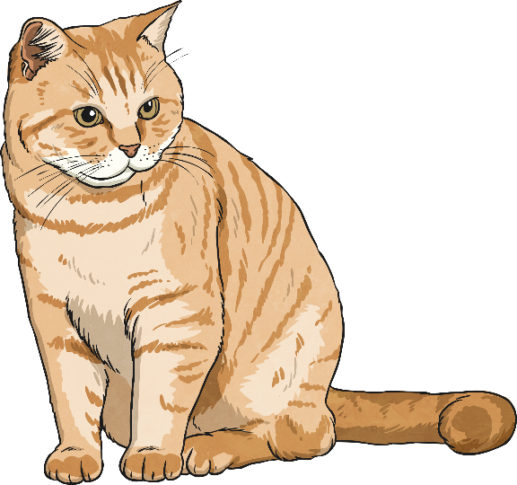
Developing a Positive Mental Attitude
Do the Things You Love
Doing the things you love doing can really help you to keep a positive mental attitude.
Maybe you have a favourite sport, a hobby or a pet to play with?
Maybe you love being with your friends or family?
Maybe you love to get stuck into a good book or watch a favourite film?

Slide 49
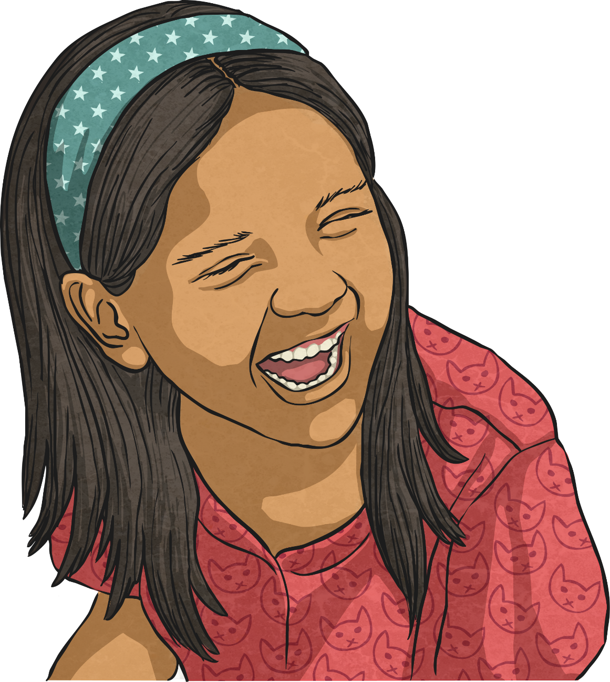
Developing a Positive Mental Attitude
Laugh Often
Laughing is really good for you!
Even just smiling can lift your mood!
So take the opportunity to share a joke, watch a funny video clip or tell a funny story.

Slide 50
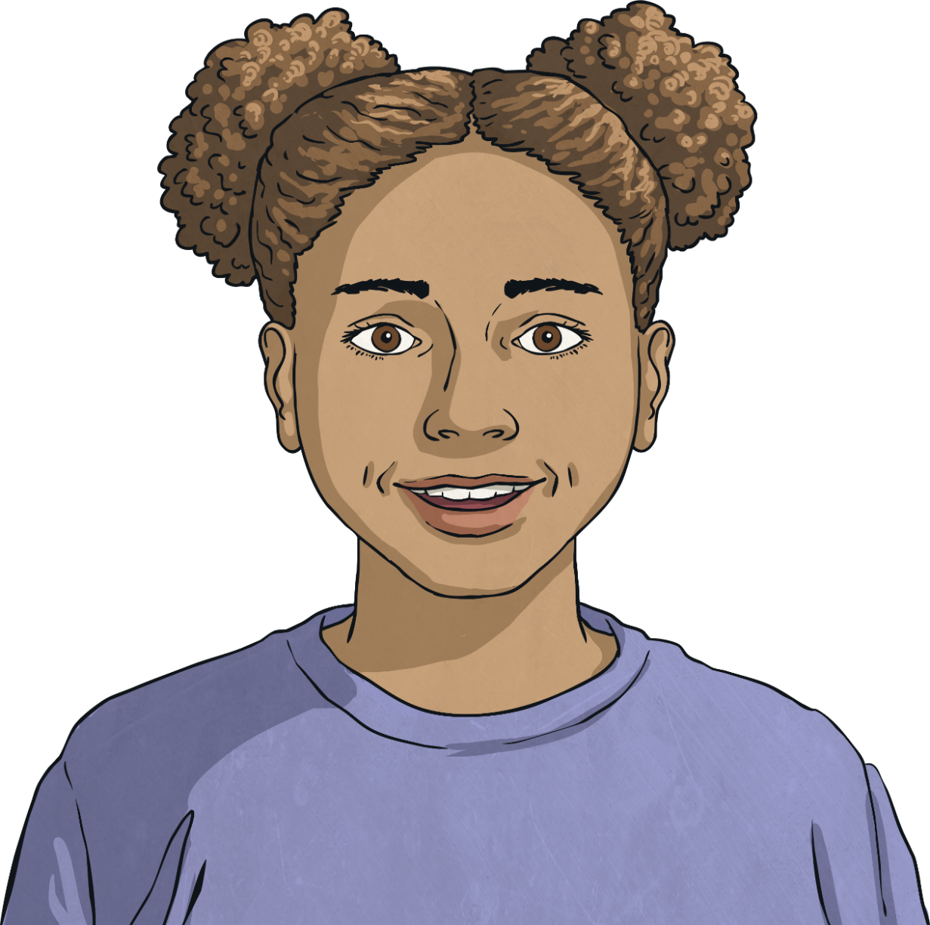
Developing a Positive Mental Attitude
Start the Day With a Positive Thought
Start as you mean to go on.
If you can start the day with a positive thought, the rest of the day may follow a positive path.
Think about something you are looking forward to each day and start the day with a smile!

Slide 51
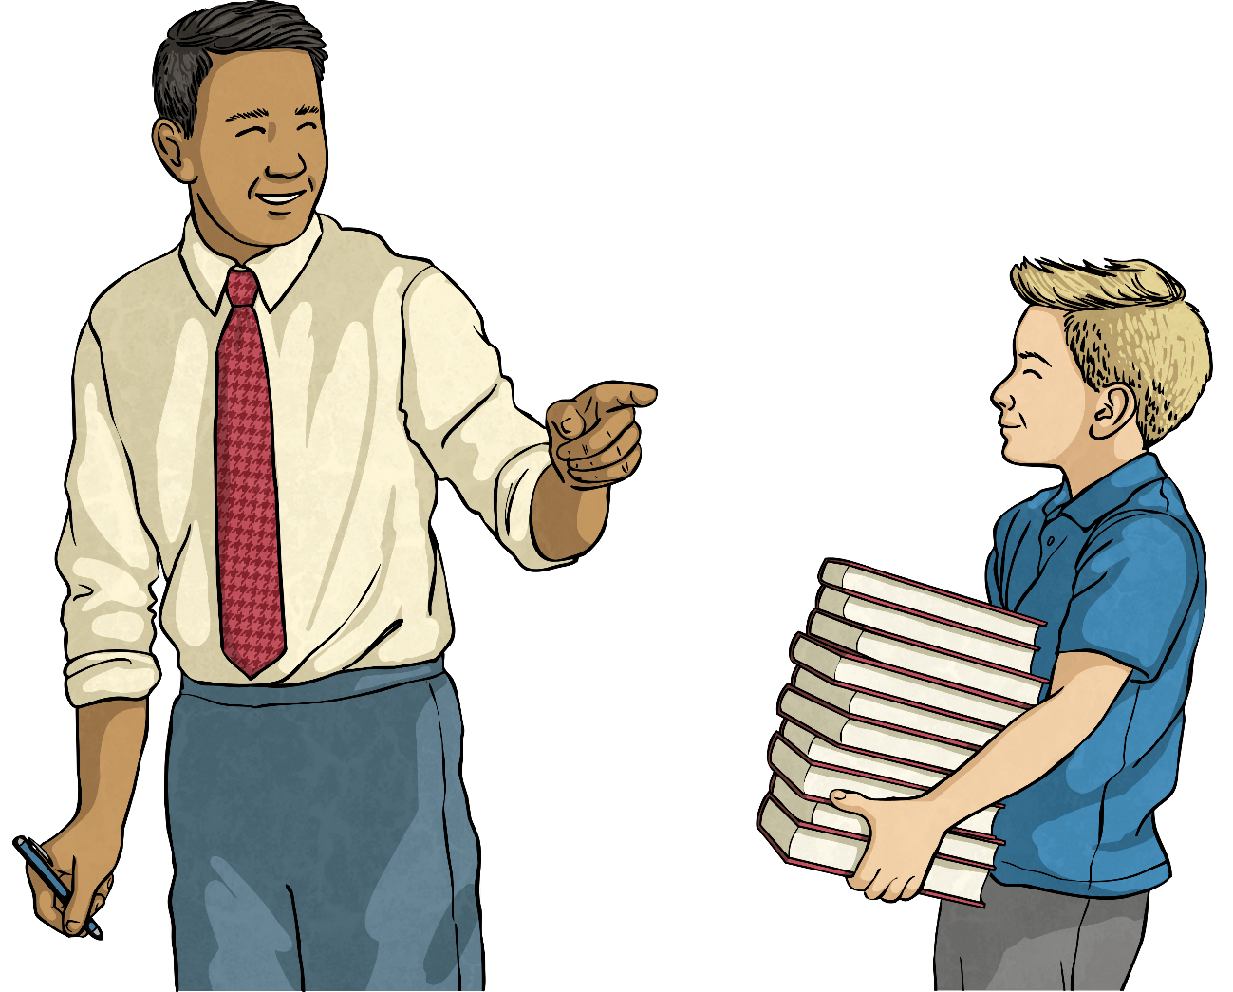
Developing a Positive Mental Attitude
Help Others
Doing things for others not only helps them but gives us a really good feeling.
Being a kind, caring and helpful person can really impact on your general outlook.
Give it a try and start today!

Slide 52
Consolidating
Reflecting

Slide 53
Consolidating

Slide 54
Positive Affirmations
A positive affirmation is a helpful thought that you can say in your head or out loud to get you feeling more positive.
The more we say these affirmations to ourselves, the more we believe them and the more positive we start to feel.
A lot of people use positive affirmations to help them develop a more positive mindset.

Slide 55
Positive Affirmations
Let’s look at some examples of positive affirmations (or helpful thoughts).
I am in charge of my life!
It’s OK to not know everything.
The best person I can be is me!
I can get through anything!
Today, I choose to be confident.
If I fall, I will get back up again.
I believe in myself.
I am going to try my best.

Slide 56
Reflecting

Slide 57
Thought or Fact?
Everyone will hate my new haircut!
I will never understand the rules of this game.
You can learn to think in a more positive way.
Exercise makes the brain release endorphins.
Laughing lifts your mood.
I will get better at this if I practise.
No one will like me if I say I enjoy puzzles and numbers.
You can talk back to negative thoughts with a positive voice.
I’ll always be rubbish at sport.

Slide 58
The Big Questions

Slide 59
How do helpful and unhelpful thoughts affect the way we feel and act?
What should we do when we have unhelpful thoughts?
How can we encourage helpful thoughts?

Slide 60
Aim
I understand the concept and impact of positive thinking.
Success Criteria
I can identify helpful and unhelpful thoughts.
I can name some strategies to deal with unhelpful thoughts.
I can generate positive affirmations.
This resource is fully in line with the Learning Outcomes and Core Themes outlined in the PSHE Association’s Programme of Study.

Slide 61
Prayer

