Slide 2
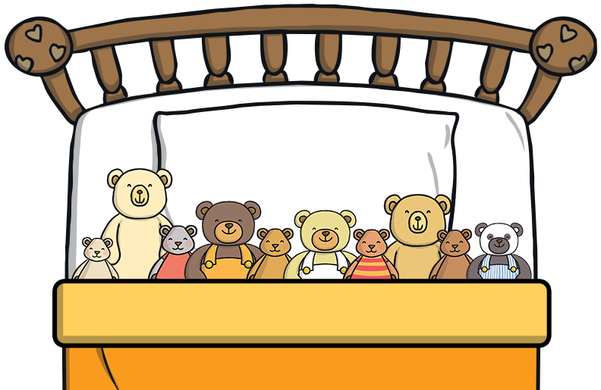
How many teddy bears are there in the bed?
1
2
3
4
5
6
7
8
9
10
There are 10 teddy bears in the bed.

Slide 3
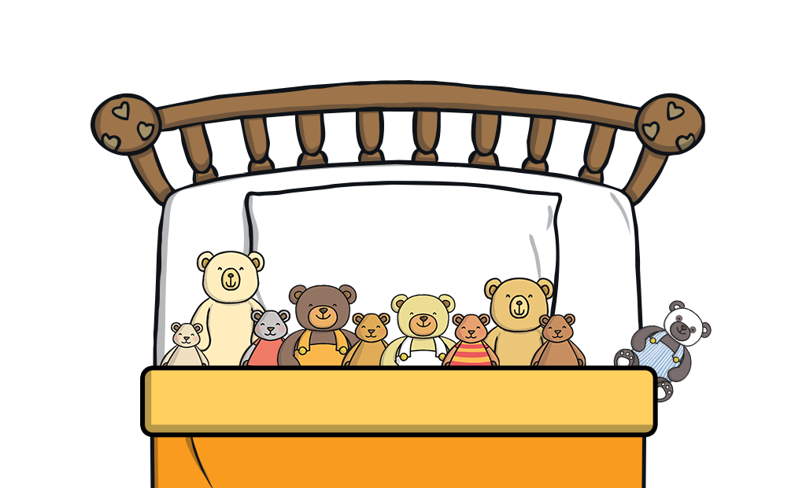
The teddy bears have rolled over and a teddy bear has fallen out of bed!
There are 9 teddy bears in the bed and 1 teddy bear has fallen out.
There are 10 teddy bears altogether.
9 + 1 = 10

Slide 4
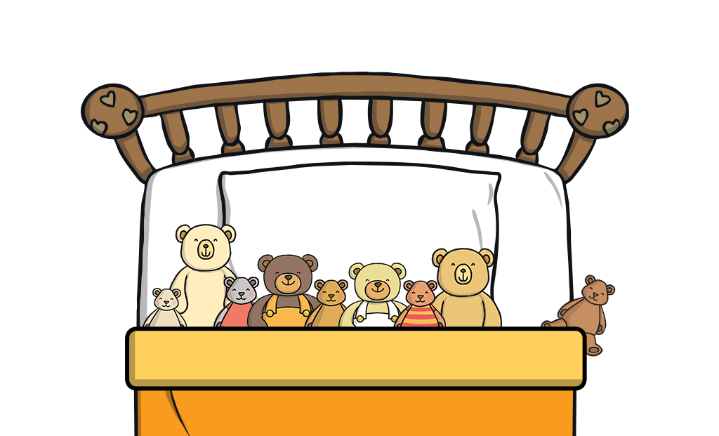
The teddy bears have rolled over and a teddy bear has fallen out of bed!
There are 8 teddy bears in the bed and 2 teddy bears have fallen out.
There are 10 teddy bears altogether.
8 + 2 = 10

Slide 5
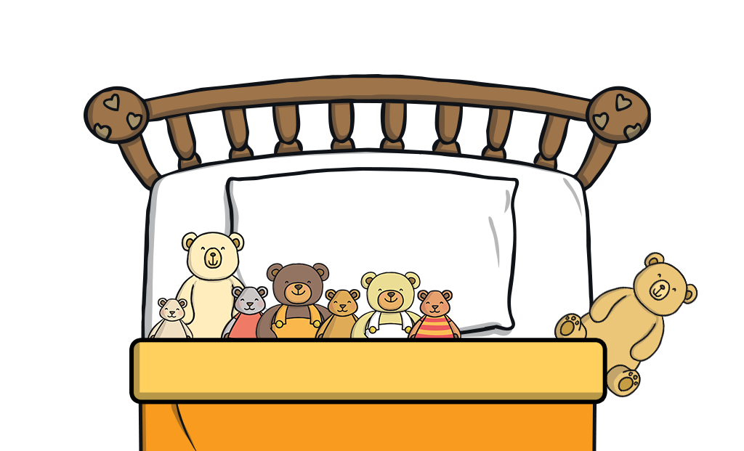
The teddy bears have rolled over and a teddy bear has fallen out of bed!
There are 7 teddy bears in the bed and 3 teddy bears have fallen out.
There are 10 teddy bears altogether.
7 + 3 = 10

Slide 6
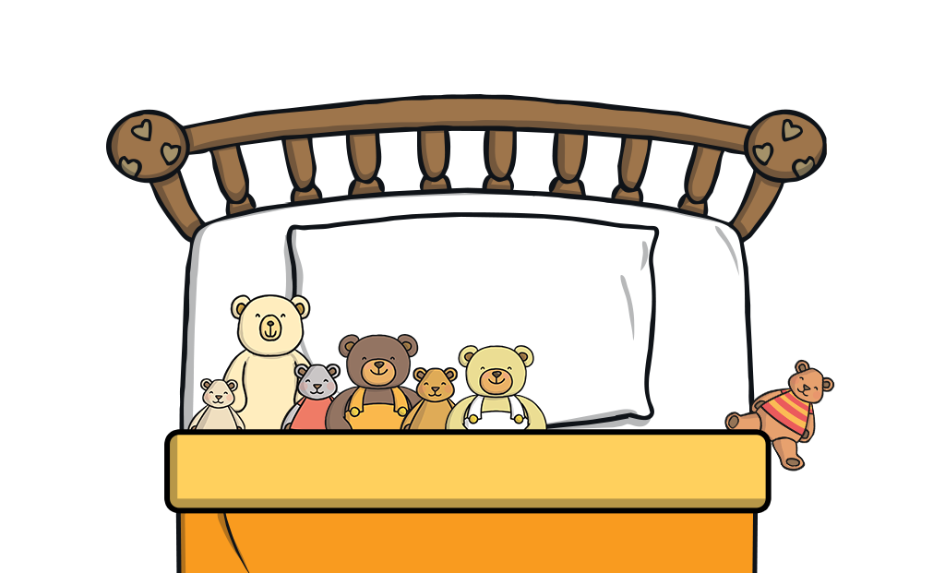
The teddy bears have rolled over and a teddy bear has fallen out of bed!
There are 6 teddy bears in the bed and 4 teddy bears have fallen out.
There are 10 teddy bears altogether.
6 + 4 = 10

Slide 7
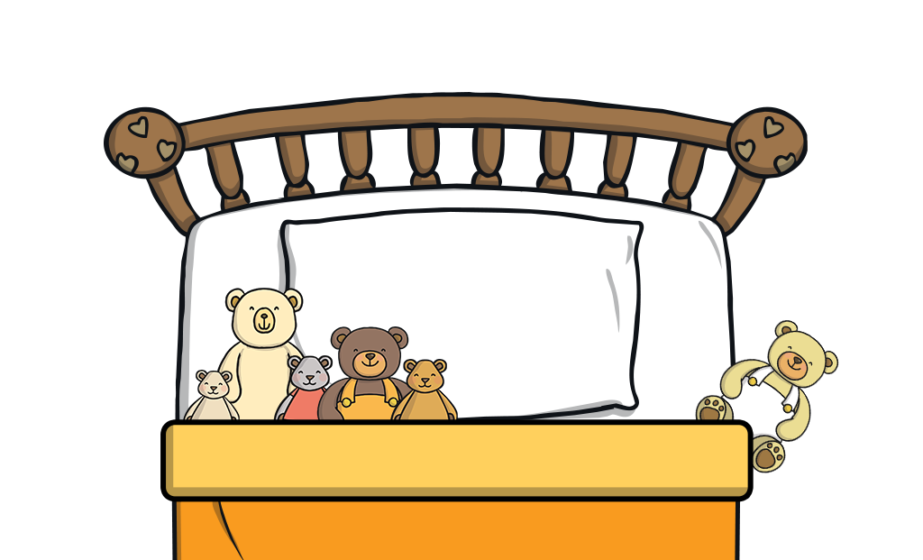
The teddy bears have rolled over and a teddy bear has fallen out of bed!
There are 5 teddy bears in the bed and 5 teddy bears have fallen out.
There are 10 teddy bears altogether.
5 + 5 = 10

Slide 8
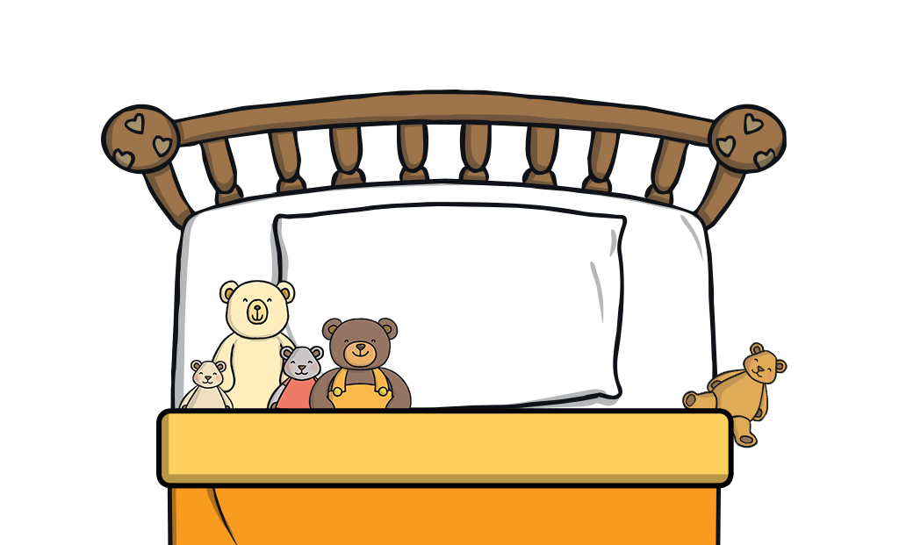
The teddy bears have rolled over and a teddy bear has fallen out of bed!
There are 4 teddy bears in the bed and 6 teddy bears have fallen out.
There are 10 teddy bears altogether.
4 + 6 = 10

Slide 9
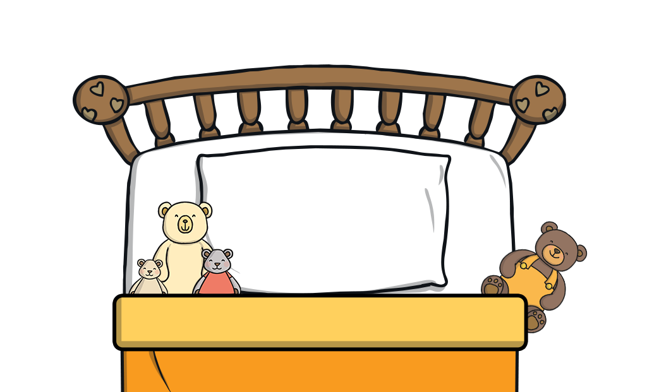
The teddy bears have rolled over and a teddy bear has fallen out of bed!
There are 3 teddy bears in the bed and 7 teddy bears have fallen out.
There are 10 teddy bears altogether.
3 + 7 = 10

Slide 10
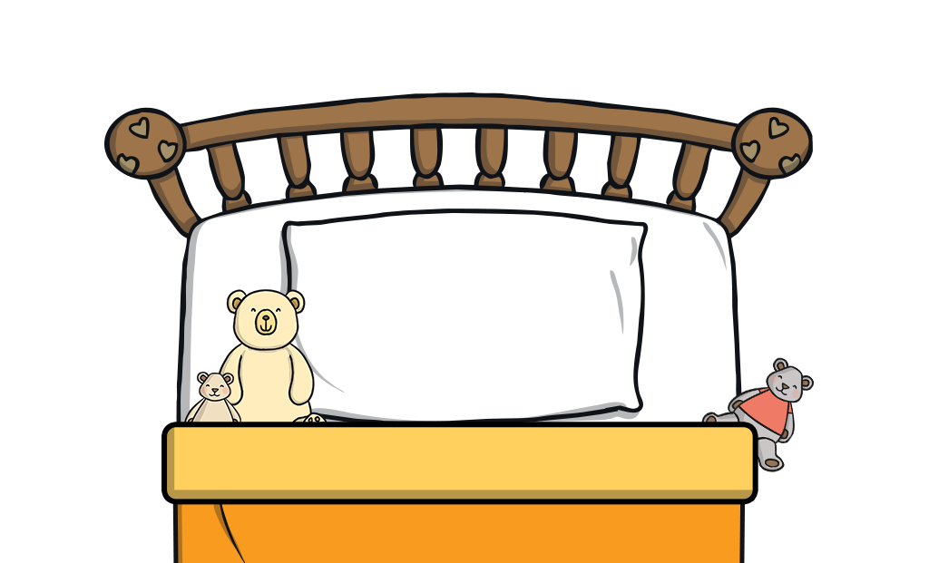
The teddy bears have rolled over and a teddy bear has fallen out of bed!
There are 2 teddy bears in the bed and 8 teddy bears have fallen out.
There are 10 teddy bears altogether.
2 + 8 = 10

Slide 11
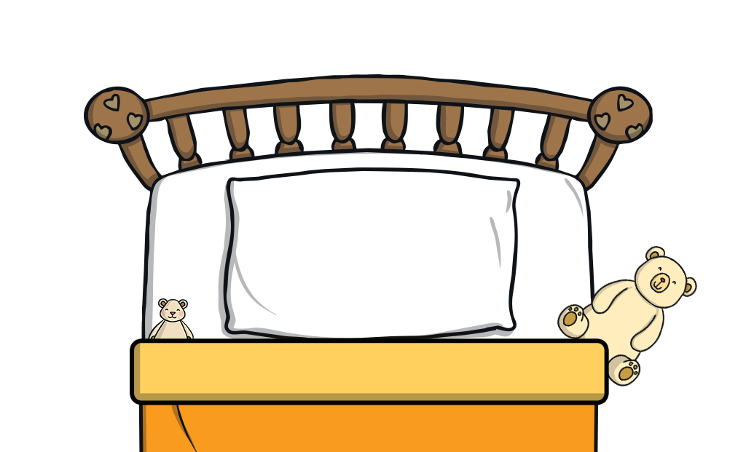
The teddy bears have rolled over and a teddy bear has fallen out of bed!
There is 1 teddy bear in the bed and 9 teddy bears have fallen out.
There are 10 teddy bears altogether.
1 + 9 = 10

Slide 12
Read these number bonds. Can you show the different ways of making 10 using your fingers?
There is 1 teddy bear in the bed and 9 teddy bears have fallen out.
There are 10 teddy bears altogether.
9 + 1 = 10
5 + 5 = 10
4 + 6 = 10
8 + 2 = 10
3 + 7 = 10
7 + 3 = 10
2 + 8 = 10
6 + 4 = 10
1 + 9 = 10

