Slide 1
INSTRUCTIONS FOR USE
We are more than happy for you to edit the
slides so that it fully meets the needs of your
class – this includes the images.
However the resource must not be distributed
to others, edited or not, without written
permission from The Primary Teacher Resource
Centre.
We hope you find the resource useful.

Slide 2
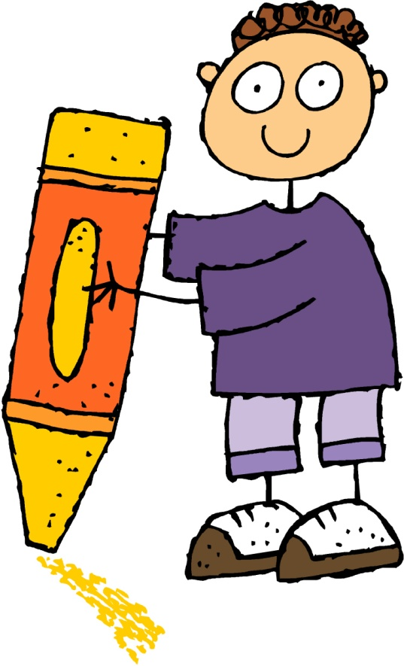
TEACH, PRACTISE, EXTEND
SYNONYMS

Slide 3
TEACH
Synonyms are words that have similar meanings.
For example:
hard – difficult huge – enormous old – ancient
safe – secure thin – lean rich – wealthy
Synonyms are used to make writing more interesting and descriptive. If you were to use the same words over and over again your writing would be really boring to read.
The word said is often over used in writing. Have your tried using some of the following words?
exclaimed, whispered, cried, announced, shouted, boasted, claimed, questioned, requested, urged.

Slide 4
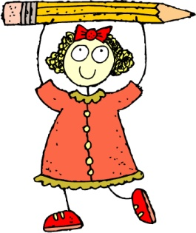
PRACTISE
Write synonyms for these words.
sad - _____
noisy - _____
clever - _____
high - _____
new - _____
quick - _____
safe - _____
dirty - _____
begin - _____
scare - _____
friendly - _____
break - _____
wet - _____
finished - _____
simple - _____
strange - _____

Slide 5
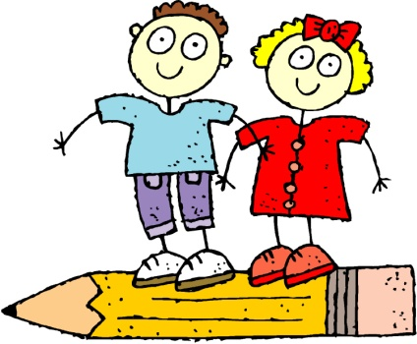
EXTEND
In each question below there are two words that are synonyms. Can you find them?
absurd, endured, lavish, ridiculous, lenient
surreal, dreary, tender, dismal, hapless
mischievous, subdued, angelic, impish, determined
forlorn, despondent, ecstatic, jealous, crustacean
counterfeit, origin, exact, symbolic, meticulous
Write the synonyms for the words below and then put both
words in a sentence.
intricate - ______
repair - _____
humble - _____

