Slide 1
PSHE and Citizenship
Relationships | Digital Wellbeing
PSHE and Citizenship | KS1 | Relationships | Digital Wellbeing | Staying Safe Online | Lesson 3

Slide 3
Aim
I know how to stay safe online.
Success Criteria
I can identify different ways we use the Internet.
I can describe some of the risks of going online.
I can tell others about Internet safety rules and explain how they help us to stay safe online.
I know how to get help if anything online worries or frightens me.
This resource is fully in line with the Learning Outcomes and Core Themes outlined in the PSHE Association’s Programme of Study.

Slide 4
The Big Questions

Slide 5
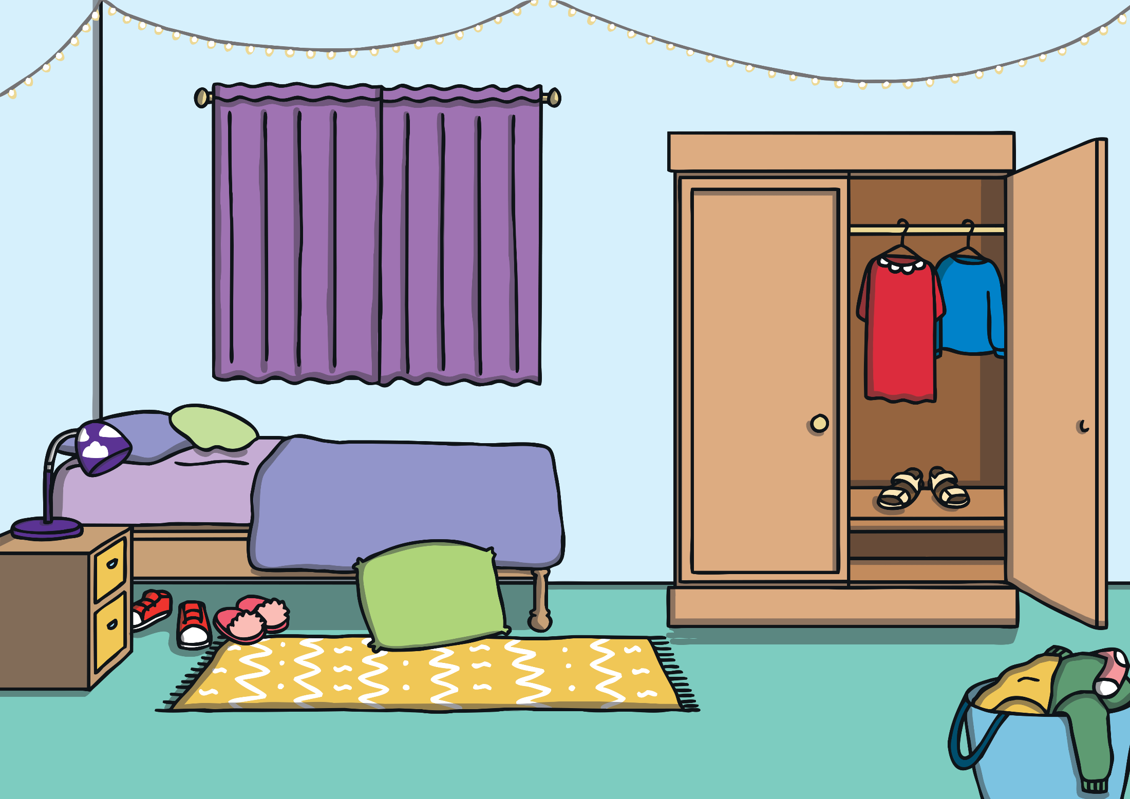
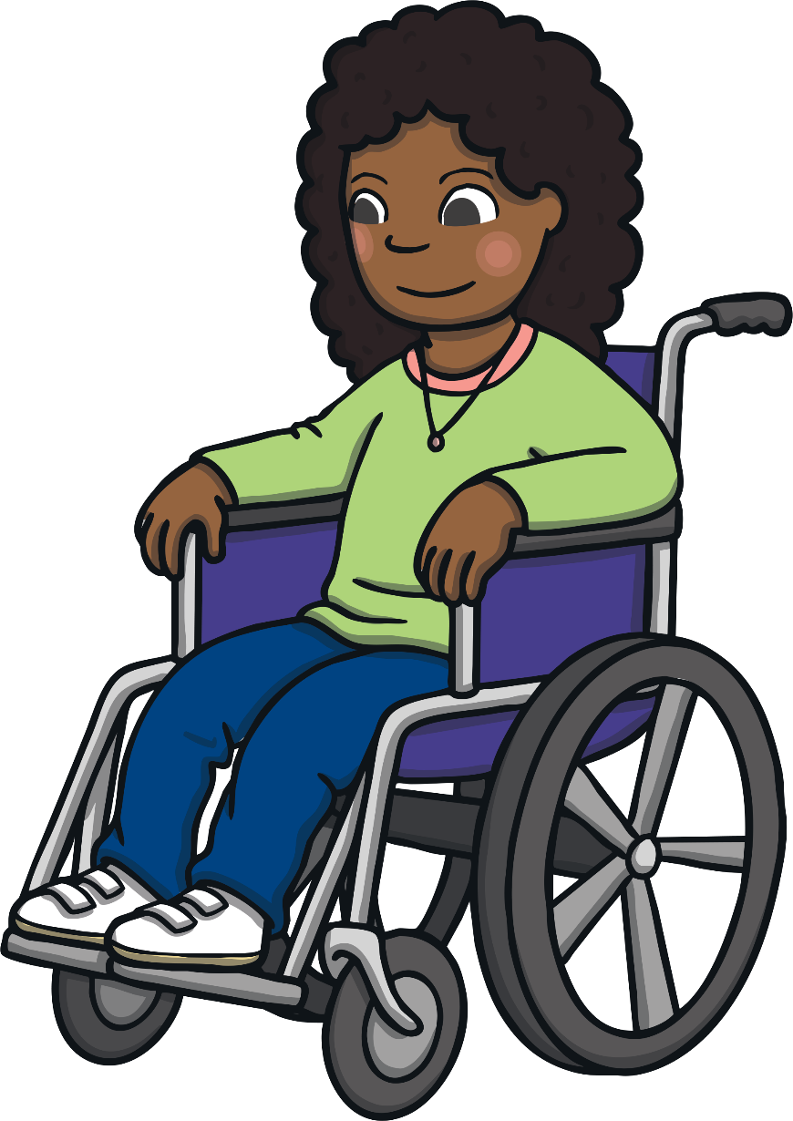
What are the risks when we go online?
What can I do if I feel frightened?

Slide 6
Reconnecting

Slide 7
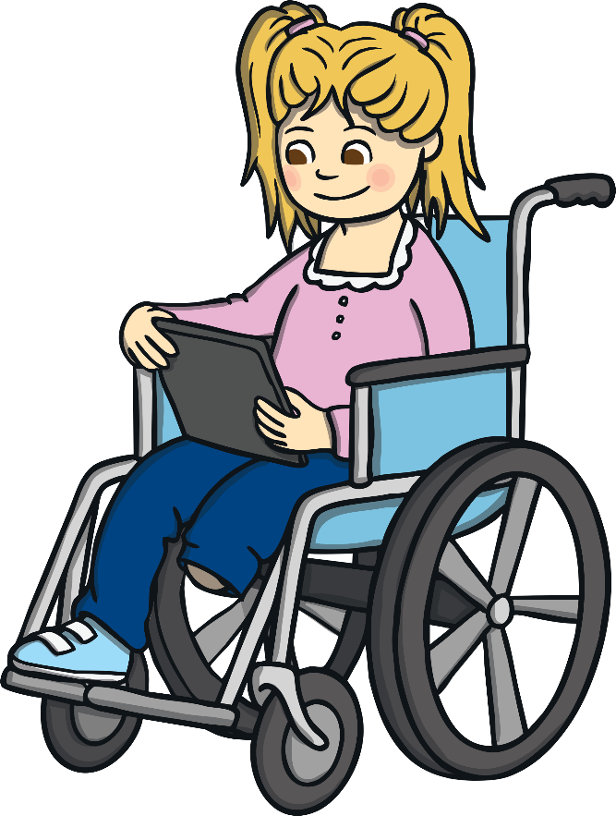
Name That Activity
The Internet can be very useful for lots of things.
We will now play a game to show lots of different ways we can use the Internet.
Working in small groups, you will be given a set of Internet Uses Picture Cards to play a game of charades with.
Share out the cards without showing anyone else what is on each card. You now need to act out the use of the Internet that is on your card without speaking.
When the rest of the group guess what you are doing, move on to the next player.
Wow! What a lot of fun and useful ways there are to use the Internet.

Slide 8
Exploring

Slide 9
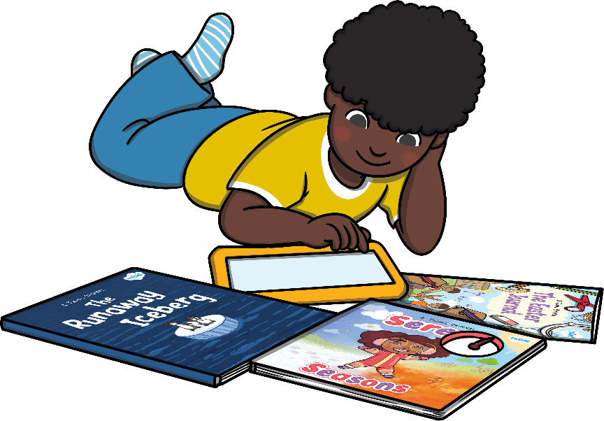
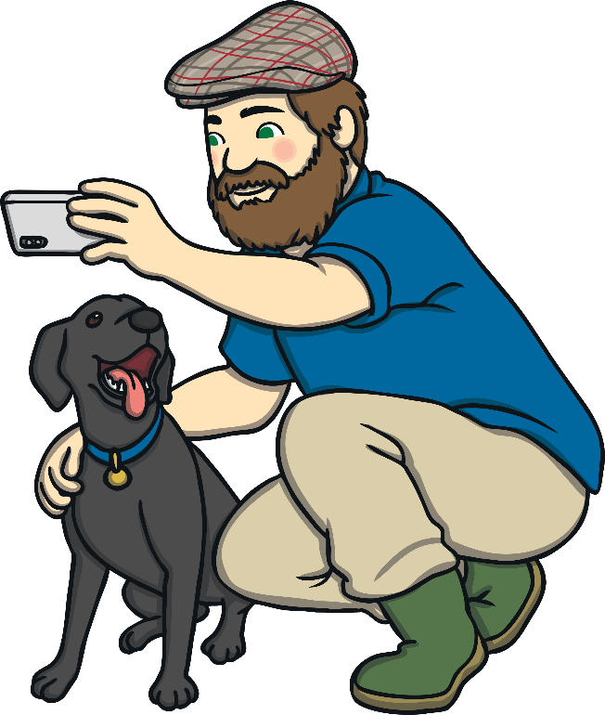
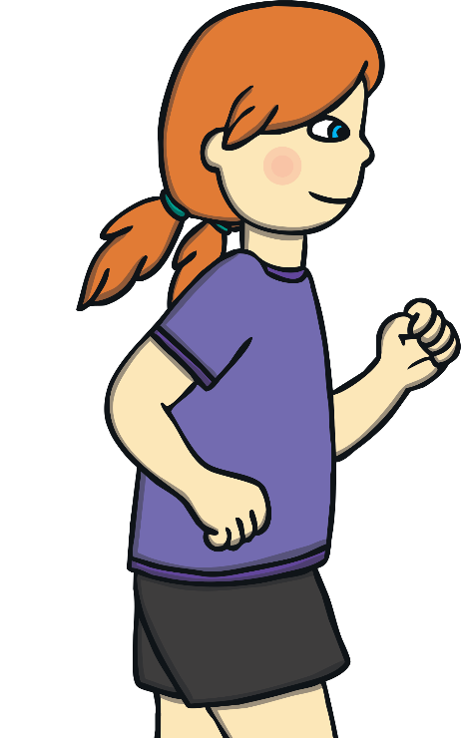
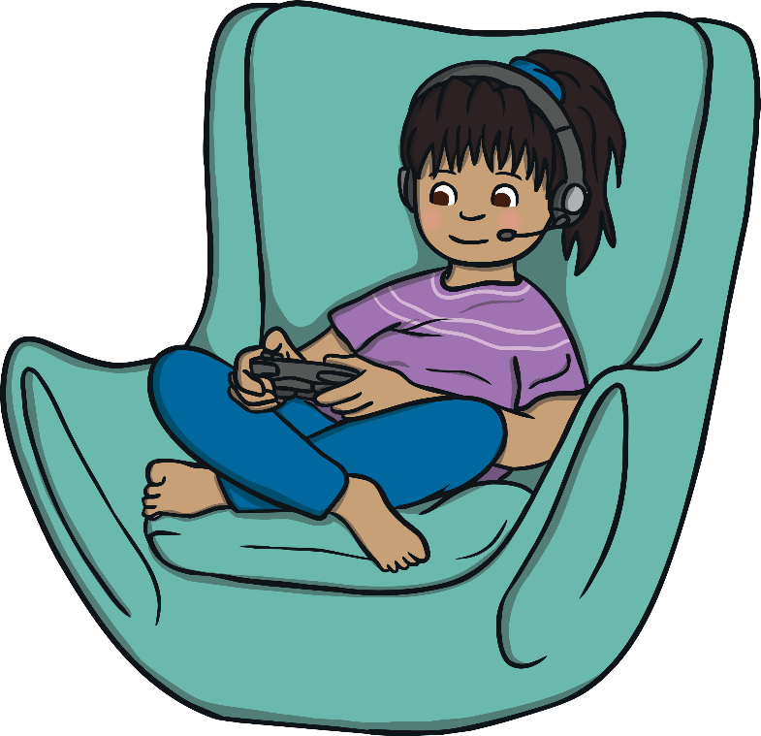
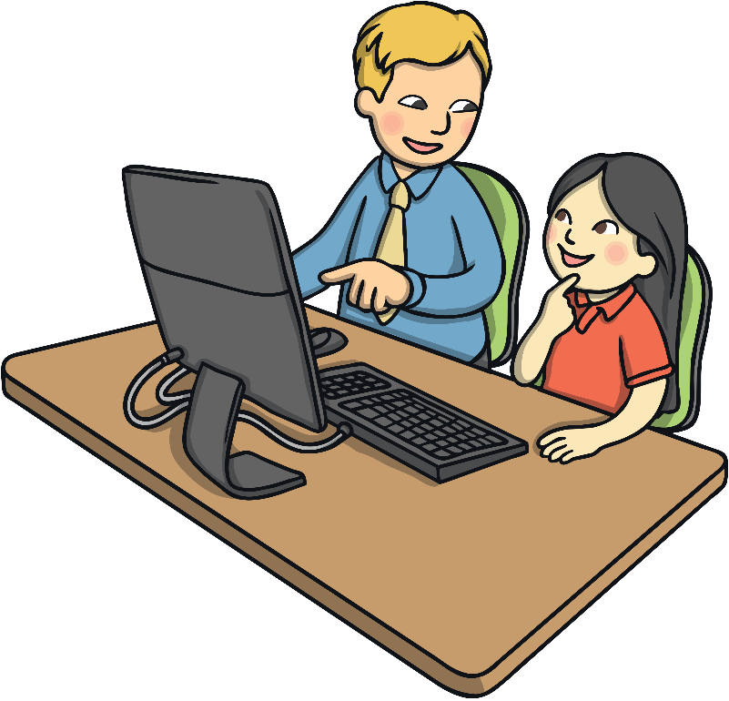
What’s the Risk?
As we have just seen, there are lots of ways we can use the Internet.
We might use it to:
find information;
learn;
play games;
message friends or family;
video call friends or family;
track physical activity.
When we use the Internet, there are some simple things to remember about how to stay safe.
We need to do this because the Internet isn’t actually owned by anyone so anybody can upload or share any information they want to.

Slide 10
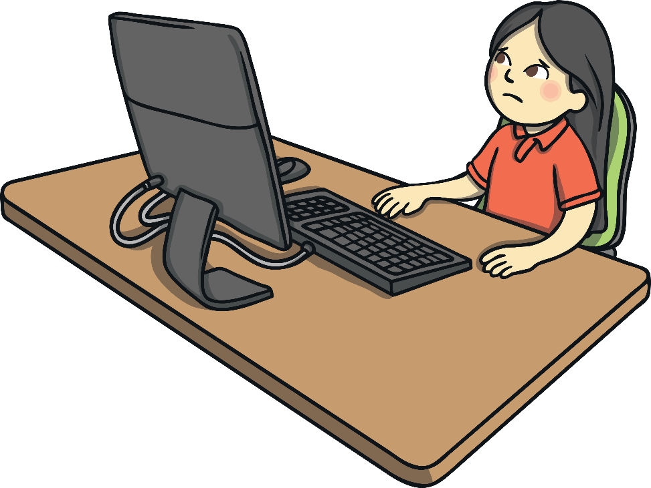
What’s the Risk?
To work out what is suitable, it is helpful to choose websites and apps we can use with the support of a trusted adult.
This way, you can be sure they are meant to be used by children of your age.
We can also make sure we stay safe on the Internet by remembering a few simple rules.

Slide 11
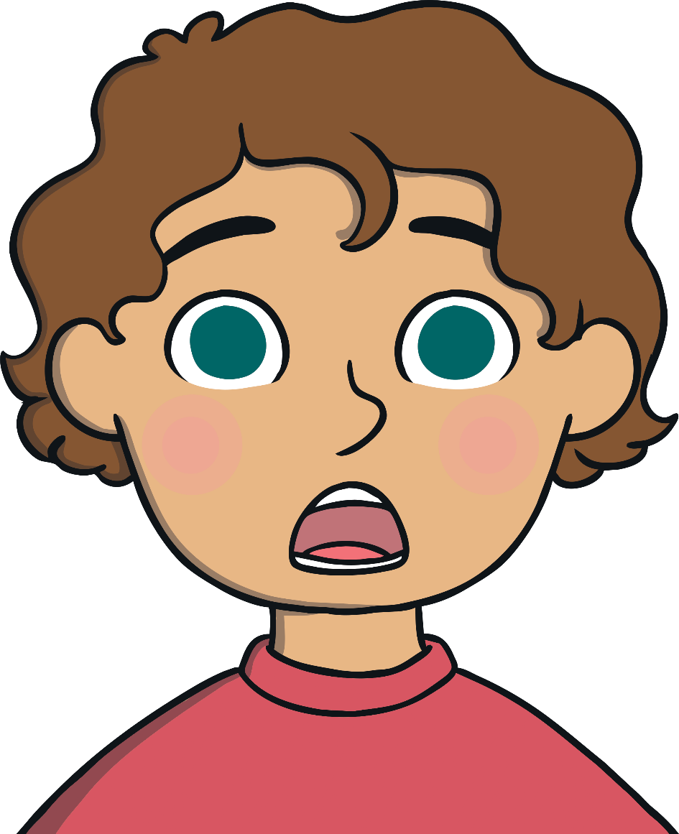
What’s the Risk?
Seeing something that is not appropriate for our age.
Some games or videos have age restrictions. This means you shouldn’t play or look at them if you are not above a certain age. It might contain things that are scary or not suitable.
18
If we see an age restriction on a video or game and we are not yet that age, it means the content is not appropriate for us. Tell a trusted adult straight away if you see something that is not appropriate and they can help.

Slide 12
What’s the Risk?
Downloading apps that appear on screen without knowing what they are.
Sometimes when we are on the Internet, links appear that we can click. These are not always from trusted websites and might ask you to download an app or video that you don’t want to.
Click here!!
To stay safe online, don’t click links that appear. Tell a trusted adult straight away and they can help.

Slide 13
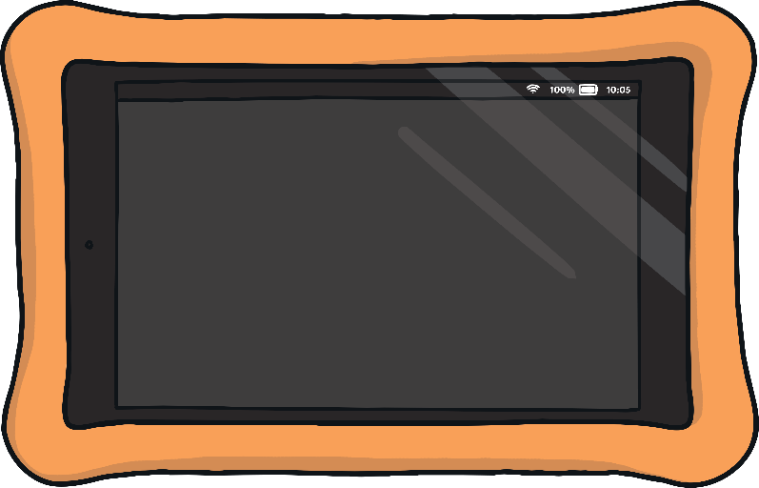
What’s the Risk?
Getting messages from people we don’t know.
If we play games online, we might be able to chat to people we know. It is important not to message or chat to people we don’t know as people might not be who they say they are.
If we were out and about and a stranger talked to us, we wouldn’t talk to them and we’d tell a trusted adult. The rule is just the same online.
How are you?
…
To stay safe online, tell a trusted adult straight away if anyone you don’t know messages you. Never share any personal information, such as your name, age, address, where you go to school or any photographs of yourself, when you are online.

Slide 14
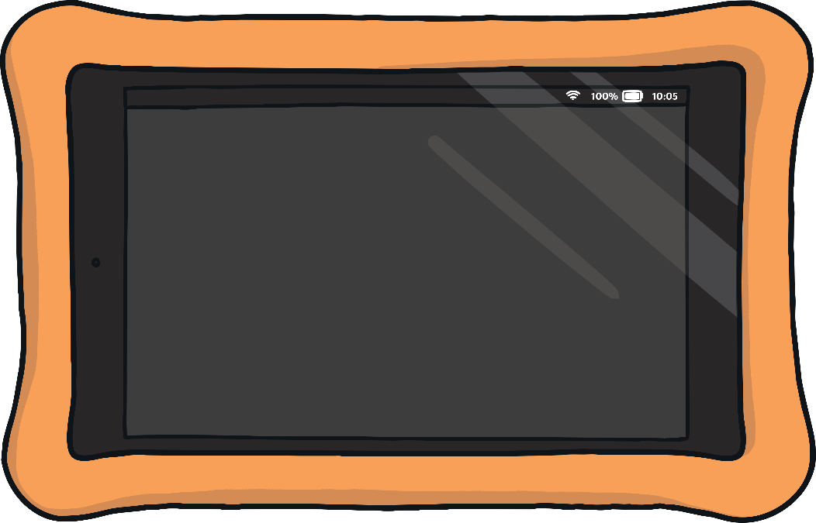
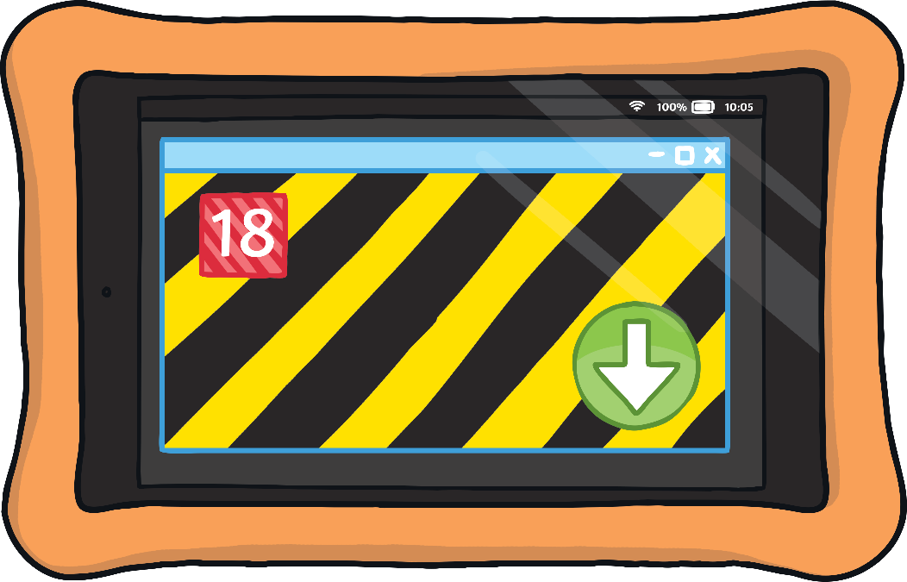
What’s the Risk?
A video that is not appropriate popping up on the screen.
Sometimes, a link to a video might appear when we are using the Internet. This may show you a video that is not suitable for children.
Watch this!
To stay safe online, don’t click on any videos or links that appear. Tell a trusted adult straight away and they can help you.

Slide 15
What’s the Risk?
To stay safe online, let’s make sure:
We get help from a trusted adult to choose websites and games that are suitable for our age.
Nothing we see or do online should make us feel uncomfortable, worried, sad or frightened.
We only play games and watch videos that are for our age group and never play or watch things that are for older children or adults.
We never click links that appear by themselves. If this happens, we must get help from a trusted adult.
If this does happen, speak to a trusted adult straight away.
We never chat to or message people we don’t know. If an online stranger talks to us, we must get help from a trusted adult.
We always treat people with kindness and respect and expect them to treat us the same way too.
We remember to balance our time online with offline activities to keep our mind and body healthy.

Slide 16
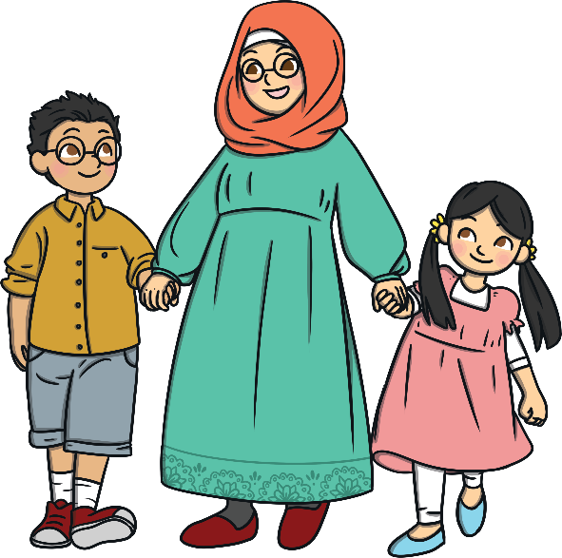
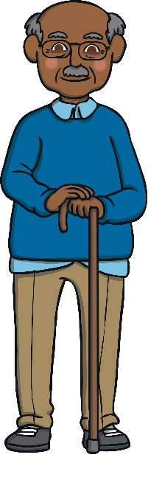
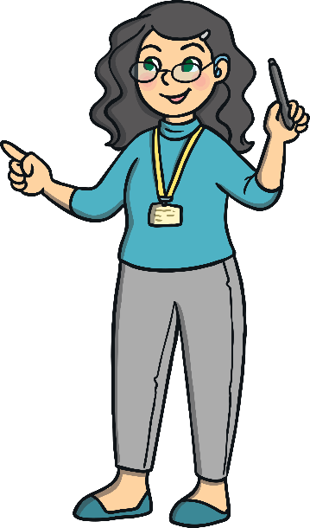
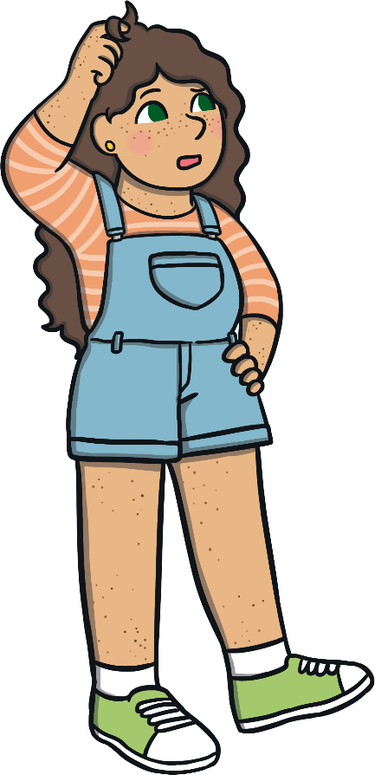
What’s the Risk?
Our trusted adults can help us to stay safe online. They can help us to choose what websites and apps to use and can help if we need it when we are using the Internet.
Let’s think about who our trusted adults might be. These are people we feel safe with and who we are able to share our thoughts and feelings with. They are the people who keep us safe and help us to feel happy and healthy.
Take a moment of quiet to think about an adult you trust and who you could ask for help if you needed to.

Slide 17
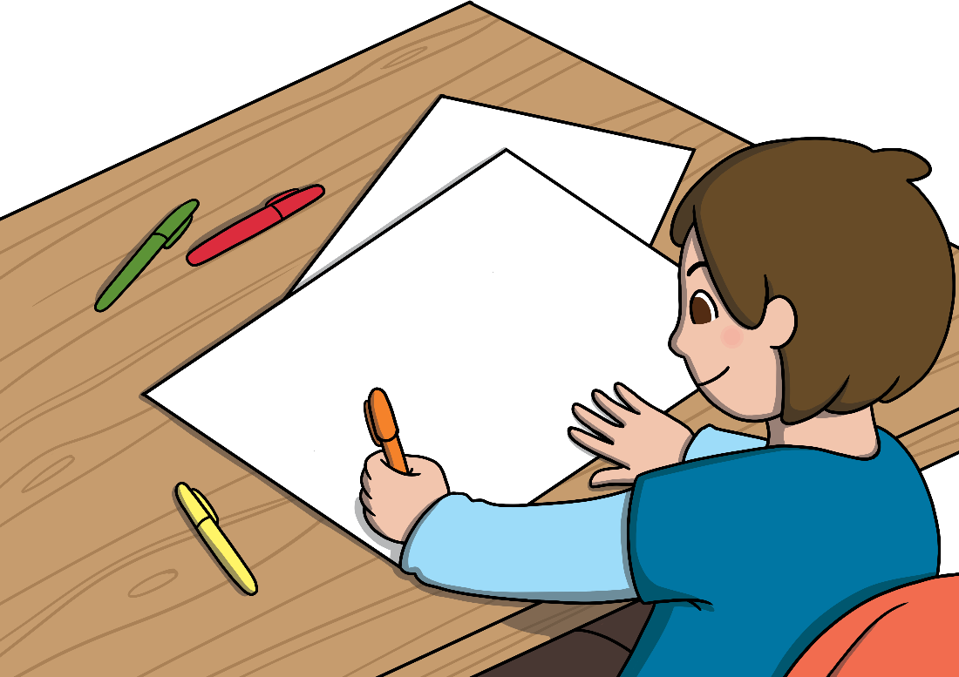
What Would You Do?
We will now think about what we should do if we come across any problems when we are using the Internet.
Look at your Staying Safe Online Picture Cards.
With your partner, look at the picture and read the sentence to think about what the risk is and what we should do if that happens.
Stick each picture on to your large sugar paper and write or draw what we should do to stay safe online.

Slide 18
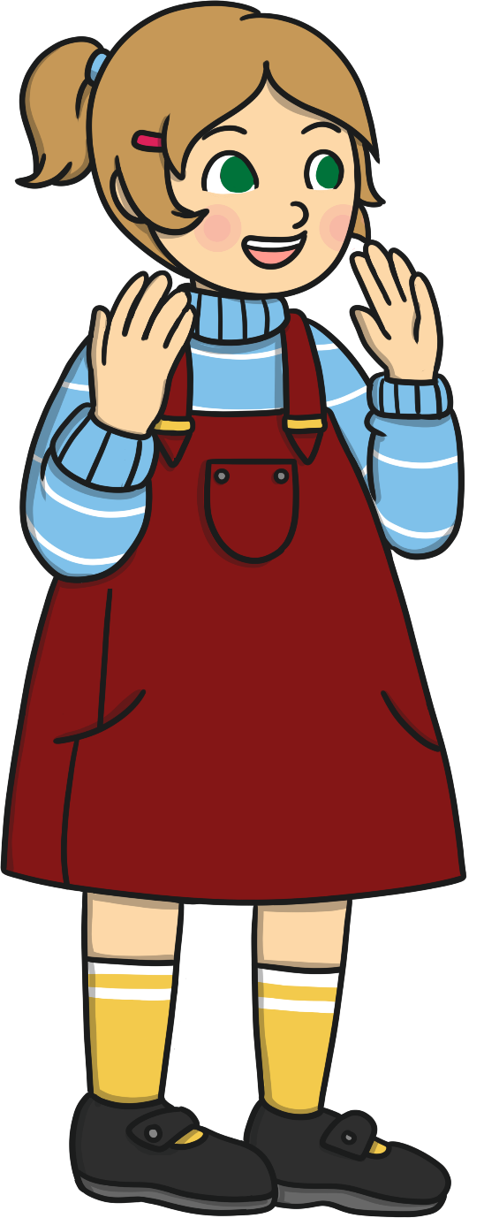
What Would You Do?
What a lot of good ideas about staying safe!
Can you share any of the ways we can stay safe online?
Let’s remember our simple rules and make sure we use the Internet safely to learn and have fun!
Consolidating
Reflecting

Slide 19
Consolidating

Slide 20
Staying Safe Online
We have thought of lots of ways to stay safe online. Now, can you help others to stay safe by creating your own online safety poster?
Try to use these words:
messaging, download, app, video, age restrictions, suitable, trusted adult

Slide 21
Reflecting

Slide 22
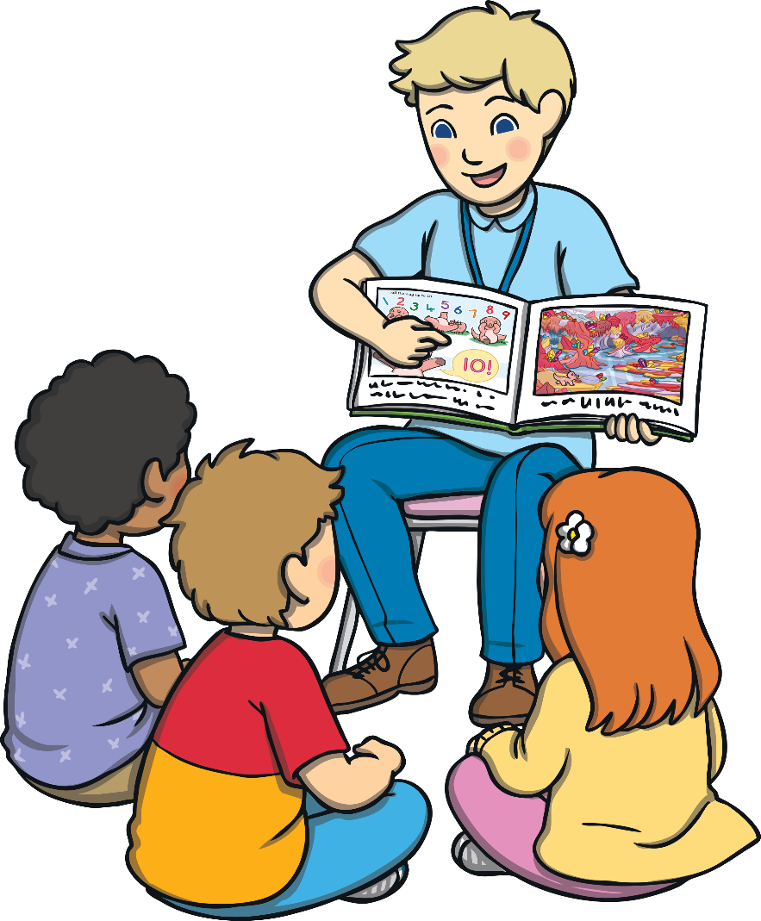
Online Safety
What a lot we have learnt about staying safe online!
Now, let’s listen to the story of how Len uses the Internet and look for ways we can help him to stay safe.
If you hear a risk, put your hands on your shoulders.
There are so many ways the Internet can help us learn and have fun. Let’s remember our online safety rules to make sure we use it responsibly and safely.

Slide 23
The Big Questions

Slide 24
What are the risks when we go online?
What can I do if I feel frightened?

Slide 25
Aim
I know how to stay safe online.
Success Criteria
I can identify different ways we use the Internet.
I can describe some of the risks of going online.
I can tell others about Internet safety rules and explain how they help us to stay safe online.
I know how to get help if anything online worries or frightens me.

Slide 27
Aim
I can explain why we keep personal information private.
Success Criteria
I understand what personal information is.
I can explain how to keep personal information private online.
I can discuss why it is important to do this.
This resource is fully in line with the Learning Outcomes and Core Themes outlined in the PSHE Association’s Programme of Study.

Slide 28
The Big Questions

Slide 29
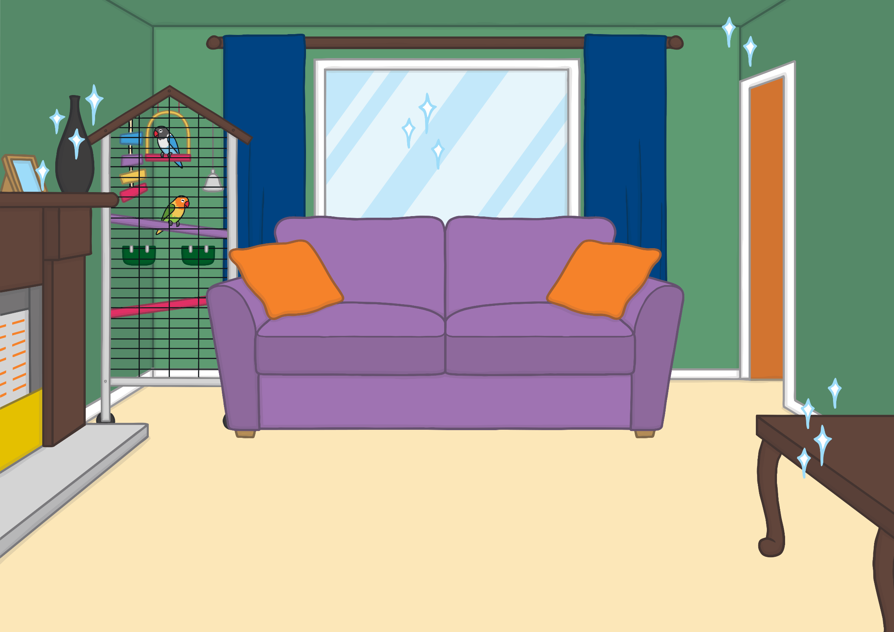
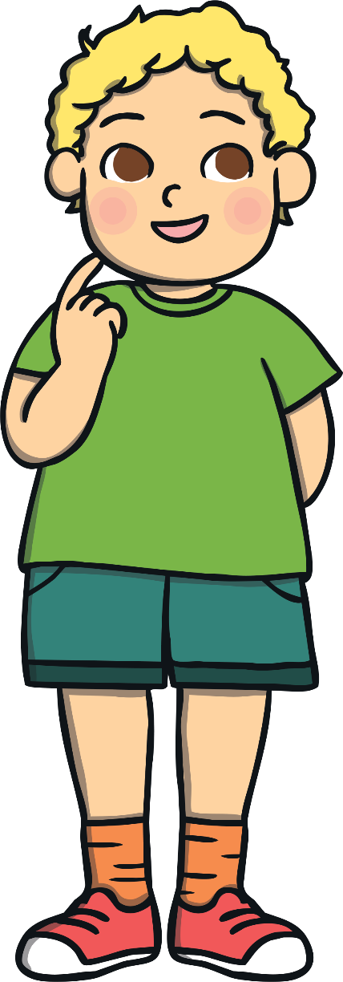
What is personal information?
How can we stay safe online?

Slide 30
Reconnecting

Slide 31
Odd One Out
In your groups, you will be given a set of Odd One Out Cards.
Read the information on each card carefully, as a group, and think about what type of information it is.
One card is the odd one out, can you spot it?
The shopping list was the odd one out because it did not contain personal information.
Can you explain which card was the odd one out?

Slide 32
Exploring

Slide 33
What Is Personal Information?
We have looked at cards with lots of personal information on. Can you explain what type of information is on the different cards?
All of these cards show examples of personal information. This is information that is about us.
Let’s think about what we can tell from the types of information we have read on the cards.

Slide 34
What Is Personal Information?
Personal information is the term used to describe any information that is about us. In the Odd One Out game, all the cards contain personal information apart from the shopping list. That’s because the shopping list could have been for anyone. All the other facts were about a specific person.
Now, let’s have a look at what we can tell from each type of personal information.

Slide 35
What Is Personal Information?
What does this show?
Who needs this information?
Why shouldn't we share it with people we don't know?
Our address tells people where we live. Our friends and family will know it because they will visit us or might send us post. People we don’t know do not need to know where we live.

Slide 36
What Is Personal Information?
What does this show?
Who needs this information?
Why shouldn't we share it with people we don't know?
Our school name tells people where we go to school and where we are every day. People we do not know don’t need to know this information.

Slide 37
What Is Personal Information?
What does this show?
Who needs this information?
Why shouldn't we share it with people we don't know?
Our email address allows people to contact us. Our friends and family may know it because they might write emails to us. People we don’t know do not need to know how to contact us directly.

Slide 38
What Is Personal Information?
What does this show?
Who needs this information?
Why shouldn't we share it with people we don't know?
Our birthday and date of birth are special dates to us. Sometimes, people use numbers from special dates as passwords or passcodes to access their devices so it is best not to share these numbers with people we don’t know.

Slide 39
What Is Personal Information?
What does this show?
Who needs this information?
Why shouldn't we share it with people we don't know?
Our bank account details tell people where we keep our money. With this information, people can use money from this account. Adults in your family may help you to set this up or look after it for you; they can help us keep this information safe. We don’t share this information with anyone else.

Slide 40
What Is Personal Information?
What a lot of personal information we have. It is all very special because it is about us!
When we use the Internet, we do not know who we are talking to or who is asking us for information so we should never share any personal information online.
?
If we receive any message or contact asking for personal information, we must tell a trusted adult straight away.
Nothing we see on the Internet should make us feel at all worried or uncomfortable. Tell a trusted adult straight away if you are concerned.

Slide 41
Guess Who!
Working in your partners, you need to go through your Guess Who Card Packs and sort them in to two piles like this:
This is Fraudster Fox.
He is trying to find out lots of information about other people by sending messages and chatting on the Internet.
Personal Information
Not Personal Information
Some cards show ways Fraudster Fox is trying to find out personal information about us. Some cards show other questions we might be asked online - for example, if we are playing a learning game.

Slide 42
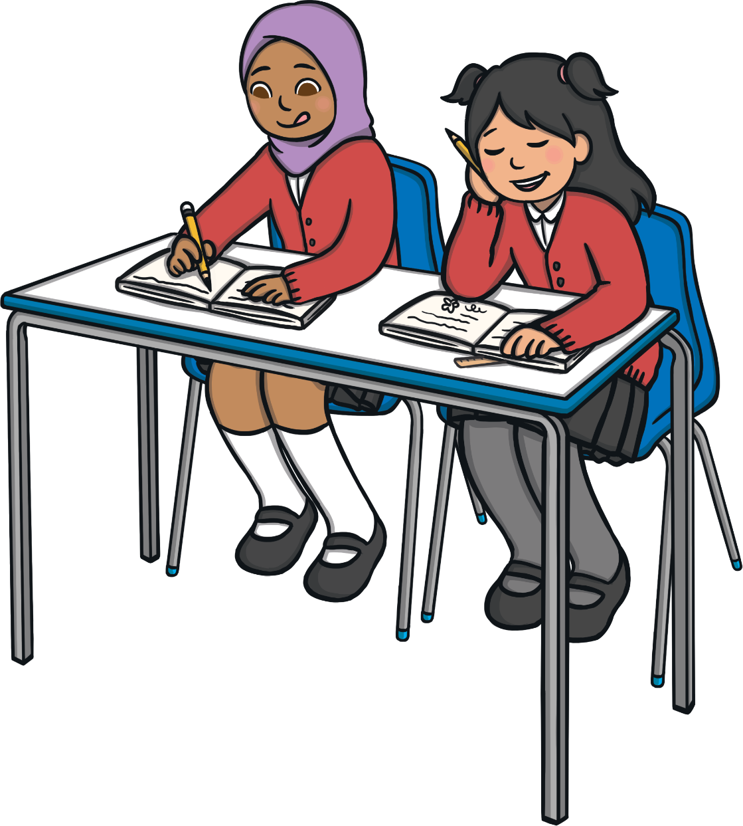
Guess Who!
Can you find the cards which show all the ways Fraudster Fox is trying to get our personal information?
Read each card carefully. Working with your partner, try to think about:
whether it is asking for information that is special to us;
what we should do about it.

Slide 43
Guess Who!
What a lot of ways Fraudster Fox is trying to trick us.
Let’s see if you found all the ways he was looking for personal information.
To stay safe online, we must never share personal information with anyone over the Internet. We don’t know who we are actually talking to and people may not be who they say they are, as we found with Fraudster Fox.
Remember, if anyone asks for personal information online, tell a trusted adult straight away.
Consolidating
Reflecting

Slide 44
Consolidating

Slide 45
Just Say No!
We have thought of lots of ways to stay safe online. Now, can you help others to stay safe by creating your own Personal Information Internet Safety Poster?
Try to use these words:
messaging, trusted adult, personal information, address, email, date of birth, passcode, password, private

Slide 46
Reflecting

Slide 47
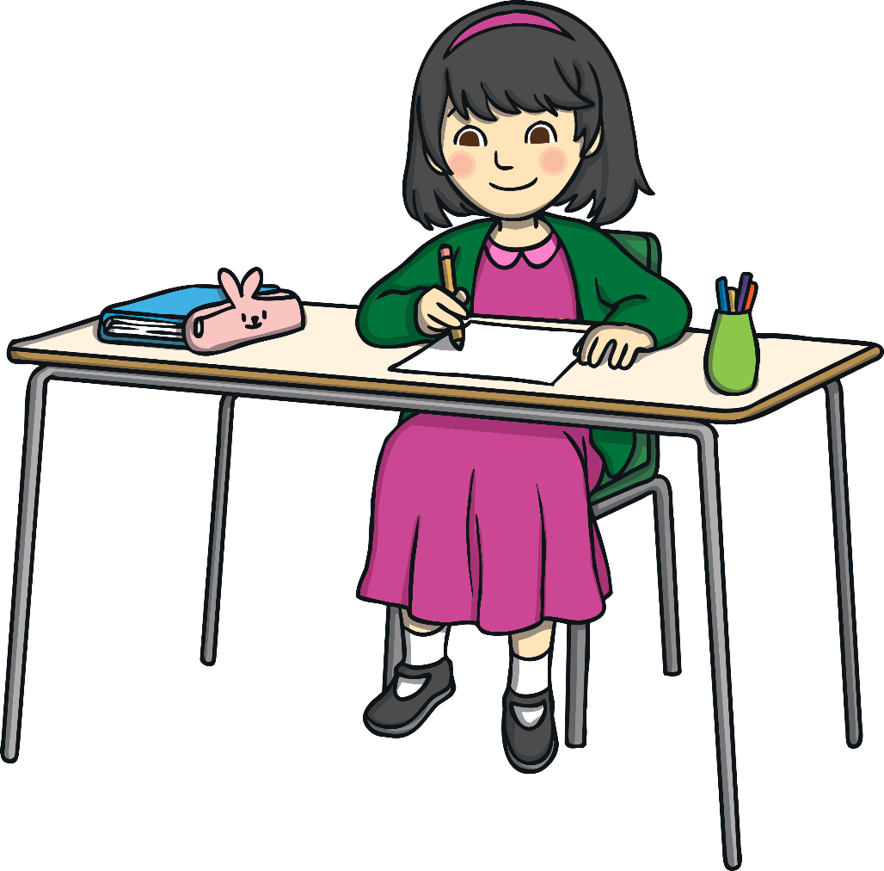
Keep It Private
We have thought a lot about how to keep personal information private. It is information about us, so we don’t share it with anyone online.
You will now be given a sticky note. Write or draw one thing that you would tell someone else about how to keep personal information private online.

Slide 48
The Big Questions

Slide 49
What is personal information?
How can we stay safe online?

Slide 50
Aim
I can explain why we keep personal information private.
Success Criteria
I understand what personal information is.
I can explain how to keep personal information private online.
I can discuss why it is important to do this.

Slide 51
Prayer Dear God, Help me to be wise and not share my personal details with others. Help me think about the consequences before I do something. Amen.

