Slide 1
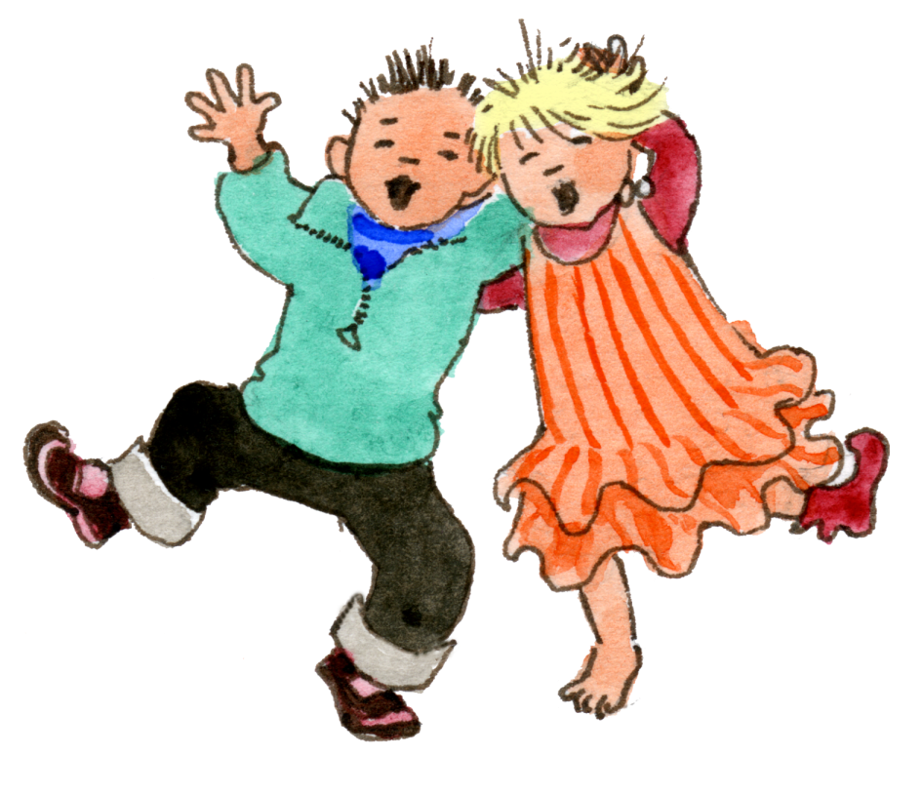
Reception
God loves each of us in
our uniqueness
1 A Journey in Love - Reception

Slide 2
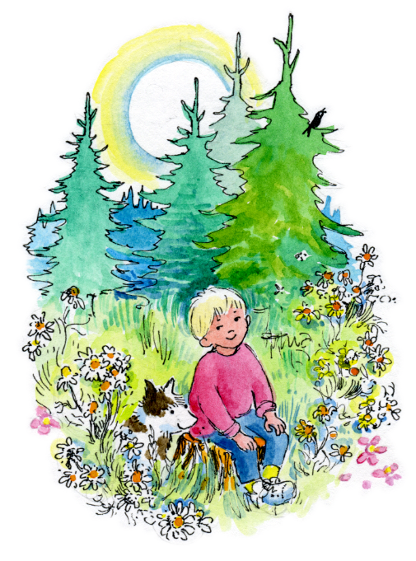
Objective
Know that God
made me and
loves me as I am.
Know that there
is no one more
special than me.
2 A Journey in Love - Reception

Slide 3
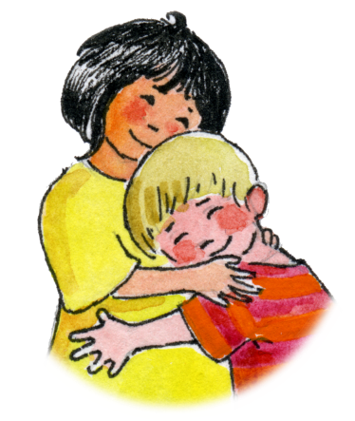
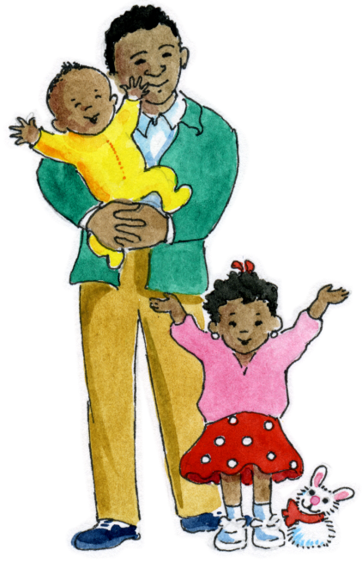
Keywords
God Unique Special Eyes | Hair Boy/Girl Hands Fingers Name | Family Love Womb Describe
3 A Journey in Love - Reception

Slide 4
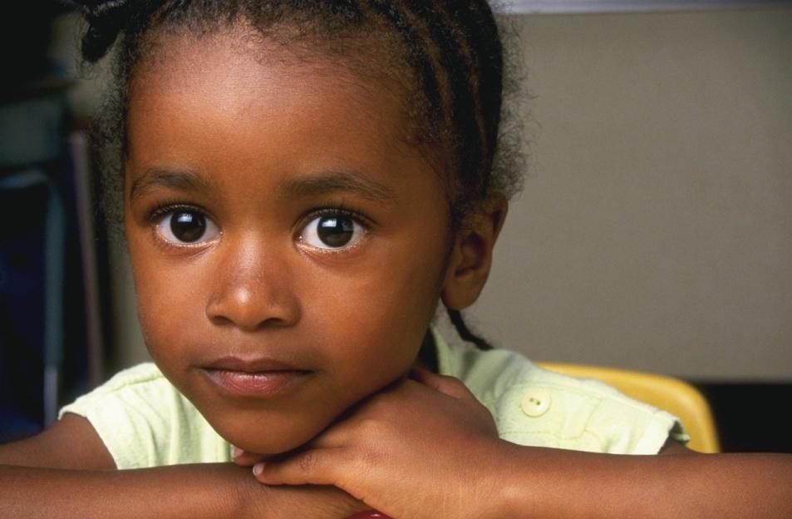
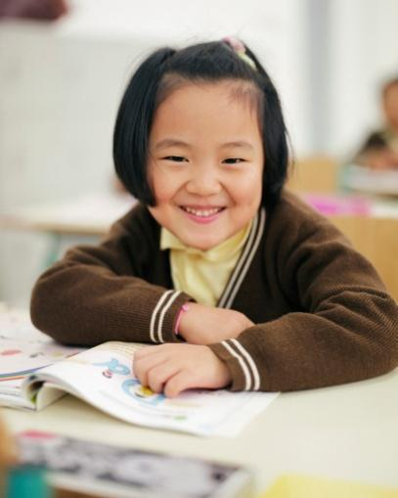
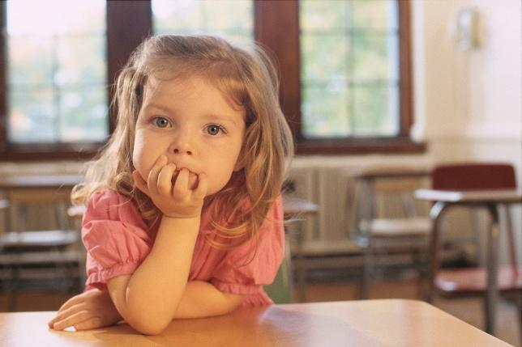
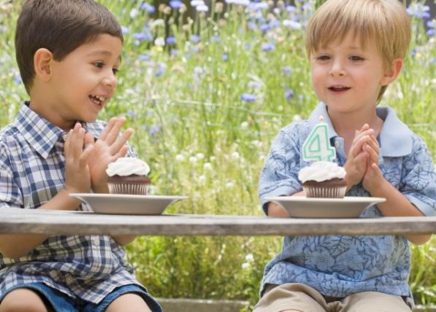
PHYSICAL
We are different
4 A Journey in Love - Reception

Slide 5
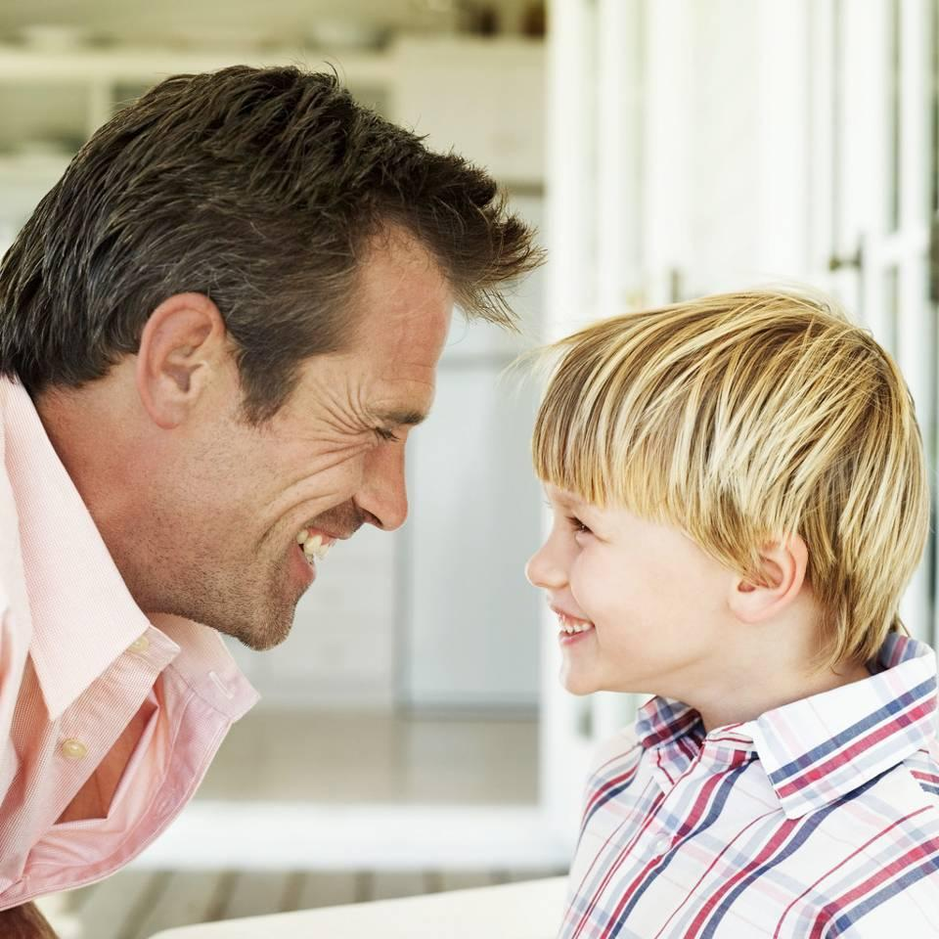
I am Unique
No one else is the same as me
5 A Journey in Love - Reception

Slide 6
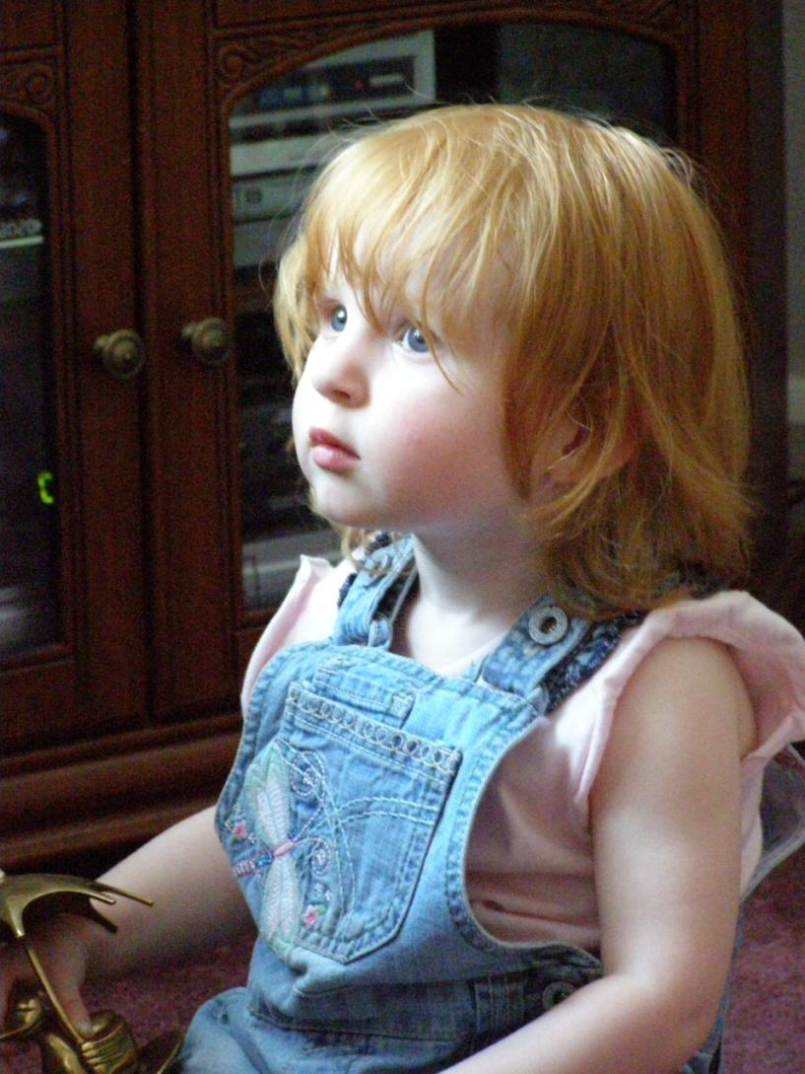
Uniqueness
Describe her…
Hair
Eyes
Lips
Skin
6 A Journey in Love - Reception

Slide 7
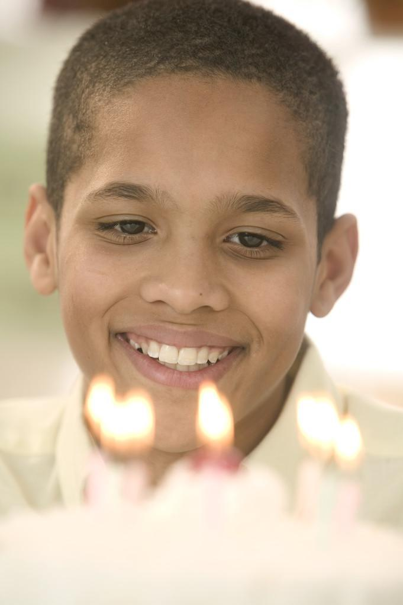
Uniqueness
Describe him…
Hair
Eyes
Lips
Skin
7 A Journey in Love - Reception

Slide 8
How are they…
…different?
8 A Journey in Love - Reception

Slide 9
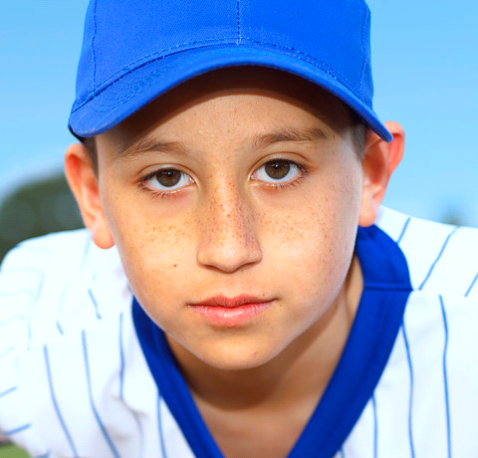
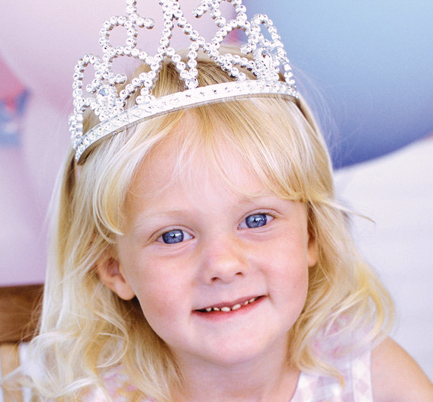
I am different.
I am special.
9 A Journey in Love - Reception

Slide 10
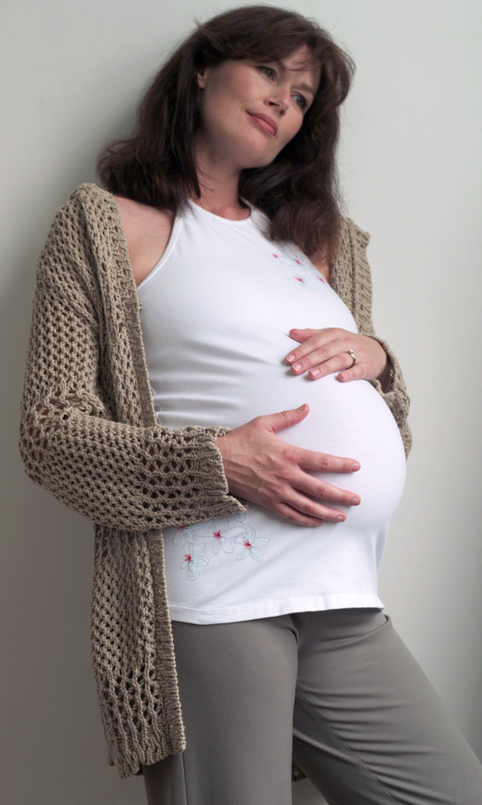
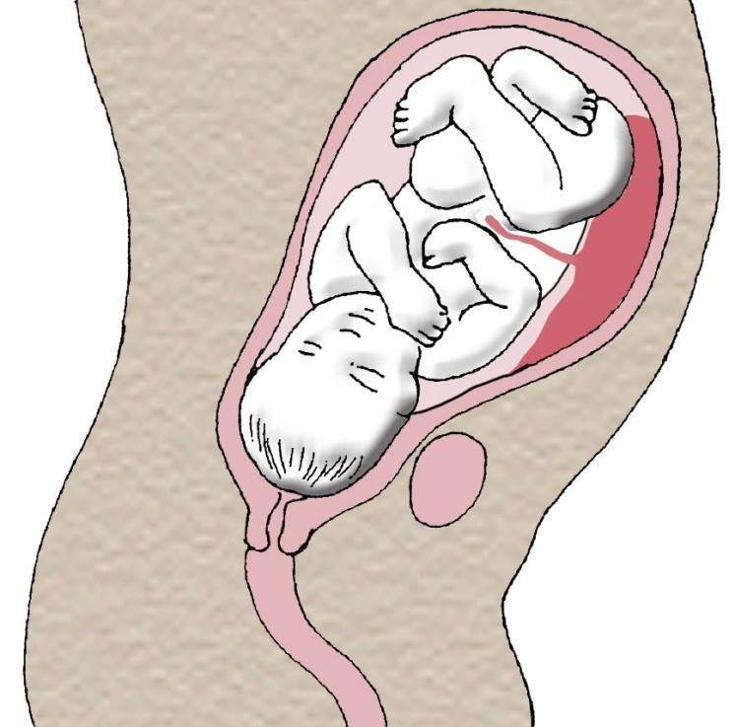
I grew for 9 months in
my mummy’s womb…
10 A Journey in Love - Reception

Slide 11
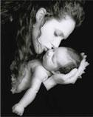
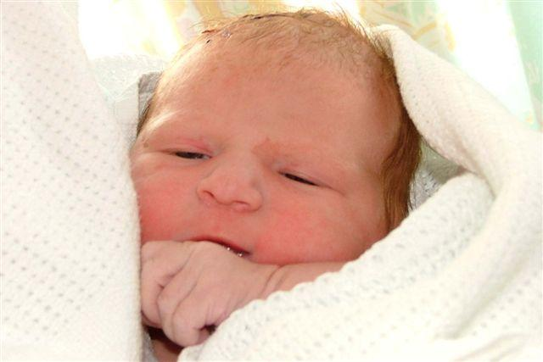
…before I was born.
11 A Journey in Love - Reception

Slide 12
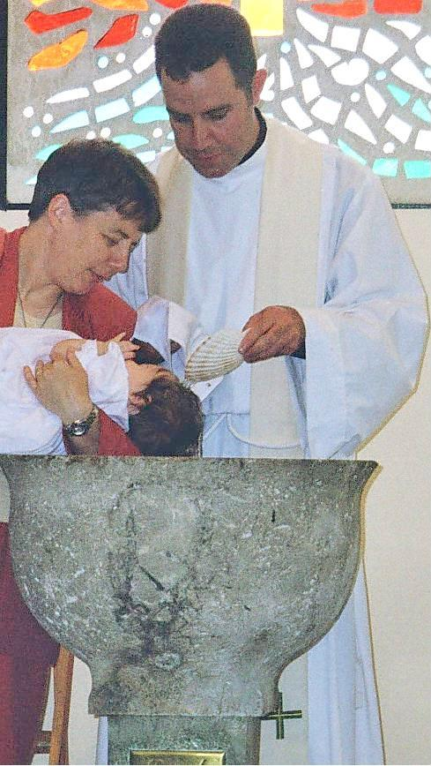
I have a
special name
12 A Journey in Love - Reception

Slide 13
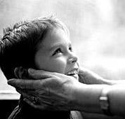
Prayer
Loving God,
Thank you for your gifts of love and for making me special with my own name.
Amen.
13 A Journey in Love - Reception

Slide 14
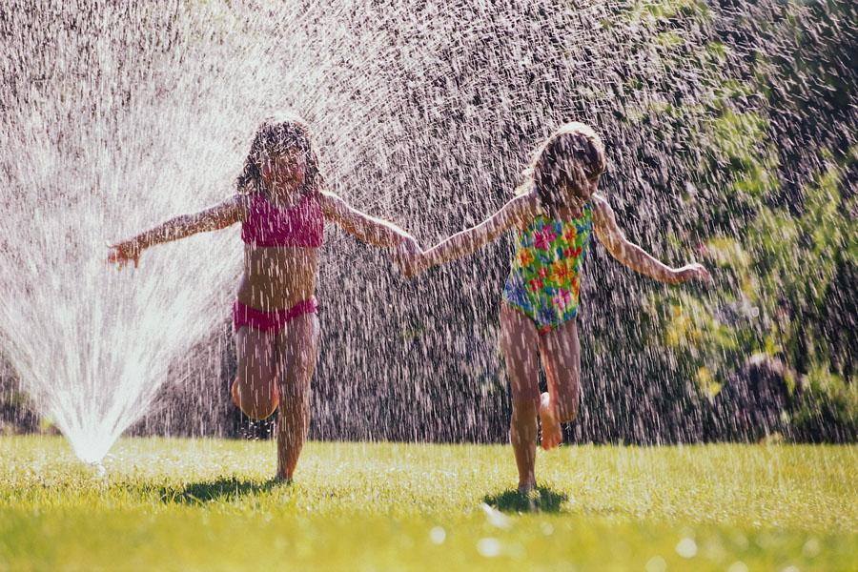
SOCIAL
Who do I play with?
14 A Journey in Love - Reception

Slide 15
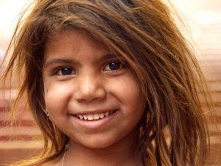
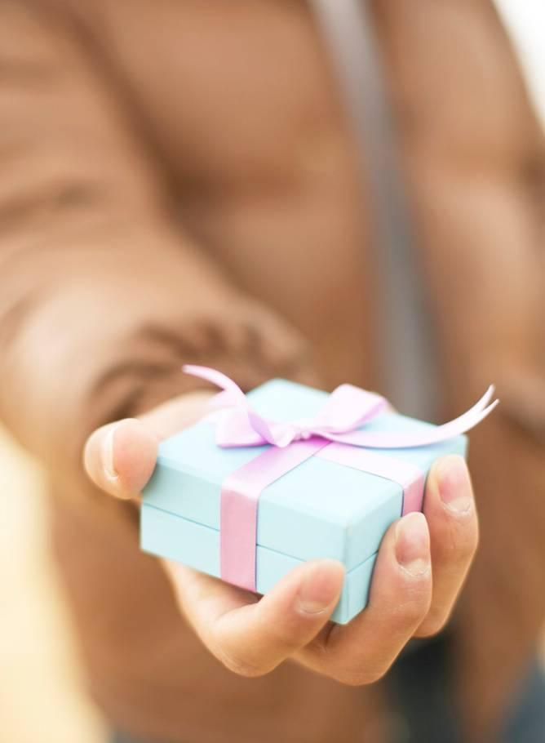
Why do they play with me?
Am I happy?
Generous?
15 A Journey in Love - Reception

Slide 16
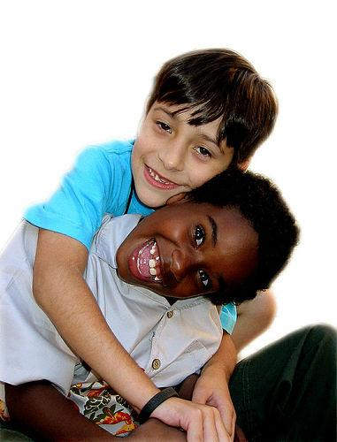
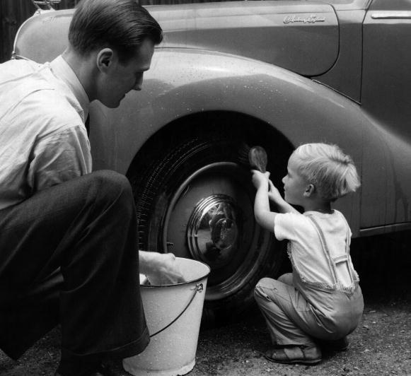
Am I…
Helpful?
Friendly?
16 A Journey in Love - Reception

Slide 17
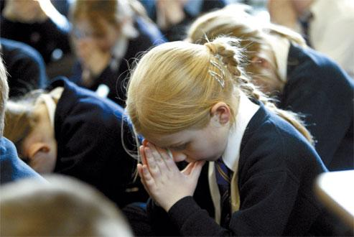
Prayer
Loving God,
Thank you for the gift of my friends at home
and at school.
Amen.
17 A Journey in Love - Reception

Slide 18
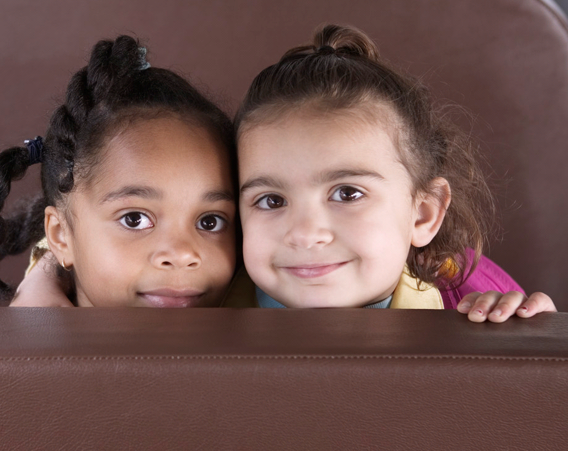
EMOTIONAL
How do I feel about my friends?
18 A Journey in Love - Reception

Slide 19
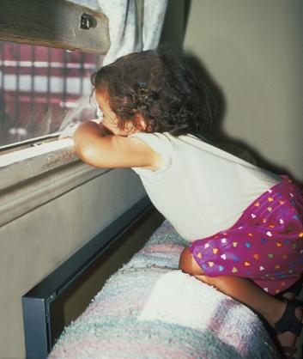
How do I feel when I am left out?
19 A Journey in Love - Reception

Slide 20
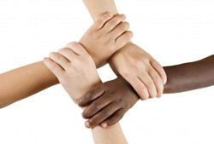
How do I care for people who are not my special friends?
20 A Journey in Love - Reception

Slide 21
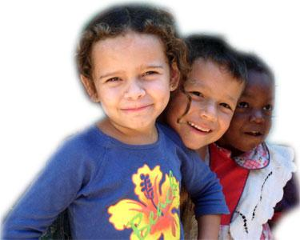
Prayer
Loving God,
Thank you for my friends.
Help me to be a good friend to everyone.
Amen.
21 A Journey in Love - Reception

Slide 22
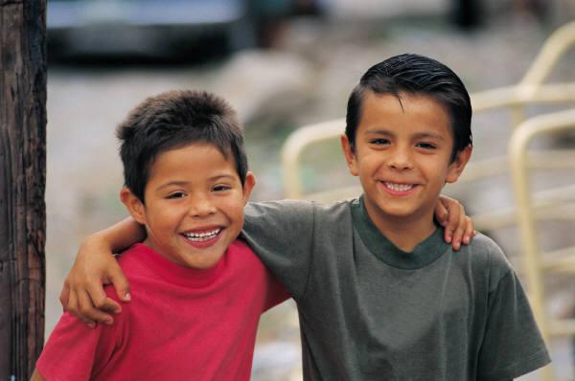
INTELLECTUAL
Is it important to have friends?
22 A Journey in Love - Reception

Slide 23
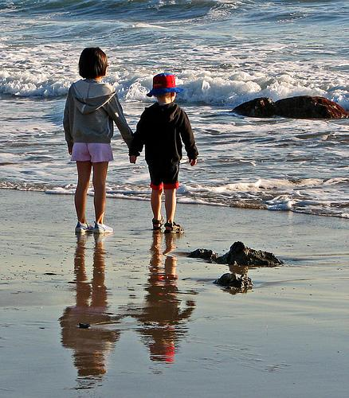
Who is a good friend?
23 A Journey in Love - Reception

Slide 24
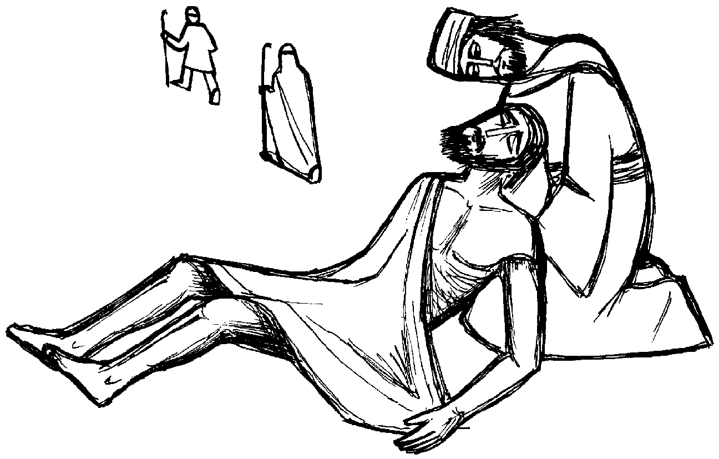
The Good Samaritan
24 A Journey in Love - Reception

Slide 25
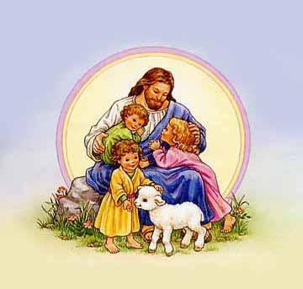
Prayer
Loving God,
Thank you for
being my friend.
Amen.
25 A Journey in Love - Reception

Slide 26
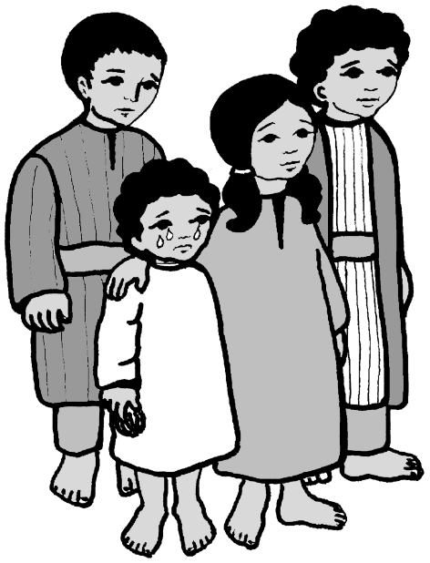
SPIRITUAL
People often used to bring children to
Jesus and when they did, Jesus always
blessed them.
26 A Journey in Love - Reception

Slide 27
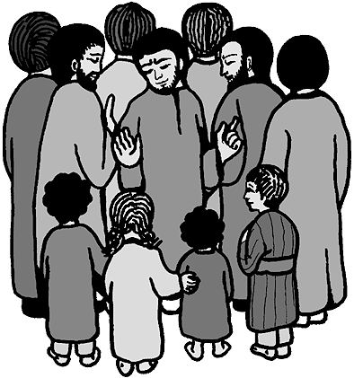
One day, however, some of the friends of Jesus told the children to go away.
27 A Journey in Love - Reception

Slide 28
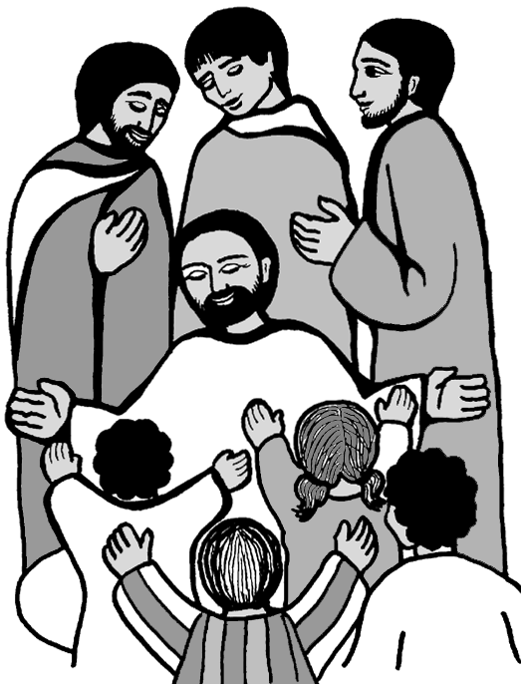
Jesus was angry when
he saw this happening,
and he said:
“Don’t stop the children
from coming to me.
Don’t send them away
like that!
Bring them back.”
28 A Journey in Love - Reception

Slide 29
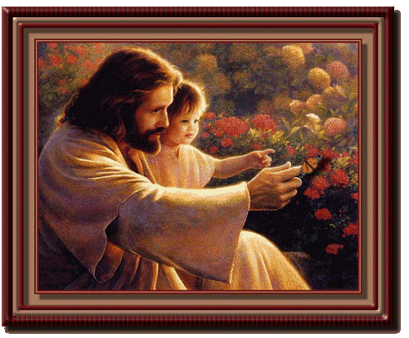
Then he put his arms round them and he blessed them.
29 A Journey in Love - Reception

Slide 30
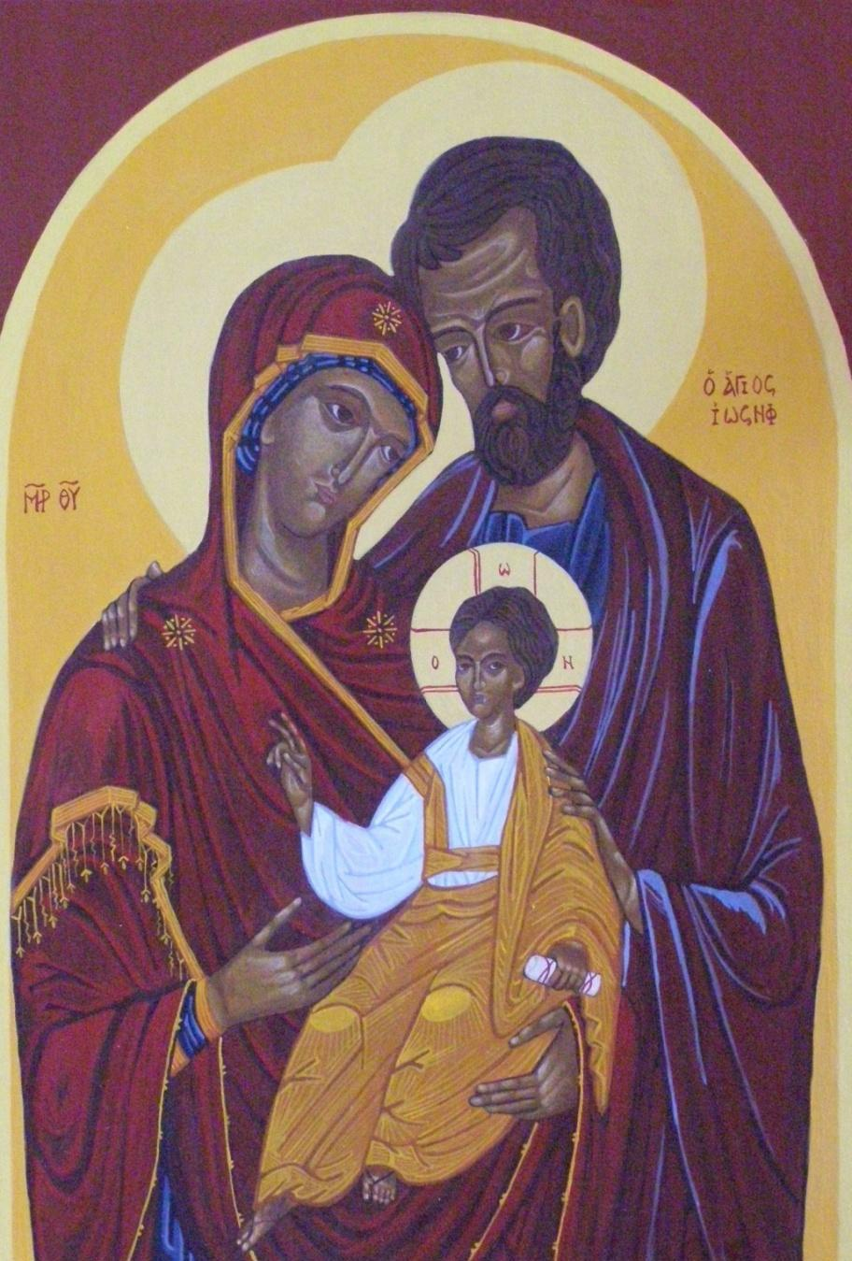
Jesus grew up
in a family
30 A Journey in Love - Reception

Slide 31
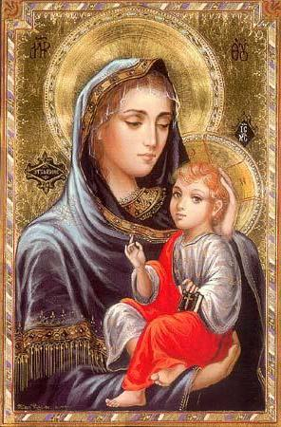
Who was the mother of Jesus?
Why is she special?
Jesus grew for
nine months in
Mary’s womb.
31 A Journey in Love - Reception

Slide 32
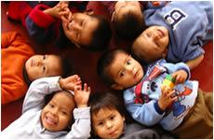
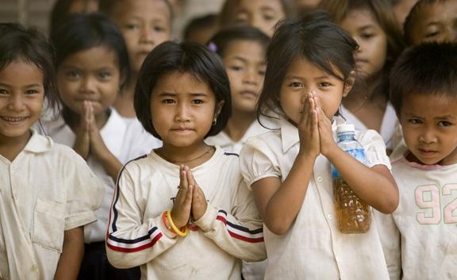
Prayer
Loving God, We know that we are unique. Although we are different from one another we are all special to you.
Amen.
32 A Journey in Love - Reception
End of presentation

Slide 33
Being a good friend
I know how to tell my friend to stop if they are doing something I don’t like.
I know not to tease or call my friends names.
I know to use kind hands and feet.
I know how to stop bullying. TASK!
Tell them you don’t like it.
Ask them to stop.
Speak to an adult at school and home.
Keep an eye on it!

Slide 34
Staying safe
I know how to stay safe.
I do not talk to strangers.
If someone gets too close to me or touches me in an inappropriate place, I tell them to stop and tell an adult I trust.
I know I should not talk to anyone online.
I know how to get help if I need it.

Slide 35
Keeping my mind & body healthy
I use positive words
I talk through my emotions- if you are sad, tell someone why.
I play outside whenever I can.
I read each day.
I complete my homework.
If I am sad or lonely, I tell someone, but I try and think of ways to make it better too.
I don’t eat too many things that are unhealthy.
I know if I am not well, I can tell an adult.
I need to wash my hands before eating.
I need to wash my body daily.
I know when it is sunny I need a sun hat and sun cream on.
I know to drink lots of water.
I know to reduce screen time down to a maximum of 1 hour a day.

