Slide 1

PSHE and Citizenship
Relationships | VIPs
PSHE and Citizenship | UKS2 | Relationships | VIPs | Secrets | Lesson 5

Slide 2
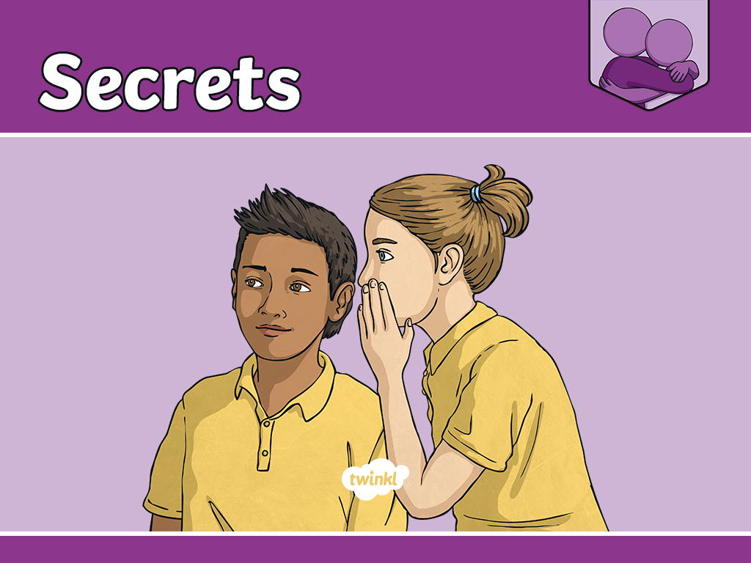

Slide 3
Aim
I can explain when it is right to keep a secret, when it is not and who to talk to about this.
Success Criteria
I can identify times when it is appropriate to share a VIP’s secret.
This resource is fully in line with the Learning Outcomes and Core Themes outlined in the PSHE Association’s Programme of Study.

Slide 4
The Big Questions

Slide 5

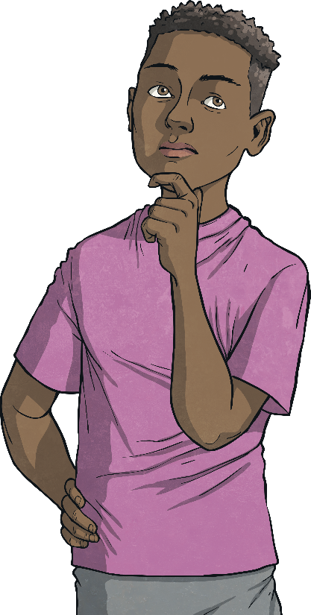
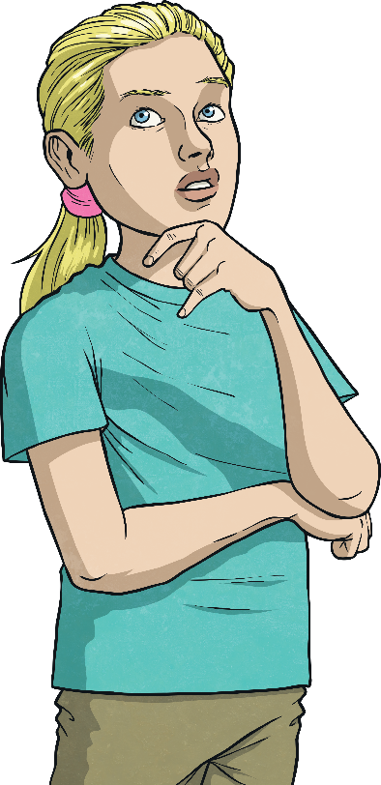
When is it OK to keep a secret?
When is this not OK? How can we know when we should break a confidence
or tell a secret?

Slide 6
Reconnecting

Slide 7

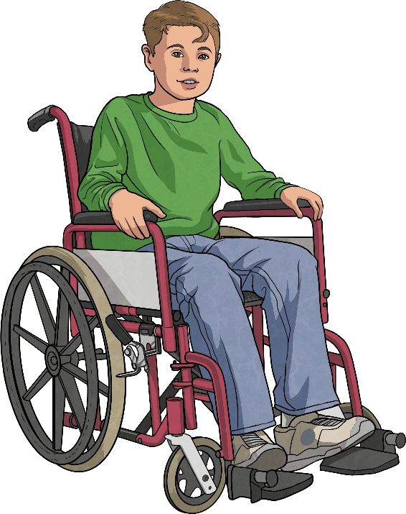
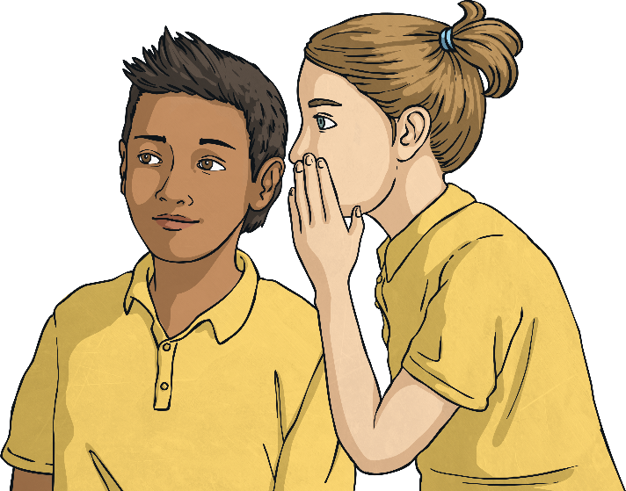
Secrets
A secret is…
‘something that is kept or meant to be kept unknown or unseen by others.’
Can you think of a secret you have ever had?
Did you tell anyone your secret or did you keep it to yourself?
Did they keep your secret or did they tell someone else?
Try and think about a secret you’ve had in
the past that was appropriate to share
with a friend.

Slide 8
Exploring

Slide 9

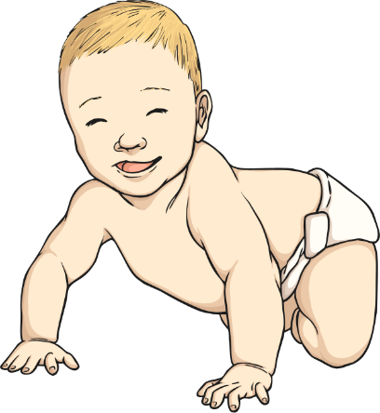
Keeping Secrets
Why might our VIPs need us to keep a secret?
To keep a surprise, such as a party or present, for someone.
So they can share exciting news with us first - for example, someone in their family is having a baby.
To keep sensitive information, such as the person in the class that they like, private.
We ask people we trust and have respect for to keep our secrets. That means it is important to maintain their trust and respect by not sharing their secrets with others. Knowing their secret does not give you the right to share it with others.
Secrets that are confidential, or ones that are exciting for our friends, are fine to keep, as long as we feel comfortable and know that no one is getting upset or hurt. Sometimes, an adult might ask us to keep a surprise secret like a birthday present for our siblings. However, an adult asking a child to keep a secret about something the child is uncomfortable with is not OK and we should always share this with another grown-up that we trust.

Slide 10

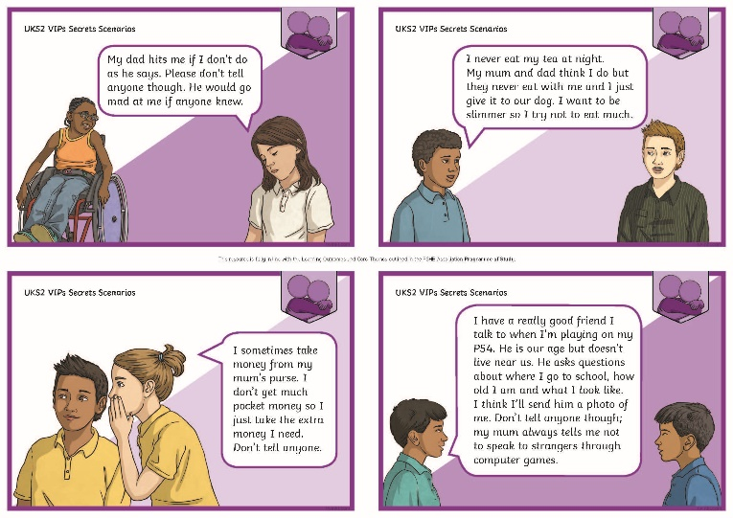
Telling a Secret
There are certain situations where we might need to share one of our VIP’s secrets.
Look at the Secrets Scenario Cards in pairs and discuss the importance of involving other people in these scenarios and secrets.
Discuss the different outcomes that are possible, depending on whether we decide to share their secret with a trusted grown-up or not.

Slide 11
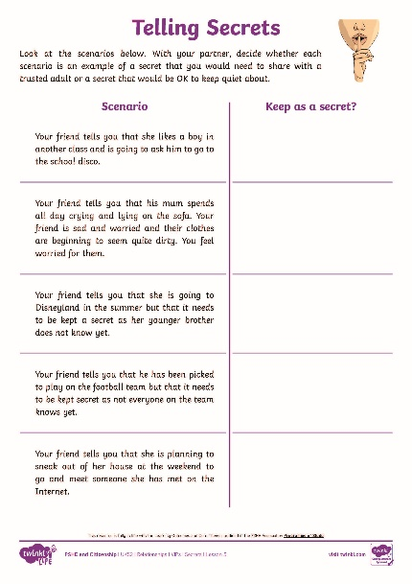
Telling a Secret
In pairs, go through the different scenarios on the Telling Secrets Activity Sheet. Discuss each scenario together and then decide whether each secret is one that is OK to keep as a secret or whether it needs to be shared with a trusted grown-up.
There is a huge difference between gossiping about someone else’s secrets with all your friends and telling a trusted grown-up someone else's secret when you are concerned or worried about them.
Consolidating
Reflecting

Slide 12
Consolidating

Slide 13


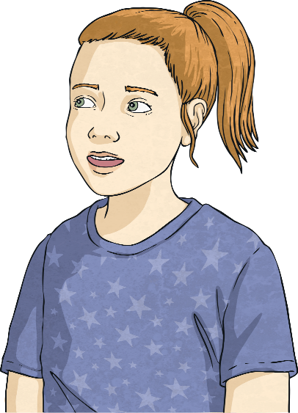
OK or Not OK?
We are going to throw a birthday party for your mum at the weekend. But don’t tell her, it is a secret!
OK, Dad, your secret’s safe with me.
In groups, discuss if this secret is fine to keep or if it should be shared.

Slide 14
OK or Not OK?
You can have this phone from me, so
we can call each other, but you mustn’t tell anyone that I’ve given it to you.
Thank you so much! I promise I won’t tell my mum or dad or anyone else.
In groups, discuss if this secret is fine to keep or if it should be shared.

Slide 15
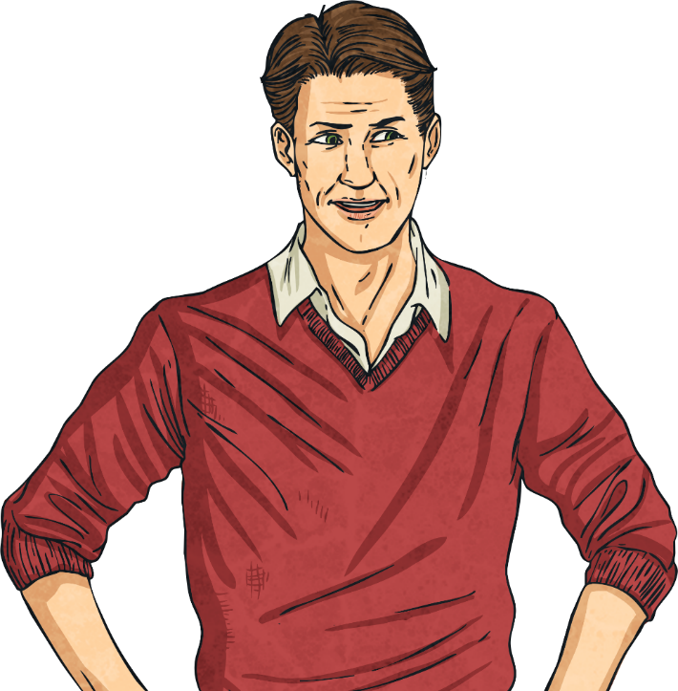
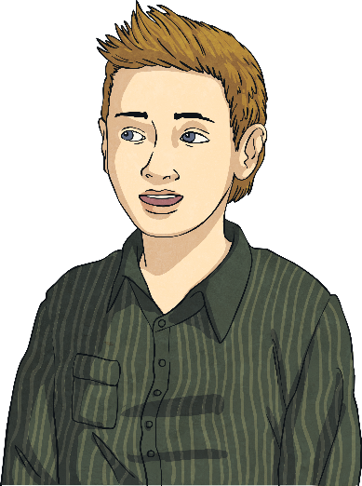
OK or Not OK?
I have bought something your sister will really like because she has worked very hard this year. Keep it a secret though because I’m not going to give it to her until after her exams.
I won’t tell her. I promise.
In groups, discuss if this secret is fine to keep or if it should be shared.

Slide 16
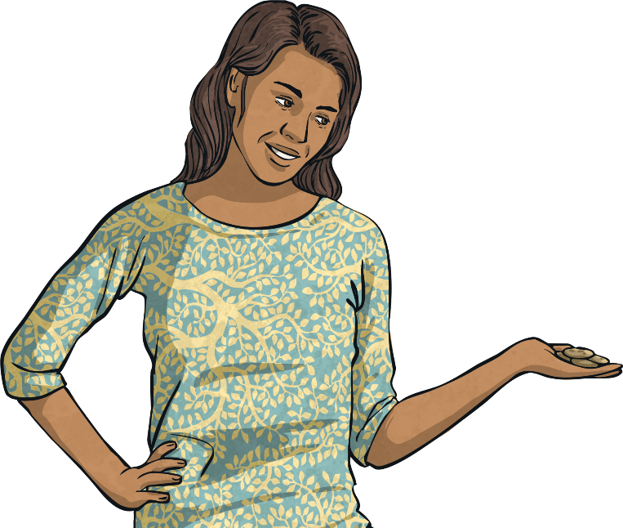
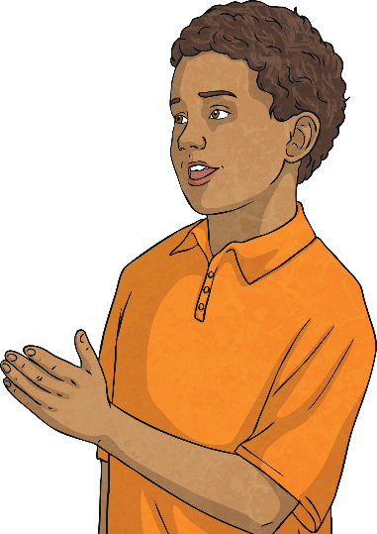
OK or Not OK?
You can have all this chocolate as my children don’t want it. Just don’t tell anyone that I’ve given it to you!
Wow, thank you. I won’t tell anyone, I promise.
In groups, discuss if this secret is fine to keep or if it should be shared.

Slide 17
Reflecting

Slide 18
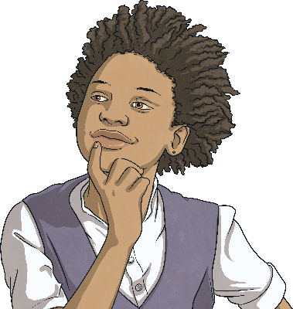
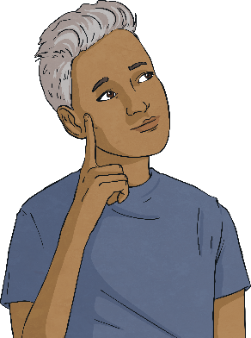
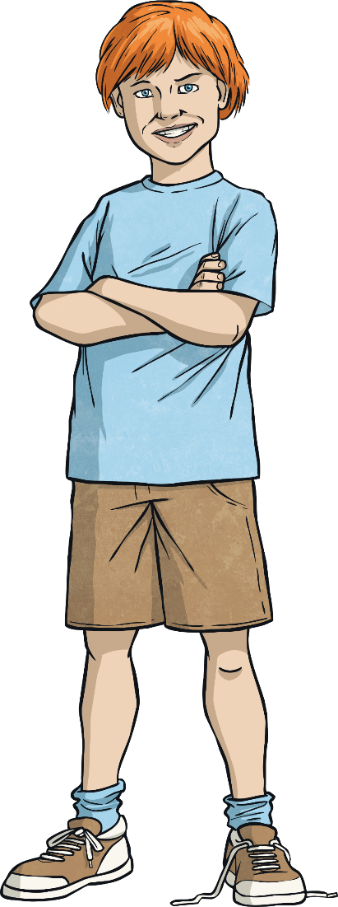
Safety
Secrets are OK to keep if they are a surprise for someone else and you can understand the need for them to be kept a secret. For example, keeping someone’s birthday present a surprise is absolutely fine as you don't want them to know what they are getting.
Which trusted grown-ups do you have in your support network who you could go to if you needed to?
An adult giving you a gift and telling you to keep it a secret is not OK. While it is lovely to receive gifts, anyone telling you to keep that gift a secret means they do not want others to know, which may mean it is an inappropriate gift or that giving you a gift is inappropriate.
It is very important to tell a trusted adult about this, or any secret that makes you feel uncomfortable, unhappy or unsafe. If the adult that is making you feel this way is within your family or support network, it is important to tell another trusted grown-up about it.

Slide 19
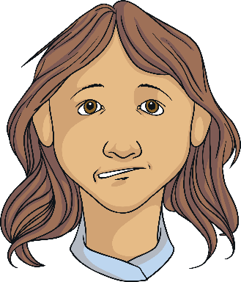
Safety
We would need to share someone else’s secret...
if the secret makes us feel uncomfortable;
if the secret makes us worry about someone else’s safety;
if the secret makes us feel worried in any other way;
if we think the secret might involve someone else doing something dangerous;
if we think the secret might involve someone else doing something they shouldn’t.

Slide 20
The Big Questions

Slide 21
When is it OK to keep a secret?
When is this not OK? How can we know when we should break a confidence
or tell a secret?
How have your answers changed since the beginning of the lesson?

Slide 22
Aim
I can explain when it is right to keep a secret, when it is not and who to talk to about this.
Success Criteria
I can identify times when it is appropriate to share a VIP’s secret.

Slide 23
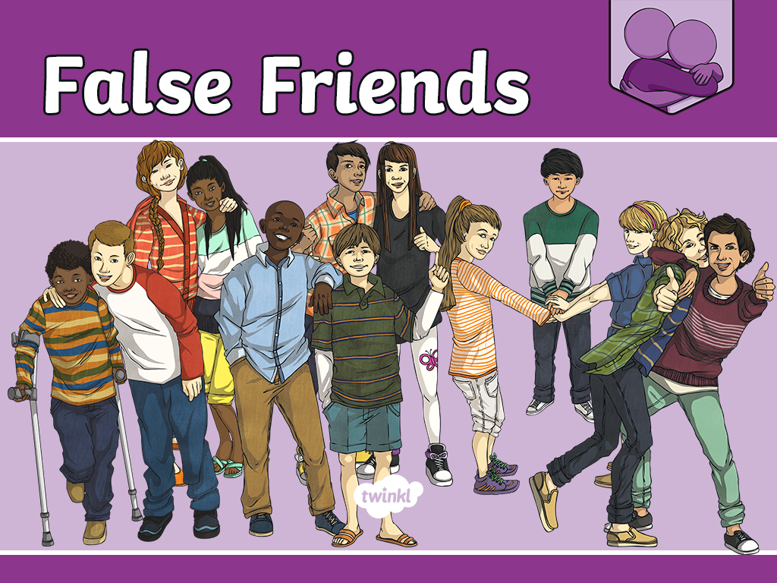

Slide 24
Aim
I can recognise healthy and unhealthy relationships.
Success Criteria
I can spot signs of an unhealthy relationship.
I can suggest different ways to end a relationship if necessary.
This resource is fully in line with the Learning Outcomes and Core Themes outlined in the PSHE Association’s Programme of Study.

Slide 25
The Big Questions

Slide 26
What are some of the signs of an unhealthy or risky relationship?
When might it be best to end a relationship and how can we do this?
Write your answers to the Big Questions on sticky notes and then stick these around the Big Questions Poster.

Slide 27
Reconnecting

Slide 28
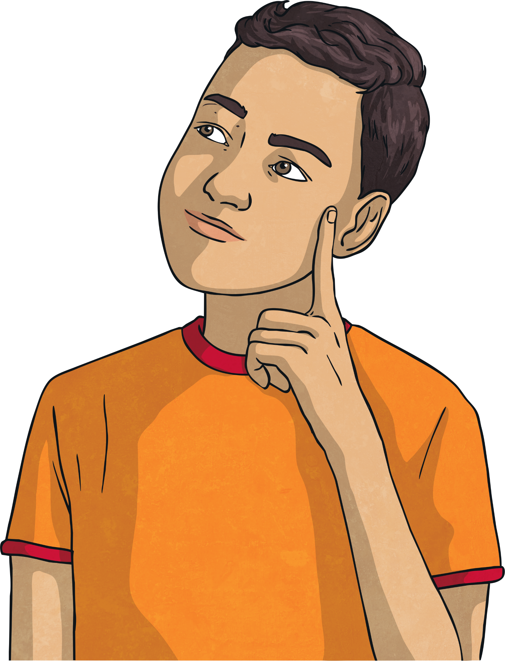
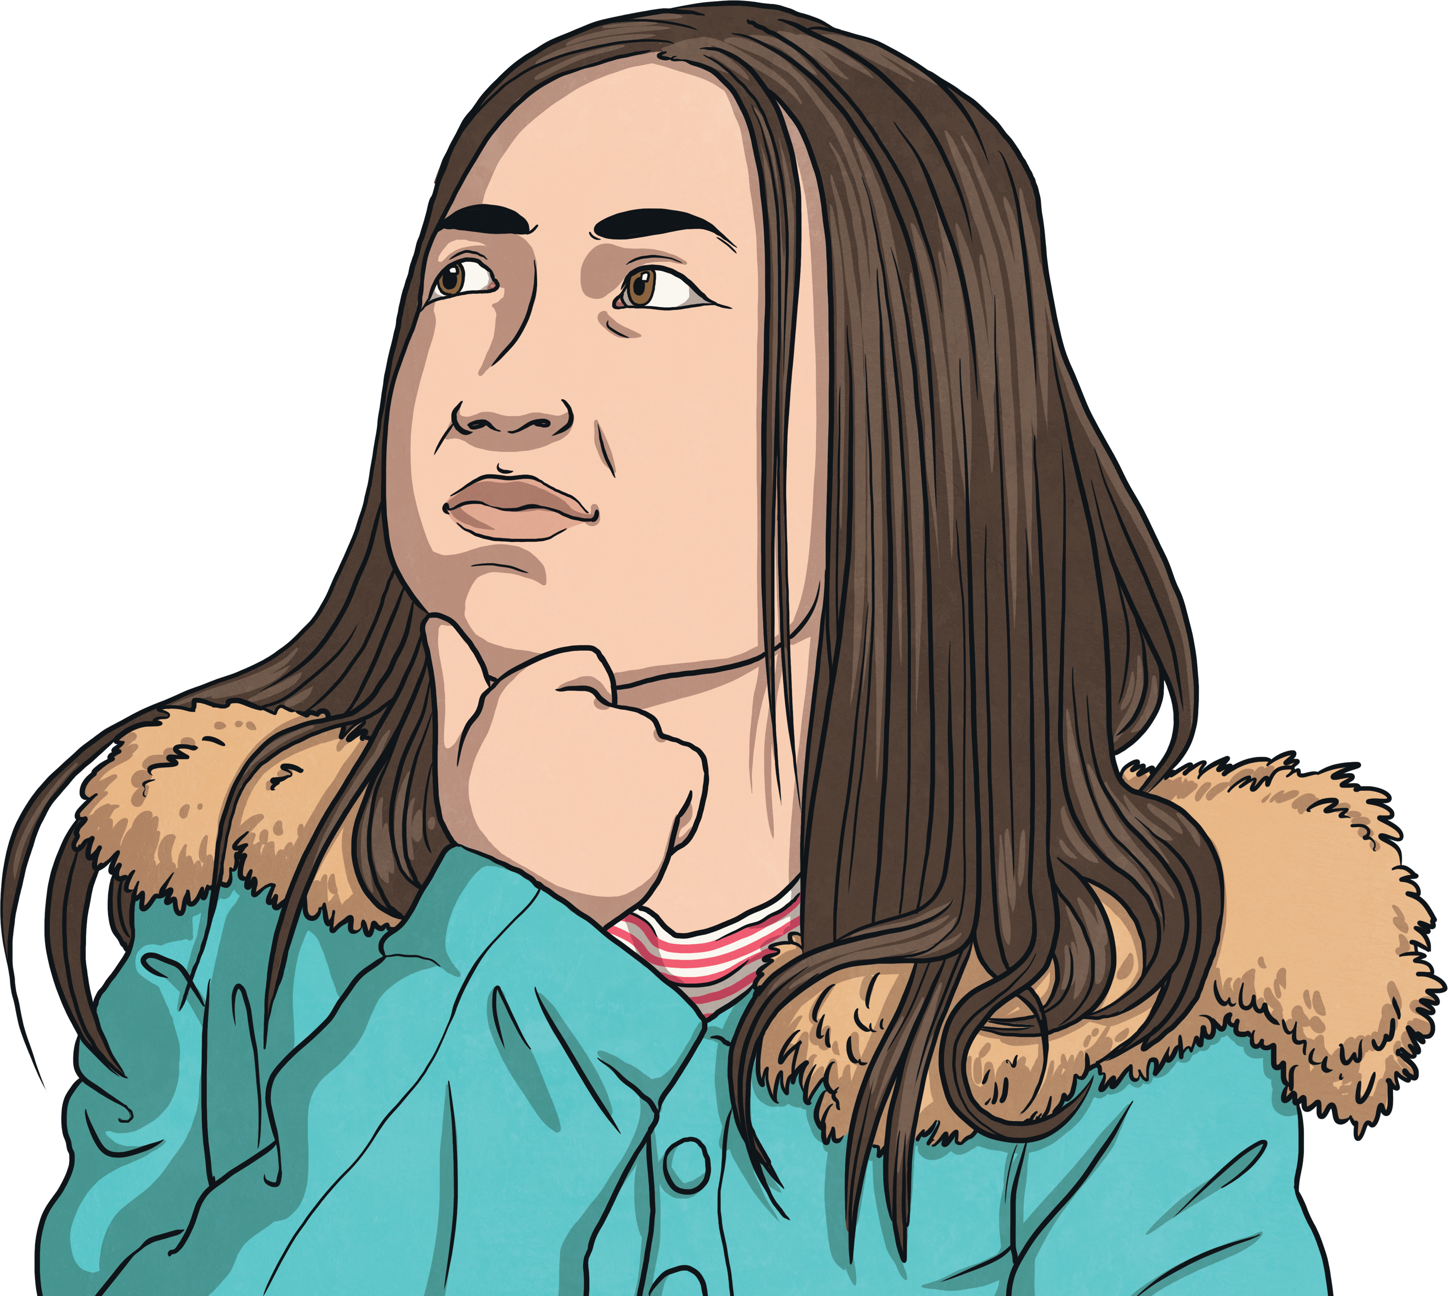
A Good Friend?
What do you believe is a healthy relationship? What do you believe is an unhealthy relationship?
False friends create unhealthy relationships.
What do you think the signs of an unhealthy relationship
would be?
This lesson will look through the ways to identify unhealthy relationships and how to end an unhealthy relationship.

Slide 29
Exploring

Slide 30
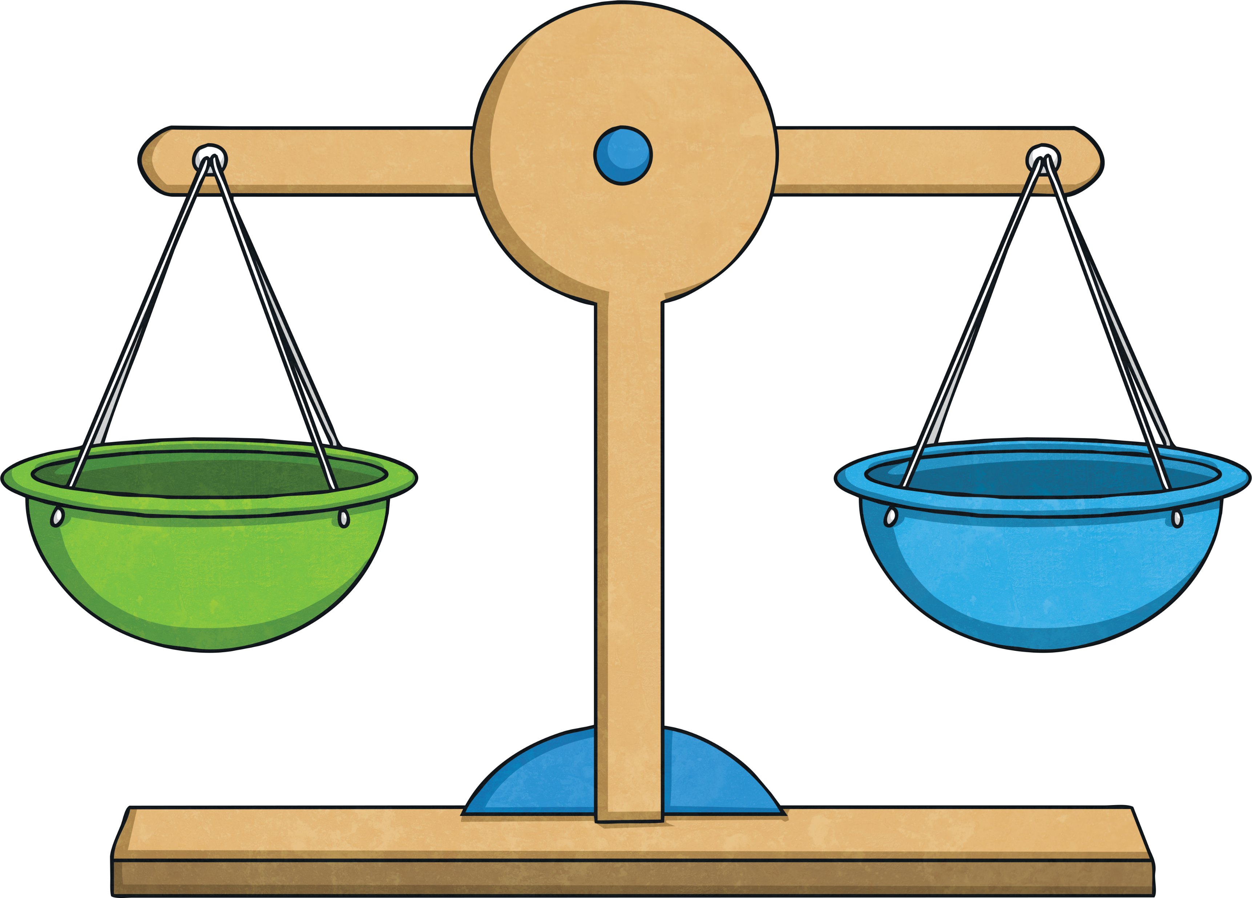
Healthy Relationships
Healthy relationships are not always happy relationships. It is totally normal for healthy relationships to have disagreements as well as happiness and fun times. A healthy relationship will always make you feel confident about the person you are and will enable you to make your own choices.
So long as a relationship is healthy and balanced, any argument or disagreement can be resolved and worked through because in a healthy relationship, the two people respect each other and therefore can work through difficult times.

Slide 31
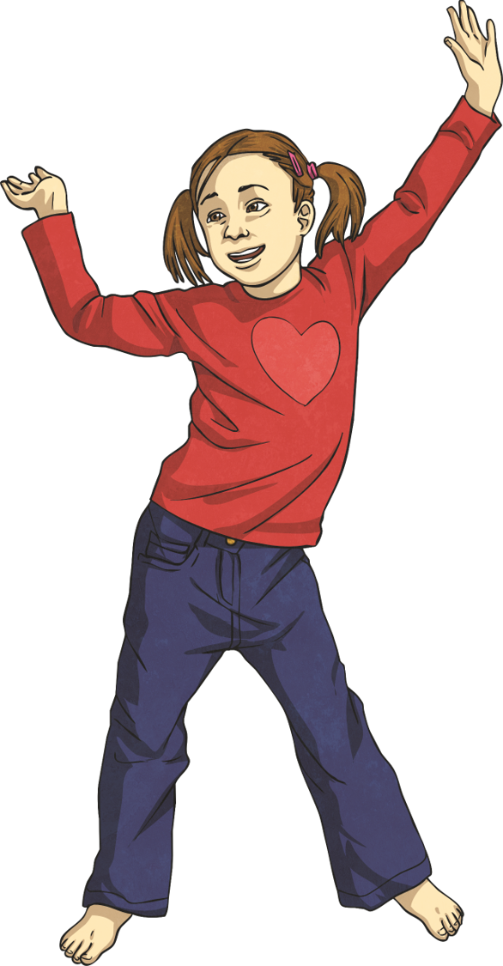
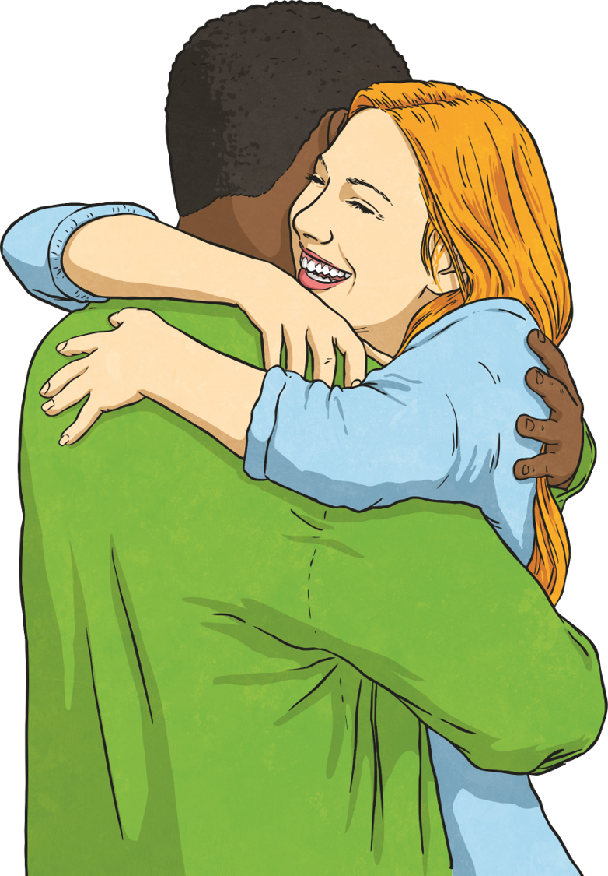
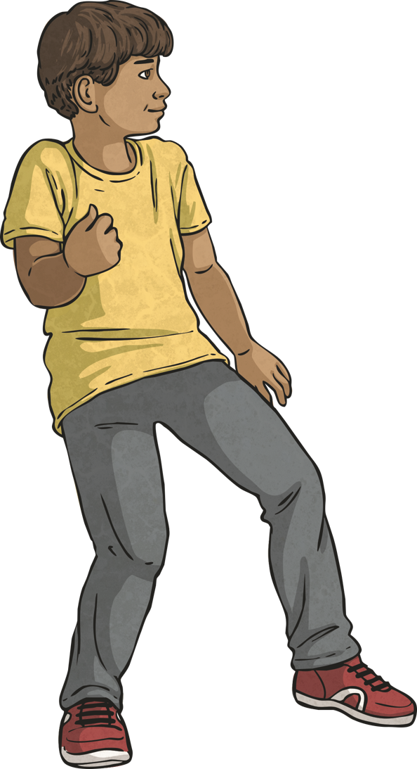
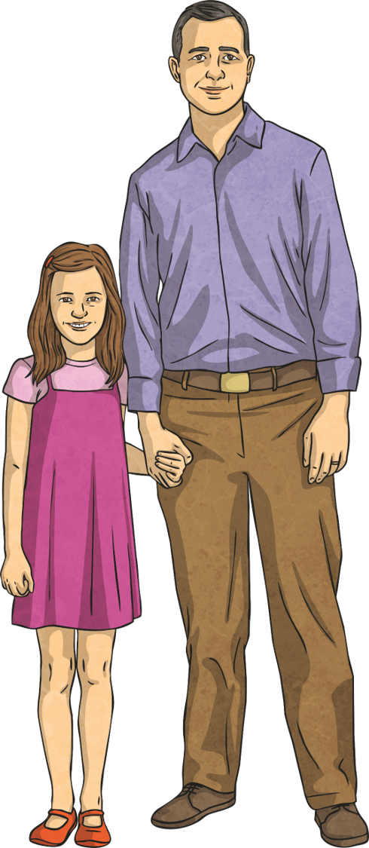
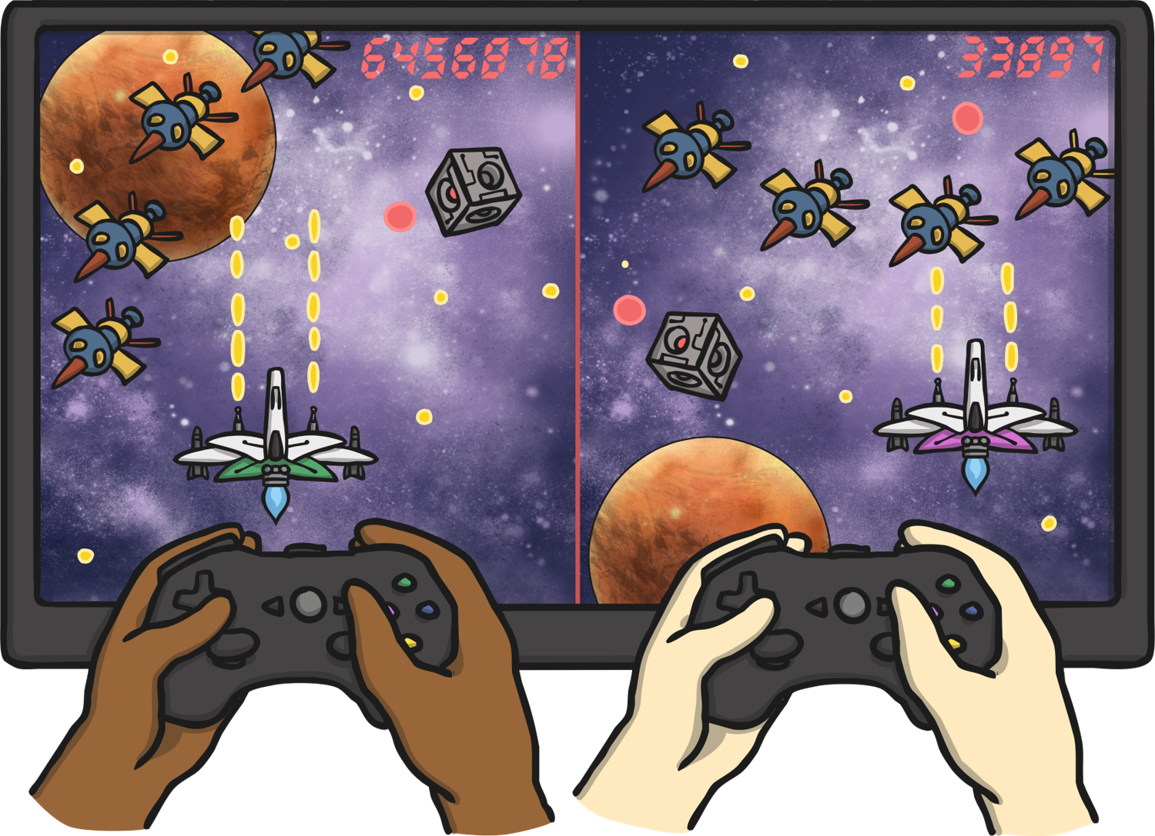
Healthy Relationships
What different sorts of relationships do people have?
Friendships
Romantic Relationships
Family Relationships
Online Relationships
Even within these groups, the relationship can feel different. For example, your relationship with a sibling might be different to your relationship with a parent.
Relationships go through different natural stages but it is always important to ensure your relationship, no matter the type of relationship, is healthy.

Slide 32
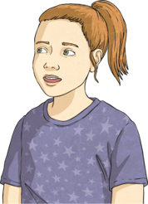
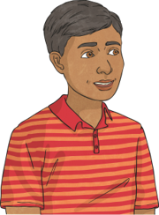
Risky Relationships
The following are signs of being in an unhealthy or risky relationship:
If they expect too much from us. If one of the people in the relationship expects their friend or family member to be there with them through everything they go through in life, it can prevent them living their own separate life. This is a sign of an unhealthy relationship.
If the relationship is unbalanced. This means one of the people in the relationship does a lot more work and puts in more effort to maintain the relationship, while the other person does very little. This can be a sign of the relationship being unhealthy.

Slide 33
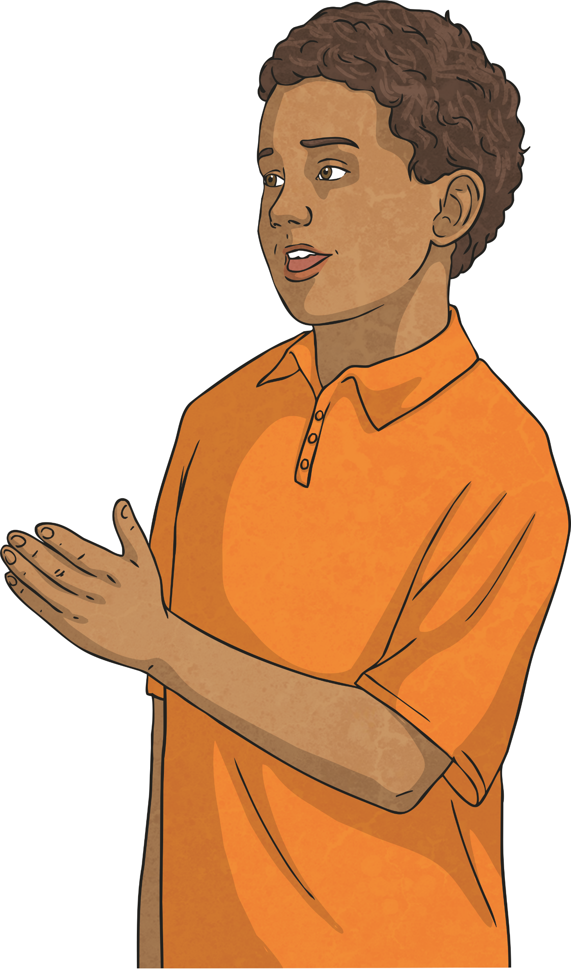
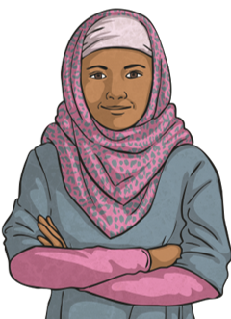
Risky Relationships
If you are made to feel guilty. Within a healthy relationship, the friends or family members would support and help each other without deliberately trying to make anyone else feel bad. A sign of an unhealthy relationship is when one of the friends or family members deliberately tries to make the other person feel bad.
If the relationship doesn’t allow change. Healthy relationships enable each of the people to progress and change through life. If one of the friends or family members cannot accept that a person has changed or that their life has changed then the relationship can
be unhealthy.

Slide 34
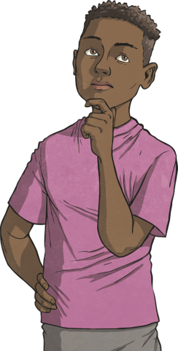
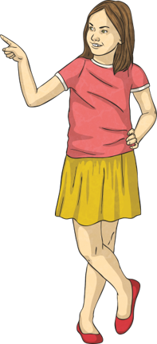
Risky Relationships
If you always accept the blame. Within a healthy relationship, both people would accept blame if they have done something wrong. Signs of an unhealthy relationship can include taking the blame for someone else purely to try and maintain the relationship. This is not healthy for the relationship.
If you feel bad about yourself. A healthy relationship would make you feel good about yourself, so if your friendship or family relationship makes you feel negatively about yourself then this is a sign of it being unhealthy.
If there is jealousy in the relationship. Within a healthy relationship, the friend or family member would feel happy if life is going well for the other person. If the person cannot feel happy for their friend or family member and feels jealous then that is a sign that the relationship is unhealthy.

Slide 35
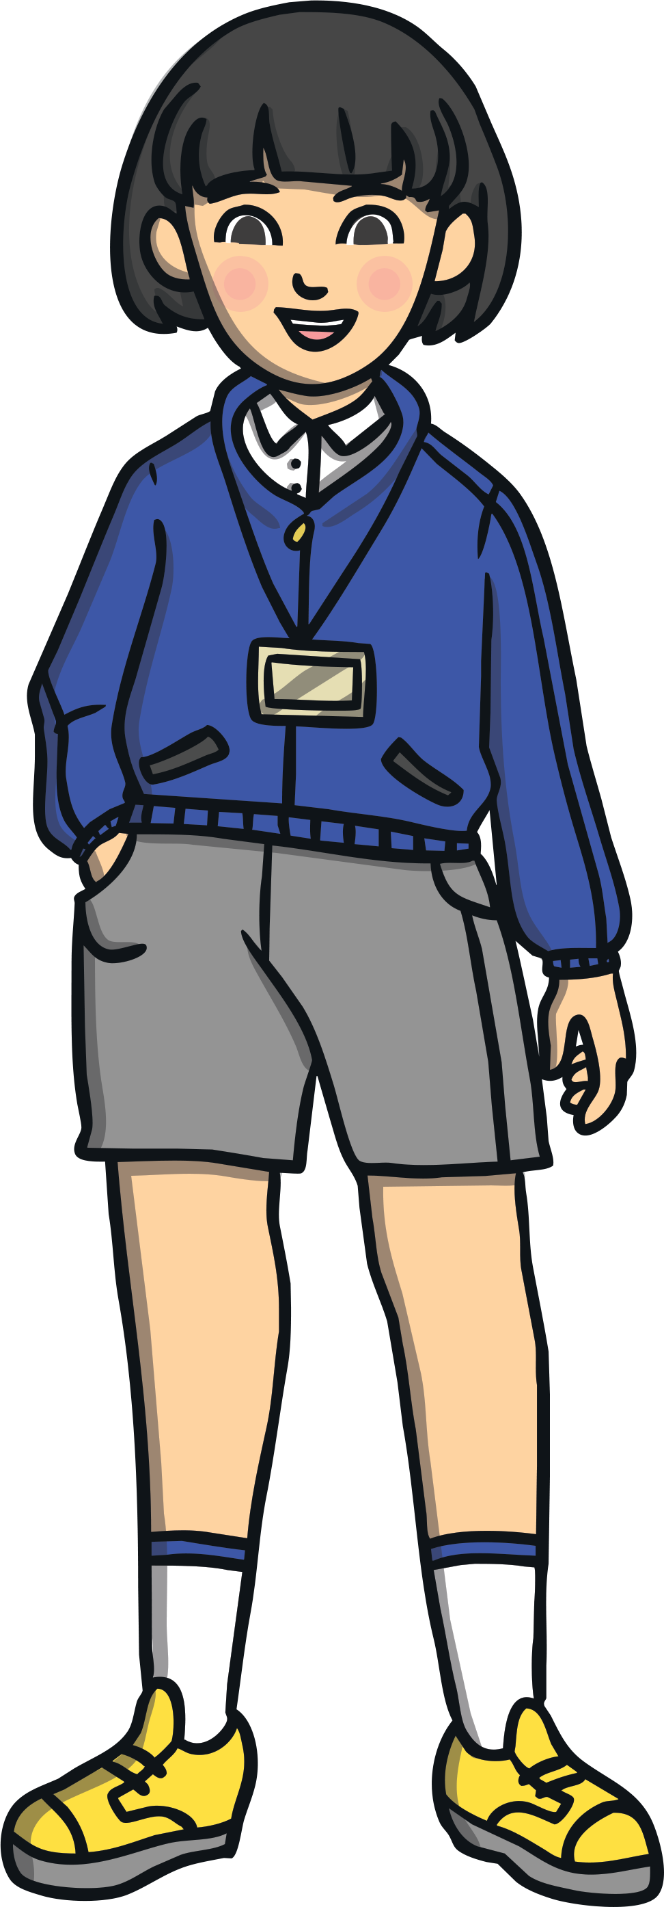
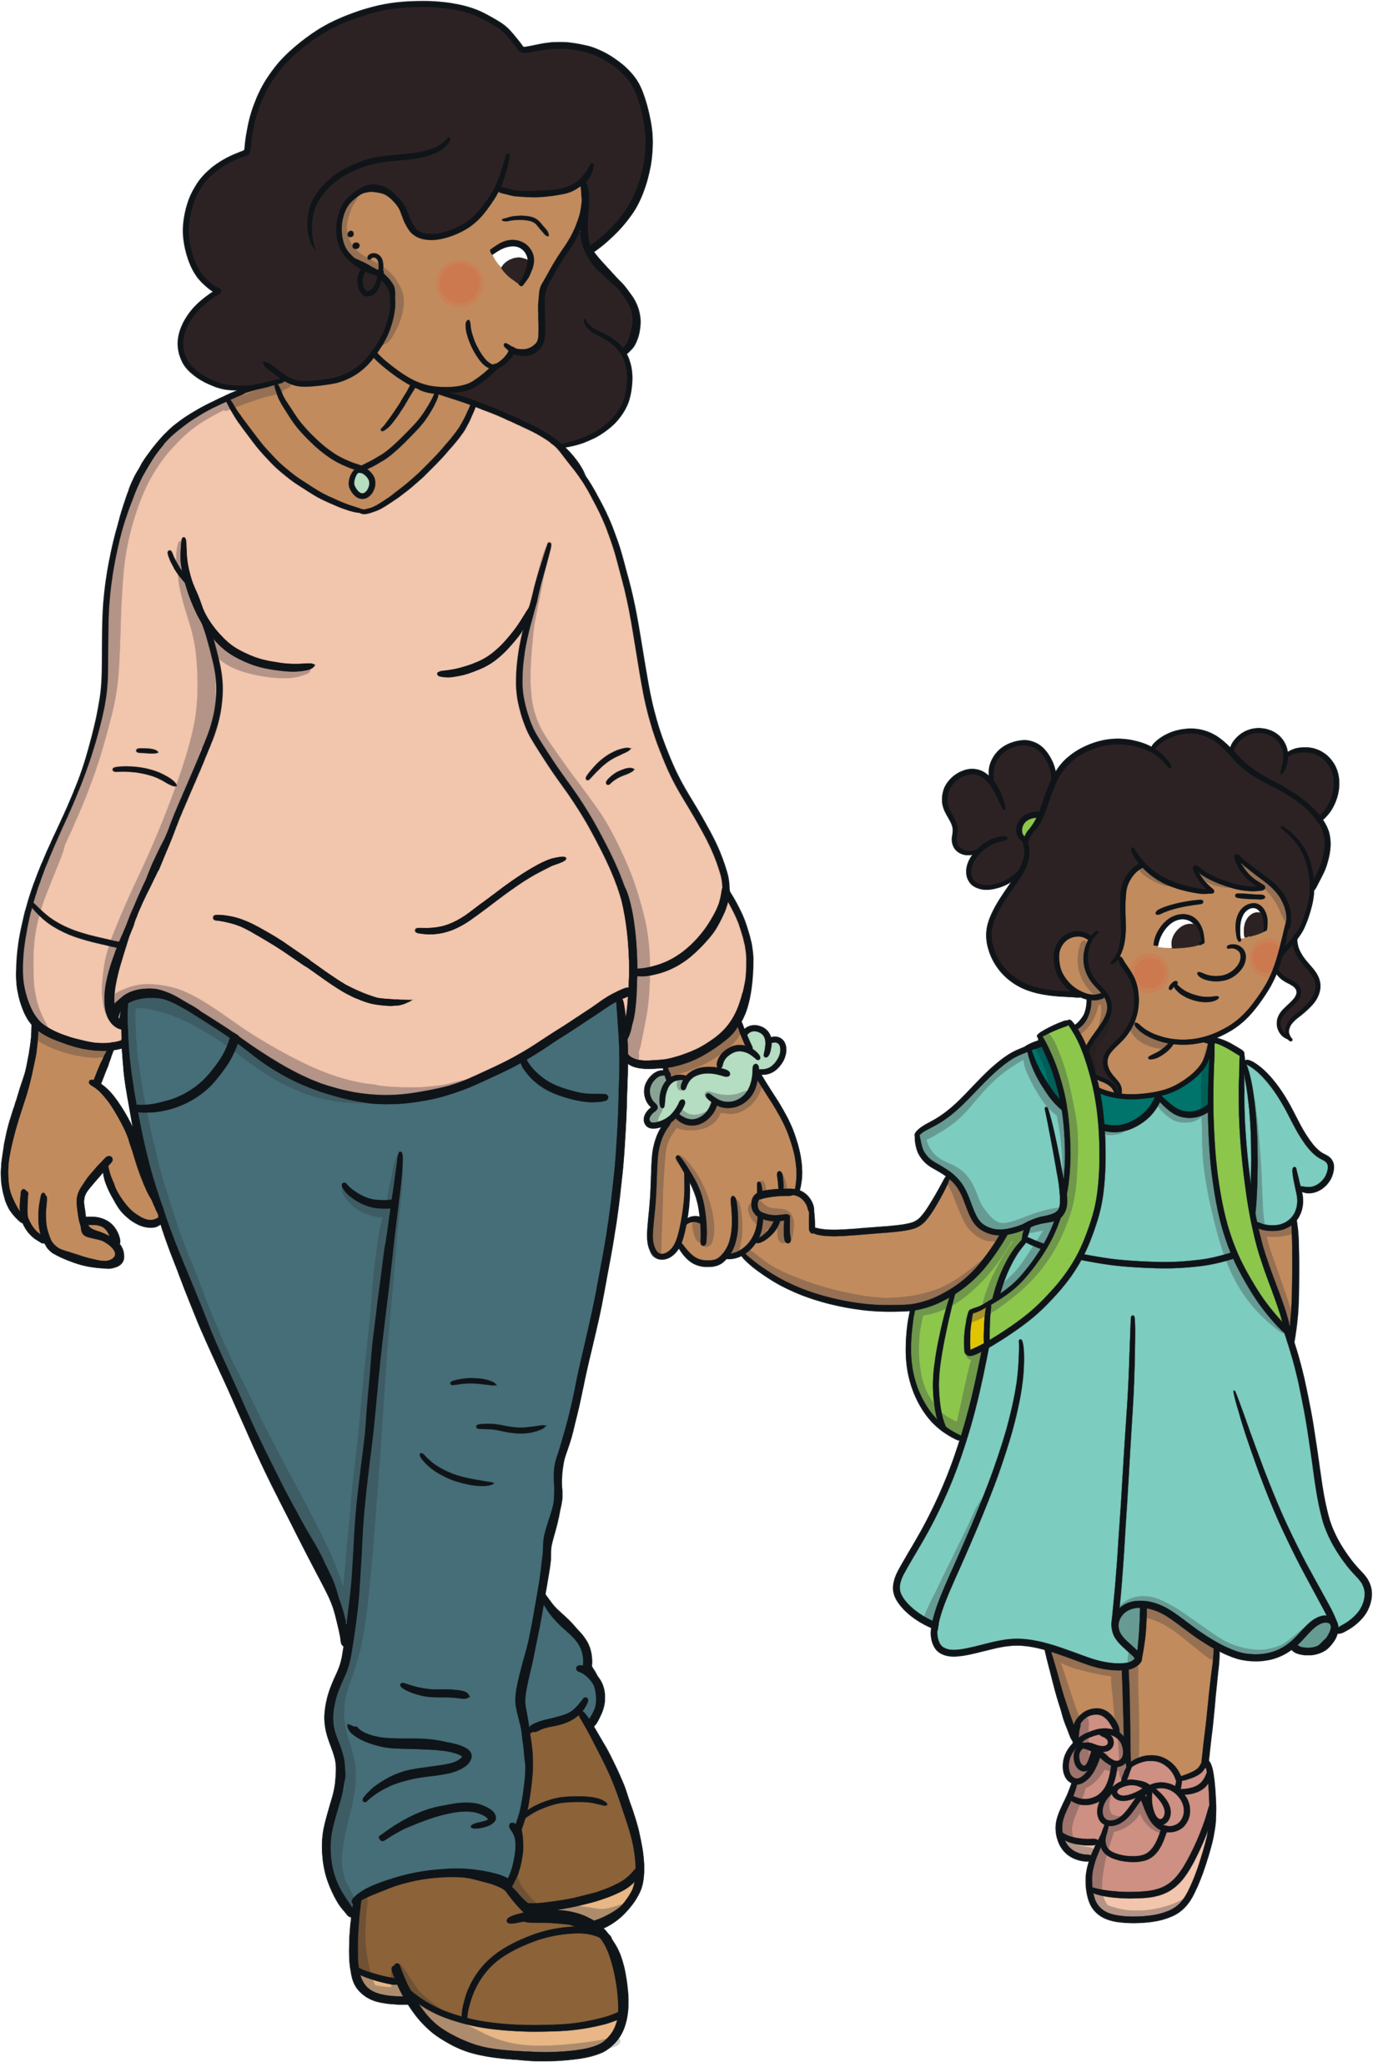
Risky Relationships
If a relationship makes us feel unhappy, unsafe or things regularly happen within the relationship that are unfair, it may be an unhealthy relationship.
If we are worried that someone special to us is feeling unhappy or unsafe within a relationship, their relationship may be unhealthy. We can help by speaking to a trusted adult about how we are feeling and get support for them.
Signs of an unhealthy relationship can be noticeable to us if we are the one in an unhealthy relationship. We may also notice if one of our VIPs is in an unhealthy relationship.
If we feel we need support for ourselves or for one of our VIPs, it is important to speak to a trusted adult about how we are feeling.
This might be:
parents or carers
school staff
teachers
other family members

Slide 36
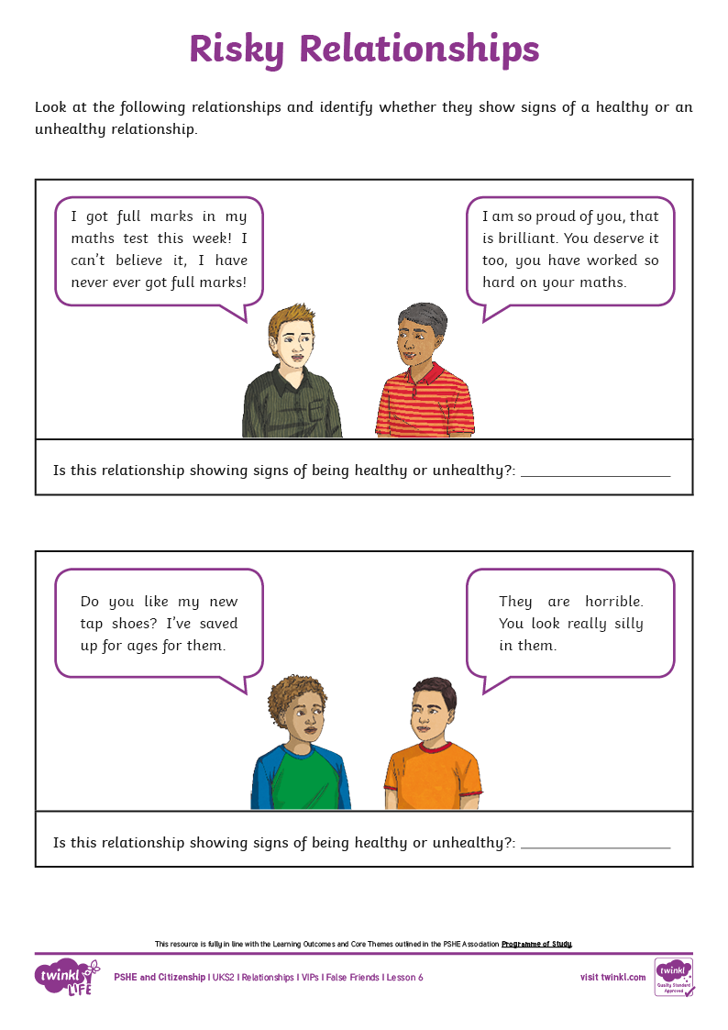
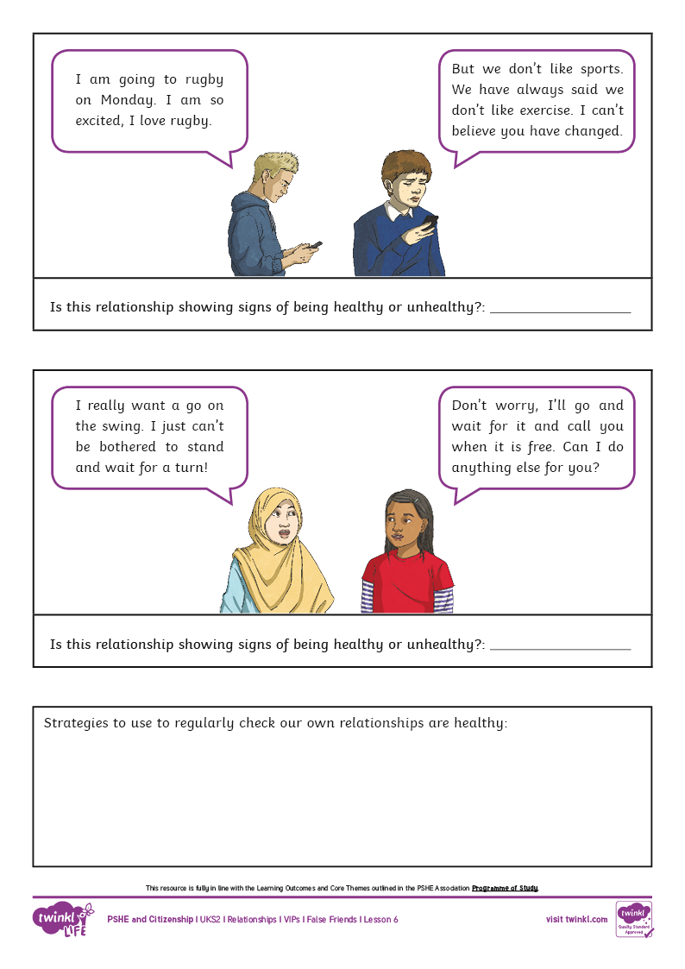
Risky Relationships
In pairs, use your Risky Relationships Activity Sheet to identify which relationships are unhealthy.
Discuss together whether the person in the relationship would be able to recognise that the relationship
is unhealthy.
Can you and your partner create a list of strategies that people could use to help them to regularly reflect on their own relationships to ensure they are healthy
and remain healthy?
Consolidating
Reflecting

Slide 37
Consolidating

Slide 38
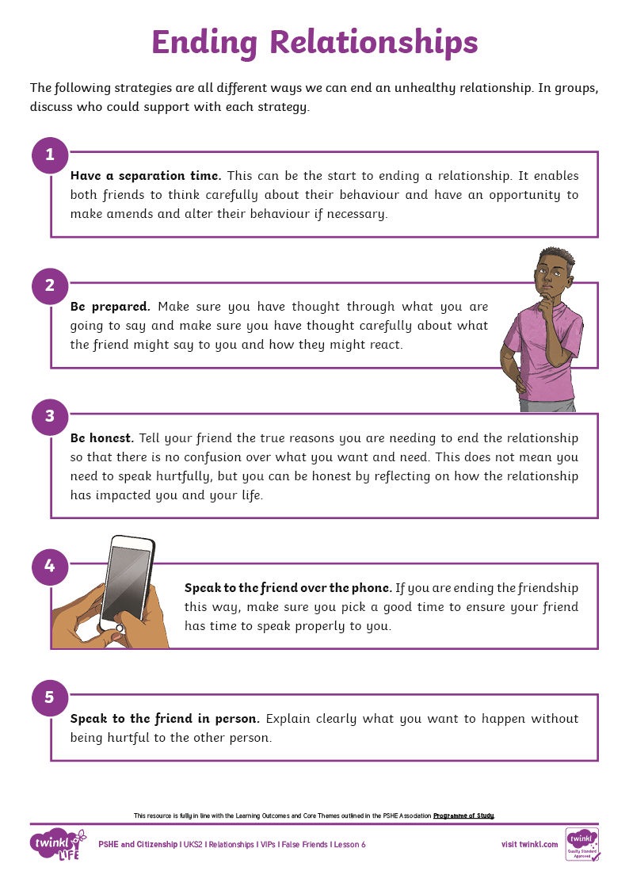
Ending Relationships
If we regularly reflect on our own relationships we will quickly spot if there is a part of the relationship that is unhealthy. Often, through honest conversations and a commitment to the relationship, we can work through the unhealthy aspects and things can change and improve.
If, however, things do not improve or if one of the people in the friendship does not want to change how they are behaving, then ending the relationship may be the best way forward in order for both people to have a healthy and happy life.
In your groups, look at the different ways a relationship can be ended using the Ending Relationships Activity Sheet.
Discuss in your group the different people who could support the ending of the relationship to ensure both friends can move on calmly and with full closure to the relationship.

Slide 39
Reflecting

Slide 40
Unhealthy Relationships
We have looked lots at how to spot unhealthy relationships or ones where we are uncomfortable or unhappy. A key part of setting up a healthy relationship that can stay healthy, whether face-to-face or online, is having really clear boundaries for your relationship. These might include:
feeling able to say if you don’t like something that is happening;
knowing you don’t have to tell each other everything and that some things can stay private;
feeling able to say a polite ‘no’ to something;
knowing that your body, your choices, your thoughts and your opinions are always your own and your friend or family member will have their own too;
not feeling like you have to drop everything else to do what
they want;
feeling able to say your own thoughts and opinions; and
knowing that you can have time apart.

Slide 41
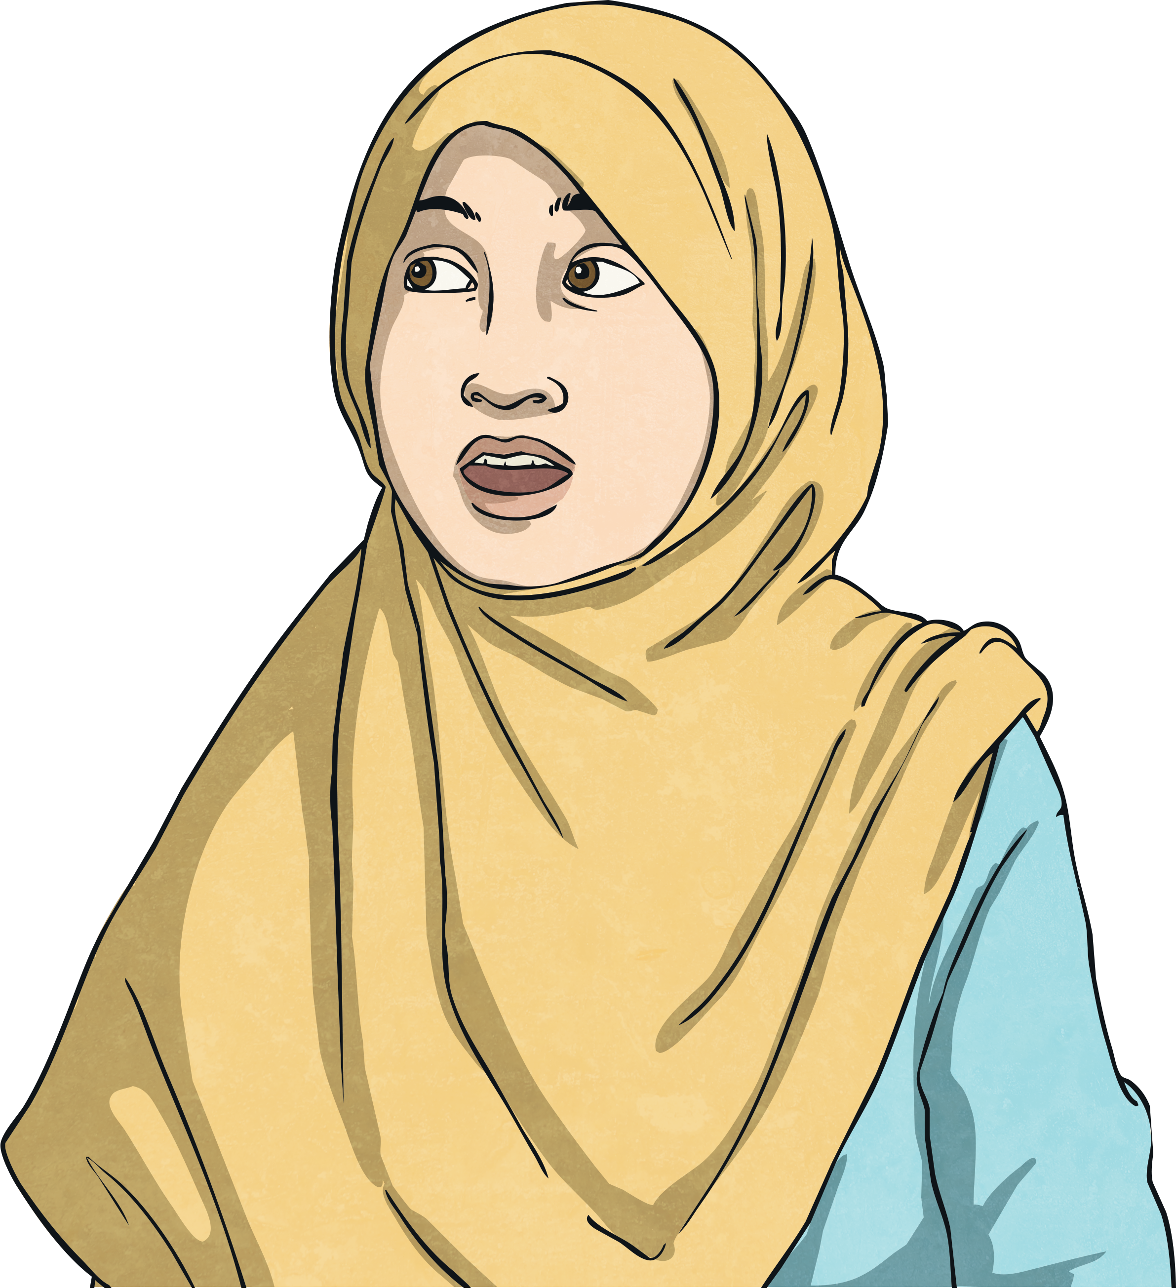
Unhealthy Relationships
Do you now feel confident identifying an unhealthy relationship?
How would you ensure your relationship is healthy?
What would you look out for?
How would you end an unhealthy relationship?

Slide 42
The Big Questions

Slide 43
What are some of the signs of an unhealthy or risky relationship?
When might it be best to end a relationship and how can we do this?
Have your answers changed since you placed your answers on the Big Questions Poster at the beginning of the lesson?

Slide 44
Aim
I can recognise healthy and unhealthy relationships.
Success Criteria
I can spot signs of an unhealthy relationship.
I can suggest different ways to end a relationship if necessary.

Slide 45
Prayer

