Slide 1
PSHE and Citizenship
Living in the Wider World | Diverse Britain
PSHE and Citizenship | UKS2 | Living in the Wider World | Diverse Britain | Respecting the Law | Lesson 3

Slide 3
Aim
I can explain why and how laws are made and identify what might happen if laws are broken.
Success Criteria
I can explain what laws are.
I can talk about how laws help me.
I understand that there are consequences to breaking laws.
I can explain what democracy means and reflect on actions which discriminate and show prejudice, identifying what I can do if I experience or witness this.
This resource is fully in line with the Learning Outcomes and Core Themes outlined in the PSHE Association’s Programme of Study.

Slide 4
The Big Questions

Slide 5
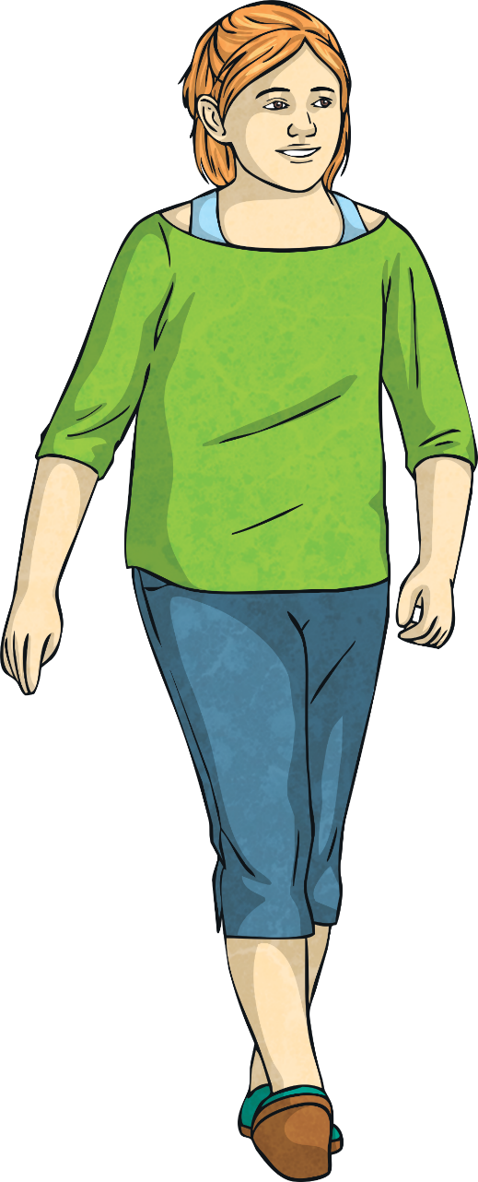
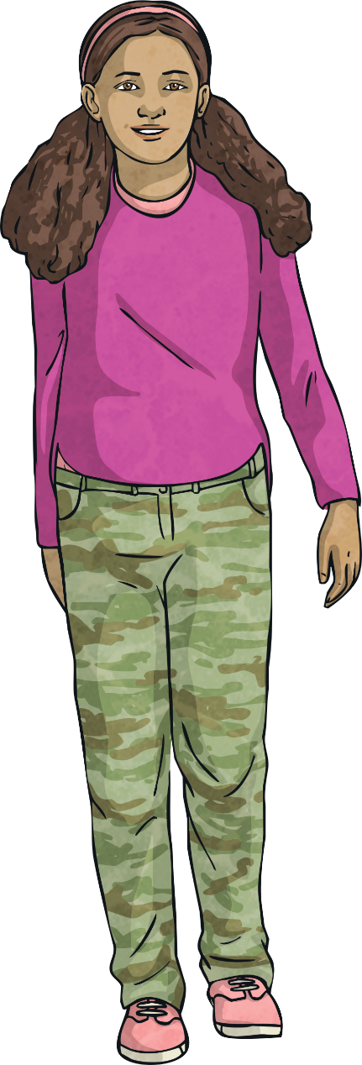
How does the law help us?
What could happen if laws are broken?

Slide 6
Reconnecting

Slide 7
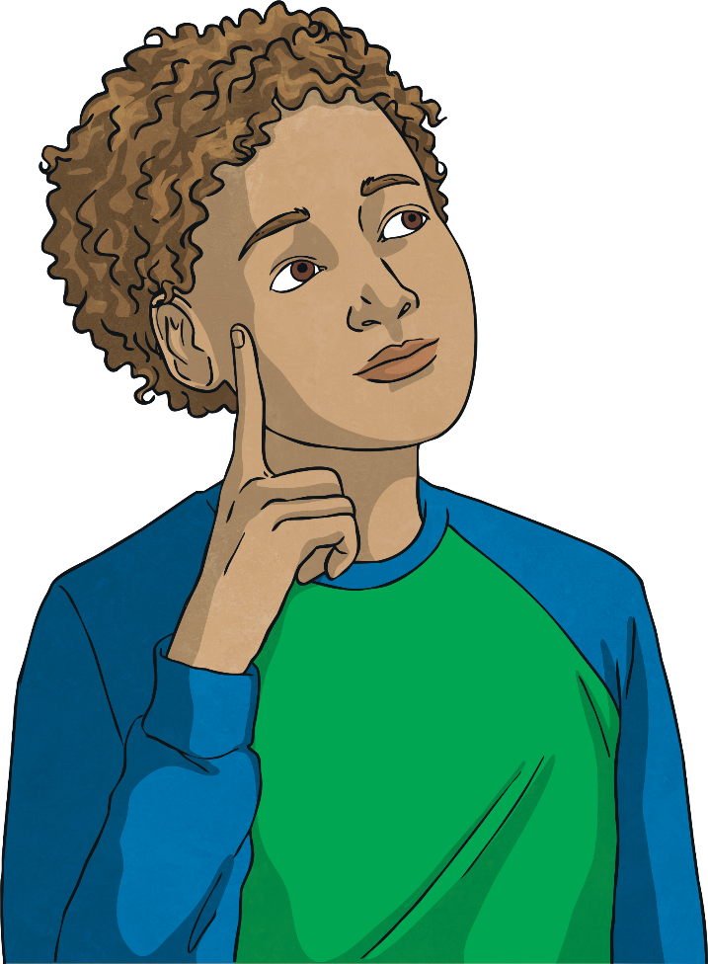
The Law
What do you already know about the law in our nation?
With a partner, write down everything you already know about the law in our nation.
Now, share all you know with the class.

Slide 8
Exploring

Slide 9
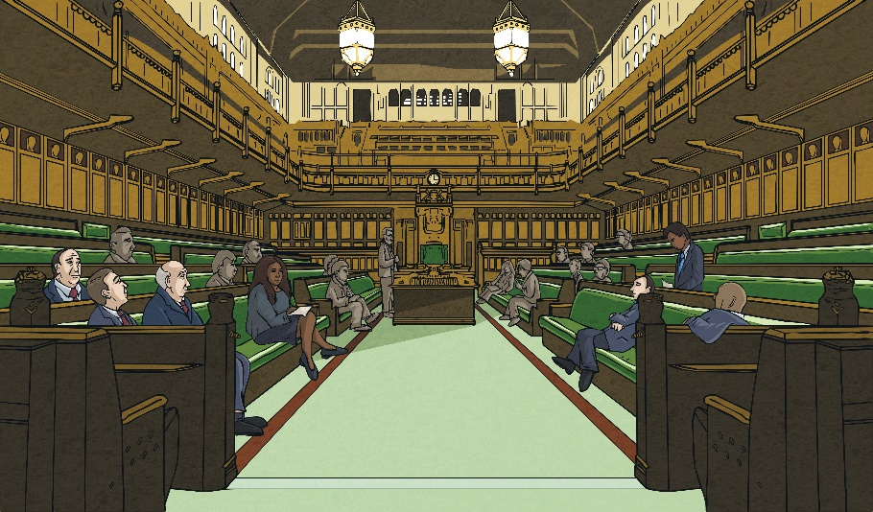
How the Law Helps Us
In our nation, there are many laws.
Laws are rules which we have to keep when working and living here.
They are made to protect all British people, helping to keep them safe, happy and well.
British laws are made in parliament at Westminster. Some British laws are also discussed in the Welsh Assembly, Scottish parliament and the Northern Ireland Assembly. Some laws apply in the whole of the United Kingdom, while others only in one, two or three of the countries. Although people who live in the Channel Islands are British citizens and the British parliament has the power to make laws for the Channel Islands, Acts of Parliament do not automatically extend to them as for the most part, they make their own laws.
Most of the laws in Britain are enforced by police officers in the different regions of the United Kingdom. Police officers are helped to enforce the laws by other groups, such as the National Crime Agency.

Slide 10
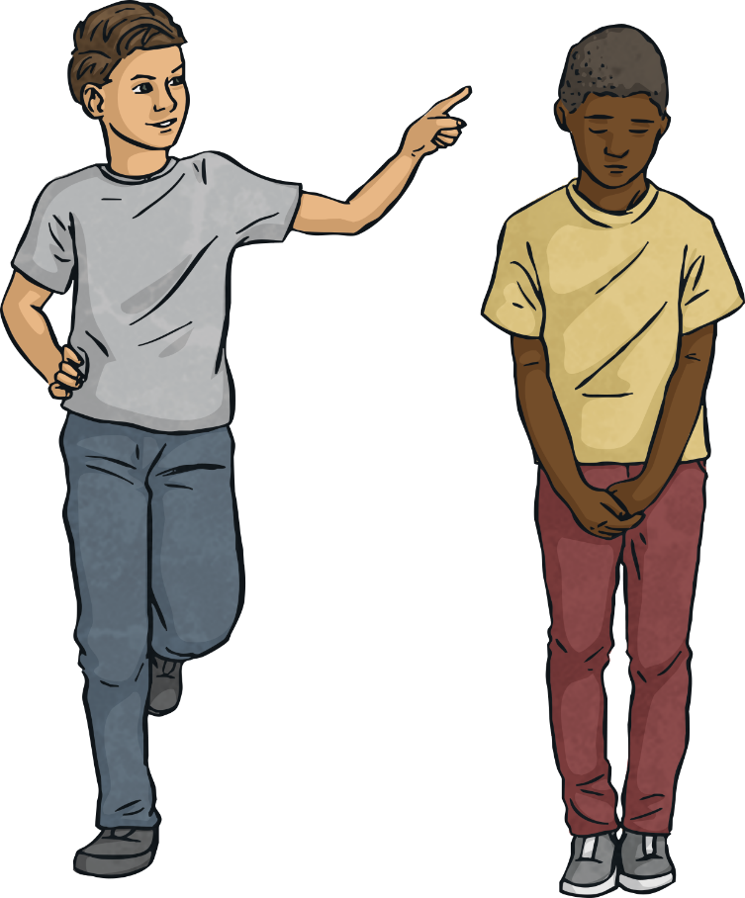
How the Law Helps Us
Our nation is a democracy. This means there is a belief in freedom and equality between all people and that the British government is based on this belief. British laws reflect this and protect the human rights of all people.
Unfortunately, there are occasions in our society where people’s human rights are not met and they are treated unfairly because of who they are, where they are from or how they choose to live their lives. This is called discrimination and is often based on prejudice - an opinion which is not reasonable or fair.

Slide 11
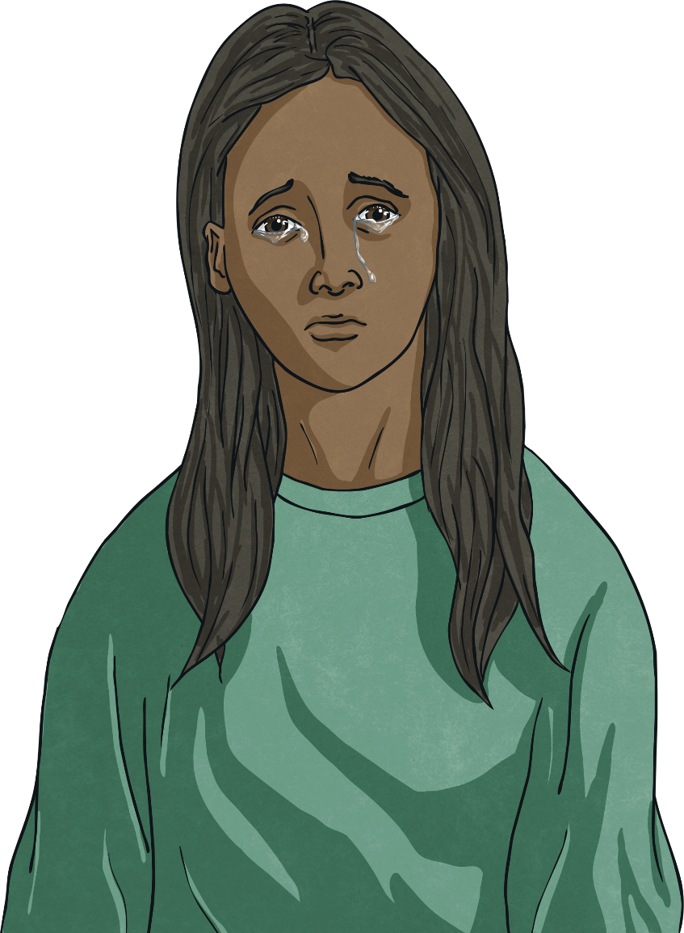
How the Law Helps Us
What might discrimination and prejudice look like in our society?
What should we do if we experience or
witness prejudice or discrimination?
All behaviour which is prejudice and discriminates is unacceptable and against British law. If you see it or it happens to you, tell an adult you trust and ask for help. If you or someone else is in immediate danger, call 999.

Slide 12
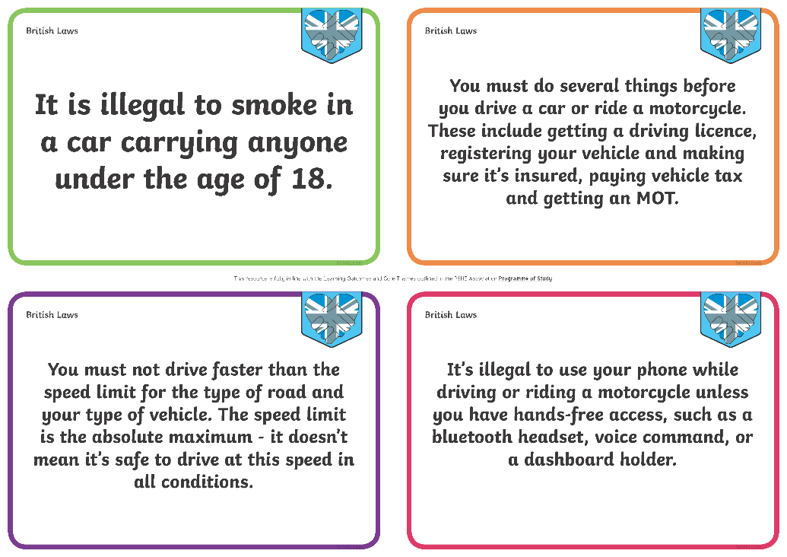
How the Law Helps Us
You are going to work in a group to take a closer look at some British laws.
Look carefully at the British law you have been given. In your group, discuss how it helps and protects British people.
Share your law and your thoughts as to how it helps British people with the class.

Slide 13
Consequences of Breaking the Law
There are consequences if we break the laws of our country.
What consequences can you think of?
The consequences are different depending on the age of the person who has broken the law but they could include getting a warning from the police, getting arrested, having to pay a fine or being sent to prison.

Slide 14
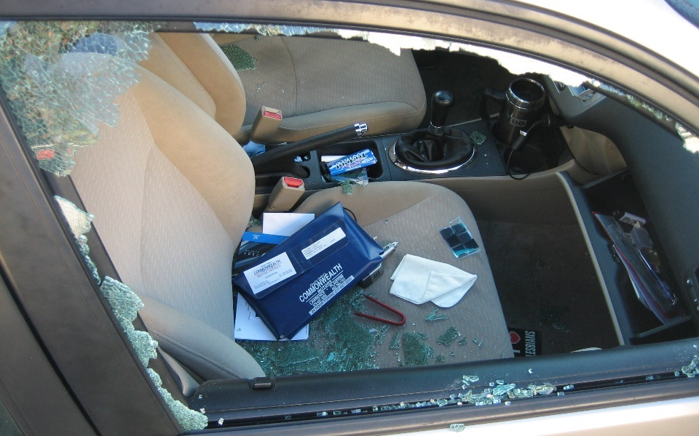
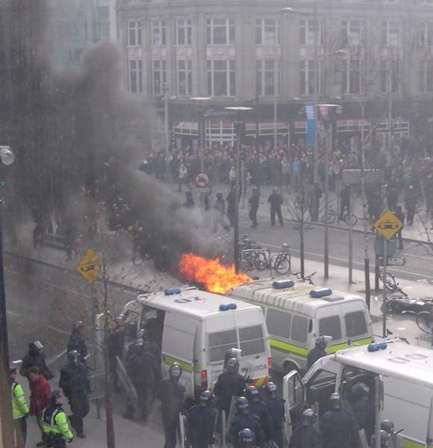
Consequences of Breaking the Law
Choosing to act in a way which breaks British law can have harmful consequences for the person breaking the law but also for the community.
Look carefully at the images below, which show people making bad choices and breaking British laws.
Consolidating
Reflecting
Photo courtesy of jon collier (@flickr.com) - granted under creative commons licence
Photo courtesy of debaird (@flickr.com) - granted under creative commons licence
What do you think the consequences were for the person who broke the law?
We all have the freedom and power to make good choices, which means we won’t face the consequences of breaking British law. Let’s all be good British citizens and keep British laws, for our own good and for the good of others.
What do you think the consequences were for the community?

Slide 15
Consolidating

Slide 16
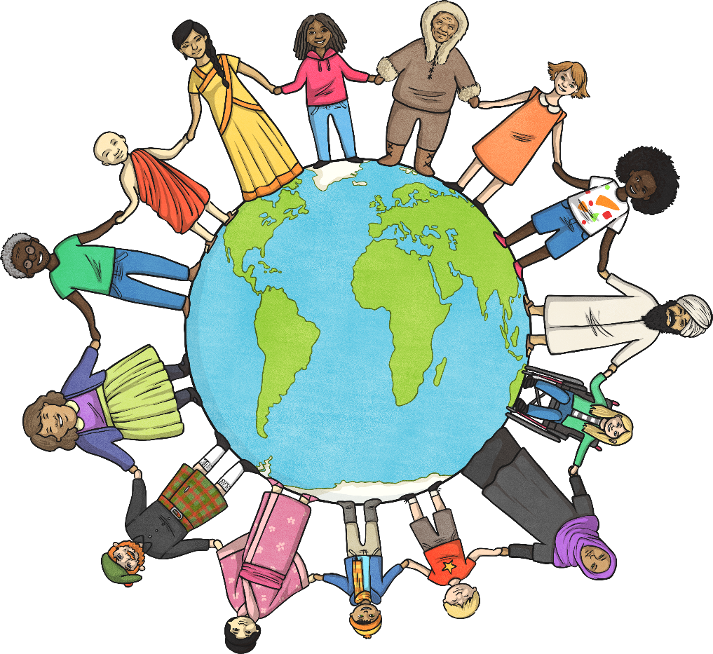
A Beginner’s Guide to British Law
British law is in an important part of our society. It keeps British people safe and happy.
Help others to understand this by writing a Beginner’s Guide to British Law. Explain what the law is, how it helps us and the consequences of breaking it.
Word Bank:
law
protect
help
safe
happy
consequence
break
choice

Slide 17
Reflecting

Slide 18
Imagining a Lawless Society
What would our nation be like if we didn’t have any laws?
Close your eyes and try to imagine this.
Open your eyes and think of one word to describe what you saw.
Share your word with the class.
Our Words to Describe a Lawless Society:
British laws are an important part of our country; they protect us and keep us safe. Let’s all work hard to respect our country’s laws.

Slide 19
The Big Questions

Slide 20
How does the law help us?
What could happen if laws are broken?
What have you learnt today which will help you make positive choices in the future?

Slide 21
Aim
I can explain why and how laws are made and identify what might happen if laws are broken.
Success Criteria
I can explain what laws are.
I can talk about how laws help me.
I understand that there are consequences to breaking laws.
I can explain what democracy means and reflect on actions which discriminate and show prejudice, identifying what I can do if I experience or witness this.
This resource is fully in line with the Learning Outcomes and Core Themes outlined in the PSHE Association’s Programme of Study.

Slide 23
Aim
I can discuss the terms democracy and human rights in relation to local government.
Success Criteria
I can talk about what local government is.
I can talk about what local government does.
I can explain how local government works.
I can think about how local government affects me and how I could become involved in it.
This resource is fully in line with the Learning Outcomes and Core Themes outlined in the PSHE Association’s Programme of Study.

Slide 24
The Big Questions

Slide 25
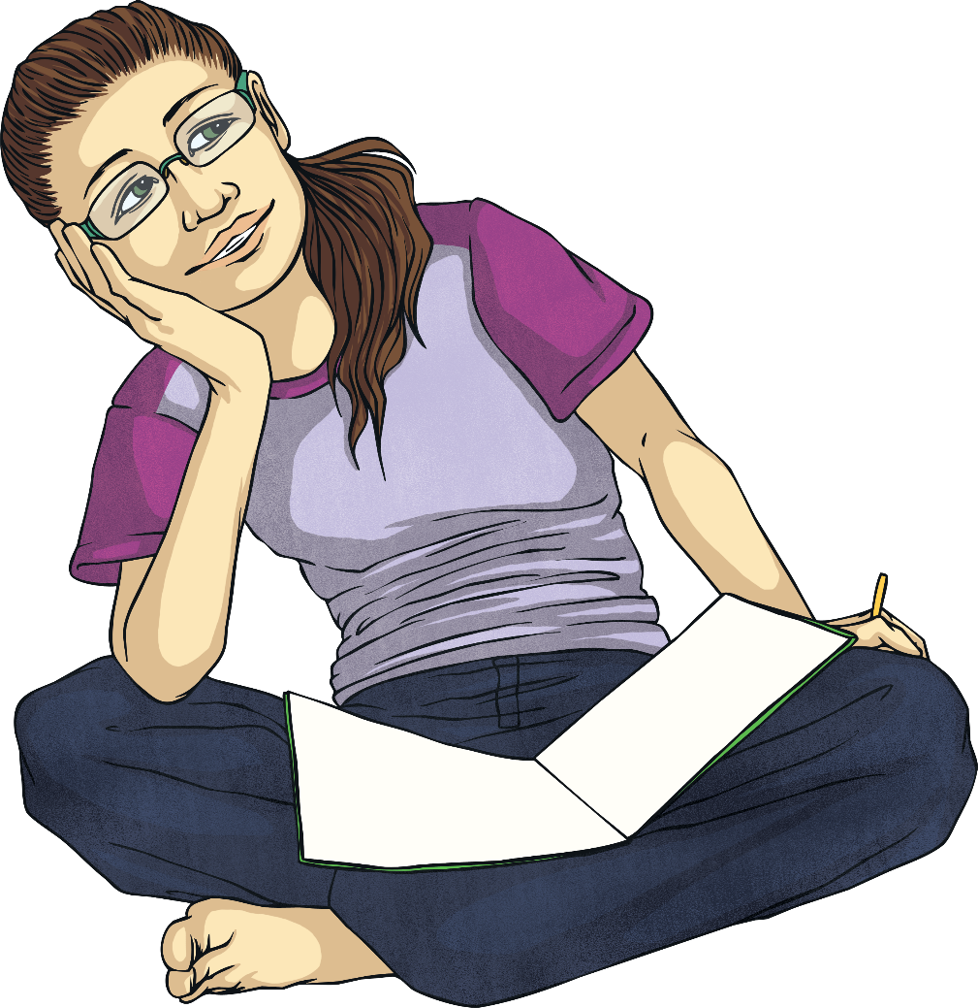
What is ‘local government’ and what does it do?
How does local government work?

Slide 26
Reconnecting

Slide 27
Democracy and Human Rights
What do you already know about democracy and human rights?
Share your thoughts with a partner and then feed back all you have talked about to the class.
What We Already Know about Democracy and Human Rights:

Slide 28
Exploring

Slide 29
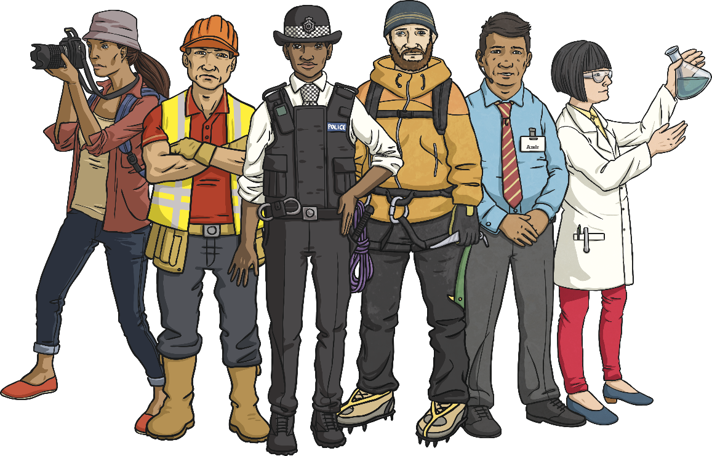
Local Government
Democracy is a belief in freedom and equality between all people.
There are basic human rights shared by all people and all societies, protecting and respecting these is an important part of democracy in Britain.
Britain is a democracy because it has a government which supports the belief in freedom and equality between all people.
It is also a democracy because the British people vote for the politicians in government.
In Britain, we have local government and national government.
Towns and other areas in Britain have a local government. It is an organisation which runs towns and small areas and the services they provide. Politicians who the people of the towns and small areas have voted for, and elected, work in local government.

Slide 30
Local Government
Local government has many different roles and responsibilities.
In your group, work to match the part of local government and the job it does.
What have you found out about the roles and responsibilities of local government?

Slide 31
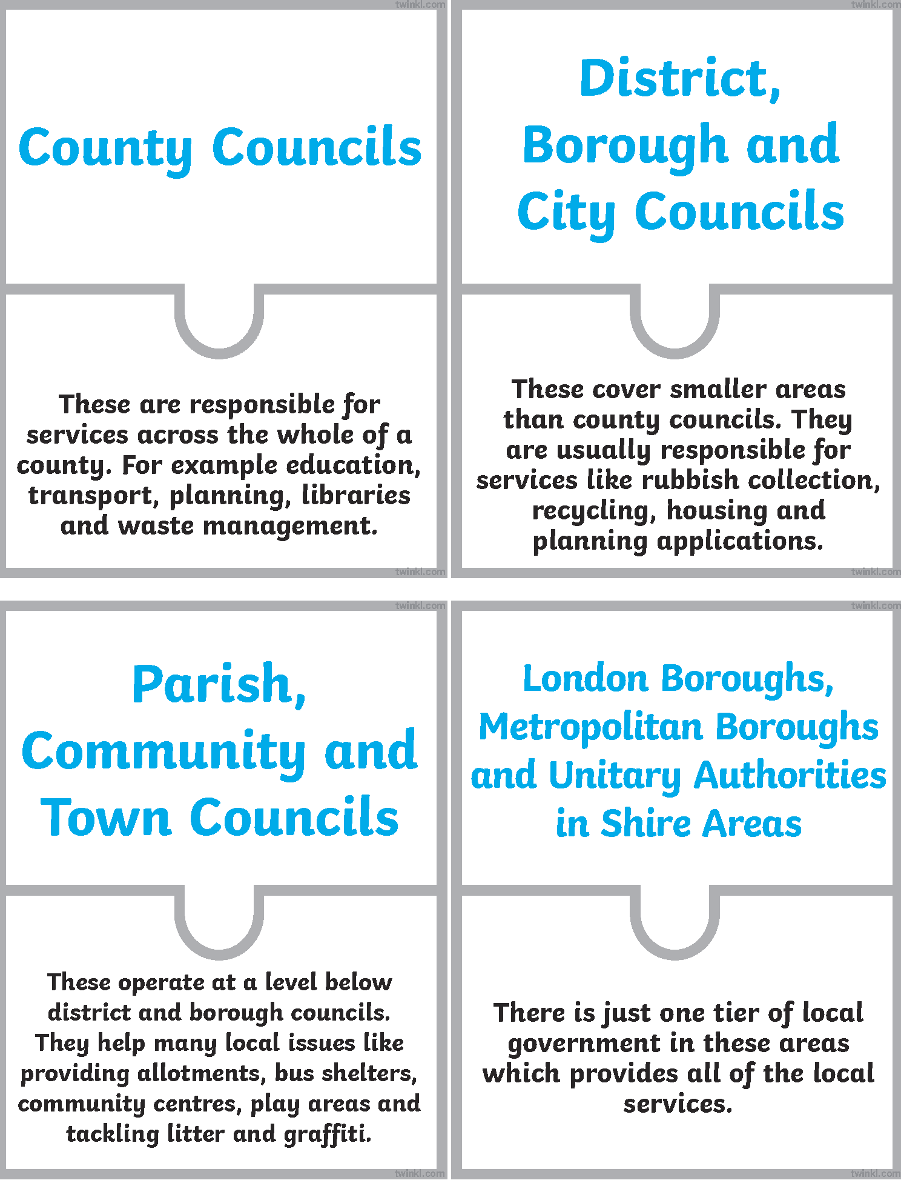
Local Government
How did you do?

Slide 32
Challenging Discrimination
What do the words below mean?
Click to reveal…
discrimination
This is when people are treated unfairly because of who they are, where they are from or how they choose to live their life.
prejudice
This is an opinion held about a person or a group of people which is not reasonable, fair or based on fact and often leads to discrimination.
stereotypes
These are a form of prejudice and often lead to discrimination. They are a widely held idea about a specific type of person which is unfair, oversimplified and over generalised.

Slide 33
Challenging Discrimination
Discrimination, prejudice and stereotypes are against all people’s human rights and do not have a place in a democracy.
Although these behaviours go against British values, there are unfortunately occasions where they occur in our society.

Slide 34
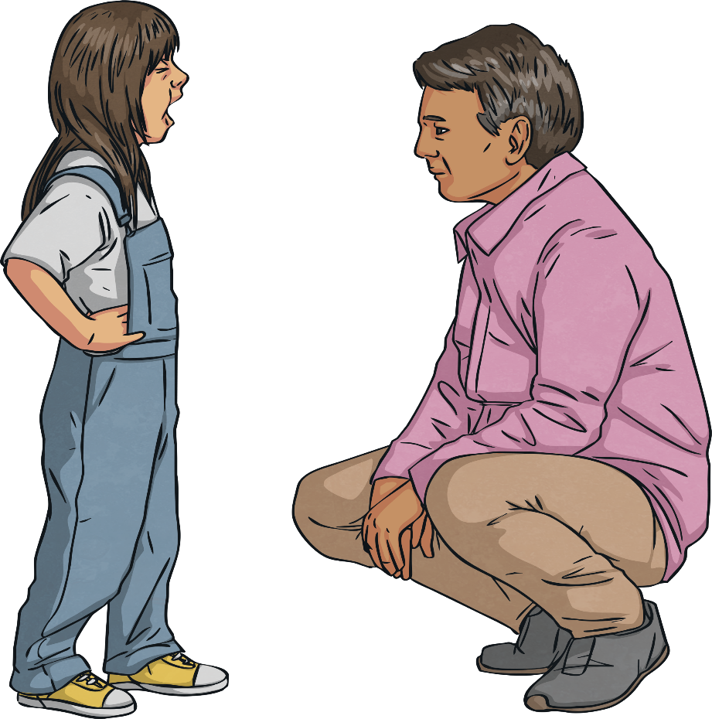
Challenging Discrimination
What can we do to challenge discrimination, prejudice and stereotypes?
We all have a shared responsibility to make choices and behave in a way which treats all people fairly, kindly and with respect, helping their human rights to be protected.
If we witness or experience discrimination or prejudice, we must tell an adult we trust and ask for help.
If we or anyone else is in immediate danger, we must call 999.

Slide 35
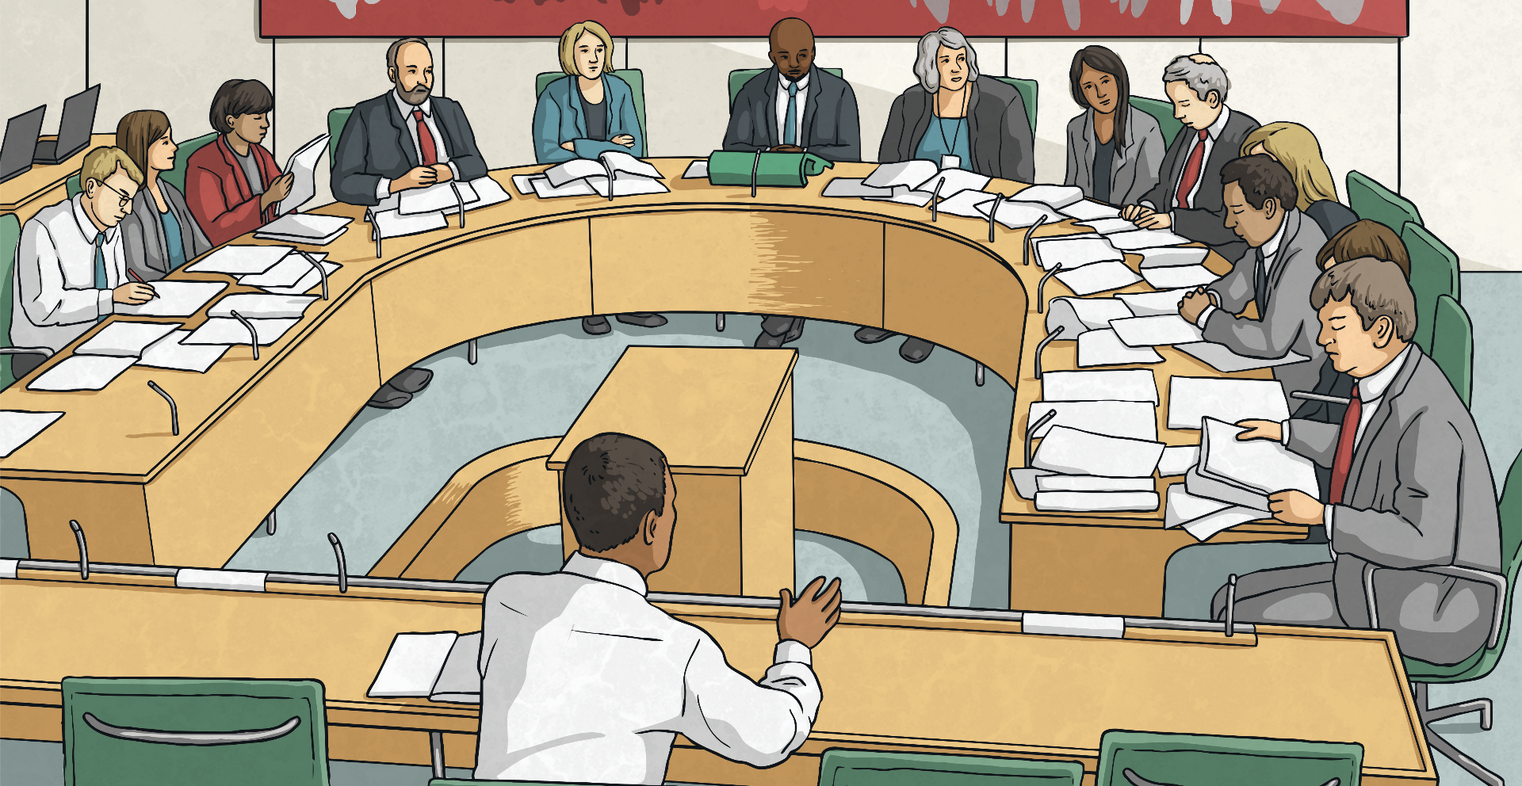
Challenging Discrimination
How can local government help to challenge discrimination, prejudice and stereotypes?
British local governments use the Equality Framework for Local Government to help local councils and communities meet their obligations under the Equality Act 2010. This helps them to eliminate unlawful discrimination, advance equality of opportunity and build positive relationships between all people.

Slide 36
Consolidating

Slide 37
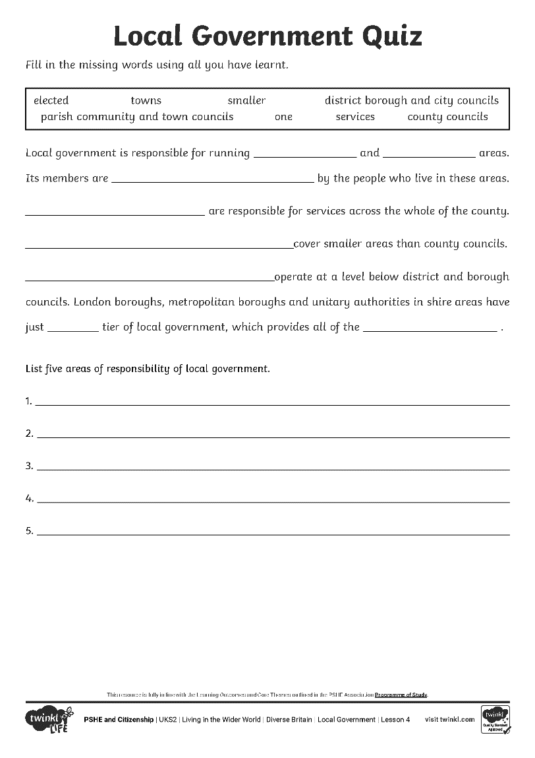
Working Together
British local government plays an important part in our daily lives.
Use all you have learnt to help you answer the quiz questions.
Word Bank:
human rights
democracy
local
government

Slide 38
Reflecting

Slide 39
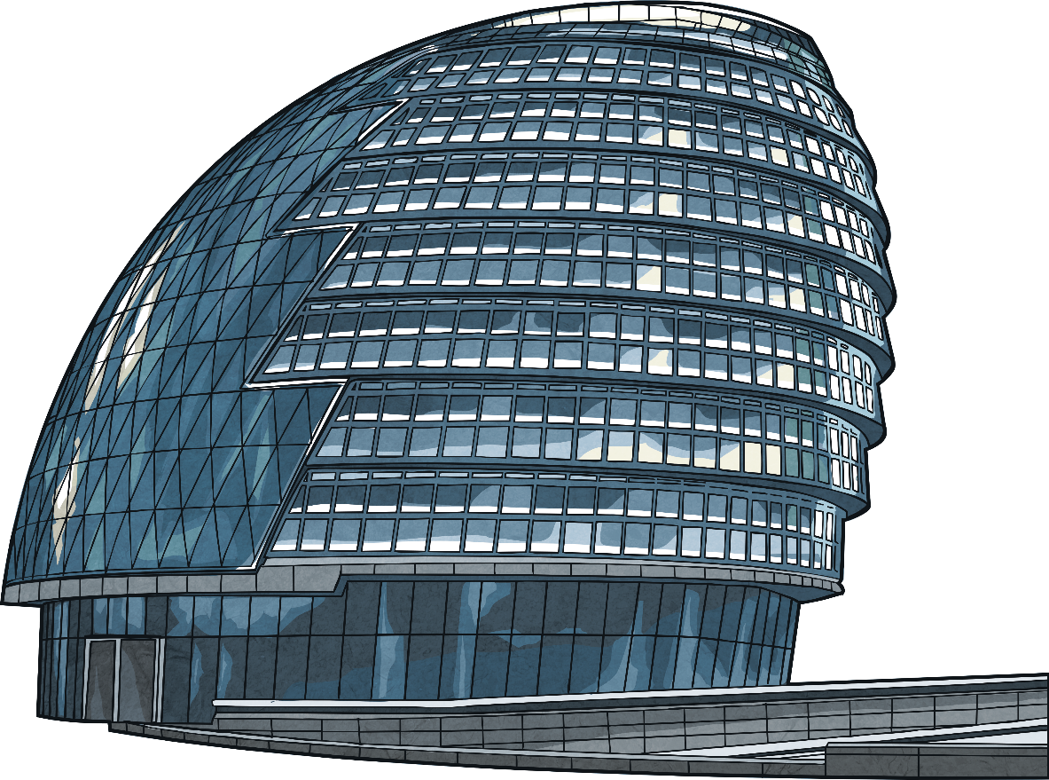
Local Government and Me
We can play an active part in local government and its projects.
Think about all we have learnt about what local government does.
Think about your answers to these questions:
How does local government benefit me?
How could I become more involved in local government?
If you feel happy to do so, share your thoughts with the class.

Slide 40
The Big Questions

Slide 41
What is ‘local government’ and what does it do?
How does local government work?
What is the most important thing you have learnt today?

Slide 42
Aim
I can discuss the terms democracy and human rights in relation to local government.
Success Criteria
I can talk about what local government is.
I can talk about what local government does.
I can explain how local government works.
I can think about how local government affects me and how I could become involved in it.

Slide 43
Prayer

