Slide 1
PSHE and Citizenship
Health and Wellbeing | Growing Up- Relationships and families
PSHE and Citizenship | LKS2 | Health and Wellbeing | Growing Up | Relationships and Families | Lesson 5

Slide 3
Aim
I understand that there are many different types of relationships and families.
Success Criteria
I can identify and describe different relationships, different families and different family members.
I can understand and use terms such as gay, lesbian, single-parent, fostered, adopted, married and civil partnership.
I can identify elements of a healthy, loving relationship.
This resource is fully in line with the Learning Outcomes and Core Themes outlined in the PSHE Association’s Programme of Study.

Slide 4
The Big Questions

Slide 5
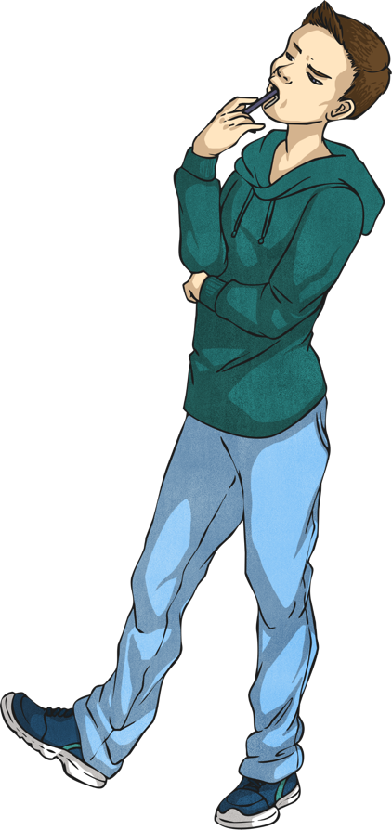
What are loving relationships like?
What kinds of family are there?

Slide 6
Reconnecting

Slide 7
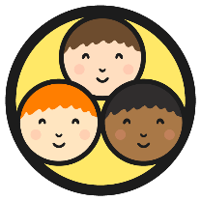
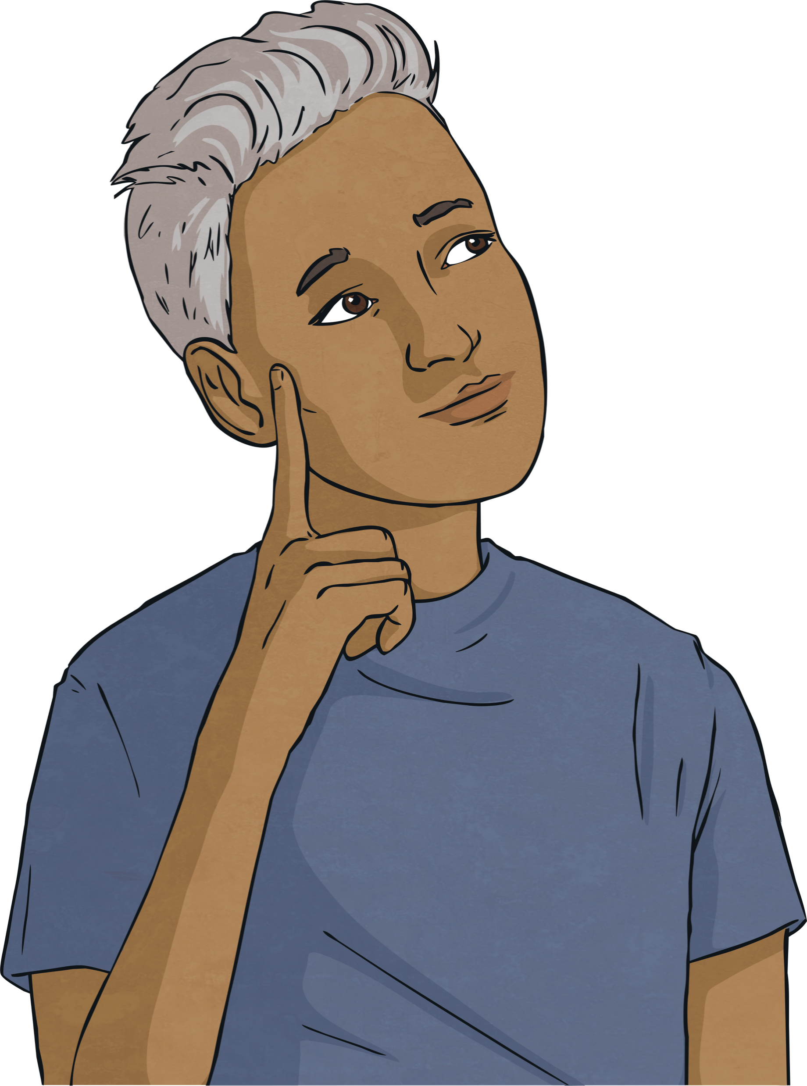
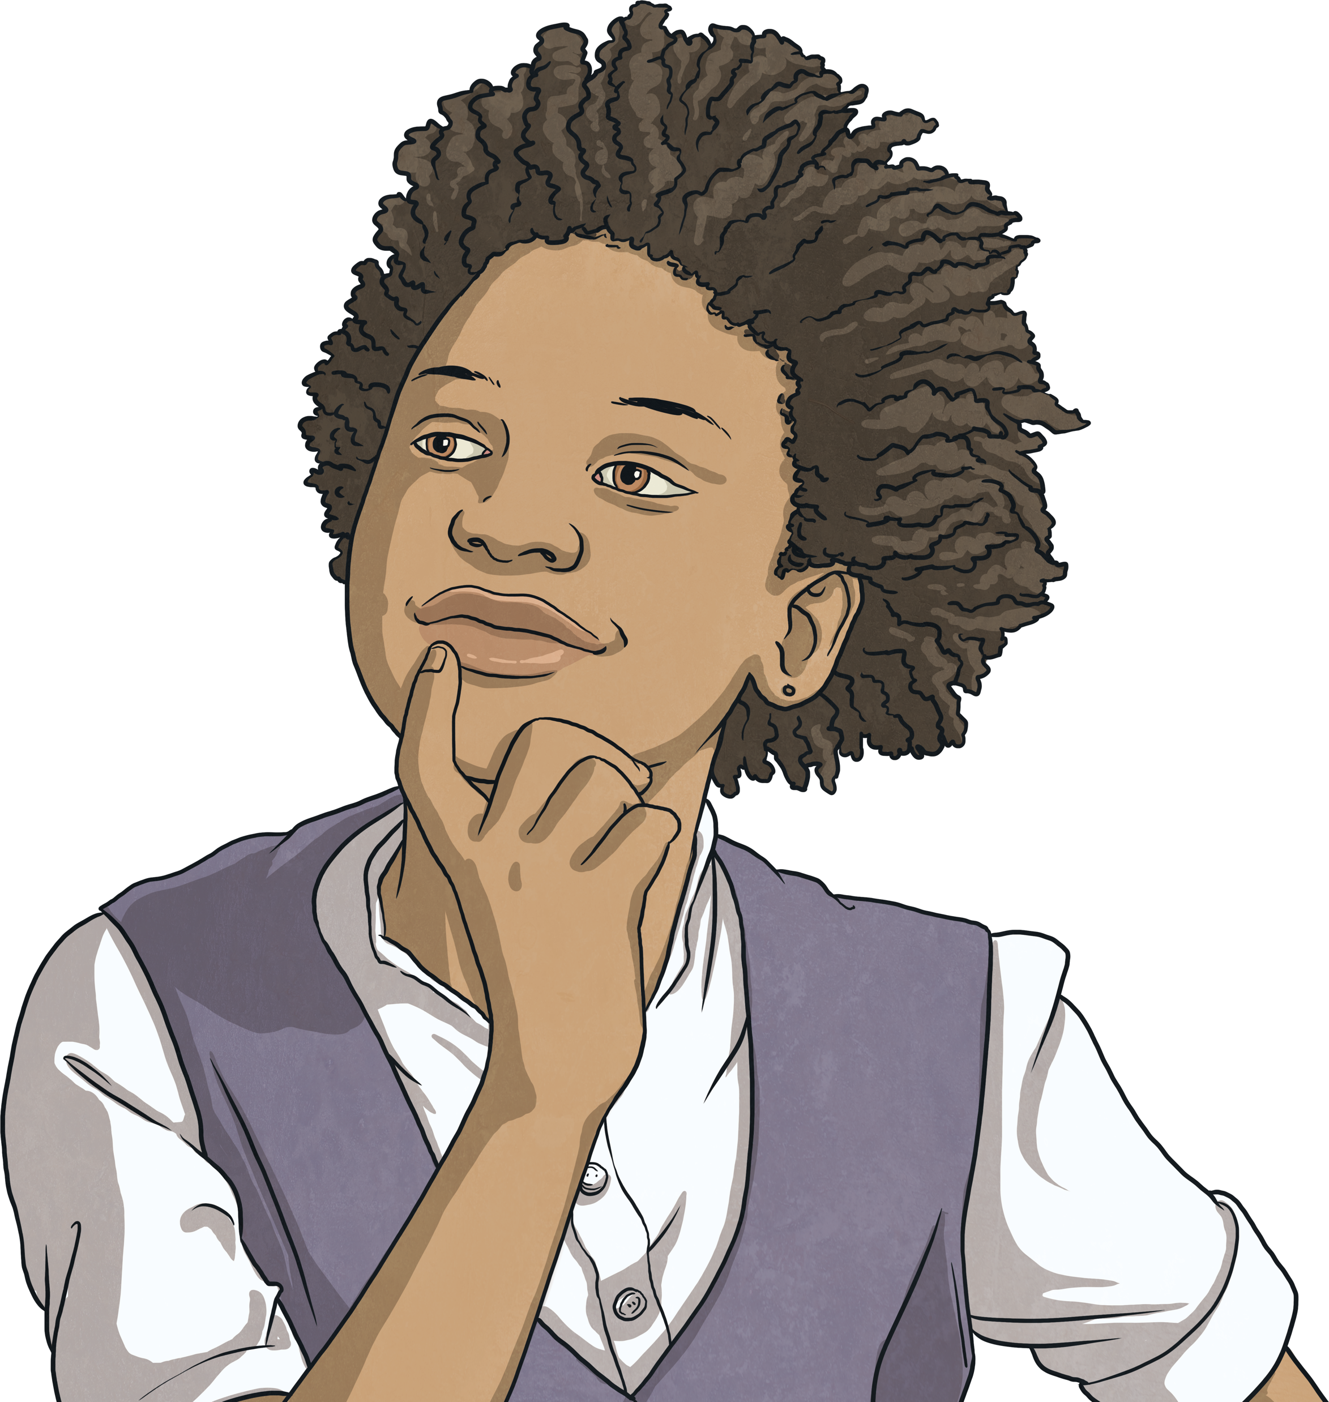
Different Relationships
Think about the relationships in your family.
What relationships do you have at school?
Are there different ways to love someone?
As we go through life, we have many different types of relationship with many different people:
We have different relationships with different family members.
We have different relationships with different friends.
Some people, when they get older, have romantic relationships with others and might choose to be part of a couple.

Slide 8
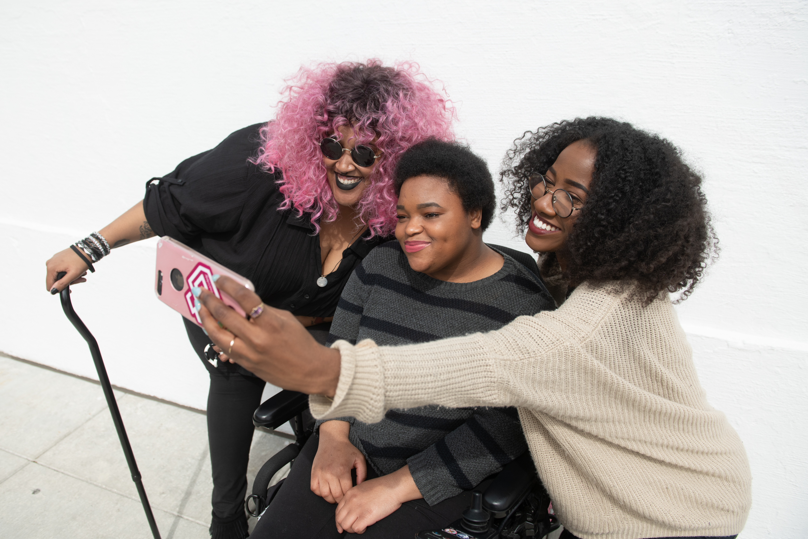
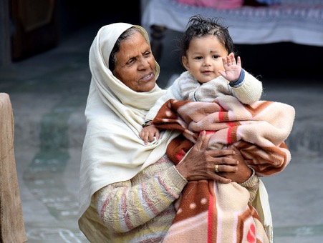
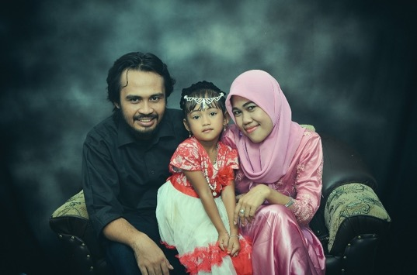
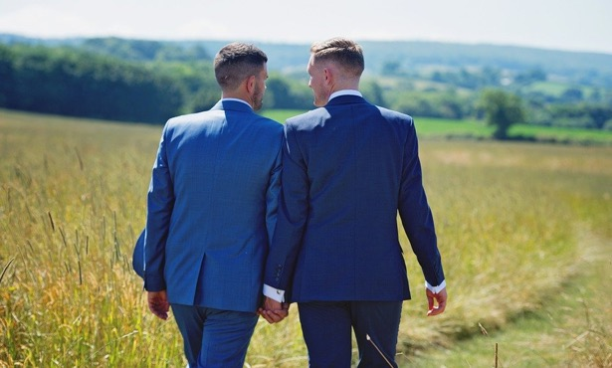
Different Relationships
What relationships can you see here?
“disabledandhere-008” by [Disabled and Here] is licensed under CC BY 4.0

Slide 9
Exploring

Slide 10
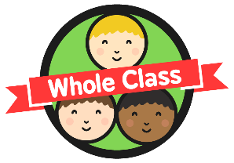
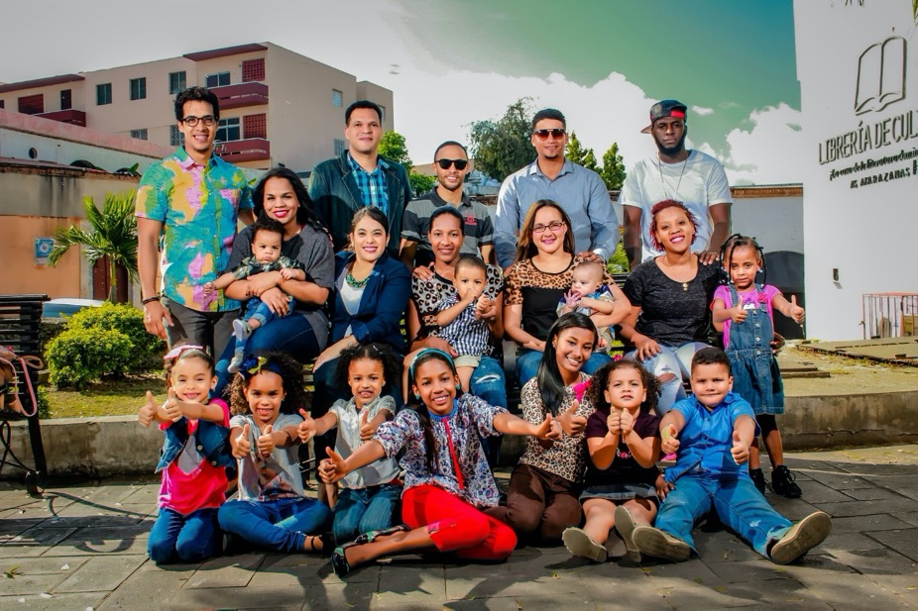
Relationships Within Families
How might all these people be related? Think of all the family member names you know to describe the relationships between people.

Slide 11
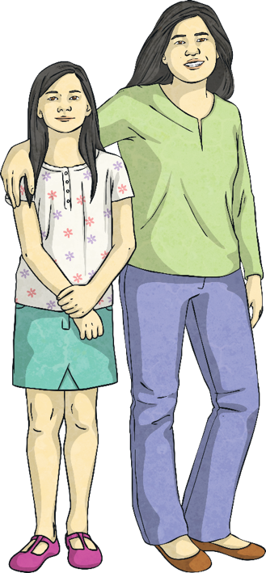
Relationships Within Families
Families can contain parents, children, grandparents, brothers, sisters, aunts, uncles and cousins.
Some families contain half-brothers or half-sisters.
Some families contain step-dads, step-mums, step-brothers or step-sisters.
Some families have no parents, while others have two mums or two dads. Two mums (a lesbian couple) or two dads (a gay couple) are called same-sex parents.
When there is just one parent in a family, they are called single-parent families.

Slide 12
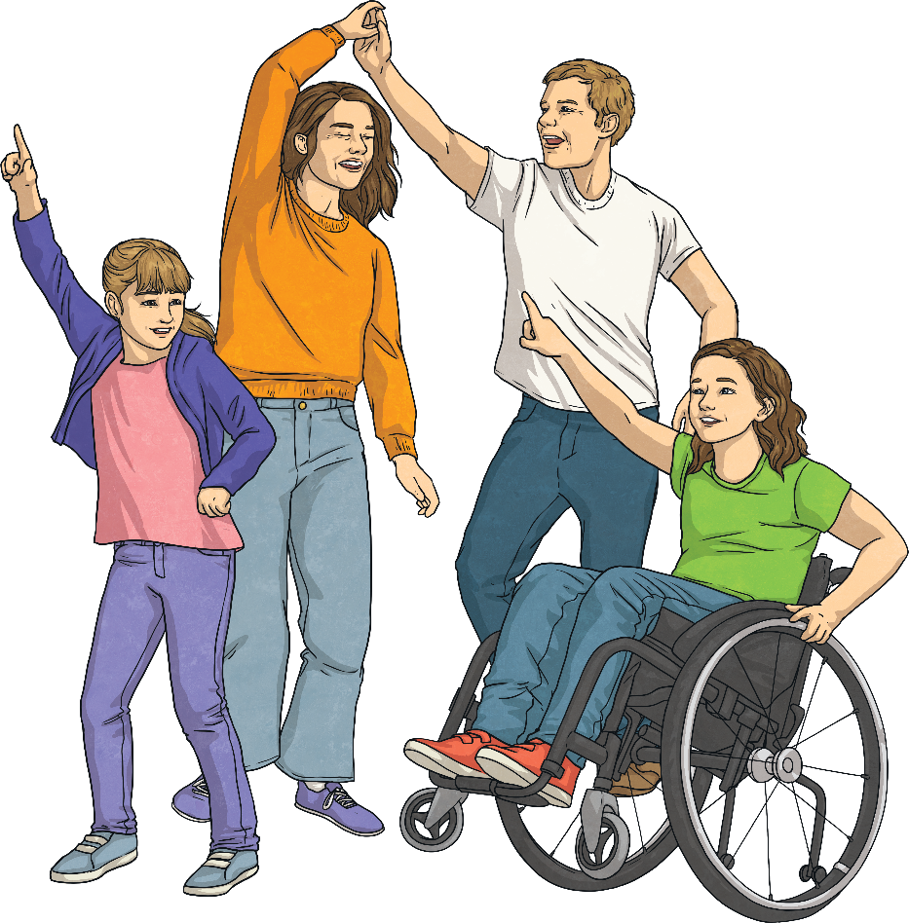
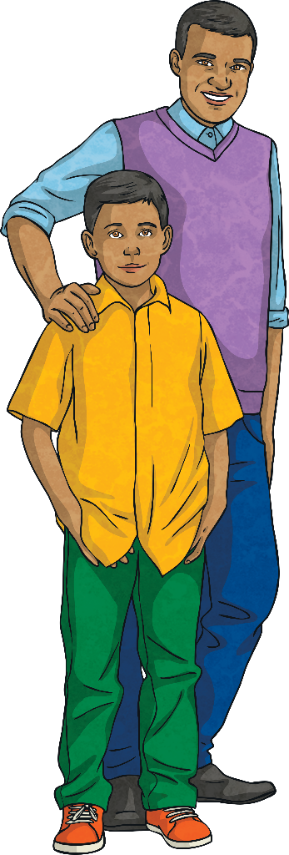
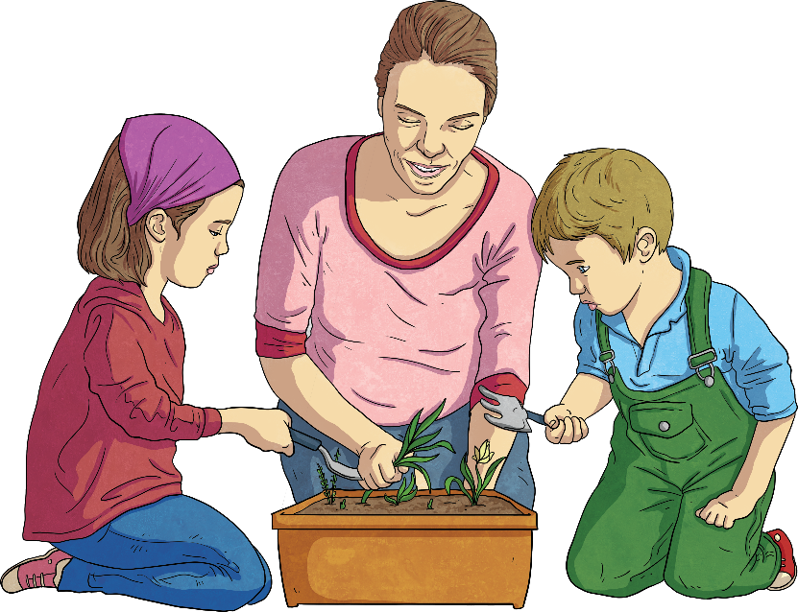
Relationships Within Families
Some children don’t live with their parents. In some families, children might be looked after by grandparents, aunties or uncles.
In other families, children live with carers - people who look after them who are not related to them but who care for them in all the same ways that a parent would care for a child.

Slide 13
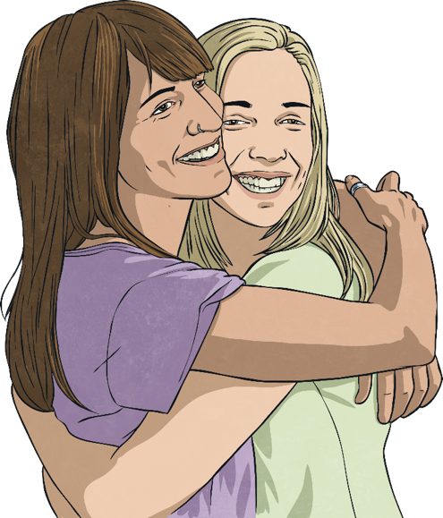
Relationships Within Families
In some families with two parents, the parents are married.
In others, the couple might be in a relationship called a civil partnership.
When two people want to be together and stay together, they make a commitment to each other. They promise to love and care for one another and often they celebrate this promise with their family and friends.
Two people who love and care for one another can be in a committed relationship, without being married or in a civil partnership.

Slide 14
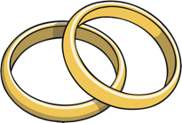
Relationships Within Families
Marriage is an agreement entered into by two people who love each other. Both people must be happy to get married.
Forcing someone to marry when they don’t want to is a crime.

Slide 15
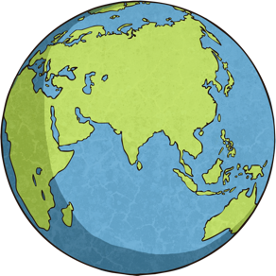
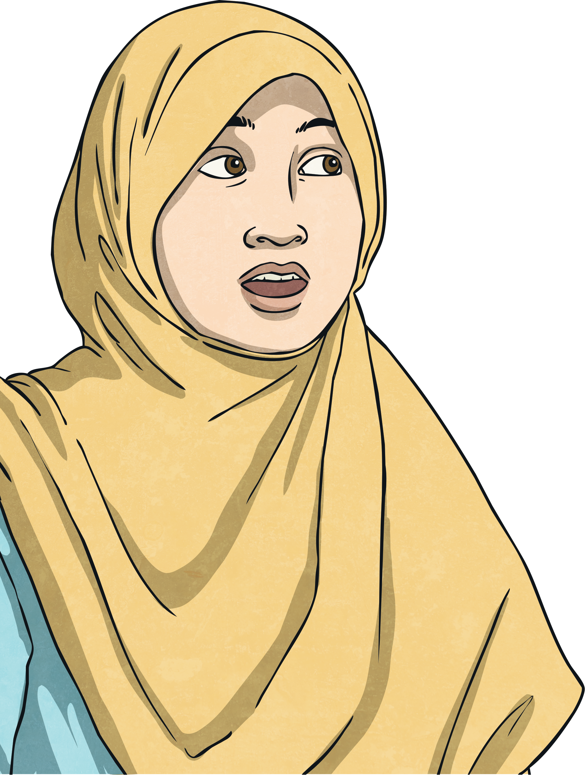
Diverse Families
Diversity means difference and it’s a great thing to celebrate. The world would be a very boring place if we were all the same!
Learning about other people, different types of relationships and other families that might be different from our own is important.
Remember – there is no ‘normal’ type of family or ‘normal’ way to be and it is important to respect the differences between us all.
Let’s meet some families and some individuals. They may be like your family or someone you know or they may be different.

Slide 16
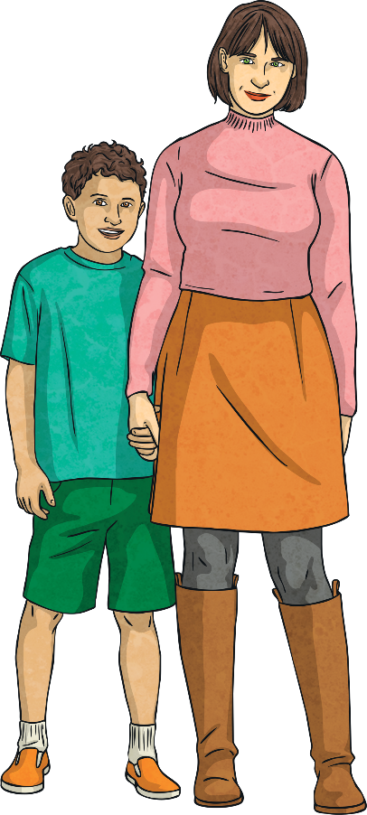
Diverse Families
This is the Ayoade-Davies family. They are a blended family.
David and Lena had both been married previously and had each had a child with the partner they were once married to.
They then split up from their partners and got divorced. Some time later, David and Lena met at the gym they both go to and began a relationship.
Four years later, they live together with David’s son, Lena’s son and the baby daughter they have had together. They have chosen not to get married.

Slide 17
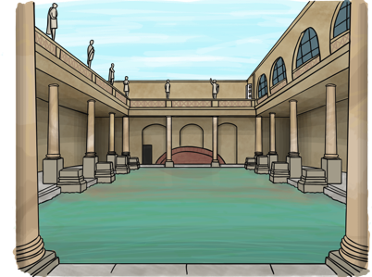
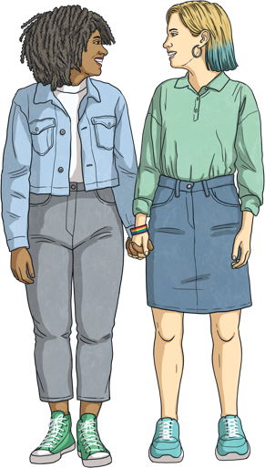
Diverse Families
This is Freya. She’s 19 and goes to university in a city called Bath, where she is studying physics.
Freya is bisexual which means she is attracted to men and women.
Freya had a boyfriend when she was at
school, before she came to university, but they broke up.
She now has a girlfriend who she met in one of her physics classes.

Slide 18
Diverse Families
This is Bella. She moved to England with her father when she was nine years old.
Sadly, when Bella was 14, her father died so her grandmother came to England to look after her.
Now, Bella is 18. She still lives with her grandmother and she also now has a son. They share a small flat.
Bella’s grandmother doesn’t speak much English, so she looks after Bella’s son while Bella works at a café to earn some money to support them all.

Slide 19
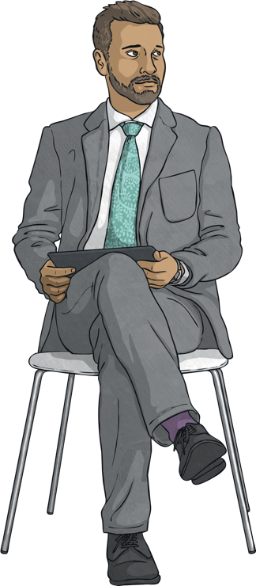
Diverse Families
This is Max. He is a tutor at a university. Max is 31 years old and lives on his own.
Max is asexual, which means he isn’t attracted to men or women. He has many close friends who are very special to him but he isn’t looking for a partner to be in a relationship with.
When Max was growing up, he was confused as everyone around him seemed to be talking about who they liked and almost all the adults he knew were in relationships.

Slide 20
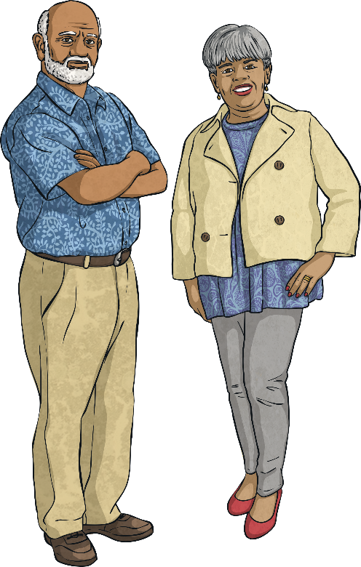
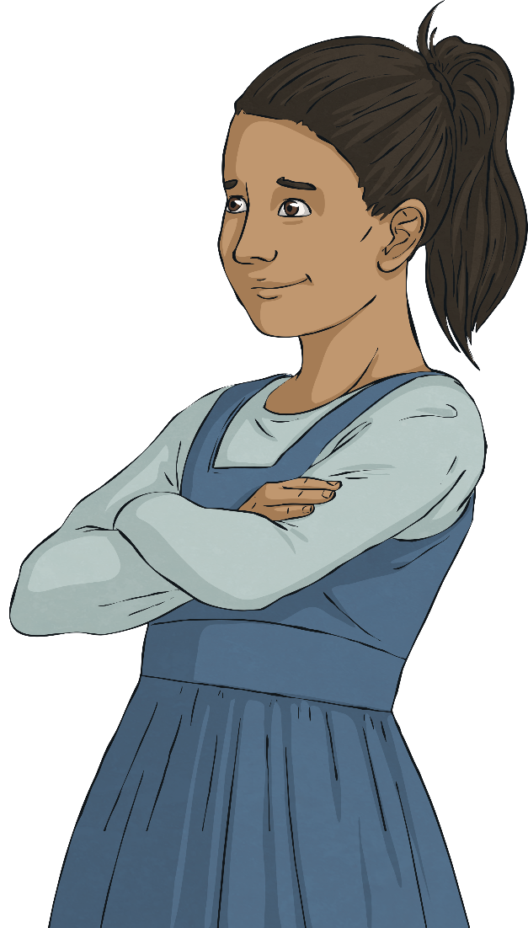
Diverse Families
This little girl is called Laila. She lives with her grandparents because her mother is poorly.
Laila’s grandparents are her main carers which means they take her to school, read her bedtime stories at night and take her to the park at the weekend.
Grandma is busy organising Laila’s birthday party at the moment, which is next month.

Slide 21
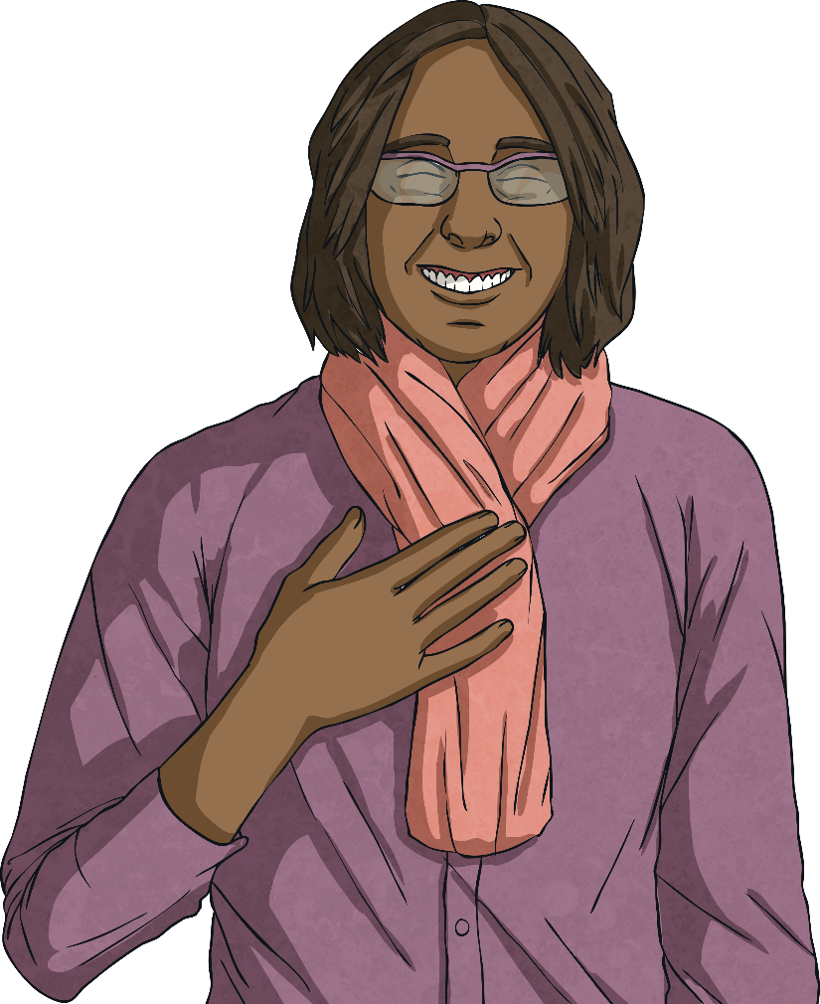
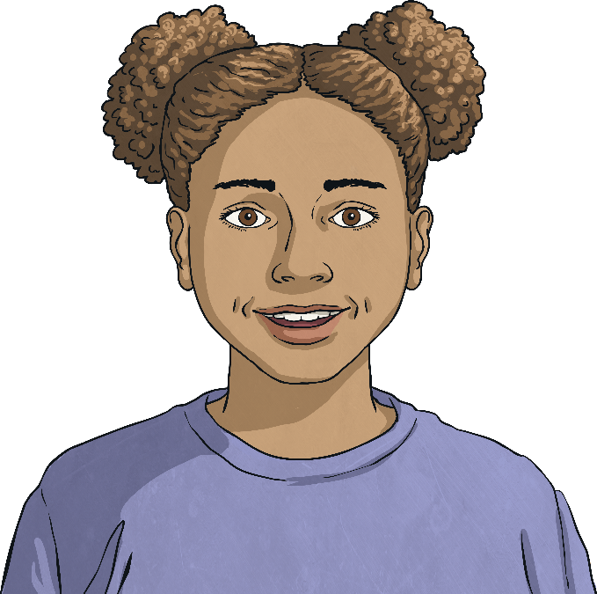
Diverse Families
This is Jo and her aunt, Ashley. Ashley looks after Jo sometimes when Jo's mum is at work.
Ashley is transgender. When she was born, she was assigned the biological sex male at birth. As she grew up however, she identified as a woman. Ashley feels much happier using the pronouns 'she' and 'her' and being thought of as a woman by others.
Jo enjoys spending time with Ashley; they like doing puzzles together.

Slide 22
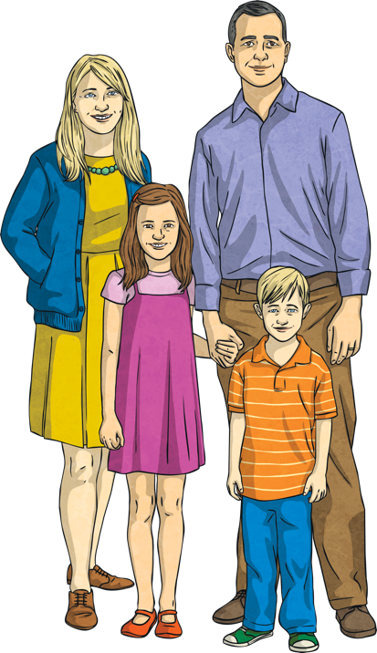
Diverse Families
Meet Katrina and Jacob. They are a married couple who are also foster parents. They have been looking after children whose parents are unable to care for them for many years now.
Sometimes, Katrina and Jacob have just one foster child living with them but, at times, there might be as many as four.
At the moment, they are looking after two children – a brother and sister.

Slide 23
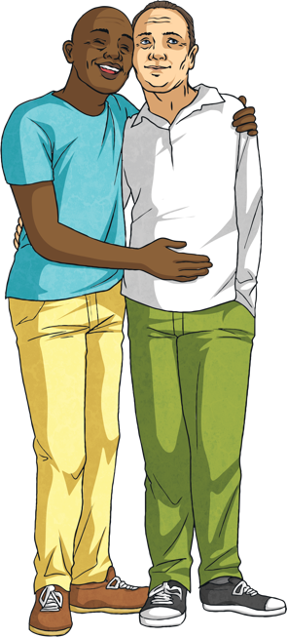
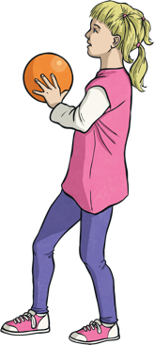
Diverse Families
This little girl is called Abigail. She was adopted as a baby by her parents, Pete and Mikey.
Abigail (or Abi for short) is growing up in a loving, secure family who can provide for her. This might not have been possible if she hadn’t been adopted.
Pete and Mikey are in a civil partnership, which is a type of committed relationship.
Abi’s favourite things to do with her dads include watching films about princesses and mermaids and going swimming.

Slide 24
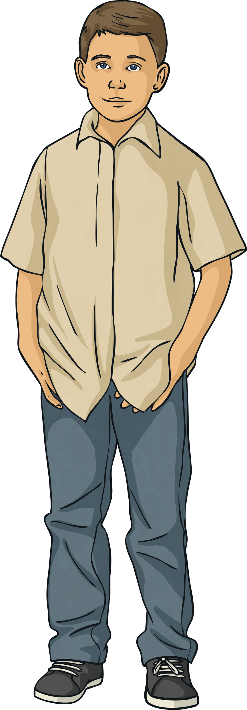
Diverse Families
Meet the Pye family. There’s Mum, Dad and their son, Jay.
Jay’s parents are married and are committed to one another but they live apart.
Jay’s mother works for a famous charity and lives abroad most of the time.
Jay lives in Scotland with his dad and they visit his mum when they can, or she comes back to Scotland to visit them.

Slide 25
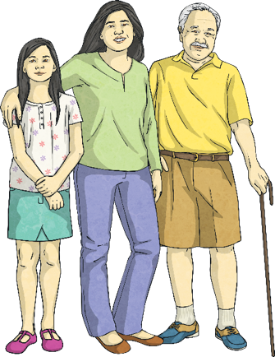
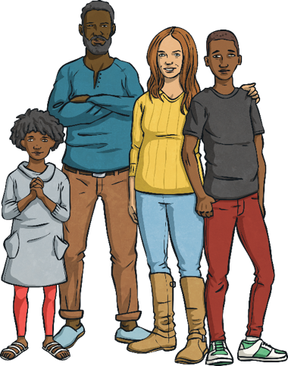
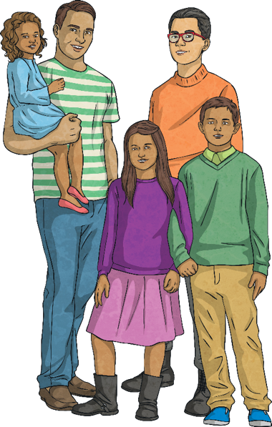
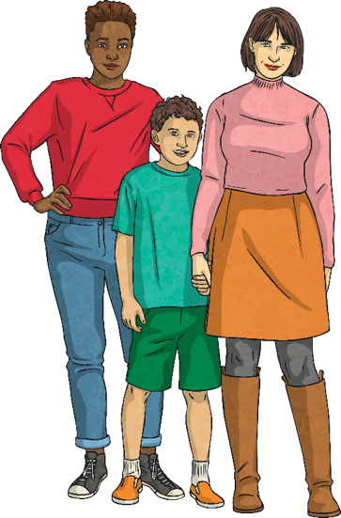
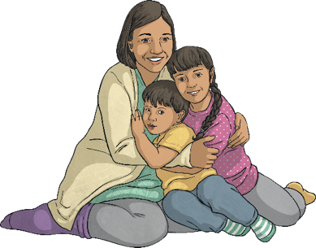
Different Families
Describe the different families you can see here with your partner.

Slide 26
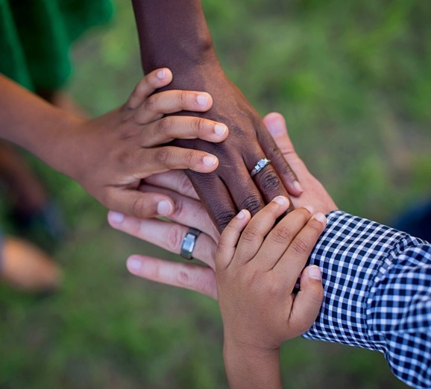
Different Families
All families are different.
Families can be very small or very large.
There can be people of different ages and people from different races.
Families can live together or apart.
There is no right or wrong when it comes to families.
But what do all families have in common?
Consolidating
Reflecting

Slide 27
Consolidating

Slide 28
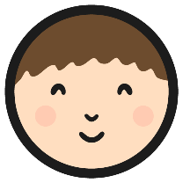
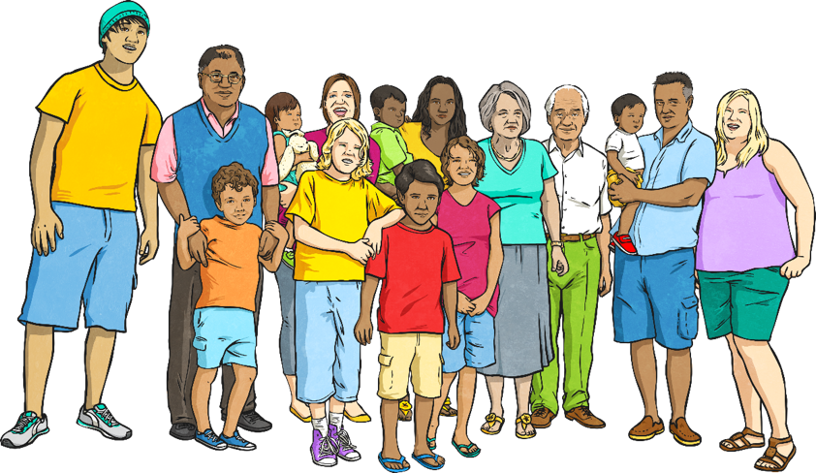
Relationships and Families
Most of us think that all families are like our own family, as that’s all we really know. Your job today is to design a poster to show people that there are lots of different families but that they all have one thing in common – love!

Slide 29
Reflecting

Slide 30
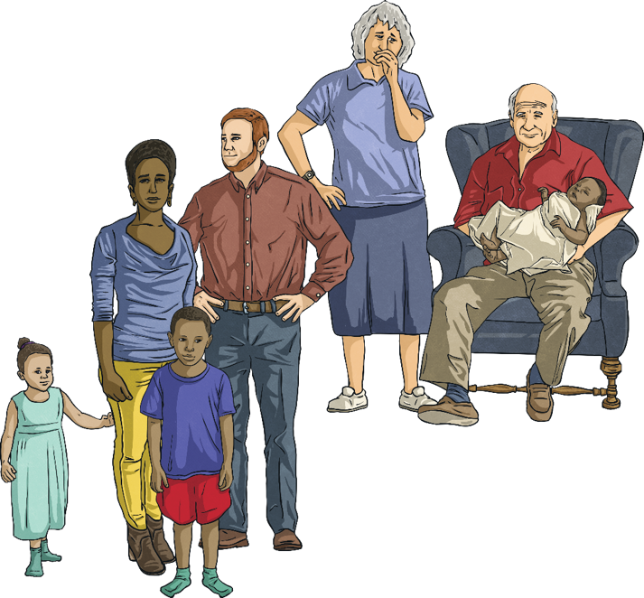
Caring and Loving
With your talk partner, list as many things as you can that lots of families have in common.
Can you think of examples of these things in your own family?
Do different people in the family have different roles?
How do the people in your family show they care for one another?

Slide 31
The Big Questions

Slide 32
What are loving relationships like?
What kinds of family are there?

Slide 33
Aim
I understand that there are many different types of relationships and families.
Success Criteria
I can identify and describe different relationships, different families and different family members.
I can understand and use terms such as gay, lesbian, single-parent, fostered, adopted, married and civil partnership.
I can identify elements of a healthy, loving relationship.
This resource is fully in line with the Learning Outcomes and Core Themes outlined in the PSHE Association’s Programme of Study.

Slide 35
Aim
I can describe how babies are made and how they are born.
Success Criteria
I can use scientific vocabulary when talking about the human body and reproduction.
I can explain what is needed to make a baby.
I understand how babies are born.
This resource is fully in line with the Learning Outcomes and Core Themes outlined in the PSHE Association’s Programme of Study.

Slide 36
The Big Questions

Slide 37
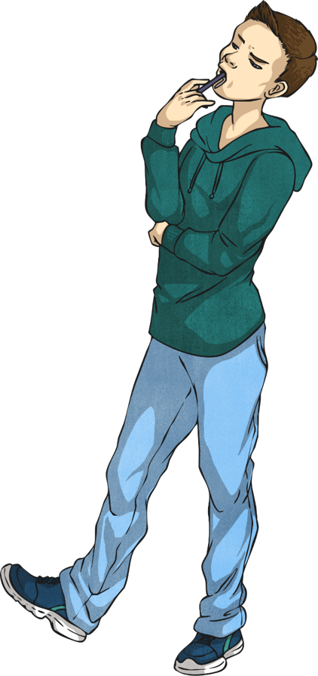
How are babies made?
How are babies born?

Slide 38
Reconnecting

Slide 39
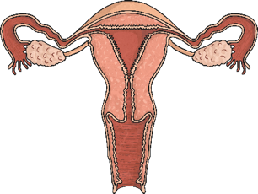
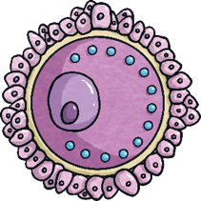
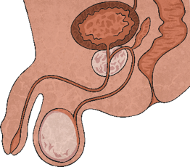
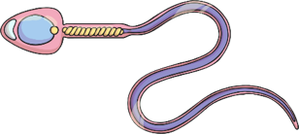
Human Reproduction
You might remember learning about human reproduction recently and what the different male and female body parts do.
Can you remember what these pictures show?

Slide 40
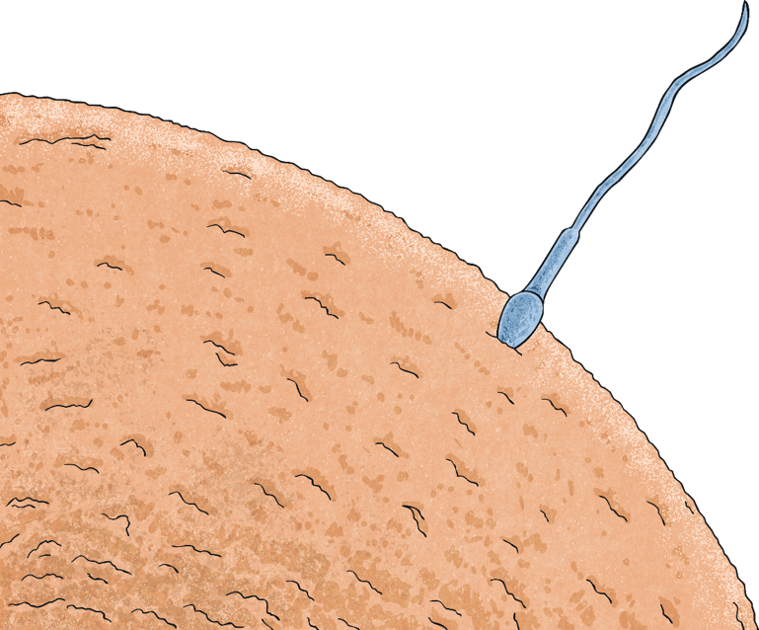
Human Reproduction
It takes two special ingredients to make a baby. An egg from a female body and the sperm from a male body.
When the sperm and the egg meet, they join together and form the start of a baby.

Slide 41
Exploring

Slide 42
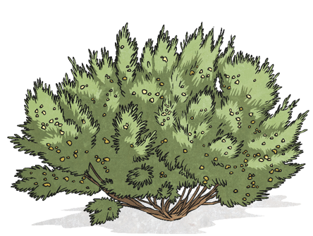
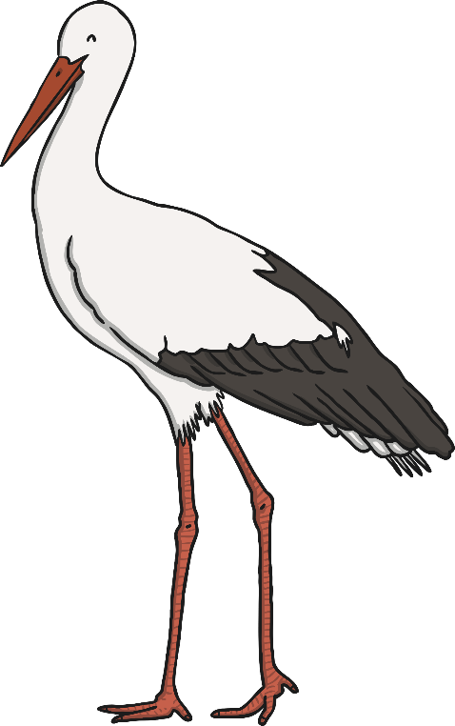
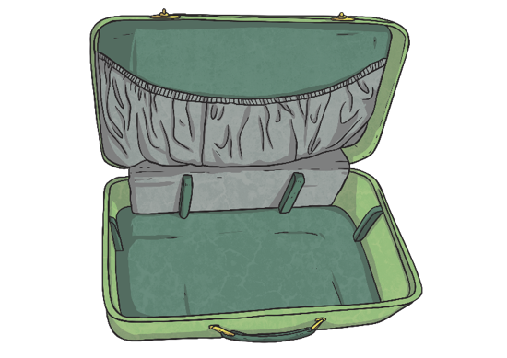
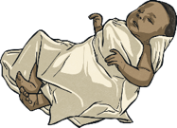
Silly Stories
Some grown-ups give some very strange answers when children ask them where they come from…
You arrived by surprise in a suitcase one day!
The stork delivered you to us!
We found you under a gooseberry bush!

Slide 43
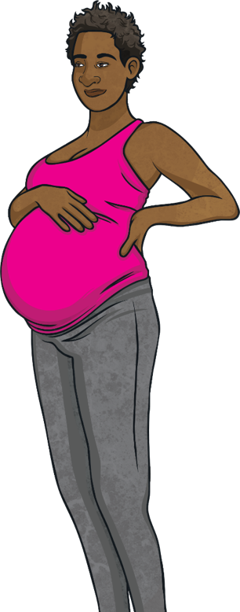
Silly Stories
Of course, we all know these stories aren’t true. We know that it takes an egg from a woman and the sperm from a man to make a baby.
We also know that a woman will carry the baby inside her as it grows. This is called being pregnant.
Then, when it is ready, the baby will be born.

Slide 44
Where Do I Come From?
When the baby is growing inside the female’s body, it is called an embryo at first, then at eight weeks, it becomes a foetus.
Four weeks after the sperm fertilises the egg, the embryo is the size of a poppy seed.
By seven weeks, it is the size of a blueberry and by 14 weeks, the foetus is the size of a lemon.
We were all this small once! It’s how we all started.

Slide 45
Where Do I Come From?
The baby grows and develops inside the mother’s uterus (womb) over nine months. It develops a heart, a spine, lungs and a brain. At about seven weeks, the foetus develops the internal sex organs that determine whether it is male or female. At around nine weeks, the external male and female body parts start to form.

Slide 46
Where Do I Come From?
While the foetus is growing inside the woman’s uterus, it is protected by a special bag of fluid. This is called the amniotic sac.
The foetus is getting all the oxygen and food it needs from its mother’s blood, through a special tube called the umbilical cord. This is attached to the baby’s tummy. It is what becomes your belly button!

Slide 47
Where Do I Come From?
The foetus continues to grow during the nine months of pregnancy. Many women go for a scan at the hospital, to see how their baby is growing and developing.
At around nine months, the baby turns head down as it gets ready to be born. It will be pushed by the mother’s body down through the vagina and will come out between the mother’s legs.
Consolidating
Reflecting

Slide 48
Consolidating

Slide 49
An Incredible Journey
We were all made with a sperm meeting an egg and you were all a foetus growing and developing over approximately nine months.
Today, we are going to write about how we were made.
Obviously you can’t actually remember it but using the timeline on your tables, you can write about what was happening at different stages and imagine what it might have been like.
We will write in first person, like a diary.

Slide 50
Reflecting

Slide 51
Inside the Uterus
With your partner, discuss if you think the foetus could hear anything from inside the mother’s uterus (or womb). How do you think the mother may have felt carrying the baby in her tummy?

Slide 52
The Big Questions

Slide 53
How are babies made?
How are babies born?

Slide 54
Aim
I can describe how babies are made and how they are born.
Success Criteria
I can use scientific vocabulary when talking about the human body and reproduction.
I can explain what is needed to make a baby.
I understand how babies are born.
This resource is fully in line with the Learning Outcomes and Core Themes outlined in the PSHE Association’s Programme of Study.

Slide 55
Prayer
Help me with positive relationships.
Help me make good choices at making good relationships for me.
Help me help my family and the people that care about me.
Amen.

Slide 56
Being a good friend
I know how to tell my friend to stop if they are doing something I don’t like.
I know not to tease or call my friends names.
I know to use kind hands and feet.
I know how to stop bullying. TASK!
Tell them you don’t like it.
Ask them to stop.
Speak to an adult at school and home.
Keep an eye on it!

Slide 57
Staying safe
I know how to stay safe.
I do not talk to strangers.
If someone gets too close to me or touches me in an inappropriate place, I tell them to stop and tell an adult I trust.
I know I should not talk to anyone online unless my parents know and have said it is ok.
I know how to get help if I need it.

Slide 58
Keeping my mind & body healthy
I use positive words
I talk through my emotions- if you are sad, tell someone why.
I play outside whenever I can.
I read each day.
I complete my homework.
If I am sad or lonely, I tell someone, but I try and think of ways to make it better too.
I don’t eat too many things that are unhealthy.
I know if I am not well, I can tell an adult.
I need to wash my hands before eating.
I need to wash my body daily.
I know when it is sunny I need a sun hat and sun cream on.
I know to drink lots of water.
I know to reduce screen time down to a maximum of 1 hour a day.

Slide 59
Do I know these things?
I know about different types of relationships i.e. Friends and family
I know friends and family should care for each other.
I know who to tell if someone has touched me in a private area.
I know that I can tell a secret if I need help or feel uncomfortable.
I know that a change in a family can be very sad i.e. death
I know that my body has changed since birth.
I know that boys and girls are different.
I know the names for different parts of my body
I know that families can be different and similar to mine.

