Slide 1
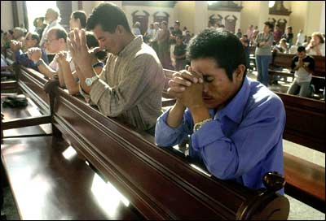
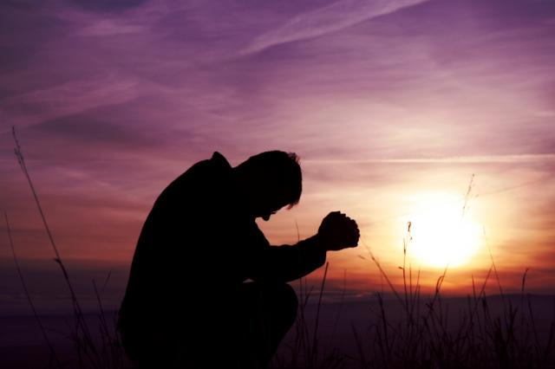
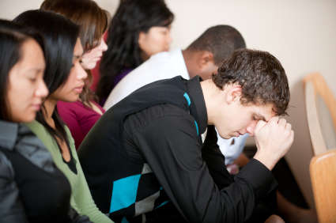
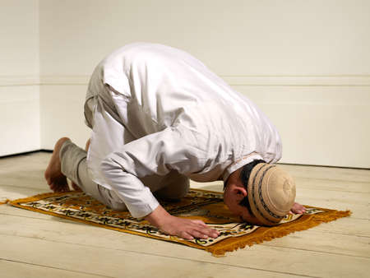
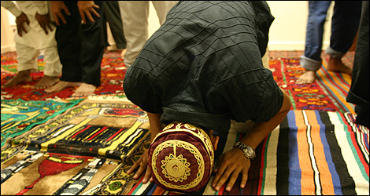
WHY do people pray?

Slide 2
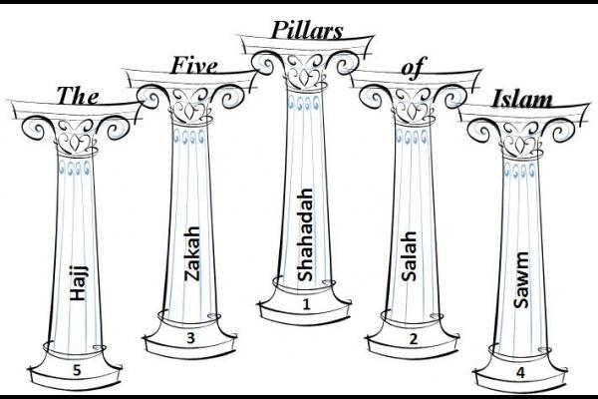
1) the shahada (Islamic creed)
2) daily prayers (salah)
3) almsgiving (zakāt)
4) fasting during the month of Ramadan (sawm)
5) the pilgrimage to Mecca (hajj) at least once in a lifetime.
Today’s lesson

Slide 3
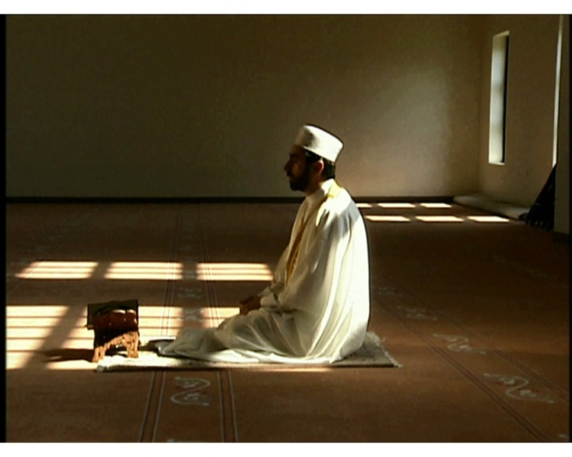
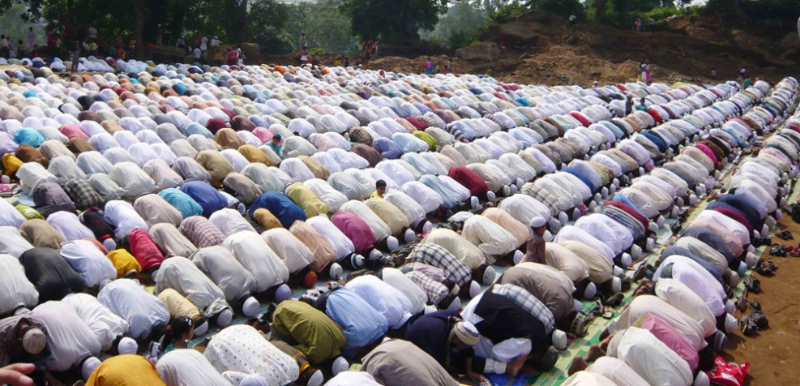
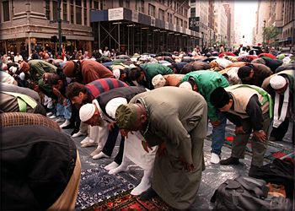
Muslims believe that God (called Allah) created human beings to worship him, so the second pillar of Islam is prayer.
Muslims must pray 5 times a day. Each time takes about 10 minutes.

Slide 4
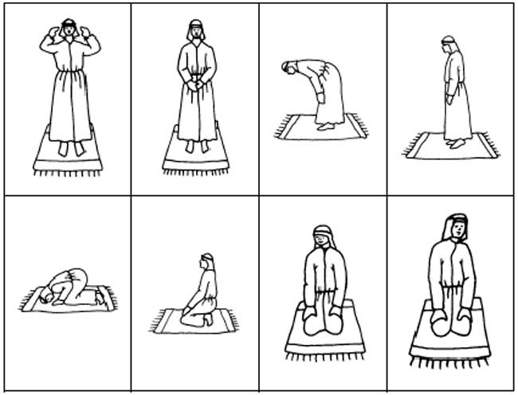
These 5 daily prayers are compulsory.
They involve a series of standing up, bowing and prostrating.

Slide 5
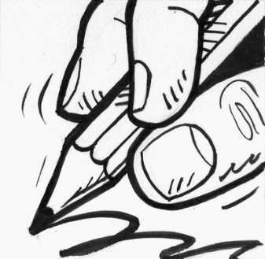
What do you think bowing represents?
It shows humility in front of God/Allah.
It shows respect for God/Allah.
It reminds Muslims that they are dependent upon God.
This helps a Muslim be obedient to God.
Bowing shows
Humility
Obedience
Respect
Dependence
COPY

Slide 6
Men should pray at mosques whenever possible.
Ladies do not have to go to mosques, they are encouraged pray in their homes.
Once a Muslim reaches 10 years of age, they must start to pray.

Slide 7
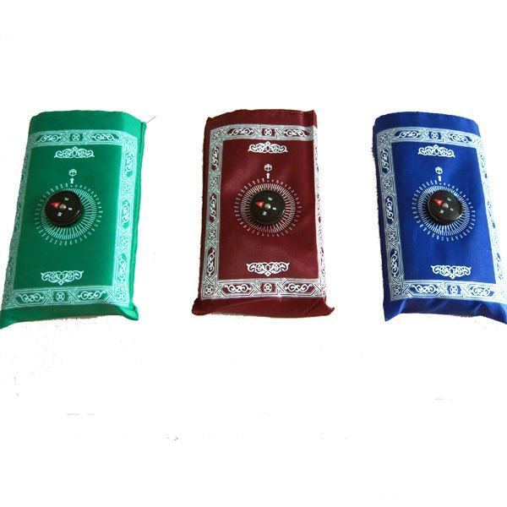
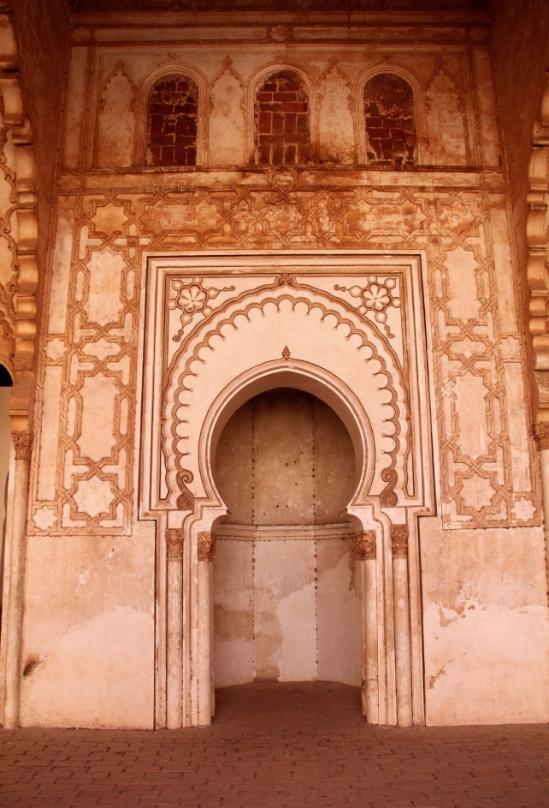
How do Muslims know the right direction (Qibla) to pray in?
Prayer mats with build in compasses.
Mihrab

Slide 8
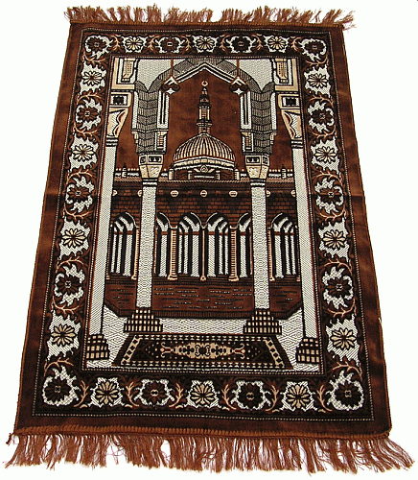
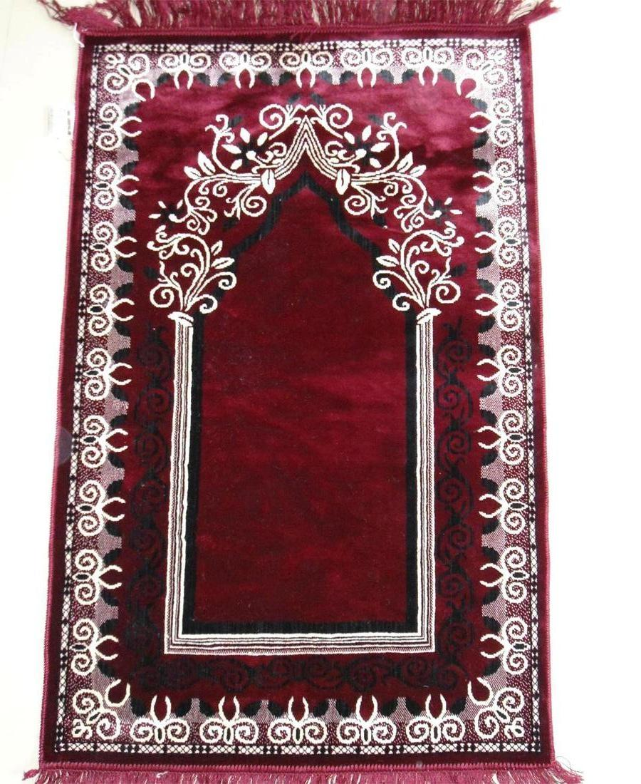
Prayer Mats

