Slide 2
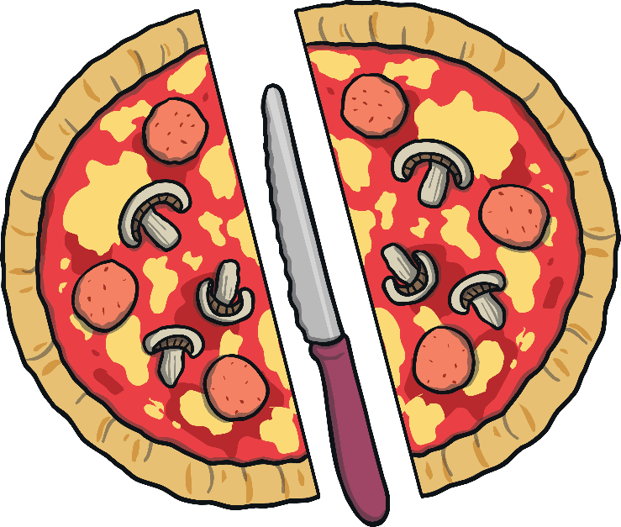
Hello!
I’m Pedro
I make delicious pizza for the customers in my restaurant.

Slide 3
I make pizzas like this. This is a whole pizza.
?
Two customers want to buy one pizza and eat half each. Can you tell me if I have cut the pizza in two halves?

Slide 4
Cutting a Pizza into Halves
I have cut the pizza into two pieces. Is each piece a half?
?
Are the two pieces the same size?
Would both customers have the same amount of pizza?
Click the question mark for some questions.

Slide 5
Cutting a Pizza into Halves
There is a piece of pizza for both customers. Will they have half each?
?
How do you know that they are not halves?
What must be the same about both pieces?
Click the question mark for some questions.

Slide 6
Cutting a Pizza into Halves
I have cut the whole pizza in a different way. Do I have two halves?
?
Why is the pizza not in halves?
How many half pieces do you need to make one whole pizza?
Click the question mark for some questions.

Slide 7
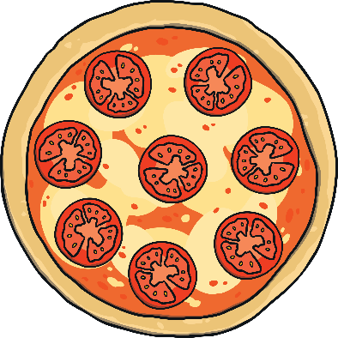
Let’s Teach Pedro about Halving
This is a whole pizza.
This pizza is in two halves.
Each piece must be the same size.
Each piece is called a half.
Two half pieces, make one whole.

Slide 8
Now I understand! Click on the knife below to see if I can cut this whole pizza in half.
click again
?
Is this two halves?
Is this still two halves? How do you know?

Slide 9
Thank you for teaching me about halving!

