Slide 2
Week 1 Objectives:
Practise recognition and recall of Phase Two and Three graphemes and reading and spelling CVC words
Teach and practise reading CVCC words
Teach and practise spelling CVCC words
Teach reading the tricky words said, so
Teach spelling the tricky words he, she, we, me, be
Practise reading and spelling high-frequency words
Practise reading sentences
Practise writing sentences

Slide 3
Phase 4: Week 1
 | Monday | Tuesday | Wednesday | Thursday | Friday
Focus | revision | revision | revision | revision | her
Revise | Practice previously taught tricky words: he, she, we, be, me. | Play quickwrite. Teacher says a sound and children have to write it on their whiteboards. | Practice previously learned GPCs from Phase 2 and 3. | Sing the alphabet song. Children to point to the letters as they sing. | Practice previously learned GPCs
Teach | 1. Teach tricky words so, said 2.Teach the difference between consonants and vowels. | Explain that we are going to look at reading and writing words where two Consonants are next to each other. |  |  | You could teach the tricky word ‘said’ as sayed (s-ai-d). We know that we don’t pronounce it like this though.
Practice | Practice the vowels – a, e, i, o, u (could use the Jolly Phonics vowel song) | Read the words: ten/t, ben/d, men/d, hum/p, Dam/p | Blend the sounds to read: belt, nest, sink, lamp, wind | Read the words: milk, golf, jump, melt, chimp | Sound buttons: bench, shelf, paint ,toast, melt, hand
Apply | Encourage children to identify which vowels are in their names. | Read the caption: You burnt the toast | Read the caption: She kept the gift | Read the Sentence: The tent is next to the pond. | Read the sentence: A chimp can jump

Slide 4
Day 1

Slide 5
revisit
Can you remember these tricky words?
the to I go no
he she me be
we was you all

Slide 6
so
There are two tricky words to learn this week. The first is quite easy. The ‘s’ sound is pronounced as normal. The ‘o’ says its letter name.

Slide 7
said
The next tricky word is a bit more tricky.

Slide 8
Can you think of some sentences using ‘so’ and ‘said’?

Slide 10
Today, we will learn about vowels. These are special letters as every word we use has at least one vowel in them. The vowels can either make a short or a long sound. (Sometimes the letter y acts as a vowel like in the word fly)
a e i o u

Slide 11
Which vowels do you have in your name? How many do you have? Who has the most vowels in their name in your family?
a e i o u

Slide 12
Day 2

Slide 13
revisit
Can you remember these sounds?
s a t p i n m
m d g o c k
e u r b f l
ff ll ss ck

Slide 14
revisit
j v w x y z zz qu
ch sh th ng ai ee
igh oa ar er or ur
oo ow oi air ear
ure

Slide 15
Can you remember which letters are the consonants? This week we are going to be reading words where two consonants are next to each other. We will have to blend these sounds to read the word.
CVCC
vowel
consonant
consonant
consonant

Slide 16
ten
Read this CVC word first:

Slide 17
tent
Now read the CVCC word:

Slide 18
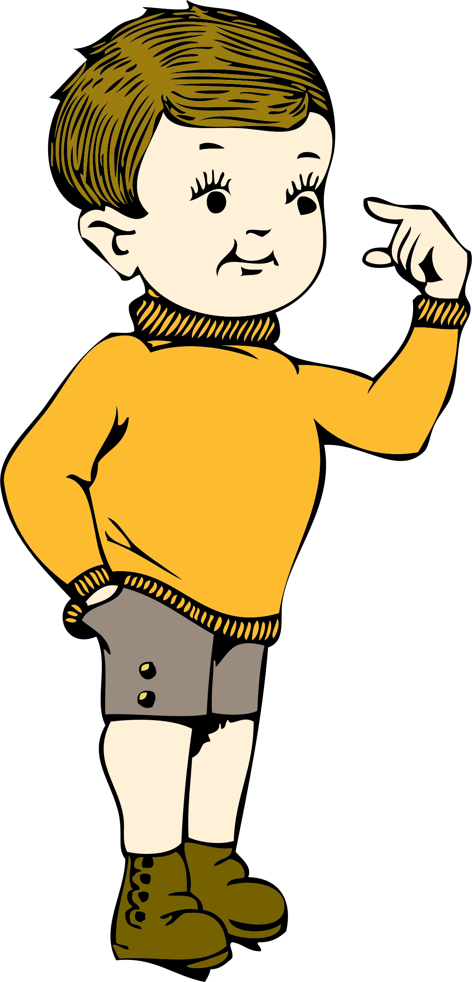
ben
Read this CVC word first:

Slide 19
bend
Now read the CVCC word:

Slide 20
men
Read this CVC word first:

Slide 21
mend
Now read the CVCC word:

Slide 22
hum
Read this CVC word first:

Slide 23
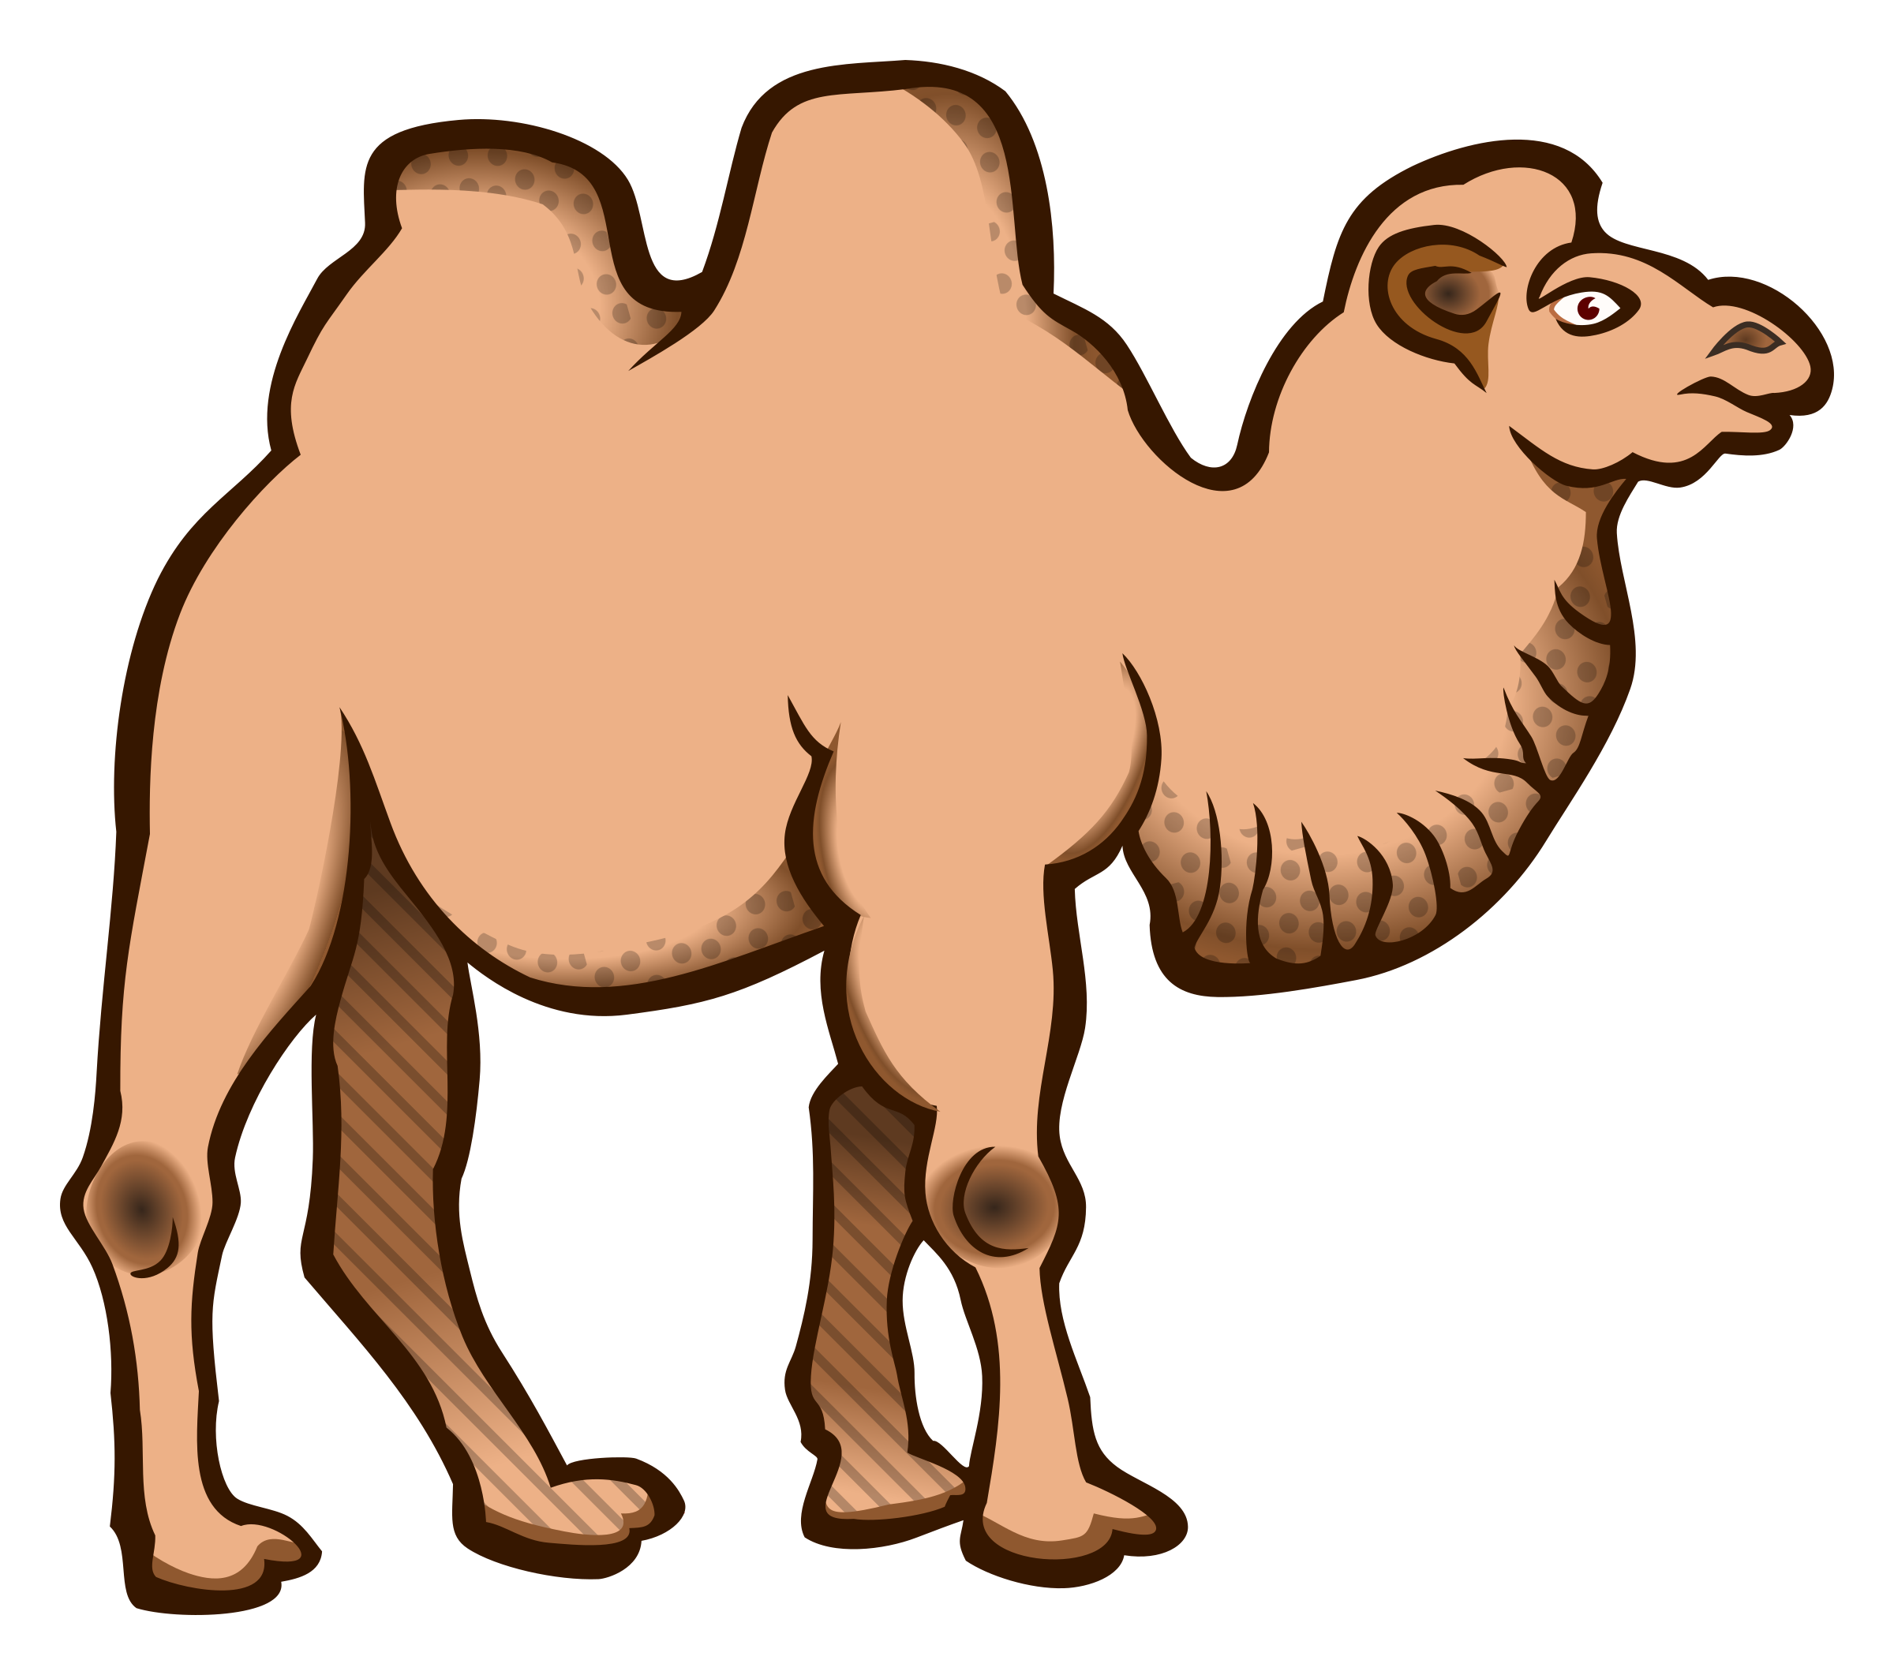
hump
Now read the CVCC word:

Slide 24
dam
Read this CVC word first:

Slide 25
damp
Now read the CVCC word:

Slide 26
You burnt the toast.
Have a go at reading this sentence:

Slide 27
Day 3

Slide 28
revisit
Can you remember these sounds?
s a t p i n m
m d g o c k
e u r b f l
ff ll ss ck

Slide 29
revisit
j v w x y z zz qu
ch sh th ng ai ee
igh oa ar er or ur
oo ow oi air ear
ure

Slide 30
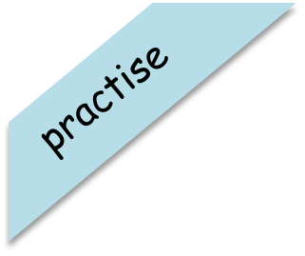
Try and spell out this word.
b
e
l
t

Slide 31
Try and spell out this word.
n
e
s
t

Slide 32
Try and spell out this word.
s
i
n
k

Slide 33
Try and spell out this word.
l
a
m
p

Slide 34
Try and spell out this word.
w
i
n
d

Slide 35
She kept the gift.
Have a go at reading this sentence:

Slide 36
Day 4

Slide 37
revisit
Can you remember these sounds?
s a t p i n m
m d g o c k
e u r b f l
ff ll ss ck

Slide 38
revisit
j v w x y z zz qu
ch sh th ng ai ee
igh oa ar er or ur
oo ow oi air ear
ure

Slide 39
Can you remember which letters are the consonants? This week we are going to be reading words where two consonants are next to each other. We will have to blend these sounds to read the word.
CVCC
vowel
consonant
consonant
consonant

Slide 40
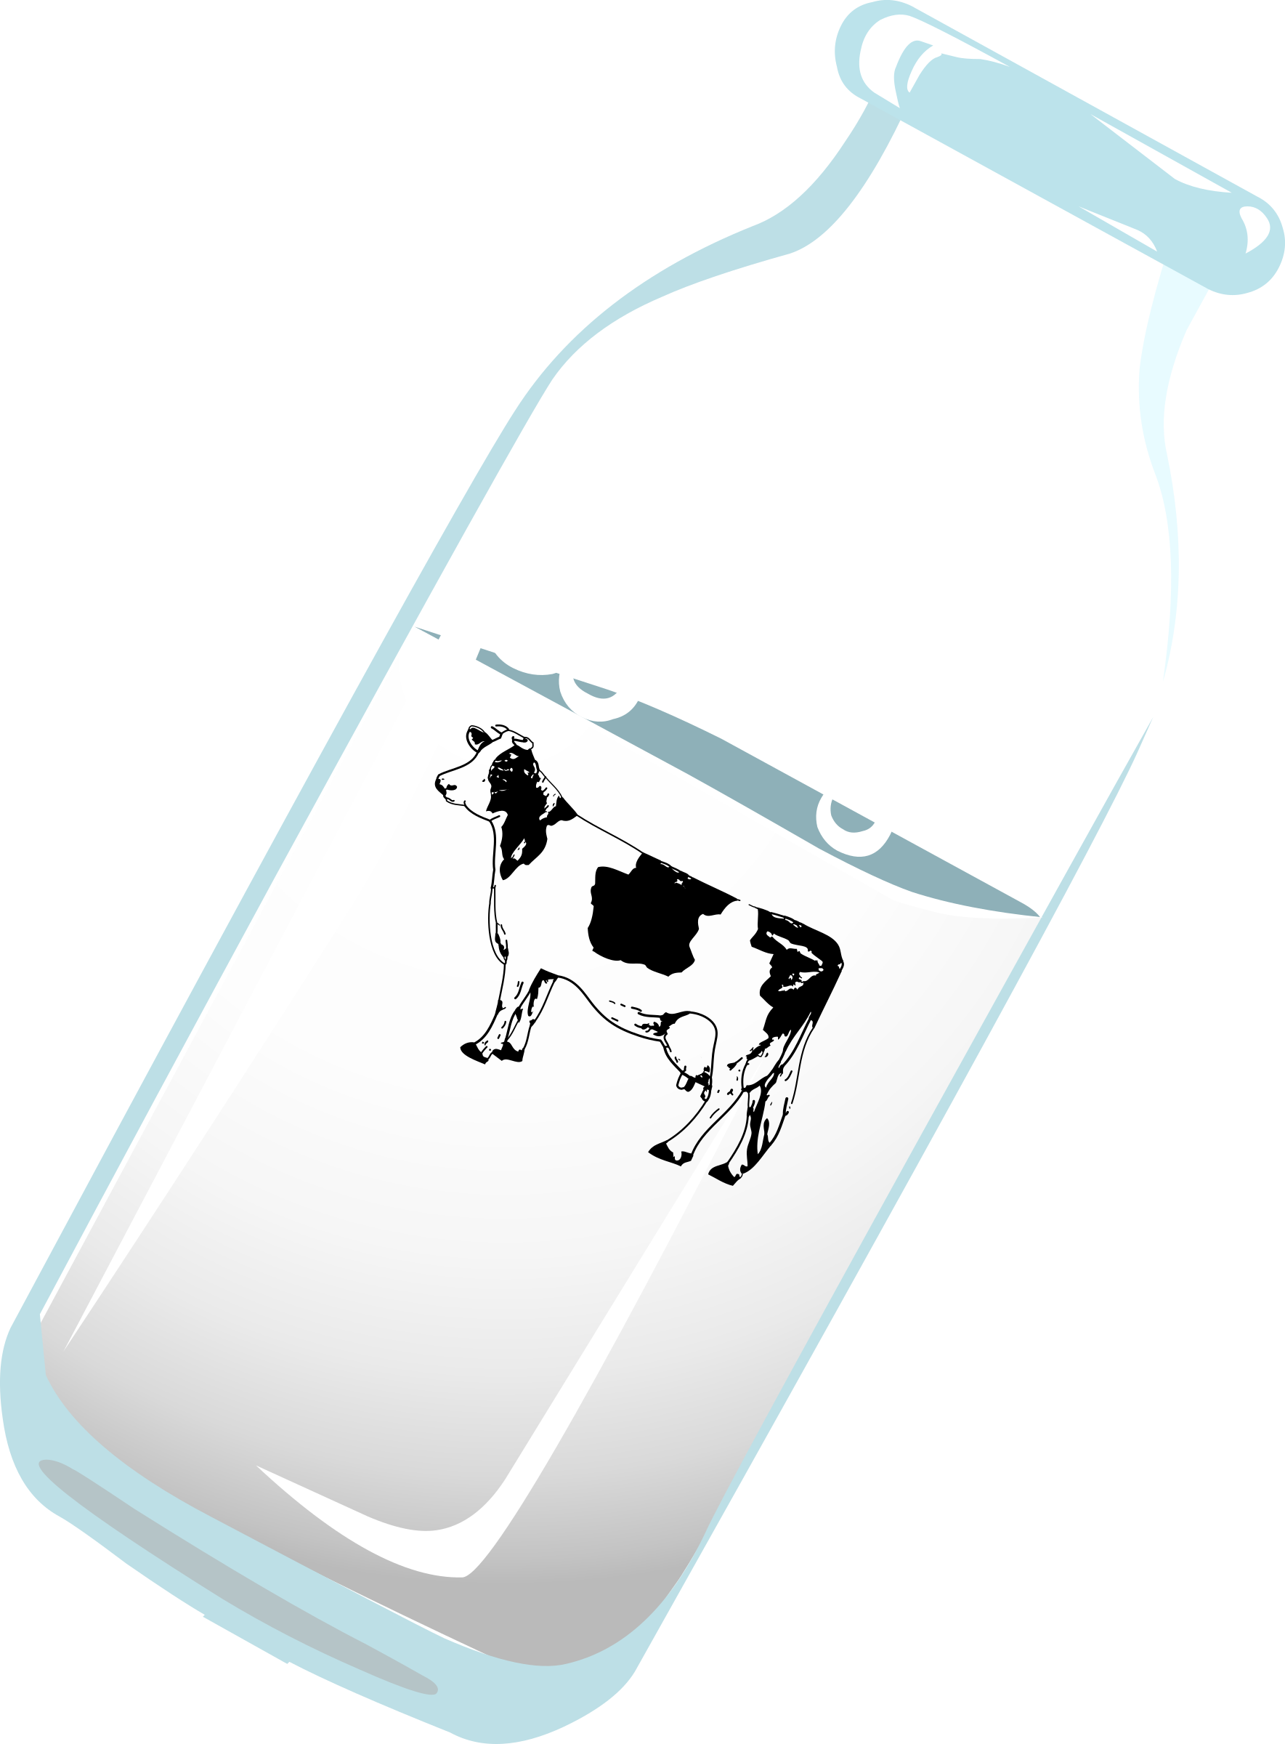
milk
Read this CVCC word:

Slide 41
golf
Read this CVCC word:

Slide 42
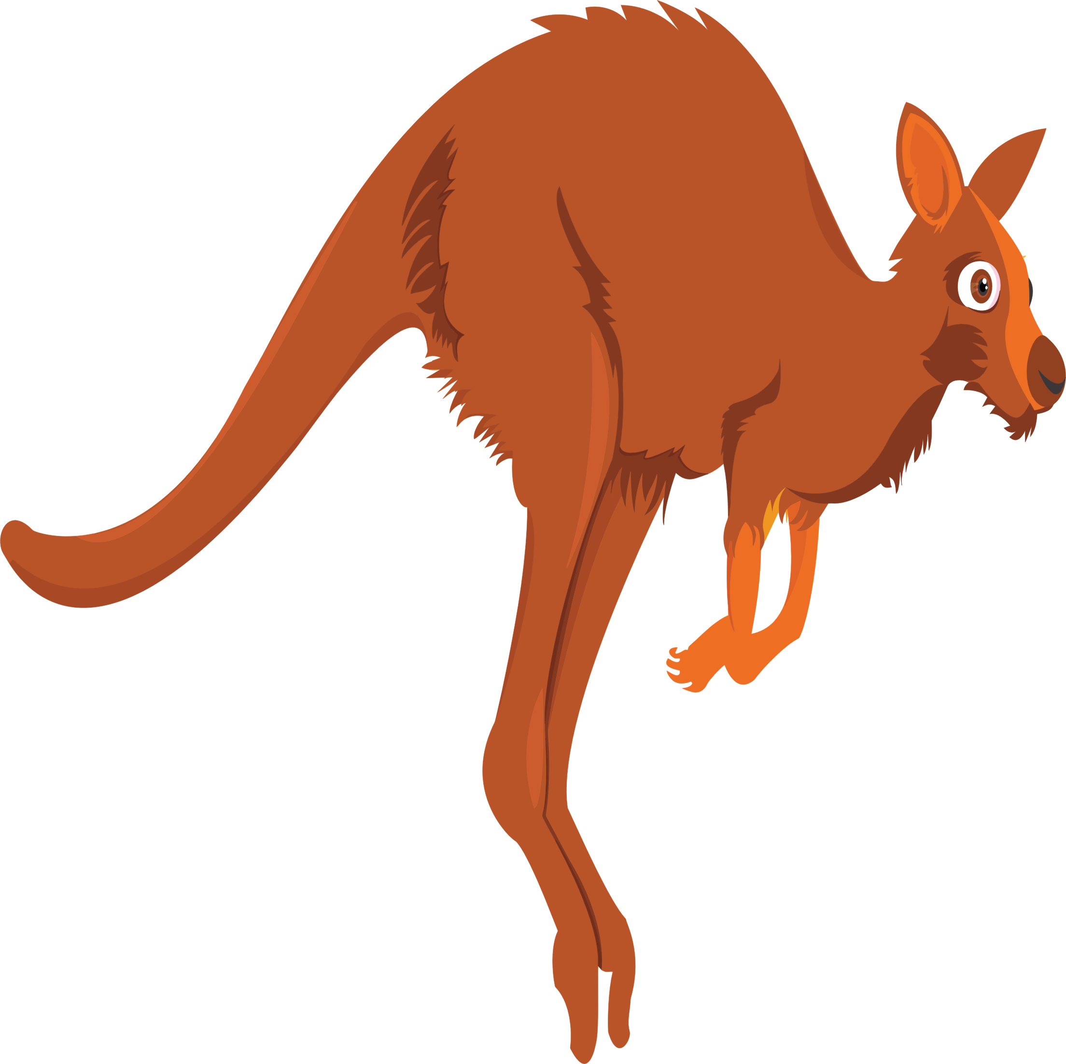
jump
Read this CVCC word:

Slide 43
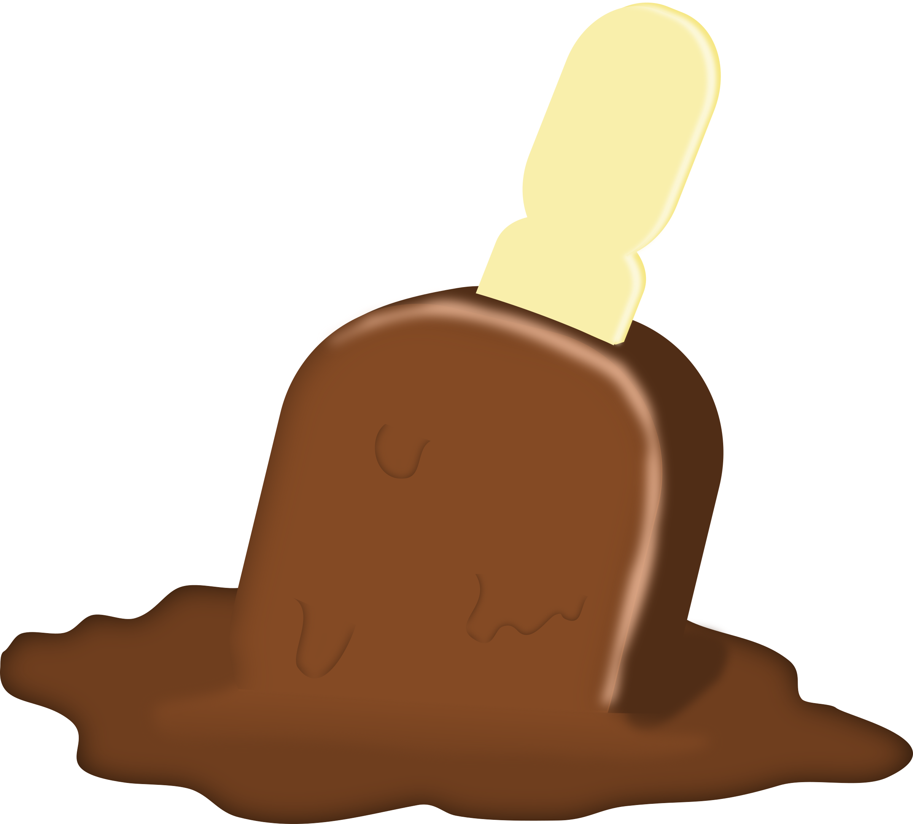
melt
Read this CVCC word:

Slide 44
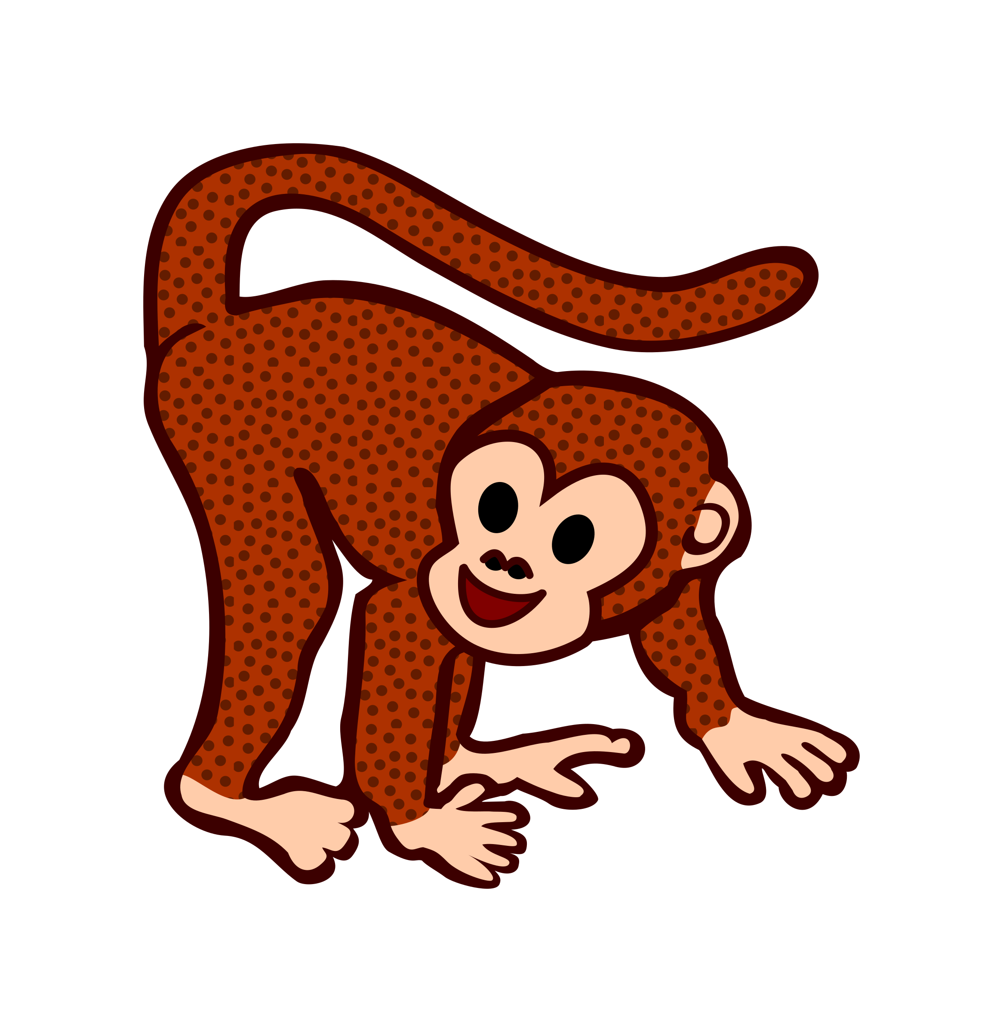
chimp
Read this CVCC word:

Slide 45
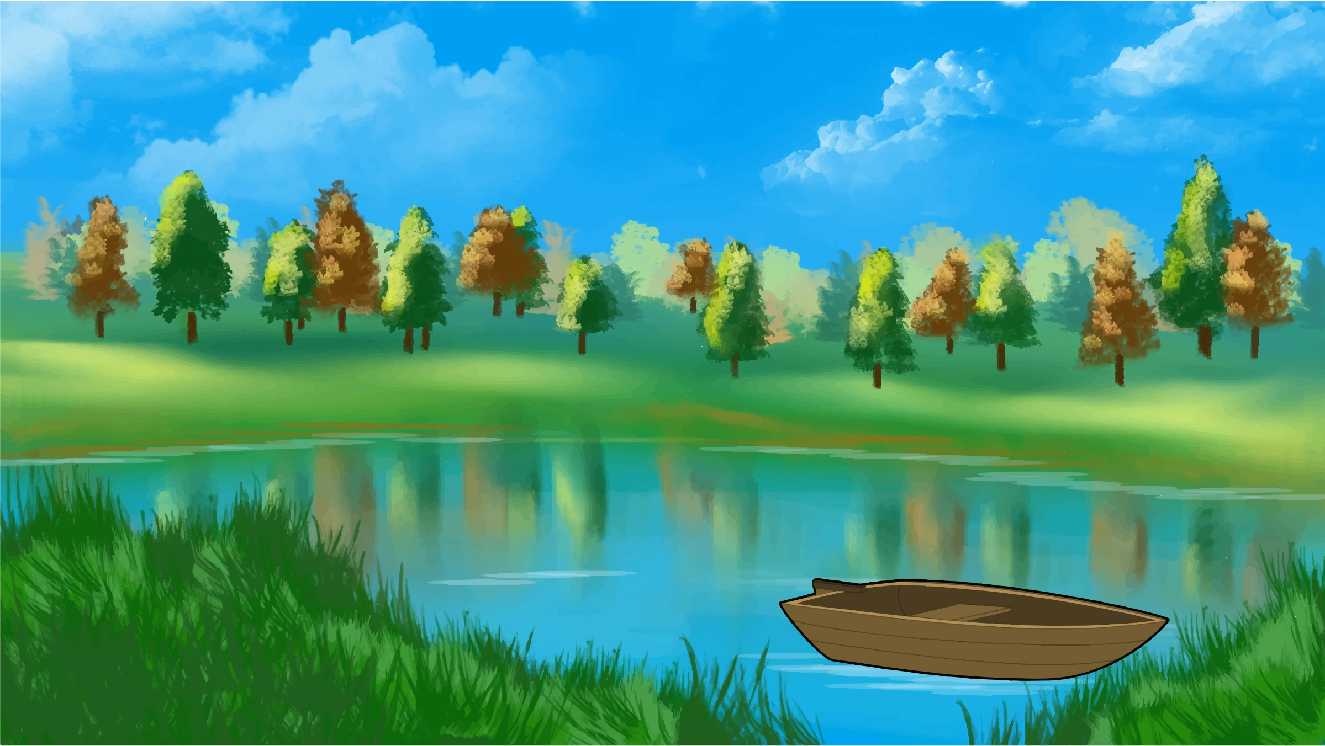
The tent is next to the pond.
Read this sentence:

Slide 46
Day 5

Slide 47
revisit
Can you remember these sounds?
s a t p i n m
m d g o c k
e u r b f l
ff ll ss ck

Slide 48
revisit
j v w x y z zz qu
ch sh th ng ai ee
igh oa ar er or ur
oo ow oi air ear
ure

Slide 49
Try and spell out this word.
b
e
n
ch

Slide 50
Try and spell out this word.
sh
e
l
f

Slide 51
Try and spell out this word.
p
ai
n
t

Slide 52
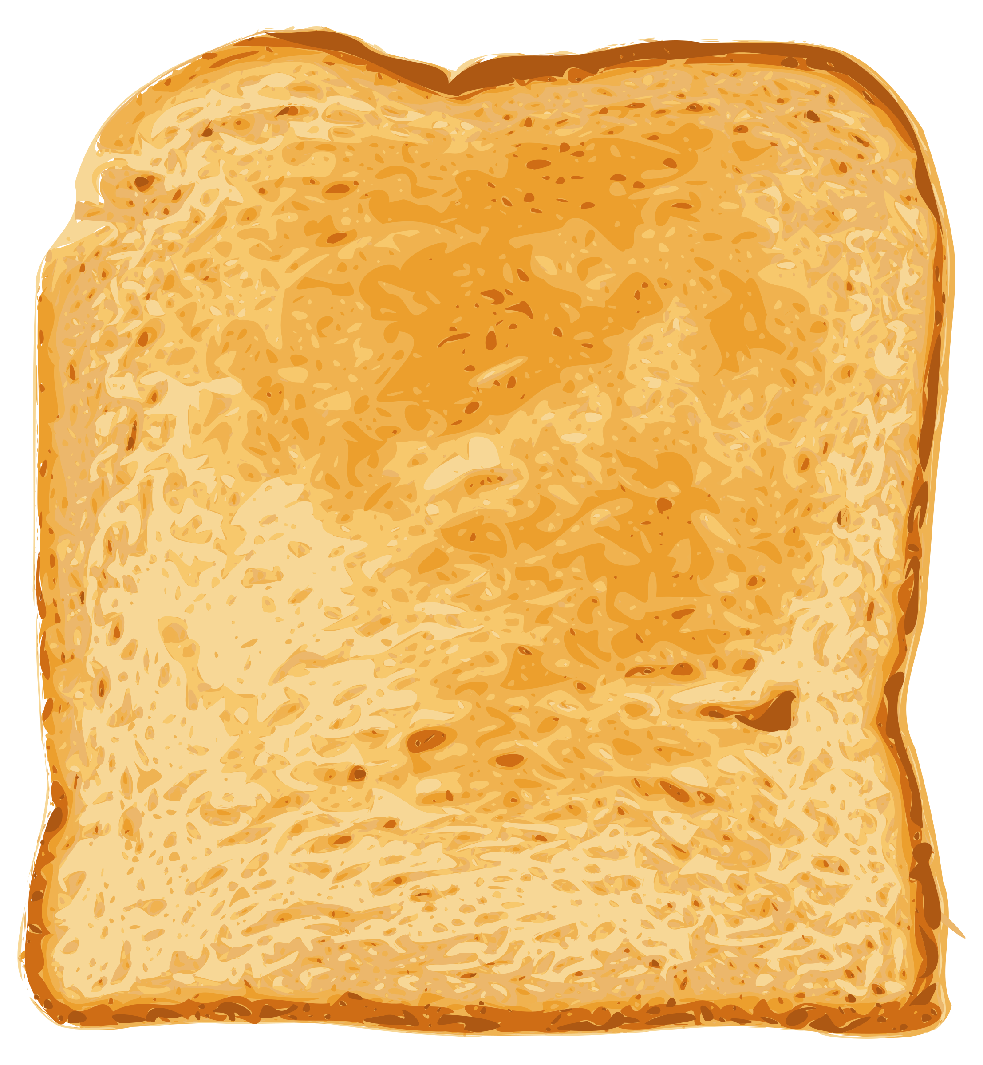
Try and spell out this word.
t
oa
s
t

Slide 53
Try and spell out this word.
h
a
n
d

Slide 54
A chimp can jump.
Have a go at reading this sentence:

