Slide 1
Phase 4 Week 5

Slide 2
revisit
Can you remember these sounds?
s a t p i n m
m d g o c k
e u r b f l
ff ll ss ck

Slide 3
revisit
j v w x y z zz qu
ch sh th ng ai ee
igh oa ar er or ur
oo ow oi air ear
ure

Slide 4
revisit
Can you remember these tricky words?
the to I go no
he she me be
we was you all

Slide 5
Day 1

Slide 6
Phonics
fl
Phase 4

Slide 7
Sound of the day
f
+
l
fl
=

Slide 8
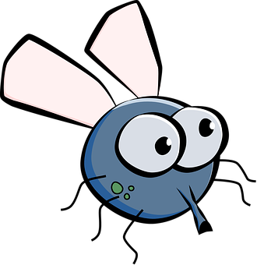
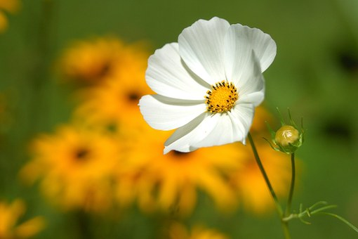
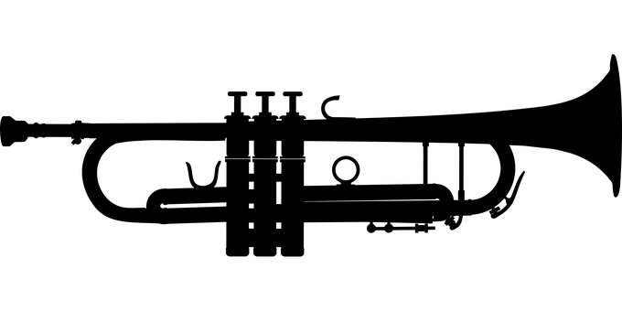
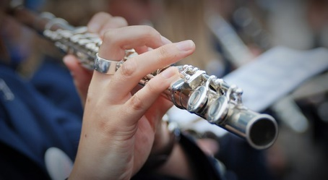
Find the odd one out

Slide 9
Can you sound these words out?
flip

Slide 10
flap

Slide 11
flick

Slide 12
flock

Slide 13
flinch

Slide 14
Can you count how many sounds there are in these words?
flee

Slide 15
fl
ee
2

Slide 16
float

Slide 17
fl
oa
t
3

Slide 18
flamingo

Slide 19
ng
a
i
o
fl
m
6

Slide 20
Phoneme Spotter - fl
There was a bright flash of lightning in the sky.
Dad got a flat tyre on his new car.
I wore pink and green flip flops on the hot floor.

Slide 21
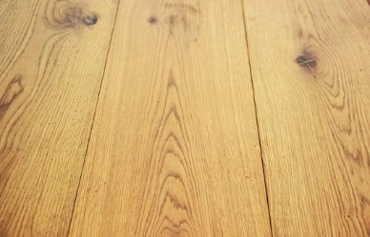
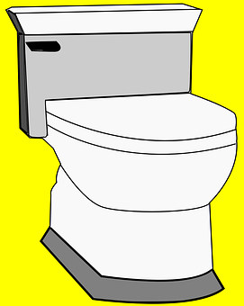
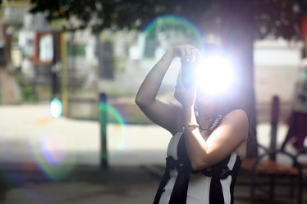
Can you write 3 fl words?
floor
flower
flash
flush
flag

Slide 22
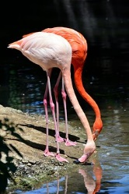
Can you write a sentence about this picture?
Have you used the word flamingo?

Slide 23
Day 2

Slide 24
Phonics
fr
Phase 4

Slide 25
Sound of the day
f
+
r
fr
=

Slide 26
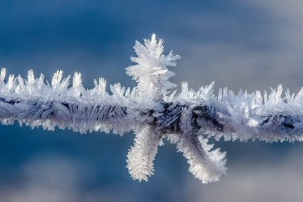
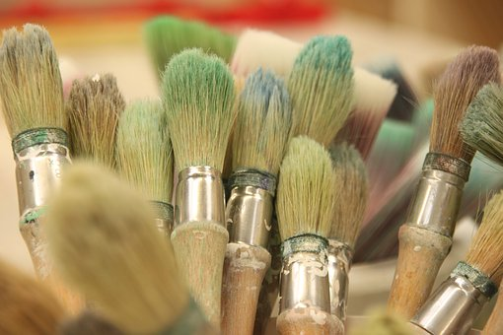
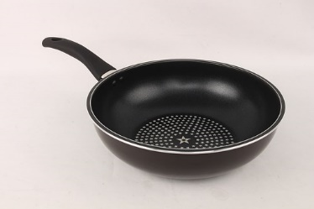
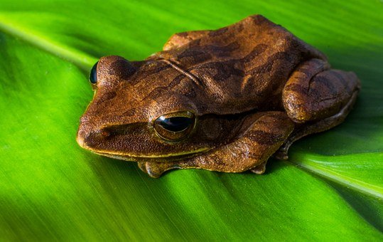
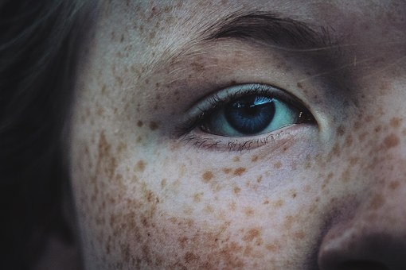
Find the odd one out!

Slide 27
Can you sound these words out?
frill

Slide 28
frog

Slide 29
free

Slide 30
fresh

Slide 31
freeze

Slide 32
Can you count how many sounds there are in these words?
from

Slide 33
fr
o
m
3

Slide 34
fright

Slide 35
fr
igh
t
3

Slide 36
French

Slide 37
e
n
ch
Fr
4

Slide 38
Phoneme Spotter - fr
I fry my eggs in a small pan.
Mum got fresh food in the supermarket.
Frank opened the freezer to find a lolly.

Slide 39
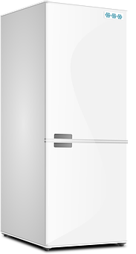
Can you write 3 fr words?
frown
frost
freezer
freckles
frog

Slide 40
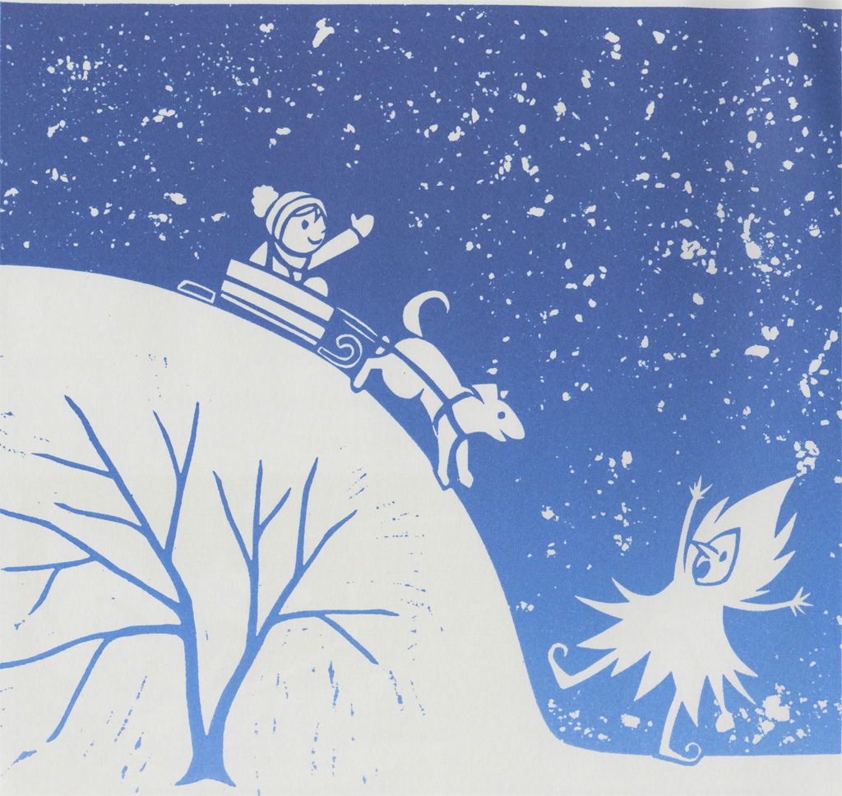
Can you write a sentence about this picture?
Have you used the word frost?

Slide 41
Day 3

Slide 42
Phonics
ft
Phase 4

Slide 43
Sound of the day
f
+
t
=
ft

Slide 44
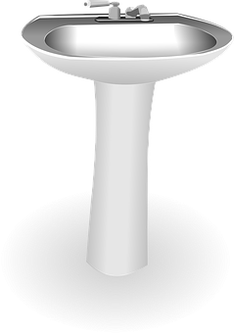
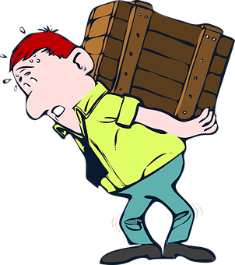
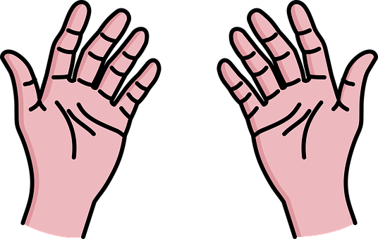
Find the odd one out

Slide 45
Can you sound these words out?
loft

Slide 46
daft

Slide 47
shift

Slide 48
drift

Slide 49
craft

Slide 50
Can you count how many sounds there are in these words?
tuft

Slide 51
u
ft
t
3

Slide 52
theft

Slide 53
th
e
ft
4

Slide 54
giftbox

Slide 55
g
ft
b
o
x
i
6

Slide 56
Phoneme Spotter - ft
The sheep pulled out a tuft of grass.
Saroo found some driftwood on the beach.
I crept up to the loft and found a secret gift.

Slide 57
Can you write 3 ft words?
gift
tuft
……of grass
raft
lift
left

Slide 58
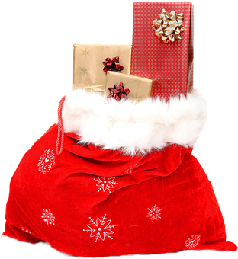
Write a sentence
Have you used the word gifts?

Slide 59
Day 4

Slide 60
Phonics
gl
Phase 4

Slide 61
Sound of the day
g
+
l
gl
=

Slide 62
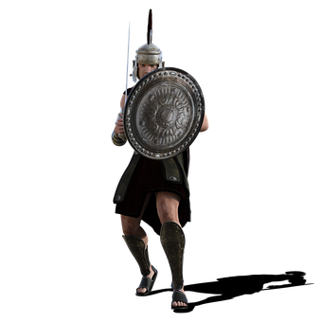
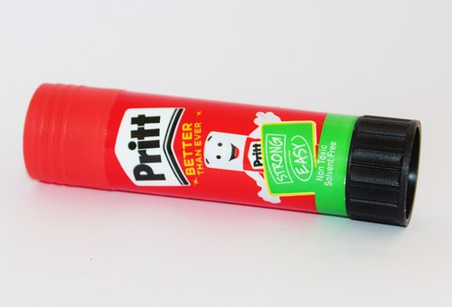
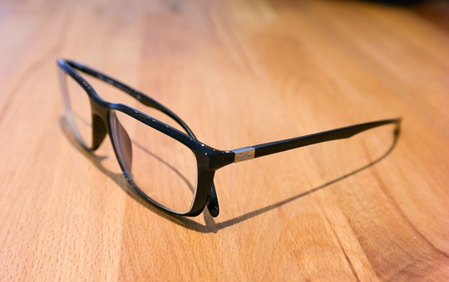
Find the odd one out!

Slide 63
Can you sound these words out?
glee

Slide 64
glass

Slide 65
glen

Slide 66
glum

Slide 67
gloom

Slide 68
Can you count how many sounds there are in these words?
glad

Slide 69
a
d
gl
3

Slide 70
glimmer

Slide 71
gl
mm
er
i
4

Slide 72
gladden

Slide 73
gl
a
e
n
dd
5

Slide 74
Phoneme Spotter - gl
Addison was full of glee at the party.
Finlay was glum during his tests.
The glasses glittered after they had been washed.

Slide 75
Can you write 3 gl words?
gladiator
glee
igloo
glasses
glitter

Slide 76
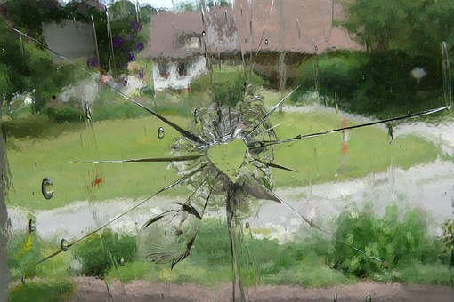
Can you write a sentence about this picture?
Have you used the word glass?

Slide 77
Day 5

Slide 78
Phonics
gr
Phase 4

Slide 79
Sound of the day
g
+
r
gr
=

Slide 80
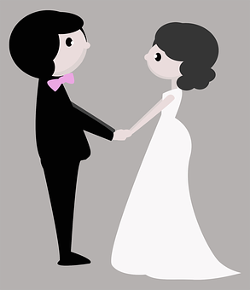
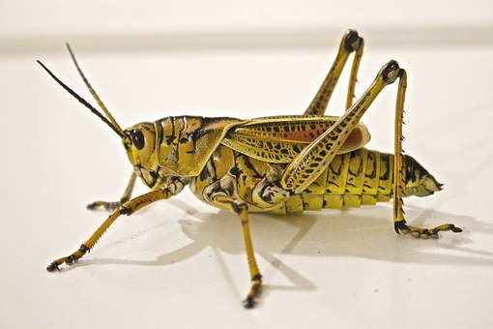
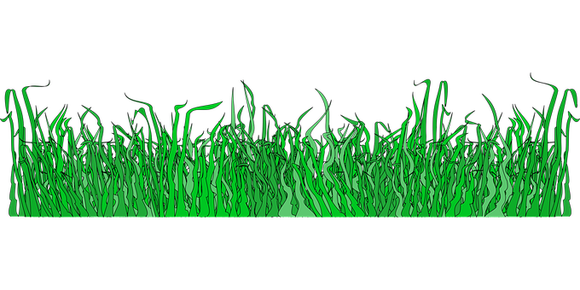
Find the odd one out!

Slide 81
Can you sound these words out?
grip

Slide 82
grit

Slide 83
greed

Slide 84
grab

Slide 85
grin

Slide 86
Can you count how many sounds there are in these words?
grain

Slide 87
gr
ai
n
3

Slide 88
grass

Slide 89
gr
a
ss
3

Slide 90
grasshopper

Slide 91
gr
a
ss
pp
er
h
o
7

Slide 92
Phoneme Spotter - gr
I grabbed my coat off the hook.
The dog growled loudly.
The grasshopper jumped high out of the grass.

Slide 93
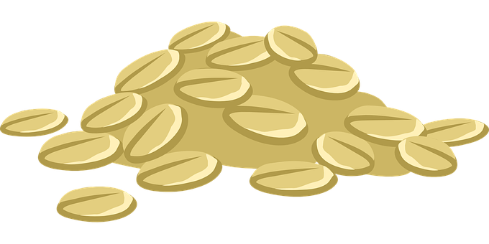
Can you write 3 gr words?
green
grain
groom
grasshopper
grass

Slide 94
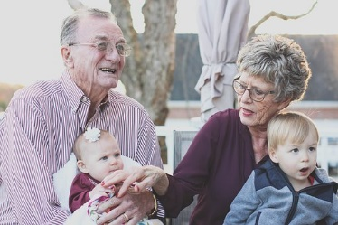
Can you write a sentence about the picture?
Have you used the word grandparents?

Slide 95
Phonics
lf
Phase 4

Slide 96
Sound of the day
l
+
f
lf
=

Slide 97
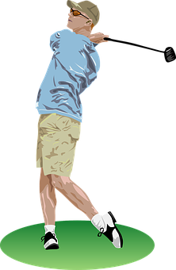
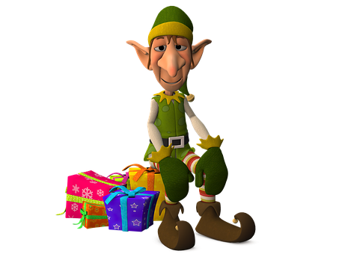
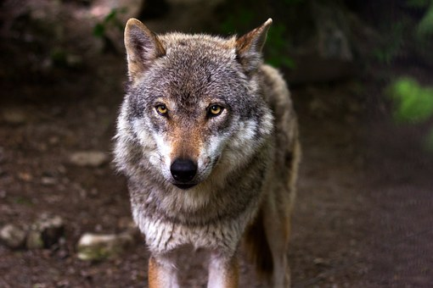
Find the odd one out!

Slide 98
Can you sound these words out?
self

Slide 99
golf

Slide 100
shelf

Slide 101
half

Slide 102
calf

Slide 103
Can you count how many sounds there are in these words?
wolf

Slide 104
o
w
lf
3

Slide 105
elf

Slide 106
e
lf
2

Slide 107
selfish

Slide 108
e
lf
s
i
sh
5

Slide 109
Phoneme Spotter - lf
My dad loves to play golf at the weekend.
The elf made me a present.
The calf was scared of the big bad wolf.

Slide 110
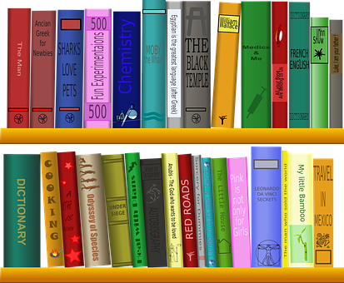
Can you write 3 lf words?
shelf
golf
elf
half
wolf

Slide 111
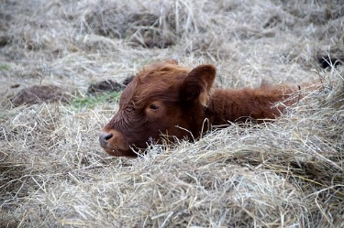
What is hiding in the hay?
Can you write a sentence?
Have you used the word calf?

