Slide 1
PSHE and Citizenship
Relationships | VIPs
PSHE and Citizenship | UKS2 | Relationships | VIPs | People We Love | Lesson 1

Slide 3
Aim
I can explain how VIPs who love and care for each other should treat each other.
Success Criteria
I can identify the features of positive family life.
I can show loving actions to other people.
I understand ways to access support if a relationship ever makes me feel unhappy or unsafe.
This resource is fully in line with the Learning Outcomes and Core Themes outlined in the PSHE Association’s Programme of Study.

Slide 4
The Big Questions

Slide 5
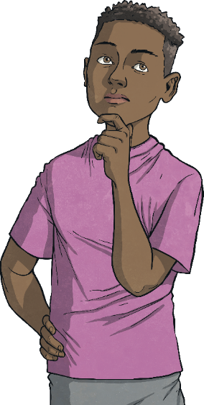
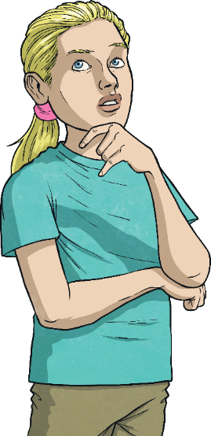
What does love mean? Who are the people we love?
How do people show their VIPs that they love them?

Slide 6
Reconnecting

Slide 7
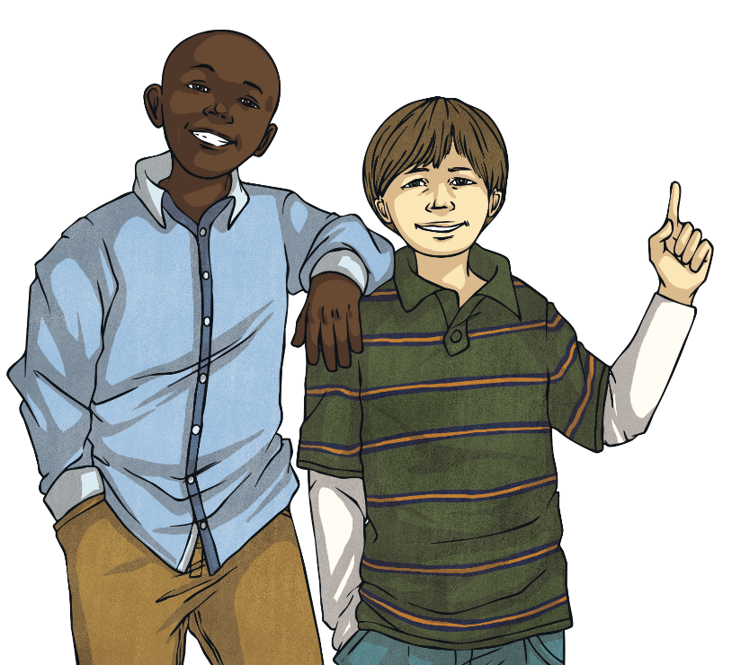
What Is Love?
Love is defined as: an intense feeling of deep affection.
How would you explain love to younger
children?
What does love mean to you?

Slide 8
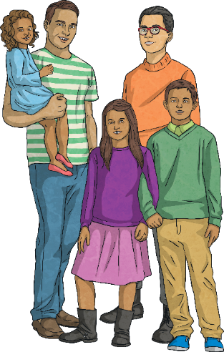
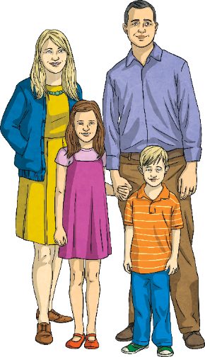
What Is Love?
Does love always make you feel the same way?
Do you ever worry about someone you love because of how much you love them?
Do you ever feel happy with someone you love because of how much you love them?
Do you ever feel sad about missing someone you love because of how much you love them?
There are many different feelings and emotions that we feel for the people we love.

Slide 9
Exploring

Slide 10
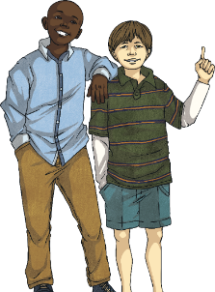
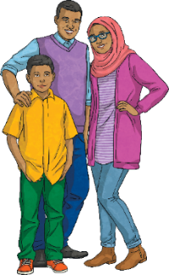
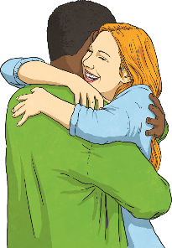
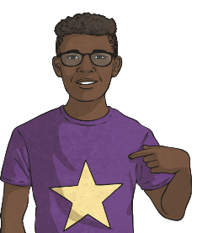
Who Do I Love?
Who are the people we love?
We love people who have different types of relationships with us.
For example, people may have the following relationships:
friendships
family
romantic
We may feel love towards these people in these relationships.
online
with ourselves

Slide 11
Who Do I Love?
This love feeling may differ, depending on the relationship and the person.
Does the love we feel for our family feel the same as the love we have for our friends?
Is romantic love the same feeling as the love we feel for our friends?
The relationships we choose to have in our life are the ones that are right for us.

Slide 12
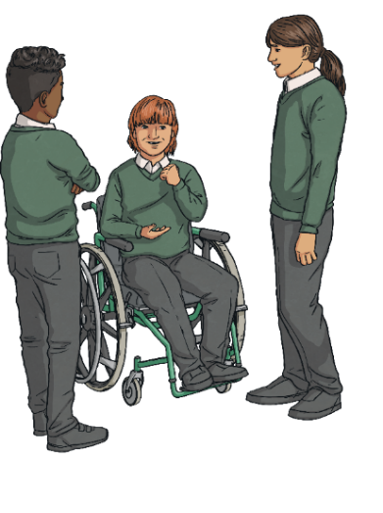
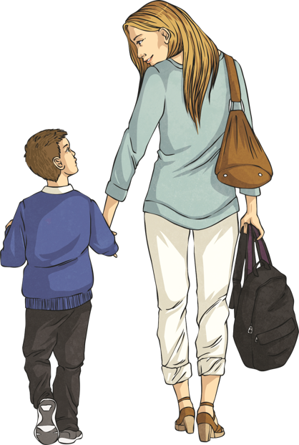
Who Do I Love?
Some of us may have many friends, some of us may have a small group of close friends.
Some families have one parent, some families have two parents, some families have parents of the opposite sex, some families have parents of the same sex.

Slide 13
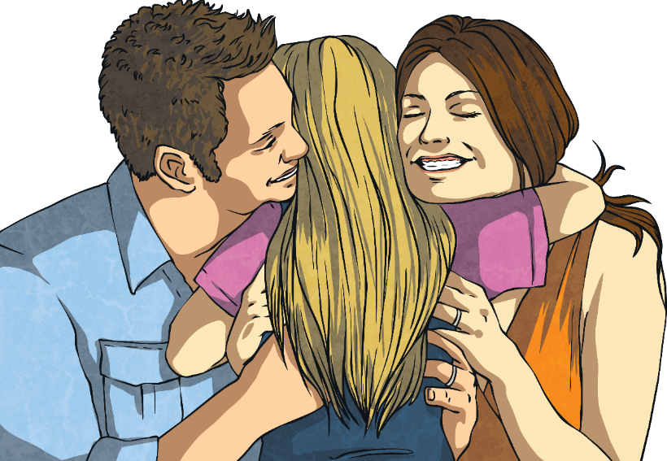
Who Do I Love?
Some people choose to spend their life in a romantic relationship, other people choose to spend their life not in a relationship.
Some people choose to have children, other people choose not to have children.

Slide 14
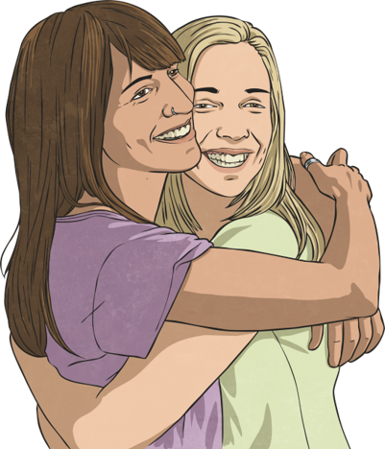
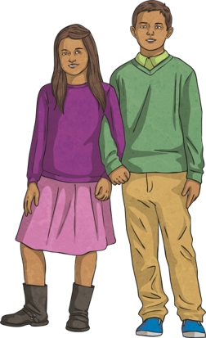
Who Do I Love?
Some people live with the person they love while other people live apart from the person they love.
Some families have step-parents, step-siblings or half-siblings.

Slide 15
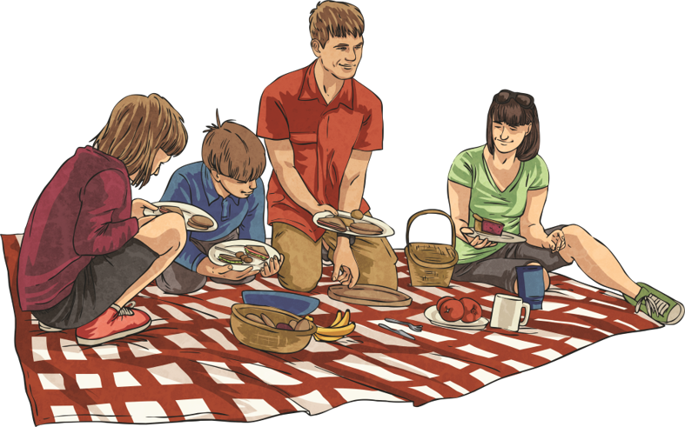
Who Do I Love?
Some children live in foster families.
There are many different types of family structures and relationships. It is important that we recognise and respect this and know that all families and relationships can give the people in them love, security and stability.
This is love.

Slide 16
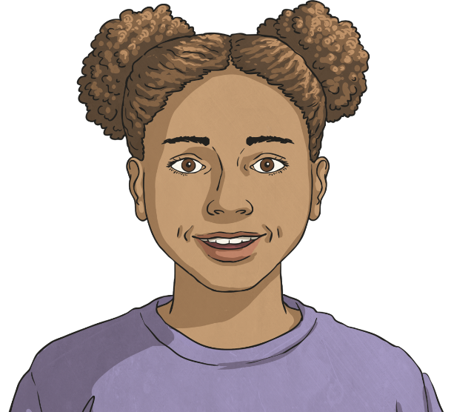
Who Do I Love?
Spend a few moments thinking about the people you love.
How do you treat a person you love?
What is the key feeling that means a person loves you?

Slide 17
Who Do I Love?
Loving relationships are ones where the people in them feel safe, secure and stable.
This doesn’t mean the relationship is always easy or constantly happy.
However, it does mean that the people within the relationship know they are loved, know they are safe, know the relationship won’t change and know that the relationship makes them feel good overall.

Slide 18
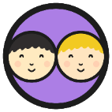
Who Do I Love?
Think about the family relationships you have. What words would you associate with a positive family relationship? Spend some time thinking about this with your partner.

Slide 19
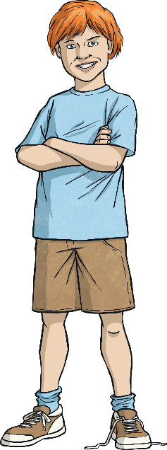
Who Do I Love?
A positive family relationship is one in which people care about each other.
Which of these characteristics did you think of? Did you think of some that are not here?
love
respect
friendship
time
care
Thinking about these key characteristics, how can we show our VIPs that we care about them?
compassion
kindness
honesty
trust
gratitude
compromise
patience
individuality
communication
understanding
commitment
being there
acceptance

Slide 20
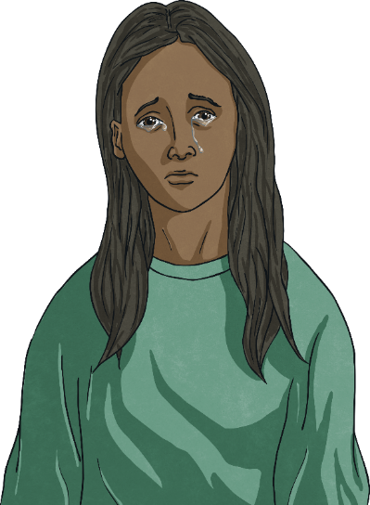
Difficult Times
Amelia lives at home with her mum and dad. Each morning she doesn’t know if she will get breakfast or whether her mum and dad will wake up before she leaves for school. Amelia doesn’t spend much time with her mum or her dad and she feels unhappy. Amelia walks to school on her own and no one knows the way she goes each day. She spends most of her day feeling hungry. Amelia doesn’t feel happy or safe.
Amelia is experiencing a difficult time.
How can we tell that Amelia is unhappy and unsafe?
What could Amelia do?
The people she loves aren’t making her feel happy or safe and this is affecting her. Amelia can get help though.

Slide 21
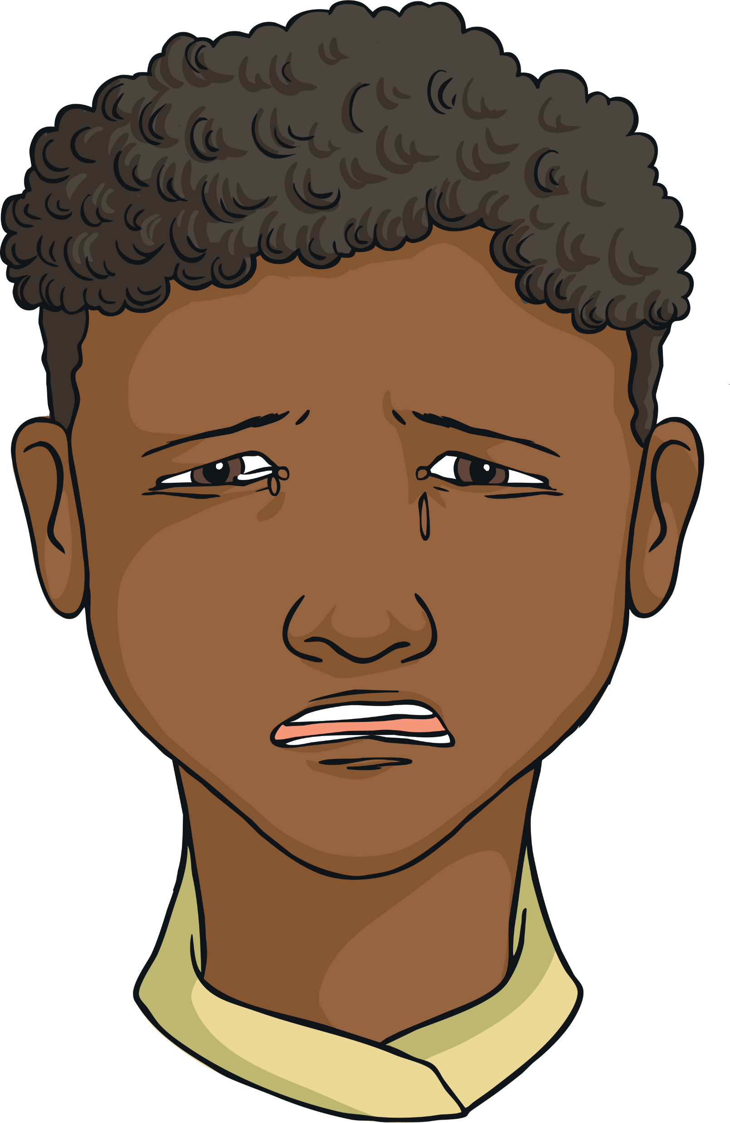
Difficult Times
Byron used to have fun with Lenny. When Lenny and Byron’s mum first got together, they would all go out for the day and laugh together a lot. Now, Lenny has started to shout at Byron and his sister. He has threatened to smack Byron’s sister when she wouldn’t stop crying.
Byron lives at home with his little sister, their mum and her new partner, Lenny. Byron and his sister see their dad every other weekend and on Wednesday nights. He really enjoys this time with his dad as they have lots of fun.
What could Byron do?
Recently, Byron has also noticed his mum has changed. She is now very quiet and doesn’t enjoy the things she used to. Sometimes Lenny shouts at her or calls her names in front of Byron and his sister. After their bedtime, Byron has heard shouting and banging, as well as the sound of things getting broken. His mum says if Byron tells his dad, Byron and his sister won’t be able to live with her any more. Byron feels very worried and this is making him sad and anxious.
Byron is experiencing a difficult time.
How can we tell that Byron is unhappy and unsafe?
The people he loves aren’t making him feel happy or safe and this is affecting him.

Slide 22
Difficult Times
As well as thinking about the relationships we are in and how they make us feel, we may also feel affected by how the relationships that our VIPs are in and how those make them feel.
Amelia felt unhappy and unsafe. The relationships with her VIPs at home were not making her feel safe and loved.
Byron felt unhappy and unsafe. He was also worried for his mum and about the impact her relationship was having on her wellbeing.
Amelia and Byron can get help though, both for themselves and for the people they love.

Slide 23
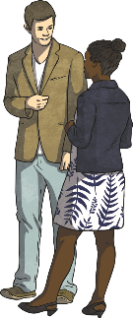
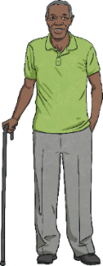
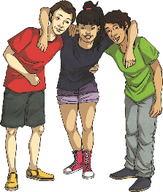
Difficult Times
If we are worried about how a relationship is making us feel, or how a relationship is affecting one of our VIPs, there are people we can speak to for help. We all have many VIPs who make up our support network. These VIPs are people who we can talk to for support and they will make sure we get the help we need.
A support group which specifically helps to support children is:
Childline: 0800 1111 www.childline.org.uk
This includes:
our friends
our teachers
other family members
Childline is confidential, which means that Amelia and Byron can contact them and know that whatever they say is kept between them and Childline. They would only say something if Amelia or Byron asked them to, if Childline felt that Amelia’s or Byron’s life was in danger, if Amelia or Byron were being hurt by someone who might hurt others, if another child was being hurt or if they had to by law (for example in a court case).
support groups

Slide 24
Difficult Times
Amelia and Byron were experiencing difficult times in their face-to-face relationships.
Many older children and grown-ups have digital relationships with their face-to-face friends and family. This can be healthy and positive, especially with those who live far away.
However, it is important to ensure digital and online relationships are healthy just like we would make sure our face-to-face relationships are healthy and positive.
Healthy digital wellbeing is very important and if you don’t feel safe or happy it is just as important to gain support and advice as it would be for a face-to-face relationship needing help.
This means that we feel safe and happy in our online relationships and interactions.

Slide 25
Difficult Times
Digital wellbeing areas to be aware of are:
If someone sends messages all the time or calls all the time when you don’t want them to.
If someone is being unkind or hassling you on social media.
If someone is sending messages on social media to try and control you or your relationship.
These are all signs of an unhealthy digital relationship and it is really important to talk to a trusted VIP or support group about them. These things are not OK and can be stopped.
If someone is trying to make you share confidential information, such as your password.
If someone is sending you messages which make you feel uncomfortable.

Slide 26
Difficult Times
Healthy relationships with our VIPs, whether they are digital or face-to-face relationships, should make us feel safe, loved and cared for. We should feel valued and respected. If we are worried about a relationship, or about one of our VIPs, it is important to speak to someone in our support network for help.
other family members
our teachers
our friends
support groups

Slide 27
How Can I Show Love?
In the stories we have looked at today, the children’s VIPs at home were not showing them care and love.
How can we show others that we care for them?
We show them respect.
We help them get support when they need it.
We make time for them.
We care for them.
We show compassion for them.
We are kind to them.
We are honest with them.
We trust them and show they can trust us.
We are friendly to them.

Slide 28
How Can I Show Love?
How can we show others that we care for them?
We negotiate and compromise with them over differences of opinion.
We are patient with them.
We recognise they are an individual and don’t have to be the same as us.
We communicate with them.

Slide 29
How Can I Show Love?
How can we show others that we care for them?
We commit to being their friend or VIP.
We are there for them.
We are grateful for them and the things they do.
We accept them for who they are without trying to change them.

Slide 30
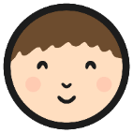
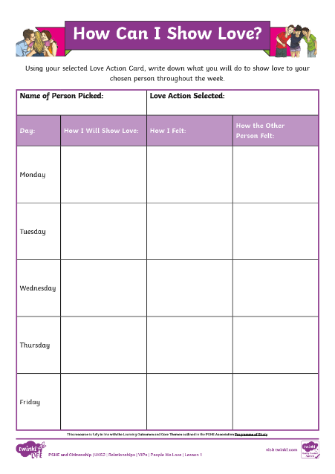
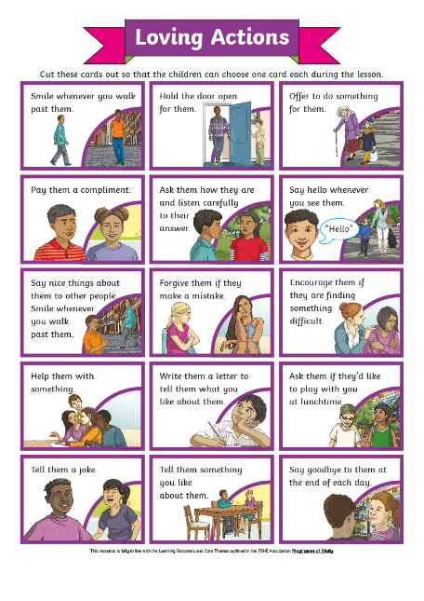
How Can I Show Love?
On the piece of paper you are given, write your name and then fold the piece of paper twice to ensure your name is now hidden. Hand your folded paper in.
Next, look at your card from the Loving Actions Sorting Cards and then take a name card. If you pick out your own name, put it back in the pot and choose another name instead.
Using the How Can I Show Love? Activity Sheet, explore how you will show loving actions to the person you have selected over the next week.

Slide 31
Consolidating
Reflecting

Slide 32
Consolidating

Slide 33
Love Connections
Spend some time thinking about the people you love and the people who love you.
On your sticky note, write about or draw a person you love. You might want to just add some keywords about why you love them or you might want to write about or draw them in detail.
The heart symbol is often used to represent love. Ancient Egyptians believed the heart showed life and morality. Many believe that love gives people energy just like the heart supplies blood to the body.
These notes will then be collected to make a class love heart to show the VIPs we have, collectively, as a class.
We are going to make a class ‘Love Heart’.

Slide 34
Reflecting

Slide 35
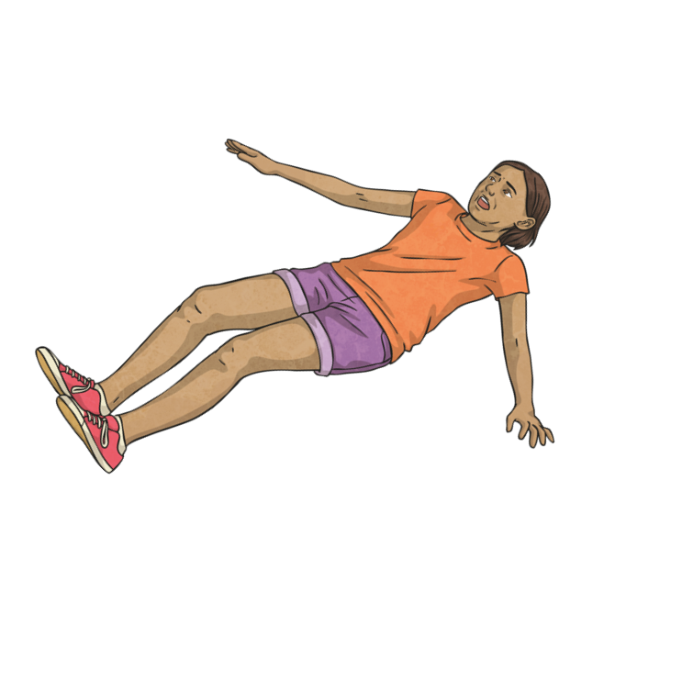
Love Yourself
In order for us to love other people, we need to be able to love ourselves and let ourselves be loved by others.
The way in which we treat ourselves and speak about (or to) ourselves will impact how we expect to be treated by other people.
Think about how you talk to yourself when something goes wrong.
‘I can’t believe I’ve fallen over. I’m so clumsy. I’m an idiot.’
Would you speak to your best friend in this way?

Slide 36
Love Yourself
We are often our own biggest critics and can be quite unkind in our words to ourselves. This impacts how we feel and the relationships we make.
It is important for our wellbeing for us to speak kindly and with love to ourselves. This then helps us to recognise how we deserve to be treated by ourselves and by other people.
Once we know how to love ourselves, we can effectively love and care for other people and love and care for the planet.

Slide 37
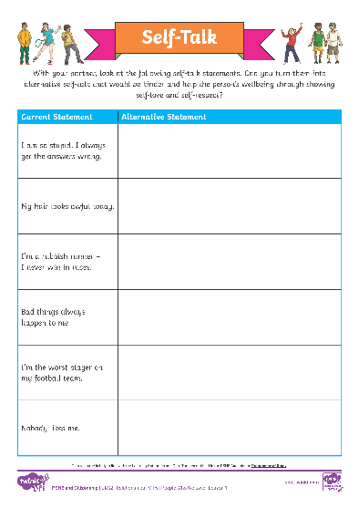
Love Yourself
The way you talk to yourself is called self-talk.
‘I can’t believe I’ve fallen over. I’m so clumsy. I’m an idiot.’
‘I can’t believe I’ve fallen over. I was running so fast that I lost control. Luckily I’m OK and I landed safely. I’ll feel better if I have a little rest and remember that everyone has accidents.’
In pairs, look at the Self-Talk Activity Sheet. Can you create alternative self-talk that shows self-love and self-respect?
In this example, this child is talking to themselves in a way that is not kind or positive to their wellbeing. This could be changed to:

Slide 38
Love Yourself
Remember, the way you speak to yourself should be in the same way you would speak to a friend or member of your family.
If your words would upset or hurt your friend or family then it is important to stop and remember to be kind and loving to yourself as well.

Slide 39
The Big Questions

Slide 40
What does love mean? Who are the people we love?
How do people show their VIPs that they love them?
What have you learnt today?
How will it help you in your daily life?

Slide 41
Aim
I can explain how VIPs who love and care for each other should treat each other.
Success Criteria
I can identify the features of positive family life.
I can show loving actions to other people.
I understand ways to access support if a relationship ever makes me feel unhappy or unsafe.
This resource is fully in line with the Learning Outcomes and Core Themes outlined in the PSHE Association’s Programme of Study.

Slide 43
Aim
I can identify different ways to calm down when I am feeling angry or upset.
Success Criteria
I understand the consequences of unkind behaviour.
I can try out techniques for calming down and identify which work best for me.
This resource is fully in line with the Learning Outcomes and Core Themes outlined in the PSHE Association’s Programme of Study.

Slide 44
The Big Questions

Slide 45
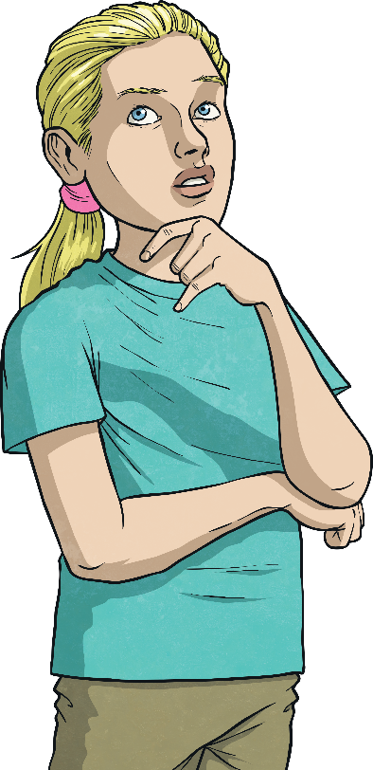
What are the consequences of behaving unkindly to the people around us?
How can we calm down when we are feeling angry or upset with other people?
What strategies do you already use when you are feeling angry or upset?

Slide 46
Reconnecting

Slide 47
Our Emotions
When we are feeling angry or upset, do all the strategies we currently use lead to productive and positive outcomes?
Do some of the strategies make either the situation worse or ourselves feel worse?
What are the different emotions we feel in our lives?
angry
depressed
confused
helpless
fearful
indifferent
afraid
sad
embarrassed
excited
loving
happy
interested
relieved
lonely
positive
peaceful
guilty
strong
relaxed
brave
jealous
anxious
hurt

Slide 48
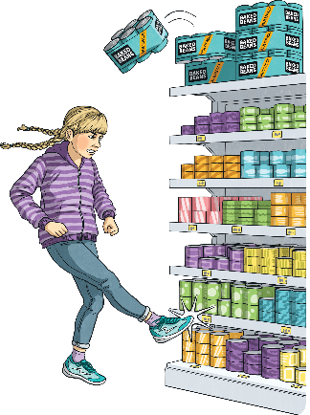
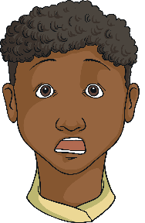
Our Emotions
Why do we need all these different emotions in our lives?
We feel emotions through our bodies and through our minds. These emotions help us to deal with situations and prepare for things that might happen. These emotions can be linked to self-protection or social survival.
For example, fear is an emotional response to certain situations. It can actually help to keep us safe, as it ensures we do not take unnecessary risks.
Guilt is an emotion we feel to ensure we make things right with our friends and to keep society functioning well. It is closely linked to our sense of doing the right thing.

Slide 49
Exploring

Slide 50
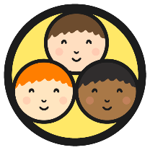
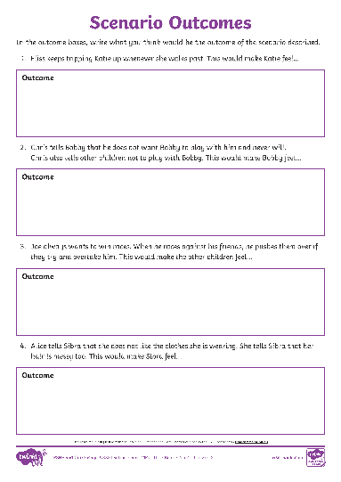
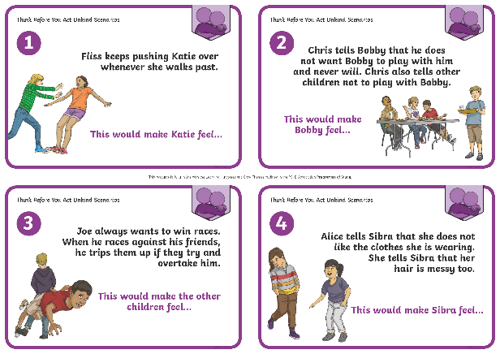
Possible Outcomes
In your group, look at the Unkind Scenario Cards and Scenario Outcomes Activity Sheet. In these scenarios, some individuals are being unkind to others.
Your group’s task is to discuss the consequence of the scenario and record the outcome in the blank box, as agreed by the group.
After the scenario cards have been completed, we will share them as a class to see if you all predicted the same consequences or if we had different opinions about what the outcomes might be.

Slide 51
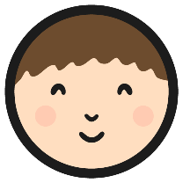
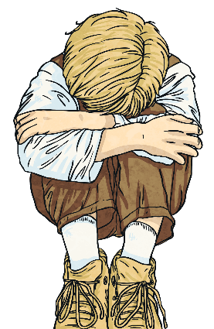
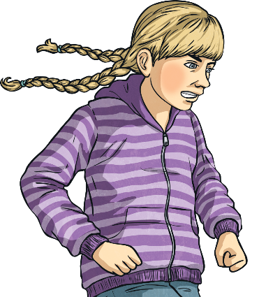
Calming Techniques
When we feel intense emotions, such as anger or sadness, it is very important to recognise these emotions.
This requires practise and there are different things to look out for in different people. Sometimes intense emotions can cause a physical reaction and make us feel hot, shaky or sick.
We need to know how to react in response to these powerful emotions in order to ensure we handle them productively and do not make a situation worse for ourselves or others.

Slide 52
Calming Techniques
Sometimes, people try to hide the emotion they are feeling. For example, someone might smile and pretend they are happy when actually they are feeling sad. This is often called ‘bottling it up’. The longer someone pretends they are not feeling the actual emotion (e.g. sadness), the harder it becomes for that person to deal with it.
Learning calming techniques is really important for ensuring that we keep ourselves and others safe and healthy while dealing with such intense emotions.
Knowing which calming techniques work best for us can help us to reflect on our true emotions, deal with them and then move on. This enables us to feel in control.

Slide 53
Calming Techniques
Let’s look at some calming techniques. We can also share any other calming techniques that we know of or use. Once we have shared all the different techniques, you will be able to choose the technique that you feel would work best for you.
Your task will then be to use your Calming Techniques Poster Activity to create a poster that shows this technique. When you have completed this, you can work with a partner to discuss your chosen technique and act out a scenario that shows the technique being applied.

Slide 54
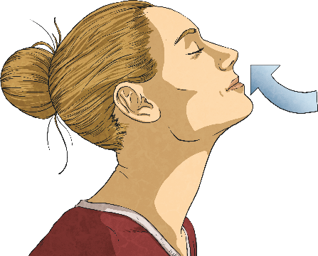
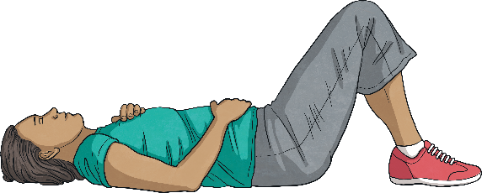
Calming Techniques
1
Breathe – When someone is experiencing an intense emotion, they often take fast and shallow breaths. By breathing slowly and deeply, the emotions can feel less intense. Breathe in slowly through your nose, hold for three seconds and then breathe out slowly through your mouth.
2
Relax – Sit down (or lie down if possible). Put one of your hands on your chest and the other hand on your stomach. Imagine the intense emotion slowly leaving your body as you do this.

Slide 55
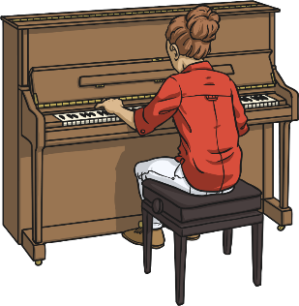
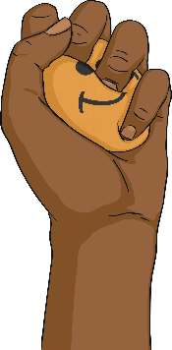
Calming Techniques
3
Be Mindful – Close your eyes and picture your favourite place. Focus on what you can hear, what you can smell and what you can see.
4
Music – Listening to music, or making our own, helps us to relax and work through intense emotions.
5
Squeeze – People can have a physical reaction when they are experiencing intense emotions. Therefore, squeezing a stress ball or hugging a cuddly toy can release this physical reaction.

Slide 56
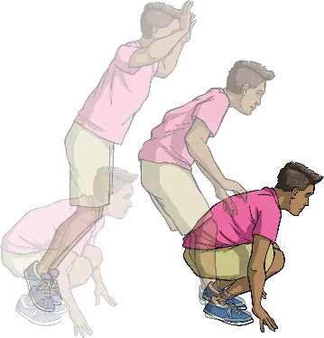
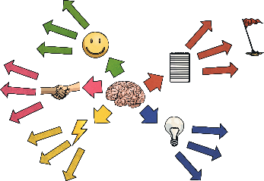
Calming Techniques
6
Exercise – Moving helps people to feel good. Hop up and down, dance or run around – whatever exercise you enjoy.
7
Positive Thinking – Address the intense emotions being felt by writing them down and then coming up with a positive solution to each of them.
Consolidating
Reflecting

Slide 57
Consolidating

Slide 58
Feeling Cross
Anger is an intense emotion that shows how much we care about something or someone. Due to its intensity and the physical reaction it can also cause, anger can be seen as an unhelpful emotion. However, although it can be an unhelpful emotion, it is a very natural emotion and it's how we react to that feeling that is important.
What causes people to feel angry, frustrated or upset?
It is actually OK to feel angry, but it is really important to have effective and positive ways to deal with this emotion.
In pairs, look at the Emotions Activity Sheet and discuss the different outcomes depending on how someone manages their anger.
Could, or should, there no longer be anger in the world?
Can anger be used in a positive way?

Slide 59
Reflecting

Slide 60
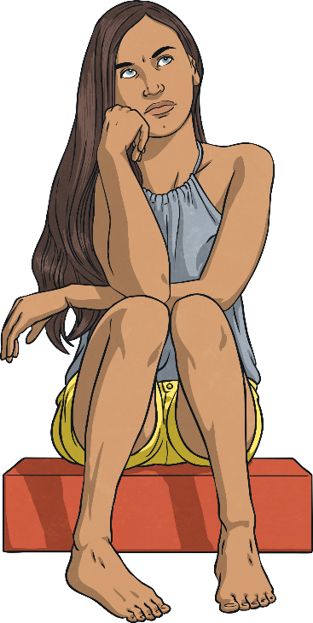
Count to Ten
A tried and tested method for giving us time to think before we act is counting to ten. This technique prevents us from acting rashly or in a way we might regret and gives us time to gain control of our feelings.
3
5
…
1
2
4

Slide 61
Count to Ten
While counting to ten, use the time to think of ten good reasons to think before you act:
We might say something we don’t mean.
We could hurt someone.
We might get into trouble.
We might embarrass ourselves.
We could lose a friend.
We might hurt ourselves.
We might regret what we say or do.
We could make our feeling of anger even more intense.
We might get a bad reputation.
We might be able to think of a way to handle this in a positive way.

Slide 62
The Big Questions

Slide 63
What are the consequences of behaving unkindly to the people around us?
How can we calm down when we are feeling angry or upset with other people?
How can calming techniques support us in thinking before we act?

Slide 64
Aim
I can identify different ways to calm down when I am feeling angry or upset.
Success Criteria
I understand the consequences of unkind behaviour.
I can try out techniques for calming down and identify which work best for me.

Slide 65
Prayer

