Slide 1
Number Bonds to 10
Mastery and Reasoning Questions

Slide 2
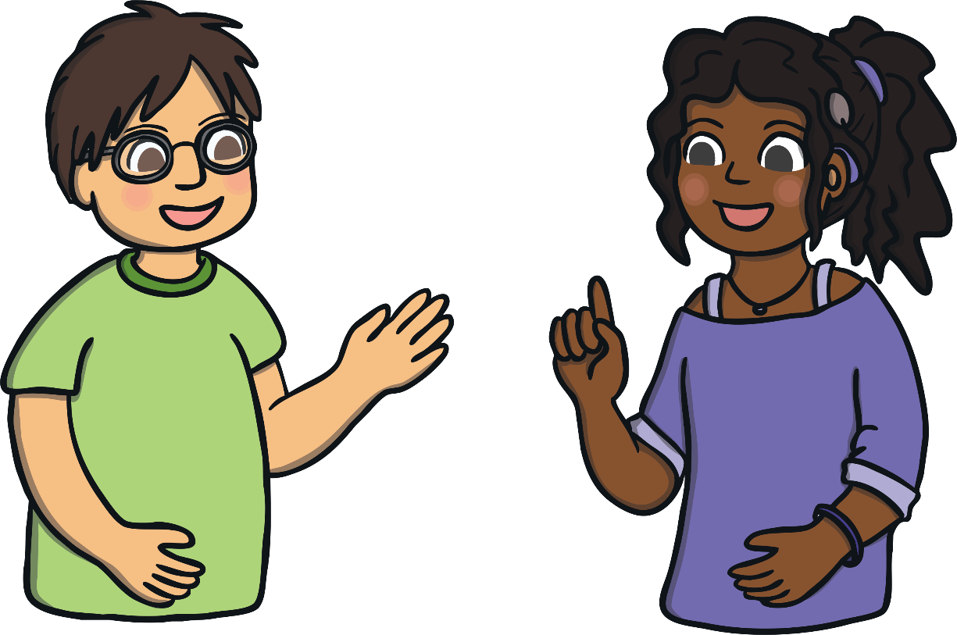
Contents
Spotty the Dog (10+0, 0+10)
Number Bond Shells at the Seaside
Jumping Frogs (9+1, 1+9)
Number Bonds to 10 Minibeast Hunt
Strawberry Addition (8+2, 2+8)
Penguin Party (3+7, 7+3)
Ice Cream Matching (6+4, 4+6)
Llama Drama! (5+5, 5+5)
Number Bonds – Odd One Out
Number Bond Fish
Busy Bee Number Bonds

Slide 3
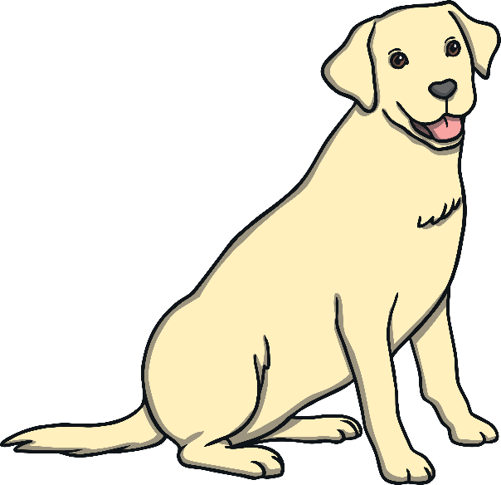
Spotty the Dog
How many spots are there altogether? Does this number change when the dogs shake their spots?
Spotty has 10 spots and his friend has 0 spots. When Spotty shakes, his spots jump on to the other dog. How many spots are there altogether?
Does 10+0 and 0+10 have the same answer? Why?
click again
reset
shake off the spots
10
0
0
10
Click on the dog to reveal questions that encourage the development of children’s mathematical reasoning skills.

Slide 4
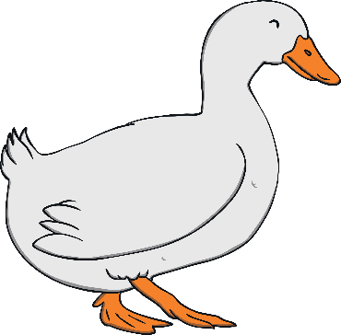
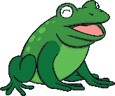
Jumping Frogs
What do you notice about the number bonds 9+1 and 1+9?
When the frogs jump, does the total number of frogs change?
How many frogs are on the logs altogether? How do you know? What happens when the frogs jump?
click again
reset
make the frogs jump
9
1
9
1
Click on the duck to reveal questions that encourage the development of children’s mathematical reasoning skills.

Slide 5
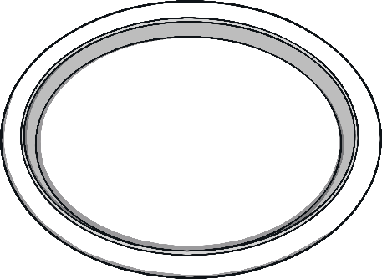
Strawberry Addition
What do you notice about the answer if the 2 and the 8 are swapped around?
Alfie and Ola have some strawberries for their snack. How many are there altogether?
What is 8 + 2? What is 2 + 8? How did you work out the answers?
swap strawberries
click again
reset
2
8
2
8
Click on the girl to reveal questions that encourage the development of children’s mathematical reasoning skills.

Slide 6
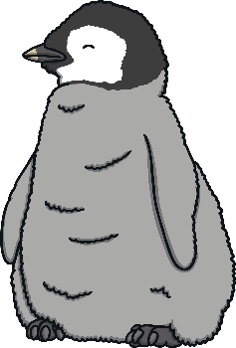
Penguin Party
What do you notice about adding the penguins together in different ways?
The penguins are having a party! Click the penguins to make them move together.
How many penguins are there altogether?
click again
reset
Click on the baby penguin to reveal questions that encourage the development of children’s mathematical reasoning skills.

Slide 7
Ice Cream Matching
What is 4+6? What is 6+4?
Can you show this number bond using your fingers?
Ice cream time! Which numbers can you see on the ice creams? What does each ice cream add up to?
What do you notice about the numbers on the ice creams?
click again
reset
4
6
6
4
Click on the ice cream van to reveal questions that encourage the development of children’s mathematical reasoning skills.

Slide 8
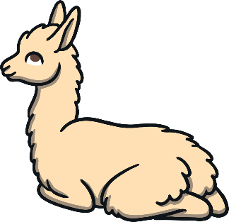
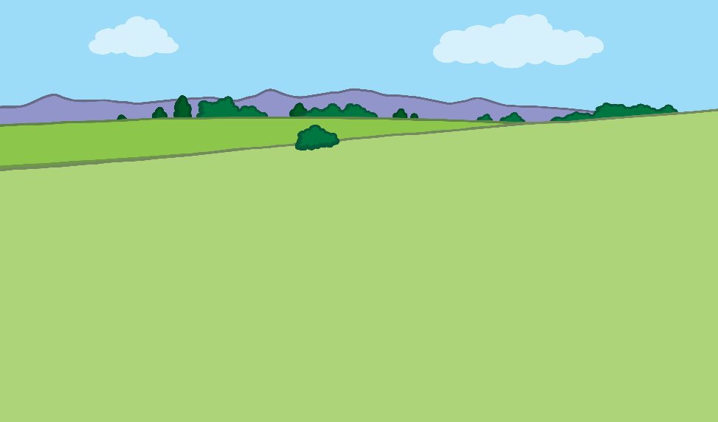
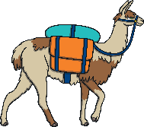
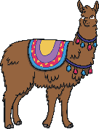
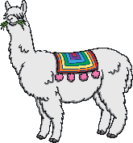
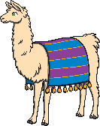
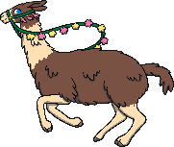
Llama Drama
If the 5s were swapped over in the number sentence ‘5 + 5 = 10’, would it make any difference to the answer?
What can you tell me about the number sentence 5 + 5?
5 llamas have escaped from the field! They need to be caught and taken back to join the other 5 llamas in the field.
How many llamas will there be when they are all back together?
click again
reset
catch the llamas
Click on the baby llama to reveal questions that encourage the development of children’s mathematical reasoning skills.

Slide 9
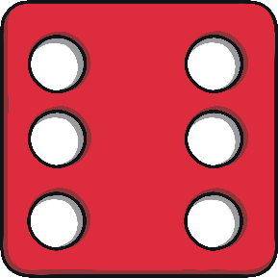
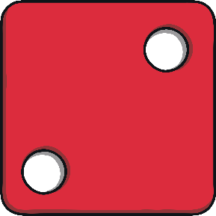
Number Bonds – Odd One Out
Which is the odd one out? Why?
Which one of these is the odd one out?
What would need to change on the dice so that it is not the odd one out?
click again
reset
Click on the star to reveal questions that encourage the development of children’s mathematical reasoning skills.

Slide 10
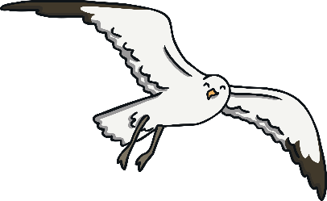
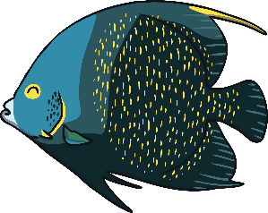
Number Bond Fish
Can you think of a different way to say a number bond to 10?
There are lots of fish in the sea. Can you find and click on the fish that show number bonds to 10? What happens when you click on the fish that do not show number bonds to 10?
What do you notice about all of the fish left in the sea?
click again
reset
2+3
7+3
9+1
0+8
5+5
10+0
7+1
5+2
8+2
6+4
Click on the seagull to reveal questions that encourage the development of children’s mathematical reasoning skills.

Slide 11
Busy Bee Number Bonds
Can you write a number sentence to show each of the number bonds to 10?
The bees are very busy! How many bees are in the hives? Move the bees one at a time and work out the matching number bond.
What is happening to the number bonds as the bees move?
click again
reset
move a bee
Click on the honey pot to reveal questions that encourage the development of children’s mathematical reasoning skills.

Slide 12
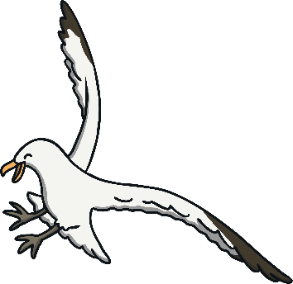
Number Bonds Shells at the Seaside
If 9 shells landed on the sand and 1 shell landed in the sea, then a big wave came and 1 shell landed on the sand and 9 shells landed in the sea, would the total number of shells be the same or different?
Can you think of any other ways to show number bonds to 10 using the shells?
Click on the ‘wave’ button. Each time, can you count how many shells appear on the sand and how many shells appear in the sea?
wave
click again
reset
Click on the seagull to reveal questions that encourage the development of children’s mathematical reasoning skills.

Slide 13
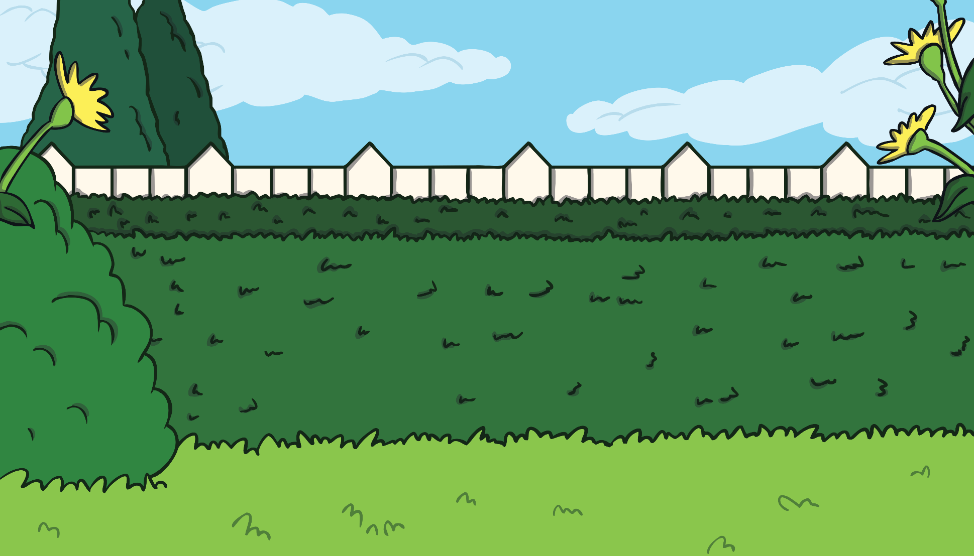
Number Bonds to 10 Minibeast Hunt
Which number bonds to 10 can you spot in the picture? Click to see the answers.
Check answers

