Slide 1
PSHE and Citizenship
Health and Wellbeing | Safety First
PSHE and Citizenship | LKS2 | Health and Wellbeing | Safety First | New Responsibilities | Lesson 1

Slide 3
Aim
I can be responsible for making good choices, to stay safe and healthy.
Success Criteria
I can name some things I can now do independently.
I can discuss my responsibilities.
I can identify who is responsible for helping to keep me safe and healthy.
This resource is fully in line with the Learning Outcomes and Core Themes outlined in the PSHE Association Programme of Study.

Slide 4
The Big Question

Slide 5
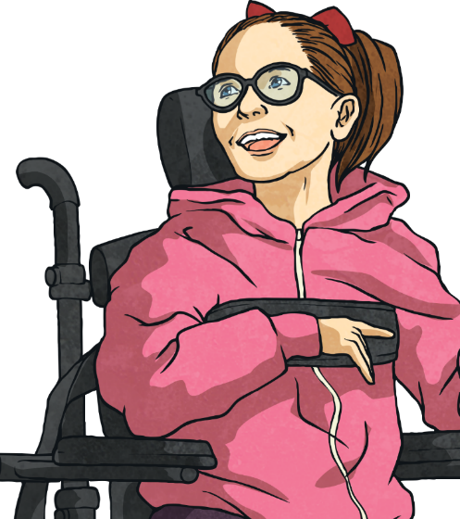
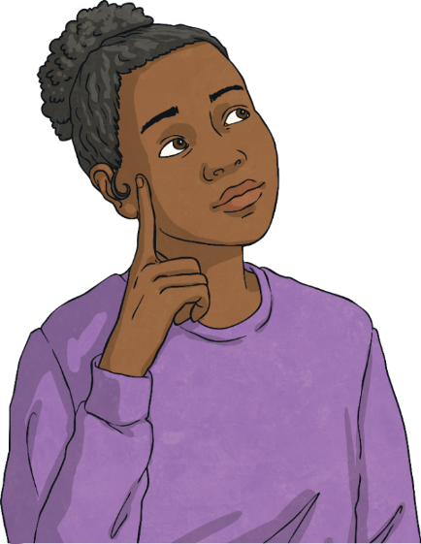
How are we becoming more independent now we are growing older?
What new responsibilities do we have as we get older?

Slide 6
Reconnecting

Slide 7
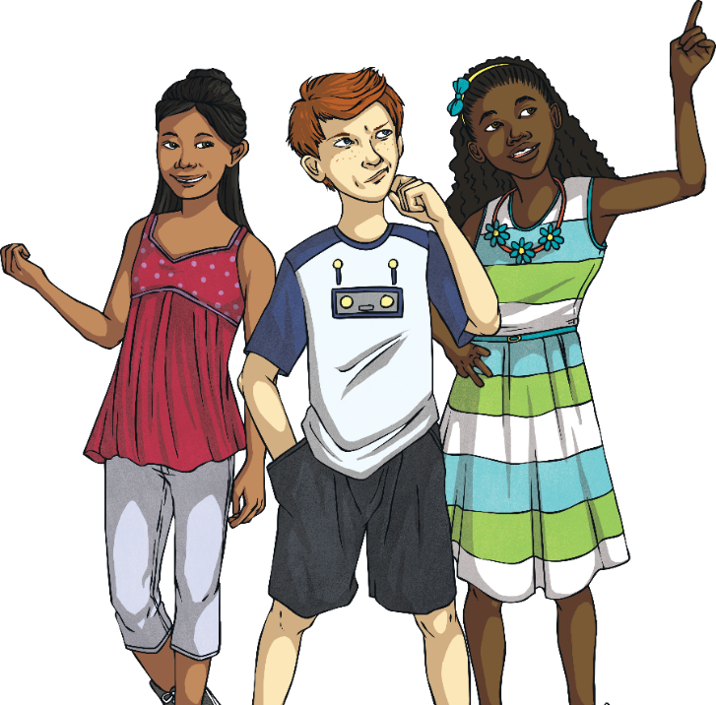
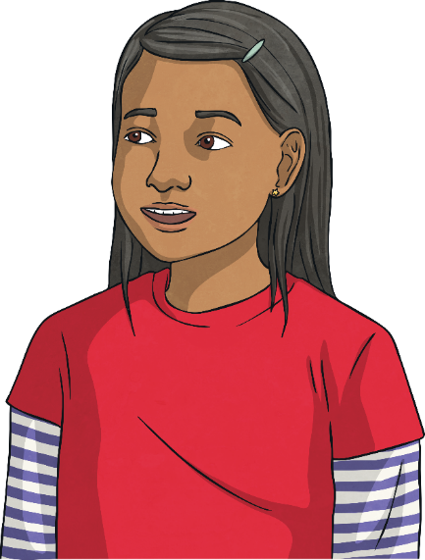
I Am Independent
What can you think of that you used to need more help with but that you can now do all by yourself? Let’s go around the class and share ideas of things we do independently.
Being independent means being able to do things for yourself or by yourself.
Does anyone know what being independent means?
As we get older, we can do more and more things on our own – things we used to need a lot of help with.

Slide 8
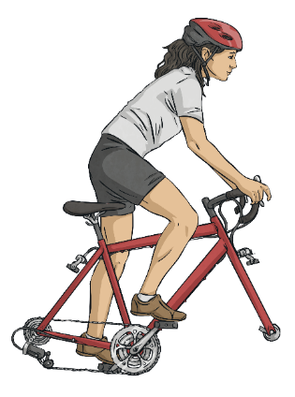
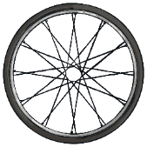
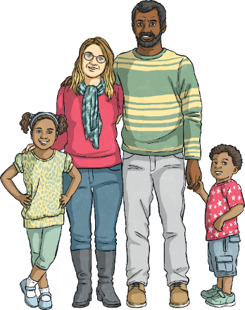
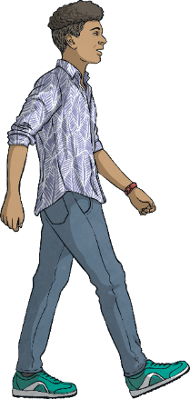
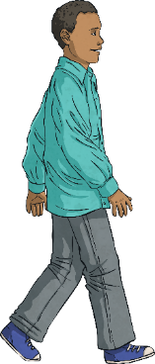
I Am Independent
Part of becoming more independent includes looking after ourselves and staying safe and healthy.
As babies and very young children, we need looking after all the time by our parents or carers. They make sure we are not in risky situations and that we are safe from potential dangers or hazards.
As we grow older, we learn about risks, dangers and hazards so that we can look out for them and take care of ourselves and others.

Slide 9
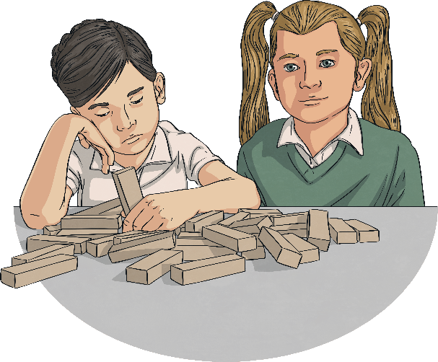
I Am Independent
As we become more independent and take care of ourselves more, we need to learn to speak out about things that worry or upset us, or make us feel uncomfortable.
This might include something we have done, something someone has said or done to us or a problem we have at school. It is important to tell a trusted adult about concerns you have, even if that concern is about another adult.
It is our responsibility to ask for advice or get help if we feel unsafe. If you ask for help and nothing happens, ask again or ask someone different.

Slide 10
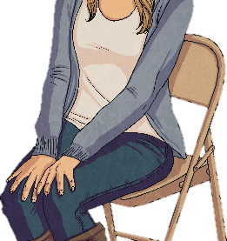
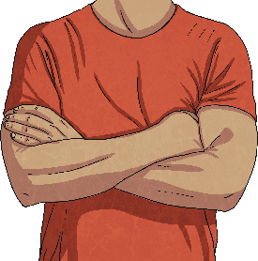
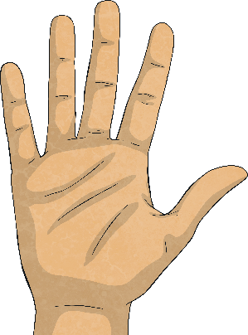
I Am Independent
Remember - your body belongs to you and you are in charge of what happens to it. If someone ever tries to touch you in a place on your body that you are not comfortable with, or in a way that does not feel right, you must tell them to stop, say it is not appropriate and push them away.
You should then tell a trusted adult straight away so that it doesn't happen again. It's never your fault if somebody touches you in a way that makes you feel uncomfortable, and it's very important that you tell someone so that they can help to keep you safe.

Slide 11
Exploring

Slide 12
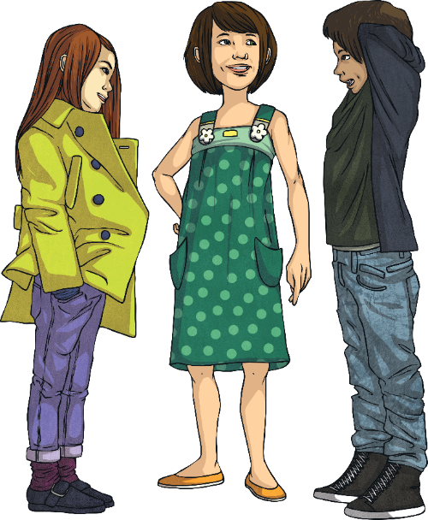
Different Responsibilities
Our responsibilities might depend on our family, our culture, our ability to do something, our age and our experience.
Different people have different responsibilities.
Have a think about whether their responsibilities are similar to yours or very different.
Let’s take a look at some children and their responsibilities.

Slide 13
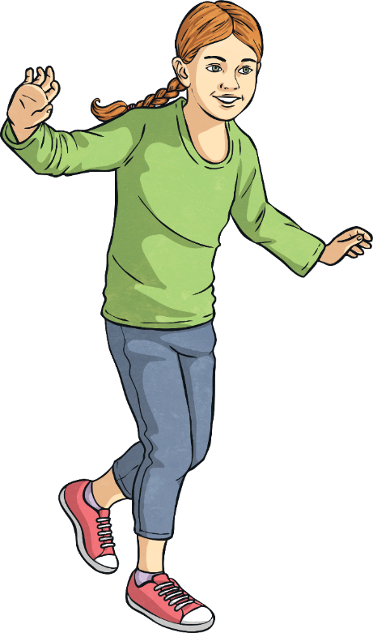
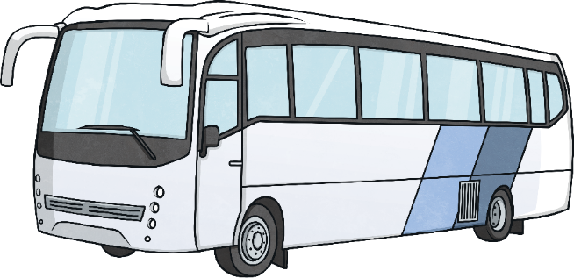
Different Responsibilities
This is Fran. She has a condition called diabetes. Fran has to be careful that her sugar levels don’t get too high or drop too low.
When she goes on a school trip, Fran has to make sure she has a snack on the long coach journey.
What are Fran’s responsibilities?
She also has to make sure she gets up and takes her insulin injection at the right time if she sleeps over at a friend’s house.
Fran has the responsibility to look after herself with the help of adults, like doctors and her parents, when she needs them.

Slide 14
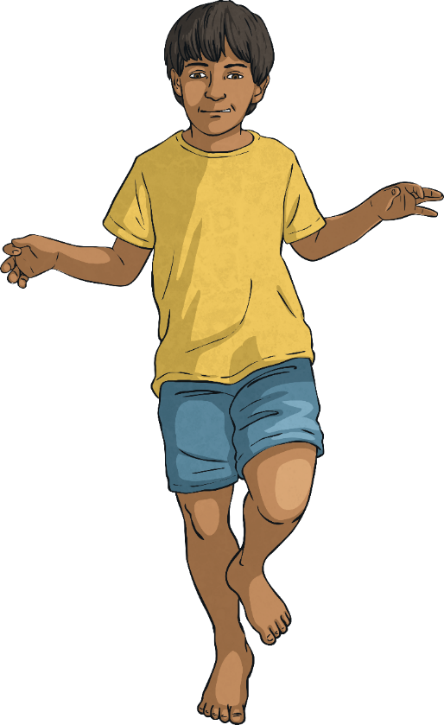
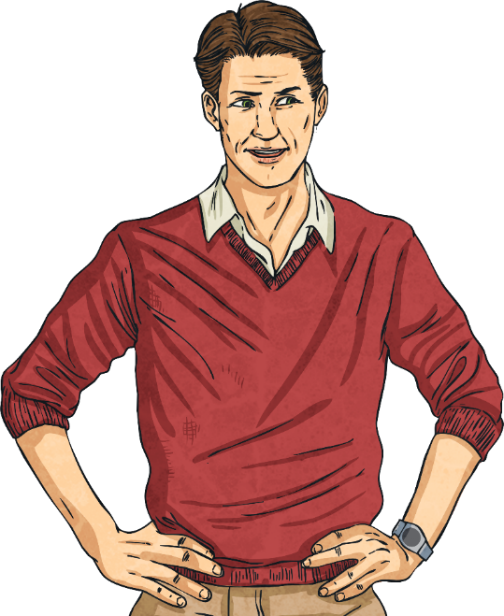
Different Responsibilities
This is Elio. He lives with his dad and his gran. Elio’s dad works early morning shifts and has to leave at three o’clock in the morning.
Elio’s gran is not very well so she can’t really look after him. Every morning, Elio gets himself up and ready for school, makes breakfast for himself and his gran then walks to school on his own.
What are Elio’s responsibilities?
Sometimes, Elio meets one of his friends on the way. It isn't far but he does have to cross three roads.

Slide 15
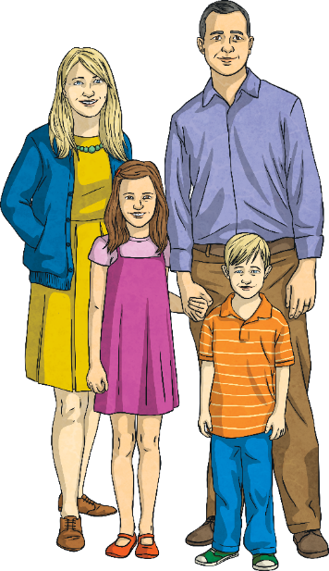
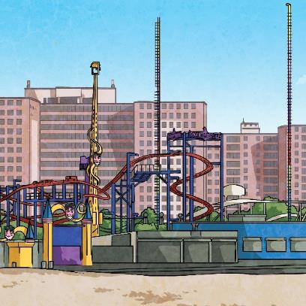
Different Responsibilities
This is Scotty. Scotty’s family travel around quite a lot, as they set up funfairs in different towns.
What are Scotty’s responsibilities?
Scotty helps set up the stalls and rides, which involves using certain tools and doing some heavy lifting.
Scotty watches the adults to see how to do it and listens to the instructions they give him so that he stays safe.

Slide 16
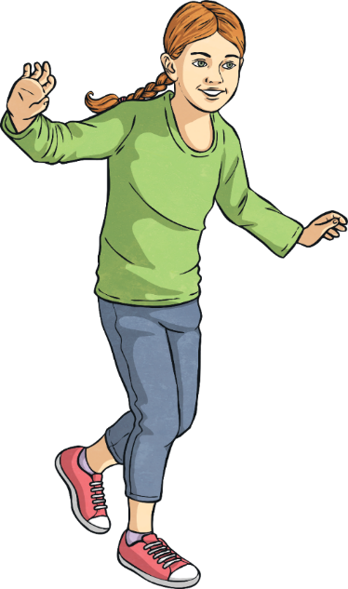
Different Responsibilities
Some responsibilities might seem challenging at first but with experience and maturity, we get more confident and can look after ourselves and others.
Some people have greater responsibilities than others. The older we get and the more independent we get, the more responsibilities we take on.

Slide 17
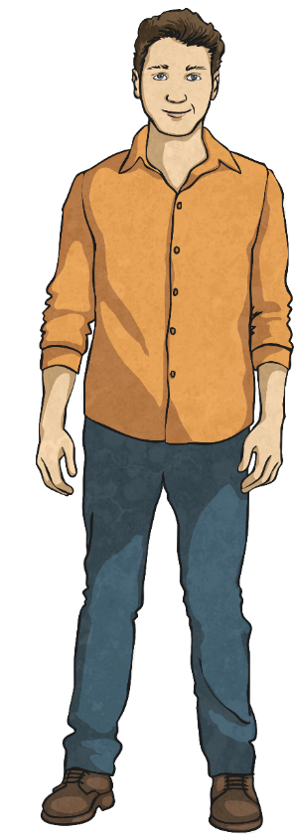
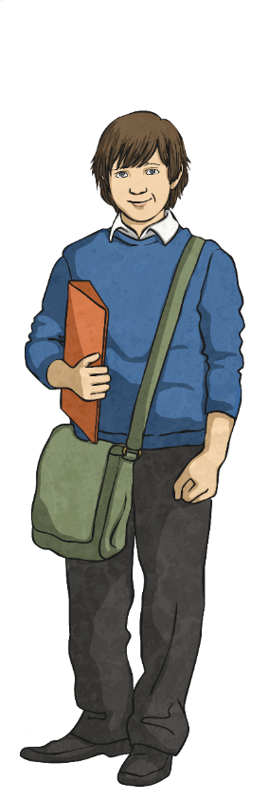
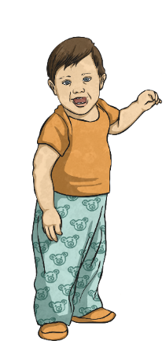
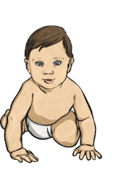
Choices and Consequences
As we get older, we have the responsibility to make good choices.
Did you know that the choices and decisions we make can lead to certain consequences?
If we decide to do or not do something, then the outcome will be affected by that decision.
For example, if we choose to consume sweet, sugary food and drinks all the time, then we might find that the consequence of that choice is that we suffer with tooth decay.

Slide 18
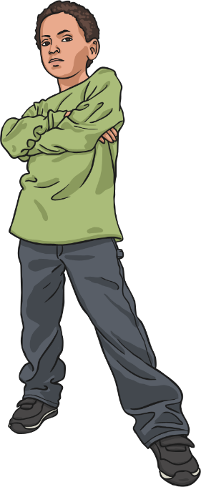
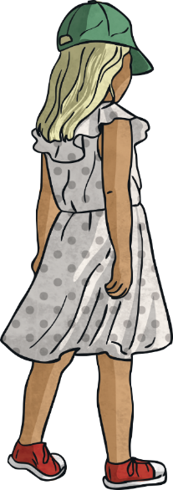
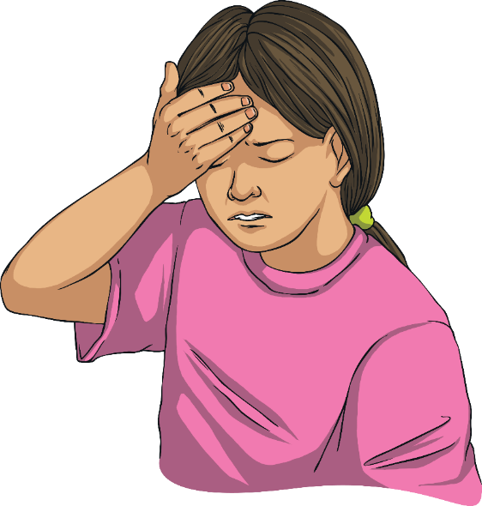
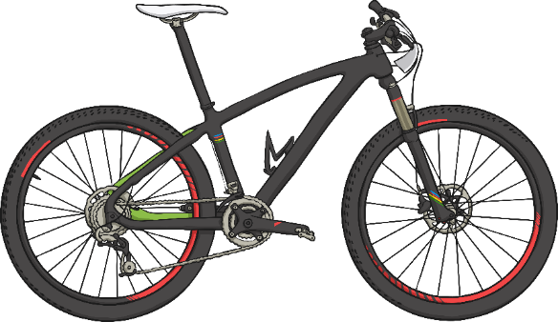
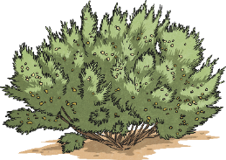
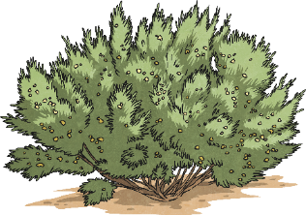
Choices and Consequences
What do you think the consequences of these children’s choices might be?
I’m going to play at the park with the older kids but I’m not telling my parents.
I’m going for a bike ride but I’m not wearing a helmet.
I have a headache so I’m going to get myself some medicine.

Slide 19
Choices and Consequences
Sometimes, there are rules we should follow that are in place to keep us safe and these rules will inform our choices. Many rules protect us from being in dangerous or uncomfortable situations. Some rules protect us from the actions of other people. Some of these rules have age restrictions that keep us safe until we are old enough to be responsible for our choices.

Slide 20
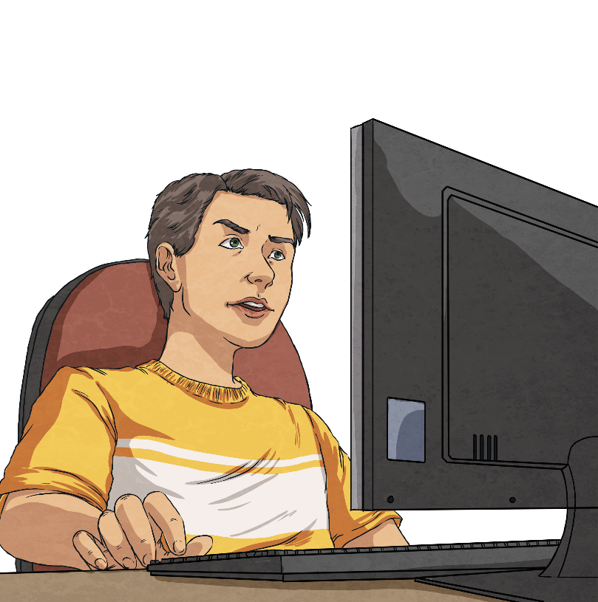
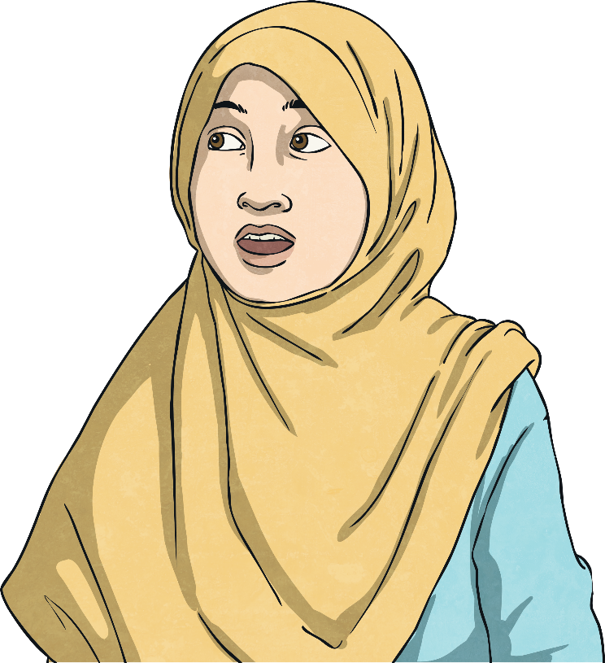
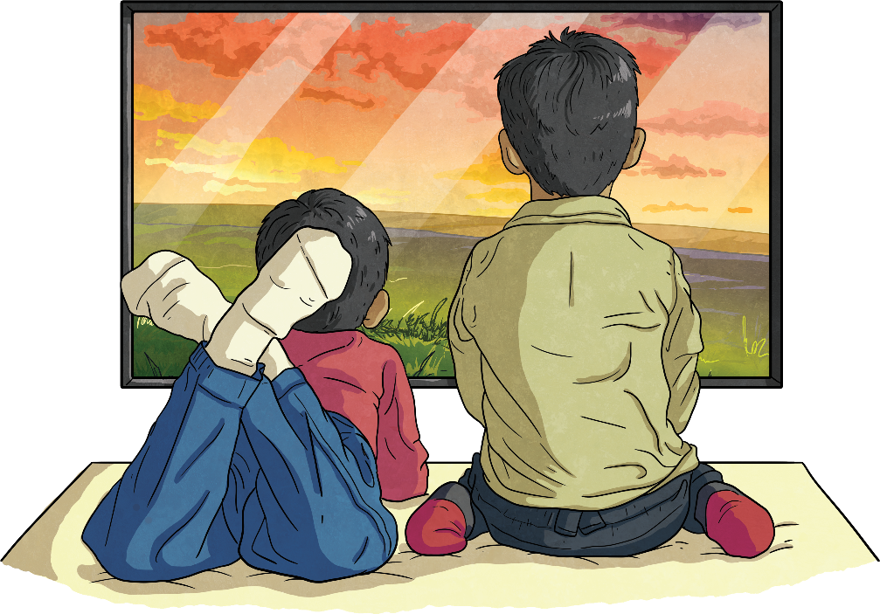
Choices and Consequences
What do you think the consequences of these children’s choices might be?
I’m going to ask my older brother to buy a new game for me because I’m too young to buy it.
I’m going to stay up extra late tonight to watch TV.
I want to sign up for a new email account but I’m not telling my parents.

Slide 21
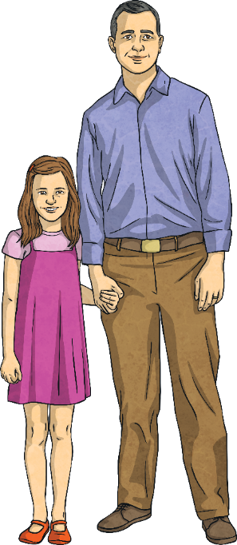
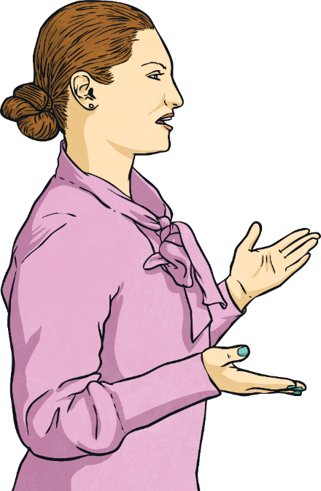
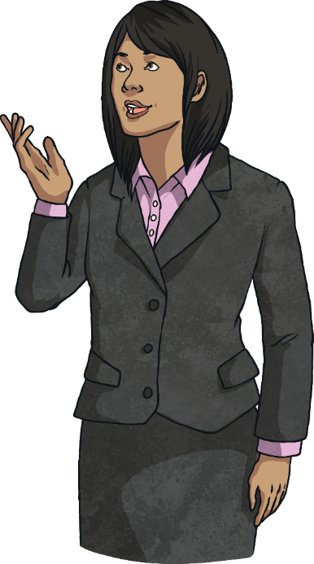
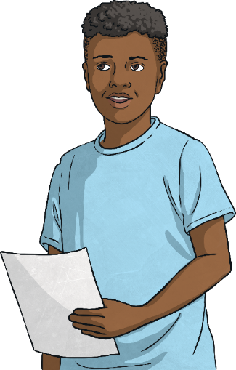
Acting Responsibly
What do you think acting responsibly means?
We can all choose to act responsibly. To act responsibly, there are a few important things we need to do.
Listen to and follow instructions.
Ask for advice if we are unsure of what to do.
Be aware of and stick to the rules.
Know who can help us and ask for help when we need it.
RULES BOOK

Slide 22
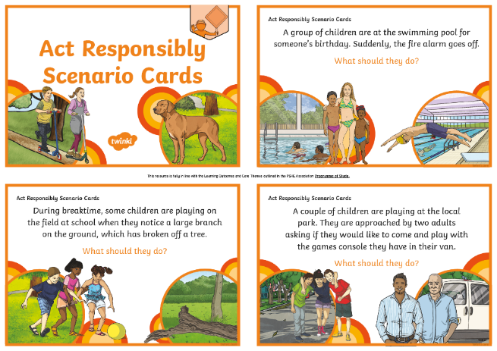
Acting Responsibly
In your groups, you are going to be looking at some scenarios and thinking about how you could act responsibly in the situation given.
Discuss what you would do then act it out!
Remember, acting responsibly means thinking about the choices you have and the consequences of those choices. Consider an action that will lead to a safe outcome.

Slide 23
Consolidating
Reflecting

Slide 24
Consolidating

Slide 25
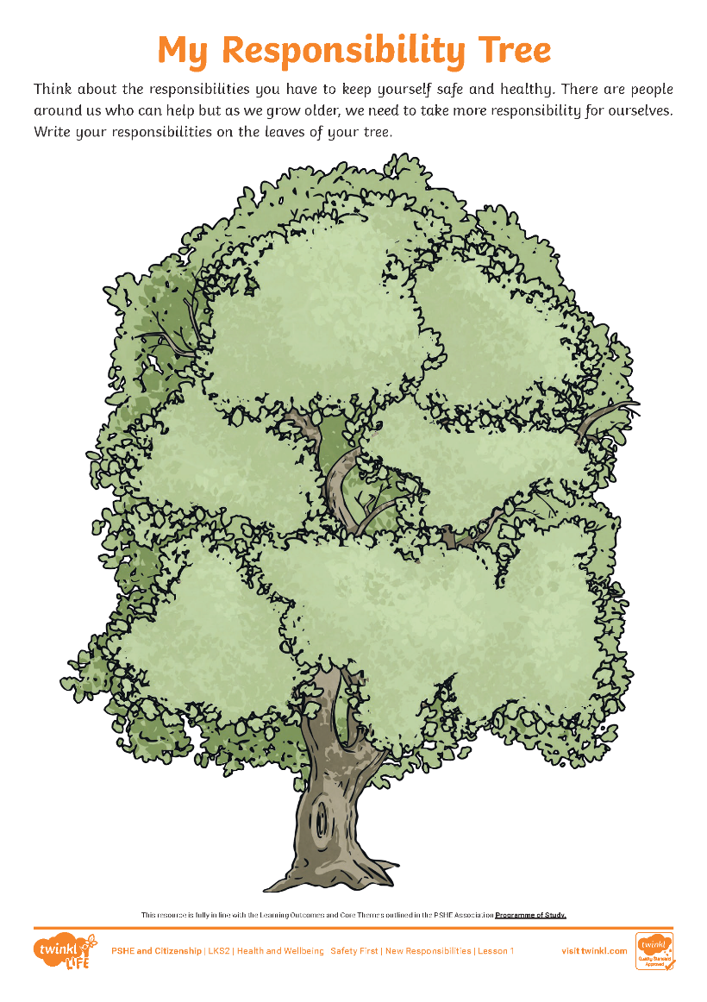
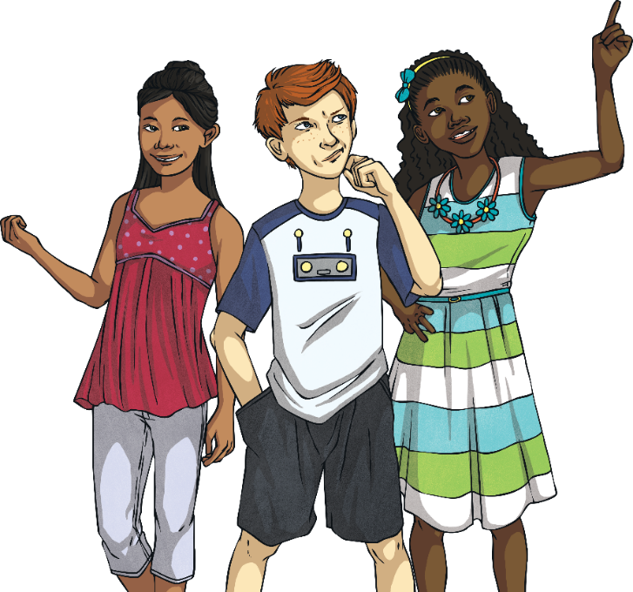
My Responsibility Tree
On your Responsibility Tree, write down any responsibilities you have.
We all have different responsibilities in our lives. We can take responsibility for ourselves and we might have responsibilities for others as we get older.

Slide 26
Reflecting

Slide 27
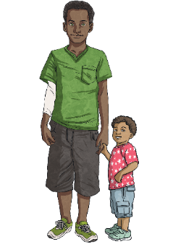
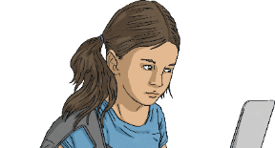
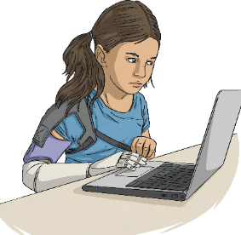
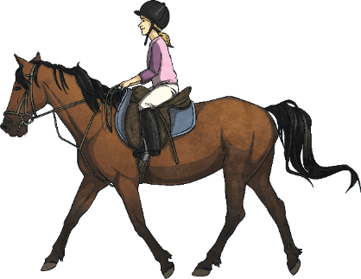
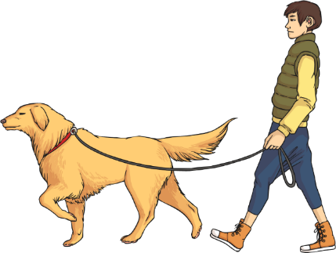
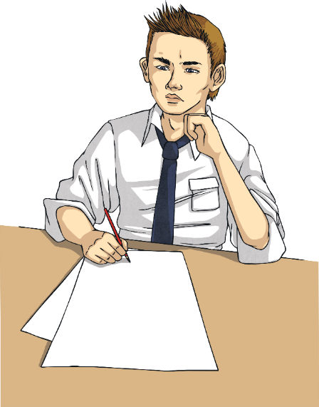
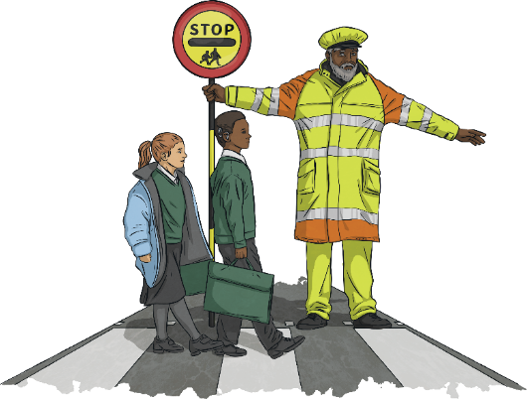
Looking Ahead
Some of you might not have many responsibilities right now. Some of you might already have quite a lot of responsibilities.
With your partner, think of three things you are likely to have responsibility for over the next few years.
These responsibilities could be at home or at school. They could be specific family or health responsibilities or everyday responsibilities that lots of people have.

Slide 28
The Big Question

Slide 29
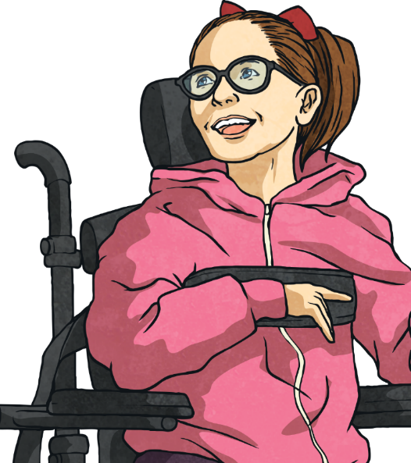
How are we becoming more independent now we are growing older?
What new responsibilities do we have as we get older?
What have you learnt today that will help you in everyday life?

Slide 30
Aim
I can be responsible for making good choices, to stay safe and healthy.
Success Criteria
I can name some things I can now do independently.
I can discuss my responsibilities.
I can identify who is responsible for helping to keep me safe and healthy.
This resource is fully in line with the Learning Outcomes and Core Themes outlined in the PSHE Association Programme of Study.

Slide 32
Aim
I can identify a risky situation and act responsibly.
Success Criteria
I can understand that in life we need to take some risks but that other risks are dangerous.
I can understand the terms ‘risk’, ‘hazard’ and ‘danger’.
I can explain how to get help in a risky or dangerous situation.
This resource is fully in line with the Learning Outcomes and Core Themes outlined in the PSHE Association’s Programme of Study.

Slide 33
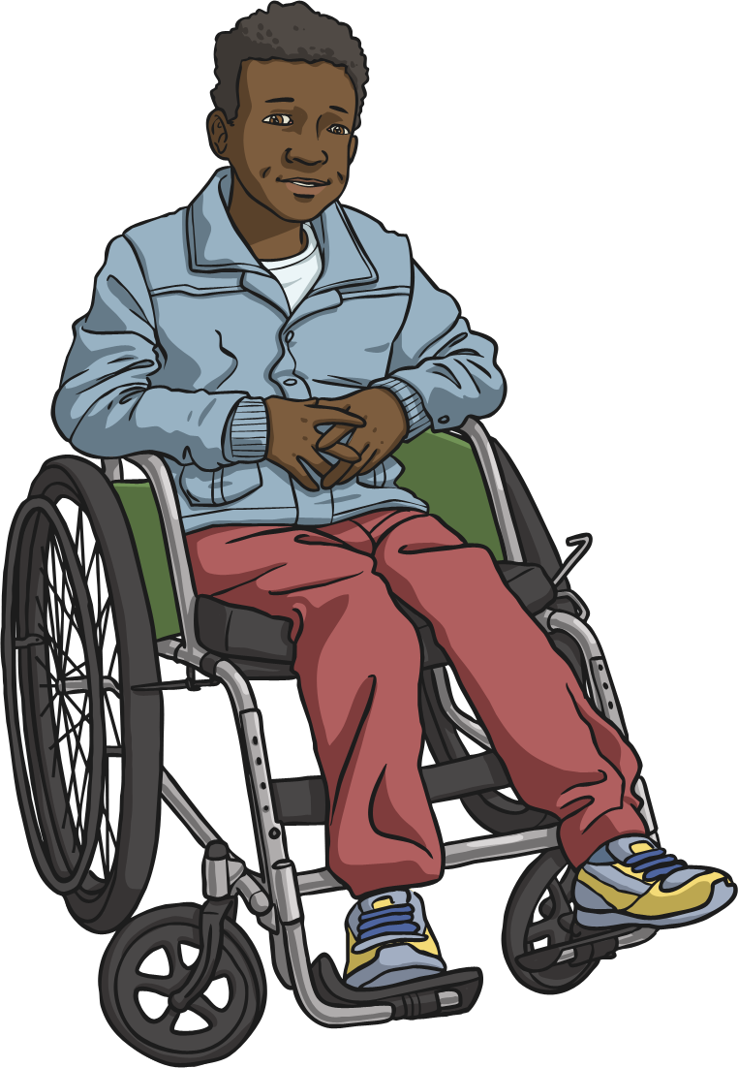
The Big Questions
What risks, hazards and dangers do we face in everyday life?
What can we do if we think we're in a risky situation?
Share your thoughts with a partner.

Slide 34
Reconnecting

Slide 35
Taking Risks
All of us take risks sometimes. In fact, we have to take risks to take on new challenges and try new things. Sometimes it’s great to take a risk and step outside of our comfort zone – it’s one way we learn.
Many risks are not considered in any way dangerous.
We might put our hand up in class to answer a question and the risk we take is getting the answer wrong.
We might not want to get the answer wrong and might worry about what others will think of us but we certainly won’t be in any danger by having a go.

Slide 36
Taking Risks
Other types of risks can lead to danger.
If we see a dog tied up outside a shop and we decide to go and stroke it, we are aware that there is a risk that the dog will bite us.
We cannot be sure there is any danger. The dog might be very friendly but there is a risk that we could get hurt.

Slide 37
Taking Risks
Think about a risk that you have taken in the past.
Would anyone like to share their example of a time when they took a risk? Remember to explain what the outcome was.
Discuss it with a partner.
Did the risk have a positive outcome? Maybe you got braver at doing something or learnt something new.
Did the risk have a negative outcome? Maybe you got hurt or injured someone else, or maybe something got broken or lost.

Slide 38
Exploring

Slide 39
Risks, Hazards and Danger
What do we mean when we use the words risk, hazard and danger?
Risk:
a situation involving exposure to danger.
Hazard:
a potential source of danger.
Danger:
the possibility of suffering harm or injury.

Slide 40
Risks, Hazards and Danger
When we are faced with a new situation that makes us feel uncomfortable, we need to assess it.
We need to ask ourselves:
What are the risks involved?
What might the outcome be?
Am I, or is anyone else, in danger?

Slide 41
Risks, Hazards and Danger
In your groups, look at the pictures and describe how the item or situation might be something risky or dangerous.
Use the word mat to help you describe the level of risk or danger when talking about the pictures.
How were the pictures risky, hazardous or dangerous?
Share your thoughts with the class.

Slide 42
Get Help
As you get older, you will get better at assessing situations for risk, making responsible choices and avoiding dangerous situations.
If this happens, it is important to know where to get help and who to ask for help.
However, there might come a time when you do find yourself at risk or faced with a dangerous situation.
Who can help when there is a hazard, a danger or an emergency?

Slide 43
Get Help
Finding a nearby grown-up is always the best thing to do, if there is a risky or dangerous situation.
Who you ask will depend on where you are. At home, you can get help from a parent or carer. At school, you can get help from a member of staff.
Sometimes, you might have to ask for help from an adult in a position of trust. For example, a shop worker or a security guard.

Slide 44
Get Help
In an emergency, you would need to get specialist help. For example, from a paramedic, a police officer or a firefighter.

Slide 45
Get Help
When someone is harmed or injured in a serious way, or there is an immediate danger like a fire, it is time to call the emergency services.
Usually, a responsible adult will do this, but there might be a time when a child has to make the call.
Would you know what to do?

Slide 46
Get Help
Step 1: Stay calm and find a phone. This could be a landline or a mobile phone.
Step 2: Call 999, then wait for an operator to answer. You don't have to unlock a mobile phone before calling 999, just press on the word 'emergency'.
9
9
9
Step 3: Listen to the operator's questions and answer them as best you can. The first question will be, 'Which service do you require? Fire and rescue, ambulance, police or coastguard.'

Slide 47
Get Help
Step 4: Try to calmly and clearly explain what has happened.
Step 5: Try to give the address of where you are or a description of where you think you are.
Step 6: Follow any advice the operator gives you, such as leaving the house if there is a danger or checking the injured person for bleeding.
When a child calls 999, the operator will stay on the phone, if they can, until the emergency services arrive.

Slide 48
Consolidating
Reflecting

Slide 49
Consolidating

Slide 50
Play It Safe
There are lots of situations in our everyday lives that can be risky and even lead to danger.
It helps to be aware of these situations so we can deal with them responsibly. This helps to keep ourselves and others safe.
You are going to play a game called ‘Play It Safe’.

Slide 51
Play It Safe
In the game, you will come across lots of risky situations, some dangerous situations and some examples of people making choices that keep themselves and others safe.
Follow the instructions to play the game in your groups.
Have fun and stay safe!

Slide 52
Reflecting

Slide 53
Live and Learn
As we grow up and experience the world around us, we learn about dangers and how to keep ourselves and others safe.
Even experiences that put us in danger or situations where we were harmed teach us something about how to stay safe in the future.
With your partner, look at the following examples and discuss what you think the child will have learnt from their experience.

Slide 54
Live and Learn
Karly loves gymnastics. When she was younger, she tried doing a cartwheel along the top of the wall outside her house.
She fell, split her lip and chipped her tooth.
What do you think she learnt from this experience?

Slide 55
Live and Learn
Adnan went on a school trip to a museum with his class but he didn’t stay with his group.
He wandered into an exhibition that looked interesting and later realised that he wasn’t with anyone he knew. This made him anxious and frightened until someone who worked at the museum spotted him and helped him find his classmates and teacher.
What do you think Adnan learnt from this experience?

Slide 56
Live and Learn
Hania is allergic to nuts. At a friend’s party, she wanted to eat what everyone else was eating and decided to have one small peanut butter sandwich.
This made her very poorly and she had to go into hospital, meaning she missed the end of the party.
What do you think Hania learnt from this experience?

Slide 57
The Big Questions
What risks, hazards and dangers do we face in everyday life?
What can we do if we think we're in a risky situation?
What have you learnt today that will help you in everyday life?

Slide 58
Aim
I can identify a risky situation and act responsibly.
Success Criteria
I can understand that in life we need to take some risks but that other risks are dangerous.
I can understand the terms ‘risk’, ‘hazard’ and ‘danger’.
I can explain how to get help in a risky or dangerous situation.
This resource is fully in line with the Learning Outcomes and Core Themes outlined in the PSHE Association’s Programme of Study.

Slide 59
Prayer

