Slide 3
Aim
I can explain how to keep money safe and why this is important.
Success Criteria
I understand that money can come from different sources.
I can explain some ways we can keep money safe.
I understand why it is important to save money.
I can discuss why we need to keep money safe.
This resource is fully in line with the Learning Outcomes and Core Themes outlined in the PSHE Association’s Programme of Study.

Slide 4
The Big Questions

Slide 5
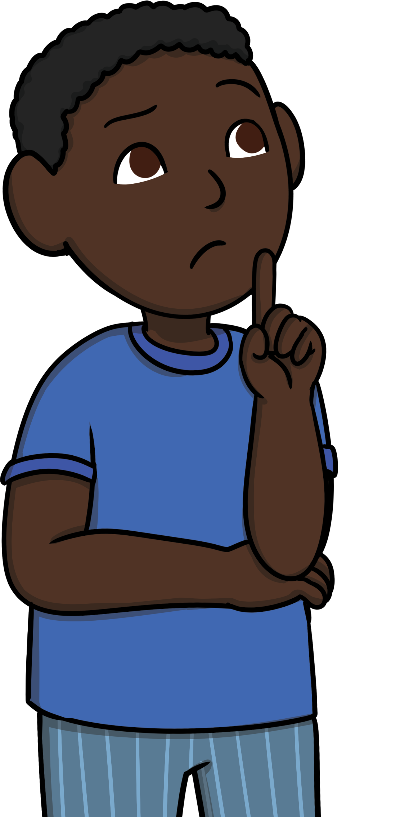
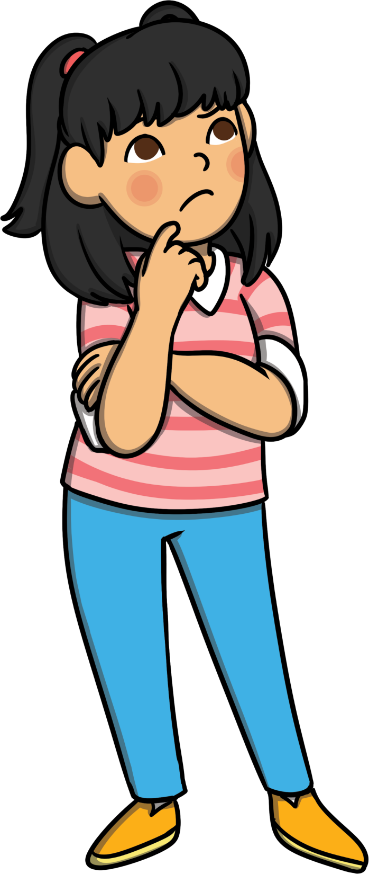
How can we keep our money safe?
Why is it important to keep
money safe?

Slide 6
Reconnecting

Slide 7


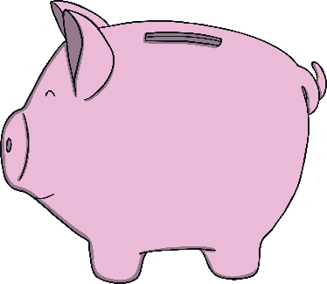
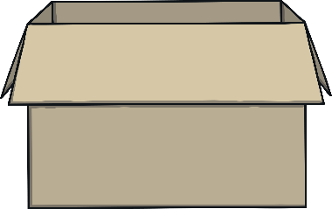
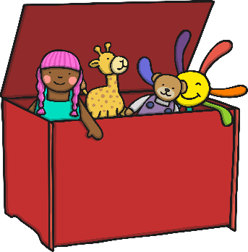
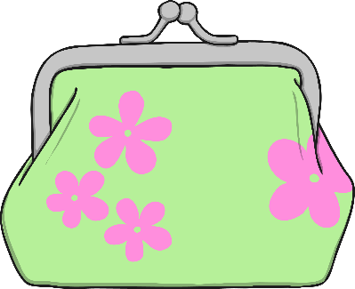
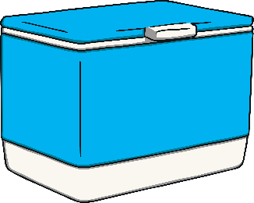
What Are These?
What do these pictures show? Can you explain what they have in common? Talk to your partner and then share your ideas with the class.

Slide 8
Exploring

Slide 9


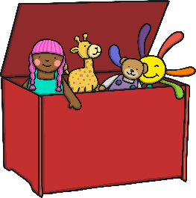

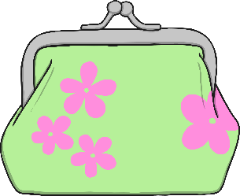
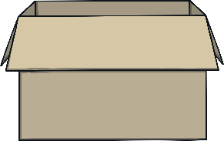
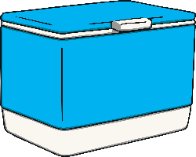
Keep It Safe
Using what we have discussed, can you complete this sentence?
One way I keep my belongings safe is…..
Now let’s look at some more items.
These are things we use a lot everyday. How do we make sure they are kept safe?

Slide 10

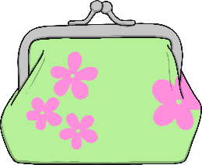
Looking After My Money
There are lots of ways
we can keep money safe. If we are looking after money that we carry around, we might
use a purse or
wallet.
If we are given some money as a gift that we want to save, we might put it in a safe place at home, like a
piggy bank.
If we are given a larger amount of money, or a regular payment, we might use a bank. Banks are
safe places that people keep large amounts
of money. If you use a bank, you have a
bank account.

Slide 11
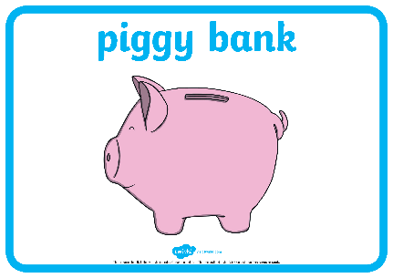
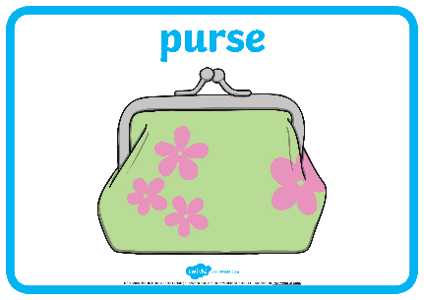
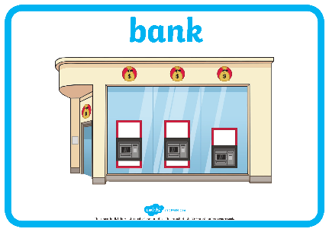
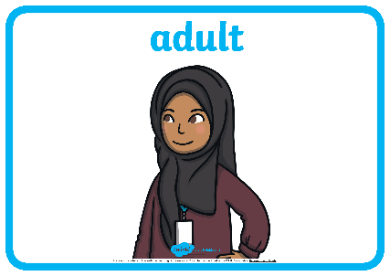
Looking After My Money?
Around the room there are pictures of ways we can save different amounts of money.
Using your Keeping Money Safe Scenario Cards, read the scenario on the card you have and talk about it together.
Then, move to the poster that you think shows how you can keep the money safe.
Now, let’s listen to each pair read their scenario and see which picture they went to.
Do you think this would be the best way to keep their money safe?

Slide 12
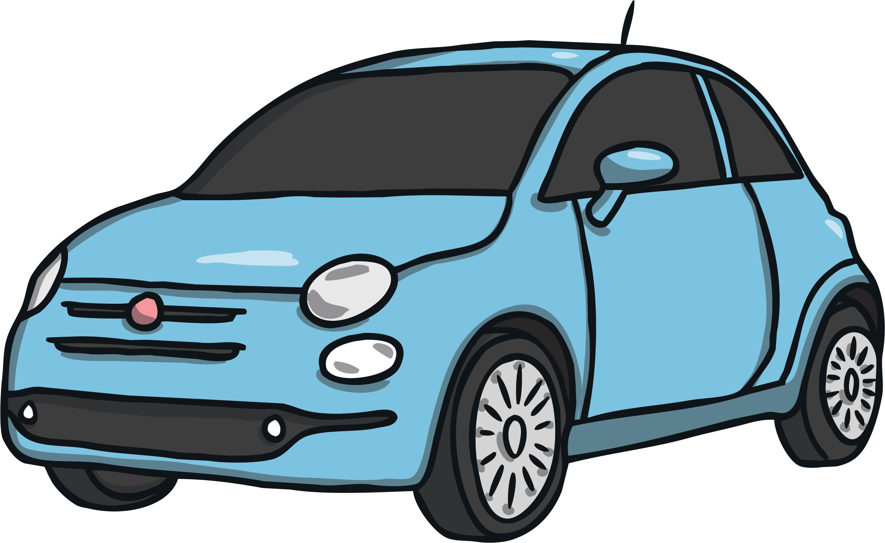
Why Do We Need to Look After Our Money?
Why is it important that we keep our money safe?
Sometimes we may want to buy things that are more expensive.
It may take a long time to save up for something special, so we
need to make sure our money is kept somewhere secure while we
are saving.
If you wanted to buy the things shown in these pictures, where might you keep your money to make sure it is secure whilst you save?
Consolidating
Reflecting

Slide 13
Consolidating

Slide 14


Helping Others Look After Their Money
You are now going to make your own poster explaining to people why it is important to save money.
Think about all the ways we have learned how to keep money safe and the reasons why it is important to save money.
Word Bank
money
piggy bank
save
wallet
savings
purse
bank account

Slide 15
Reflecting

Slide 16
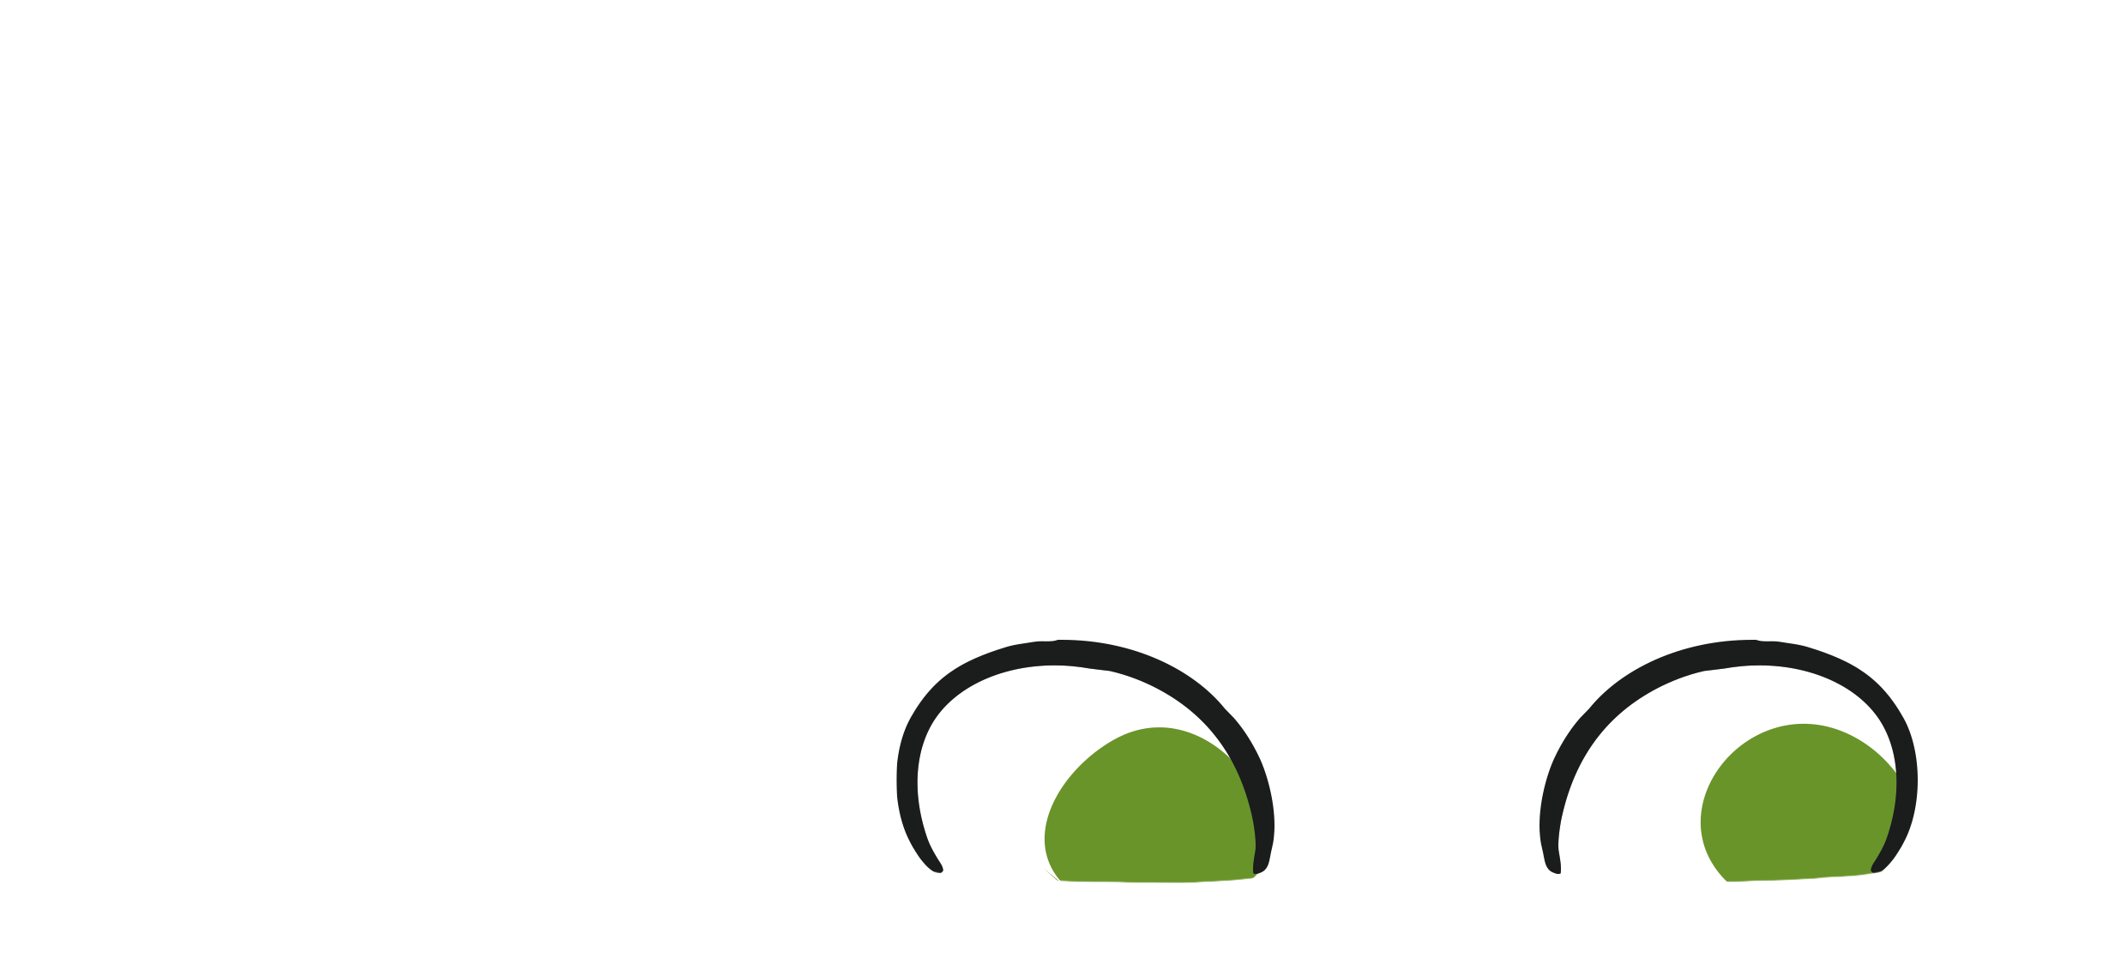
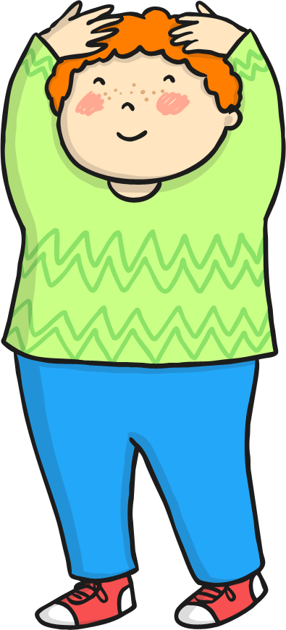

Saving Up
For the pictures that are about to appear, show how you think you should keep your money safe to save up for each item. If you think you should:
Use a purse or wallet
Put your hands on your head

Slide 17
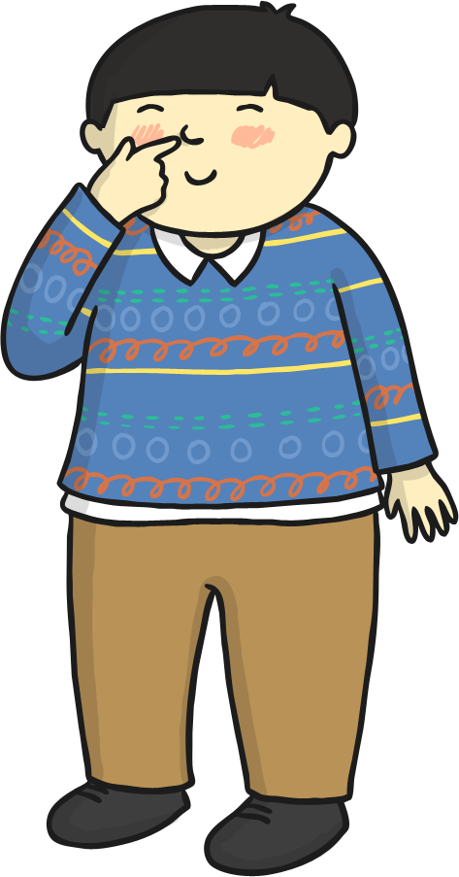
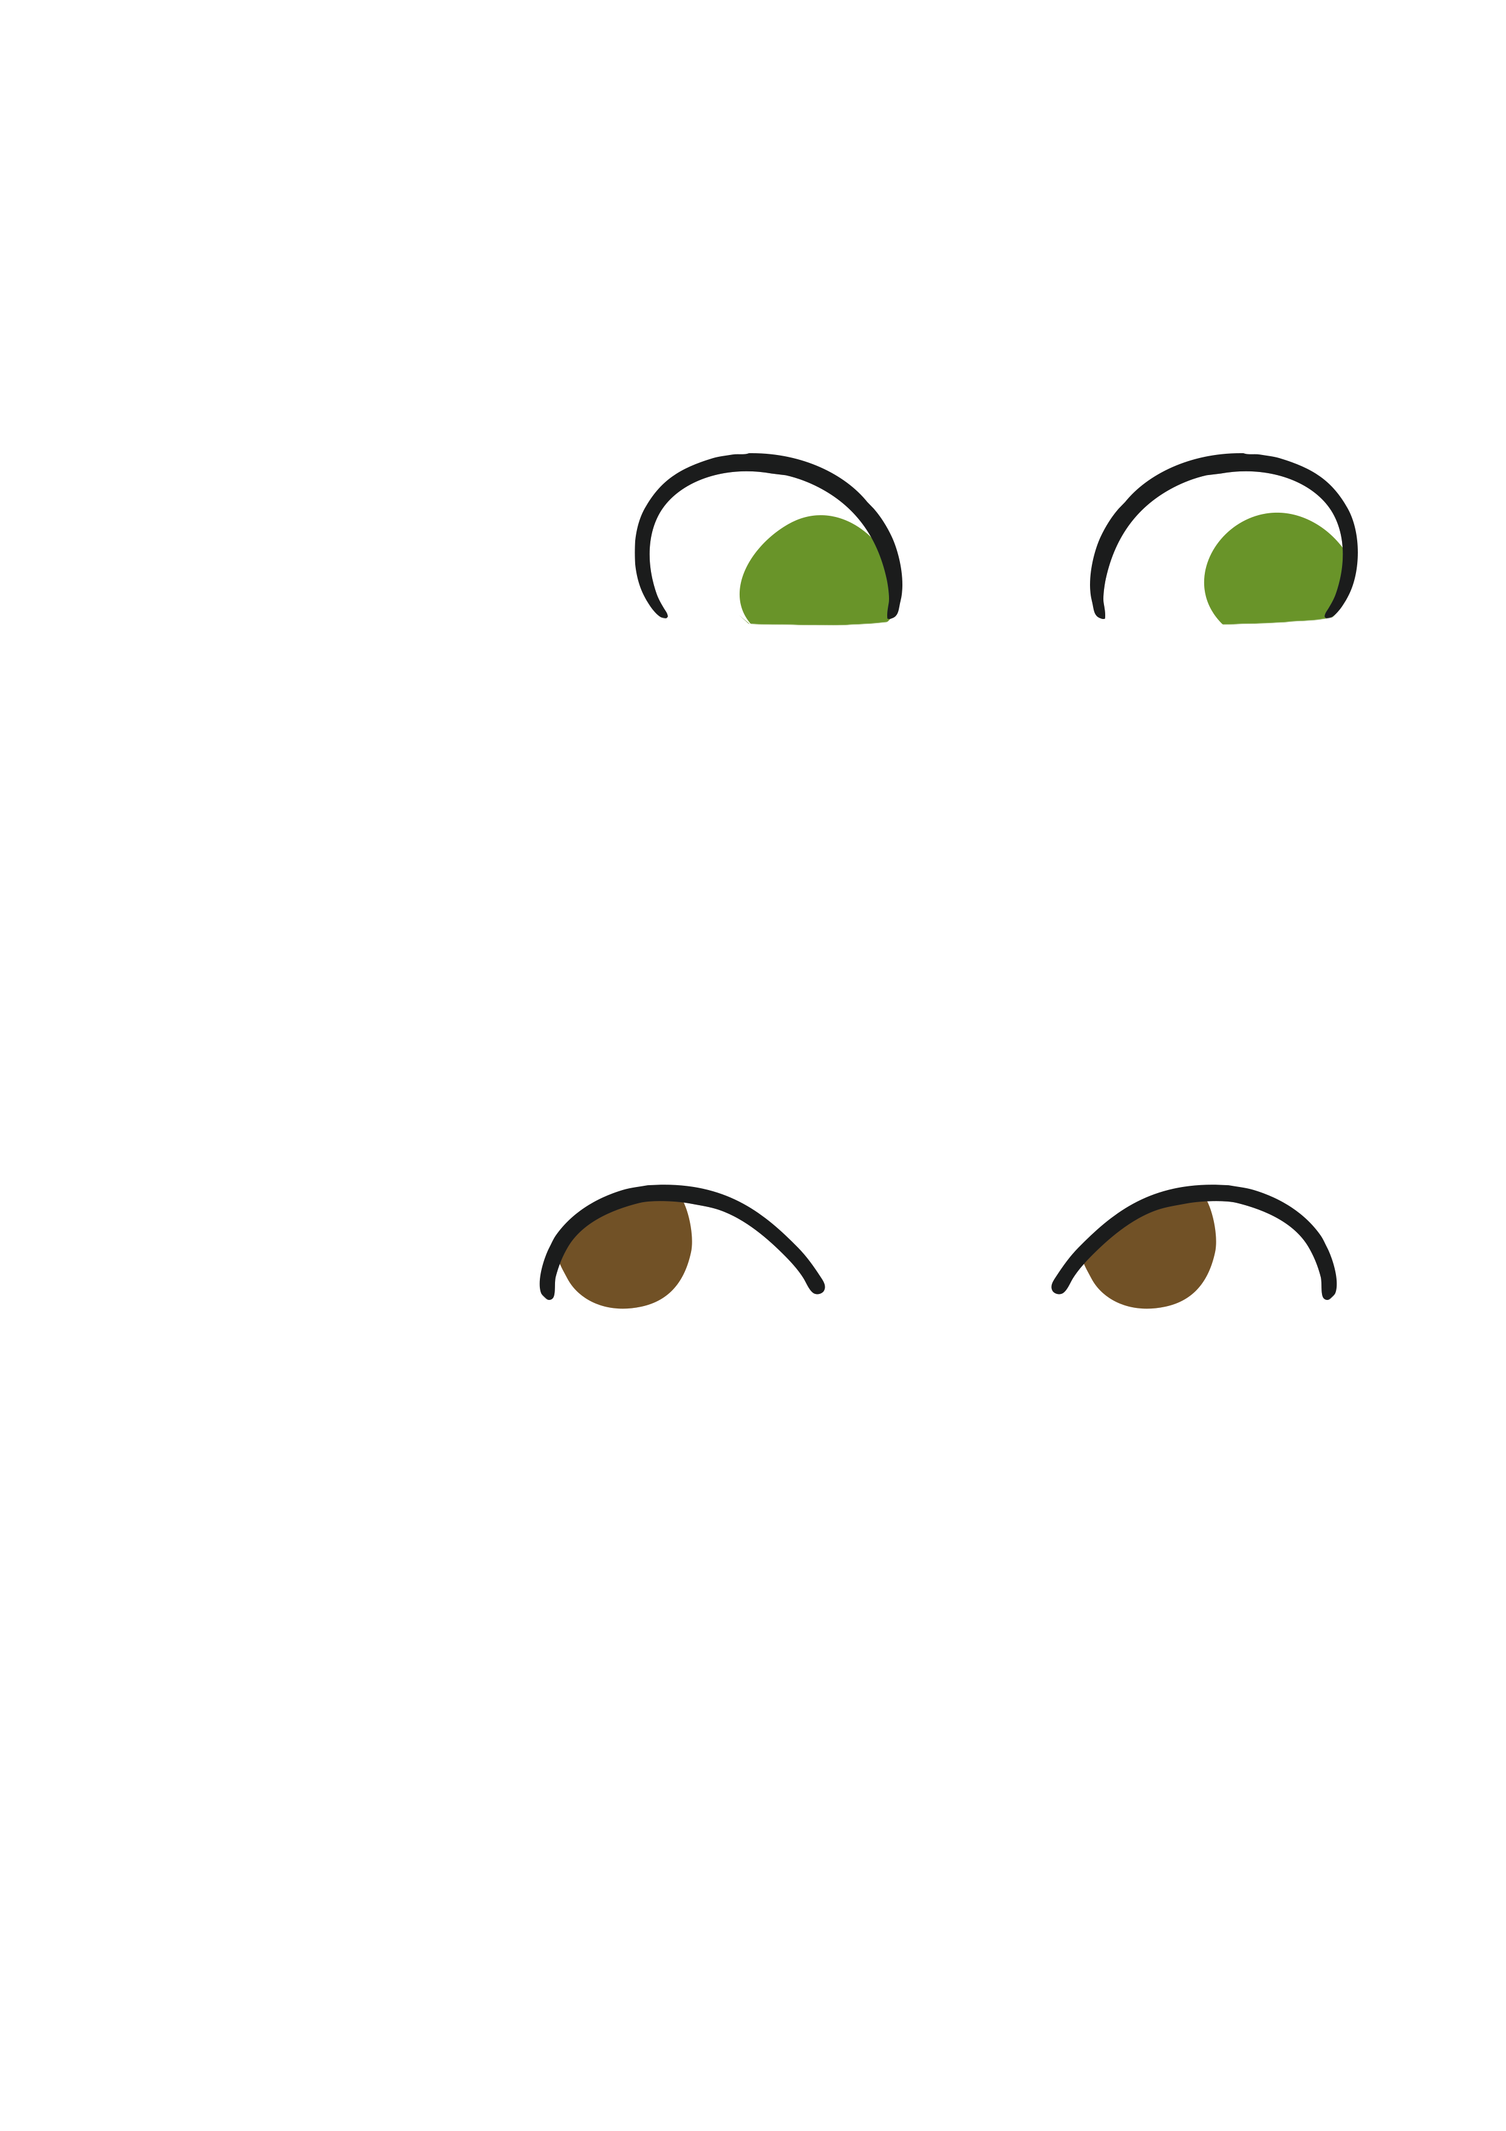
Saving Up
For the pictures that are about to appear, show how you think you should keep your money safe to save up for each item. If you think you should:
Give it to a trusted adult
Put your finger on nose

Slide 18
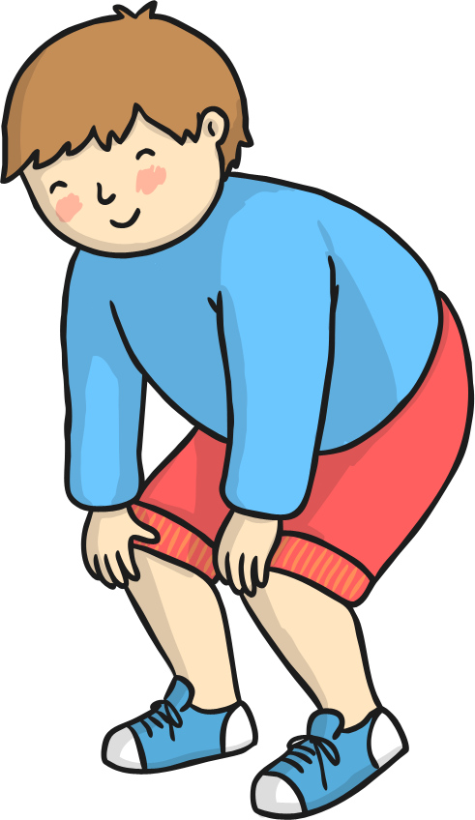
Saving Up
For the pictures that are about to appear, show how you think you should keep your money safe to save up for each item. If you think you should:
Keep it in a bank
Put your hands on knees

Slide 19
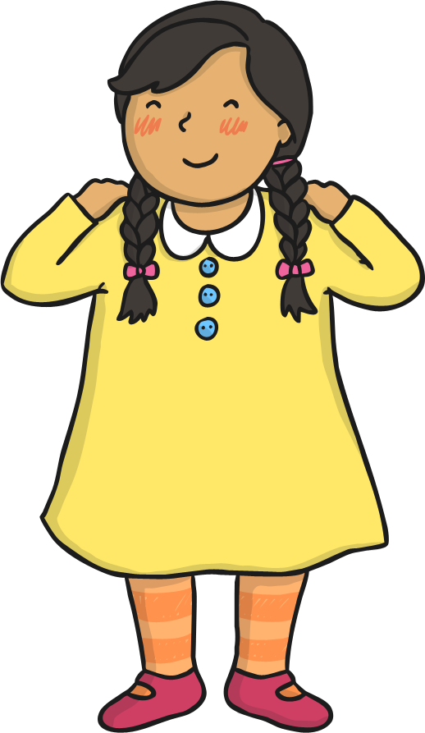
Saving Up
For the pictures that are about to appear, show how you think you should keep your money safe to save up for each item. If you think you should:
Put it in a piggy bank
Put your hands on your shoulders

Slide 20
Saving Up
a magazine

Slide 21
Saving Up
a pair of trainers

Slide 22
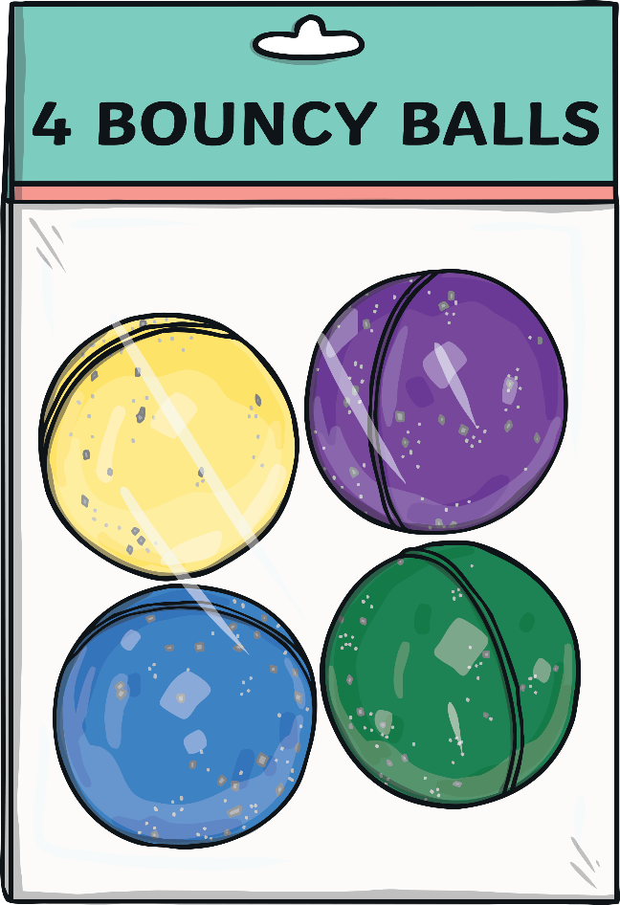
Saving Up
a toy

Slide 23
Saving Up
a bike

Slide 24
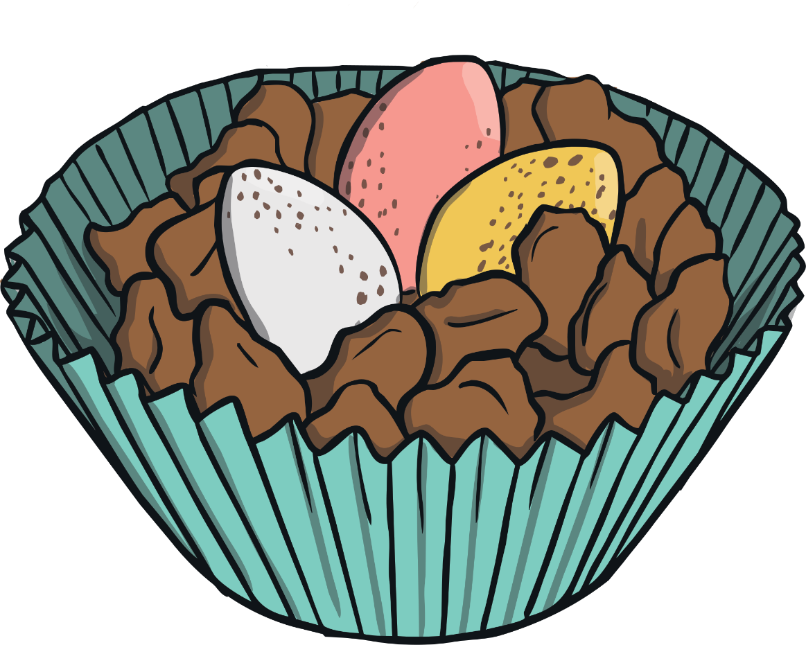
Saving Up
a cake from a stall

Slide 25
Saving Up
a house

Slide 26
The Big Questions

Slide 27
How can we keep our money safe?
Why is it important to keep
money safe?

Slide 28
Aim
I can explain how to keep money safe and why this is important.
Success Criteria
I understand that money can come from different sources.
I can explain some ways we can keep money safe.
I understand why it is important to save money.
I can discuss why we need to keep money safe.
This resource is fully in line with the Learning Outcomes and Core Themes outlined in the PSHE Association’s Programme of Study.

Slide 30
Aim
I can explain choices people have about spending money and why it is important to keep track of what is spent.
Success Criteria
I can understand what influences people’s spending.
I can discuss why it is helpful to keep track of what is spent.
This resource is fully in line with the Learning Outcomes and Core Themes outlined in the PSHE Association Programme of Study.

Slide 31
The Big Questions

Slide 32
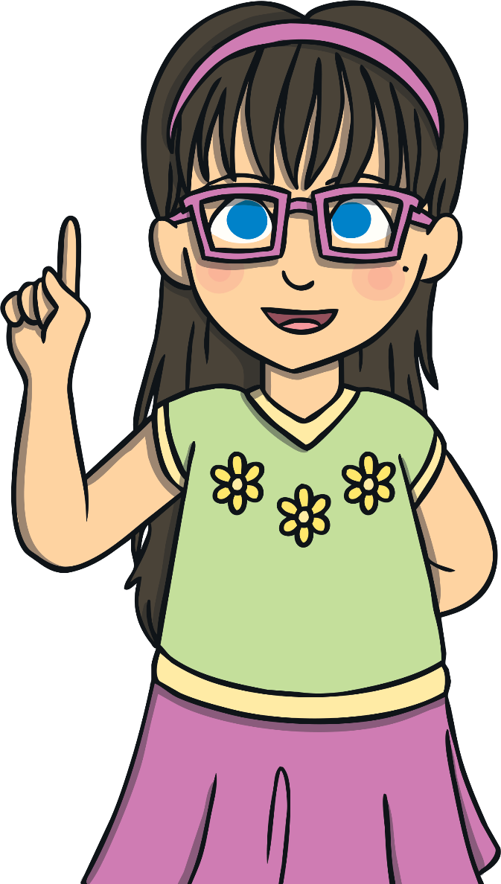
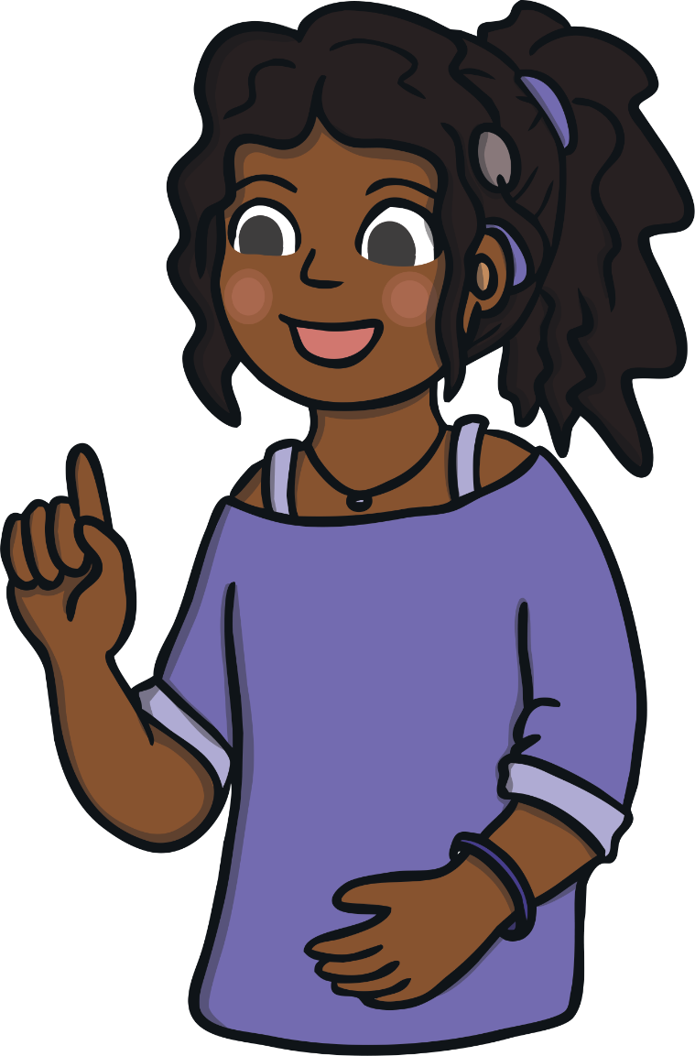
What choices do we have
about spending money?
How can we keep track of what
we spend?

Slide 33
Reconnecting

Slide 34
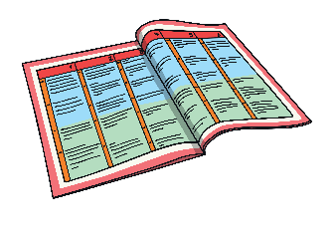

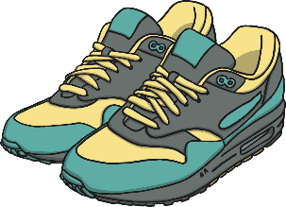


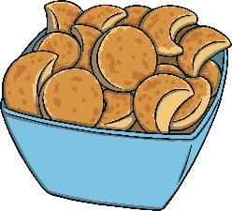
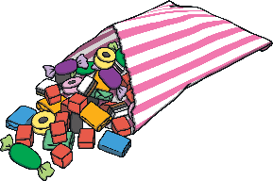

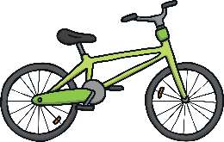
What Choices Do People Have About What to Spend?
You have £2. What would you like to buy?
Why would you buy
that?
70p
£30
£1.50
90p
15p
What would
you buy?
Can you
afford it?
£25
25p

Slide 35







What Choices Do People Have About What to Spend?
You have £2. What would you like to buy?
70p
£30
25p
£25
£1.50
90p
15p
£4
What would you choose to buy in each of these scenarios?
Going on a long train journey
Going to play in the park
Going to your friend's house
Buying a present for your auntie's new house
What we are doing can also influence what we spend our money on.

Slide 36
Exploring

Slide 37
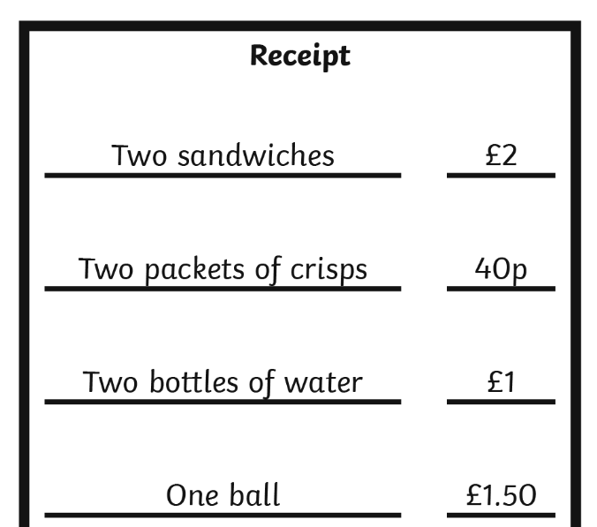
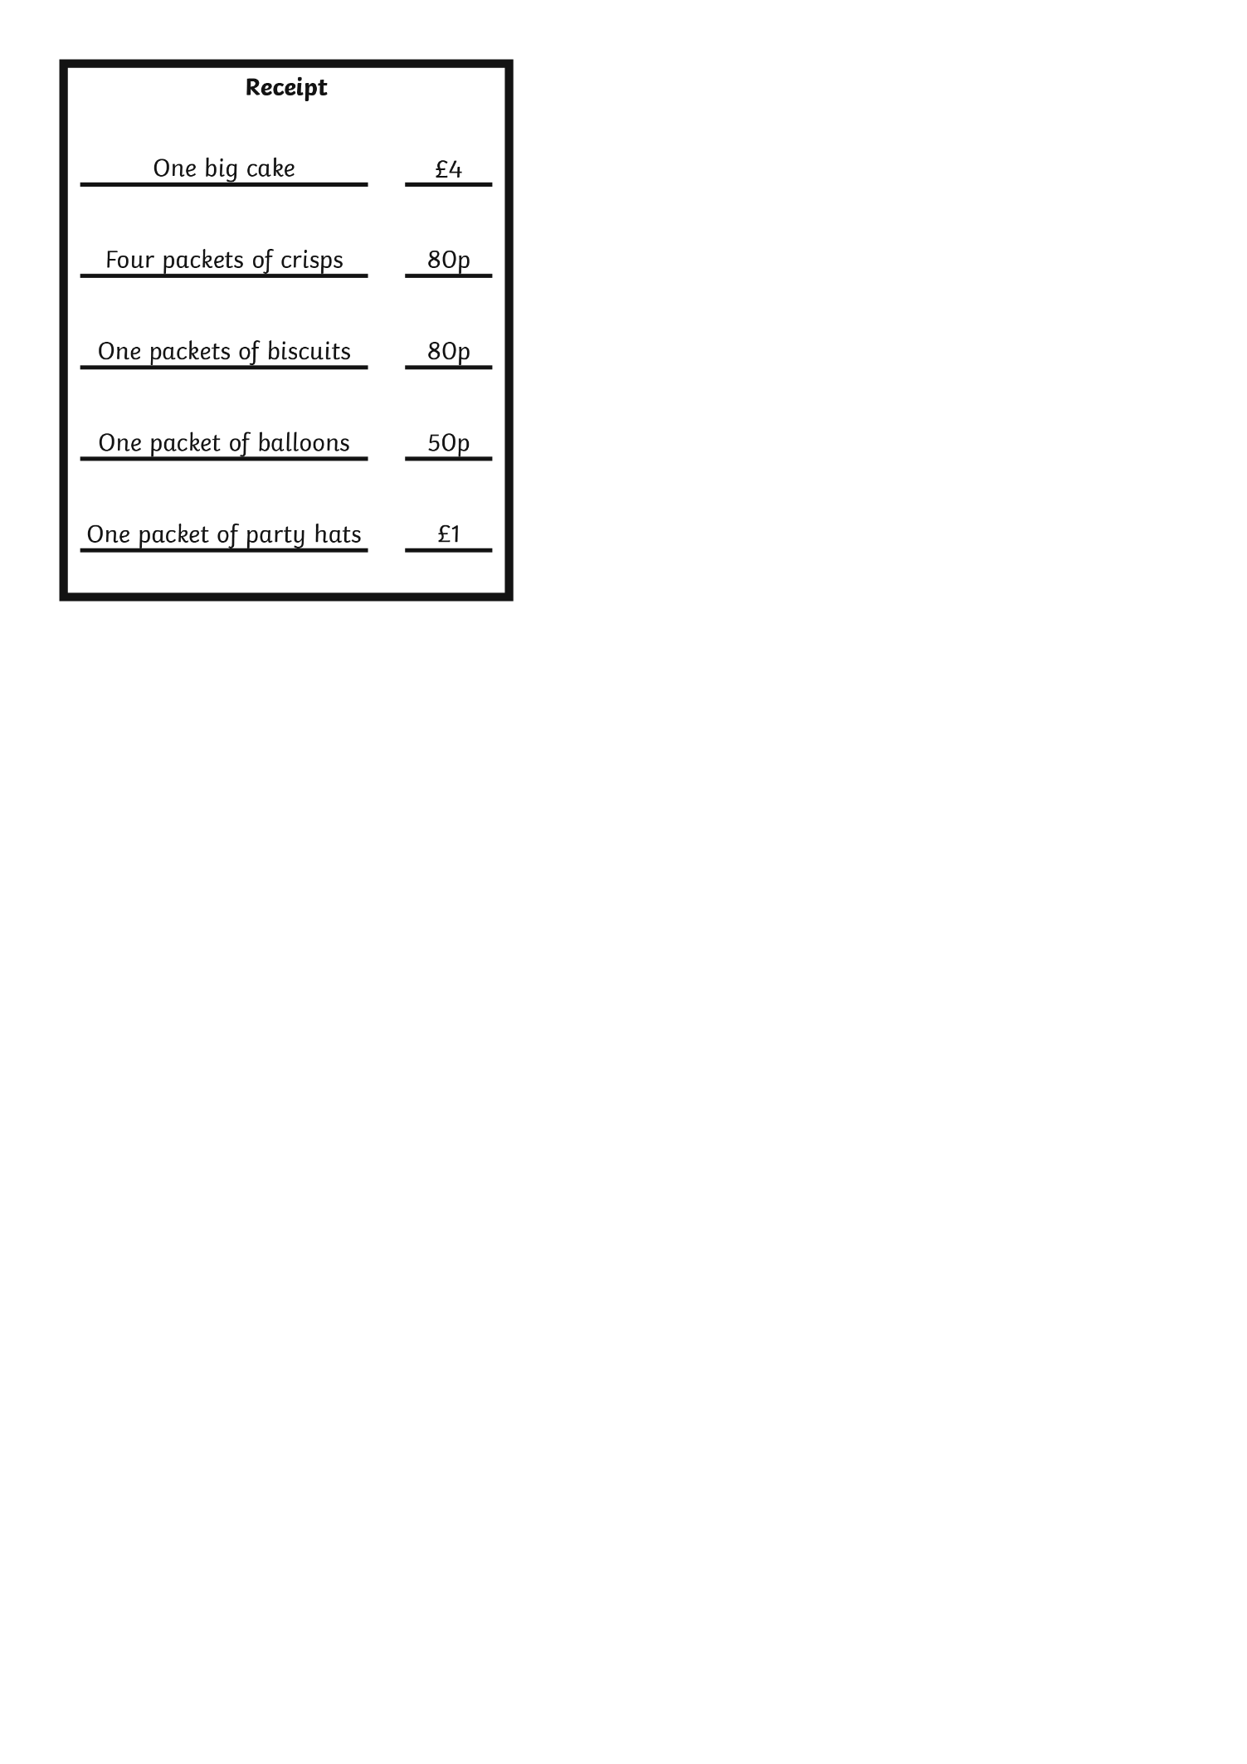
Where The Money Goes
The things we do, such as going to the park, having a birthday party or going on holiday, influence what we spend our money on.

Slide 38


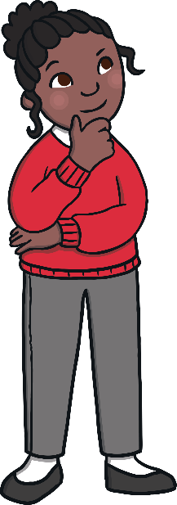

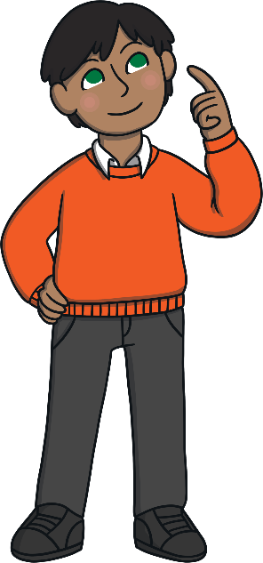
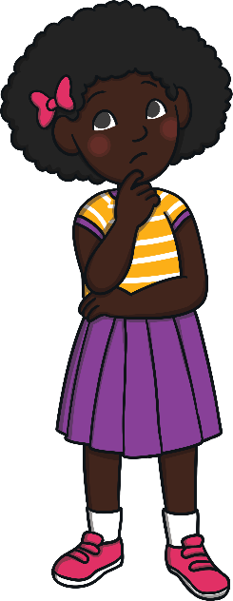
Where The Money Goes
These children each get £2 pocket money a week. Can they afford what they want? If they can’t, what could they do?
£50
£1.99
£7
35p

Slide 39




How Can We Keep Track?
We are going to take it in turns to say what we have bought and how much it cost. You can use the sentence starter ‘I went shopping and I bought… for… .’.
We are going to play a game to work out how we can keep track of what we spend. Look at your card but don’t show anyone else what is on it.
The next person in the circle must repeat what the previous speaker(s) bought and add their item to the list.
They can say: ‘... went shopping and bought… for… . I went shopping and I bought… for… .’.
You need to repeat what everyone who has spoken before you has bought.
How far around the circle can we get, remembering
what everyone has bought?
50p
20p
It is sometimes difficult to remember what we have spent on each item. So, we need another way to keep track.

Slide 40

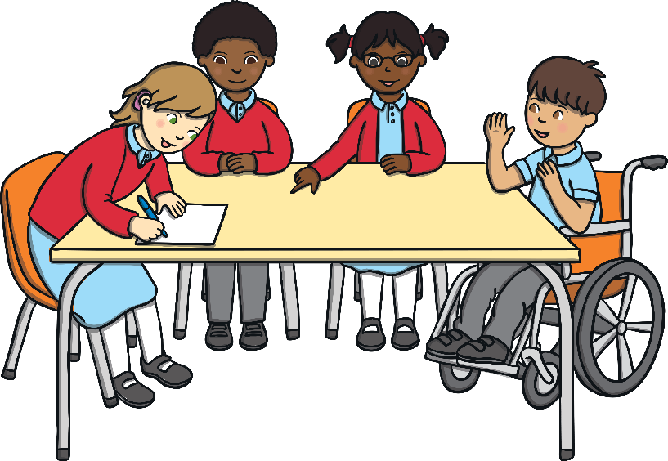
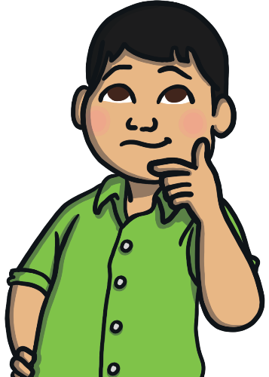
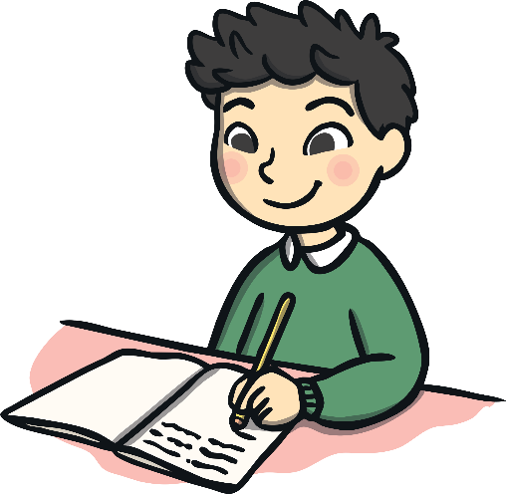
Ways To Keep Track
In small groups, you are now going to play the shopping game again.
Is it easier to remember what each person bought? Why?
Now you can choose a way to record what you bought as a group.
Consolidating
Reflecting

Slide 41
Consolidating

Slide 42
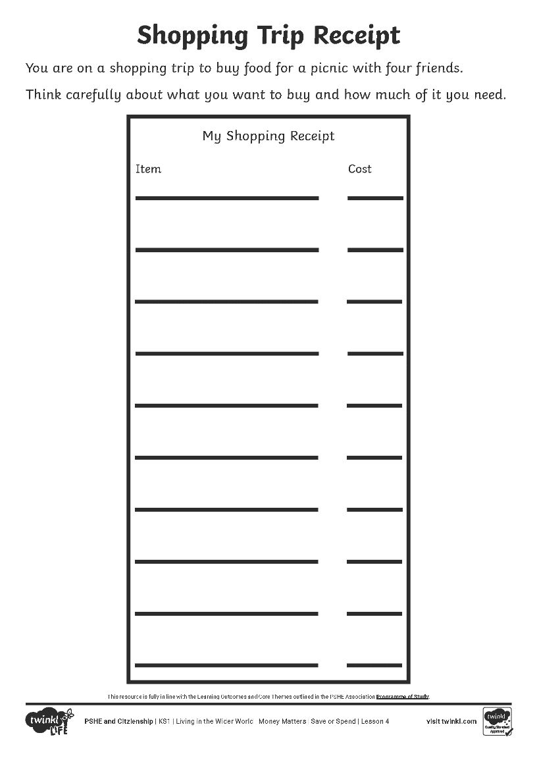
How I Keep Track
You can now make your own receipt for a shopping trip using your Shopping Trip Receipt Activity Sheet. Remember to look carefully at why you are going shopping, it may affect what you choose to buy. Look carefully at the Shop Poster Resource Sheet, which shows what you can buy, and choose your items.
You can record what you buy any way you choose.

Slide 43
Reflecting

Slide 44
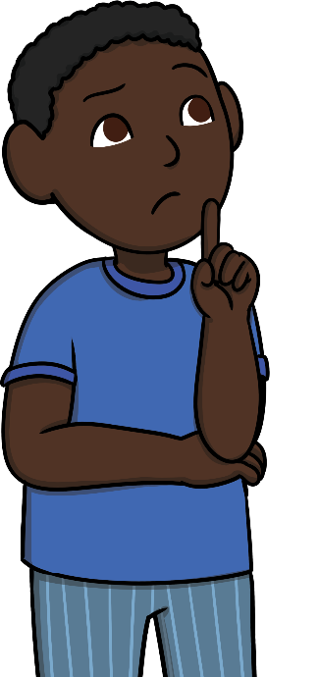

Why Keep Track?
What influences what we spend our money on?
How can you keep track of what you spend money on?
Why is it important to do this?
Thinking about today’s learning, write one piece of advice on a sticky note to remind us to keep track of our money.

Slide 45
The Big Questions

Slide 46
What choices do we have
about spending money?
How can we keep track of what
we spend?

Slide 47
Aim
I can explain choices people have about spending money and why it is important to keep track of what is spent.
Success Criteria
I can understand what influences people’s spending.
I can discuss why it is helpful to keep track of what is spent.
This resource is fully in line with the Learning Outcomes and Core Themes outlined in the PSHE Association Programme of Study.

Slide 48
Prayer

