Slide 2
Aim
I can explain the movement of the Moon.
Success Criteria
I can explain that the Moon orbits the Earth not the Sun.
I can explain how the Moon moves relative to the Earth.
I can explain how the Earth and Moon move relative to the Sun.

Slide 3
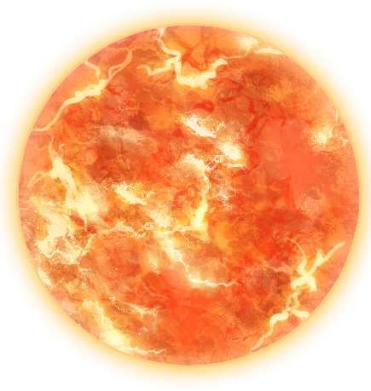
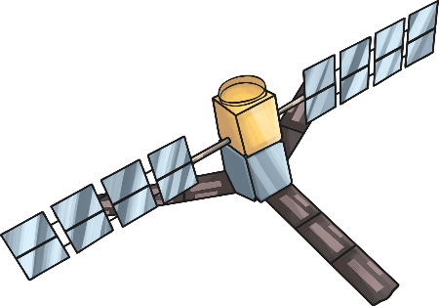
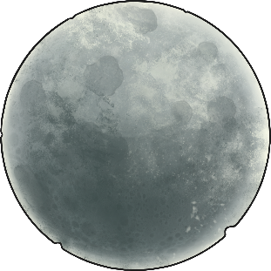
Orbiting Objects
We know the Earth orbits the Sun.
Are there any objects that orbit the Earth?
Does it move in any other type of way?

Slide 4
Moon Movement
How does the moon move?
Does it rotate?
Why is the moon only lit from one side?

Slide 5
You are now going to make a simple model to show how the moon moves around the earth, whilst the earth moves around the sun.
The instructions are in resources files.
If you don’t have a split pin improvise with something else if possible.
Eg. just put a small pencil through the hole to spin it around.

Slide 6
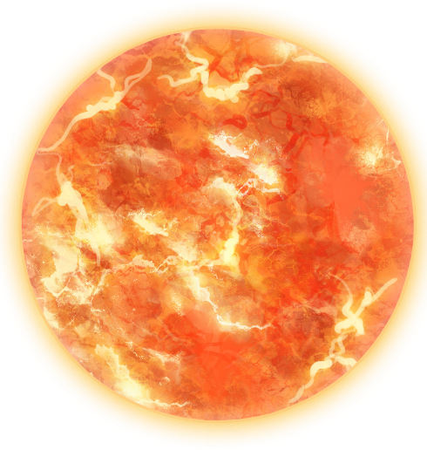
Model Making

Slide 7
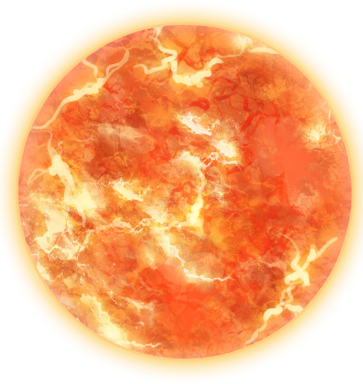
Explanation Text – Movement of the Moon
Rotate
Moon
Axis
Earth
Orbit
Night
Day
Heat
Sun
Light
Reflect
Because / due to
So,
As

Slide 8
Moon Models
show your model to someone and demonstrate how it works.
Explain what is happening as you use your model.

Slide 9
Aim
I can explain the movement of the Moon.
Success Criteria
I can explain that the Moon orbits the Earth not the Sun.
I can explain how the Moon moves relative to the Earth.
I can explain how the Earth and Moon move relative to the Sun.

