Slide 2
Aim
I can explain how adverts try to influence our spending and why they do this.
Success Criteria
I can talk about how adverts try to influence our spending.
I can give some reasons as to why they do this.
This resource is fully in line with the Learning Outcomes and Core Themes outlined in the PSHE Association Programme of Study.

Slide 3
The Big Questions

Slide 4
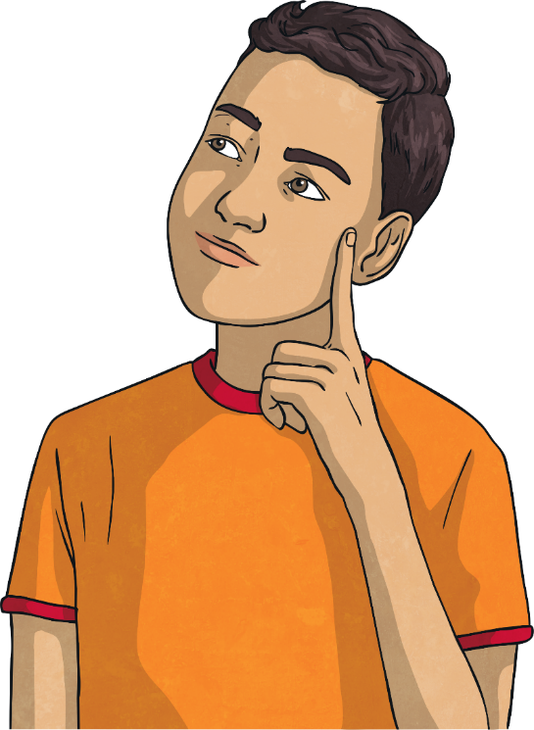
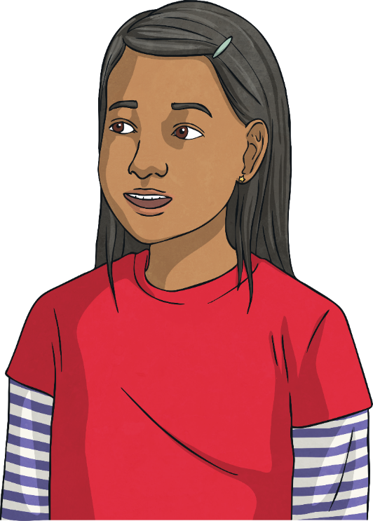
Why do adverts try to influence the way we spend money?
How do they do it?

Slide 5
Reconnecting

Slide 6
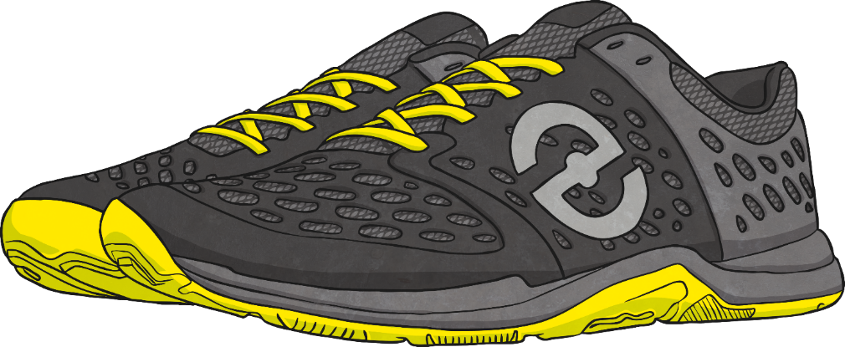
Why Advertise?
We have been thinking about where money comes from and what we can spend it on. Now let’s consider how companies try to influence our spending.
Speedz Trainers
Super cushioned soles for great comfort.
Elastic laces for convenience.
Bouncy rubber toes for super speed.
Run faster than competitors.
A brilliant choice for comfort!
Only £59.99
What is this advert trying to do?
How does it try to influence you?
Why is it doing this?
What is good about this advert?

Slide 7
Exploring

Slide 8
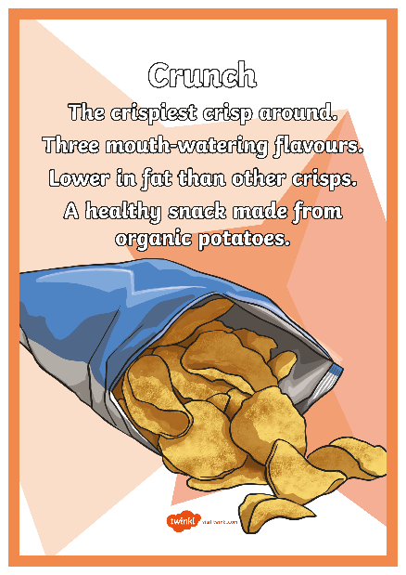
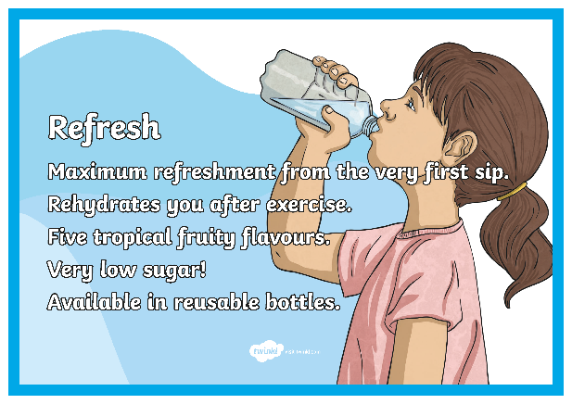
We Want Your Money
Look at the advertisements displayed around the room. Walk around the room to have a closer look at each of them. Talk to your partner about which one interests you.
Why did you choose that advertisement?
Is the product something you would like to spend your money on?
What makes it an appealing advertisement?
What makes a good advert?

Slide 9
Make Your Own Advert!
Most advertisements are from companies that want you to spend your money with them. If you buy their product, they make profits and therefore financial gain. Some advertisements offer services to help people but most companies still stand to make money from their consumers.
Working in small groups, you are now going to make your own advertisements for television. You will be given a card with information about the product or service you are advertising. In your advertisement, try to make it clear why you are advertising and what you can offer.
After you have worked on your advert, each group will have the chance to perform their advert to the rest of the class.

Slide 10
Make Your Own Advert!
Now we will watch the advert performances.
While you are watching, try to think about these questions:
What is this advert trying to make you spend money on?
How is it trying to influence your spending?
Why is it trying to do this?
Consolidating
Reflecting

Slide 11
Consolidating

Slide 12
Make Your Own Poster
You have made some fantastic adverts! Now we can make some posters to go with them. Remember to keep these questions in mind:
What is this advert trying to make you spend money on?
How is it trying to influence your spending?
Why is it trying to do this?
Word Bank
money
influence
spending
advertising
ethical
advertisement
profit
financial gain
consumer

Slide 13
Reflecting

Slide 14
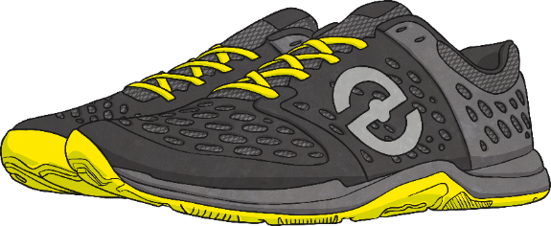
Choosing Your Product
Speedz Trainers
Tread Trainers
Super cushioned soles for great comfort.
Elastic laces for convenience.
Bouncy rubber toes for super speed.
Run faster than competitors.
A brilliant choice for comfort!
Only £59.99
Comfy soles.
Laces to keep shoes safely in place.
Cushioned toes for speed.
How does the advertisement influence your spending?
Which would you choose to spend your money on? Why?
These two advertisements are for a similar product.
The adverts we have looked at have used lots of different strategies to influence our spending.
price
environmental considerations
ethical ingredients
appealing to health benefits

Slide 15
Choosing Your Product
Talking to your partner, think about what you will look for in adverts in the future when you consider products you want to buy.

Slide 16
The Big Questions

Slide 17
Why do adverts try to influence the way we spend money?
How do they do it?

Slide 18
I can explain how adverts try to influence our spending and why they do this.
Success Criteria
I can talk about how adverts try to influence our spending.
I can give some reasons as to why they do this.

Slide 20
Aim
I can explain ways I can keep track of what I spend and why it is important to do this.
Success Criteria
I can discuss ways of keeping track of my spending.
I can explain why it is important to keep track of what we spend.
This resource is fully in line with the Learning Outcomes and Core Themes outlined in the PSHE Association Programme of Study.

Slide 21
The Big Questions

Slide 22
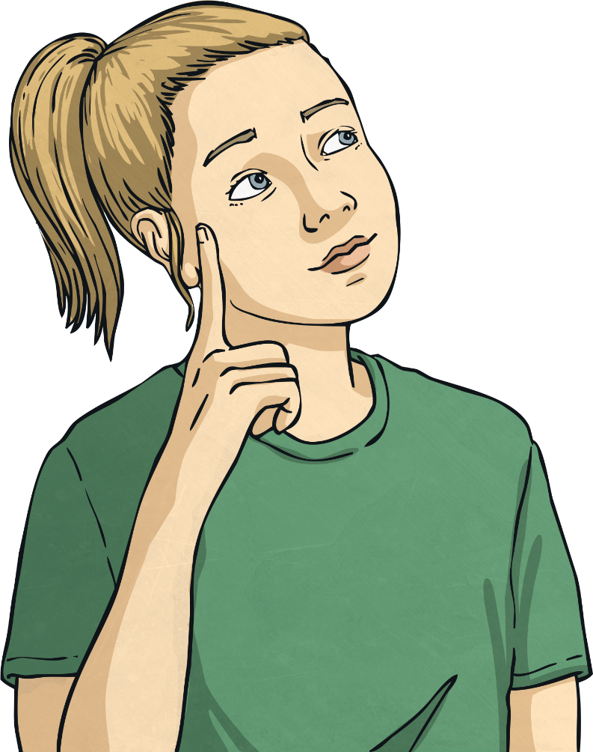
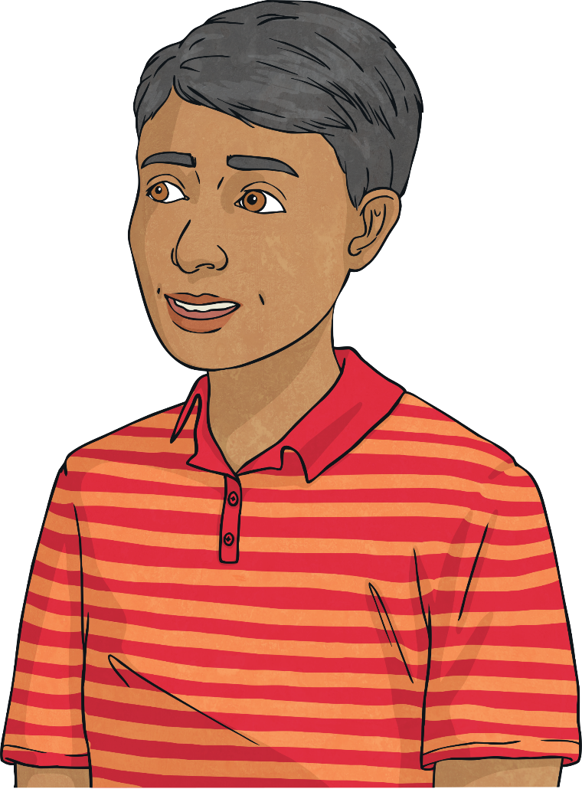
How can we keep track of money?
Why is it important to do this?

Slide 23
Reconnecting

Slide 24
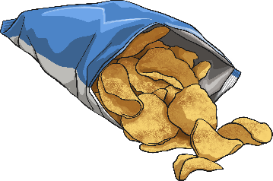
How Much Did It Cost?
I have been shopping for things I need for a party.
I spent £15 at the shop and bought various amounts of these items:
Do you think I purchased a lot of items for the money that I spent?

Slide 25
How Much Did It Cost?
To work out whether I managed to get a lot for my money, what further information do you need?
Do you think I got a lot of items for the money I spent?
How does this information help?

Slide 26
Exploring

Slide 27
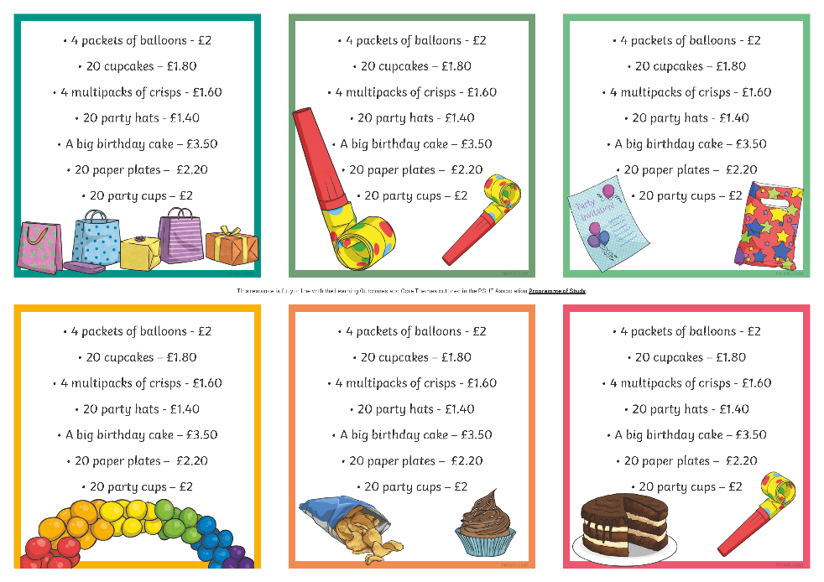
Each and Every Penny!
It can be difficult to keep track of how much we have spent if we are unclear on how much things cost.
Working in pairs, we are now going to play a game.
In front of you, you have another list of items that were needed for a party.
Look at it for 20 seconds and see how many items with prices you can remember.
After a few seconds, your partner will ask you to recall the items that were on this list to see how much you can remember!

Slide 28
Each and Every Penny!
How did you do? Now let’s change roles and try again.
What was the total cost of the items you could remember?
How many items did you remember?
It is difficult to remember all that we have purchased if it is not recorded somehow. To make sure we know where our money has gone, we need to make sure we record what we spend. This way, we can be sure our money is going towards useful items we need.

Slide 29
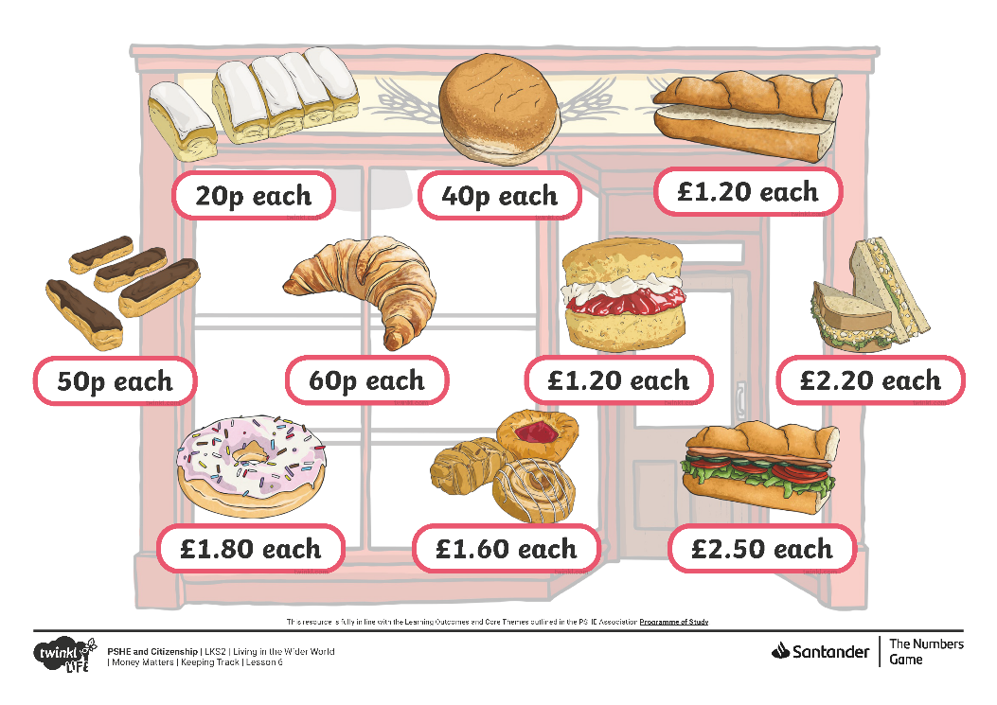
Let’s Go Shopping
You now have the chance to go shopping for an event using the Shopping Scenario Card you have been given.
There are shop fronts displayed around the classroom for you to visit in order to choose items to buy for your event.
You need to record on your whiteboard what you would like to buy and how much each item costs.
Can you now return to your table and calculate your total spend? Write the total on a sticky note.
You will now swap lists with another pair and they will be your shopkeeper. They will calculate what you need to pay and charge you the right amount.
Looking at the total on your sticky note, is the shopkeeper charging you the right amount? How do you know?

Slide 30
Consolidating
Reflecting

Slide 31
Consolidating

Slide 32
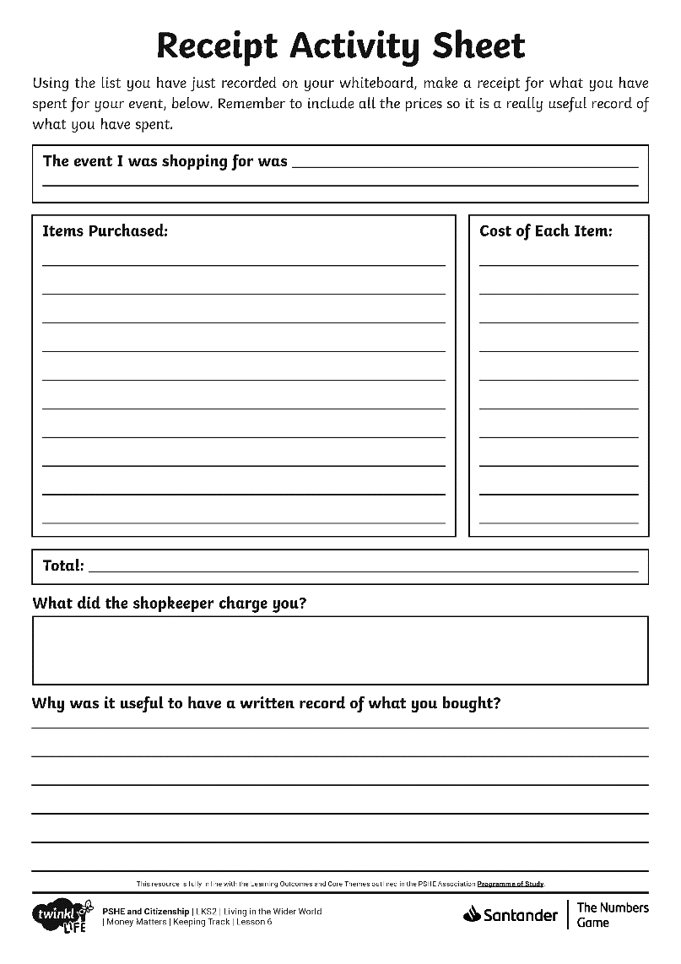
What I Bought
Using the Receipt Activity Sheet you have been given, you can now record what you have bought in the shopping activity.
Make sure you record what you think is important, this might include items, prices and how many you bought of each item.
Word Bank:
money
receipt
record
keep track
change
balance
budget
spending

Slide 33
Reflecting

Slide 34
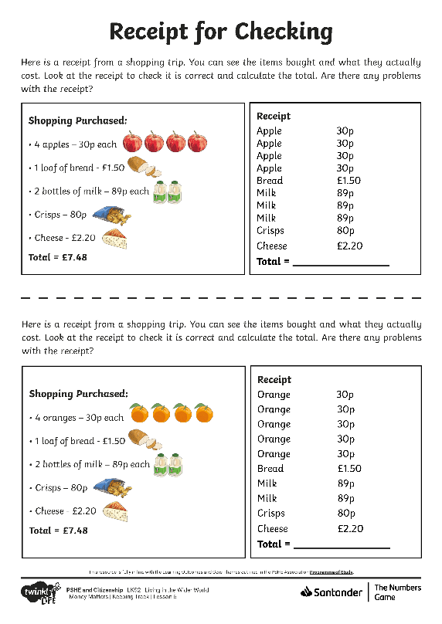
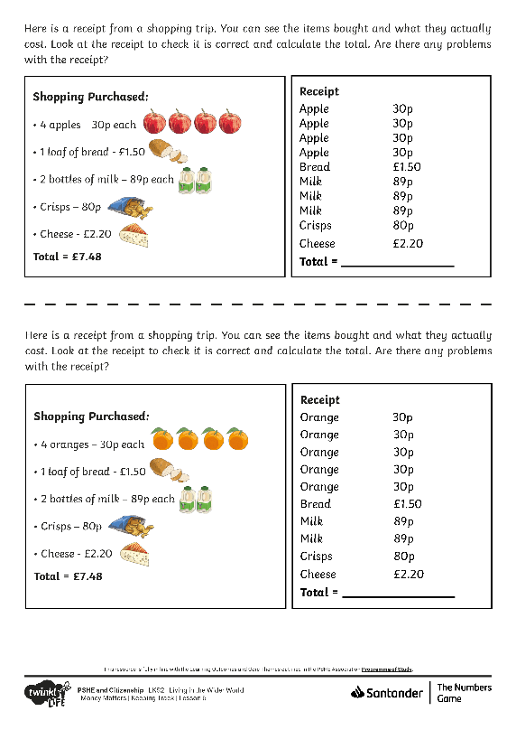
Why Keep Track?
Why is it important to keep track of what we spend?
You now have a receipt from a shopping trip. Work with your partner to check it. Is the receipt correct? Have you been charged the right amount? Can you identify any other reasons that it is important to keep track of what we spend?
When we are planning our spending, it is important to think about our budget. In a similar way, it is important to keep track of what we have spent so we know where our money has gone.

Slide 35
The Big Questions

Slide 36
How can we keep track of money?
Why is it important to do this?

Slide 37
Aim
I can explain ways I can keep track of what I spend and why it is important to do this.
Success Criteria
I can discuss ways of keeping track of my spending.
I can explain why it is important to keep track of what we spend.

Slide 38
Prayer

