Slide 1
PSHE and Citizenship
Health and Wellbeing | Think Positive
PSHE and Citizenship | KS1 | Health and Wellbeing | Think Positive | Go-Getters | Lesson 3

Slide 3
Aim
I can set myself goals and consider how to achieve them.
Success Criteria
I understand that positive thoughts can help me achieve my goals.
I understand that resilience means trying again and not giving up.
I can think of things I would like to learn, get better at or achieve.
This resource is fully in line with the Learning Outcomes and Core Themes outlined in the PSHE Association’s Programme of Study.

Slide 4
The Big Questions

Slide 5
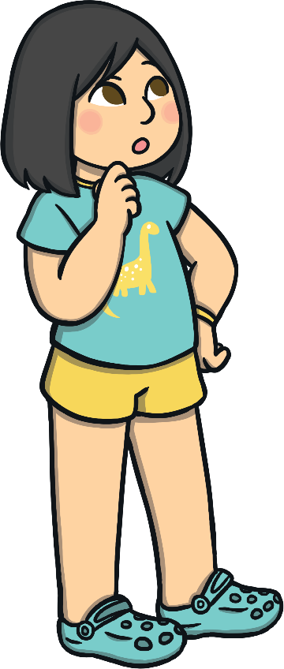
What are helpful and unhelpful thoughts?
What can we do if we find something challenging?
Talk quietly with a partner about how you might answer these questions.

Slide 6
Reconnecting

Slide 7
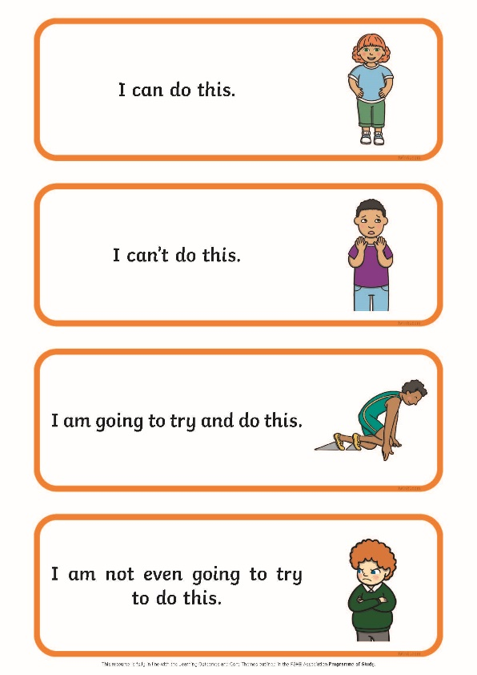
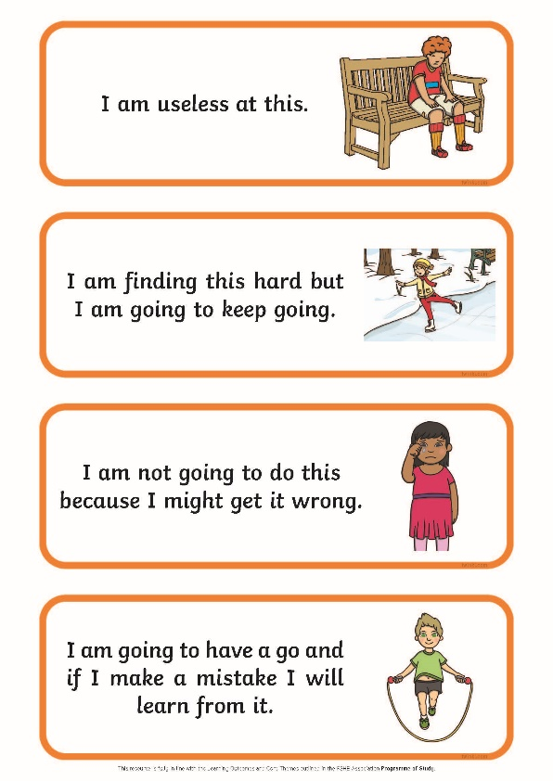
Positive and Negative Thoughts
We can have both positive and negative thoughts.
In your groups, look at the thoughts on your table.
Sort them into two groups – positive thoughts and negative thoughts.
How did your group decide where each thought should go? Share your ideas with the class.

Slide 8
Exploring

Slide 9
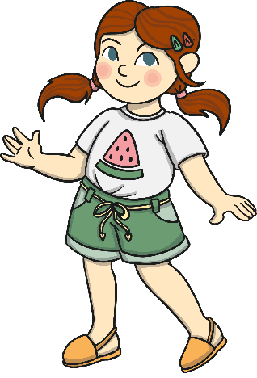
Facing New Challenges
Throughout our lives, we come across new challenges. We constantly have to learn new skills or get better at things.
When you were a baby, you had to learn to walk and talk.
You learnt to feed and dress yourself.
You have also learnt to count, to draw, to write, to run and to jump.
Wow! That’s a lot of challenges you’ve had over the years, but you have achieved so much!

Slide 10
Facing New Challenges
When we are facing a new challenge, it can be very useful to have a positive mindset.
All those positive thoughts that we have been learning about can be really helpful when we want to learn something new or get better at something we find hard.
Meet Miah and Peter…

Slide 11
Facing New Challenges
Miah thinks in a positive way. When she has to try something new or learn a new skill, she thinks things like, ‘This is exciting’ or ‘I’ll give this my best shot’.
Peter thinks in a negative way. When he has to try something new or learn a new skill, he thinks things like, ‘This is too hard’ or ‘I’ll never be able to do this’.
Which thoughts do you think are helpful and which are unhelpful?
Whose thoughts will help them succeed in the new challenge?

Slide 12
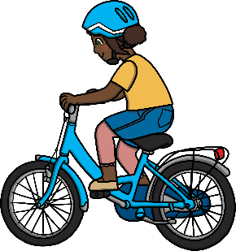
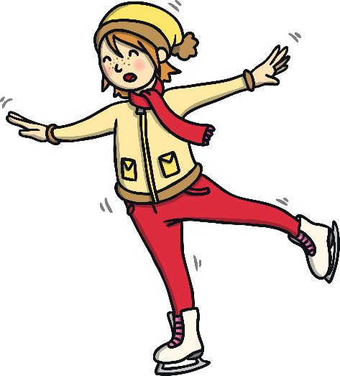
Showing Resilience
What is resilience?
Not being afraid to fail.
Accepting when things go wrong.
Trying again and again.
Learning from mistakes.
Being prepared to give something a go.
Not giving up!

Slide 13
Showing Resilience
Someone who shows resilience is someone who doesn’t give up when they find something challenging.
They persevere – that means they stick at it and try again.
People who persevere have much more chance of succeeding.
If you give up at something straight away, you will never achieve your goal.
If you persevere and show resilience, you’ll be able to get better at something and make steps towards achieving your goal.
It’s like riding a bike…

Slide 14
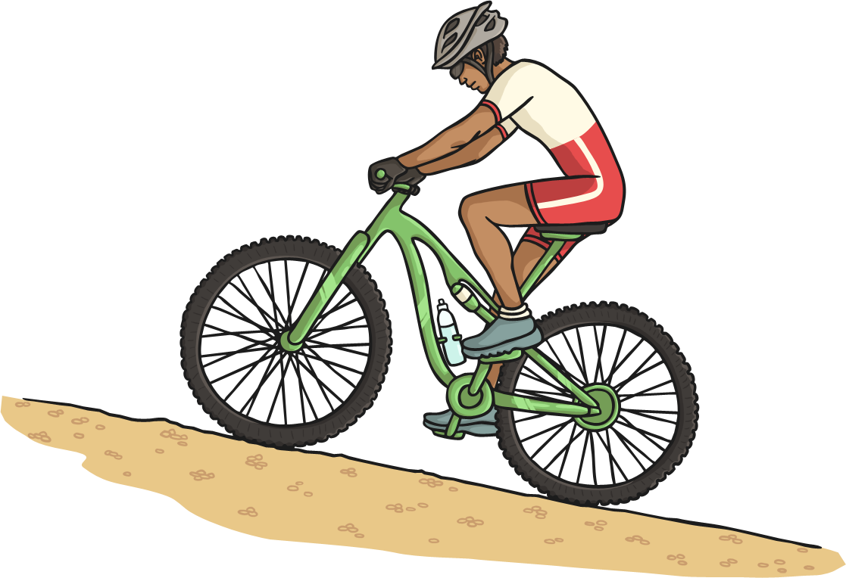
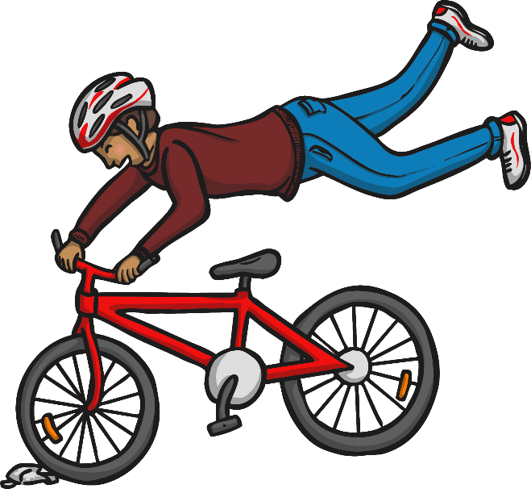
Showing Resilience
If you gave up the first time you wobbled…
Or if you never got back on your bike after falling off…
You’d never get better and you’d never learn how to do it.

Slide 15
Go-Getters
Consolidating
Reflecting

Slide 16
Consolidating

Slide 17
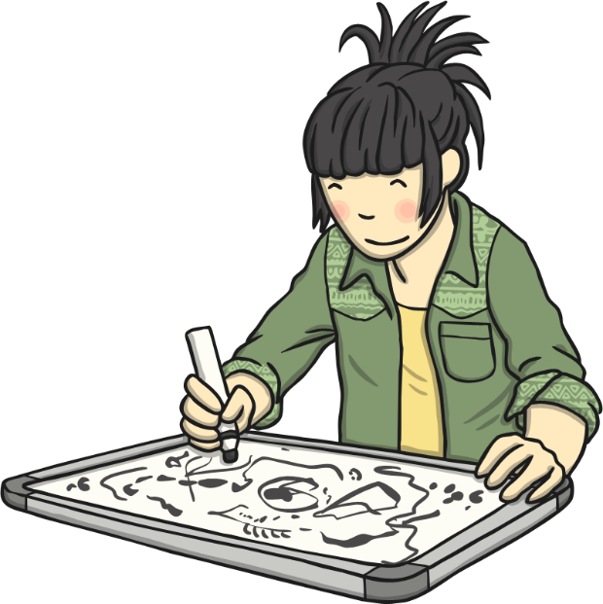
Take the Challenge!
Today you are all going to have a go at lots of different activities.
We are all different, so what one person finds challenging, another may find easy.
We can all learn to do something if we put time and effort into practising.

Slide 18
Take the Challenge!
What will you do to complete the challenges around the classroom today?
What sorts of thoughts will you have?
Will you need to persevere with something you find challenging?
Let’s find out what the different challenges are…

Slide 19
Take the Challenge!
drawing
balancing
word search
tangram
dot to dot
tongue-twisters

Slide 20
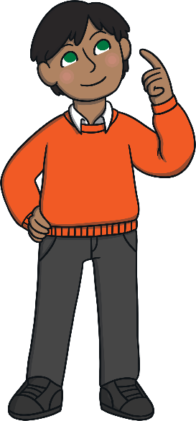
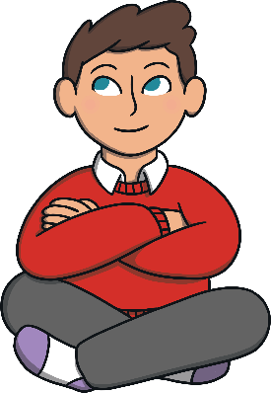
Take the Challenge!
What sorts of thoughts were going through your head, or what were you saying when you were attempting a difficult challenge?
Did you have different thoughts in your head or make different comments during the challenges you found easier?
Which activity would you choose to do again, if you were allowed another try?
Why would you choose this one?
It is really important that we keep trying at things we find challenging. Use positive thoughts to help you do this!

Slide 21
Reflecting

Slide 22
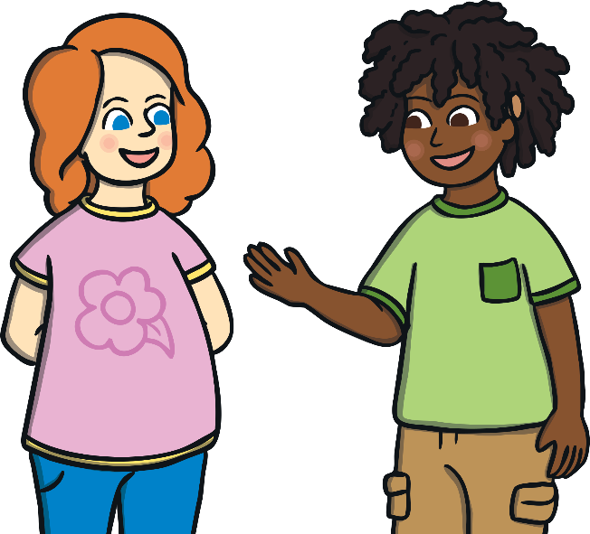
My Goals
Setting goals for ourselves can help us learn and achieve new and exciting things.
Tell your partner something you would like to achieve, learn to do or get better at.
What will your goal be?
How will you achieve your goal?
What sorts of helpful thoughts will you use to help you achieve your goal?
We can all be go-getters if we show resilience and perseverance!

Slide 23
The Big Questions

Slide 24
What are helpful and unhelpful thoughts?
What can we do if we find something challenging?
What have you learnt today that is going to help you in your day-to-day life?

Slide 25
Aim
I can set myself goals and consider how to achieve them.
Success Criteria
I understand that positive thoughts can help me achieve my goals.
I understand that resilience means trying again and not giving up.
I can think of things I would like to learn, get better at or achieve.
This resource is fully in line with the Learning Outcomes and Core Themes outlined in the PSHE Association’s Programme of Study.

Slide 27
Aim
I can discuss my feelings and opinions with others and cope with difficult emotions.
Success Criteria
I can identify good and bad feelings.
I can discuss what causes negative emotions.
I can name some strategies to cope with difficult feelings.
This resource is fully in line with the Learning Outcomes and Core Themes outlined in the PSHE Association’s Programme of Study.

Slide 28
The Big Questions

Slide 29
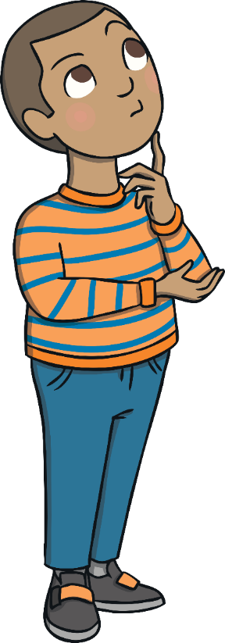
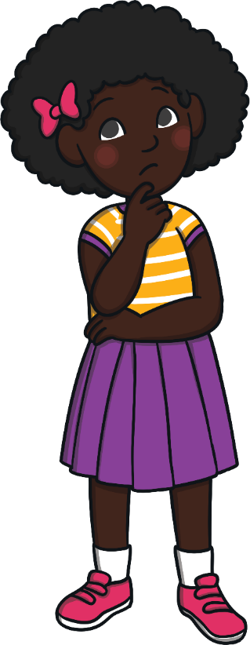
What things make us feel cross, worried or sad?
What can we do if this happens?

Slide 30
Reconnecting

Slide 31
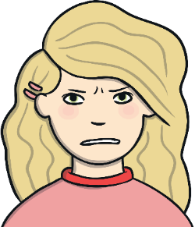
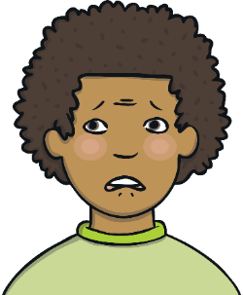
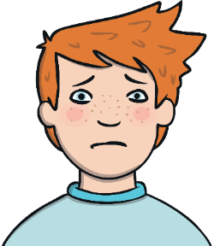
What Makes Us Feel Cross, Worried or Sad?
Have a think about a time when you have felt cross, sad or worried. Can you remember what made you feel that way?
Maybe you have seen things happen to other people you know, or perhaps on TV, that have made them feel cross, sad or worried.
Have you read any books where something happens to make someone feel cross, sad or worried?
Let’s share some of your ideas.

Slide 32
Exploring

Slide 33
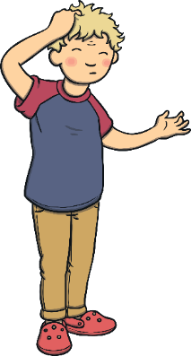
Uncomfortable Feelings
When we are cross, sad or nervous, it can feel uncomfortable and difficult to manage.
Can you think of any other feelings that are uncomfortable?
Talk to your partner about uncomfortable feelings.
If you feel happy to, share your thoughts with the class.
embarrassed
frightened
confused
left out

Slide 34
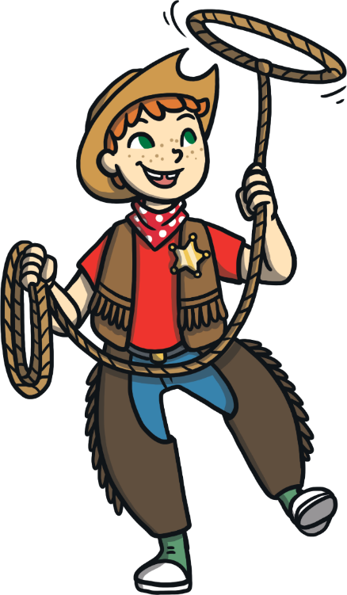
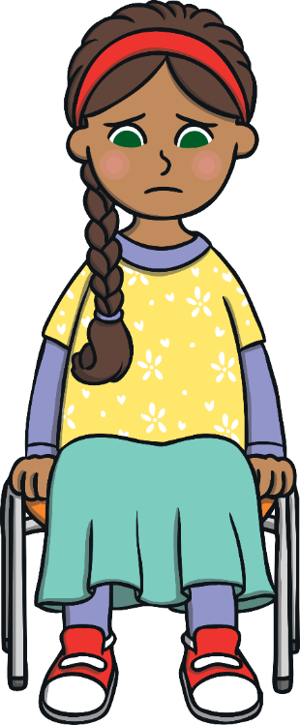
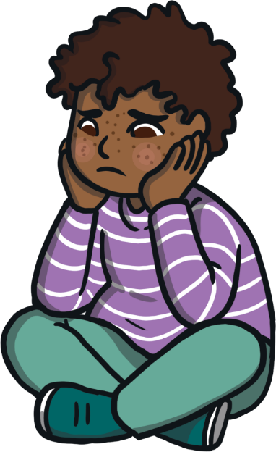
Uncomfortable Feelings
It can give us a very unpleasant feeling if we feel lonely or isolated. This could make people feel very sad and worried.
Sometimes it can be nice to do something for ourselves,
If people feel lonely or isolated it is very important to talk to an adult and get help to feel happy again.
but if this happens more than we want, or if it upsets us, it can make us feel lonely.
What would it feel like to be lonely? What might you notice about someone else if they were feeling lonely?
Sometimes it can seem like everyone is too busy to play or chat.

Slide 35
How Would You Feel?
We are all different and we all feel differently about things that happen.
Being able to understand our feelings and talk about them is really important.
Let’s think about some different things that could happen and how they would make you feel.
If they have never happened to you, you will have to try to imagine how you would feel if they did happen.
There are some posters around the room showing different emotions.
When I read out the question, you can move to the poster that shows how you would feel if that happened to you.

Slide 36
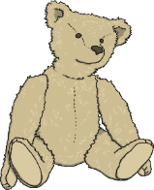
How Would You Feel?
How would you feel if you lost your favourite toy?
How would you feel starting at a new school, on your first day?
How would you feel if someone broke your model you had built, on purpose?
How would you feel if you had to sing on your own, in front of the whole school?
How would you feel trying ice skating for the first time?
How would you feel if no one would play with you at play time?
How would you feel if you missed the start of the film, at the cinema?
How would you feel if someone scribbled all over a great picture you had drawn?

Slide 37
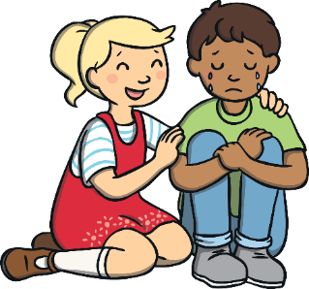
Let It Out
Feelings like anger, sadness and anxiety can be uncomfortable feelings, but they are normal feelings.
Everyone feels like this at times because of the things that happen.
It’s not wrong to feel these emotions, but we do have to learn how to cope with feeling this way.
We need to learn what to do when we are angry, that won’t involve anyone being hurt or getting into trouble.
We need to know how to feel better when we are sad.
We also need to know how to get help with feelings of worry.

Slide 38
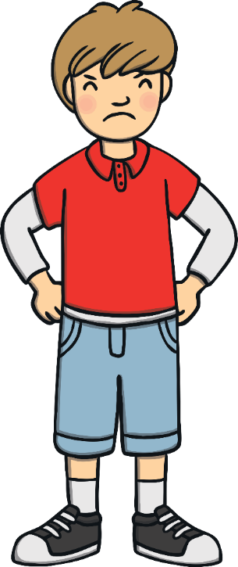
Let it Out
Walk away from the thing making you angry.
Stretch up and relax your muscles.
Talk to a friend about what is making you angry.
Count backwards from 20.
Take some deep breaths of fresh air.
Find somewhere you can go to shout.
Tell yourself, ‘I am in control of my anger.’
Coping With Feeling Cross

Slide 39
Let it Out
Talk to a person you trust about what is making you sad.
Cry – it is OK to let out your sadness.
Think of something that makes you feel happy.
Cuddle your favourite soft toy.
Tell yourself, ‘This feeling won’t last long. I will be happy again.’
Play with a pet – they can cheer you up.
Coping With Feeling Sad

Slide 40
Let it Out
Remind yourself about the people that care about you and how you feel when you are around them.
Find someone else who looks lonely and suggest an activity you can do together.
Tell a friend or a trusted grown-up that you are feeling lonely.
Think of an activity that you enjoy to keep you busy for a while.
Think about three things that you are grateful for.
Coping With Feeling Lonely

Slide 41
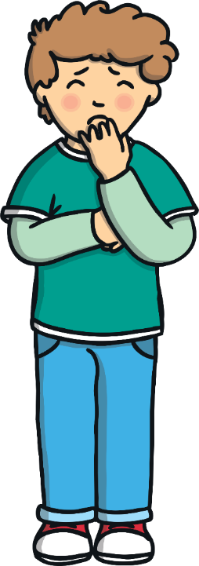
Let it Out
Imagine yourself being confident and not worried.
Think about the last time you were worried and how you got through it.
Tell someone how you feel and what is worrying you.
Ask yourself, ‘What’s the worst that can happen?’
Write the worry down and put it away in a safe place.
Remind yourself that the thing you are worried about will soon be over.
Tell the worry to go away and that you are in control.
Coping With Feeling Worried

Slide 42
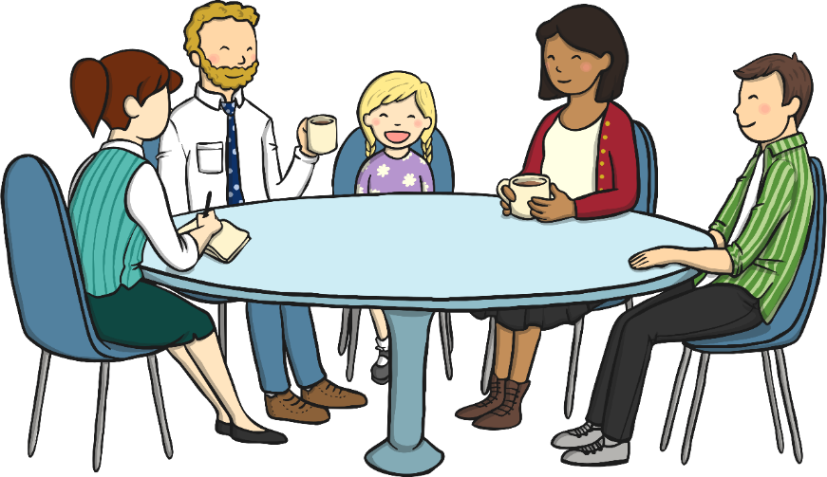
Let It Out
It is normal for people to feel all of these feelings from time to time. We've learnt lots of ways that people can help themselves feel better when this happens.
Don't forget, you can always share your feelings with someone who you trust.
Consolidating
Reflecting

Slide 43
Consolidating

Slide 44
My Emotions Toolkit
Think carefully about all the different things you can do when you are cross, worried or sad.
How can you cope with these sorts of difficult emotions?
What can you do that might make you feel better?
Today, you are going to create an Emotions Toolkit – a box with tools inside. Each tool will have a special job to do. They will each contain a suggestion of something you can do to help deal with difficult emotions such as sadness and anger.

Slide 45
My Emotions Toolkit
Write your ideas on all the tools.
Carefully cut out each tool.
Decorate the toolbox template.
Carefully cut the toolbox out.
Fold the toolbox along the dotted lines.
Put glue on the tabs and stick the sides together.
Put all your tools in your toolbox!

Slide 46
Reflecting

Slide 47
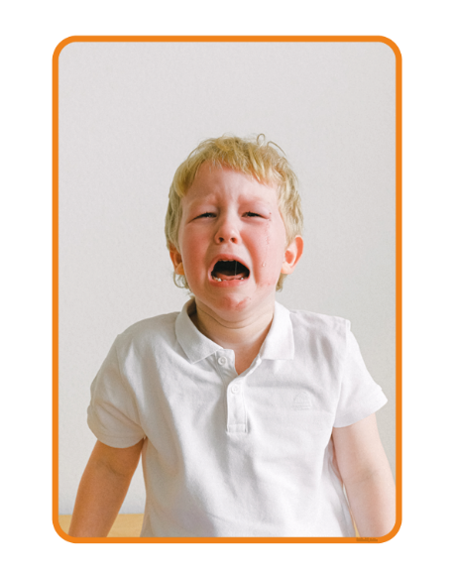
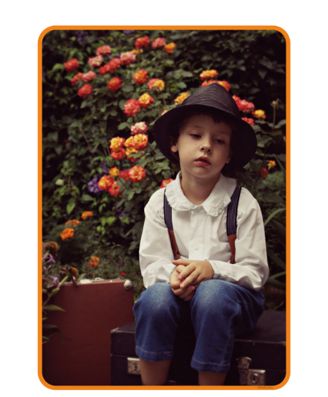
Different Emotions
In your groups, look at the photos showing different emotions.
Pick a photo and discuss how you think the person in the picture is feeling.
Can you think of something that might have happened to make the person in the picture feel this way?
However you are feeling, it can help to let it out.

Slide 48
The Big Questions

Slide 49
What things make us feel cross, worried or sad?
What can we do if this happens?

Slide 50
Aim
I can discuss my feelings and opinions with others and cope with difficult emotions.
Success Criteria
I can identify good and bad feelings.
I can discuss what causes negative emotions.
I can name some strategies to cope with difficult feelings.
This resource is fully in line with the Learning Outcomes and Core Themes outlined in the PSHE Association’s Programme of Study.

