Slide 1
PSHE and Citizenship
Living in the Wider World | Aiming High
PSHE and Citizenship | KS1 | Living in the Wider World | Aiming High | Looking Forward | Lesson 6

Slide 3
Aim
I can think about things I would like to achieve in the future.
Success Criteria
I can talk about my goals for the future.
I can explain why they are important to me.
I can think about how I can achieve my goals.
I can show respect to people who have different goals to me.
This resource is fully in line with the Learning Outcomes and Core Themes outlined in the PSHE Association’s Programme of Study.

Slide 4
The Big Questions

Slide 5
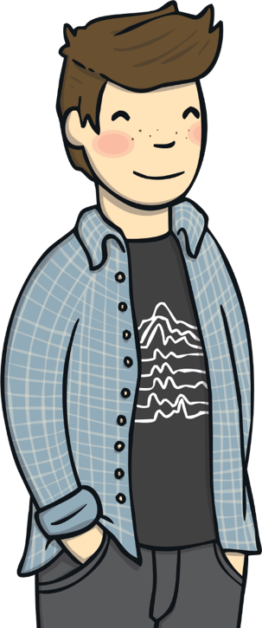
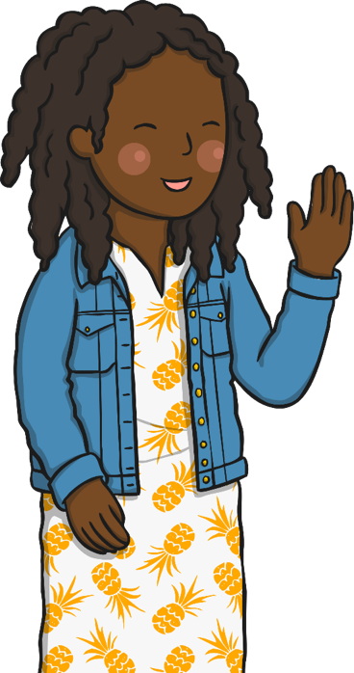
What are our goals for the future?
How can we achieve our goals?
Share your thoughts with a partner.

Slide 6
Reconnecting

Slide 7
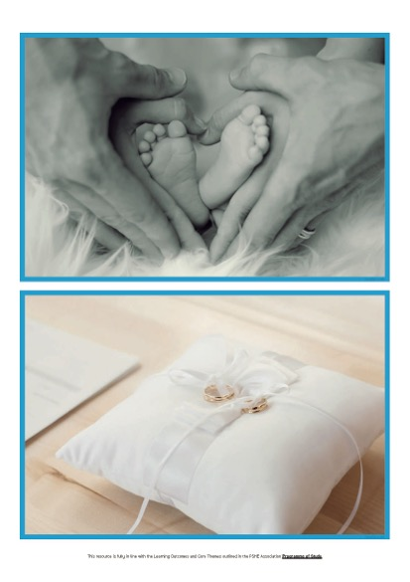
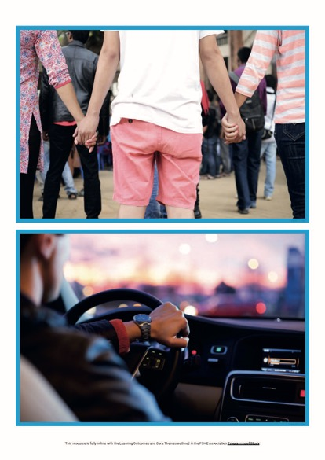
What Do These Pictures Show?
In your group, look carefully at the picture you have been given. With each other, talk about your answers to the questions.

Slide 8
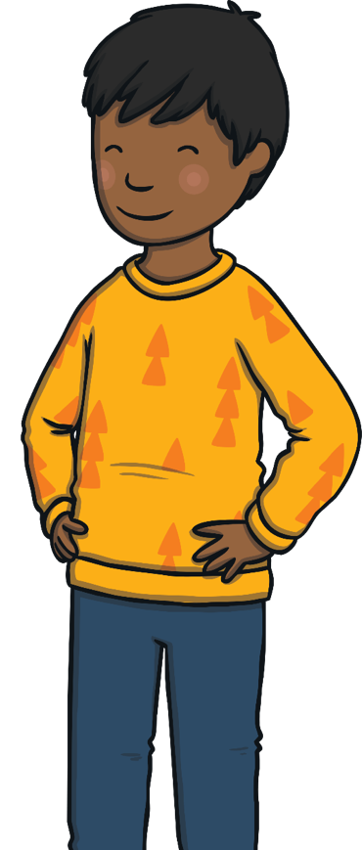
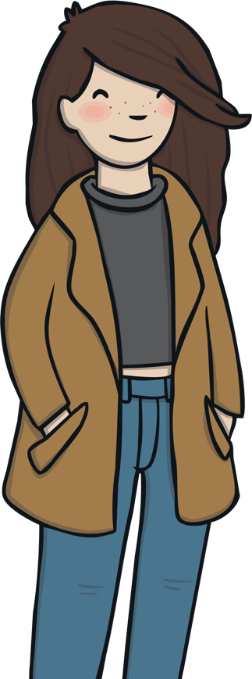
What Do These Pictures Show?
What is your picture of?
What goal for the future is being shown?
Having things we want to achieve in the future is very exciting! It is important to remember that different things are important to different people and we must be respectful of everyone’s goals for the future.
When you have finished, share your picture and your ideas with the rest of the class.

Slide 9
Exploring

Slide 10
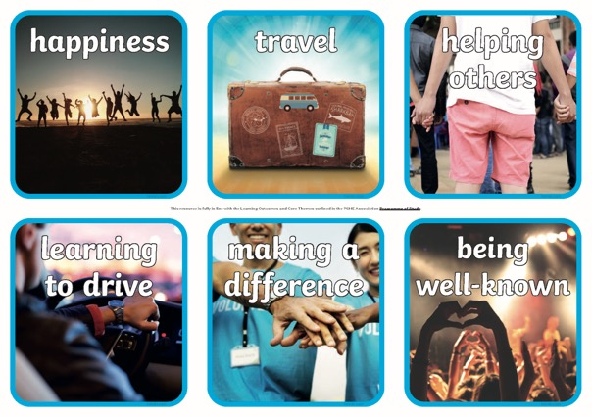
What’s Important to Us?
There are lots of things we could aim to achieve in the future. These pictures show examples of some ideas of what some people might want. It is great to have ambitions for the future and these may be the same or different to those of others.
Working in pairs, you are now going to use an ordering activity to show which goals are important to you for your future.
Look carefully at the cards you have been given and arrange them in a way that shows how important each one is to you. Put the most important achievement at the top and the least important one at the bottom. There can be as many as you like that share the same importance. You can also use the blank cards if you would like to, to draw some of your own goals for the future.

Slide 11
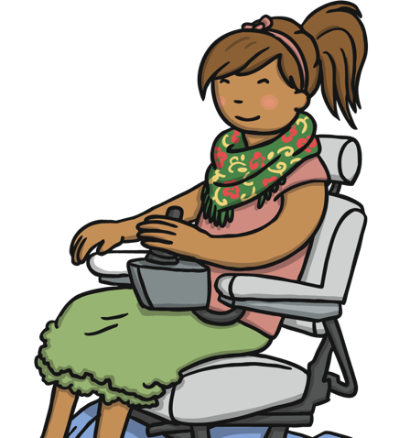
Are Our Goals the Same?
Was that easy to do? Did you and your partner agree on all the same goals being important? You might have had quite different ideas of what was important to you, because we are all different.
We are now going to walk around the room to see how others have sorted theirs. While you do this, think about these questions.
Have other pairs sorted their cards in a similar way to you?
Are there any differences?
Why do you think this is?
What do you think you need to do to achieve some of your goals?

Slide 12
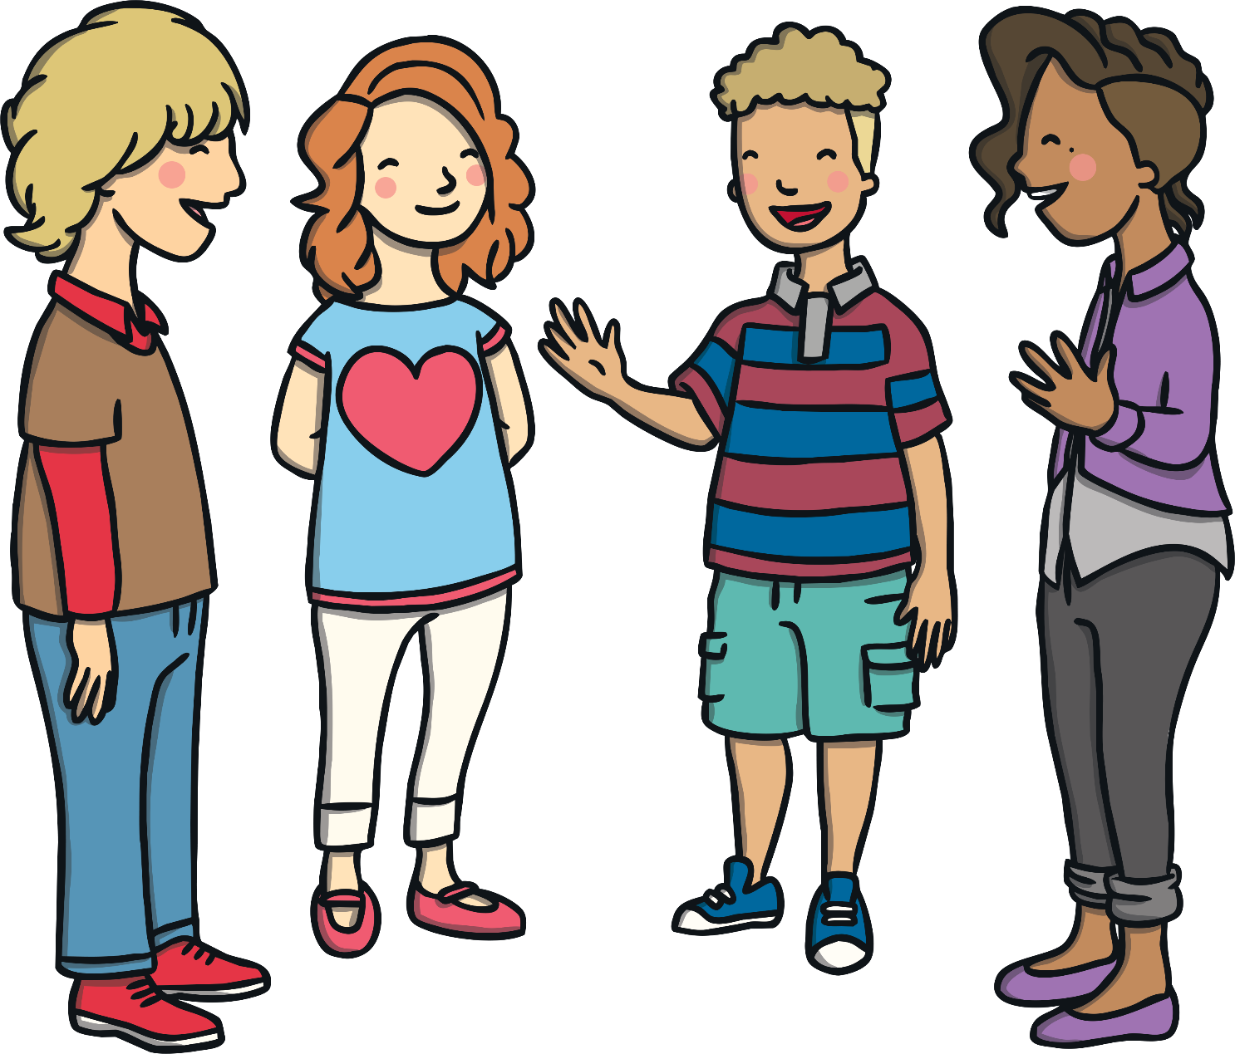
Consolidating
Reflecting

Slide 13
Consolidating

Slide 14
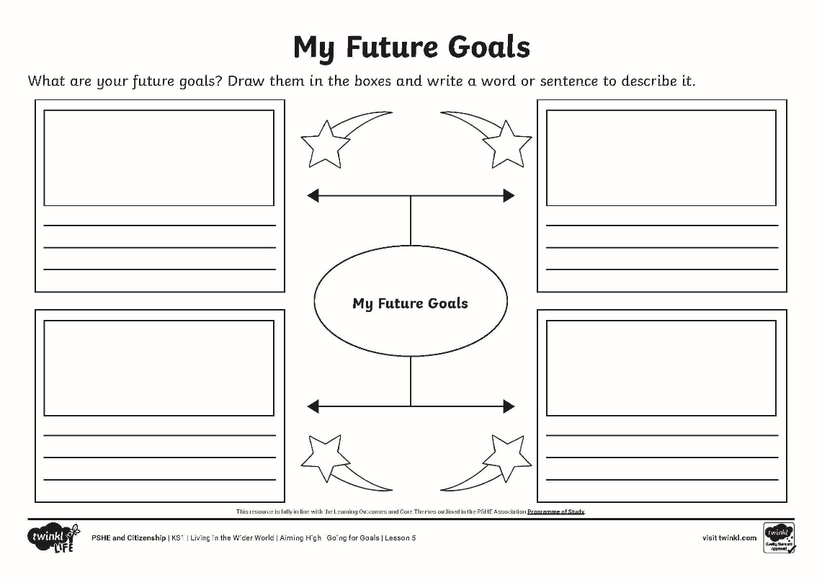
My Future Goals
What are your future goals?
Draw pictures to show what you would like to achieve and write words to give as much detail as you can about these goals.

Slide 15
Reflecting

Slide 16
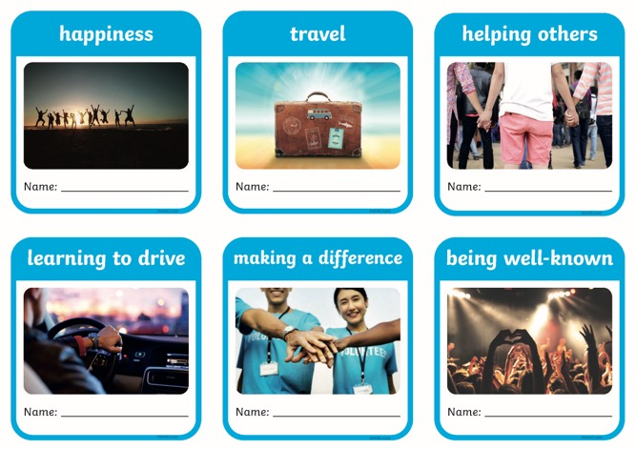
Find Someone Who…
In today’s lesson we have thought about what we might like to achieve in the future. We may each want slightly different things and this is OK. In fact, it is exciting!
We are going to find someone who aims for each of the goals on your Find Someone Who... Cards.
Walk around the classroom, talking to other children to find someone who aims for each of these things.
We all have different goals. This is great and helps make the world an exciting and very special place to live. Go for your goals and work hard to achieve your dreams!

Slide 17
The Big Questions

Slide 18
What are our goals for the future?
How can we achieve our goals?
What is the most interesting thing you have learnt? Have your answers changed at all from the beginning of the session?

Slide 19
Aim
I can think about things I would like to achieve in the future.
Success Criteria
I can talk about my goals for the future.
I can explain why they are important to me.
I can think about how I can achieve my goals.
I can show respect to people who have different goals to me.
This resource is fully in line with the Learning Outcomes and Core Themes outlined in the PSHE Association’s Programme of Study.

Slide 21
Aim
I can think about changes that might happen to me and consider how I feel about them.
Success Criteria
I can identify things I have enjoyed during this school year.
I can talk about things that might be different during next school year.
I can share how I am feeling about the changes.
I can identify things I am looking forward to during the next school year.
I can offer advice to others who might be feeling worried about change.
This resource is fully in line with the Learning Outcomes and Core Themes outlined in the PSHE Association’s Programme of Study.

Slide 22
The Big Questions

Slide 23
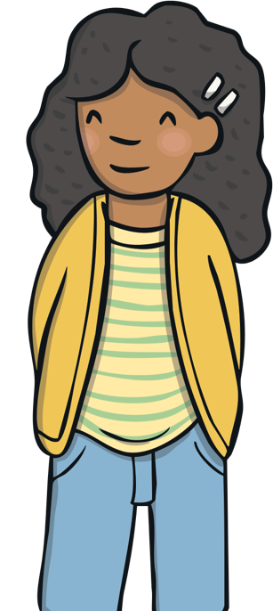
How might next year be different from this year?
What are we looking forward to about next year?

Slide 24
Reconnecting

Slide 25
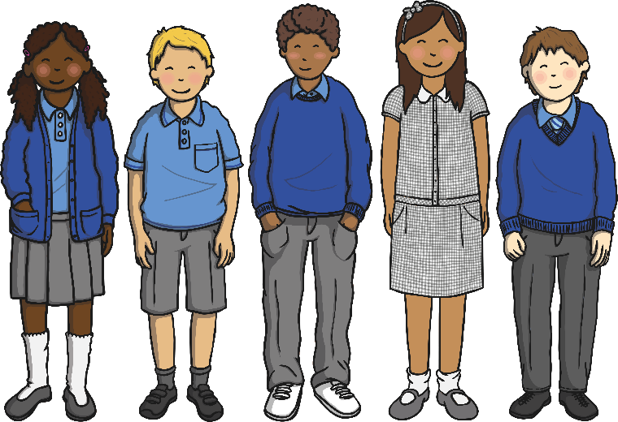
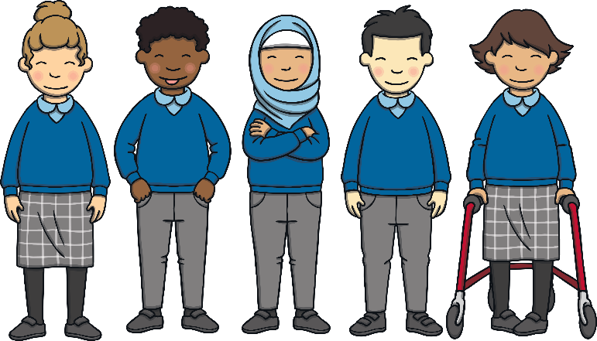
We’ve Had Such Fun!
Today we will be thinking about how certain things change as we go through school.
What do you remember about your time in last year’s class?
funny
happy
exciting
scary
What has been the same as in this year’s class? What has been different?

Slide 26
We’ve Had Such Fun!
With your partner, using the colourful pens and the sugar paper, write or draw things that you have learnt, enjoyed and improved during this school year.
You can record your ideas like this:
This Year
What a lot of wonderful memories! When things end or change it can feel a little unsettling, this is OK. It can help us to think of all the good times when things change, this helps us to look forward to all the new and exciting things ahead!

Slide 27
Exploring

Slide 28
Different or the Same?
There are lots of things that we do as we go through school. We improve at lots of things and certain things might be similar or different from one year to the next.
Working in pairs, you are now going to think of things that might be the same or different next year.
We will use this spinner to start our discussions. Talk to your partner about any similarities and differences you think there will be next year in…
Now, talk to each other about how you feel about the differences?
responsibilities
classroom
friendships
routines
Is there anything anyone would like to share with the class?
homework
playtime
Remember that although difference can be unsettling, it can also mean exciting changes and things to look forward to!
Spin

Slide 29
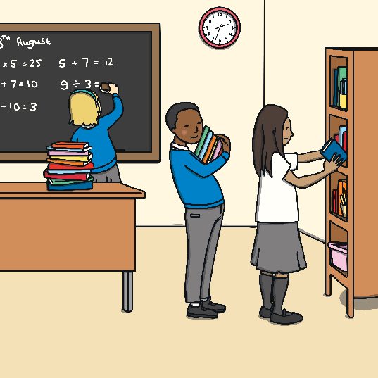
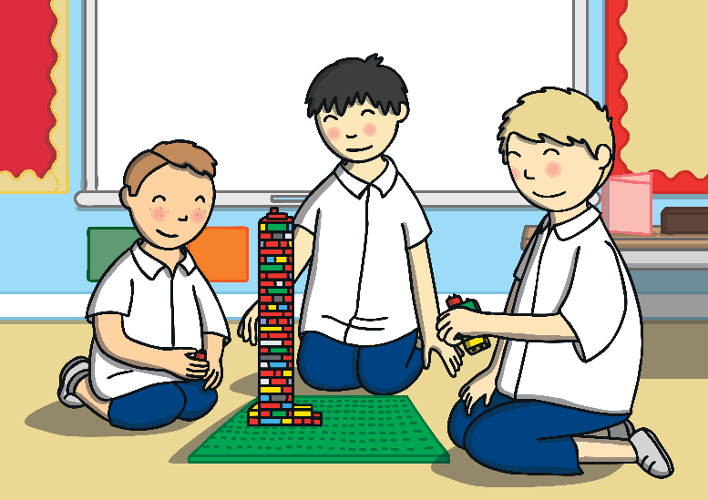
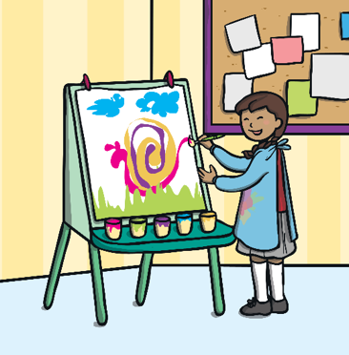
Tell Me About…
You are now going to team up with another pair to make a small group.
In your small group, choose one thing you are all looking forward to next year and create a role play to share with the class.
Your role play could be about the classroom, the day-to-day routines, playtimes, home learning, your friends, responsibilities or another area of school of your choice.

Slide 30
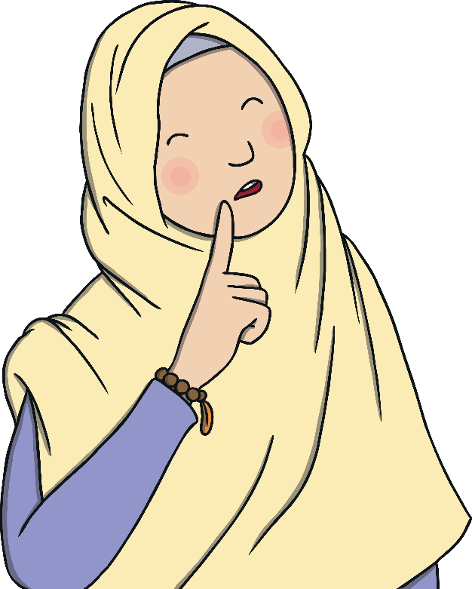
Tell Me About…
Now let’s share our role plays.
Are you looking forward to this as well?
What a lot to look forward to about the school year ahead!
Consolidating
Reflecting

Slide 31
Consolidating

Slide 32
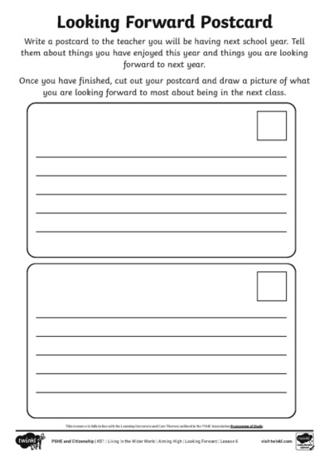
Looking Forward
Write a postcard to the teacher you will have next year to explain some of the things you are looking forward to next year at school.
You might also want to include things you have enjoyed about this year.
Add a picture on the front of your postcard to show what you are looking forward to most.
Word Bank:
change
different
progress
improve
goals
new
achievements
routine
challenge
success
exciting

Slide 33
Reflecting

Slide 34
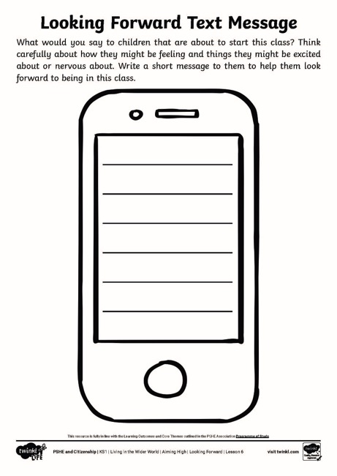
Looking Back
In today’s lesson we have thought about what we are looking forward to about next year.
How do you think children in the year below might feel about coming into this class?
We are now going to write them a message to help them feel less worried about the change and give them lots to look forward to!
Change can feel a bit scary, that is OK and quite expected. Change can also bring lots of new adventures and lots of exciting things to look forward to.

Slide 35
The Big Questions

Slide 36
How might next year be different from this year?
What are we looking forward to about next year?
What have you learnt today that has helped you?

Slide 37
Aim
I can think about changes that might happen to me and consider how I feel about them.
Success Criteria
I can identify things I have enjoyed during this school year.
I can talk about things that might be different during next school year.
I can share how I am feeling about the changes.
I can identify things I am looking forward to during the next school year.
I can offer advice to others who might be feeling worried about change.
This resource is fully in line with the Learning Outcomes and Core Themes outlined in the PSHE Association’s Programme of Study.

Slide 38
Prayer
Dear God,
Help me to look at my options for the future.
Others to share prayers…
Amen.

