Slide 1
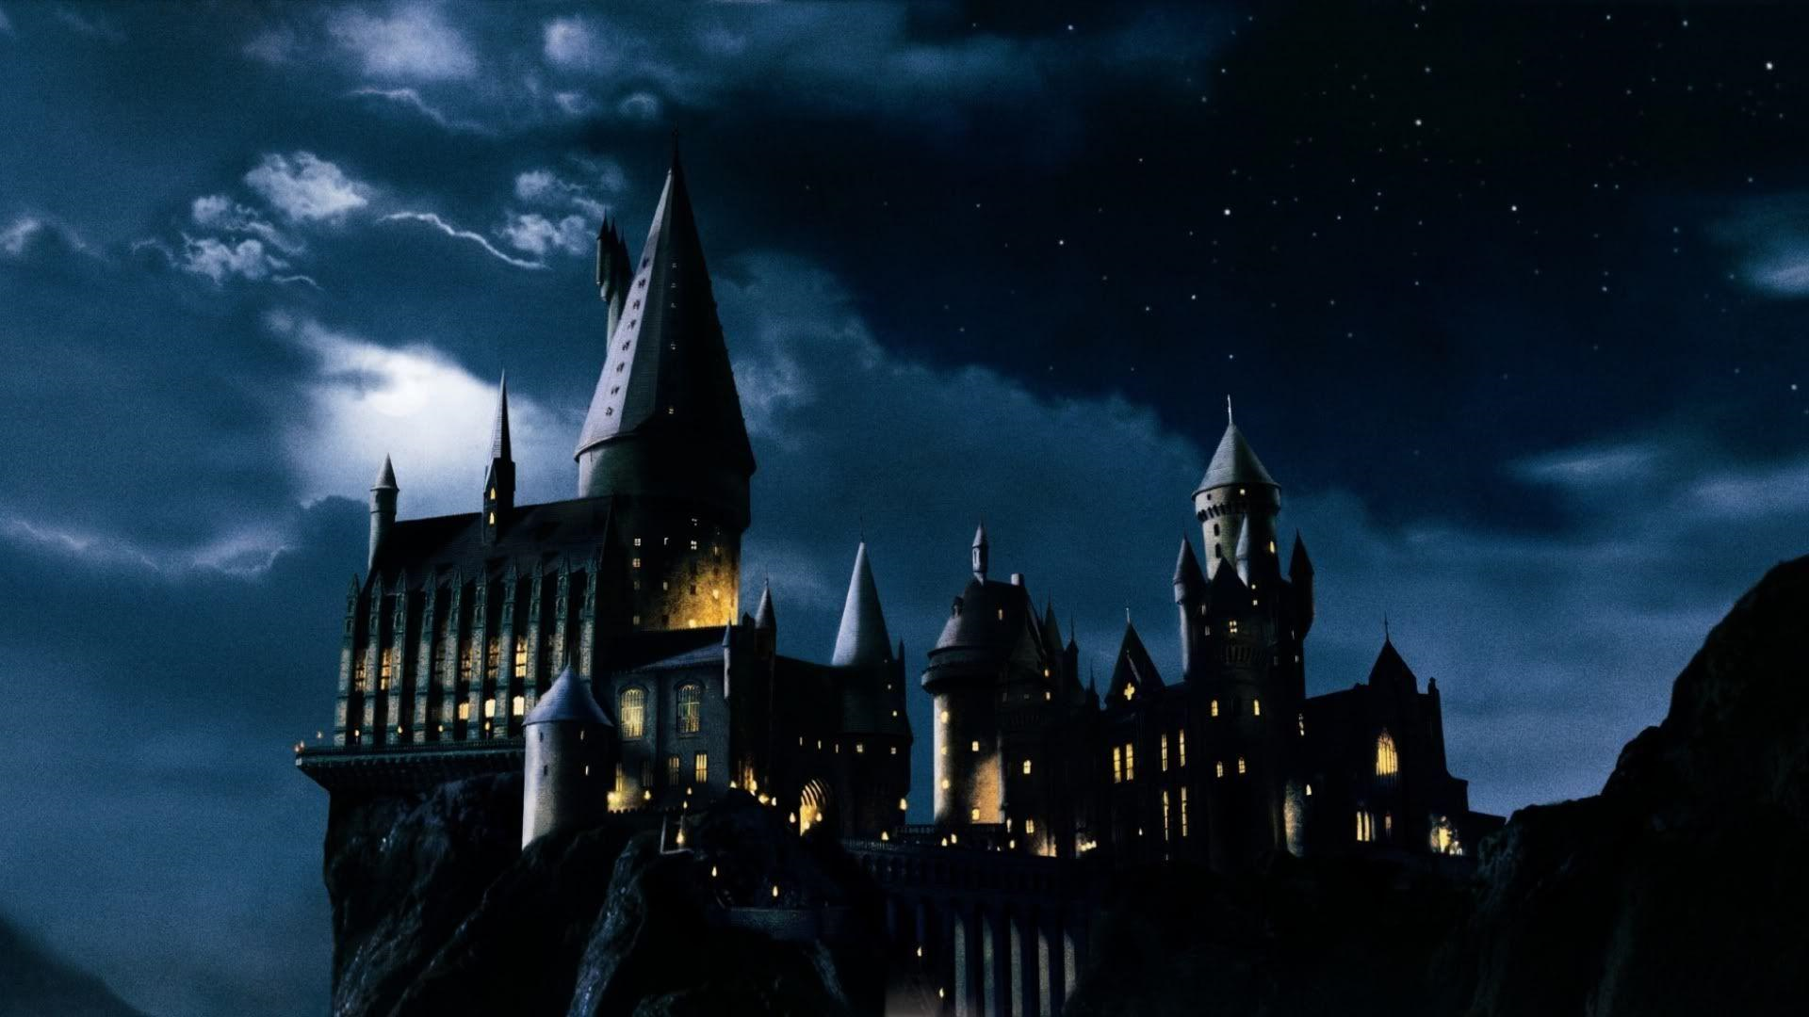

Introduction
Planning home learning
for week 22nd June 2020
To start, Click on sound icon below.

Slide 2
Harry Potter and the philosophers stone. Week 1
English topic

Slide 3
Our new topic is going to be Harry Potter and the Philosophers stone.
The next slide includes an audio book, if you don’t have access to the book.

Slide 4
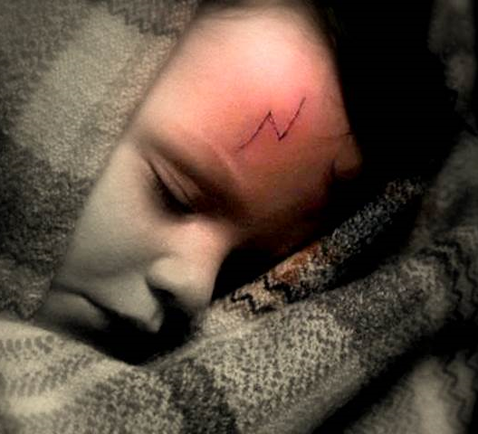
Chapter 1
The Boy Who Lived (lesson 1+2)
Click on the link below for the audio book. Listen only to chapter 1
https://stories.audible.com/pdp/B017V54W6O?ref=adbl_ent_anon_ds_pdp_pc_cntr-0-0

Slide 5
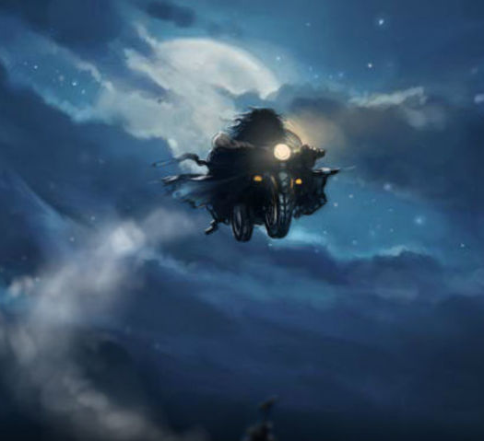
Lesson 1
The Chapter begins describing the tension between the wizarding world and the ordinary world.
Create a chart separating the differences between the two worlds.
Describe the types of clothes they wear and what different people there are. Write as much as you can think of.
Ordinary World | Wizarding World
e.g. Albus Dumbledore They wear cloaks | e.g. Vernon Dursley they wear a coat.

Slide 6
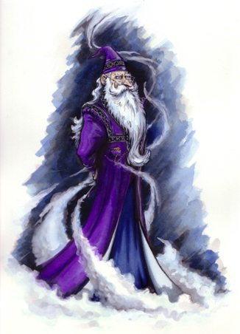
Lesson 1
Albus Dumbledore
"He was tall, thin and very old, judging by the silver of his hair and beard, which were both long enough to tuck into his belt. He was wearing long robes, a purple cloak which swept the ground and high-heeled, buckled boots. His blue eyes were light, bright and sparkling behind half-moon spectacles and his nose was very long and crooked, as though it had been broken at least twice. This mans name was Albus Dumbledore.”
What in this text shows that Dumbledore is magical?
What suggests he is a good person?
Answers on next page. Don’t take a peek!

Slide 7
Answers.
"He was tall, thin and very old, judging by the silver of his hair and beard, which were both long enough to tuck into his belt. He was wearing long robes, a purple cloak which swept the ground and high-heeled, buckled boots. His blue eyes were light, bright and sparkling behind half-moon spectacles and his nose was very long and crooked, as though it had been broken at least twice. This mans name was Albus Dumbledore.”
What in this text shows that Dumbledore is magical? Beard, which were both long enough to tuck into his belt. He was wearing long robes, a purple cloak.
What suggests he is a good person?
His blue eyes were light, bright and sparkling behind half-moon spectacles.

Slide 8
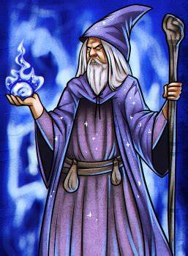
Lesson 2
Creating your own wizard.
Now it is time for you to create your own wizard.
You will need to include lots of description and make it as imaginative as you want.
It can be a good wizard or even an evil one!
Also, you may include a drawing of your wizard and try to make it as colourful and creative as possible!

Slide 9
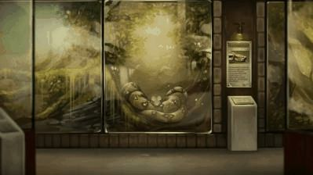
Chapter 2. The vanishing Glass.(lesson 3+4+5) click on link for the audio book.
Read chapter 2 only. https://stories.audible.com/pdp/B017V54W6O?ref=adbl_ent_anon_ds_pdp_pc_cntr-0-0

Slide 10
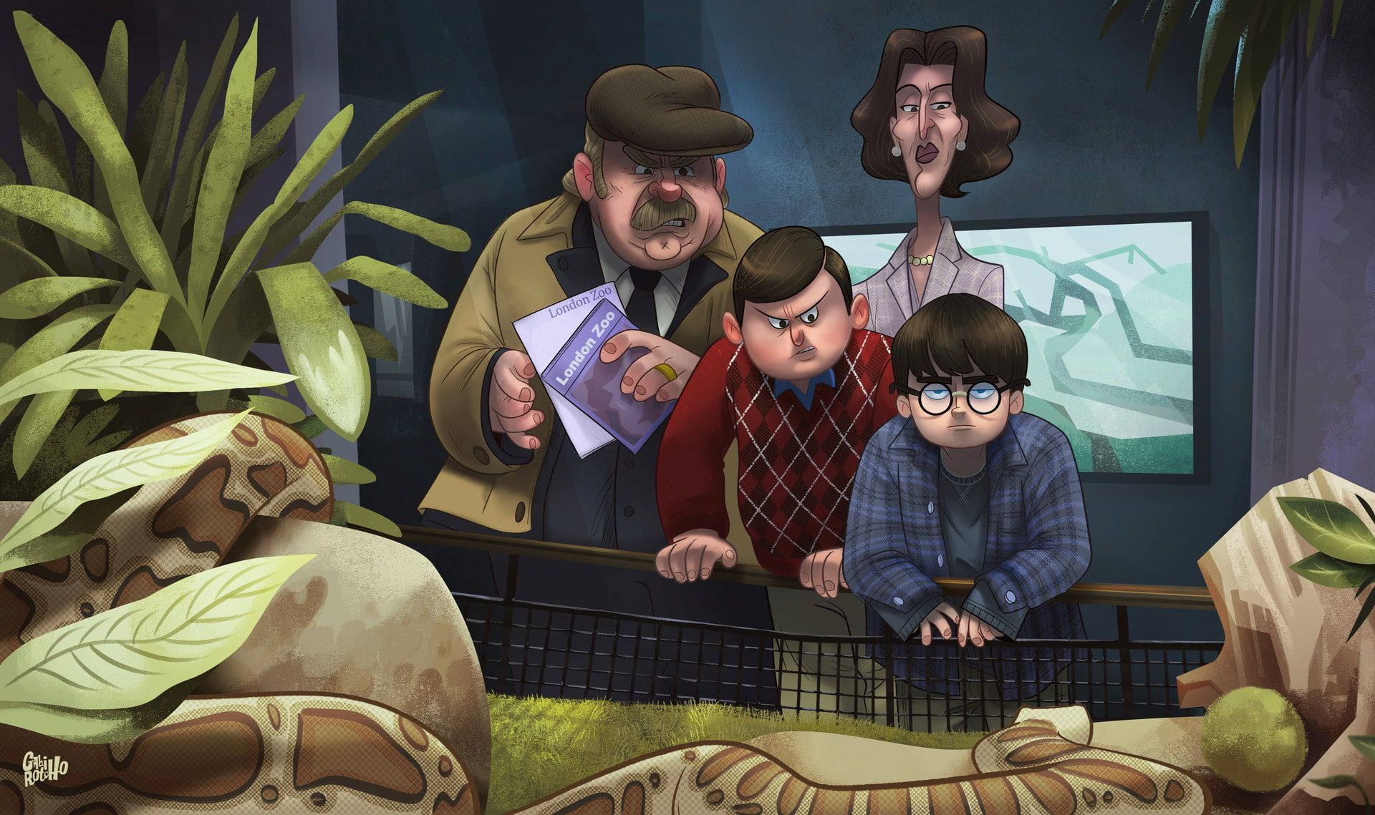
Lesson 3
Comprehension
Answer the following questions in full sentences:
What does Harry dream about before he is woken up? (page 19)
What does Harry like about his appearance and why? (page 20)
List the presents Dudley has opened. (page 21)
Why does Dudley cry? Is he really upset? (page 22)
What is the magical event mentioned including school? (page 23)
What type of ice cream does Harry receive? Why? (page 24)
How does the snake behave towards Harry? (page 25)
What does the snake say to Harry when it escapes? (page 26)

Slide 11
What does Harry dream about before he is woken up? (page 19)
It was a good one. It was about a flying motorbike. He feels as though as he’s had it before.
What does Harry like about his appearance and why? (page 20)
He likes his thin scar, shaped like a bolt of lightening.
List the presents Dudley has opened. (page 21)
He has opened: a racing bike, remote control aero plane, gold wrist watch, 16 computer games.
Why does Dudley cry? Is he really upset? (page 22)
Dudley does this to get anything he wants. He pretends that he’s crying because Harry has to come with them to the zoo. He’s not actually crying
What is the magical event mentioned including school? (page 23)
Harry’s hair grew back the next day after his Aunt had chopped it off. Harry was sitting on the chimney of the school kitchens.
What type of ice cream does Harry receive? Why? (page 24)
A cheap lemon ice lolly.
How does the snake behave towards Harry? (page 25)
Opened its ‘beady eyes’ and ‘raised its head’. It winks at Harry. Harry winks back. The snake jerks his head towards Uncle Vernon and raised his eyes like he gets it. He is in fact speaking to him.
What does the snake say to Harry when it escapes? (page 26)
“Brazil here I come. Thanks, amigo!”
Answers

Slide 12
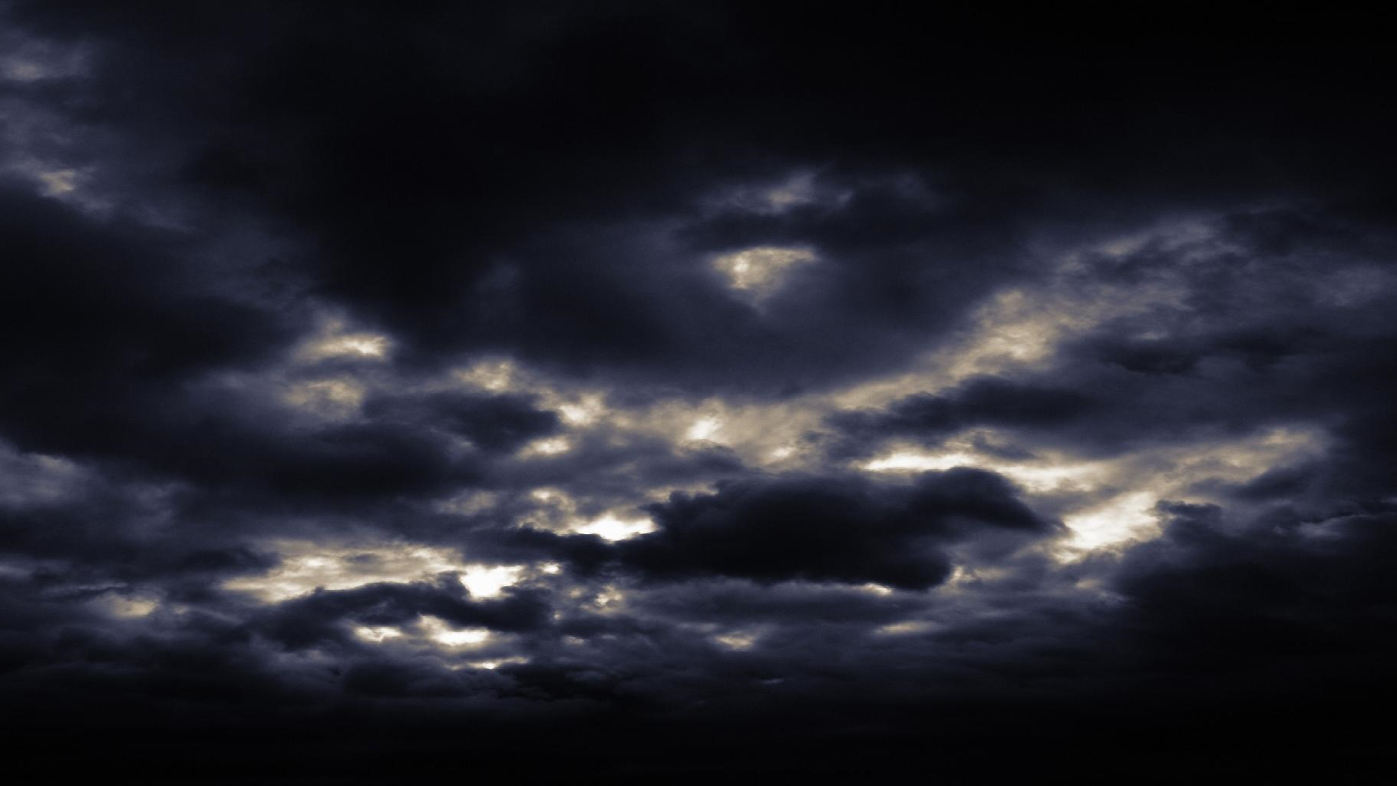
Lesson 4
Harry’s magical experiences
In this chapter it mentions many times Harry had some experiences that couldn’t be explained, or how they happened.
Imagine and describe another magical situation in Harry’s life that may have happened by accident and caused chaos to the people around him.
Make it as imaginative as you want an make sure to add lots of detail.

Slide 13
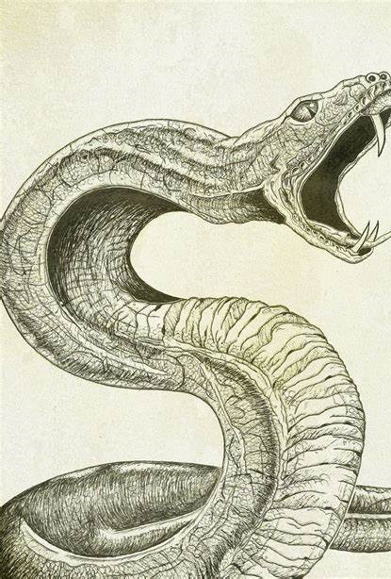
Lesson 5
A balanced argument
Harry speaks to a snake at the zoo and learns that the snakes family were from Brazil.
Suddenly, the glass magically vanishes and escapes.
The snake then replies, “Thankssss, Brazil here I come!” The snake couldn’t wait to escape to Brazil. Why do you think he wanted to leave the zoo? Y
You are now going to write a discussion text comparing a zoo to the wild. Move onto the next slide for some help with this.

Slide 14
Click on the link below to take you to a Bitesize video about a discussion of whether tourists are a good thing or bad thing on our mountains. Listen to the video.
Think about the pros and cons of having tourists as discussed in the video.
https://www.bbc.co.uk/bitesize/clips/zm3nvcw

Slide 15
How to write a balanced argument.
First of all read the eg of a balanced argument about ‘should homework be banned’ in the resource file- balanced argument.
Look at the layout phrases and words used; the introduction; arguments used for and against and the summary at the end.
Notice that there is an argument for and against homework. It is not just the authors own point of view.

Slide 16
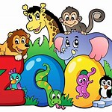
Should Zoos be allowed?
This is the title of your balanced argument. You need to research zoos and make a list of arguments for and against zoos.
Using the planning grid in resources make a list of the above.
Use the writing frame to plan out your balanced argument and edit it.
Write up in best your argument.
Use the following slide of useful vocabulary to help you.
Use the check list on the following slide to help you check you have used all the features you need to.

Slide 17
Use some of these useful words and phrases to help write your argument
Useful Words and Phrases
Causal/ Contrasting Conjunctions and Adverbials
Firstly Secondly Due to On the one hand
Because Consequently As a result For this reason
Hence Thus In consequence Nevertheless
In conclusion In order to In this way Otherwise
An outcome of Since So that Subsequently
Therefore Accordingly Although Many people
Some people Though Even though While
On the other hand However On the flip side Despite this
Otherwise Nonetheless On balance
.

Slide 18
Balanced Argument Checklist
The opening paragraph introduces the argument.
It contains opposing views of for and against.
There is evidence to support your arguments.
There is a concluding paragraph that includes the writer’s own opinion.
It is interestingly written.
It is written in the third person (except final paragraph).
The final paragraph is written in the first person.
It is written using formal and technical language.
It contains a mixture of causal conjunctions and adverbials that have been used

Slide 19
End of week one!

