Slide 1
PSHE and Citizenship
Living in the Wider World | Aiming High
PSHE and Citizenship | LKS2 | Living in the Wider World | Aiming High | Goals | Lesson 2

Slide 3
The Big Questions

Slide 4
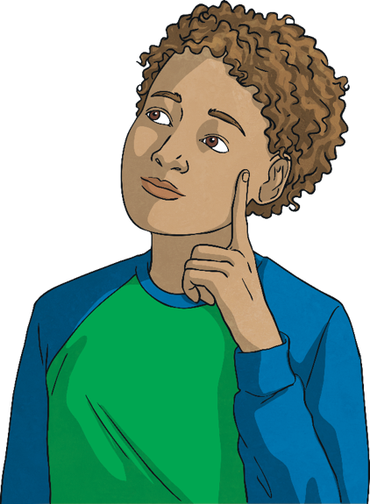
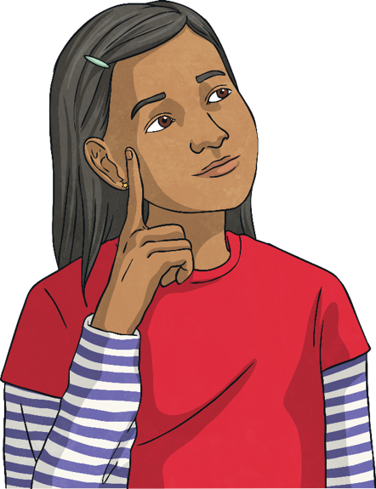
What would we like to achieve over the year ahead?
What do we need to do to help us achieve our goals?
Discuss your thoughts in your groups.

Slide 5
Reconnecting

Slide 6
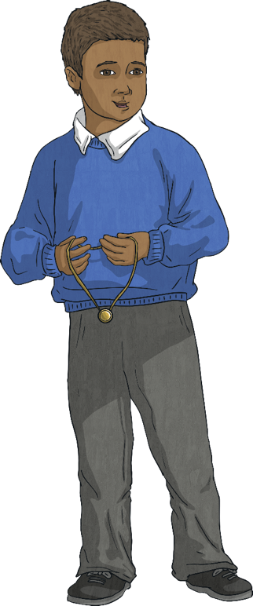
Actions Create Achievements
Goals are things we would like to achieve. Our actions and behaviours help us to achieve our goals.

Slide 7
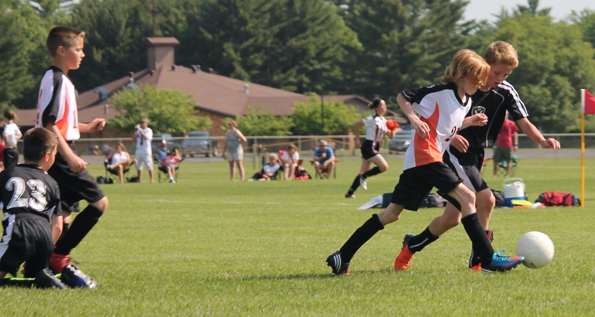
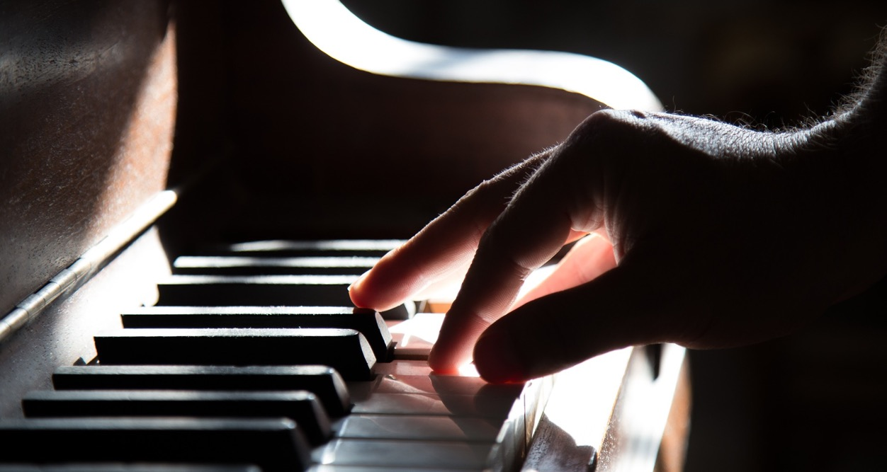
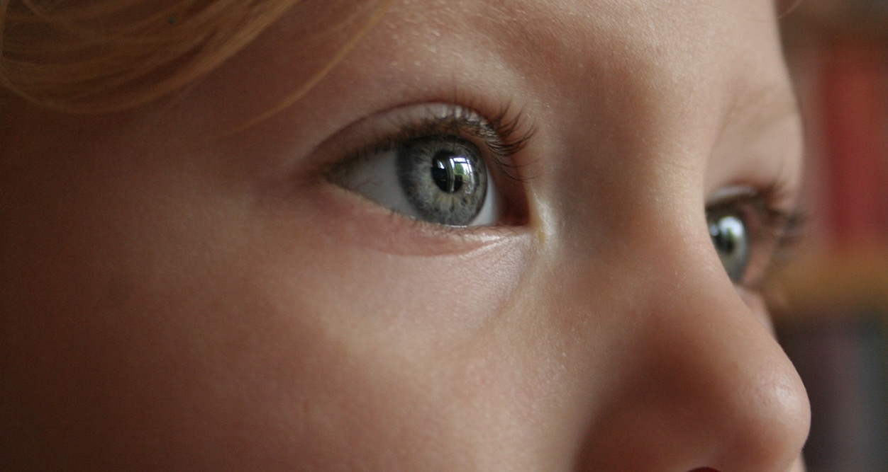
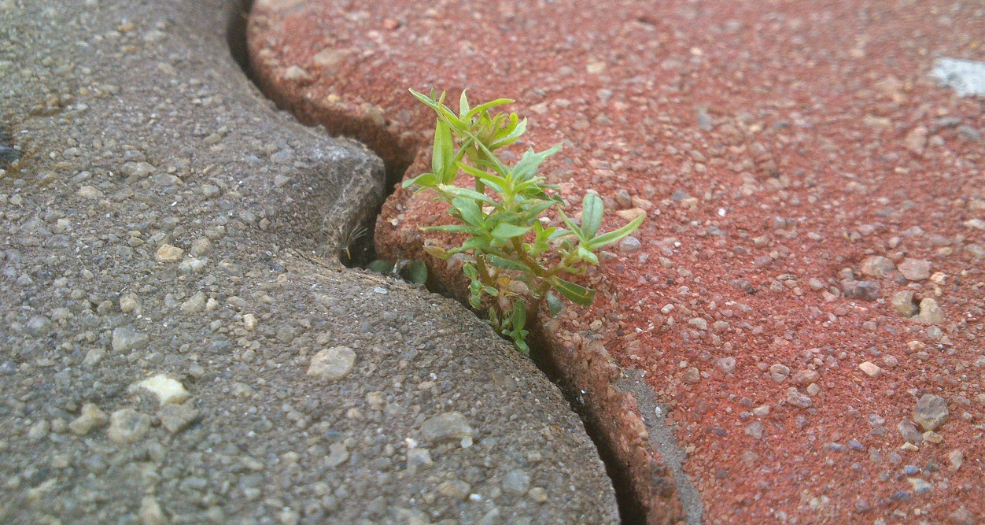
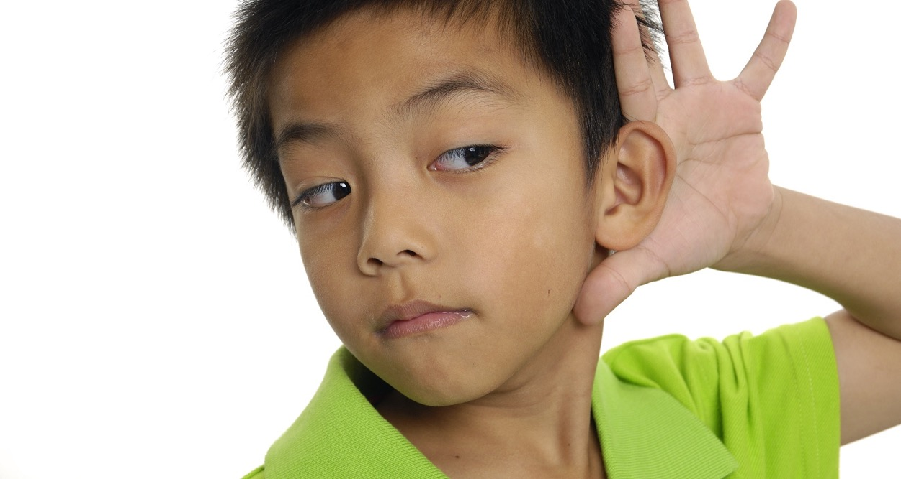
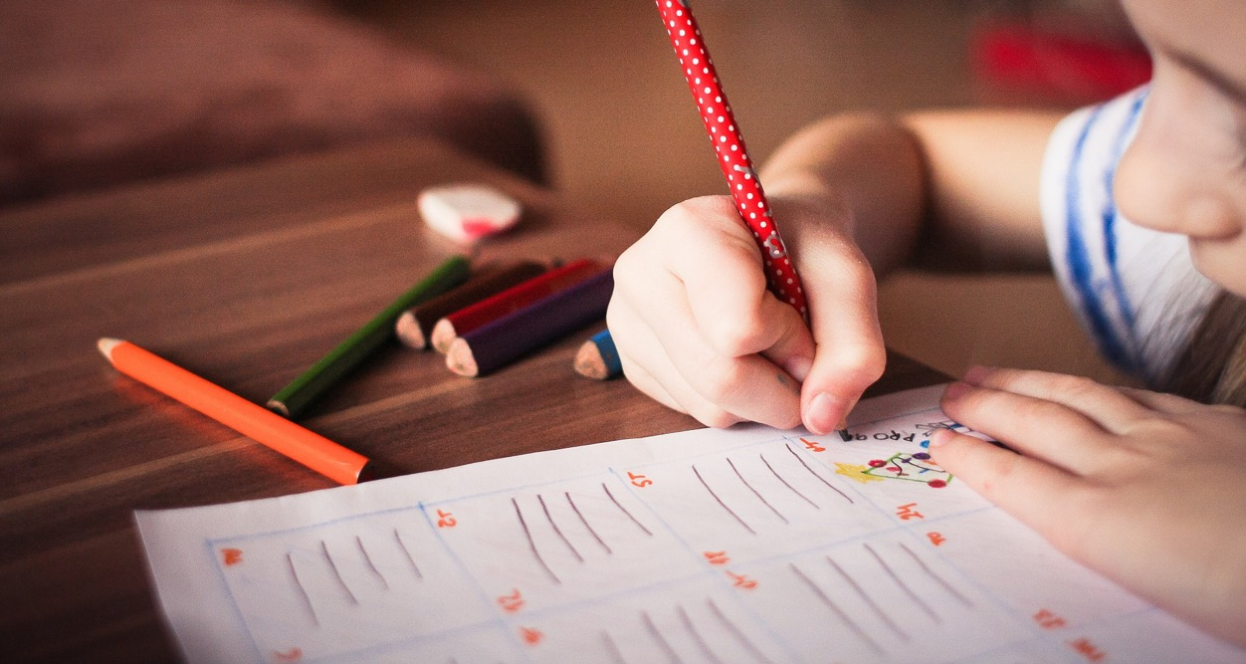
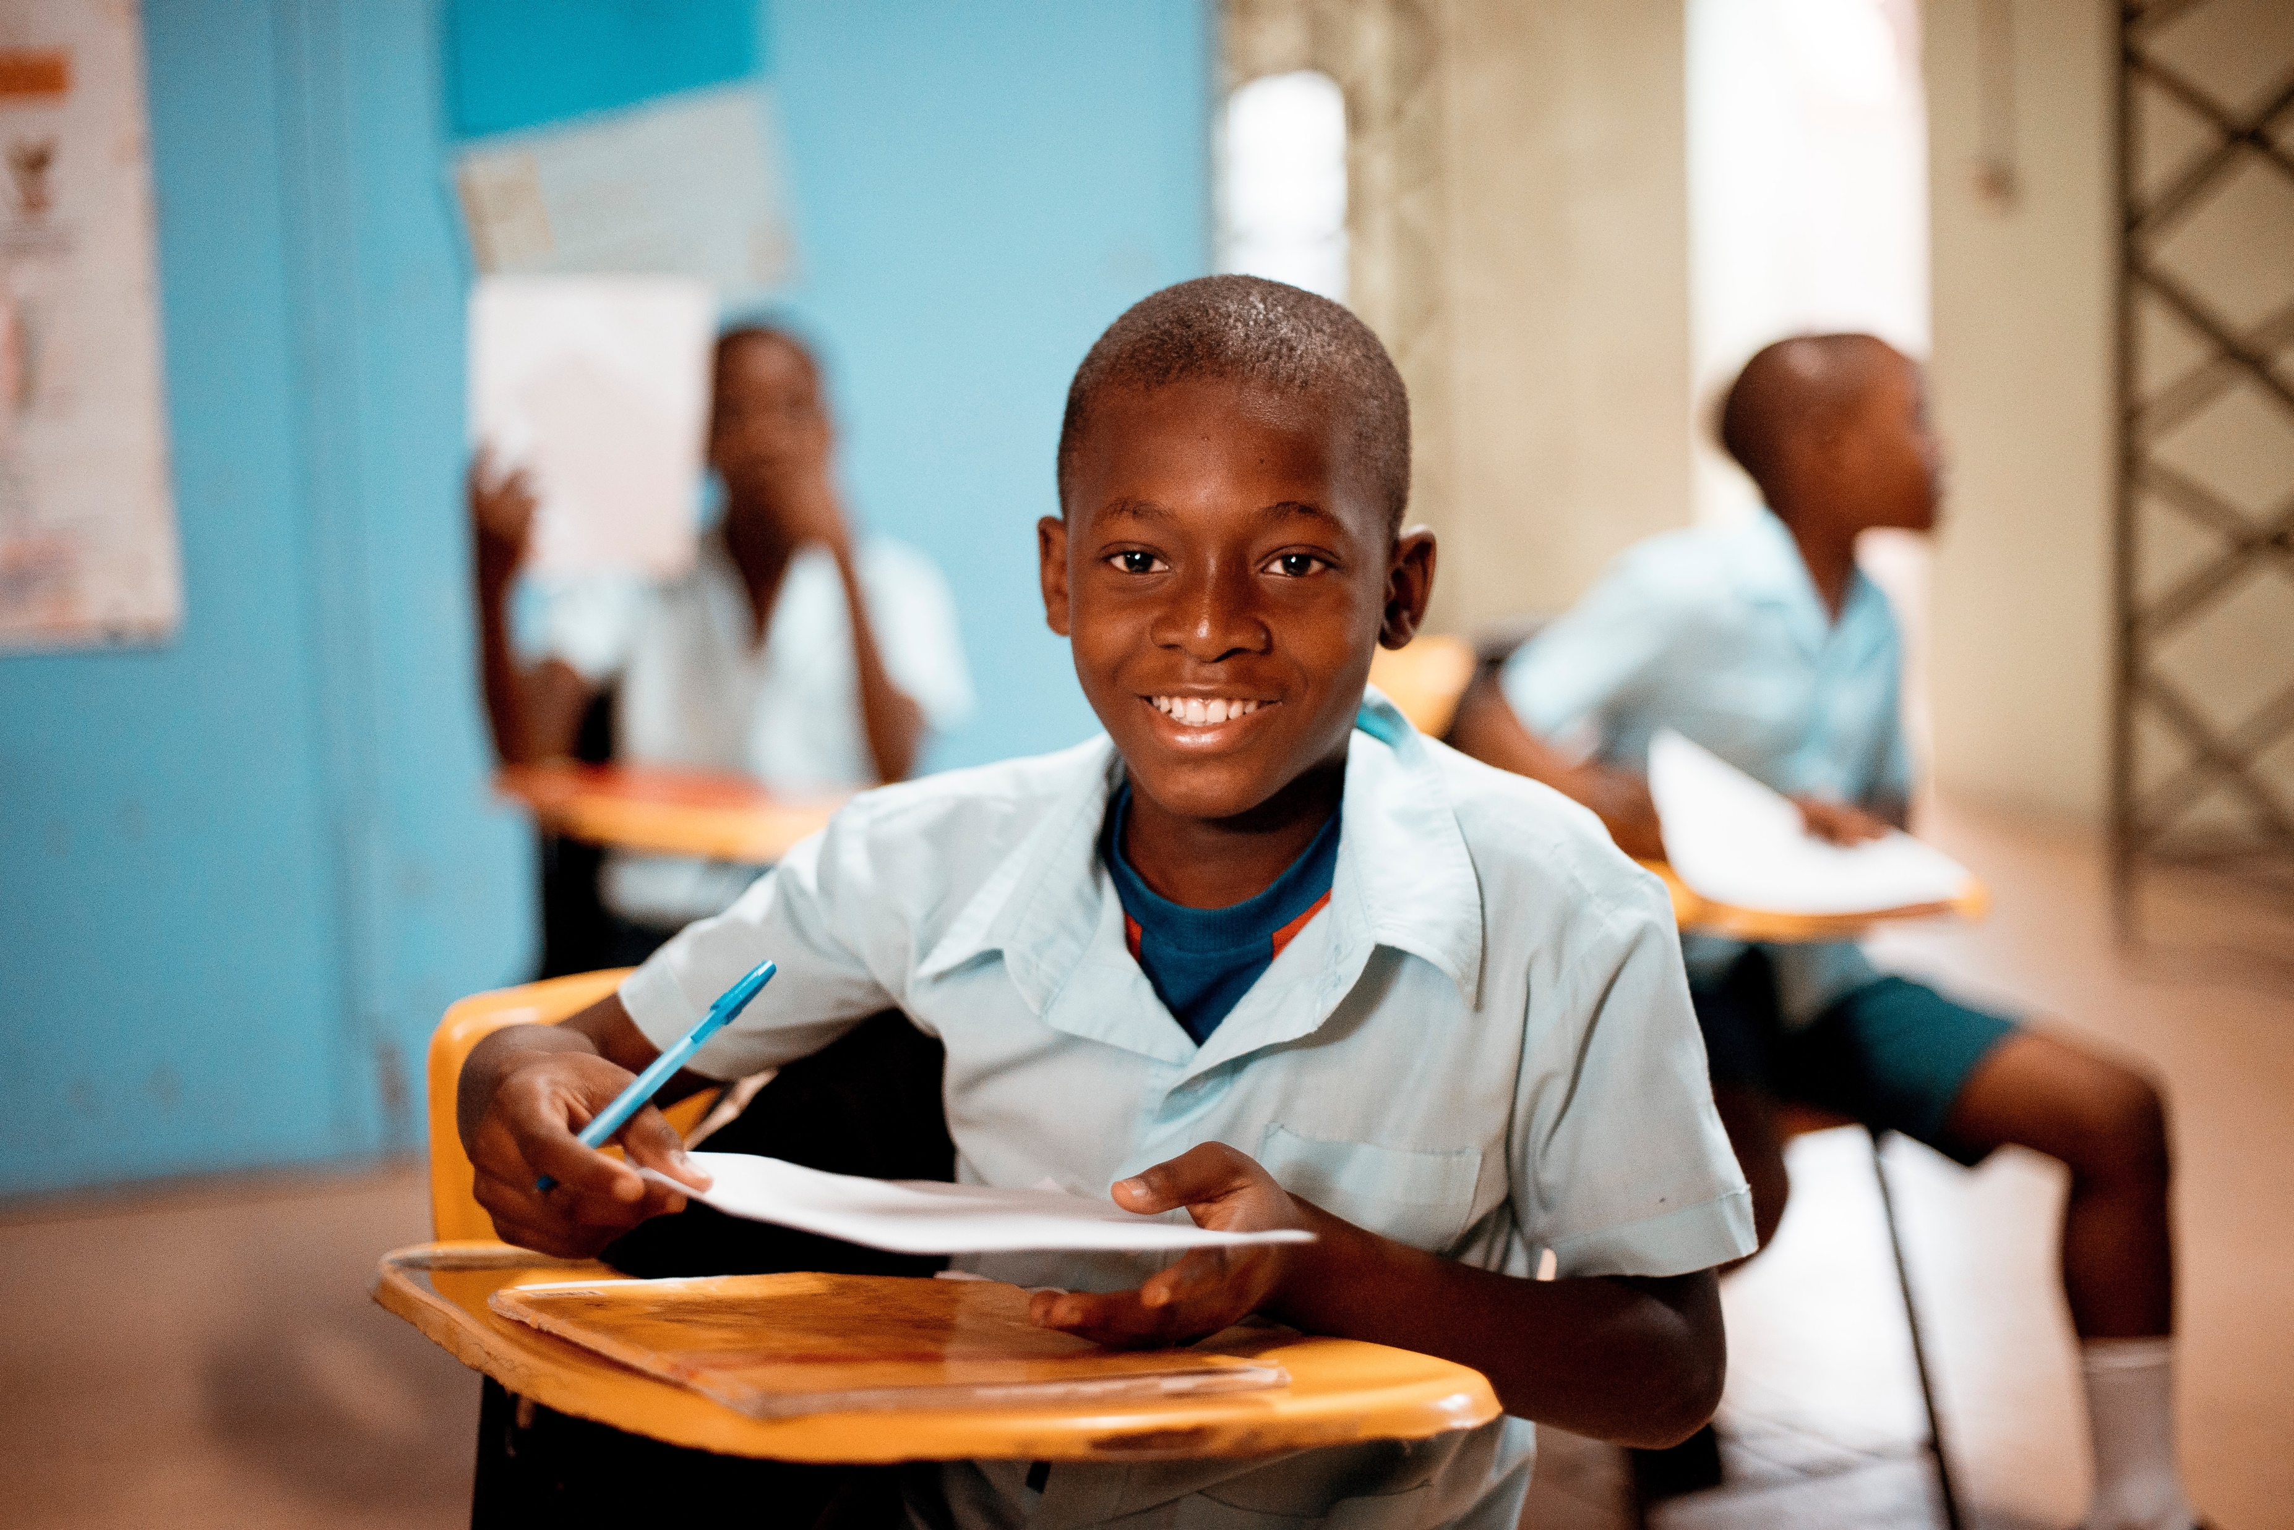
Actions Create Achievements
Actions create achievements!

Slide 8
Exploring

Slide 9
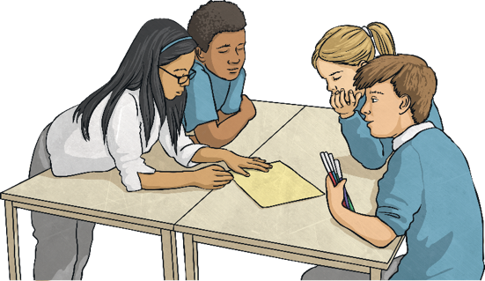
What Are My Goals?
We all have different goals. Working with your partner, read through these goals.
I would like to get better at spelling.
I would like to improve my handwriting.
I would like to get better at problem-solving.
I would like to learn more about planets.
I would like to learn how to play an instrument.
I would like to learn how to ride a bike.
I would like to get better at playing tennis.
I would like to learn how to cook.
I would like to be more patient.
I would like to keep my room tidy.
What actions might help us to achieve these goals? Share your thoughts with your partner and then with the class.

Slide 10
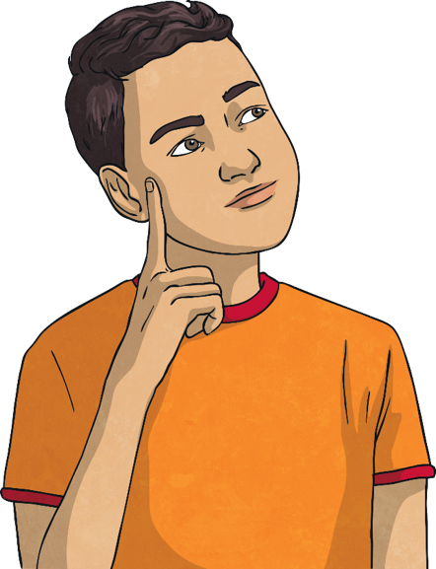
What Are My Goals?
We have thought of many possible goals people might have. Now let’s think about our own personal goals.
What is your personal goal for the year ahead?
What do you need to do to achieve this goal?
Share your thoughts with your partner and then with the class, if you feel happy to do so.
Remember, actions create achievements!

Slide 11
How Can We Achieve Our Goals?
We have to take steps, small and large, to help us achieve our goals. These steps can be easy or a little tricky. The important thing is that we keep going!
Example:
Practise scoring at school and in my garden.
Join a football club.
Keep calm and focused during matches.
I would like to get better at scoring goals in football.
Consolidating
Reflecting
Actions create achievements!

Slide 12
Consolidating

Slide 13
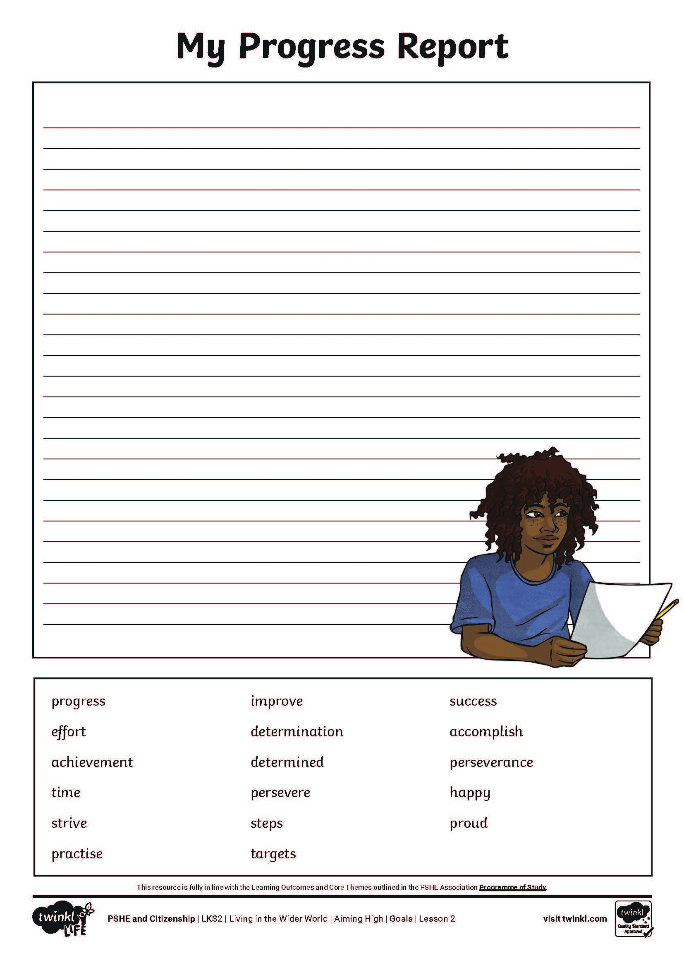
My Progress Report
Imagine you have achieved your goal. On your activity sheet, describe what your goal was, what you did to help you achieve it and how it felt once you were successful.
Word Bank
progress
effort
time
strive
practise
improve
persevere
steps
targets
success
accomplish
perseverance
happy
proud
determined
determination
achievement

Slide 14
Reflecting

Slide 15
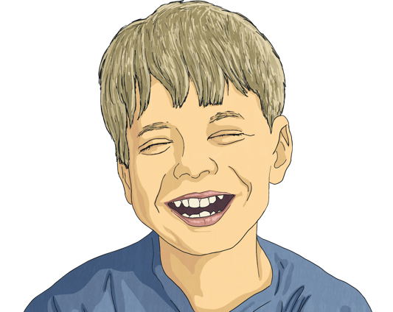
The Feeling of Success!
Now, let’s think about the goal you have set today. Imagine what it will feel like to achieve your goal. Close your eyes, if you are happy to, so you can concentrate on the experience.
Try to think about:
what you can see;
what you can hear;
how you feel;
who is with you;
what they would say.
If you are happy to do so, please share your thoughts with someone else.
We can achieve our goals by taking positive actions and when we succeed it feels good!

Slide 16
My Progress Report
Imagine you have achieved your goal. On your activity sheet, describe what your goal was, what you did to help you achieve it and how it felt once you were successful.
Word Bank
progress
effort
time
strive
practise
improve
persevere
steps
targets
success
accomplish
perseverance
happy
proud
determined
determination
achievement

