Slide 1
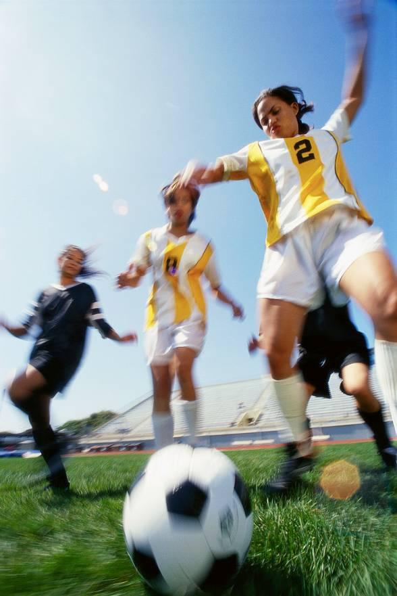
Eagles Topic 1
God loves me in
my changing
and development
^{1 A Journey in Love - Year 5}

Slide 2
Objectives
* Know that as we grow we will become
different in our…
…bodies
…feelings
…love of God
^{2 A Journey in Love - Year 5}

Slide 3
Keywords
External
Internal
Change
Develop
Ovulation
God
Sensitivity
Puberty
Presence
Celebrate
^{3 A Journey in Love - Year 5}

Slide 4
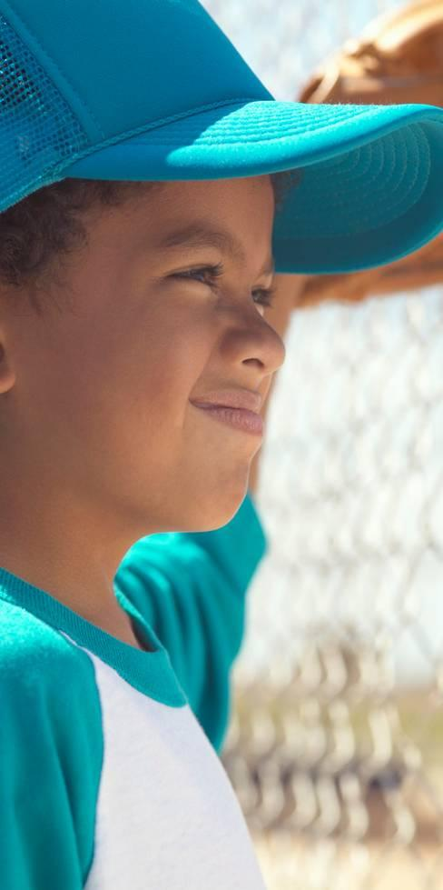
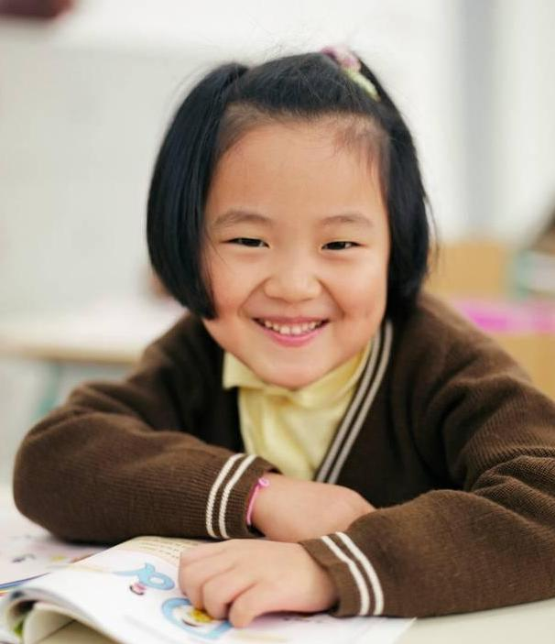
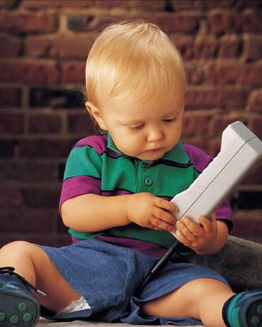
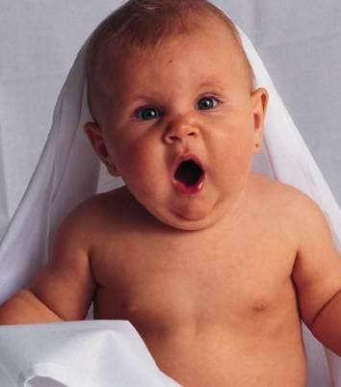
Physical and Intellectual
We have changed in many ways since
we were born.
We have grown…
^{4 A Journey in Love - Year 5}

Slide 5
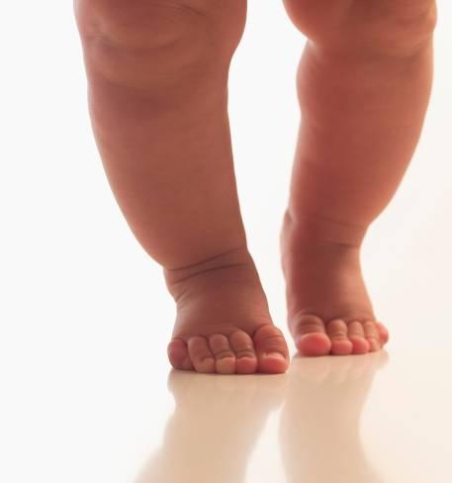
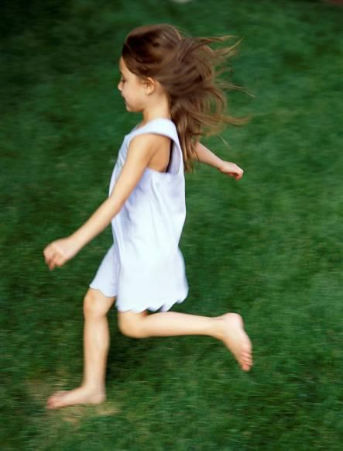
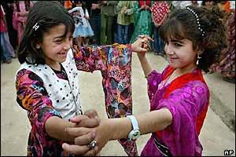
We can do more…
Run
Walk
Feed ourselves
Dance
^{5 A Journey in Love - Year 5}

Slide 6
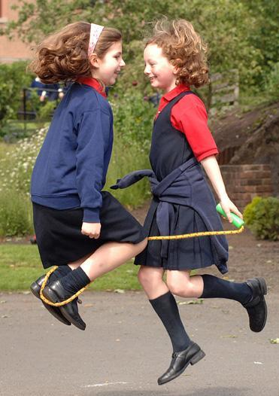
Read and write
Play
Make friends
^{6 A Journey in Love - Year 5}

Slide 7
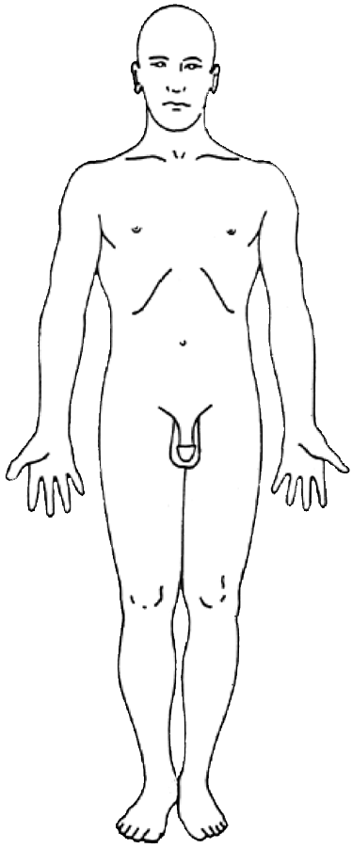
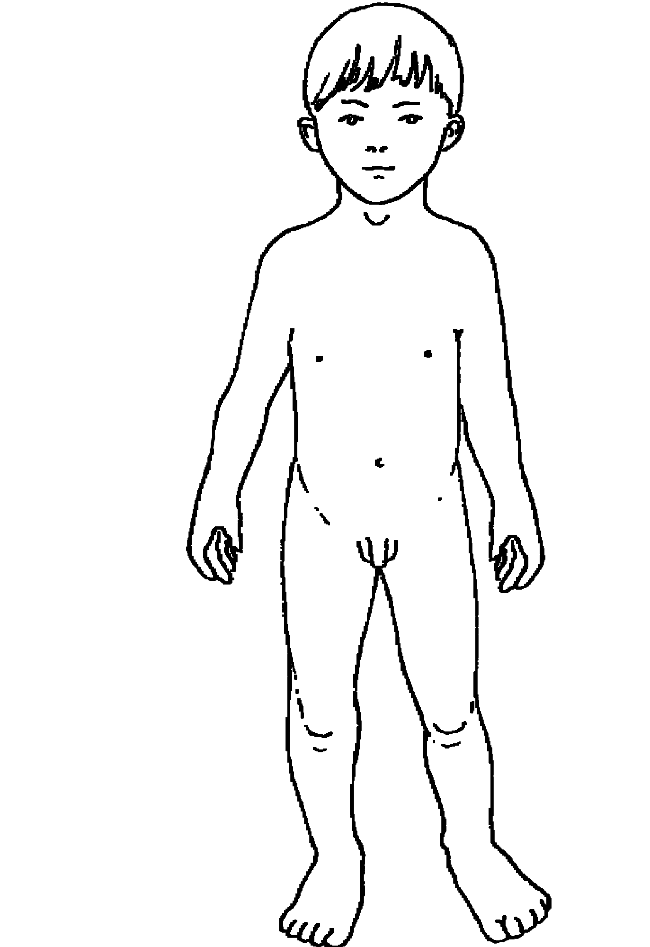
We will change more before we are grown
boy…
…to man
^{7 A Journey in Love - Year 5}

Slide 8
Physical changes in boys
Testosterone in the bloodstream triggers changes
Muscles and bones develop
Voice deepens
Waist thickens
Limbs lengthen in proportion to body
Shoulders broaden
Adam’s apple enlarges
Hair can grow on face, chest and back as well as underarms and pubic area
^{8 A Journey in Love - Year 5}

Slide 9
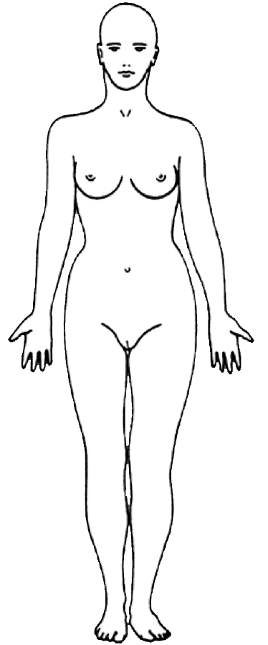
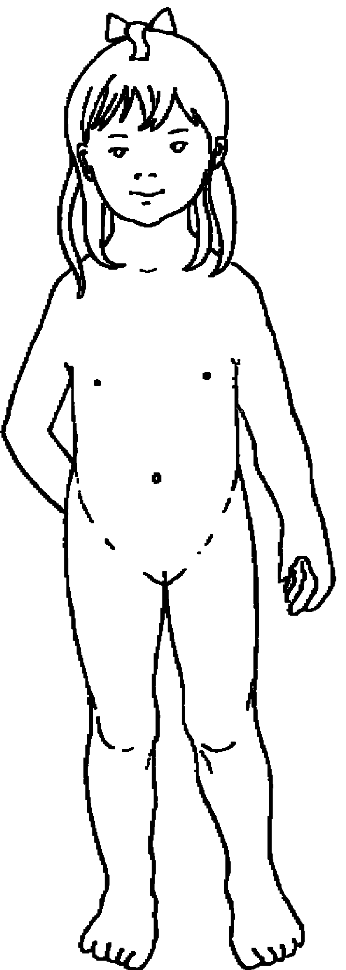
girl…
…to woman
10 A Journey in Love - Year 5

Slide 10
Physical changes in girls
Breasts develop
Hips broaden and waist slims
Ovaries produce oestrogen
Hormonal activity
Menstruation begins (about 12 months after breasts begin to develop)
Usually start to grow hair on underarm, pubic area and legs
11 A Journey in Love - Year 5

Slide 11
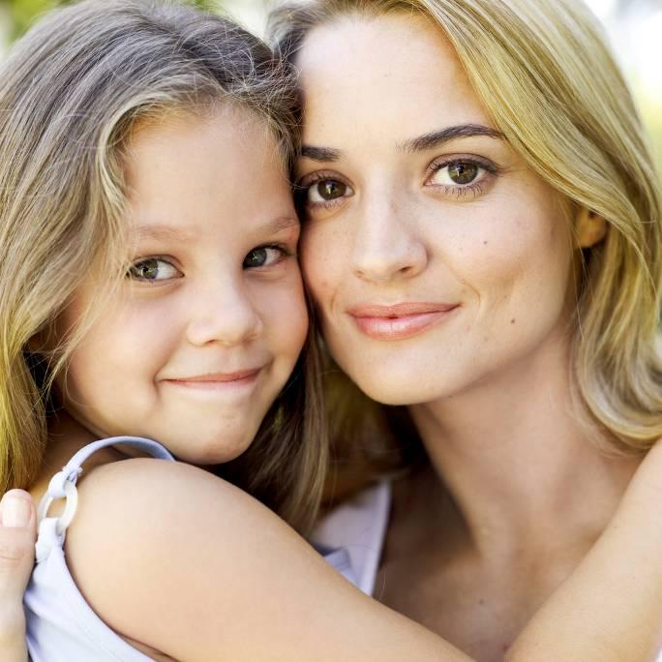
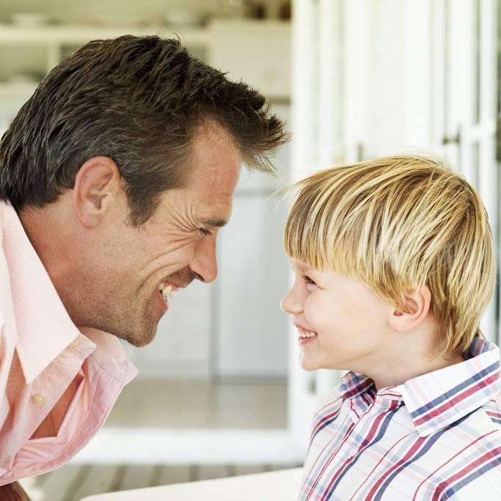
These changes are a natural part of growing up
Physical changes from child to adult mean they bring the ability and potential to become a mother or father.
15 A Journey in Love - Year 5

Slide 12
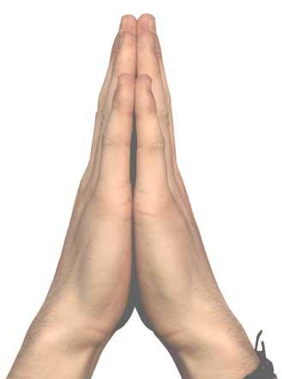
Prayer
Think about how I am growing and developing. Celebrate these changes.
Giver and protector of life,
guide me as I grow
and develop.
Amen.
^{16 A Journey in Love - Year 5}

Slide 13
Social/Emotional
As we grow up our feelings and behaviour change
Production of hormones triggers sexual desire, arousal and urges
Evolving a set of values and moral codes
Seeking independence
Risk-taking behaviour
Concern for the future
Identity formation
17 A Journey in Love - Year 5

Slide 14
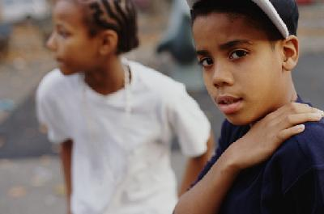
Need for privacy
Easily embarrassed
Moods swing up and down without much warning
May be divided loyalty between self, friends and parents
How can we be more sensitive to our emotional
development and other people’s?
18 A Journey in Love - Year 5

Slide 15
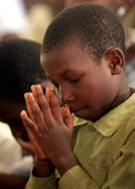
Prayer
Loving Lord,
help us to respect and understand each other better as we continue to change and grow.
Amen.
19 A Journey in Love - Year 5

Slide 16
Spiritual
To live is to change
and to be perfect
is to have changed often.
Cardinal Newman
20 A Journey in Love - Year 5

Slide 17
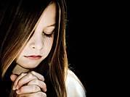
Prayer
God, grant me the serenity to accept the things I cannot change,
courage to change the things I can,
and the wisdom to know the difference.
Amen.
21 A Journey in Love - Year 5

Slide 18
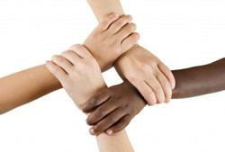
A Friendship Blessing
May you be blessed with good friends.
May you learn to be a good friend yourself.
May you be able to journey to that place in your soul where there is great love, warmth, feeling and forgiveness.
May this change you.
^{22 A Journey in Love - Year 5}
End of presentation

Slide 19
Do I know these things?
I feel good about myself and my body.
I know the language that I use to describe parts, changes and feelings in my body.
I know about the changes of puberty in girls and boys.
I recognise different types of love and who can share it i.e. parents, friends, parents love for their child.
I know that families can be different i.e. 2 dads, foster, 2 mums etc. These all provide love and nurture to children.
I know what physical contact is appropriate. I know who to tell if it is not appropriate. I know the that secrets which impact on me are not good and should be told to an adult.

Slide 20
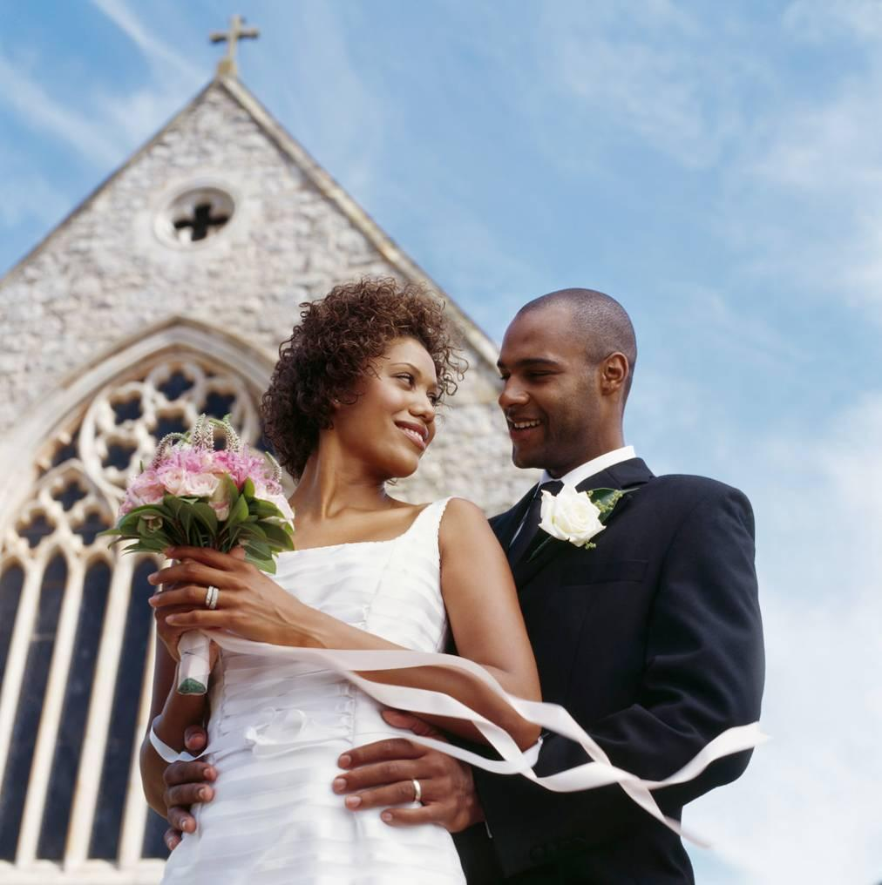
Eagles Topic 2
The wonder of
God’s love in
creating new life
^{1 A Journey in Love - Year 6}

Slide 21
Objectives
Know that we are made to love and to be loved.
Learn the proper ways in which we show our love for one another and for God.
^{2 A Journey in Love - Year 6}

Slide 22
Keywords
God
Christian
Appropriate
Dignity
Sexuality
Intercourse
Fiancé
Fallopian
Conceive
Relationship
Uterus
Cervix
Marriage
^{3 A Journey in Love - Year 6}

Slide 23
The circle of love and life
Marriage
‘Make love’
Choosing
a fiancé(e)
New life
and love
LOVE CIRCLE
First signs
of romantic
love
Self-centred
love
Give and take
of love
‘click’
^{4 A Journey in Love - Year 6}

Slide 24
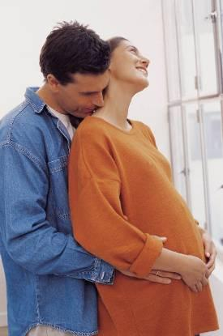
Love proclaims its presence by signs and the deepest, most intimate and most wonderful of human signs of love is the gift of self in sexual intercourse.
But the natural outcome (all conditions being fulfilled) of sexual intercourse is the conception of new life.
As co-creators the parents bestow life on a new human being.
^{5 A Journey in Love - Year 6}

Slide 25
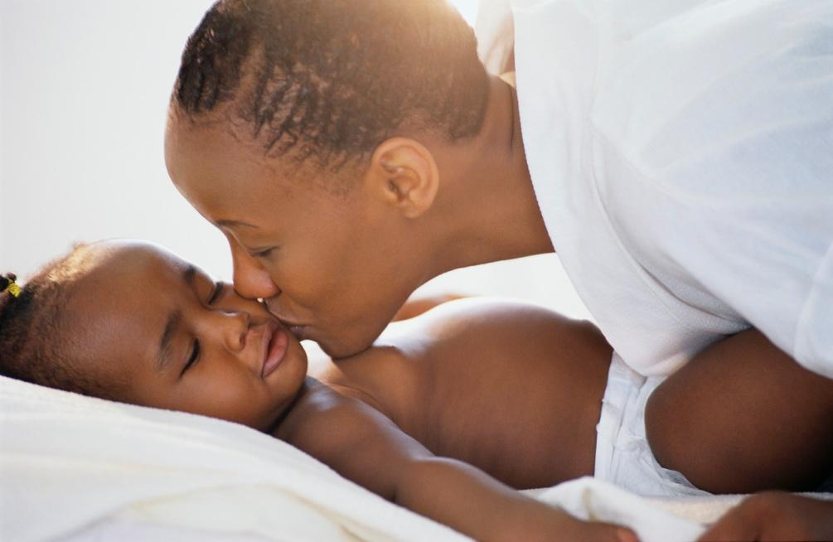
That human being needs love and will, in time,
express love:
will make love,
and a new
human being
will join us!
To remove ‘life’, ‘love’ or ‘sex’ from the circle destroys God’s intended balance and produces severe problems for society.
^{6 A Journey in Love - Year 6}

Slide 26
We are not some casual and meaningless product of evolution. Each of us is the result of a thought of God.
Benedict XVI
^{7 A Journey in Love - Year 6}

Slide 27
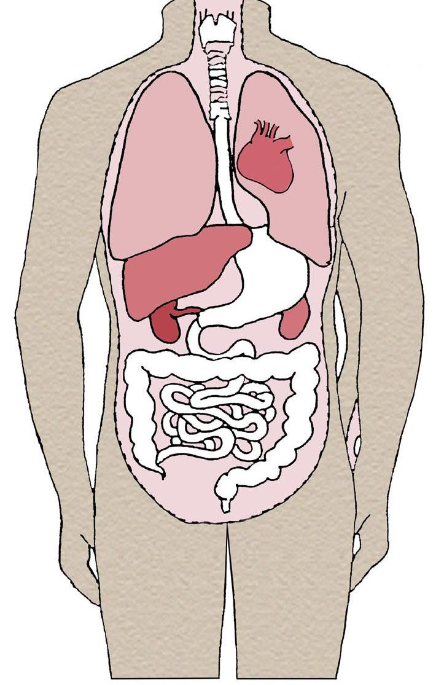
PHYSICAL
In all of us
Voice box
Heart
Lungs
Liver
Stomach
Kidneys
Large intestine
Small intestine
^{8 A Journey in Love - Year 6}

Slide 28
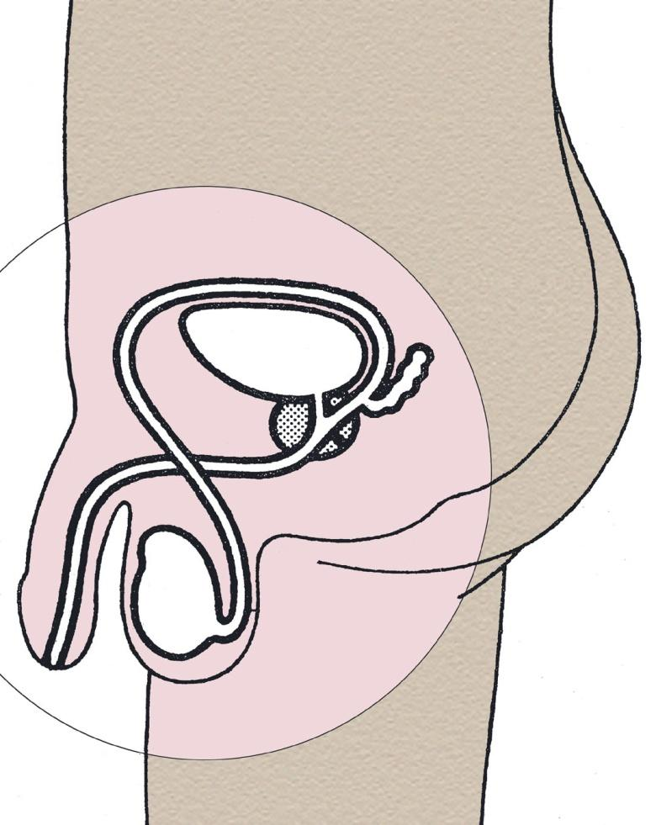
In boys
Sperm duct
Bladder
Prostate gland
Penis
Testicle
Scrotum
^{9 A Journey in Love - Year 6}

Slide 29
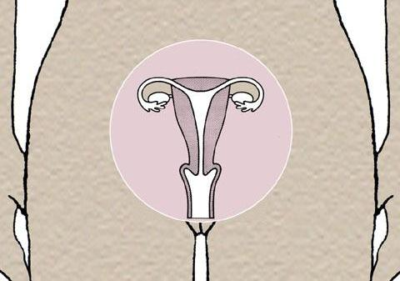
In girls
Fallopian tube
Ovary
Uterus (womb)
Cervix
Vagina
10 A Journey in Love - Year 6

Slide 30
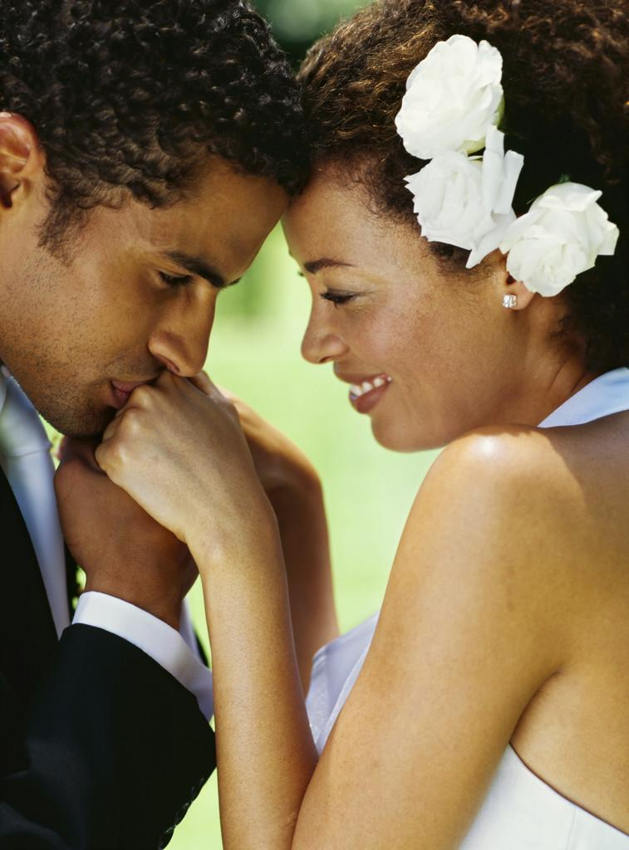
Sexual intercourse between two people is a joyful expression of their love for each other, it is important that you truly love someone.
It is an act of self-giving
made by two people
who want to give
everything of themselves
to the person they love
and respect.
11 A Journey in Love - Year 6

Slide 31
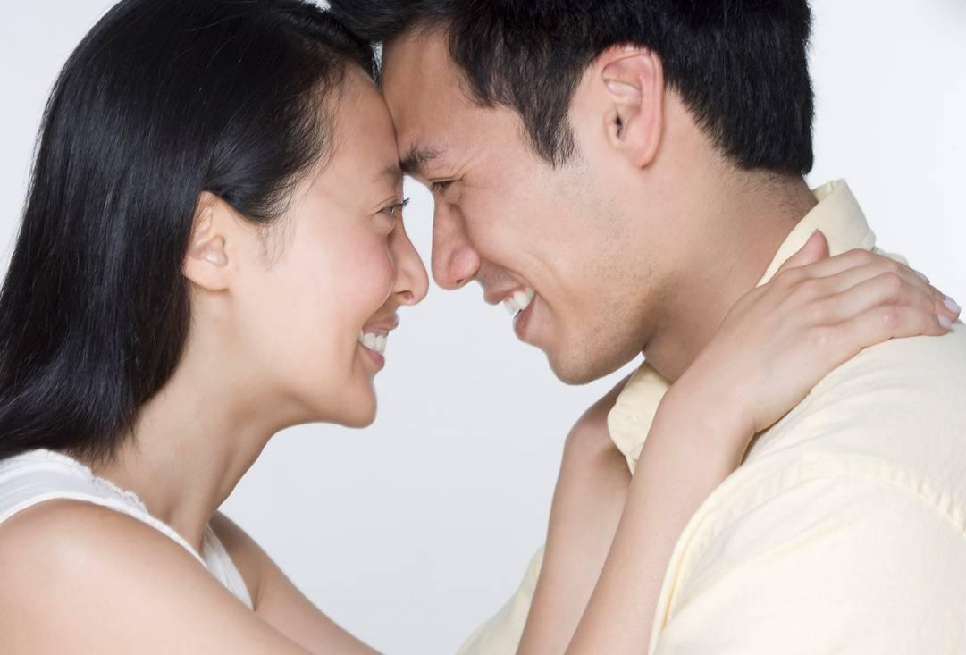
Prayer
For the beauty of the gift of love,
we thank you Lord.
18 A Journey in Love - Year 6

Slide 32
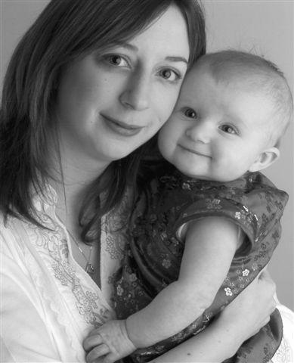
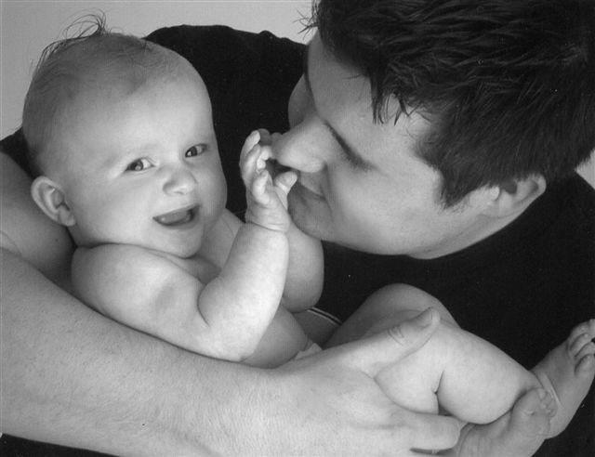
For mothers
and fathers,
we thank you Lord.
19 A Journey in Love - Year 6

Slide 33
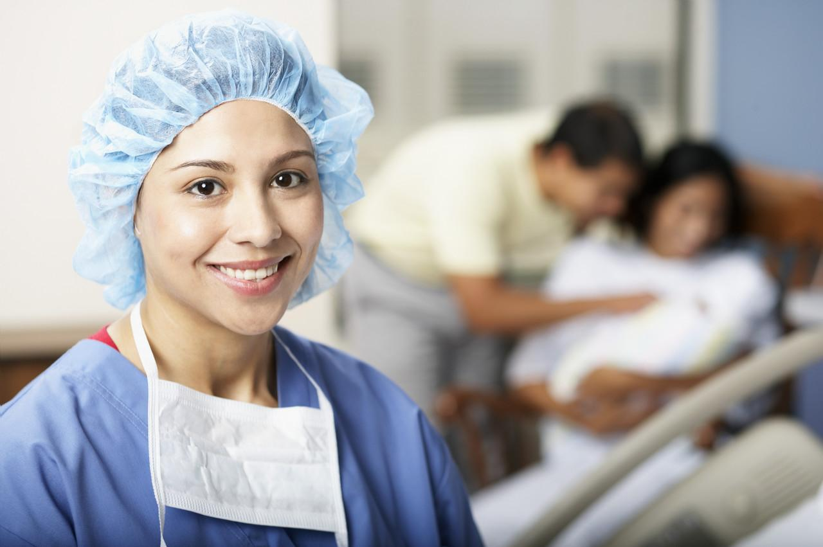
For doctors and nurses,
we thank you Lord.
20 A Journey in Love - Year 6

Slide 34
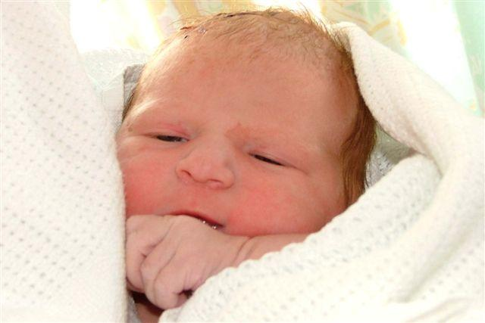
For all babies and the miracle of new life,
we thank you Lord.
Amen.
21 A Journey in Love - Year 6

Slide 35
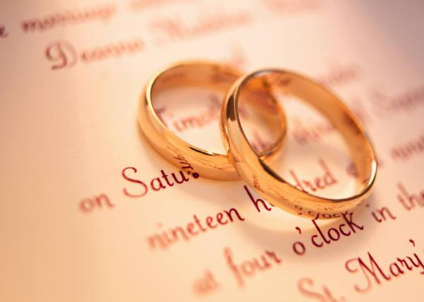
Emotional
Relationships develop and eventually you may be able to use the word ‘love’.
Real love reveals itself in complete commitment.
22 A Journey in Love - Year 6

Slide 36
Love is caring and sharing with another
person.
We can love many people. However,
two people can be drawn to a love that
at its deeper levels becomes more and
more exclusive.
Intimacies are shared with the loved
one and not with others.
23 A Journey in Love - Year 6

Slide 37
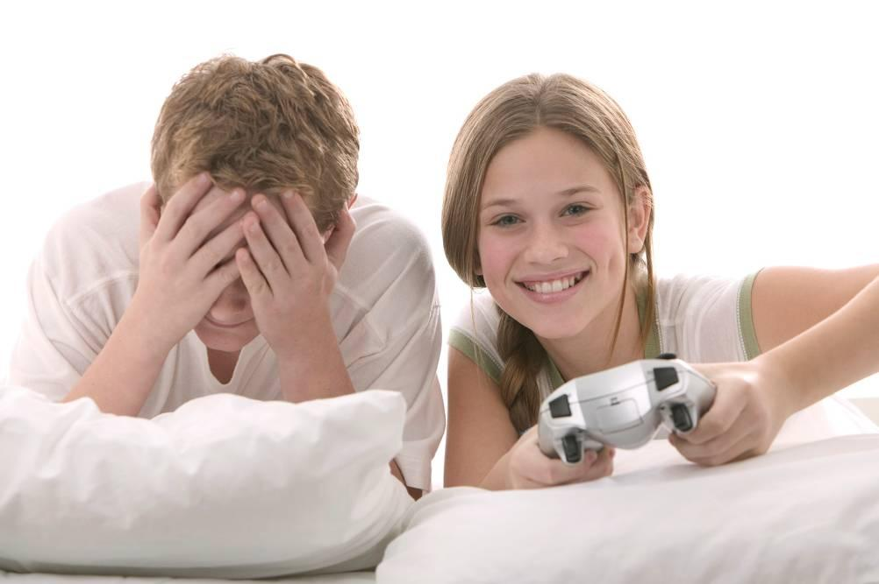
Love needs more than a single dimension, such as…
a common interest, sexual attraction,
or similar ideas.
A basis for love needs to grow and develop, so that the two people are more and more generous in their
shared love.
24 A Journey in Love - Year 6

Slide 38
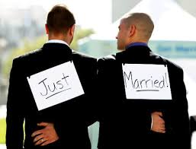
The relationship needs time to develop and mature…
…ultimately people may decide to marry
25 A Journey in Love - Year 6

Slide 39
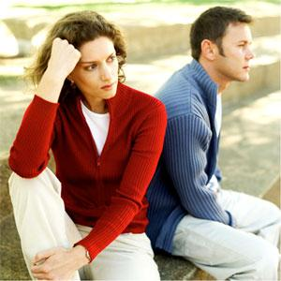
Without love, relationships will fail because living with another human being means that they will find out exactly what you are like.
What matters is what kind
of person you are and what
qualities you bring to
the relationship.
26 A Journey in Love - Year 6

Slide 40
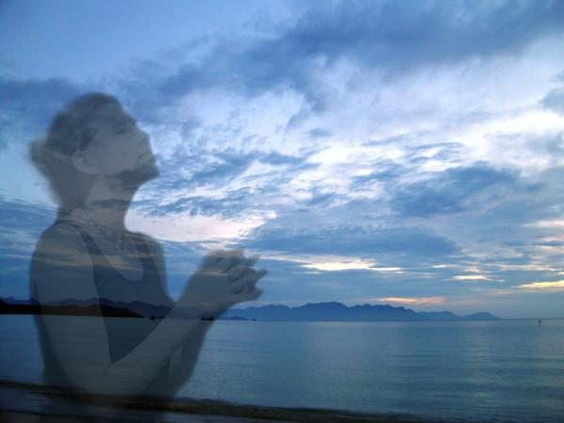
Prayer
Source of Love,
help us to love and respect each other
and enjoy the beauty of happy friendships.
Amen.
27 A Journey in Love - Year 6

Slide 41
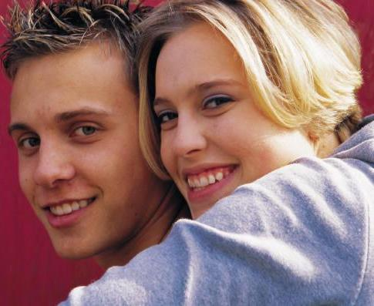
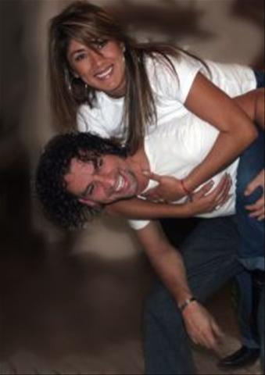
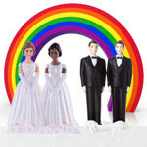
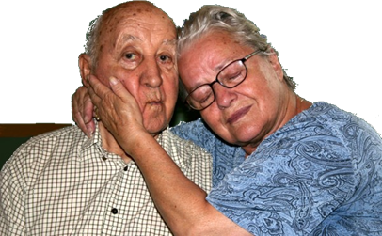
Social
What signs of love do you see in people around you?
28 A Journey in Love - Year 6

Slide 42
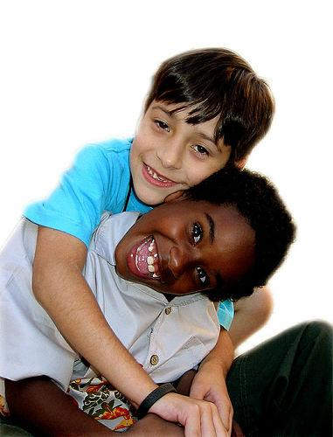
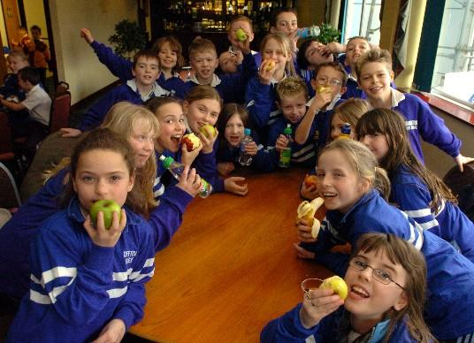
What different kinds of friends
can you have?
Best friend
School friends
30 A Journey in Love - Year 6

Slide 43
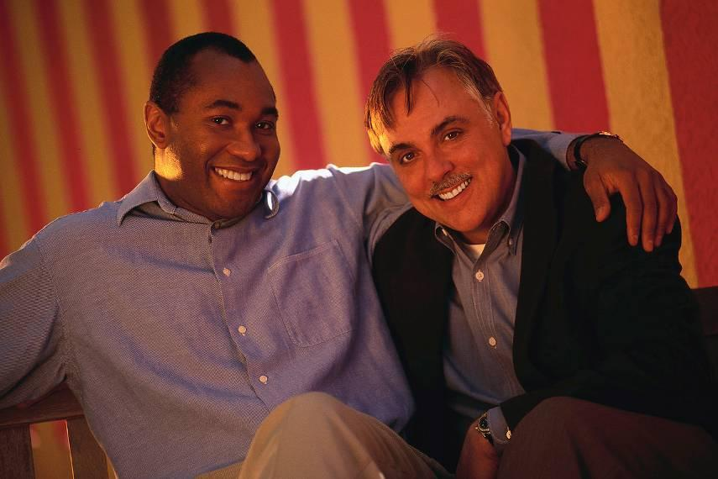
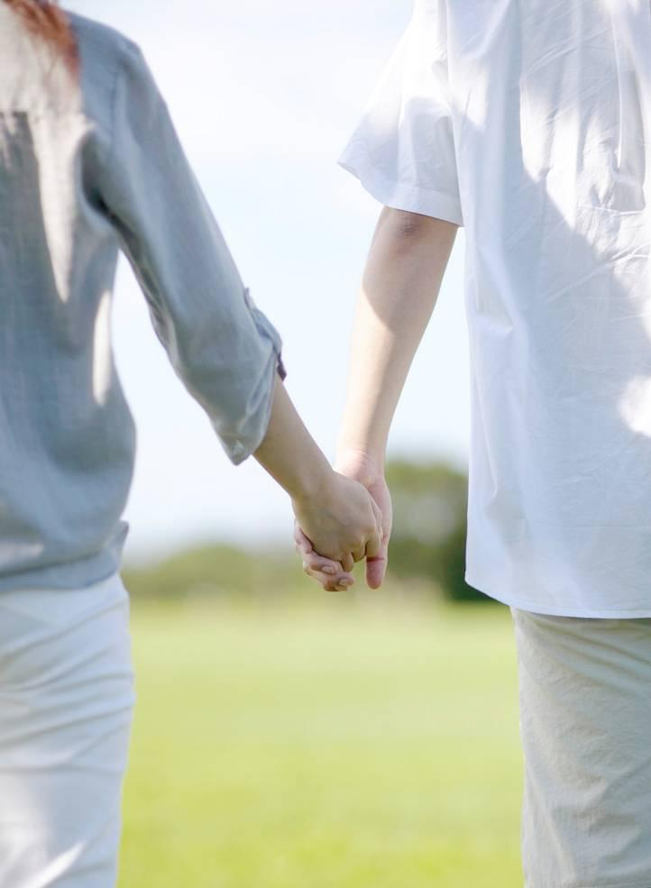
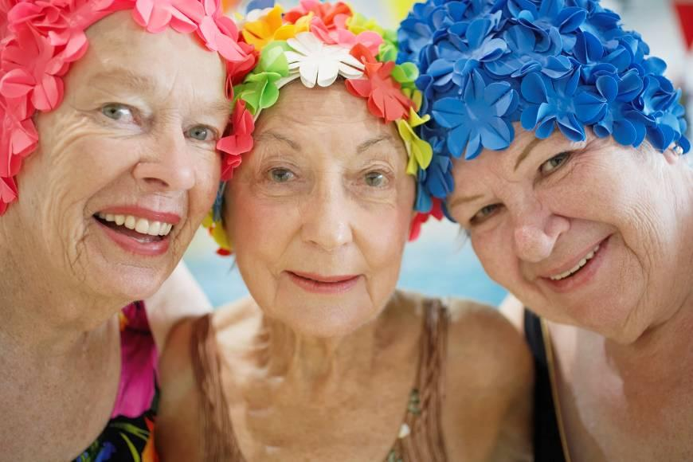
Boyfriend/girlfriend
Lifelong friends
31 A Journey in Love - Year 6

Slide 44
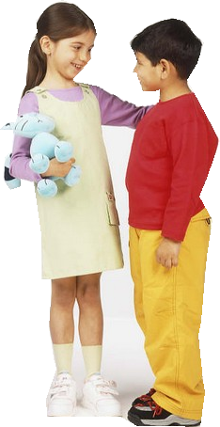
Prayer
Jesus, our friend and brother,
embrace in your love all our friends.
Amen.
32 A Journey in Love - Year 6

Slide 45
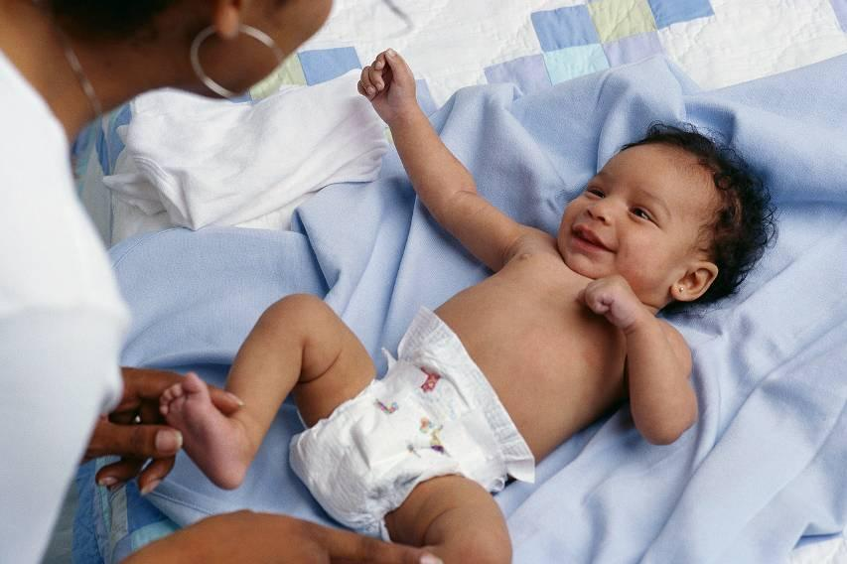
Spiritual
God makes new life begin
through the love that parents have
for each other.
33 A Journey in Love - Year 6

Slide 46
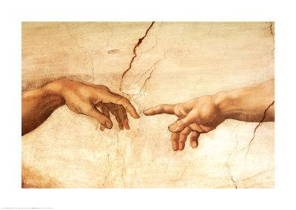
We celebrate God’s creative love in creating us as his children.
34 A Journey in Love - Year 6

Slide 47
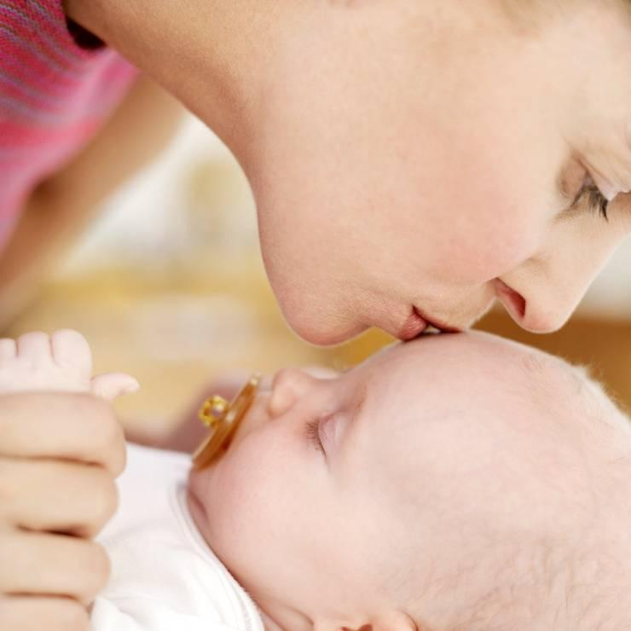
We recognise that we grow as human beings as we give and receive love.
35 A Journey in Love - Year 6

Slide 48
Marriage is living out love
36 A Journey in Love - Year 6

Slide 49
As Christians we appreciate the sheer wonder of the sexual act. God created the incredible natural process by which Man and Woman bring new life into the world.
The Church celebrates this in the Sacrament of Marriage.
^{37 A Journey in Love - Year 6}

Slide 50
“Marriage based on
exclusive and
definitive love
becomes the icon
of the relationship
between God and
his people and vice
versa. God’s way of
loving becomes the
measure of human love.”
Deus Caritas Est 11
^{38 A Journey in Love - Year 6}

Slide 51
Prayer
We praise and thank you,
Lord,for gifts of life and love.
Help us to use
these wisely as
we continue to
journey in love.
Amen.
39 A Journey in Love - Year 6

Slide 52
Journey of Life
For each of us, life is like
a journey.
Birth is the beginning of
this journey,
And death is not the end;
but the destination.
40 A Journey in Love - Year 6

Slide 53
It is a journey that takes us
From youth to age,
From innocence to awareness,
From ignorance to knowledge,
From foolishness to wisdom,
From weakness
to strength
and often back again.
41 A Journey in Love - Year 6

Slide 54
From offence to forgiveness,
From pain to compassion,
From fear to faith,
From defeat to victory
and from victory to defeat.
42 A Journey in Love - Year 6

Slide 55
Until looking backward or ahead,
we see that victory does not lie
at some high point along the way,
but in having made
the journey,
stage by stage.
End of presentation
Adapted from an old Hebrew prayer.
43 A Journey in Love - Year 6

Slide 56
Do I know these things?
I know about human reproduction including conception.
I know about the changes of puberty in girls and boys and can look after my body (washing etc).
I know my body is special and know that have to make good choices when making physical contact with others. I know how to stay safe during contact with others.
I know that a committed relationship is important before babies. I need to be in a loving relationship, financially stable, a good education to have a good career, responsible etc..
I know that families can be different i.e. 2 dads, foster, 2 mums etc. These all provide loving and stable relations that can nurture children.
I know relationships can change over time.
I know to ask for help if I feel peer pressure, anxiety or uncomfortable feelings.

Slide 57
Being a good friend
I know how to tell my friend to stop if they are doing something I don’t like.
I know not to tease or call my friends names.
I know to use kind hands and feet.
I know how to stop bullying. TASK!
Tell them you don’t like it.
Ask them to stop.
Speak to an adult at school and home.
Keep an eye on it!

Slide 58
What is bullying? Someone who does something continuous.
Have you told them to stop?
Have you told them you don’t like it?
Do you continue to play with them?
Have you told an adult at school and home?
What did they do to upset you? Put it in to context.

Slide 59
Staying safe
I know how to stay safe.
I do not talk to strangers.
If someone gets too close to me or touches me in an inappropriate place, I tell them to stop and tell an adult I trust.
I know I should not talk to anyone online.
I know how to get help if I need it.

Slide 60
Keeping my mind & body healthy
I use positive words
I talk through my emotions- if you are sad, tell someone why. If I am sad or lonely, I tell someone, but I try and think of ways to make it better too.
I play outside to get exercise each day.
I read each day and I complete my homework.
I don’t eat too many things that are unhealthy.
I know if I am not well, I can tell an adult.
I need to wash my hands before eating.
I need to wash my body daily.
I know that smoking and drugs are harmful to my body.
I know when it is sunny I need a sun hat and sun cream on.
I know to drink lots of water.
I know to reduce screen time down to a maximum of 1 hour a day.

Slide 61
Helping others
I know that if someone needs help, I can ask someone around or ring for the emergency services.
I know how to listen and not judge others.
I know if I am low, I need to speak to someone.

Slide 62
Other learning
Staying safe on the internet.
Boys and girls separate puberty talk
Boys and girls separate sex talk

