Slide 1
PSHE and Citizenship
Health and Wellbeing | It’s My Body
PSHE and Citizenship | LKS2 | Health and Wellbeing | It’s My Body | Drugs: Healing or Harmful? | Lesson 5

Slide 3
Aim
I know how to take medicine safely and keep safe around drugs.
Success Criteria
I know how to identify risks in familiar situations.
I know what is safe to eat or use and what is not.
I know where I can find help in a risky or dangerous situation.
This resource is fully in line with the Learning Outcomes and Core Themes outlined in the PSHE Association’s Programme of Study.

Slide 4
The Big Questions

Slide 5
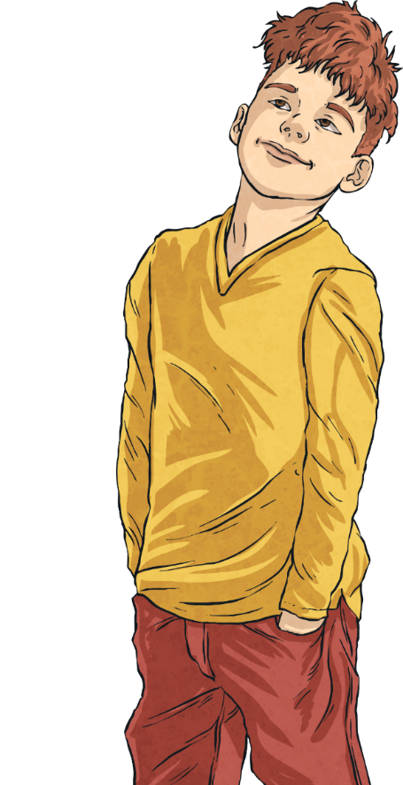
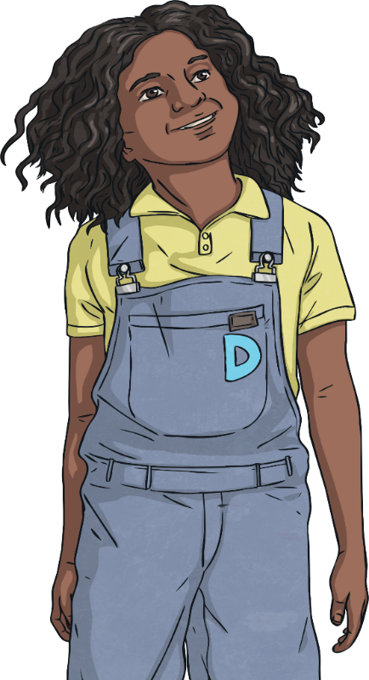
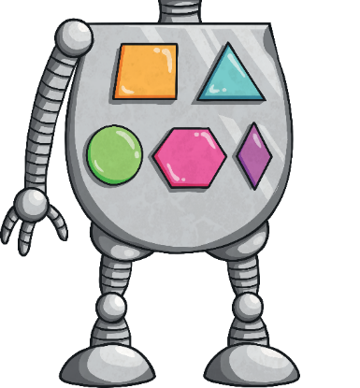
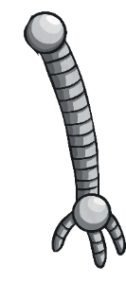
What are drugs?
How can I stay safe around drugs?

Slide 6
Reconnecting

Slide 7
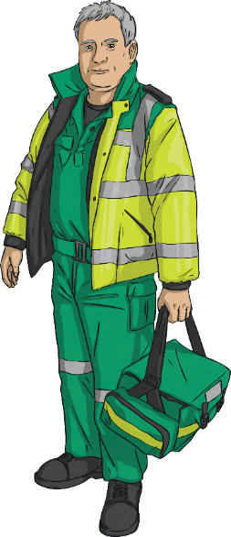
Is This a Drug?
On the next slide you will see lots of different items. As a class, decide if you think the item is a drug or not.
This lesson is all about drugs.
All drugs can have side effects so it’s important to use them carefully.
Drugs can cause damage if they are not taken sensibly.
Drugs can help us to heal when we are ill, whether it’s antibiotics for an infection or pain relief when we are sore.

Slide 8
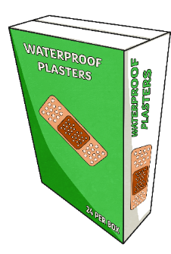
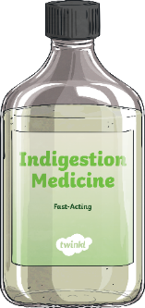
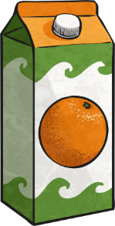
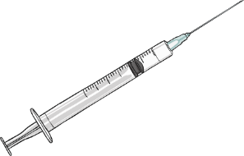
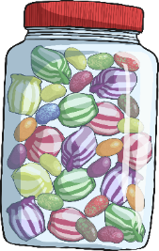
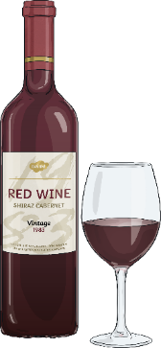
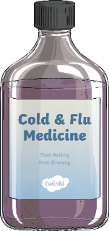
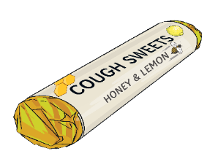
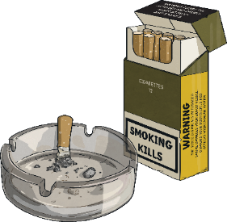
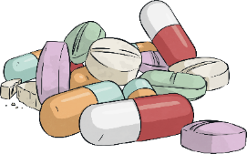
Is This a Drug?
Drug
Not a Drug

Slide 9
Is This a Drug?
Drug
Not a Drug
Drug
Not a Drug
Drug
Not a Drug
Is this what you expected?

Slide 10
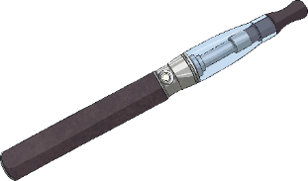
Is This a Drug?
Some of these drugs are legal but they are restricted.
That means you have to be a certain age to buy or consume them.
Alcohol is a legal, restricted drug.
Do you know the legal age to buy and smoke cigarettes and e-cigarettes in the UK?
You have to be 18 - an adult - to smoke or drink alcohol in the UK. Why do you think this is?
Cigarettes contain nicotine, which is in tobacco. This too is a legal, restricted drug.
Do you know the legal age to buy and drink alcoholic drinks in the UK?

Slide 11
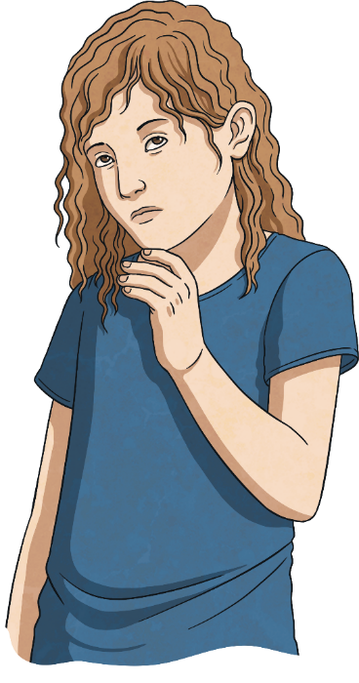
Is This a Drug?
A drug is something that causes a change in us once inside our bodies. Alcohol and nicotine are types of drugs that can be harmful to our bodies.
Alcohol relaxes people but it also slows down the brain and reactions.
Smoking cigarettes can make people feel dizzy and sick. Some smokers develop a cough.
Do you know any ways in which tobacco or alcohol can harm the body?
It is very dangerous (and illegal) to drive when you have alcohol in your body.
Cigarettes can turn smokers’ fingers and teeth yellow and give them bad breath.
Drinking a lot of alcohol can make people sick and give them headaches.
If a person smokes for a long time, it increases the risk of developing serious diseases, such as lung cancer and heart disease.
Some people who drink a lot for a long time may damage their liver or get blood poisoning.
These adults are enjoying a glass of wine with their meal.
Some people like the way it tastes or the way it makes them feel.
So, why do people choose to drink alcohol or smoke cigarettes?

Slide 12
Exploring

Slide 13
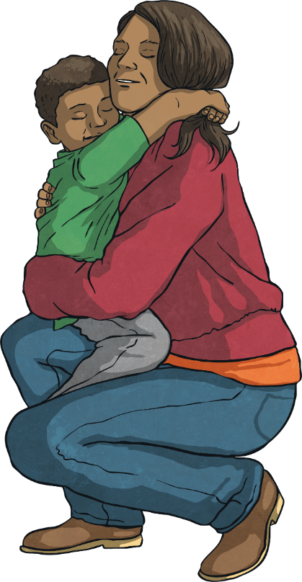
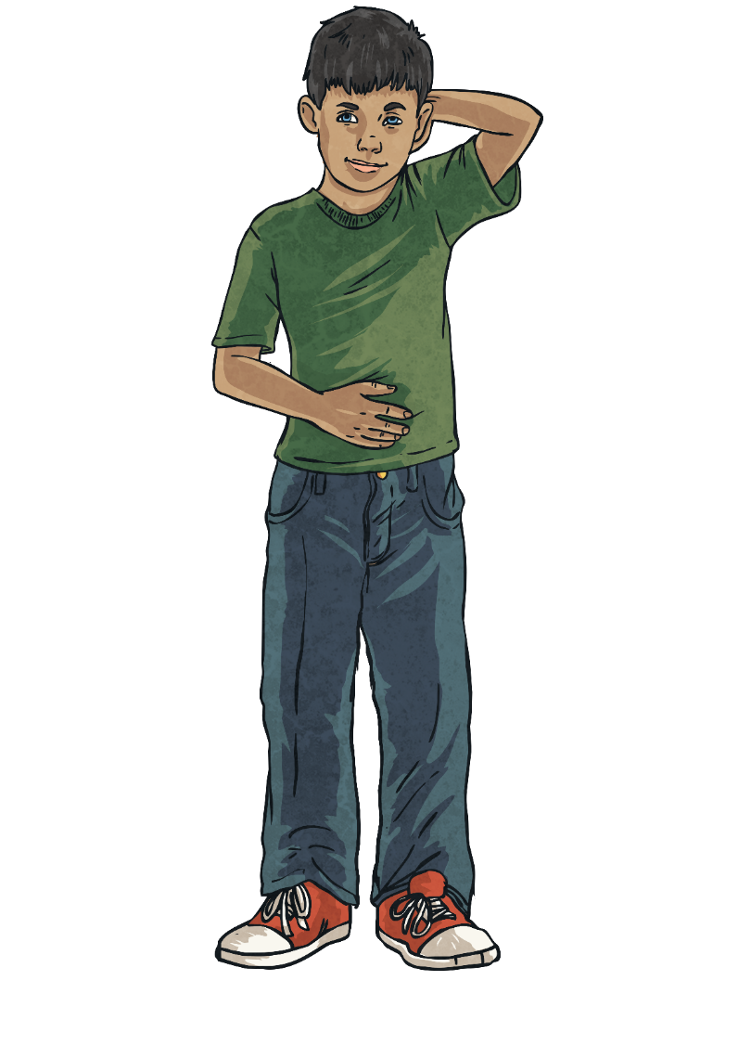
Does It Heal?
?
?
Drugs can be things that help us get better. They are sometimes prescribed by a doctor and have something in them that is not helpful if we are otherwise healthy.
Most drugs and medicines are both healthy and dangerous – it depends who you are, how you take them and what health issues you have. It is important to take medicines carefully.
?
?
?

Slide 14
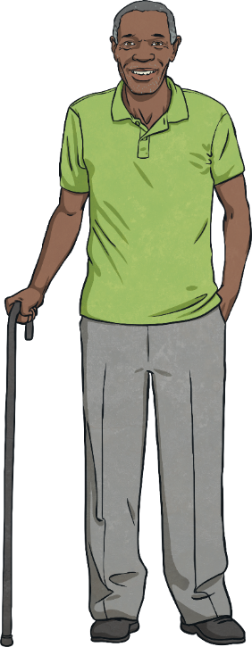
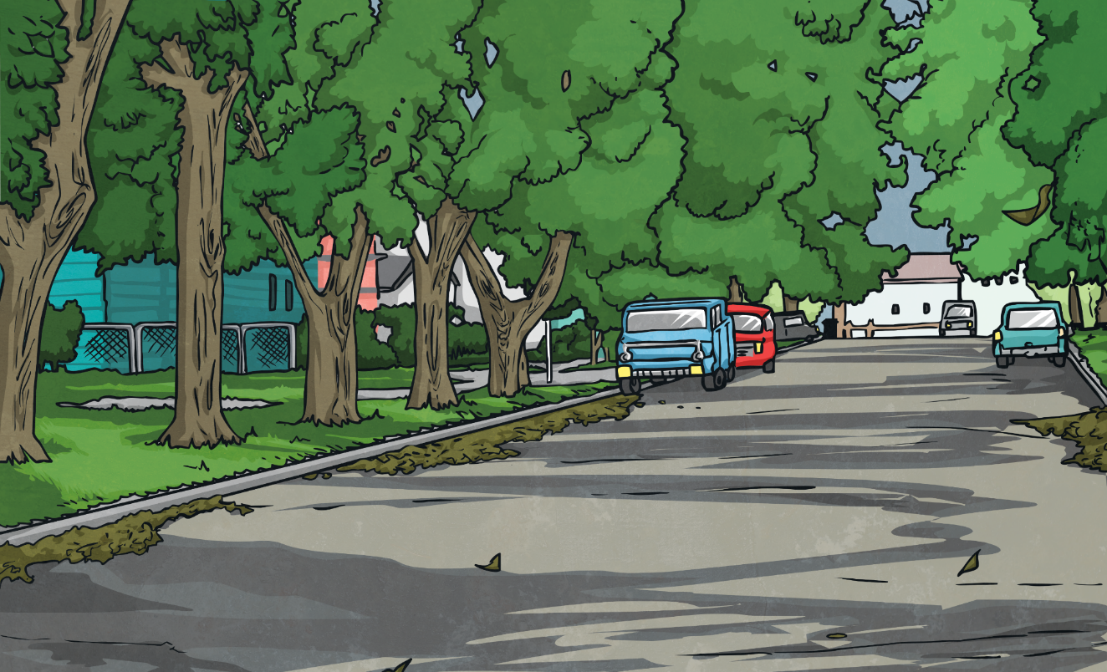
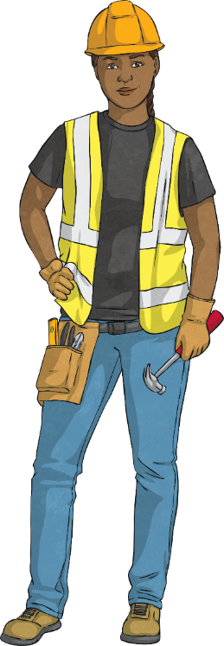
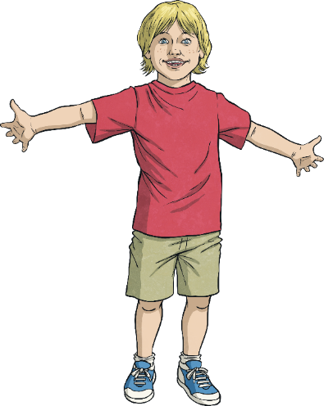
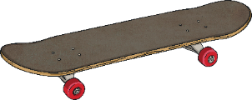
Does It Heal?
Medicine that helps one person might be very very dangerous for another person. When we are ill, our bodies have particular needs. That’s why medicine works.
Can I take someone else’s medicine?

Slide 15
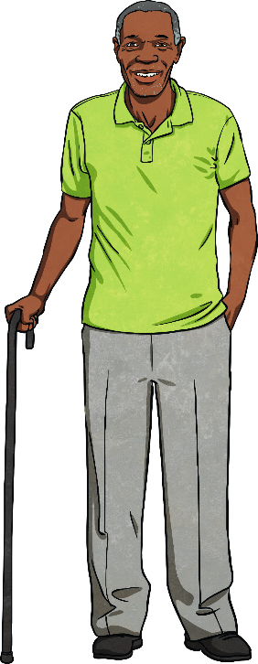
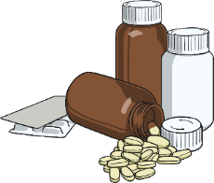
Does It Heal?
If you have a heart problem, you might take tablets for your heart. If you take someone else’s heart tablets when you don’t need them, you might end up in hospital.

Slide 16
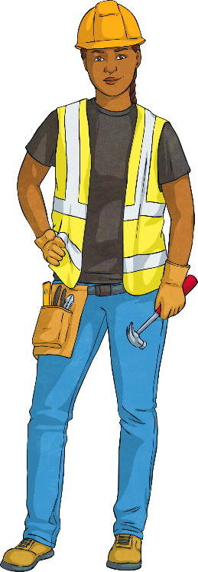
Does It Heal?
It’s really important that you never take medicine that is not prescribed for you.

Slide 17
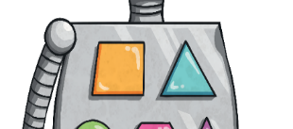
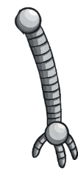
Does It Heal?
There are some drugs that adults might choose to have because they like them.
What about smoking, drinking coffee or drinking alcohol?

Slide 18
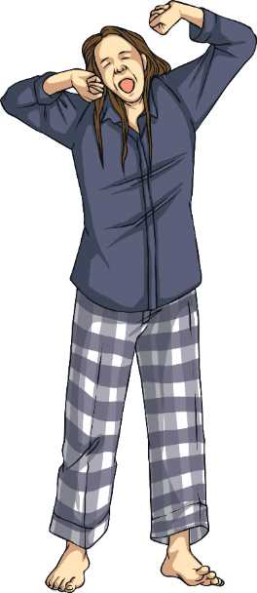
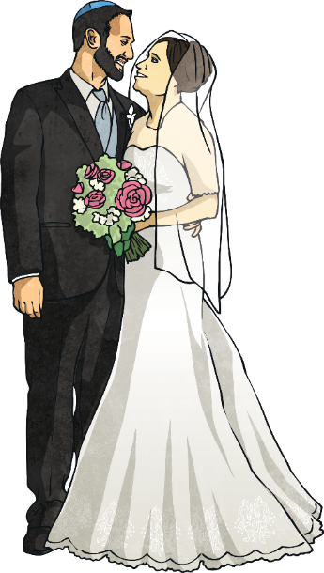
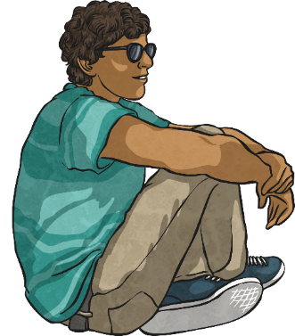
Does It Heal?
These things have something in them that changes the way we feel. They are like drugs but they do not need a prescription – you can buy them from the shops.
Even though these drugs are legal and adults can choose to have them, they still need to be careful about how they use them.

Slide 19
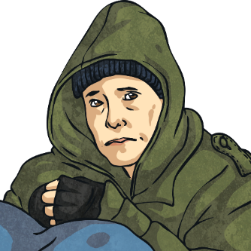
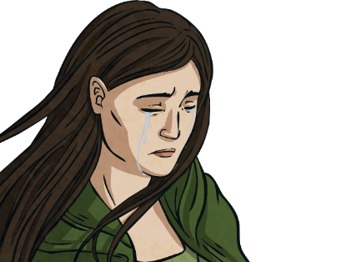
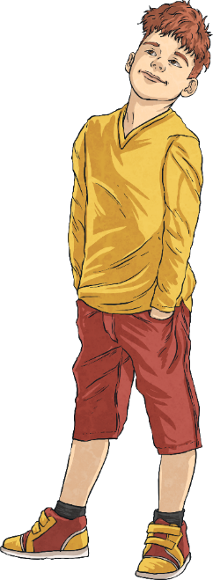
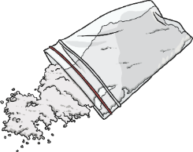
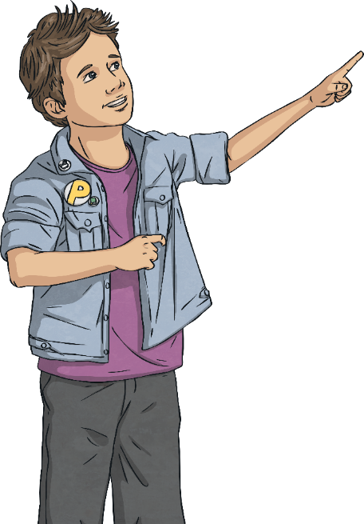
Does It Heal?
What about illegal drugs?
Some adults take illegal drugs hoping these will make them feel good. Illegal drugs are dangerous for lots of reasons and can be very harmful.
Someone who takes illegal drugs might not be able to look after themselves or others and they might need help from a professional.

Slide 20
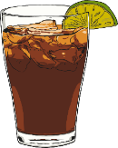
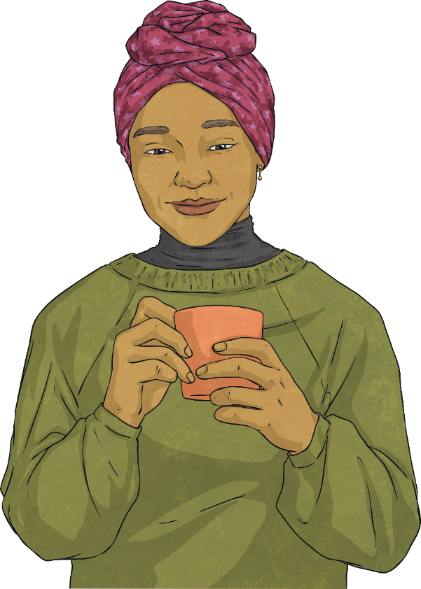
Does It Heal?
For example, caffeine makes the brain feel more alert. A person might start to rely on caffeine to help them stay awake and focussed.
Addictions can be harmful and when any kind of drug use becomes a habit, it can be difficult to break that habit.
Many illegal drugs, as well as some legal drugs, can be addictive. This means that people’s bodies get used to the feeling they give and they then want more of the drug.
As their body gets used to the caffeine, the person might need more to help them get the same feeling they used to get from just a little amount.

Slide 21
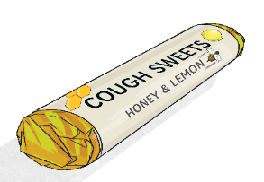
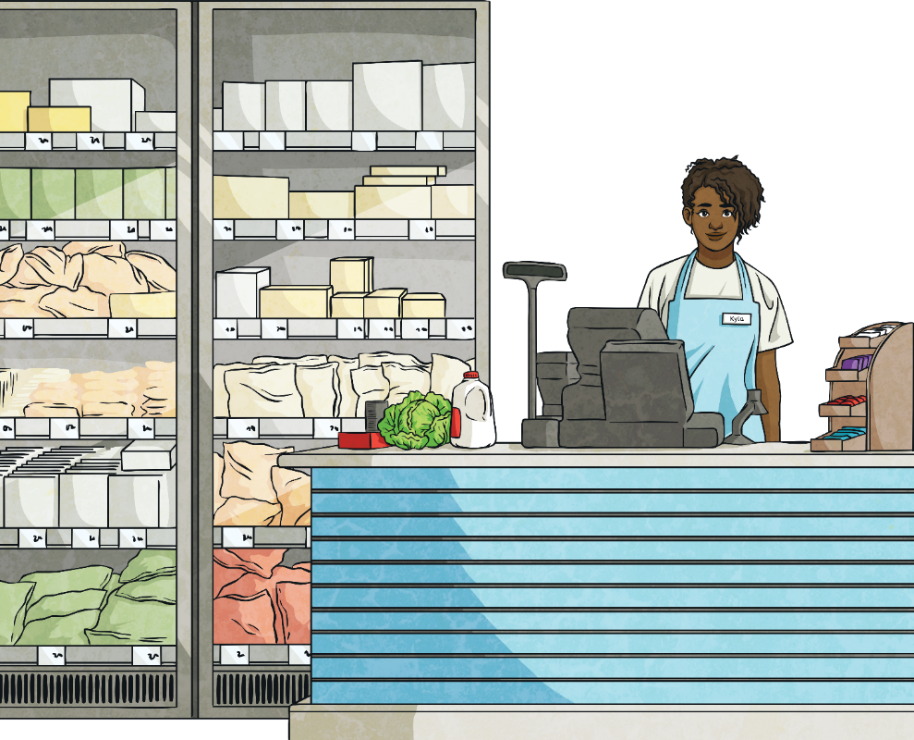
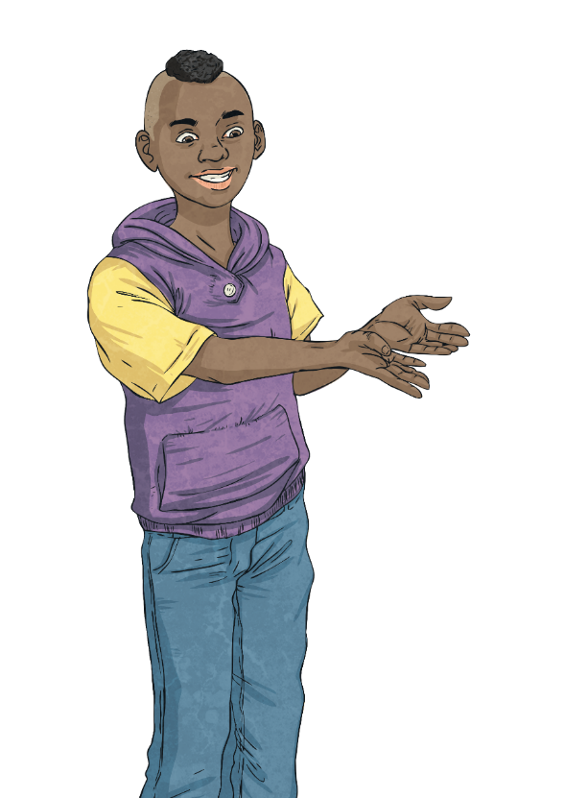
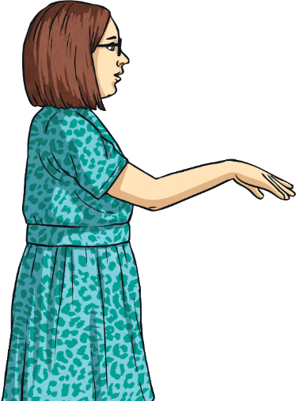
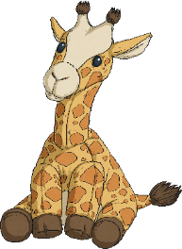
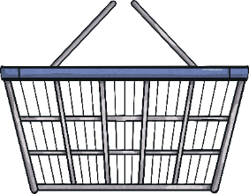
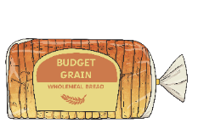
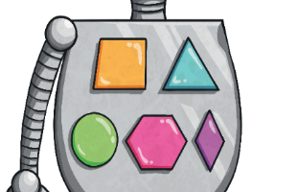
Does It Heal?
You can buy them from a shop but remember that they are not normal sweets.
Cough sweets contain medicine that helps to soothe your throat. If you eat too many of these when you don’t need them, you might get a stomach ache or start to feel unwell.
What about cough sweets?
Cough sweets look a lot like normal sweets. They can taste nice and some people enjoy eating them.

Slide 22
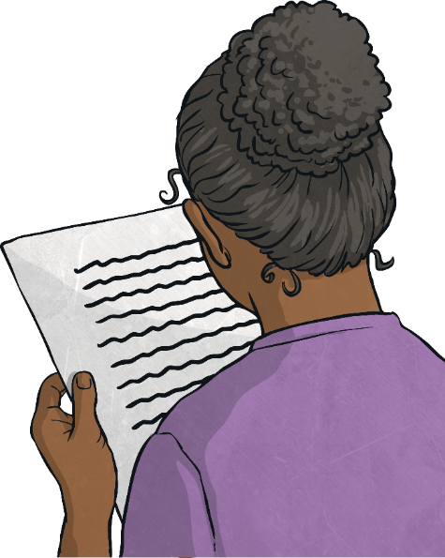
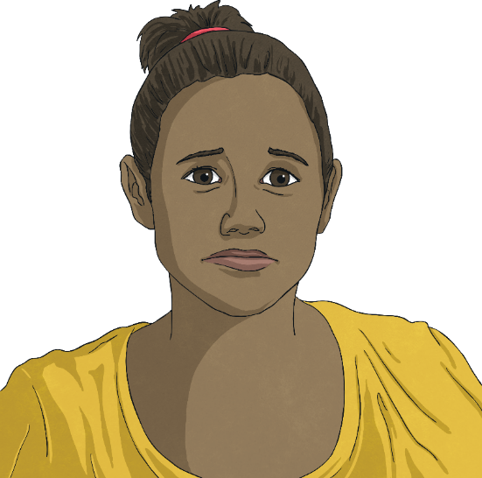
Does It Heal?
It is really important to follow the instructions on the packet and only ever take medicine that has your name on it.
Sometimes, the doctor might prescribe you some medicine if you are unwell.
What happens if I get medicine from the doctor?
Prescription Instructions

Slide 23
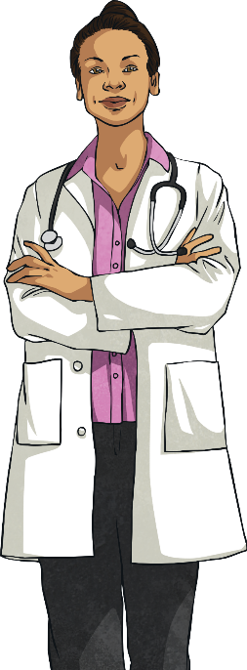
Does It Heal?
You should always take antibiotics carefully. These are a strong medicine and we can become immune to them if we take them too often. This means that they might not work if you become ill in the future.
Some medicines don’t work properly if we take them the wrong way. They might not heal your health condition if you take too little or they might make you ill if you take too much.

Slide 24
Emergency!
Once you have decided, create a role play demonstrating how the emergency happened and, most importantly, how to get help.
Discuss different options and decide between you which you think is the most appropriate and effective response.
In this activity, you will work with a partner to find different ways to respond to the emergency on your Emergency Situation Role-Play Card.

Slide 25
Emergency!
Is this response safe?
Will it get help quickly?
Is there another way to get help?
Watch the role plays carefully and ask yourself:
Let’s share our role plays.

Slide 26
Emergency!
There are many ways to act in an emergency. The most important thing is that you ask for help and that you do this as quickly as possible.
Remember:
Find someone who can help.
Tell them what is wrong.
If they can’t help, ask someone else.
If you’re not sure who to ask, speak to a teacher or friendly adult.
If someone’s life may be in danger, call 999.

Slide 27
Emergency!
Consolidating
Reflecting

Slide 28
Consolidating

Slide 29
Postcard to an Alien
Using everything you have learnt today, you are going to write a postcard to an alien who wants to visit Earth.
On your postcard, write tips and advice on how to stay safe around drugs.
Once you have given the alien your best advice, you can:
draw on the front of your postcard;
write the address;
draw a stamp.

Slide 30
Reflecting

Slide 31
What Happens Next?
There are many dangerous situations. It is important that we are aware of the risks and know what to do. We need to keep ourselves and others safe.
Look at the following situations. Using everything you have learnt today, decide what needs to happen next.
A child wants to drink a bottle of cough syrup.
A teenager is offering a child a cigarette in the park.
A child thinks taking someone else’s medicine will make them feel better.

Slide 32
What Happens Next?
Always follow the instructions on medicines.
I can choose to be healthy.
Only take your own medicine, never someone else’s.
Remember…
Get help if you are worried.

Slide 33
The Big Questions

Slide 34
What are drugs?
How can I stay safe around drugs?

Slide 35
Aim
I know how to take medicine safely and keep safe around drugs.
Success Criteria
I know how to identify risks in familiar situations.
I know what is safe to eat or use and what is not.
I know where I can find help in a risky or dangerous situation.

Slide 37
Aim
I know how to make better choices and choose healthy habits.
Success Criteria
I know my choices have consequences.
I can identify habits that will help me.
I know how to deal with habits that are unhelpful.
This resource is fully in line with the Learning Outcomes and Core Themes outlined in the PSHE Association’s Programme of Study.

Slide 38
The Big Questions

Slide 39
What choices do I have?
How can I make better, healthier choices?

Slide 40
Reconnecting

Slide 41
Choices and Habits
Habits are things we do often. Our habits can affect what happens to us.
If you choose to brush your teeth twice a day, your teeth will be healthy.
If you choose to practise a musical instrument regularly, you will get better.
If you choose to be kind to others, they will be kind to you.
The things we choose to do now can help us later.

Slide 42
Choices and Habits
When we are children, our habits affect our future.
When he was young, he played football every day in the playground.
This is Jeff. He is a sports coach.

Slide 43
Choices and Habits
When we are children, our habits affect our future.
When he was young, he played football every day in the playground.
This is Jeff. He is a sports coach.
. As a teenager, he played football for his local team.

Slide 44
Choices and Habits
When we are children, our habits affect our future.
When he was young, he played football every day in the playground.
This is Jeff. He is a sports coach.
. As a teenager, he played football for his local team.
Now, he teaches people how to improve their football and teamwork skills.

Slide 45
Exploring

Slide 46
Healthy Choices and Habits
You can choose to apply a sun cream especially for children's delicate skin and reapply it throughout the day. You can choose to wear a sun hat and stay in the shade during the hottest part of the day. Choosing to drink lots of water will also help to keep your body well in hot weather. Making these choices will help to keep you safe in the sunshine and help to protect against skin damage, including skin cancer.
You can choose to do a range of activities - those which help look after your mind and body. For example, playing outside, riding a bike, drawing, making and colouring, doing a jigsaw, dancing to music, reading and playing a board game with family and friends. By choosing to be keep your mind and body active in your free time, you can help protect them from the dangers linked to being inactive and still for too long and too often, including heart disease and obesity.
You can choose healthy snacks most of the time to keep your body and mouth healthy. Whatever you choose to eat, you can make the choice to brush your teeth at least twice a day - when you get up and before you go to bed. You can, with a trusted adult, choose to make sure you visit a dentist regularly for a check up and follow the advice they give you on how best to look after your teeth and keep your mouth healthy, including flossing. These choices will help protect you against tooth decay and bad breath.
We can make choices and develop habits which are healthy. Look at the following scenarios and, with a partner, decide what the healthy choice would be.
It is a really hot day and you want to play outside. What choices can you make which would help protect you?
You are thinking about how to spend your free time. What choices can you make which would help look after your body and mind?
You are choosing a snack after school. What choices can you make which keep your teeth and mouth healthy?

Slide 47
Healthy Choices and Habits
You can choose to apply a sun cream especially for children's delicate skin and reapply it throughout the day. You can choose to wear a sun hat and stay in the shade during the hottest part of the day. Choosing to drink lots of water will also help to keep your body well in hot weather. Making these choices will help to keep you safe in the sunshine and help to protect against skin damage, including skin cancer.
You can choose to do a range of activities - those which help look after your mind and body. For example, playing outside, riding a bike, drawing, making and colouring, doing a jigsaw, dancing to music, reading and playing a board game with family and friends. By choosing to keep your mind and body active in your free time, you can help protect them from the dangers linked to being inactive and still for too long and too often, including heart disease and obesity.
You can choose healthy snacks most of the time to keep your body and mouth healthy. Whatever you choose to eat, you can make the choice to brush your teeth at least twice a day - when you get up and before you go to bed. You can, with a trusted adult, choose to make sure you visit a dentist regularly for a check-up and follow the advice they give you on how best to look after your teeth and keep your mouth healthy, including flossing. These choices will help protect you against tooth decay and bad breath.
It is a really hot day and you want to play outside. What choices can you make which would help protect you?
You are thinking about how to spend your free time. What choices can you make which would help look after your body and mind?
You are choosing a snack after school. What choices can you make which keep your teeth and mouth healthy?

Slide 48
Healthy Choices and Habits
What habits do you have?
On one, write or draw a good habit you have – a habit of yours that you love.
You are each going to get two sticky notes.
Do you have good and bad habits?
Can you give some examples?
On the other, write a bad habit you have – one you’d like to leave behind.

Slide 49
Making Healthy Choices and Developing Healthy Habits
Some habits are good for everyone, like getting enough sleep. Other habits are more dependent on what you want to achieve.
If you want to be a great ballet dancer, practising ballet regularly will be very helpful. Practising the piano may be fun but it will not be as helpful in achieving your goal.
If you want to be a firefighter, practising climbing and following instructions will be helpful. Practising sewing may be fun but it will not be as helpful in achieving your goal.

Slide 50
Making Healthy Choices and Developing Healthy Habits
Colour the helpful habits in green. These habits will help David become a superhero.
We’re going to sort David’s habits – David wants to be a superhero.
What sorts of habits would a superhero need?
What habits should a superhero avoid?
Colour the unhelpful habits in red. These habits will not help David become a superhero.

Slide 51
Reflecting
Consolidating

Slide 52
Consolidating

Slide 53
My Helpful Habits
Think about all of the habits you have that could help someone else. Maybe you read every night or you choose healthy food as a snack.
Create a cartoon to show your helpful habits using your My Helpful Habits Activity Sheet.

Slide 54
Reflecting

Slide 55
Habit Breakers
Some habits are really difficult to break. Let’s look at these habits and decide how easy or difficult it would be to change them.
Going out to play with friends or exercising instead of playing a video game or watching TV.
Doing homework as soon as you get it so you’re not in a rush.
Ignoring a story about someone that might not be true.
Eating fruit and vegetables instead of sweets or chocolate.
Taking some time out to calm down instead of hitting someone when you feel very angry.

Slide 56
Habit Breakers
I can choose healthy habits and replace unhealthy ones.
Remember!
Good habits can help us achieve our goals.
We can replace our unhealthy habits with healthy ones.

Slide 57
The Big Questions

Slide 58
What choices do I have?
How can I make better, healthier choices?
What have you learnt today?
How will it help you in your daily life?

Slide 59
Aim
I know how to make better choices and choose healthy habits.
Success Criteria
I know my choices have consequences.
I can identify habits that will help me.
I know how to deal with habits that are unhelpful.

