Slide 1
PSHE and Citizenship
Relationships | Be Yourself
PSHE and Citizenship | UKS2 | Relationships | Be Yourself | Do the Right Thing | Lesson 5

Slide 3
Aim
I can identify when I might have to make different choices to those around me.
Success Criteria
I can explain what a tricky situation is.
I can describe strategies I can use to help me make positive choices and describe how I can apply them.
This resource is fully in line with the Learning Outcomes and Core Themes outlined in the PSHE Association’s Programme of Study.

Slide 4
The Big Questions

Slide 5
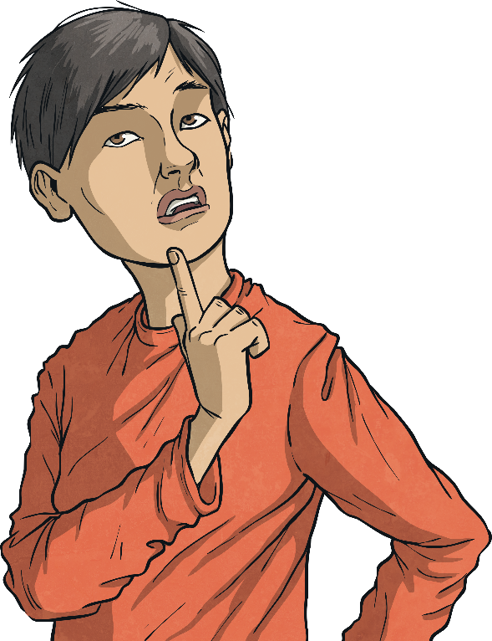
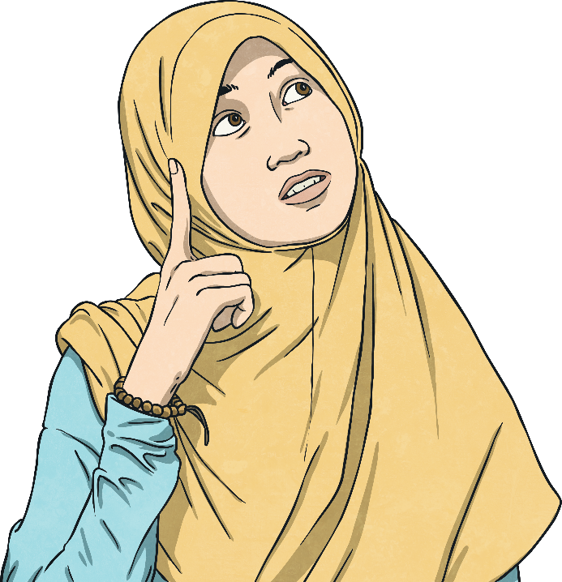
How can we know when we might have to make a different choice to those around us?
How can we do the right thing even if others do not?

Slide 6
Reconnecting

Slide 7
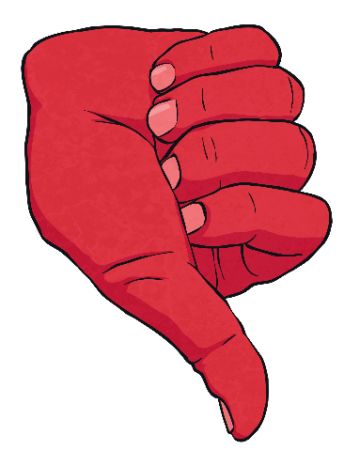
Tricky Situations
We can all find ourselves in tricky situations.
Which of the following would you describe as tricky situations?
Your friend invites you to play at their house.
Your friend says you can sit down next to them.
Your friend asks if you want to try something you know you are not allowed to do.
Your friend asks if you want to go shopping with them.
Your friend tells you to run across the grass at school as a dare when you're not allowed to go on it.
Tricky situations are ones which make you feel uncomfortable, ones which are dangerous and ones which involve resisting pressure to do something you feel is wrong.

Slide 8
Exploring

Slide 9
Doing the Right Thing
If you find yourself in a tricky situation, you need to make sure you feel confident enough to do the right thing.
What could you do if your friends were trying to encourage you to do something that you did not want to do?
Share your thoughts with a partner and then with the class.
Doing the right thing doesn’t always feel easy but it is important that you make choices which keep you safe, happy and healthy.

Slide 10
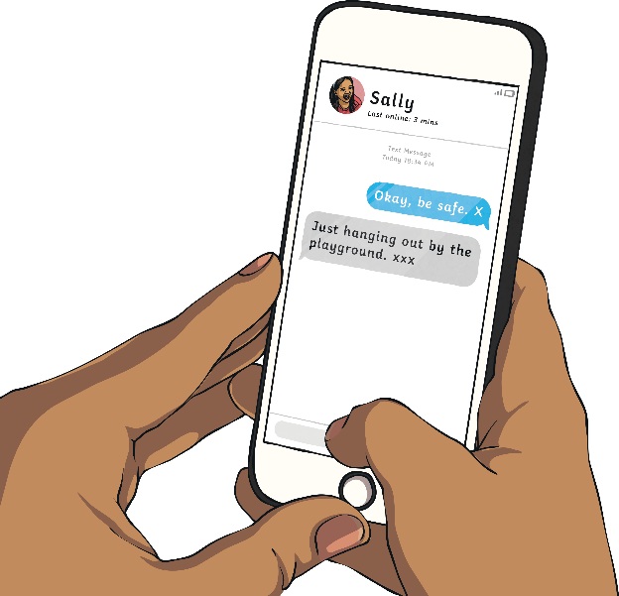
Making Positive Choices
How can you make choices which keep you safe, happy and healthy when you are in a tricky situation?
You can remove yourself from the situation. Having a set code with a trusted family member can ensure you can get away from a situation. This might be putting ‘xxx’ at the end of a text message or having a code word in a phone call. You might also feel able to get away from the situation yourself. Once you are physically away from the situation you can have the space to make your own choice and voice this from a distance.

Slide 11
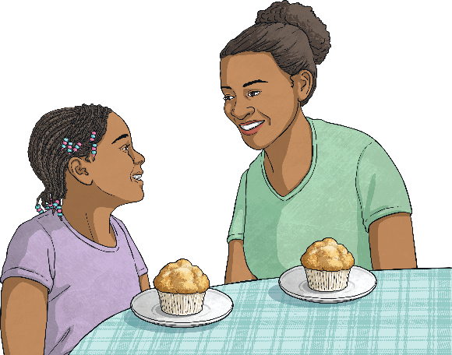
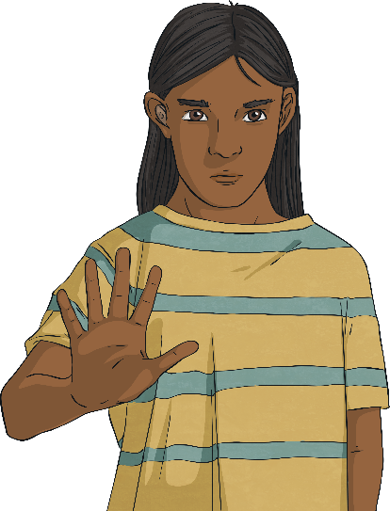
Making Positive Choices
You can tell a trusted adult.
If you are in a friendship in which you are being put in tricky situations, then the friendship itself is unhealthy. By telling a trusted adult about this friendship you will have support and guidance on how to handle the situation.
You can be assertive.
You have the right to make your own choices, no matter who the other person is. If you confidently say what you want to do or do not want to do, then that choice cannot be taken away from you. It can help to practise saying the words aloud beforehand to help you sound strong and confident.

Slide 12
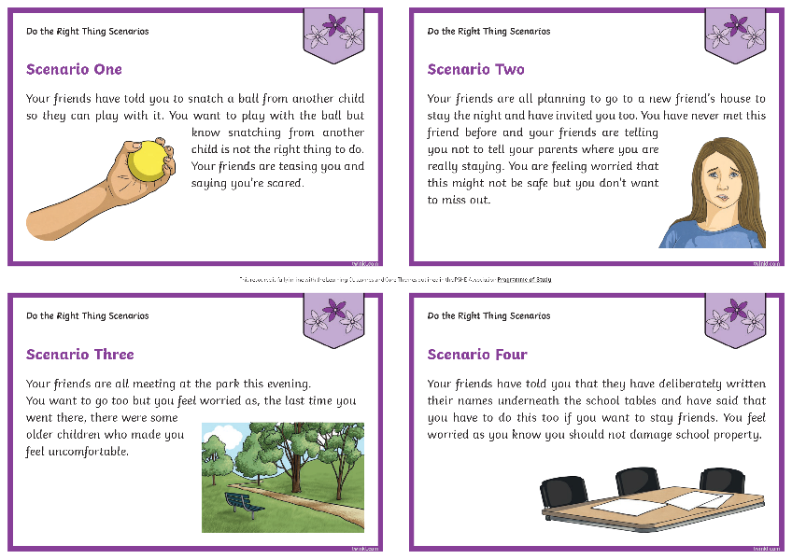
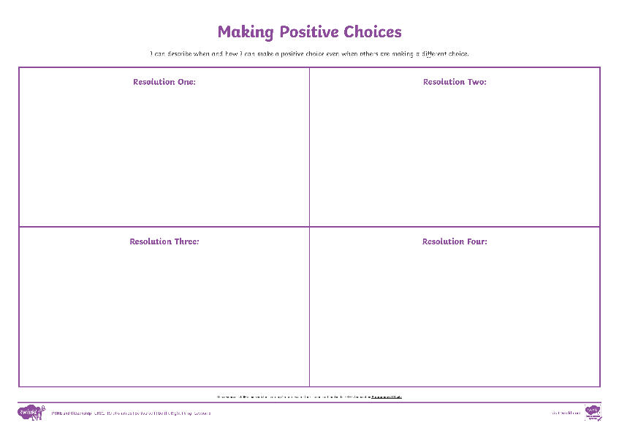
Making Positive Choices
Look at your Do the Right Thing Scenario Cards with your group. Discuss these and then record a solution to each one on the Making Positive Choices. Each solution needs to include those involved in the situation doing the right thing by making a positive choice.
Consolidating
Reflecting

Slide 13
Consolidating

Slide 14
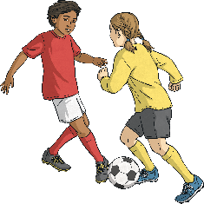
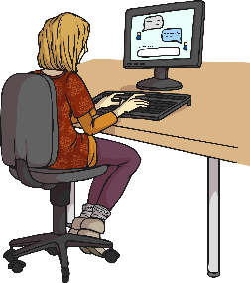
Peer Pressure
Peer pressure describes a situation in which your friends are influencing the choices and decisions you are making.
In pairs, can you make a role play showing how you could resist peer pressure in one of these situations? Remember to use the strategies you have learnt in today’s lesson.
Scenario One: Your friends are all saying they are going to leave your football team as they have heard another team has a better kit. You like your team and have played for them for years. You do not want to leave but your friends are saying that if you are their friend you will come to the new team too.
Scenario Two: It is the school disco on Friday. Your friends are all saying they are going to wear makeup to the disco. You don't normally wear makeup as your mum and dad think you're too young to wear it. Your friends are saying you won't look like them if you haven't got makeup on and that they will sneak some makeup in their pocket for you to put on at the disco.
Scenario Three: Your friend has met a new friend on the Internet. They are planning to meet up at the weekend in town and have asked you to come too but to keep it a secret. You feel worried that this could be dangerous. Your friend is saying a true friend would come too.

Slide 15
Reflecting

Slide 16
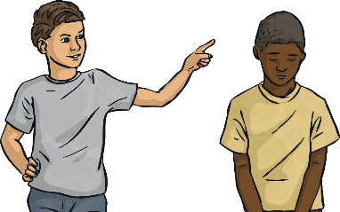
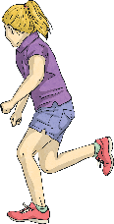
Applying Solutions
These are the tricky situations we discussed at the beginning of the lesson.
Your friend asks if you want to try something you know you are not allowed to do.
Your friend says you should run across the grass.
Can you now apply one of the strategies from today’s lesson to these situations to resolve them?
Doing the right thing doesn’t always feel easy but it is important you make choices which keep you safe, happy and healthy.

Slide 17
The Big Questions

Slide 18
How can we know when we might have to make a different choice to those around us?
How can we do the right thing even if others do not?
How have your answers changed since the beginning of the lesson?
Which strategies could you see yourself using in the future?

Slide 19
Aim
I can identify when I might have to make different choices to those around me.
Success Criteria
I can explain what a tricky situation is.
I can describe strategies I can use to help me make positive choices and describe how I can apply them.

Slide 21
Aim
I can explore how it feels to make a mistake and describe how I can make amends.
Success Criteria
I can identify the emotions I feel when I make a mistake.
I can remind others of things to do to make amends.
I can explain different strategies to re-frame unhelpful thinking after a setback.
This resource is fully in line with the Learning Outcomes and Core Themes outlined in the PSHE Association’s Programme of Study.

Slide 22
The Big Questions

Slide 23
How might we feel if we have made a mistake or done something wrong?
What can we do about it?
Share your thoughts with a partner.

Slide 24
Reconnecting

Slide 25
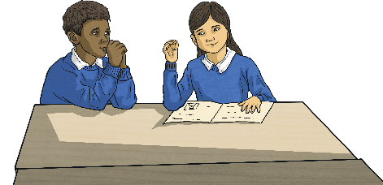
Making a Mistake
We all make mistakes.
How do you feel when you make a mistake?
Share your thoughts with a partner and then with the class, if you feel happy to.
What do you do if you make a mistake?
Share your thoughts with a partner and then with the class, if you feel happy to.
It is important not to worry when you make a mistake. Mistakes are how you learn and move forward.

Slide 26
Exploring

Slide 27
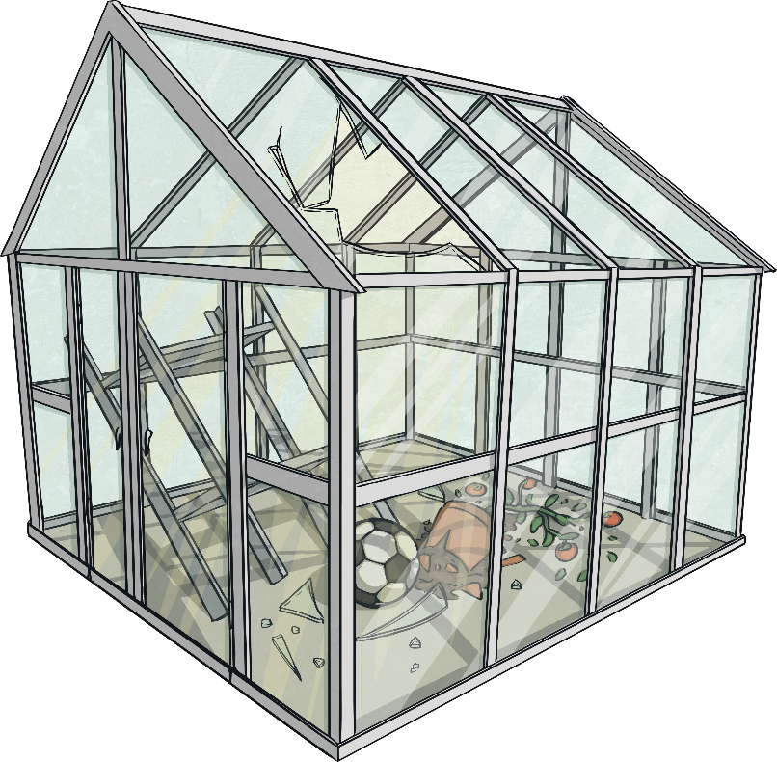
Different Responses
You are now going to read about how two children made the same mistake, but responded very differently.
Aadi was walking and kicking his ball on the way home from school. He kicked it too hard and it hit a greenhouse in someone’s garden. It smashed the window. Aadi felt so guilty and worried so much that he went very quiet and did not know what to do. He ran straight home and hid in his bedroom and cried.

Slide 28
Different Responses
Jessie was walking and kicking her ball on the way home from school. She kicked it too hard and it hit a greenhouse in someone’s garden. It smashed the window. Jessie felt so guilty and worried that she went and knocked on the person’s door and explained what had happened. She said sorry and said that she would save up and pay to replace the broken glass.

Slide 29
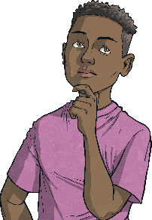
Different Responses
What were the differences in the way the two children responded to the same mistake?
Why do we handle our mistakes differently?
By apologising, taking responsibility and trying to make things better, Jessie’s way of handling the mistake actually let her make amends. After this conversation, she could move on and know that everything was OK. Aadi’s way of dealing with things meant that the guilt and anxiety he was feeling stayed with him for a long time.
There are four things you can do when you make a mistake to make amends and to help you feel better.
You can apologise if someone or something has been hurt by your mistake.
You can take responsibility for the mistake.
You can take action to make things better.
You can remember that everyone makes mistakes and that mistakes help you learn.

Slide 30
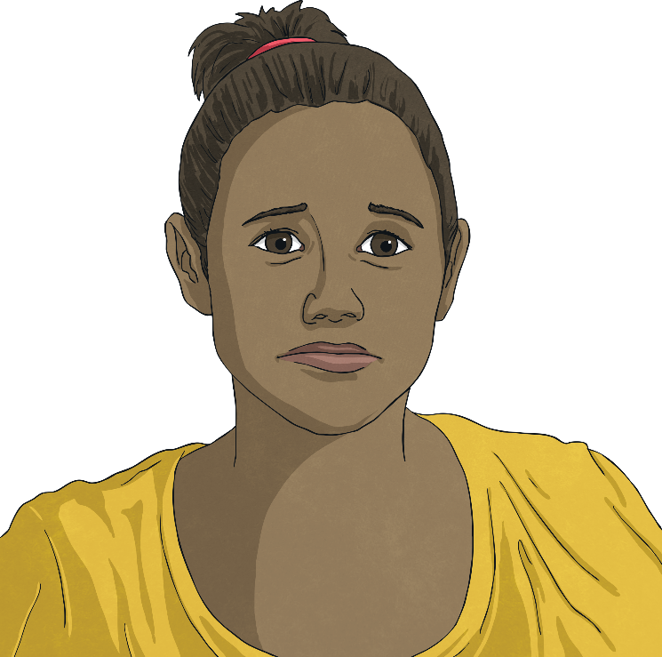
Different Responses
It is normal and healthy to feel guilty after doing something wrong. This is a helpful part of knowing that we need to make amends. It allows us to be forgiven and to move on from the incident. However, people can sometimes continue to feel bad or ashamed after the incident. These thoughts are unhelpful as they don’t help to resolve the situation and they affect our feelings. These are called unhelpful thoughts.
When we feel like this, it is important to go back to the facts. For example, if, after Jessie had apologised, offered to pay to fix the greenhouse and been forgiven by the owner of the greenhouse, Jessie still had thoughts that she had done a bad thing or that she was a bad person, Jessie’s wellbeing might start to become affected.

Slide 31
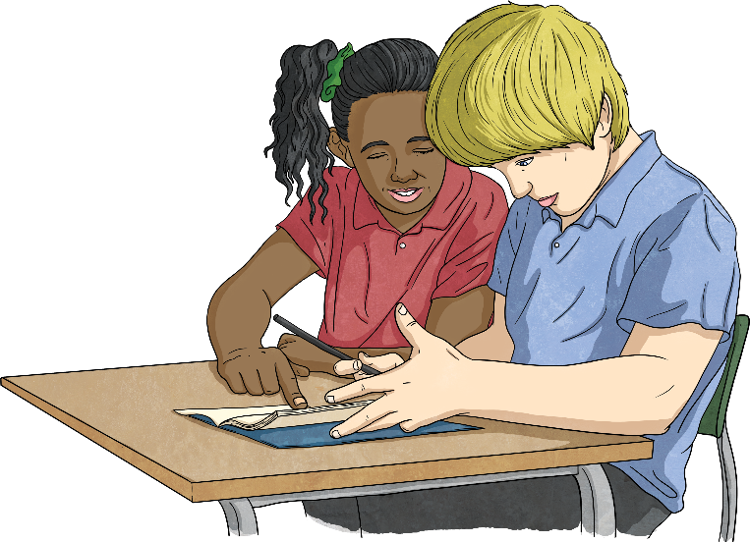
Different Responses
If this happens, Jessie can instead consider the facts. She knows that she has broken the greenhouse but that it can be fixed. She knows that she has accepted responsibility, made a genuine apology and offered to help to make amends by giving money to pay for the greenhouse to be fixed. Jessie knows she did not intentionally break the greenhouse and she knows she did the right things to make amends. By looking at the facts like this, Jessie can challenge and re-frame her unhelpful thoughts.
Often, we can help others to think in terms of the facts when they are feeling guilt, shame or worry. However, it can feel harder to do the same for ourselves. It is really important to move past feelings of guilt after you have made amends so that you regain your wellbeing and avoid self-punishment.

Slide 32
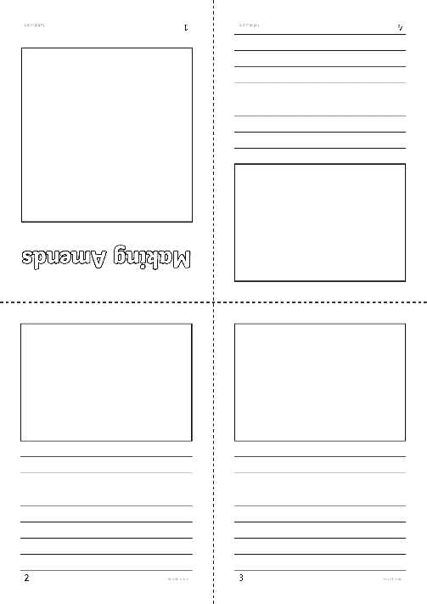
Feelings and Making Amends
Using your Making Amends Storybook Activity Sheet, create your own storybook to show someone making a mistake. Make sure your story looks at how the person making the mistake feels. Your story then needs to show how the person can make amends for their mistake. The ending needs to include how that person feels after making amends and the lessons they have learnt.
Remember, a person’s thoughts can affect their feelings but any unhelpful thoughts can be re-framed.
Consolidating
Reflecting

Slide 33
Consolidating

Slide 34
Making Amends
Using the Making Amends Poster Activity Sheet, your task is to create a poster to remind others of the things they can do if they have made a mistake or done something wrong. Remember to highlight that mistakes are an opportunity to learn and move forward.

Slide 35
Reflecting

Slide 36
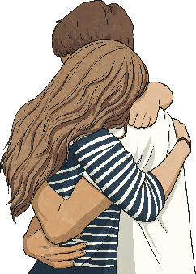
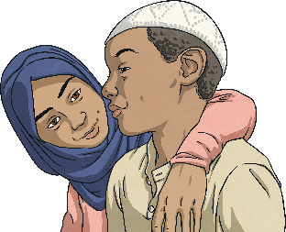
Moving On
When we make amends after making a mistake, we make the situation better. We also make ourselves feel better.
By making amends, we allow ourselves to move on and leave behind uncomfortable feelings such as guilt and anxiety.
Making amends allows us to turn a negative situation into a positive situation.
Take a moment of quiet to think about all of this.
Do you have any thoughts you would like to share with the class?

Slide 37
The Big Questions

Slide 38
How might we feel if we have made a mistake or done something wrong?
What can we do about it?
Why is it important to make amends?
How have your answers changed since the beginning of the lesson?

Slide 39
Aim
I can explore how it feels to make a mistake and describe how I can make amends.
Success Criteria
I can identify the emotions I feel when I make a mistake.
I can remind others of things to do to make amends.
I can explain different strategies to re-frame unhelpful thinking after a setback.

Slide 40
Prayer

