Slide 1
PSHE and Citizenship
Health and Wellbeing | Safety First
PSHE and Citizenship | LKS2 | Health and Wellbeing | Safety First | Dangerous Substances | Lesson 5

Slide 3
Aim
I know about dangerous substances and how they affect the human body.
Success Criteria
I understand what drugs, cigarettes and alcohol are.
I understand the impact drugs, cigarettes and alcohol have on the body.
I understand the dangers of drugs, cigarettes and alcohol.
This resource is fully in line with the Learning Outcomes and Core Themes outlined in the PSHE Association’s Programme of Study.

Slide 4
The Big Questions

Slide 5
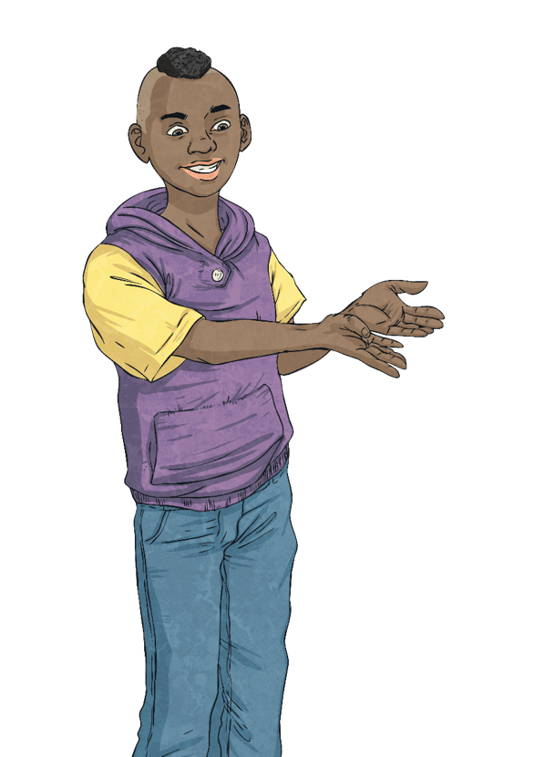
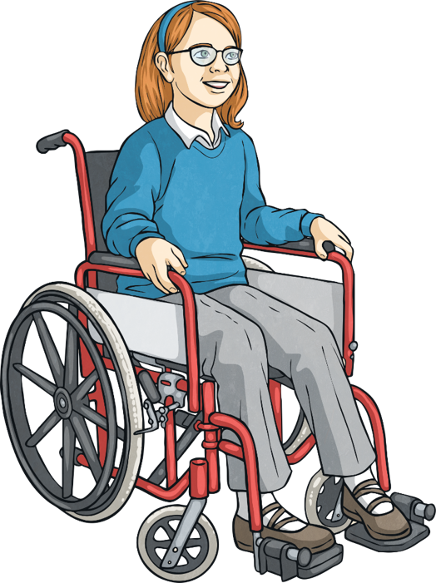
What are drugs, cigarettes and alcohol?
How do they affect the body and why are they dangerous?
Take a moment to think quietly about your answers to these.

Slide 6
Reconnecting

Slide 7
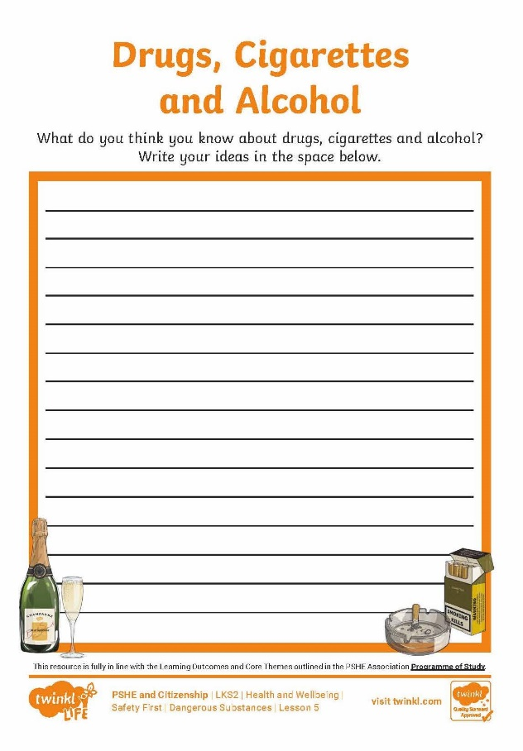
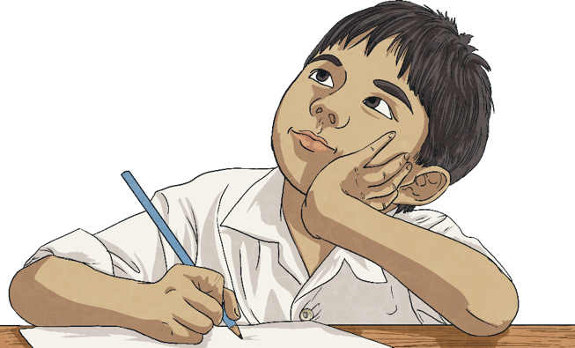
Drugs, Cigarettes and Alcohol
You might be familiar with the words ‘drugs’, ‘cigarettes’ and ‘alcohol’ or you might not.
On your activity sheet, write down or draw what these words mean to you. If you really don’t know, that’s OK. You can just put a question mark.

Slide 8
Exploring

Slide 9
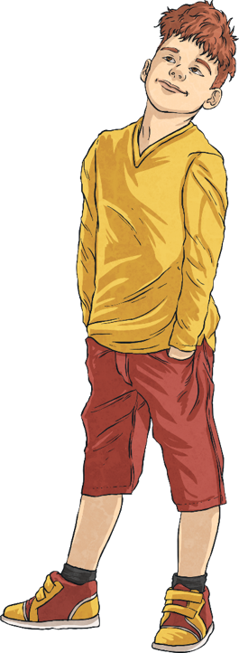
What Is a Drug?
It is OK if you don’t know or if everyone in the group disagrees. It is still useful to have the discussion and share your ideas and views with one another. Make sure everyone listens respectfully to each person in the group.
You might have heard the term ‘drug’ before and you might all have different ideas about what this word means.
Afterwards, we will look at them as a class.
In your groups, look at the pictures on the following slide and discuss which ones you think are pictures of drugs or things that contain a drug.

Slide 10
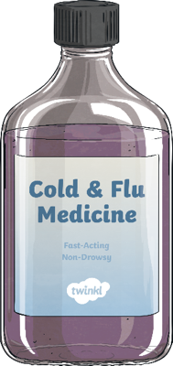
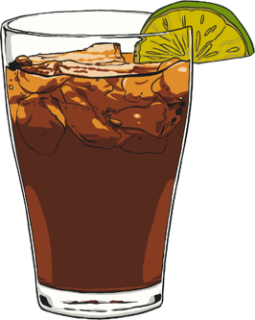
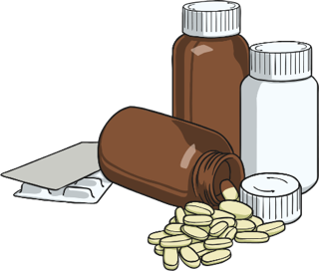
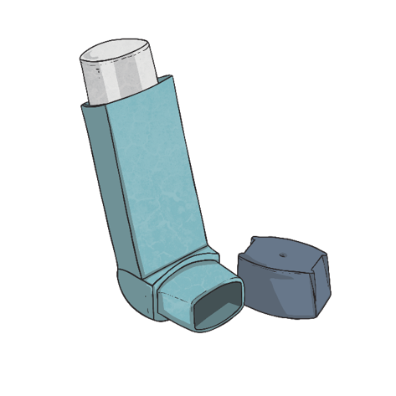
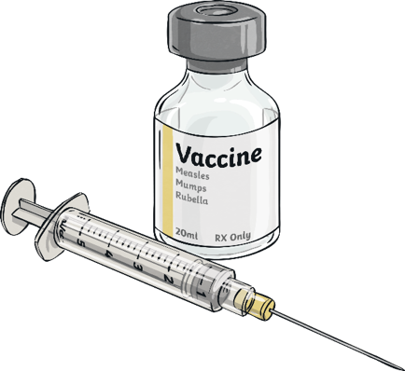
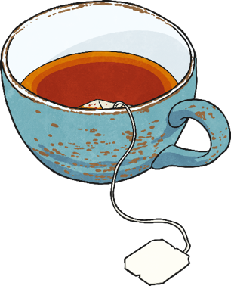
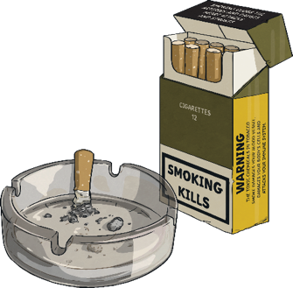
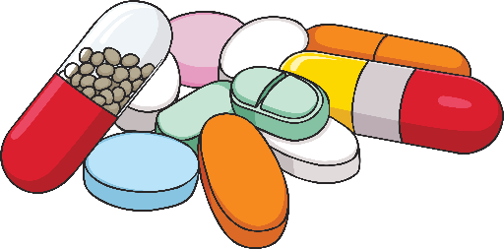
What Is a Drug?

Slide 11
What Is a Drug?
Which pictures did you think showed drugs or things with a drug in them?
You might be surprised to know that all the pictures were either a drug or contained a drug!
Even some drinks, such as cola, tea and coffee contain a drug called caffeine. Caffeine is labelled a drug because it stimulates the central nervous system and gives people a short-term energy boost .

Slide 12
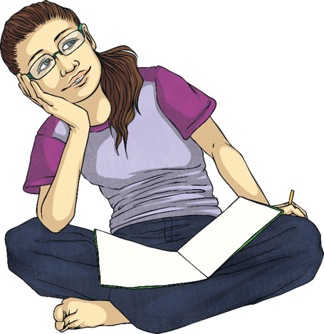
What Is a Drug?
A lot of people think of the word ‘drug’ as always being a bad thing.
However, not all drugs are harmful if taken appropriately. Some drugs can actually help our health and wellbeing.
The definition of a drug is ‘a substance that causes a physiological change on the body when it enters the body’.
This means that drugs affect the way we think, feel or behave.
Can you think how the things in the pictures might cause a change in the body or affect the body? Let’s take another look…

Slide 13
What Is a Drug?

Slide 14
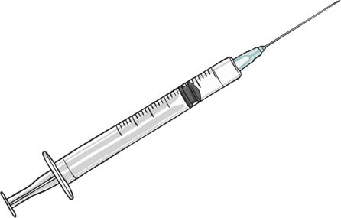
Are All Drugs Dangerous?
When we take medicines prescribed by our doctor, we want the drug in the medicine to cause a physiological change in our body. That change might be that we want to stop pain, stop a cough or fight an infection.
We might take a drug as a pill, a medicine or an injection to prevent us from getting ill. For example, when people travel to certain countries, they have vaccines to stop them from contracting an illness when abroad.
Some people have an illness called diabetes. They take a drug called insulin to prevent them from getting ill.
Other people take a drug in their asthma inhaler to prevent them from having an asthma attack.

Slide 15
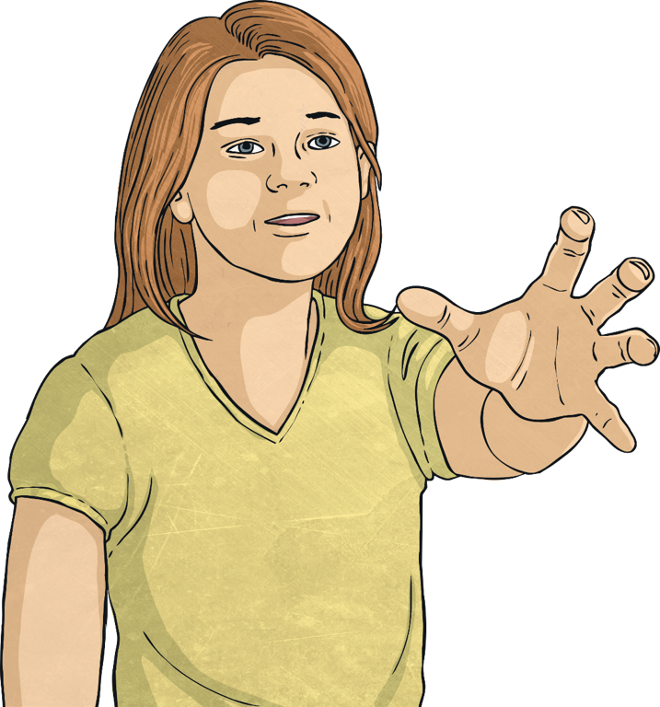
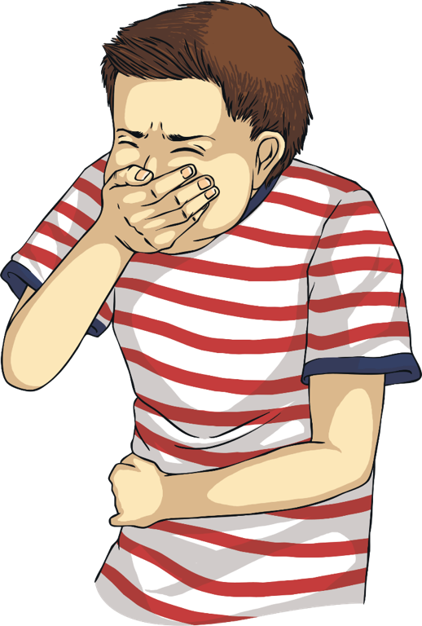
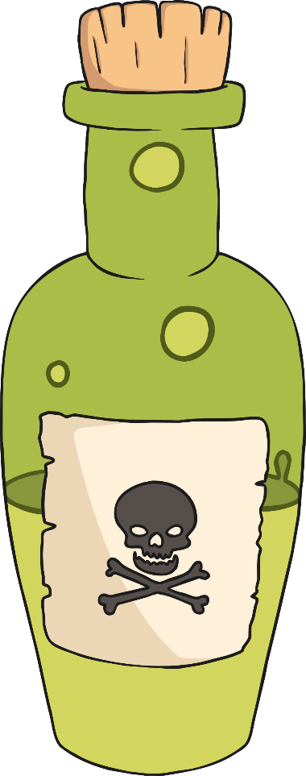
Are All Drugs Dangerous?
All drugs can be dangerous if they are taken incorrectly.
People must never have someone else’s medication if a doctor hasn’t prescribed it for them.
Having too much of a drug, even a medicine to make you feel better, can make you very poorly. That is why it is important to always check the instructions and take the right dose.

Slide 16
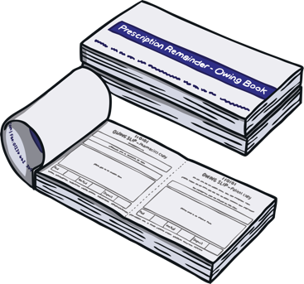
Are All Drugs Dangerous?
There are some rules that help us to take drugs correctly and safely. Many drugs can be prescribed for us by a doctor or bought in a shop, such as a chemist, where a pharmacist can check they are safe for us to take.
Medication should always be stored safely by an adult, out of sight and reach of children. Medication should always be given by an adult, who can read the label carefully to check the drugs and ingredients in the medication are suitable.
Most medication has an expiry date and it shouldn’t be taken or used after this date. We must only ever take or use drugs prescribed or recommended for us and never take someone else’s medication.

Slide 17
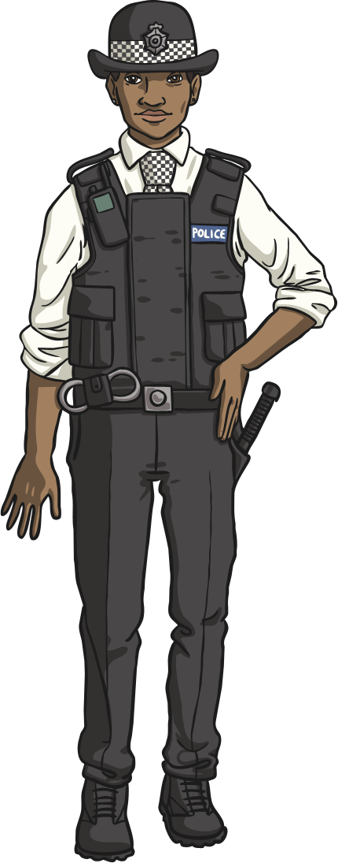
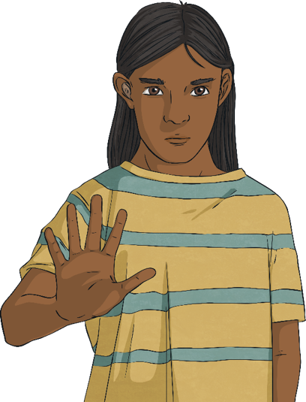
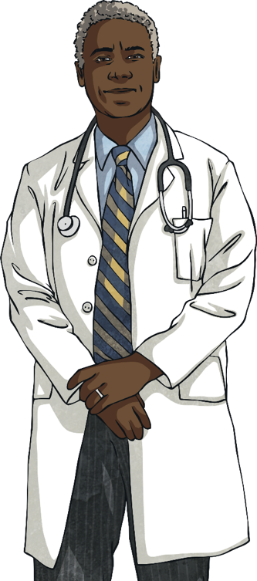
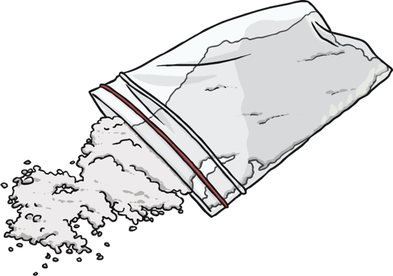
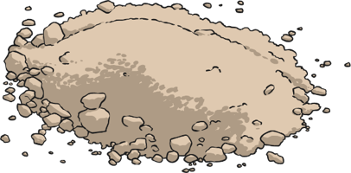
Are All Drugs Dangerous?
Some drugs are illegal. They are drugs that are considered especially dangerous.
We must never take anything from someone we do not know or trust because we cannot be sure that it doesn’t contain a dangerous substance.
They might make people very ill or significantly change the way people think and act, which can be very dangerous.

Slide 18
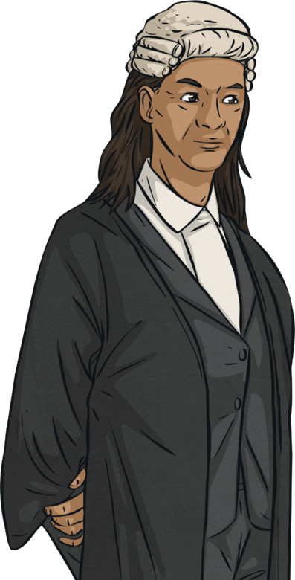
Drinking and Smoking
It is illegal for anyone under the age of 18 to buy and drink alcohol.
wine
beer
cider
Alcoholic drinks include:

Slide 19
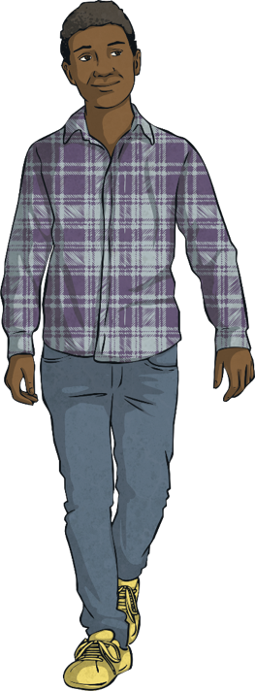
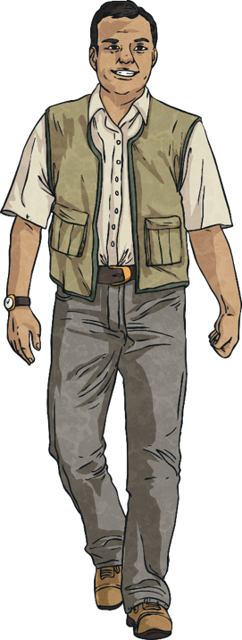
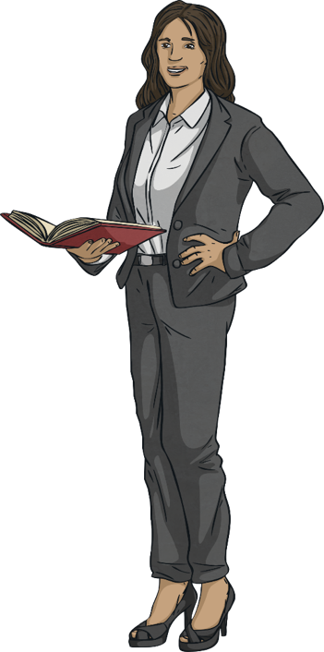
Drinking and Smoking
Some adults drink alcohol on special occasions and some adults have an alcoholic drink more frequently.
Some adults choose never to drink alcohol.

Slide 20
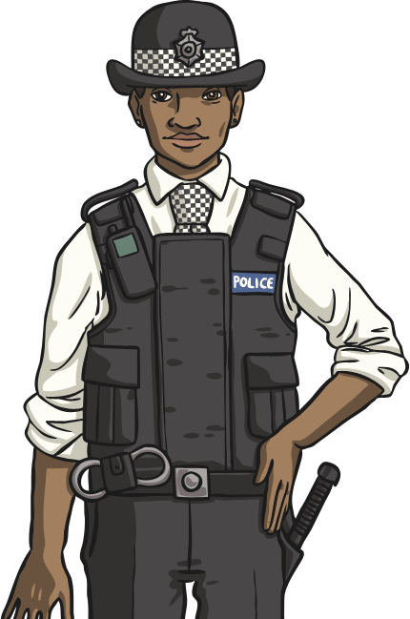
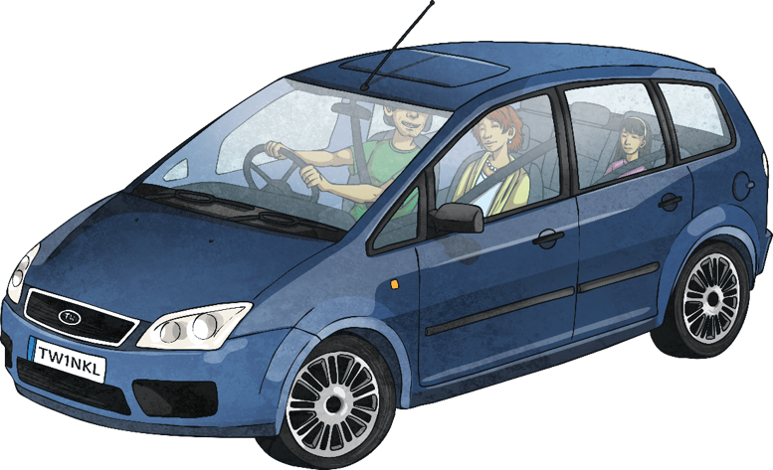
Drinking and Smoking
Alcohol can affect the body in different ways.
It is illegal to drive when you have been drinking alcohol. This is because it slows down the messages the brain sends to the body and slows down the body’s reaction times.

Slide 21
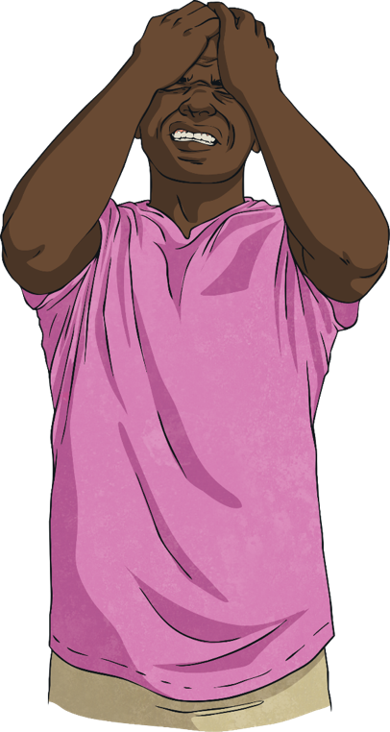
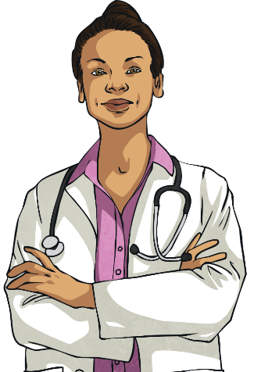
Drinking and Smoking
Alcohol can affect the body in different ways.
Alcohol can give people headaches and make them feel sick if they drink too much.

Slide 22
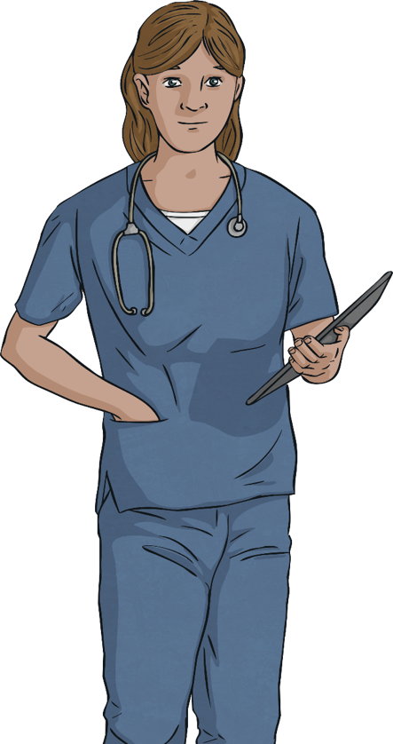
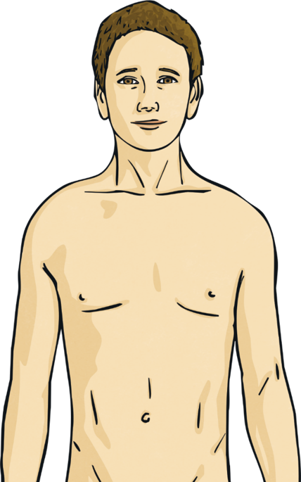
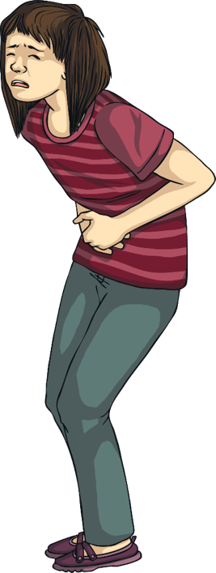
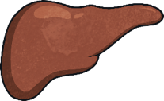
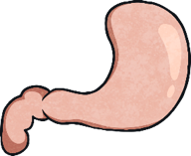
Drinking and Smoking
Alcohol can affect the body in different ways.
People who drink a lot of alcohol, over a long period of time, can have problems with their stomach and liver and may be more at risk of certain types of cancer.

Slide 23
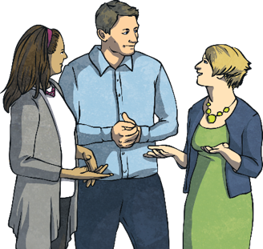
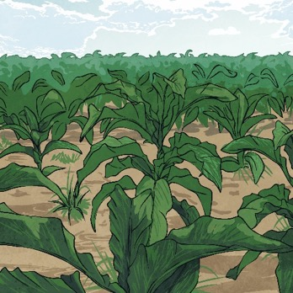
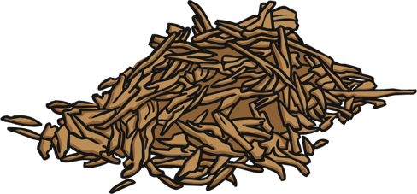
Drinking and Smoking
It is illegal for anyone under the age of 18 to buy and smoke cigarettes.
Some adults smoke cigarettes and others choose not to.
Cigarettes are made from tobacco.
Tobacco is made from leaves rich in nicotine.

Slide 24
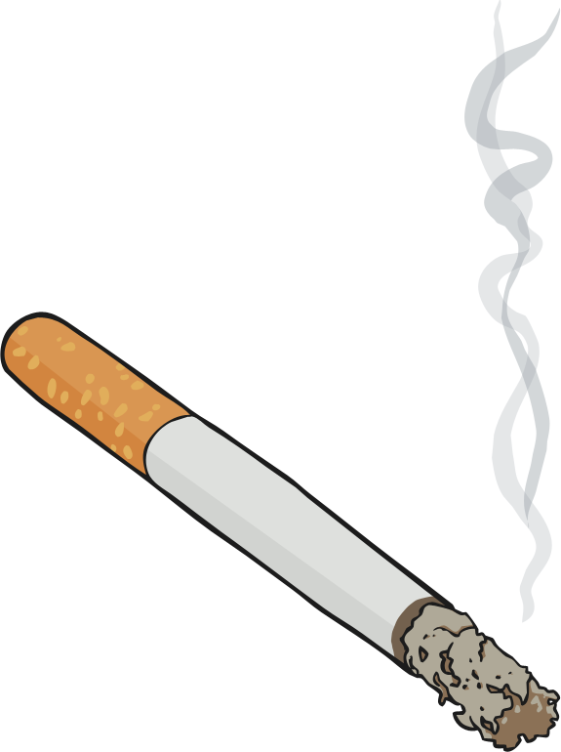
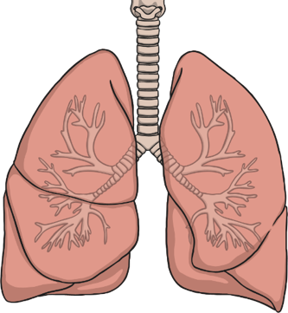
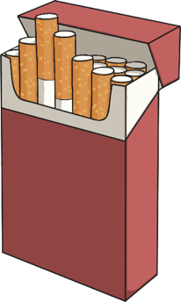
Drinking and Smoking
Tobacco smoke is a dangerous substance as it contains a mixture of chemicals that enter the blood stream. These chemicals can cause diseases, such as cancer.
The nicotine in the tobacco is addictive. This means your body wants more and more of it.

Slide 25
Drinking and Smoking
Some adults smoke electronic cigarettes.
These are called e-cigarettes. It is also called vaping.
Because they do not contain tobacco, e-cigarettes are not as harmful to the body as it is the tobacco that damages the lungs.
They do not contain tobacco but they do usually contain nicotine and other chemicals which may be harmful.

Slide 26
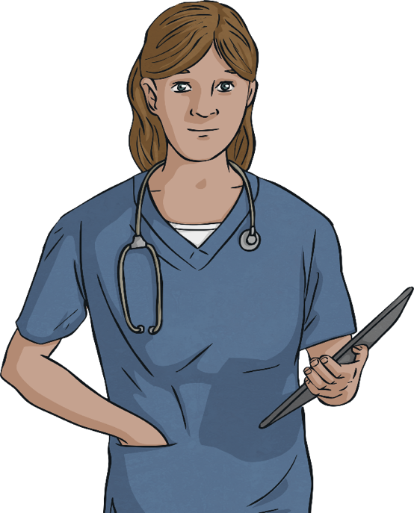
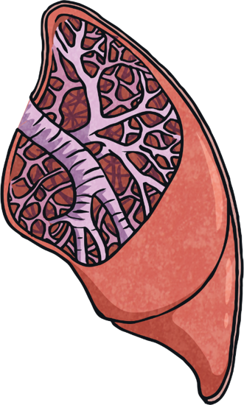
Drinking and Smoking
Some adults smoke electronic cigarettes.
However, nicotine is an addictive drug and some research also suggests that the flavourings used in e-cigarettes could cause lung diseases.

Slide 27
Drinking and Smoking
As adults, people can choose what they want to put into their body. Understanding the risks and dangers allows people to make an informed decision.
As a child, smoking and drinking alcohol is incredibly harmful. That is why it is illegal for children to smoke and drink alcohol.
Consolidating
Reflecting

Slide 28
Consolidating

Slide 29
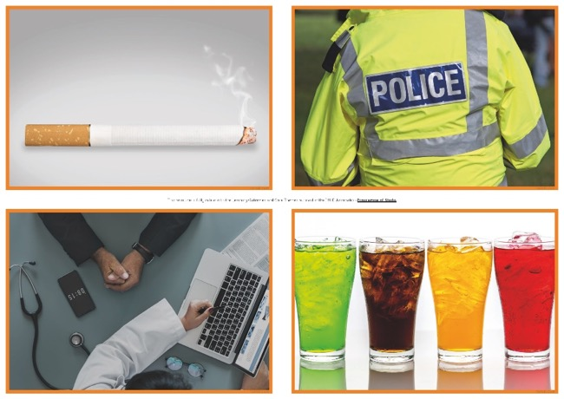
Helpful or Harmful?
We have learnt that some drugs can be helpful, while others can be harmful.
We must remember that all drugs can be harmful if too many are taken or if they are taken by the wrong person.
In your groups, use the photographs to help you plan a presentation about drugs that you will share with the class. Try to include as much information as you can.
Make sure everyone in your group has a job to do and that it is one that they feel comfortable doing.

Slide 30
Reflecting

Slide 31
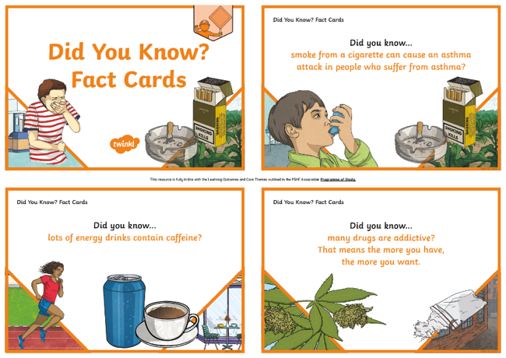
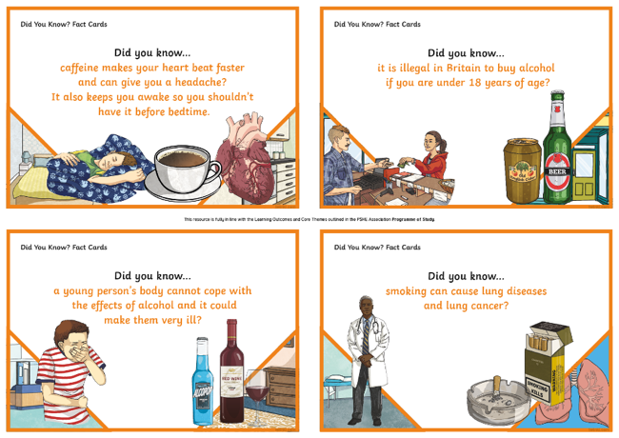
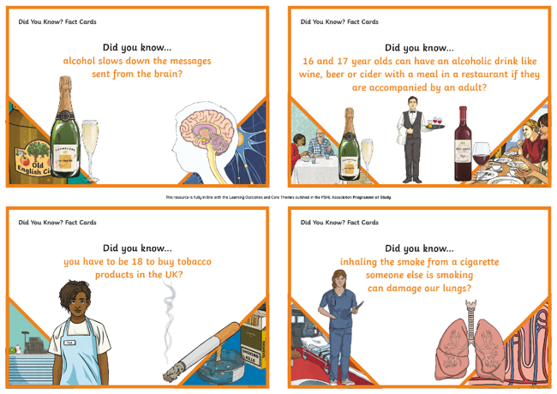
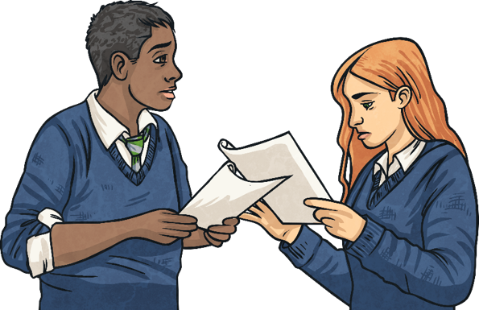
Did You Know?
We have learnt a lot about different drugs including medicines, cigarettes and alcohol.
In pairs, you are going to look at some fact cards.
Take turns to read one out to each other.
Think about whether you already knew the information on the card or whether it is new information.

Slide 32
The Big Questions

Slide 33
What have you learnt today that will help keep you safe?
How will the things you have learnt today help you make informed decisions in the future?
What are drugs, cigarettes and alcohol?
How do they affect the body and why are they dangerous?

Slide 34
Aim
I know about dangerous substances and how they affect the human body.
Success Criteria
I understand what drugs, cigarettes and alcohol are.
I understand the impact drugs, cigarettes and alcohol have on the body.
I understand the dangers of drugs, cigarettes and alcohol.
This resource is fully in line with the Learning Outcomes and Core Themes outlined in the PSHE Association’s Programme of Study.

Slide 36
Aim
I know how to respond in emergency situations.
Success Criteria
I can identify hazards and dangers in emergency situations.
I know ways to make myself and others safe in emergency situations.
I can advise others on how to give first aid.
This resource is fully in line with the Learning Outcomes and Core Themes outlined in the PSHE Association’s Programme of Study.

Slide 37
The Big Questions

Slide 38
How can I deal with injuries and illness?
How do I respond to an emergency situation?

Slide 39
Reconnecting

Slide 40
Spot the Hazard
It can feel daunting to be the first person to respond to an emergency situation.
The most important thing to do is stay calm and stay safe.
First, we should always use our senses to check the area for hazards that
could cause danger for ourselves or others.

Slide 41
Spot the Hazard
In your pairs, look carefully at the scene in the picture you have been given from the Spot the Hazard Picture Pack.
Your picture shows an emergency situation but there are lots of hazards.
Circle as many hazards as you can see and discuss with your partner why these could be a danger to the injured person or any person trying to help.

Slide 42
Spot the Hazard
Answers…

Slide 43
Exploring

Slide 44
Seeking Help
An emergency situation often involves a casualty (an injured or ill person).
Some emergency situations involve injuries or illnesses that cannot be dealt with safely without the help of the emergency services.
How might you recognise this type of situation?
It is often difficult to know whether we can help someone alone in an emergency situation or if we require the emergency services. It is always best to call for help if we are unsure and if there is no adult close by to help us to make that decision.
There are two numbers you can call to reach the emergency services: 999 or 112.

Slide 45
Seeking Help
Being one of the first people on the scene when someone has been hurt or has fallen ill can be distressing and could easily cause you to panic.
It is important to stay calm in order to keep yourself and others safe. Try counting to ten and taking some deep breaths while you check for hazards.
Always talk to the casualty about what is happening and what you are doing to help them. This will help to reassure them and keep them calm. This will also help you to think about each step that you will follow to help them.

Slide 46
Seeking Help
Remember - always try to:
Keep yourself and the casualty safe.
Stop anyone from getting any further injuries.
Treat injuries quickly and safely.
Seek help from the emergency services if needed.

Slide 47
Seeking Help
After you have checked that it is safe to help the casualty, follow the steps in the primary survey (with DR ABC) below to decide how best to help a casualty.
Hi I’m DR ABC
Click for more info..
D is for Danger – check for hazards to assess the danger.
The primary survey includes a series of checks to help the first aider decide if there are any urgent threats to the casualty’s life.
R is for Response – talk to the casualty and try to get a response.
A is for Airway – check the casualty’s airway and clear it if necessary.
These checks are in order of importance and it is always best to shout for help and ask someone else to dial 999 or 112 if possible while you work through these steps.
B is for Breathing – check the casualty is breathing.
C is for Circulation – check the casualty for bleeding.
next slide

Slide 48
Seeking Help
D is for Danger
Go back
Assess the hazards and check for signs of danger before going closer to the casualty.
Check that the area is safe for you and the casualty.
Ask someone to dial 999 or 112 and ask for the police or fire service, as well as an ambulance, if there is a danger that prevents you from helping the casualty.
If you are alone with the casualty, make this telephone call yourself.

Slide 49
Seeking Help
R is for Response
Go back
Talk to the casualty, tell them who you are and ask them questions to try to get a response.
Kneel next to the casualty's chest and gently shake their shoulders, asking them to open their eyes or answer your questions..
If the casualty opens their eyes or tries to speak to you, they are responsive. If they do not respond to you, they are unresponsive and must receive
medical help urgently.
Ask someone to dial 999 or 112 or do this yourself if you are alone with the
casualty and this has not already
been done.

Slide 50
Seeking Help
A is for Airway
Go back
Check that the casualty’s airway (the passage to the lungs through which air passes) is open and clear. If they can talk to you, their airway is clear.
If they do not respond to you, their airway may be blocked and will need to be opened. You can do this by placing one hand on their forehead and gently tilting their head back using two fingers from the other hand to lift their chin.
By this time, someone else should have dialled 999 or 112, or you will need to have done this yourself if you are alone with the casualty.
Top Tip: Use the speakerphone facility on the phone so you won’t need to hold it to your ear.

Slide 51
Seeking Help
B is for Breathing
Go back
Check to see if the casualty is breathing by placing your ear above their mouth. Listen for breathing, check you can feel their breath on your cheek and look down from here to their chest to see if it is moving.
Look, listen and feel for up to ten seconds to see, hear or feel if they are breathing normally.
By this time, someone else should have dialled 999 or 112, or you will need to have done this yourself if you are alone with the casualty.
If the casualty appears to be breathing normally but is unresponsive, place them in the recovery position and keep monitoring them until emergency help arrives.

Slide 52
Seeking Help
C is for Circulation
Go back
When you have completed all of the steps above, you need to look and check for signs of severe bleeding.
If they are bleeding severely, you will need to try to control and treat the bleeding by putting pressure (pressing down) on the wound.
By this time, if you haven’t already done so, shout for help and ask someone else to dial 999 or 112. You will need to do this yourself if you are alone with the casualty.

Slide 53
Seeking Help
Calling 999 or 112 will connect you with an emergency services operator
who will ask you which emergency service you require.
They may connect you with only one emergency service or more depending on what you ask for.
When connected, you may also be asked for the following information:
Your name
Your location
What has happened
How many people are hurt
Details about the casualties
The operator will most likely stay on the phone with you until help arrives and give you more information about how to help the casualty.

Slide 54
First Aid
Some emergency situations involve injuries that can be dealt with safely using our own first-aid skills.
What do the words ‘first aid’ mean to you?

Slide 55
First Aid
Anyone can be a ‘first-aider’.
First aid involves being one of the first people at a scene when someone is injured or ill.
Knowing some first-aid techniques can help us to recognise and treat
common injuries.
These are important skills that we might need at any point in our lives.
A first-aider should try to:
Keep themselves and the casualty (injured person) safe.
Stop anyone from getting any further injuries.
Treat injuries quickly and safely.
Seek help from the emergency services if needed.

Slide 56
First Aid
Some of the common injuries that we might be able to deal with using our first-aid skills include:
Bleeding
Burns and scalds
Choking
It is important to still seek help either from an adult or healthcare
professional if you are unsure what to do or if the casualty’s condition is
not getting any better.

Slide 57
First Aid
Minor bleeding such as cuts (when the skin is fully broken) and grazes (when only the top layers of skin have been damaged) can be treated by:
Cleaning the wound under cool, running water.
Patting it dry with sterile gauze (thin clean cloth).
Covering it with a plaster.
Having the affected area raised above the head.

Slide 58
First Aid
Nosebleeds can be treated by:
Try to wear gloves, if there are some available, when dealing with bleeding to help prevent passing infection between the casualty and the first-aider.
Sitting the casualty down and asking them to lean forward.
Pinching the softest part of the nose for ten minutes.
Checking if the bleeding has stopped and repeating step two if not.
Rechecking if the bleeding has stopped and repeating step two if not.
Rechecking if the bleeding has stopped and seeking medical help if not.

Slide 59
First Aid
It is essential to treat severe bleeding while waiting for the emergency
services to arrive.
5.
1.
Remember to put on gloves if there are some available.
If a bandage is too tight, it may stop the blood being able to flow as it should through the area of the wound. To check this, press the skin beyond the bandage for five seconds. It should turn pale. Release the pressure and check that normal skin colour returns within two seconds.
If not, loosen the bandage and reapply it a little more loosely.
2.
Using a sterile dressing, press directly onto the wound to try to stop the bleeding.
3.
Ask someone else to dial 999 or do this yourself if there is nobody else to help. Tell the call operator about the position and extent of the bleeding.
4.
Wrap a bandage around the area of the cut to keep the dressing in
place. Make sure it is firm enough so that it applies pressure but not too tightly.
Severe bleeding must always be treated as a medical emergency and
medical advice must be sought urgently. We will find out how to treat shock shortly.

Slide 60
First Aid
Burns (caused by dry heat) and scalds (caused by wet
heat) can both be treated in a similar way by:
1.
Cooling the burn or scald under cool, running water for at least ten minutes.
2.
Removing any clothing or accessories close to the injury, taking care not to touch the burn or scald and not removing anything stuck to it.
3.
Covering the burn or scald loosely with clean layers of cling film or a clean plastic bag.
4.
Avoiding putting ice, gels or creams on the affected area.
Casualties may go into shock. Find out how to treat shock here.
5.
Seeking medical help, even if the burn or scald only appears minor.

Slide 61
First Aid
Shock is a medical emergency. It can happen when blood cannot flow around the body as it normally does.
There are lots of medical conditions that can cause shock, including bleeding and burns and scalds (because of the fluid lost from the body).
Look out for the signs of shock after an injury:
Sweating but cold, clammy and pale skin, sometimes turning blue.
A weak but fast pulse.
Fast, shallow breaths and possibly gasping for air.
Feeling and possibly being sick.
Becoming unresponsive.

Slide 62
First Aid
After you have treated the cause of shock, follow these steps to help your casualty feel better:
1.
Lie the casualty down and raise their legs. Support their legs on a chair or low table.
2.
Dial 999 or 112 (if you haven’t already done this) and tell the call operator you think the casualty is in shock.
Talk to the casualty constantly and reassure them that you are there and that help is on the way to keep them calm.
3.
4.
Check for tight clothes, especially around the casualty’s neck, chest or waist and loosen them if needed.
5.
Cover the casualty with a blanket to keep them warm.
Monitor them constantly. If they become
unresponsive, follow the steps in the primary survey.
6.

Slide 63
First Aid
Choking happens when the airway becomes partly or completely blocked,
stopping the casualty from being able to breathe properly. This can be fatal.
Look for signs of choking such as a red and puffed face, difficulty breathing,
coughing or talking, and the casualty grabbing or pointing towards their throat or neck.
Ask the casualty to cough to try to clear the blockage and check if there is
anything that can be removed from inside their mouth.

Slide 64
First Aid
If the casualty cannot breathe, cough or make any noise, they need urgent help:
4.
With your other hand, grab your fist and pull sharply inwards and upwards.
1.
Give up to five sharp back blows, hitting them firmly between the shoulder blades with the heel of your hand.
5.
After each abdominal thrust, check if there is anything in the casualty’s mouth. If the blockage has not cleared, call 999 or 112 for emergency help and continue steps one to five while waiting for help to arrive.
2.
After each back blow, check if there is anything in the casualty’s mouth. If the blockage has not cleared, move to the next step.
6.
If first aid clears the blockage but the casualty has received abdominal thrusts, or if the casualty is a baby, a child or elderly and only received back blows, they must still be checked by a healthcare professional such as a doctor, nurse or paramedic.
3.
Stand behind the casualty and put your arms around their waist, making a fist with one of your hands and put it between the casualty’s belly button and the bottom of their chest.

Slide 65
Consolidating
Reflecting

Slide 66
Consolidating

Slide 67
First Aid Advice
We have learnt a lot about recognising and treating injuries in this lesson.
Passing that advice on to others might be helpful so they can feel confident in
treating minor injuries safely.
On the First Aid Advice Posters, look carefully at the injury and read its
description. Then, add advice to the poster to explain how to treat the injury safely.

Slide 68
Reflecting

Slide 69
What Would You Do?
In your groups, read through each of the First Aid Scenario Cards and
decide what you would do to help. You will need to think about: the primary
survey and whether you would use your own first-aid skills to treat the injury, call the emergency services for help or both.

Slide 70
The Big Questions

Slide 71
How do I respond to an emergency situation?
How can I deal with injuries and illness?
What have you learnt today?
How will it help you in your daily life?

Slide 72
Aim
I know how to respond in emergency situations.
Success Criteria
I can identify hazards and dangers in emergency situations.
I know ways to make myself and others safe in emergency situations.
I can advise others on how to give first aid.
This resource is fully in line with the Learning Outcomes and Core Themes outlined in the PSHE Association’s Programme of Study.

Slide 73
Prayer

