Slide 1
PSHE and Citizenship
Relationships | Digital Wellbeing
PSHE and Citizenship | KS1 | Relationships| Digital Wellbeing | Communicating Online | Lesson 5

Slide 3
Aim
I know how to communicate online in ways that show kindness and respect.
Success Criteria
I can talk about ways people communicate online.
I understand that people may behave differently online.
I can explain what to do if I am worried about anything I see online.
I know how to show respect and kindness online.
This resource is fully in line with the Learning Outcomes and Core Themes outlined in the PSHE Association’s Programme of Study.

Slide 4
The Big Questions

Slide 5
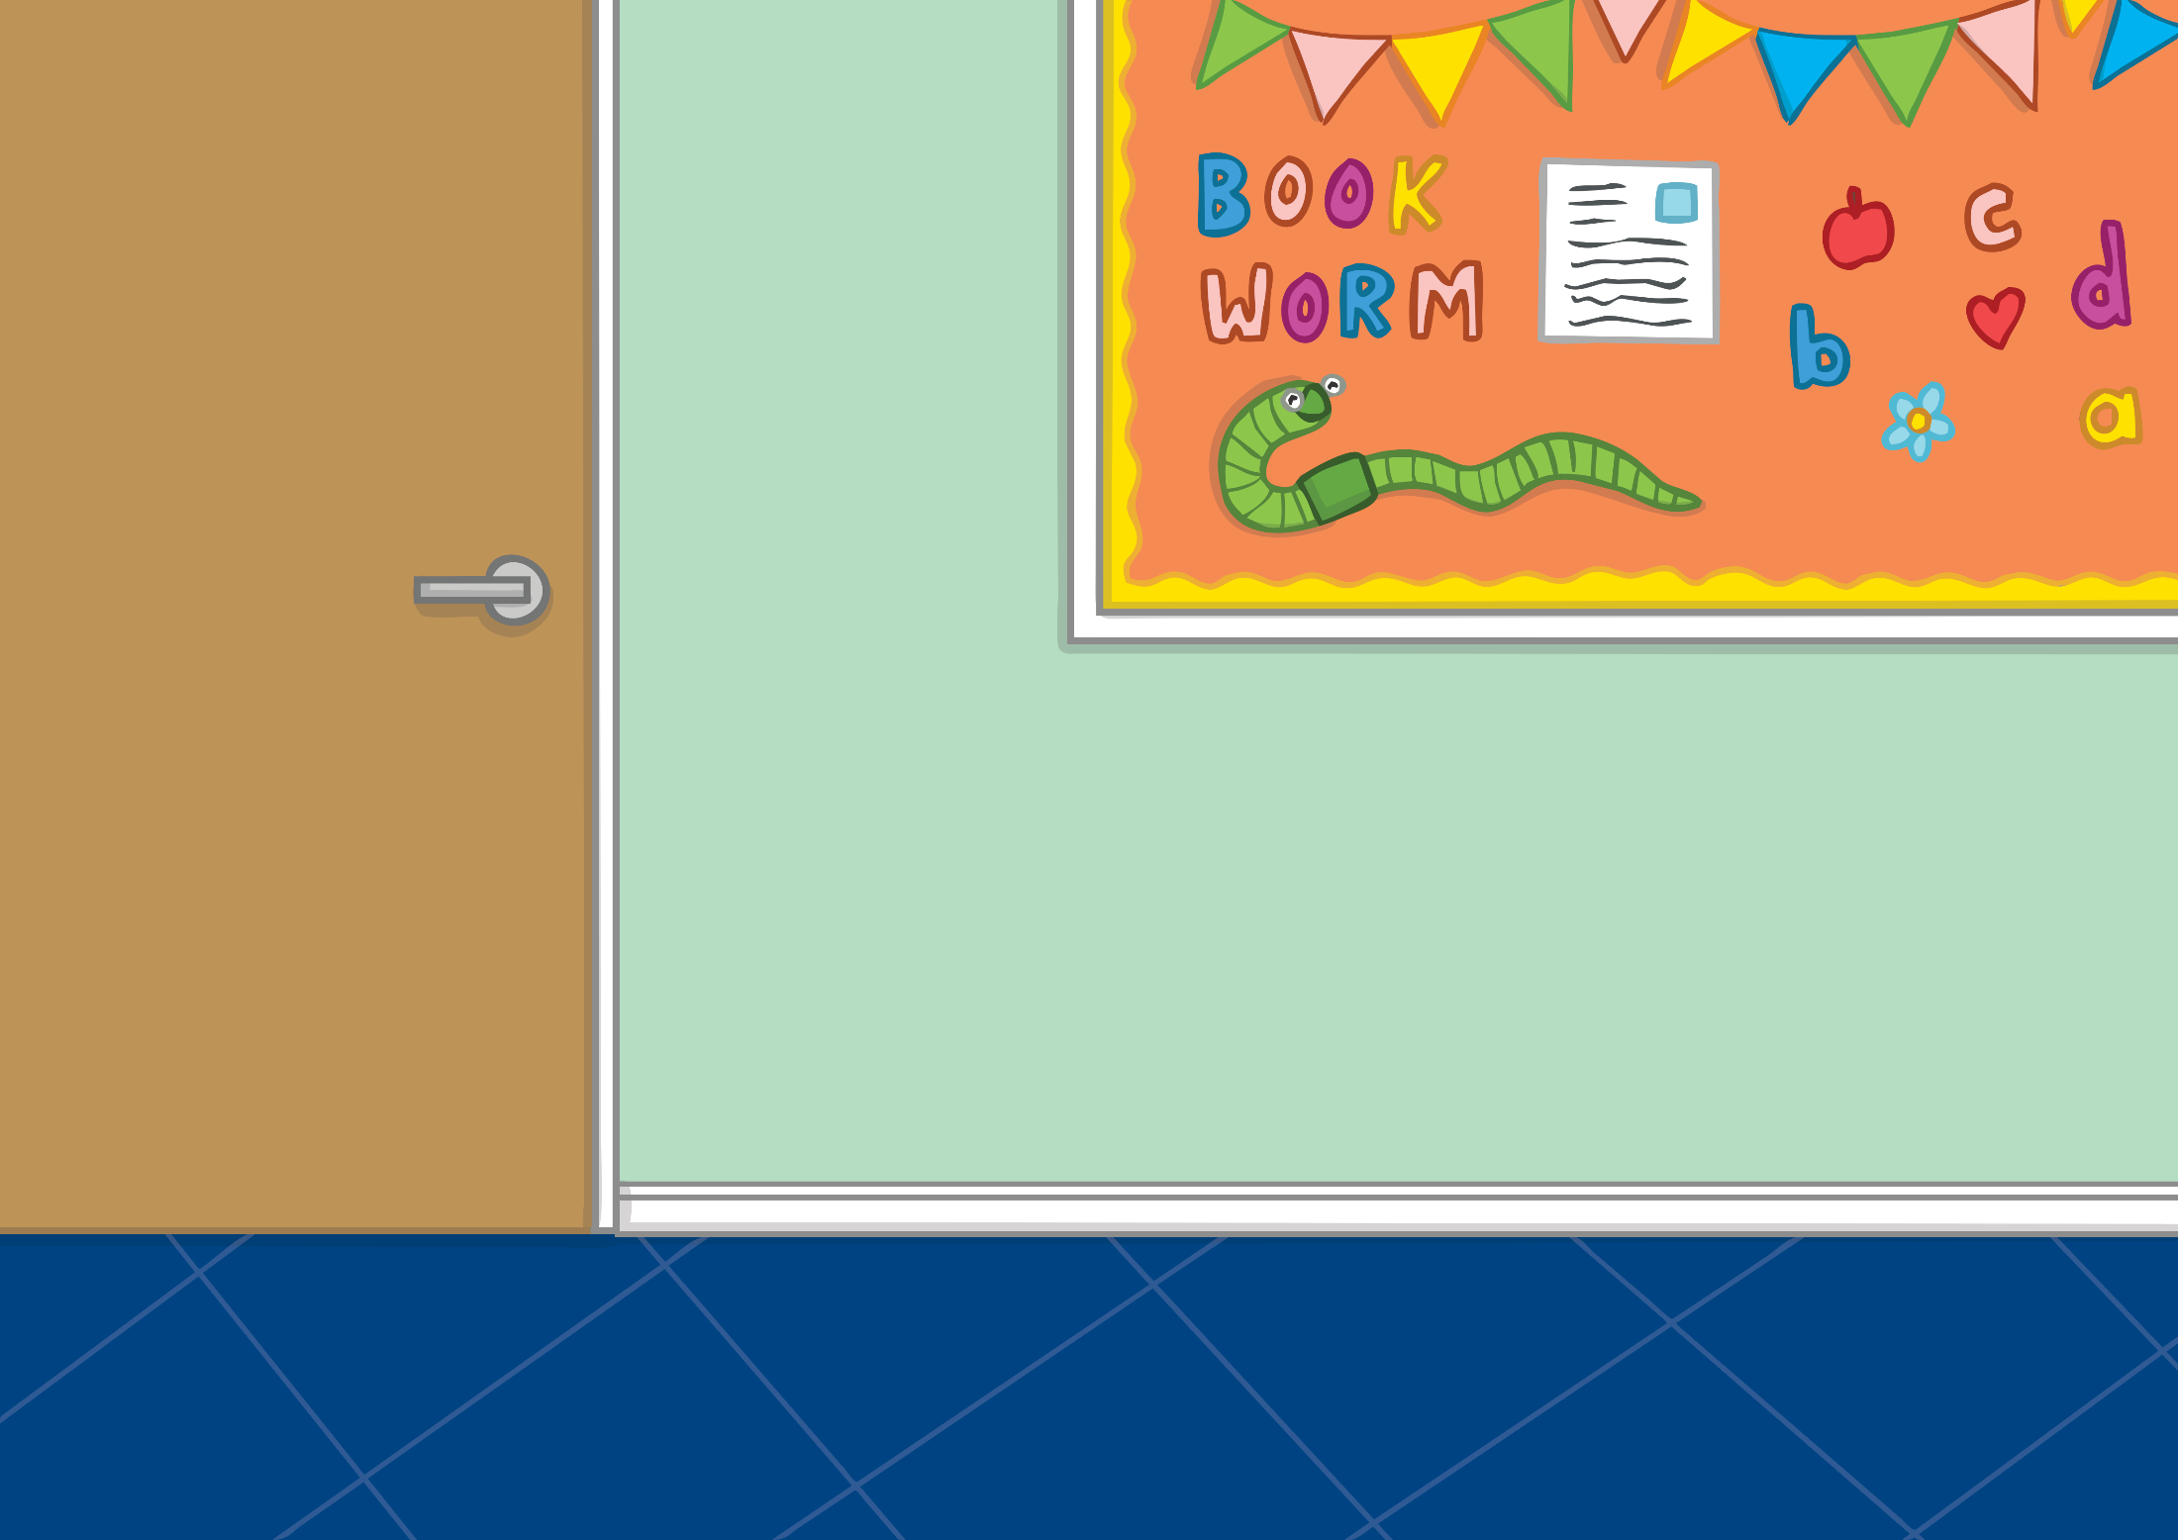
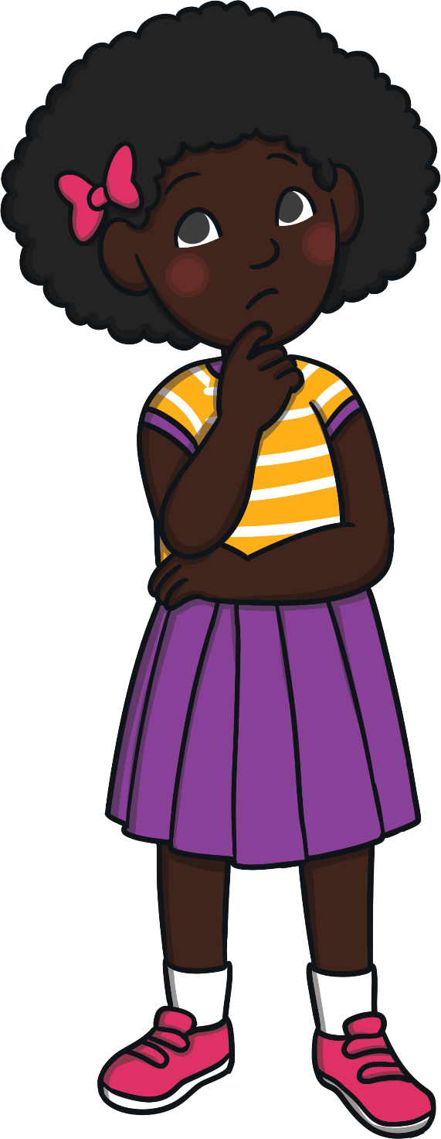
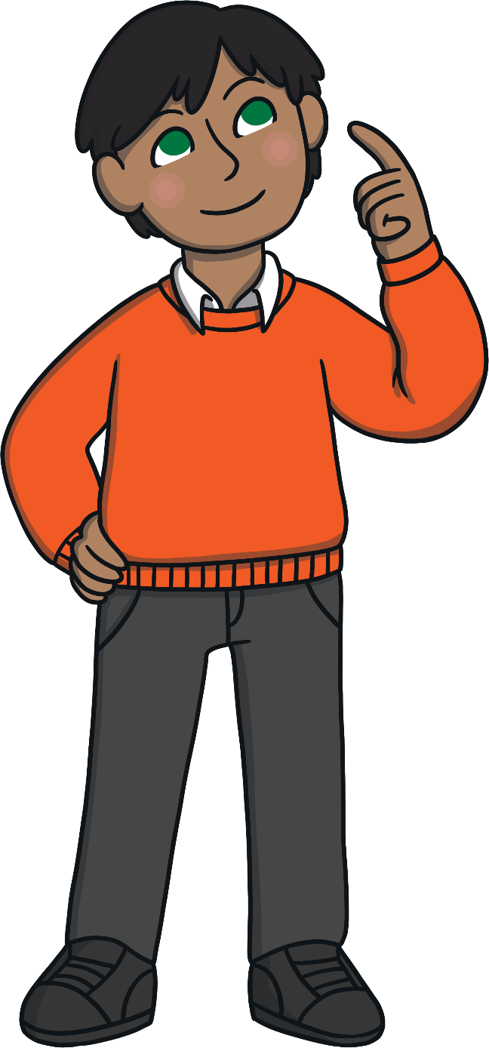
How can we use the Internet to communicate with others?
How can we show respect and kindness online?

Slide 6
Reconnecting

Slide 7
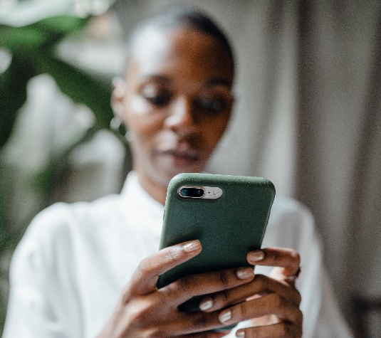
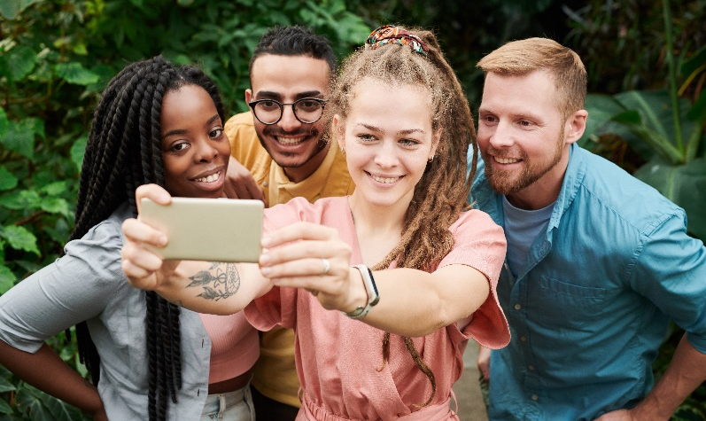
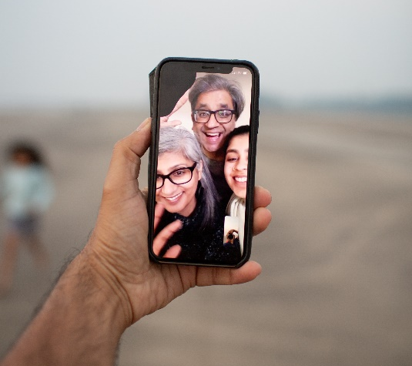
Ways to Say It
The Internet can be useful in many different ways.
One way of using the Internet is to communicate with family and friends. Communicate means to say something to someone.
There are a lot of ways that we can use the Internet to communicate with others.
In this lesson, we will think about the different ways people use these methods and what effect that may have.
How many ways of using the Internet to communicate with others can you think of?
text messaging
social media
picture sharing
video calls

Slide 8
Exploring

Slide 9
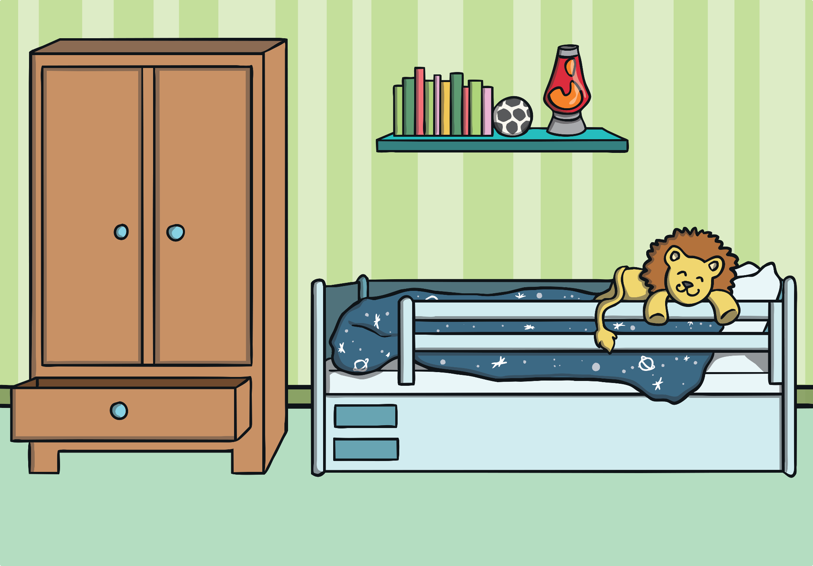
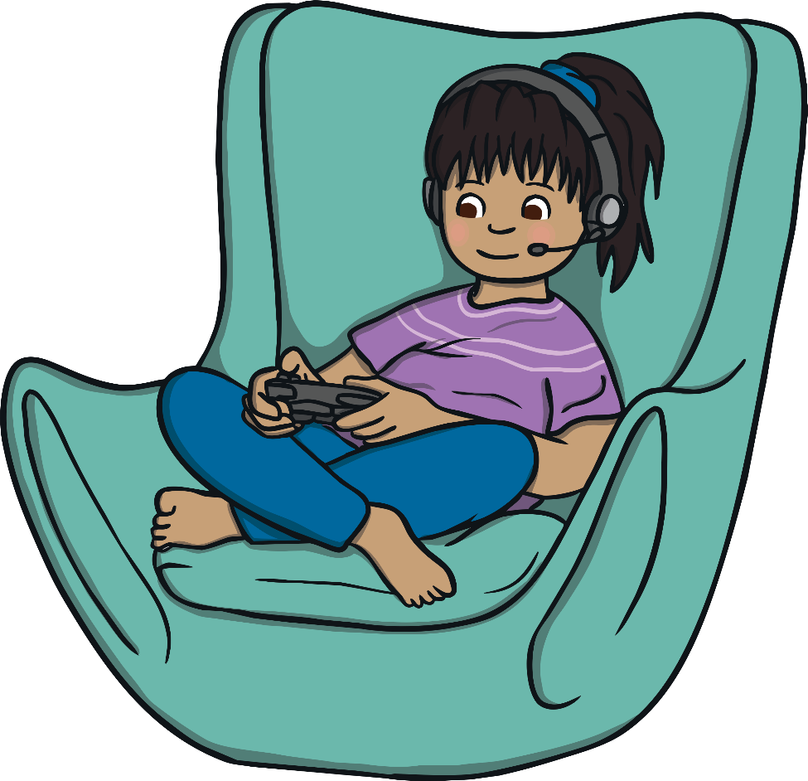
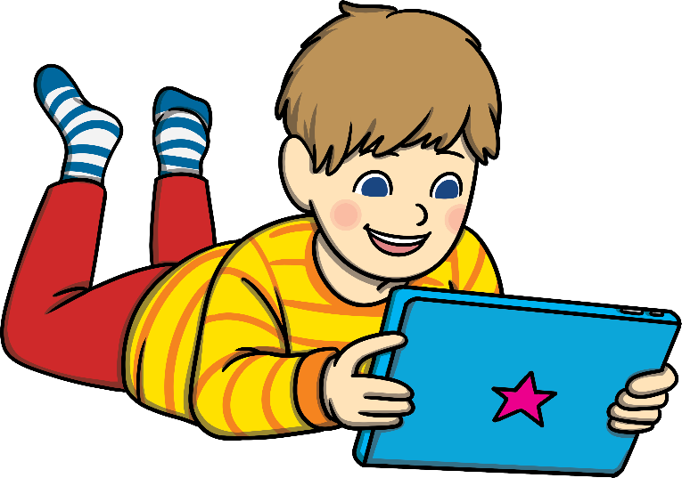
Get the Message!
Sometimes, people use the Internet to communicate with someone directly. This might be through a text message, a picture message, an email or a video call.
When people do this, they know who they are speaking to, messaging or communicating with.
There are so many ways we can communicate over the Internet.

Slide 10
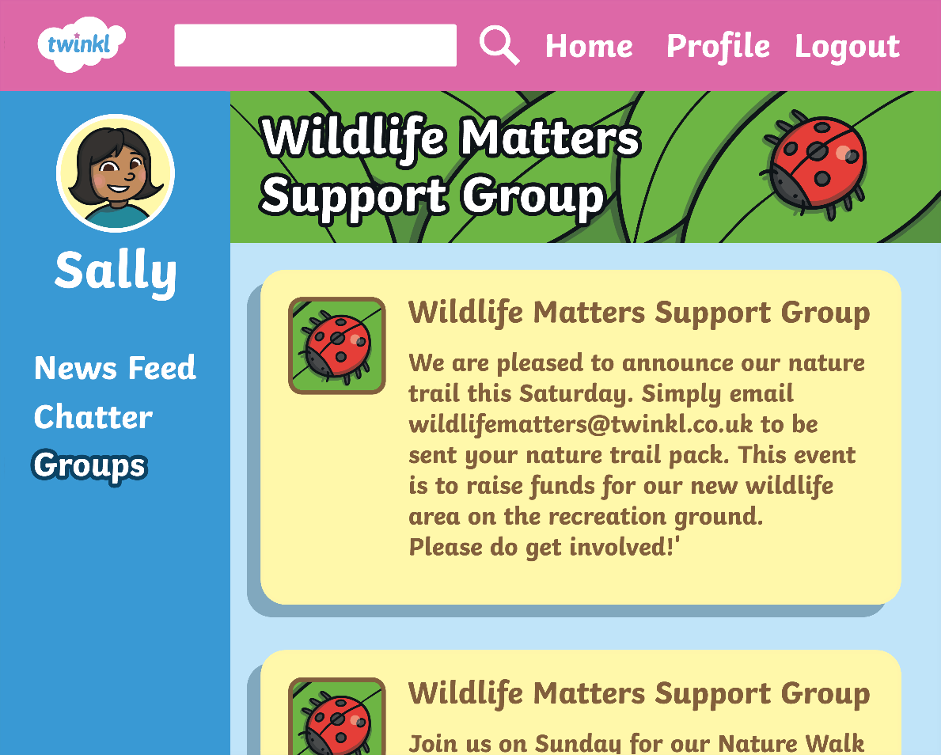
Get the Message!
Sometimes, people use the Internet to share information with a group. This could be with people they know or people they don’t know.
Now, let’s think about the different views we all may have.
Websites like this, and the messages on them, can be seen by lots of people and anyone can write a comment. These websites can be helpful but the people accessing them may not have the same opinions as each other.

Slide 11
Get the Message!
Let’s think about just how easy it can be to react to something. We will now look at some pictures of different things.
Using your Emoji Message Cards, display one of the emojis to show how you feel about that picture.
Fold your card along the dotted line so that you can show only one face at a time. We will now look at some different pictures. Show what you think about each picture by displaying either your smiley or your neutral emoji.

Slide 12
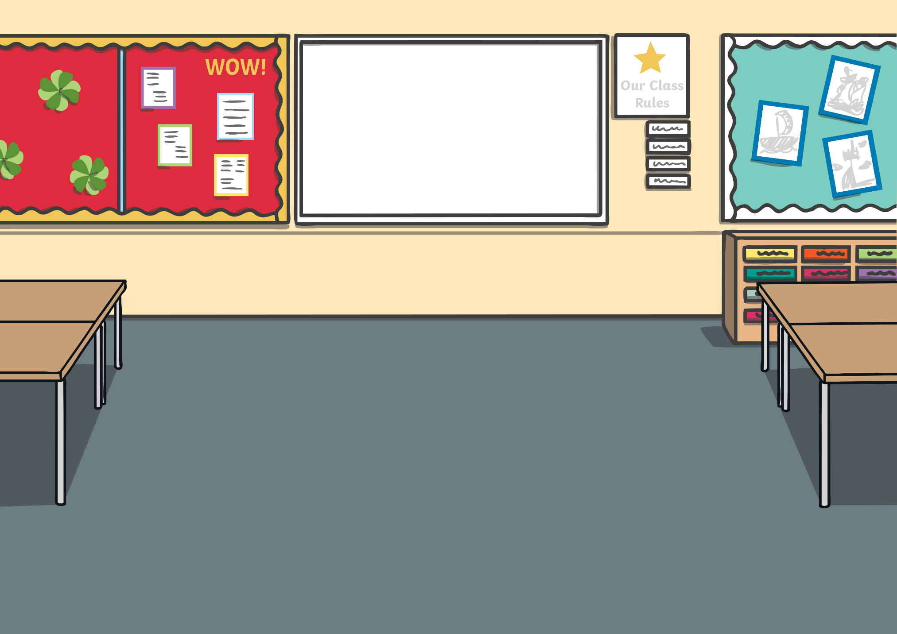
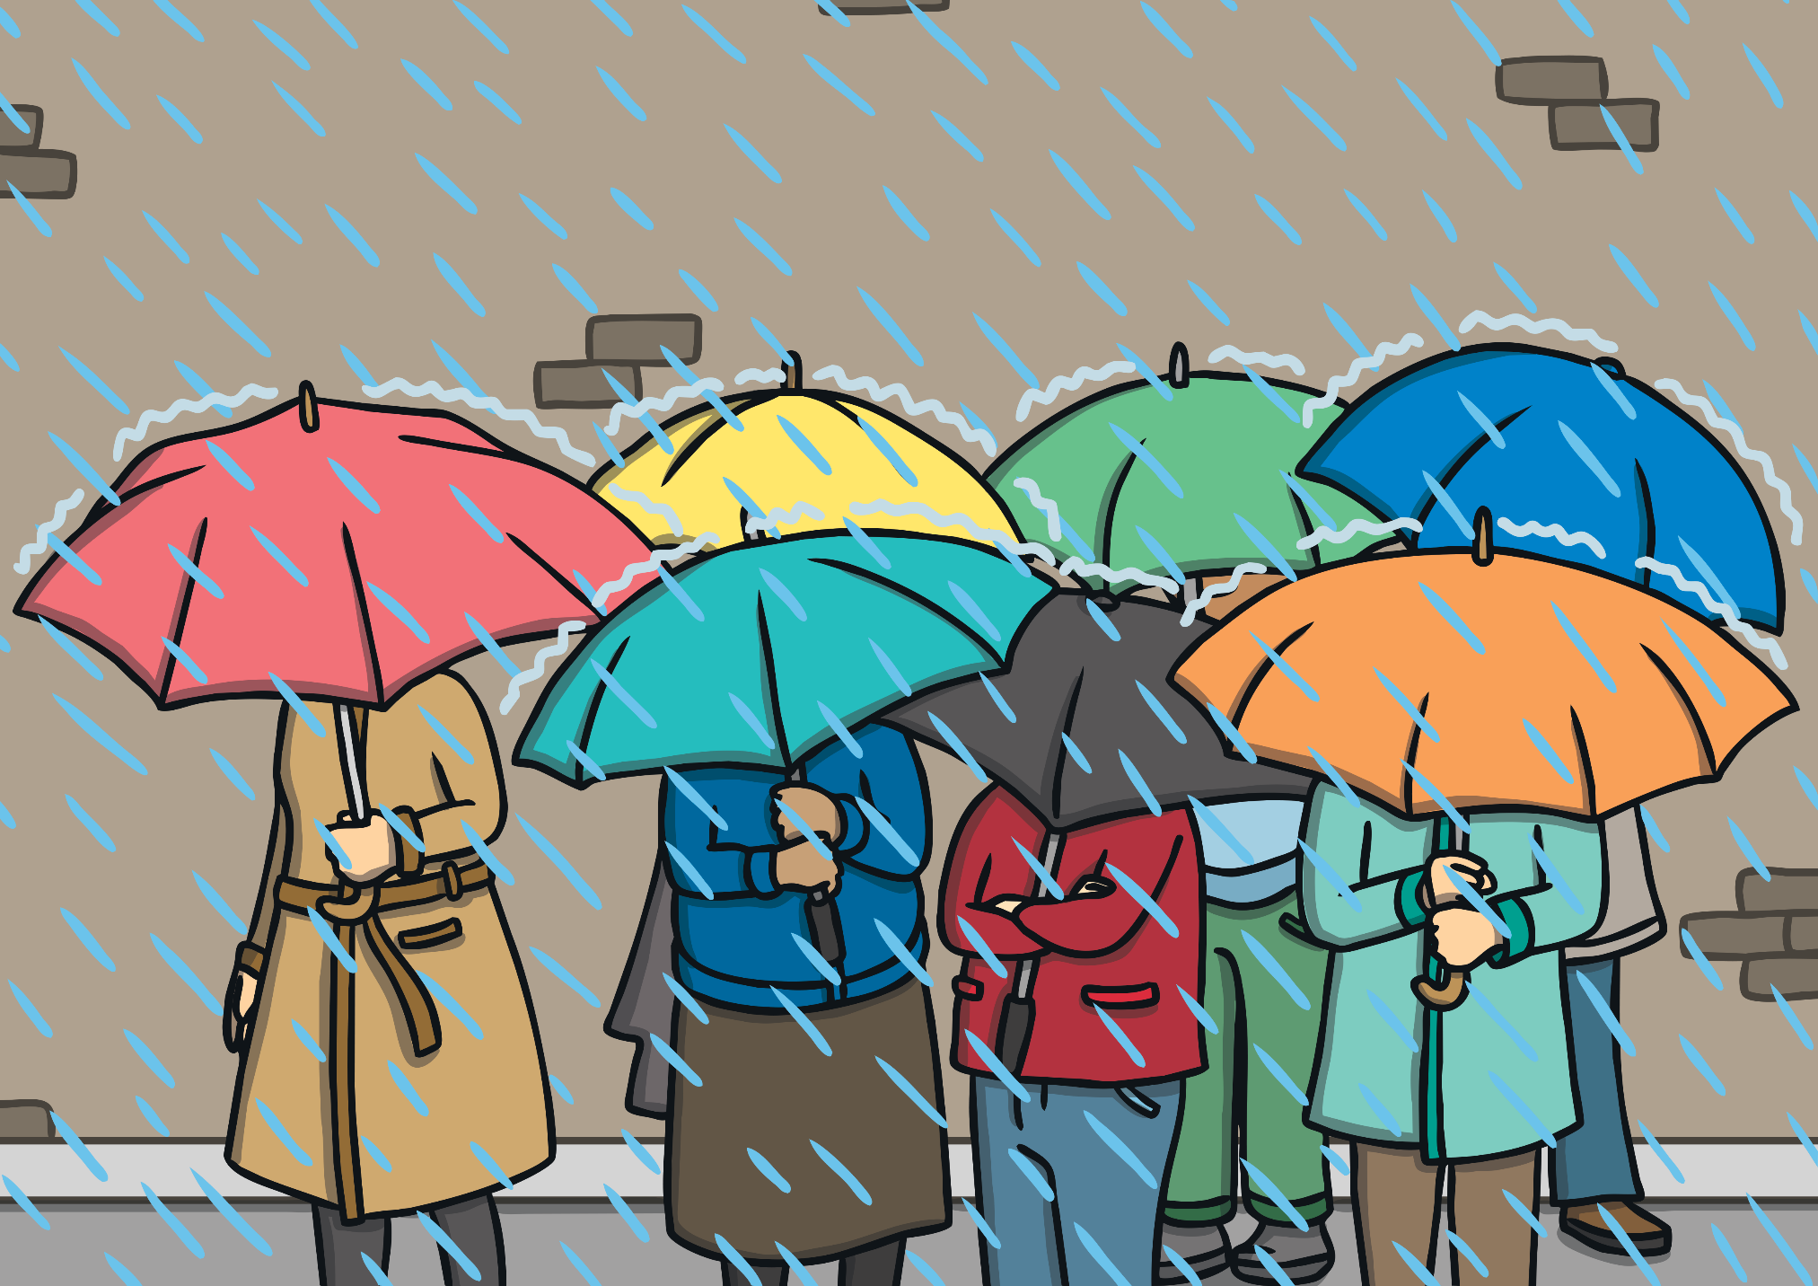
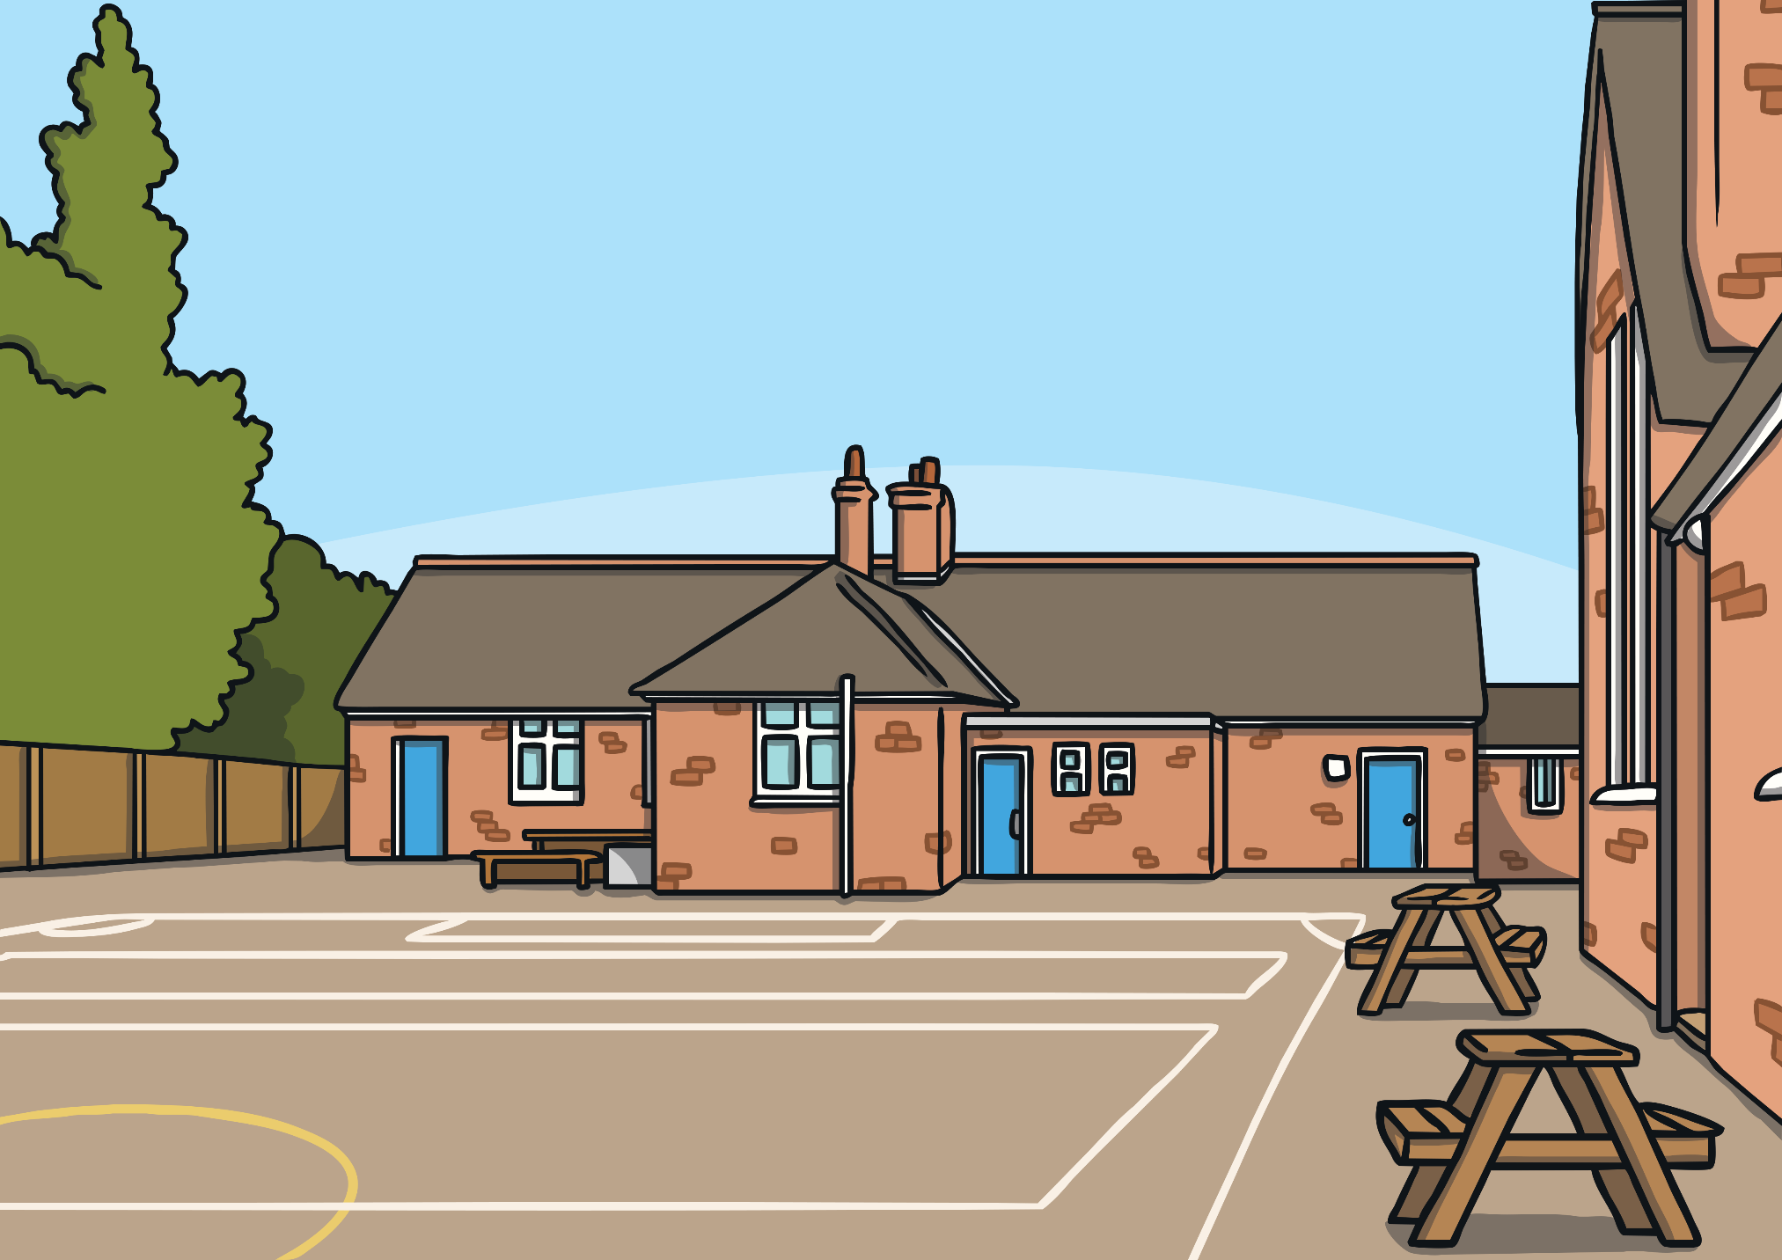
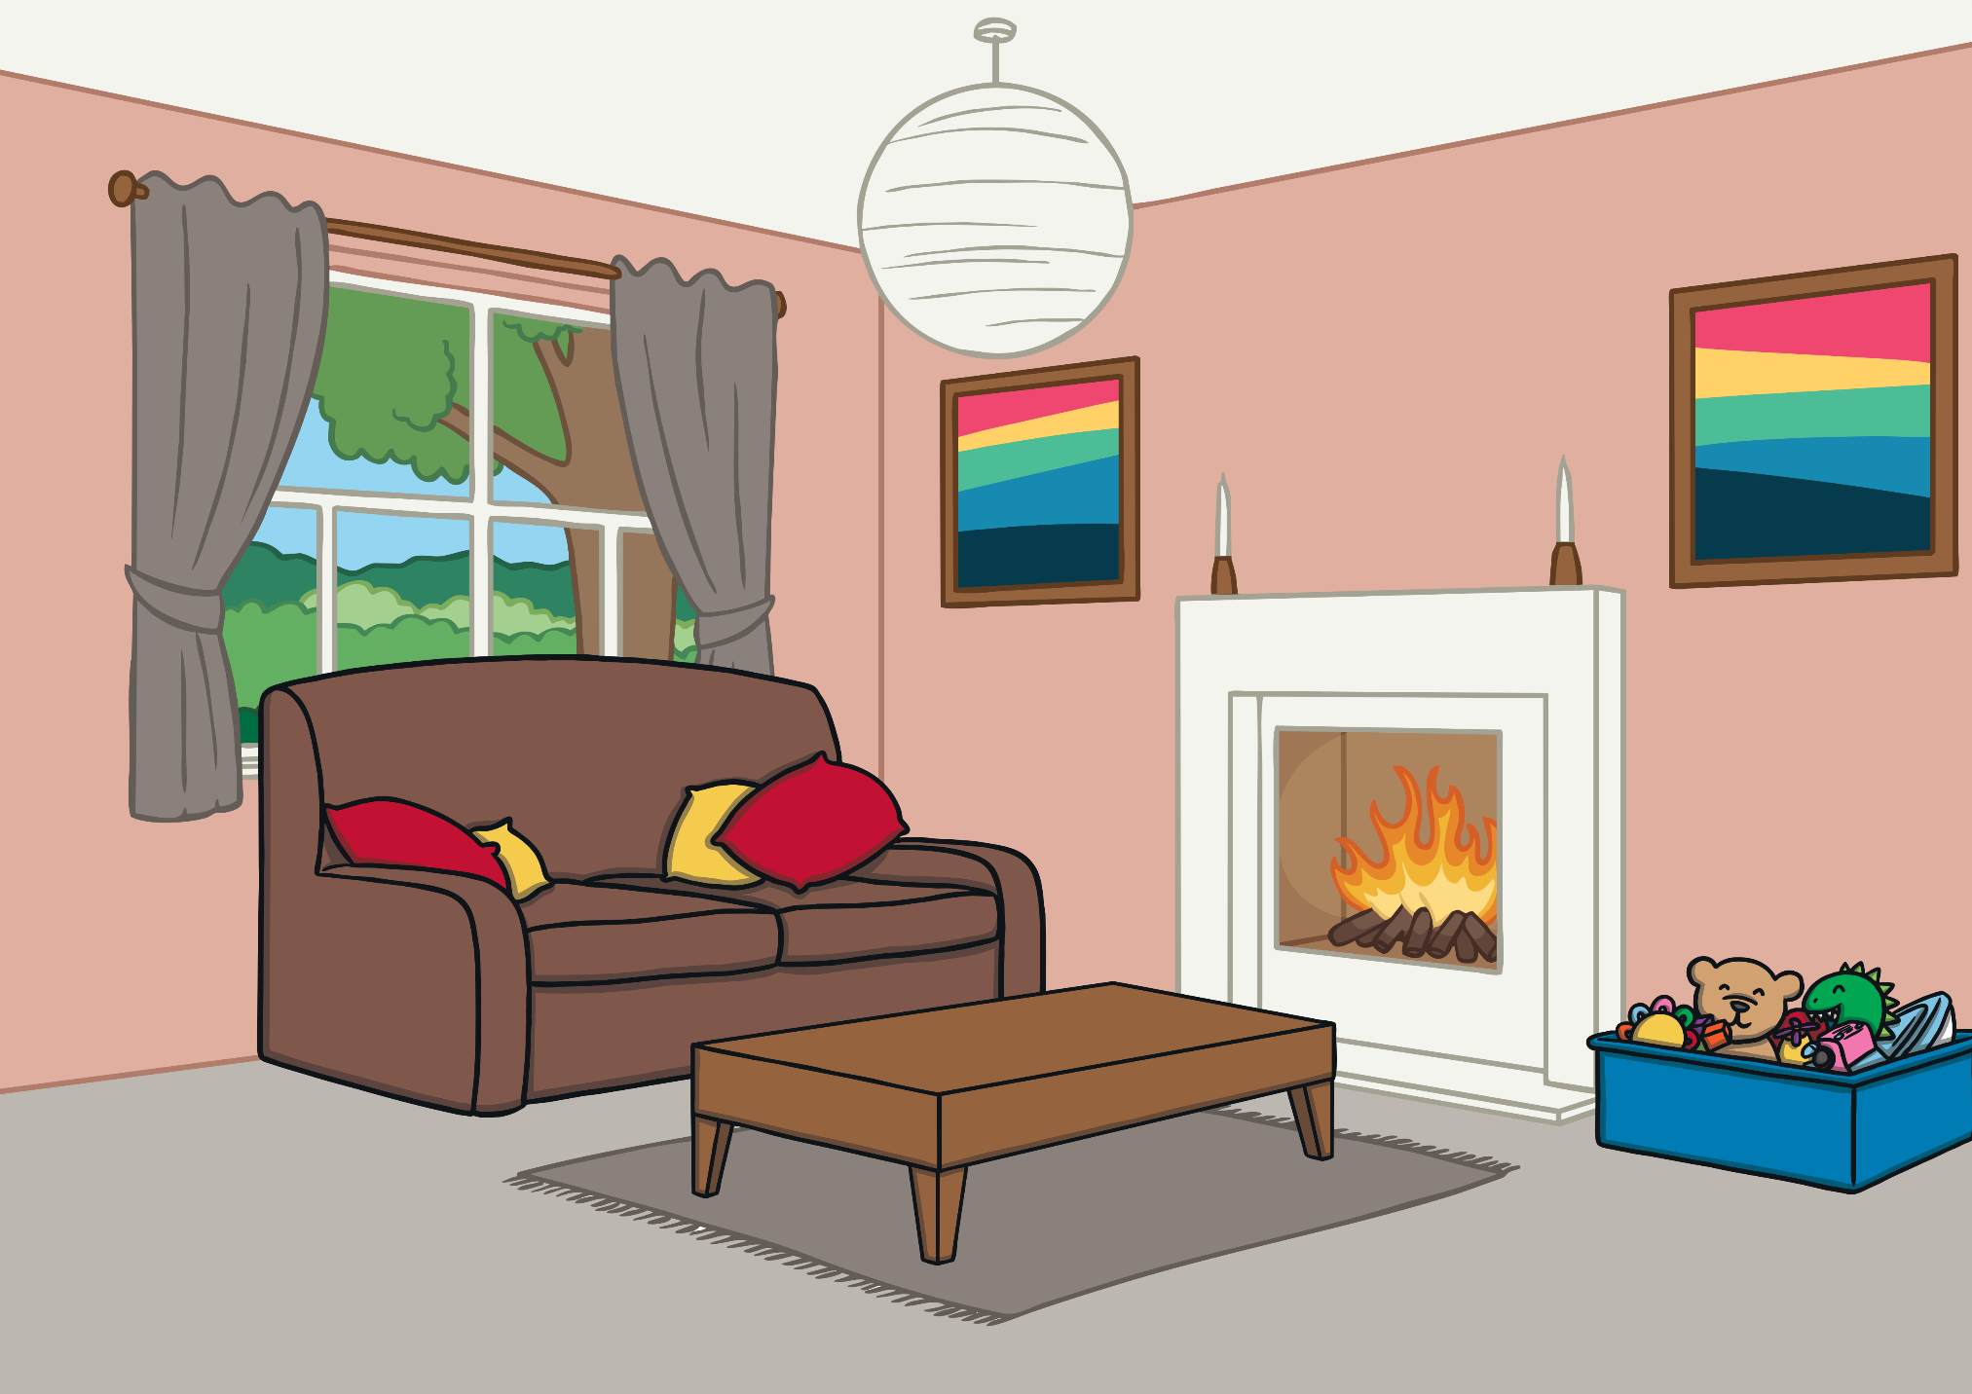
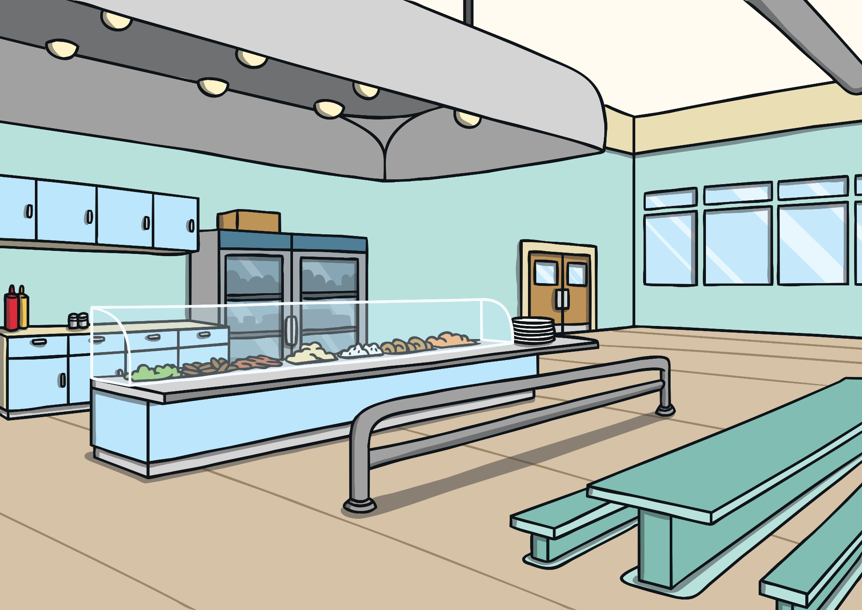
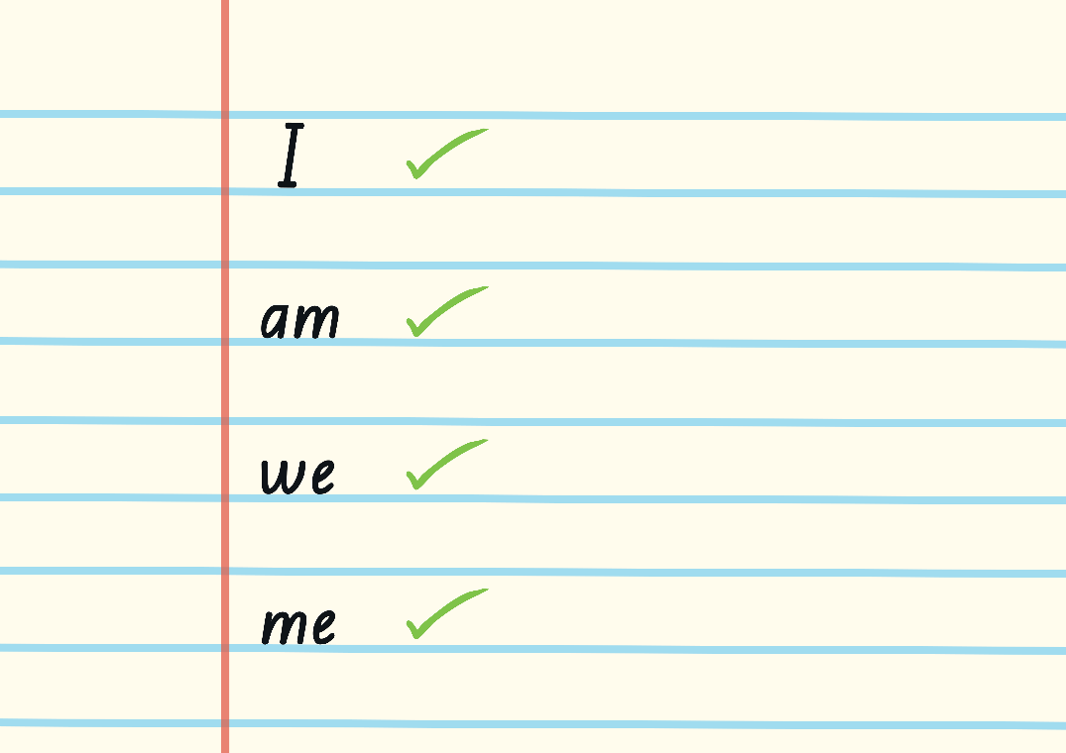
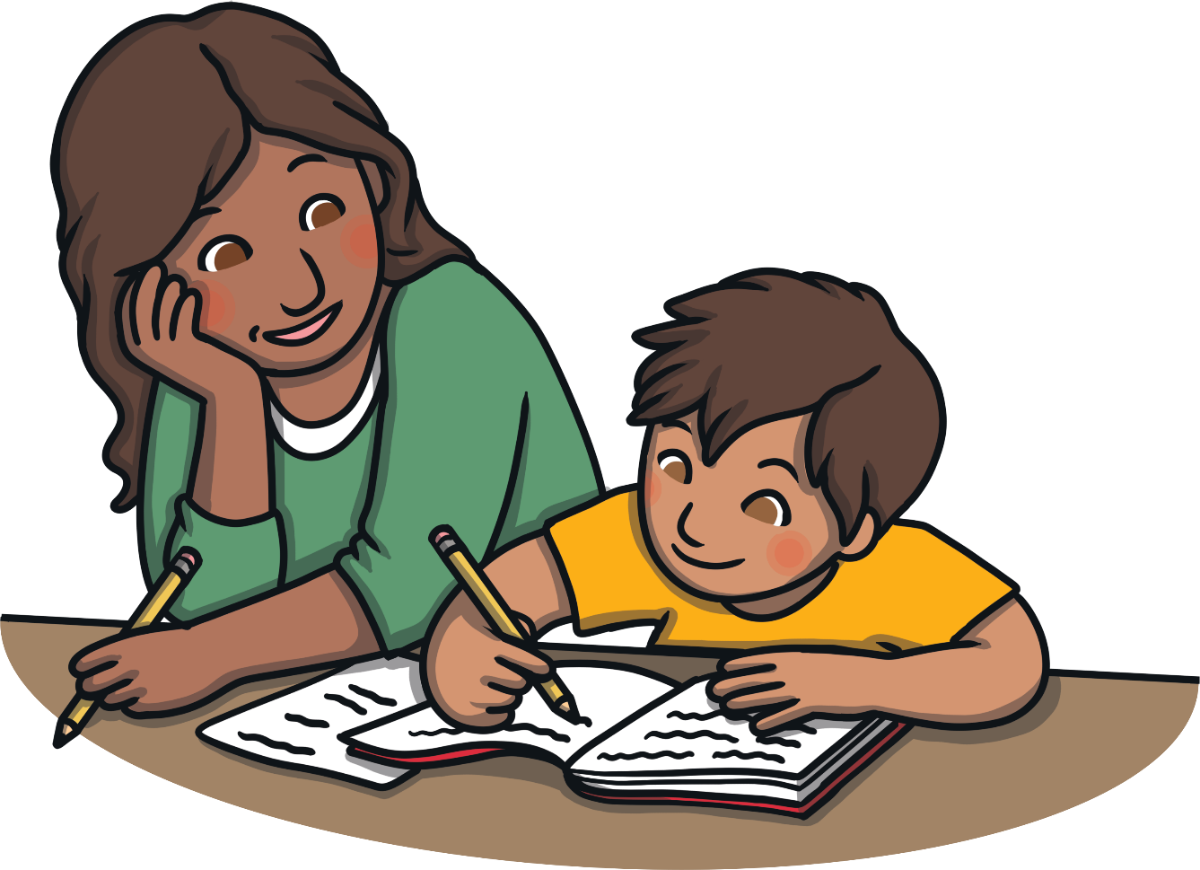
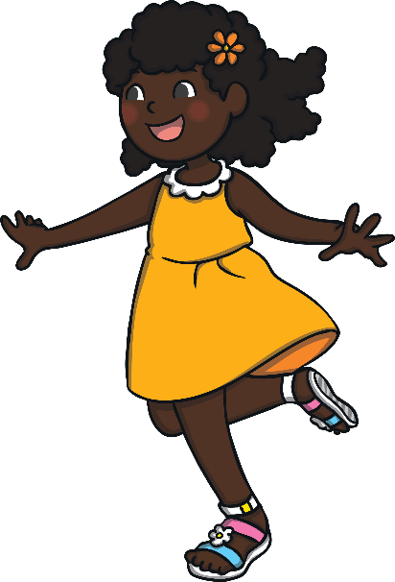
Get the Message!
There’s a spelling test today.
It’s PE today.
We’ve got homework to do.
There’s broccoli for lunch.
It’s raining.

Slide 13
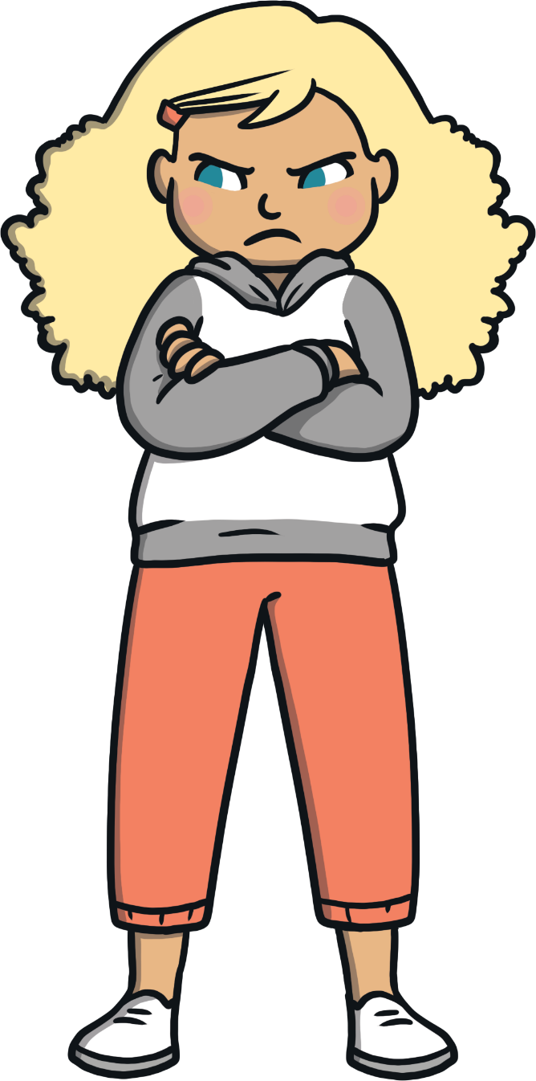
Get the Message!
How easy did you find it to decide which emoji to show? Did we always think the same thing?
When people tell or show us things, there are lots of ways to react.
When we communicate over the Internet, we may see lots of different reactions.

Slide 14
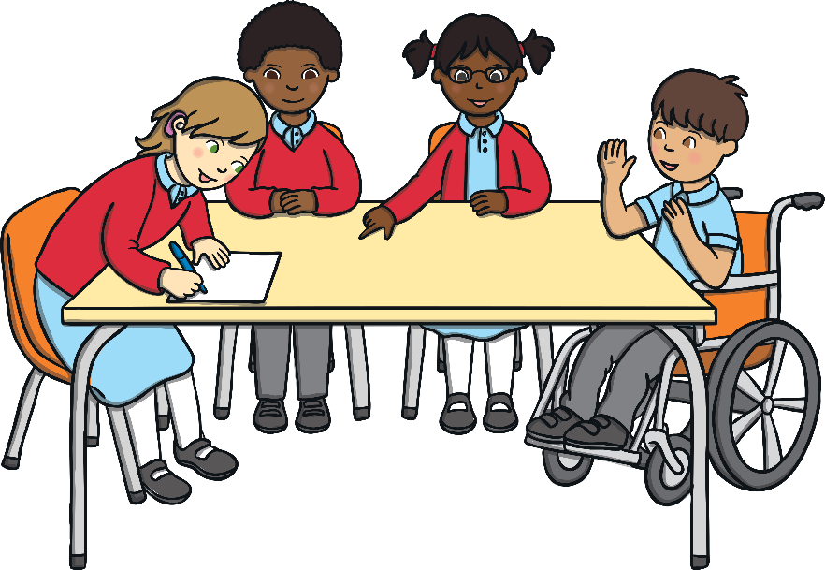
Would You Say It?
When people communicate online, they might sometimes say things or give an opinion that they wouldn’t share if they were speaking to someone face-to-face.
Work in your groups to read through the cards in your Would You Say It? Sorting Cards and sort them into two groups:
Messages that may cause good feelings.
Messages that may cause uncomfortable feelings.

Slide 15
Would You Say It?
Let’s see what we thought about these messages.
Messages sent over the Internet, whether it is directly to us or something we see on social media, may make people feel good or may cause uncomfortable feelings.

Slide 16
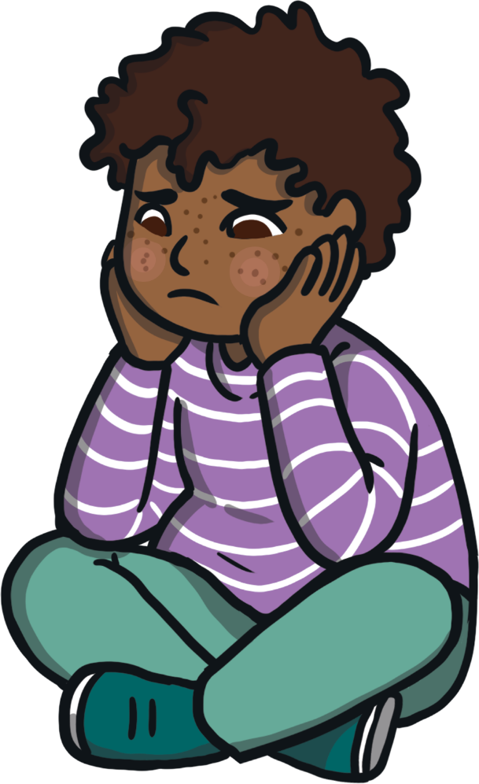
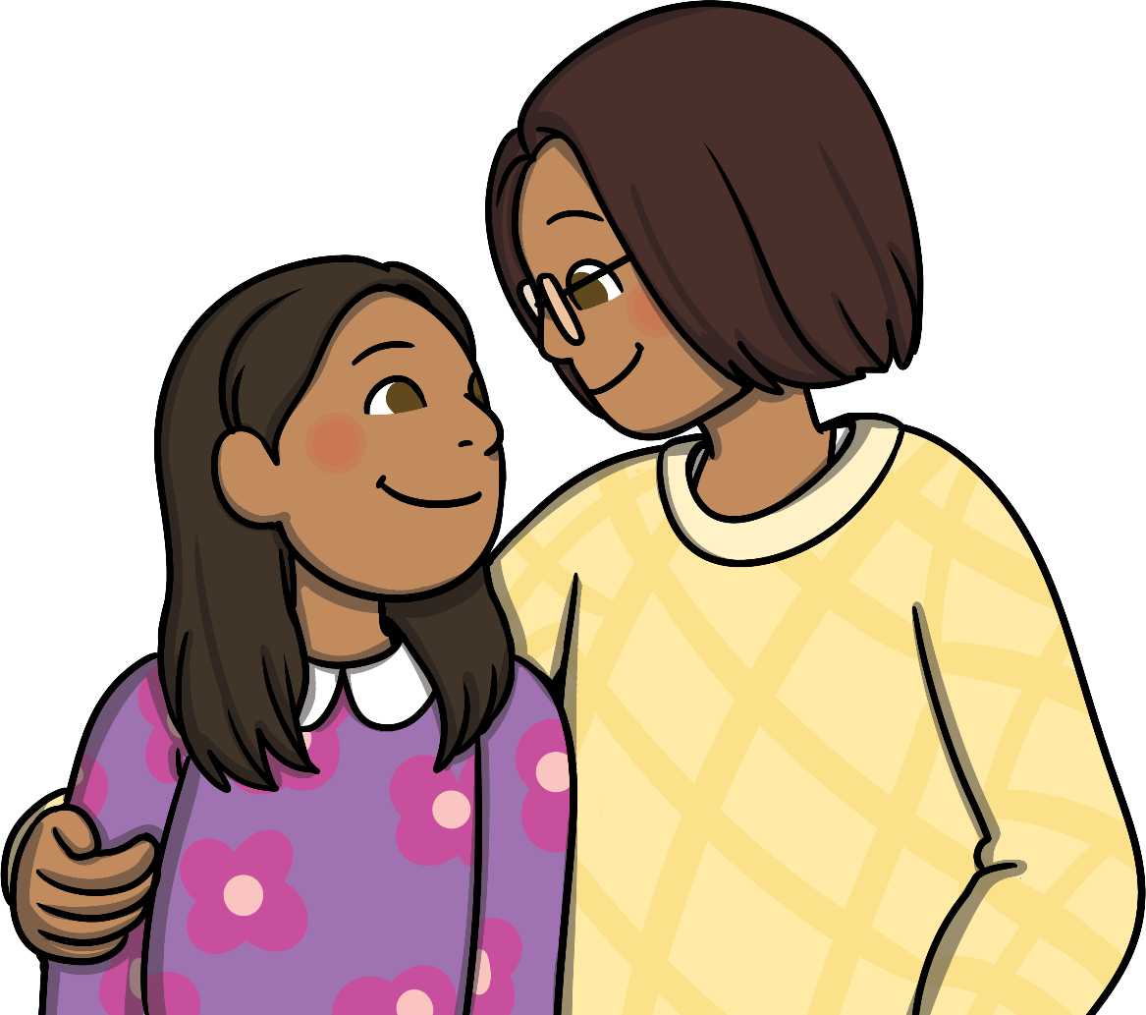
Would You Say It?
If someone says something unkind about something we care about, it can make us feel uncomfortable. This can lead to feelings of worry or upset. Sometimes, these feelings stay with us for a long time.
If anything we see on the Internet makes us feel worried, we must tell a trusted adult straight away. They can help us.
This is not OK. It is not OK to make anyone else feel uncomfortable. Everyone has the right to feel comfortable with who they are and what they like. This should be respected and valued.
If we ever feel uncomfortable feelings, we must speak to a trusted adult about how we feel.
We should feel proud of who we are, of what we like and of what we do.

Slide 17
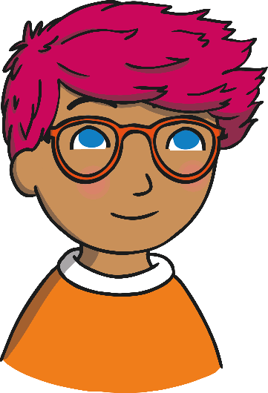
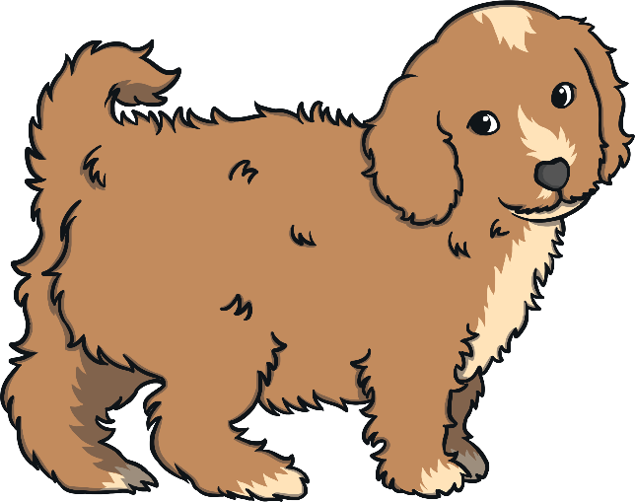
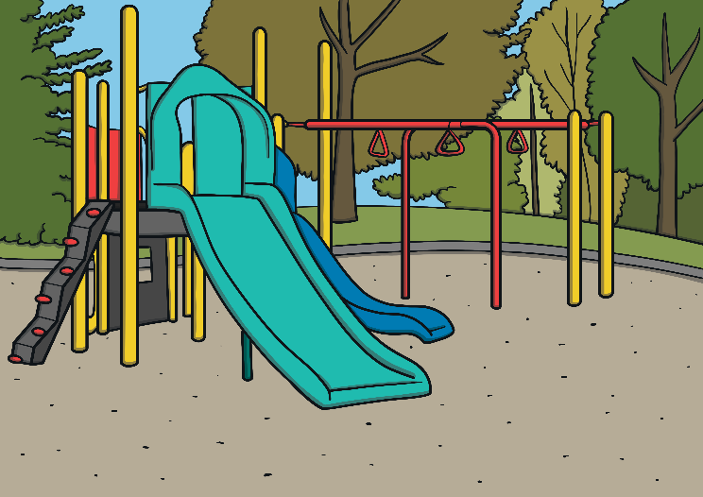
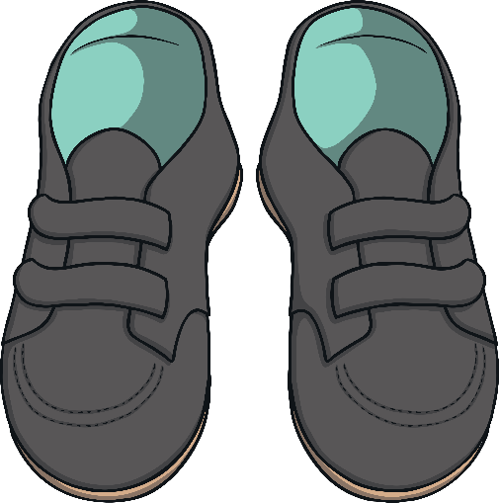
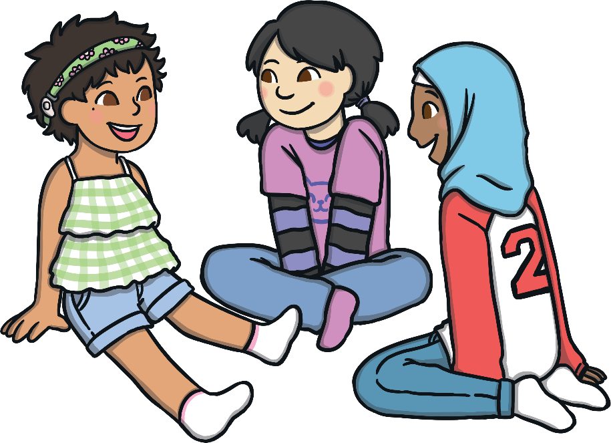
Would You Say It?
We can also think about our own comments that we make online. We must always make sure these are kind and respectful. This way, we can help other people feel good and feel good about ourselves too.
I’m feeling a bit sad - I’m not allowed to come to the park.
I just went shopping for school shoes – these were the only ones in my size!
We got a puppy at the weekend!
Look at my new haircut.
Work as a group to write a reply to each of the messages that appear.
…
…
…
…

Slide 18
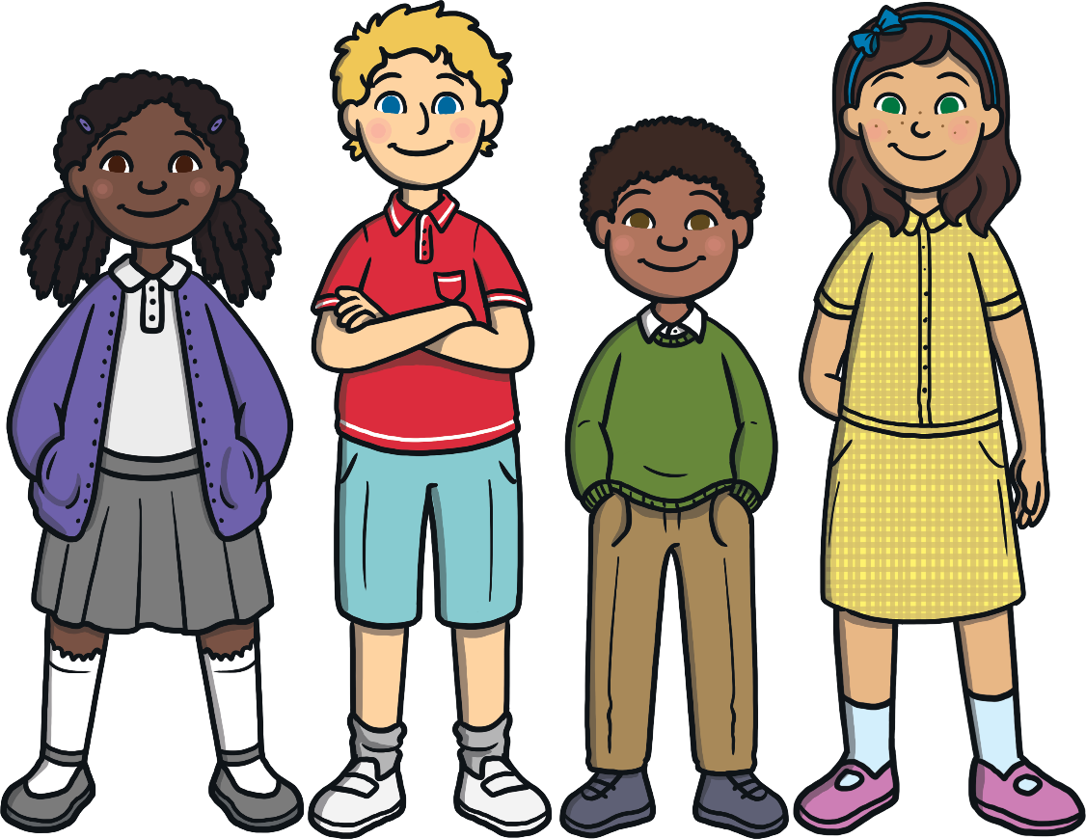
Would You Say It?
It is important to treat others as we want to be treated. Let’s make sure all of our online comments show kindness and respect to others. If we consider the feelings of others in all that we say, we can help people to feel good!
By considering other people’s feelings, we can make sure our comments and messages are positive and we can show our friends that we care about them.
Consolidating
Reflecting

Slide 19
Consolidating

Slide 20
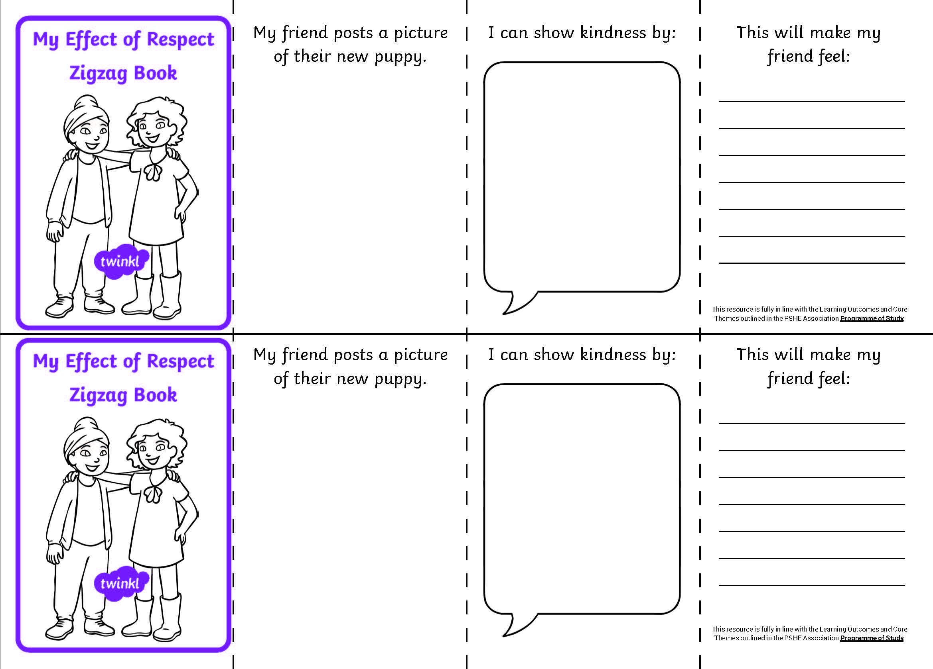
The Effect of Respect
We have thought a lot about the effects of online communication and how important it is to use our words to show respect and kindness.
We will now make our own Effect of Respect Zigzag Book to show the effects of kind and respectful comments.
Fold your paper in half, bringing the short edges together.
Then, fold each short edge back to meet the fold.

Slide 21
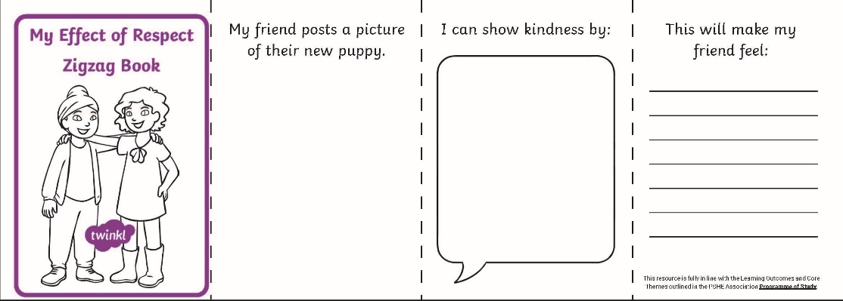
The Effect of Respect
Let’s think about what we can include in our Effect of Respect Zigzag Book to show the effects of kind and respectful comments.
Think about:
how your friend feels about what they are telling you;
why they are sharing this with you;
what you can say that will show kindness and respect;
how this will make them feel.
Try to use these words:
communicate, message, comment, respect, kindness, positive, support, feelings, helpful

Slide 22
Reflecting

Slide 23
Ways to Help
We have thought a lot about the importance of showing kindness and respect in what we say to others online.
You will now be given a sticky note. On it, write one piece of advice you would give to other children about how to make sure our comments show care, kindness and respect.
There are so many ways to communicate online. Let’s make sure we always use kind and respectful comments to help people around us feel good.

Slide 24
The Big Questions

Slide 25
How can we use the Internet to communicate with others?
How can we show respect and kindness online?

Slide 26
Aim
I know how to communicate online in ways that show kindness and respect.
Success Criteria
I can talk about ways people communicate online.
I understand that people may behave differently online.
I can explain what to do if I am worried about anything I see online.
I know how to show respect and kindness online.

Slide 28
Aim
I understand that not everything on the Internet is true.
Success Criteria
I can talk about the different information we might find on the Internet.
I can discuss examples of false information.
I can suggest ways to find out if something online is true.
This resource is fully in line with the Learning Outcomes and Core Themes outlined in the PSHE Association’s Programme of Study.

Slide 29
The Big Questions

Slide 30
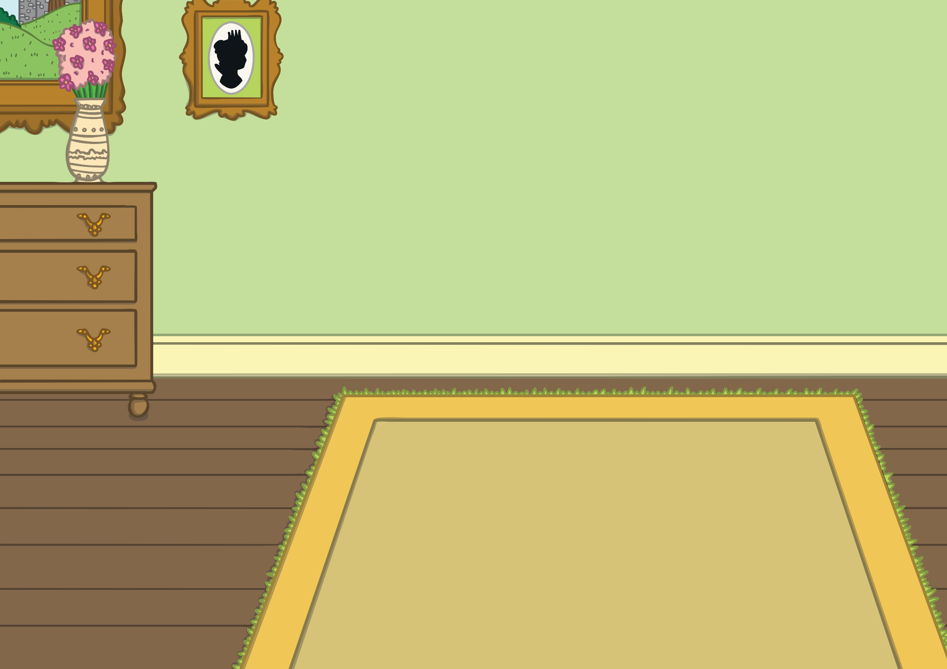
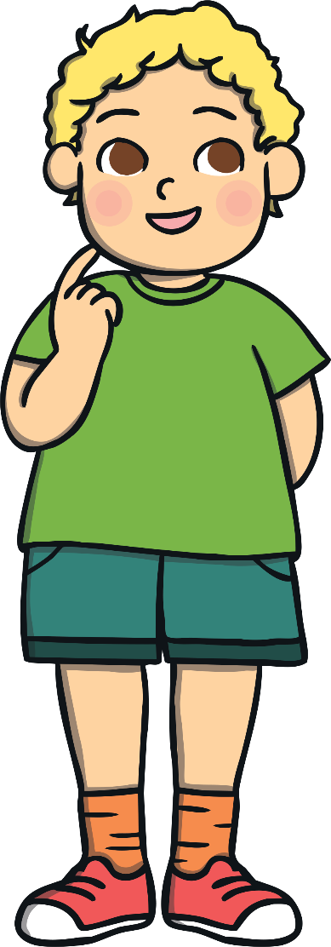
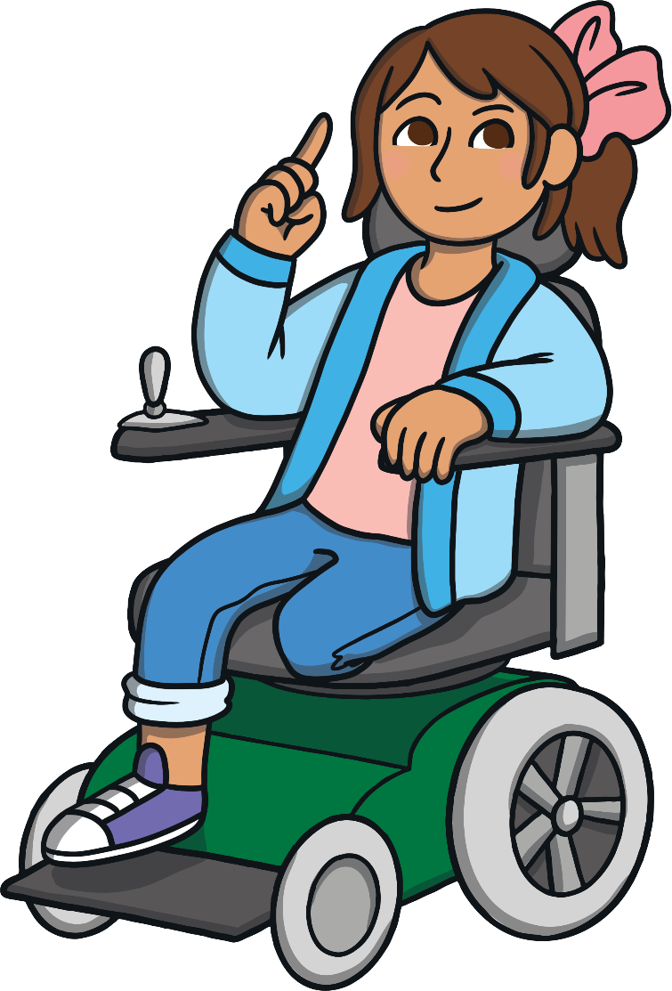
Can we trust everything we see on the Internet?
How do we know what is true?

Slide 31
Reconnecting

Slide 32
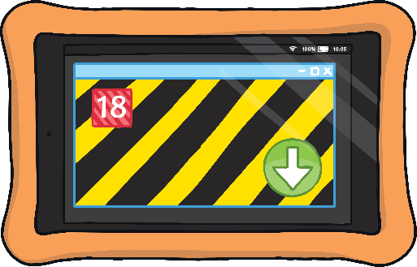
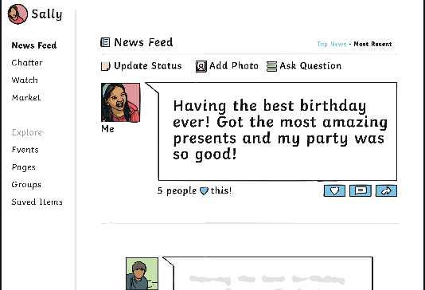
Is It True?
We can see and read so much information on the Internet.
Do you think we can trust everything we see online? Is it always true?

Slide 33
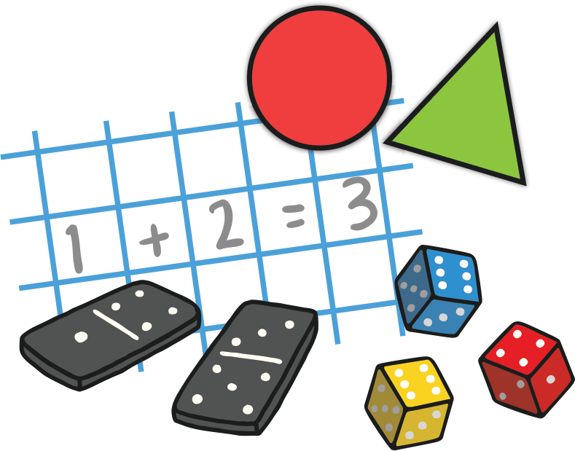
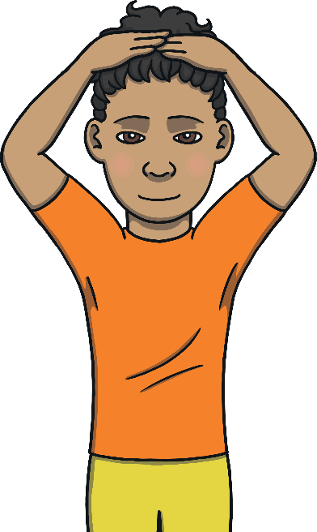
Is It True?
We will now play a game called ‘Is It True?’. You will see some pictures and sentences and you need to decide if they are true or false.
I think this is true.
I think this is false.
If you think what you read is true, put your hands on your head but if you think that what you read is false, put your hands on your shoulders.
I will go to the park today.
We have a maths lesson next.
The sky is green.
It is raining outside today.

Slide 34
Is It True?
We have learnt that the information we see online may not always be true and about how important it is to find out for sure before we believe it.
In the game, we could look for specific information to check whether something was true or false or we could use what we already know.
When we look on the Internet, lots of it may seem new to us so using what we already know may not be enough.

Slide 35
Exploring

Slide 36
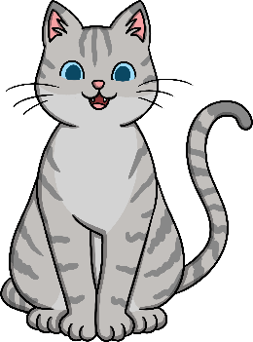
Spot It!
We are now going to look at some examples of information on the Internet. In each example, however, what we read may not be true.
All About Cats!
This may be because:
Cats are common household pets in the UK.
the person writing the information may have made a mistake;
someone may be writing something false to play a joke;
Many families have a pet cat and it is considered part of the family.
what we are reading may be trying to make us believe false information on purpose.
Cats have four legs, soft fur and can be black, white, ginger or pink.
After you have heard the information, talk to your partner about why you think it is false. Can you explain any reasons for why it was written?
It is unlikely that anyone wants us to believe that cats can really be pink but it is more likely someone has made a mistake in what they wrote. Cats can’t be pink!
Do you think this information is true or false?

Slide 37
Spot It!
Let's look at another example. After you have heard the information, talk to your partner about why you think it is false. Can you explain any reasons for why it was written?
I did so well at football club last night!
In the game at the end of training I scored like 50 goals!!
Scoring this many goals would be too difficult in one short match. It is more likely that the person wants to show how well they did and how proud they feel, rather than actually meaning to say something that isn’t true.
Do you think this information is true or false?

Slide 38
Spot It!
Let's look at another example. After you have heard the information, talk to your partner about why you think it is false. Can you explain any reasons for why it was written?
Stores Astounded over Demand!
Stocks of this new toy aeroplane are vanishing across the country as customers rush to buy them.
Every child in the country wants one and not many more will be made! If you are one of the many people longing for this toy, don’t wait around! Go get yours now!
The website cannot actually know what every child wants, so we need to ask more questions. Maybe the toy company has paid money to have this written so they sell more of the aeroplane.
Do you think this information is true or false?

Slide 39
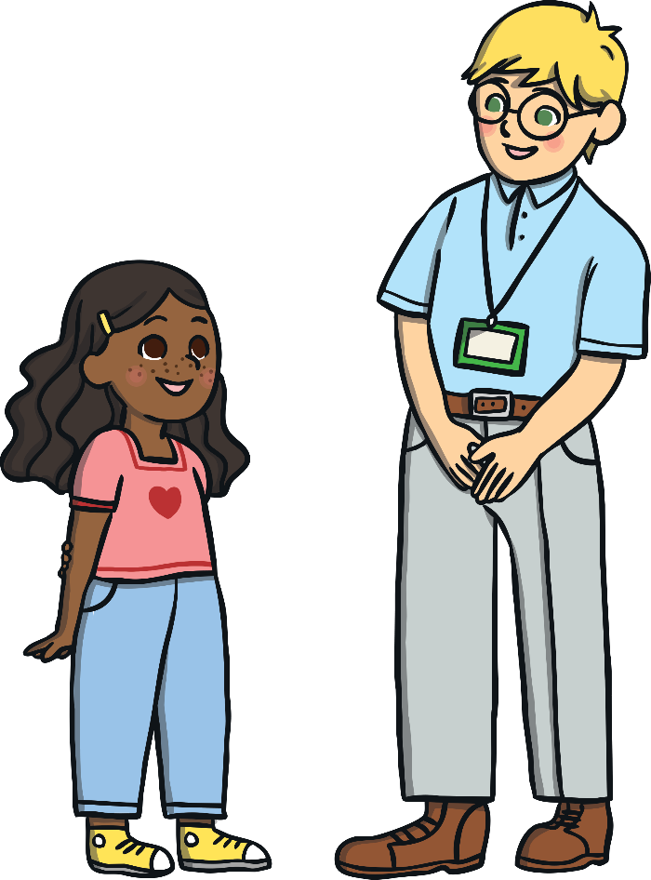
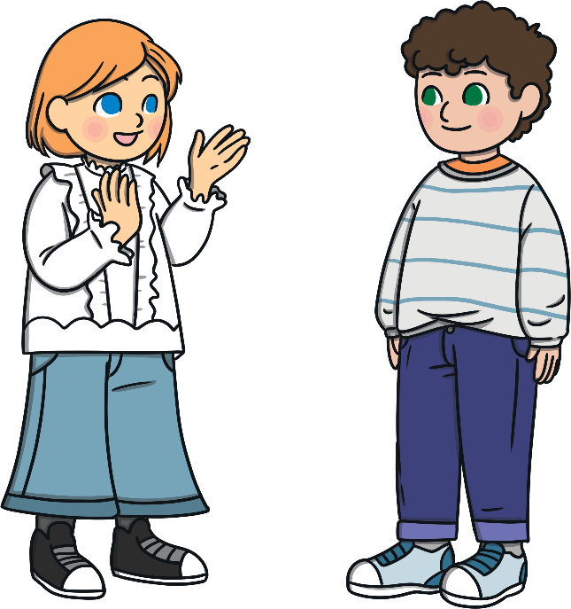
Spot It!
Not everything we read on the Internet is true.
If we’re not sure, there are certain ways to check.
We could ask the person who wrote it, if this is possible. If you want to know if something is true, it’s fine to ask.
We could talk about it with a trusted adult and ask them to help us.
We could check the facts with a reliable website. If a well-known charity or organisation has been named in the information, this is really good sign!

Slide 40
Find the Facts!
Let’s be false-information detectives!
Working as a group, read the information you have on your cards and discuss:
whether you think it is true;
what made you decide this;
what you could do next to check it out further.

Slide 41
Find the Facts!
Let’s see what each group decided.
True
False
False
True
Remember, we were looking at:
whether you think it is true;
what made you decide this;
what you could do next to check it out further.

Slide 42
Find the Facts!
What a lot of information we can find online!
Although it can be very useful, we must remember it may not always be true and we might want to check it out.
Anyone can share any information they want to on the Internet. Let’s make sure that what we share shows respect and kindness and that we ask a trusted adult if there’s something we are not sure about.
To do this we can:
talk about it;
ask the person who posted it, if possible;
check with a reliable website.
Consolidating
Reflecting

Slide 43
Consolidating

Slide 44
True or False?
We have learnt that the information we see online may not always be true and how important it is to find out for sure before we believe it.
Let’s help others understand this too.
Create your own True or False? Poster to help other children understand that what they see online may not always be true.
Try to include these words:
messages, jokes, false, fake, news, information, research, chat, check, trusted adult

Slide 45
Reflecting

Slide 46
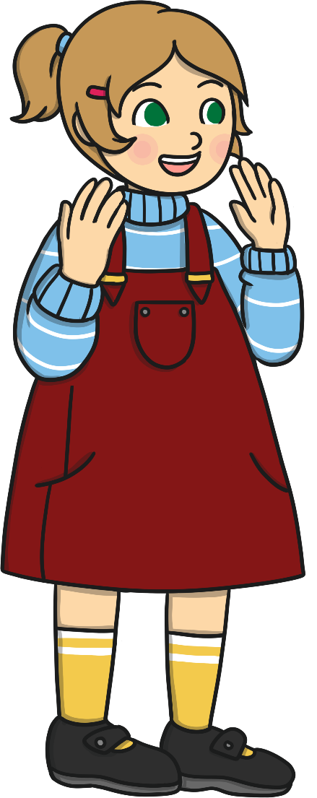
Ways to Help
On the Internet, it is easy for people to write what they like.
In pairs, we will now put what we have learnt into practice!
One of you needs to pretend to be a child who has tried to research information for their homework on parrots but is confused by what they’ve read.
Sometimes it is true.
Let’s remember:
what we see online might be true or it might not;
how to check what we are reading or seeing;
to always treat others online with kindness and respect;
to use the Internet responsibly.
Sometimes it is a joke.
The other needs to pretend to be a trusted adult who can help by reminding them what to do to check any information they have read online.
Sometimes it is a mistake.
Sometimes it is someone trying to trick us.

Slide 47
The Big Questions

Slide 48
Can we trust everything we see on the Internet?
How do we know what is true?

Slide 49
Aim
I understand that not everything on the Internet is true.
Success Criteria
I can talk about the different information we might find on the Internet.
I can discuss examples of false information.
I can suggest ways to find out if something online is true.

Slide 50
Prayer

