Slide 1
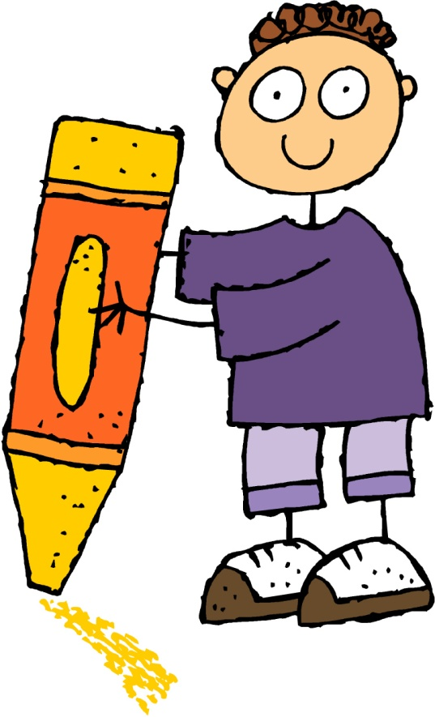
TEACH, PRACTISE, EXTEND
ANTONYMS

Slide 2
TEACH
Antonyms are words that have opposite meanings.
For example:
cold – hot large – small old – young
strong – weak rough – smooth up – down
Sometimes you can make an antonym using a prefix.
For example:
happy – unhappy kind – unkind appear – disappear
likely – unlikely patient - impatient interior – exterior

Slide 3
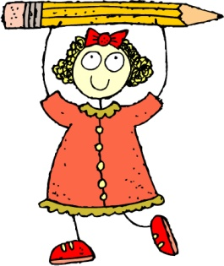
PRACTISE
Write antonyms for these words.
night - _____
private - _____
polite - _____
grow - _____
dangerous - _____
crooked - _____
top - _____
qualified - _____
deep - _____
arrival - _____
always - _____
begin - _____
cheap - _____
maximum - _____
sweet - _____
fade - _____

Slide 4
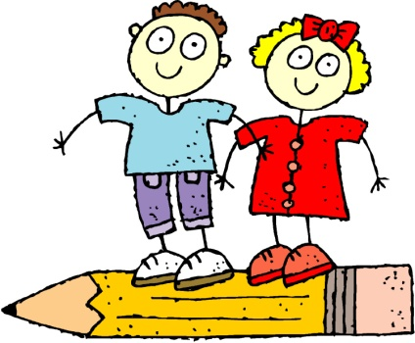
EXTEND
Write an antonym for the each of the words below.
create - _____
permanent - _____
serious - _____
accurate - _____
humble - _____
accidental - _____
Now write sentences containing both words.

